Slide 1
CSE 410
Feb 27, 2020

Slide 2
Order of presentations
Human Acceptance
Multiple fairness
Teaching tools
Around 20 mins per group (presentation + Q&A)
5 mins break

Slide 3
Human Acceptance

Slide 4
Multiple fairness

Slide 5
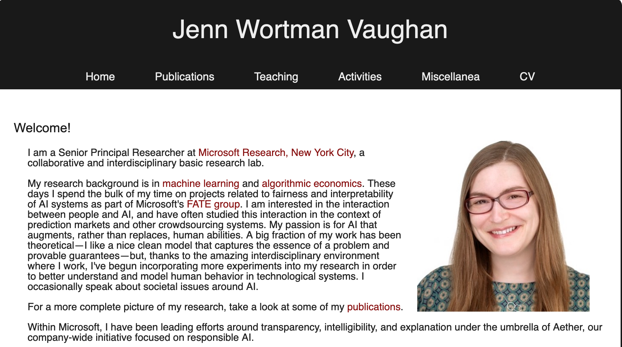
Passphrase for today: Jenn Wortman Vaughan

Slide 6
Teaching tools

Slide 7
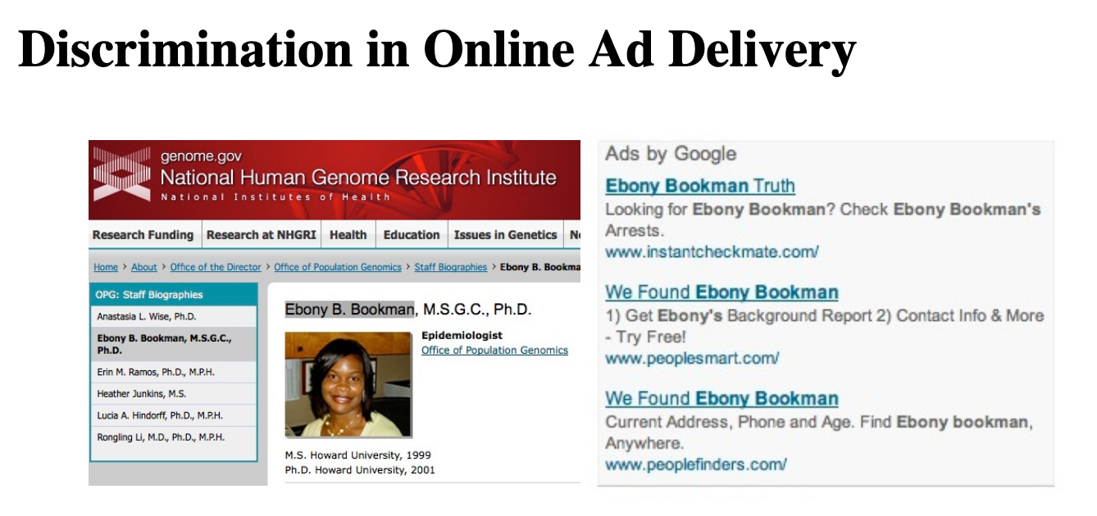
Paper discussion next Thursday

