Slide 1
CSE 410
Mar 3, 2020

Slide 2
Paper discussion next Thursday

Slide 3
Discussion Summaries due tomorrow
By 5pm on Autolab

Slide 4
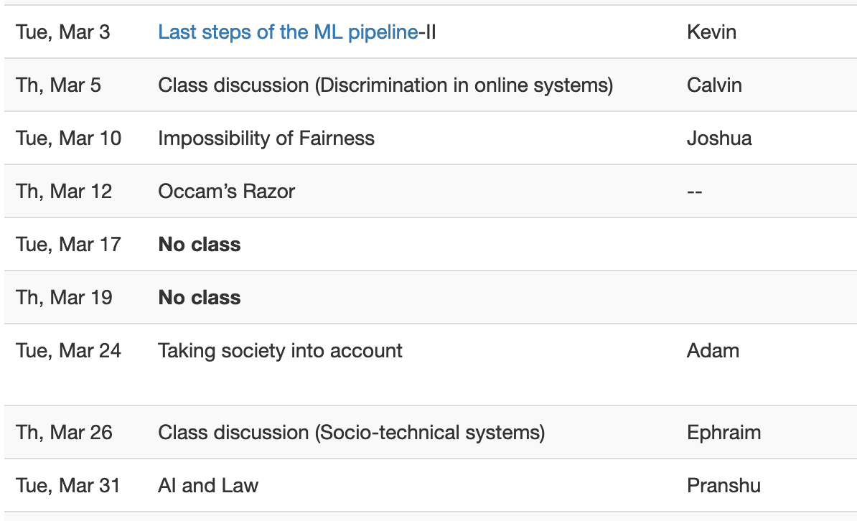
Proof reading schedule fixed

Slide 5
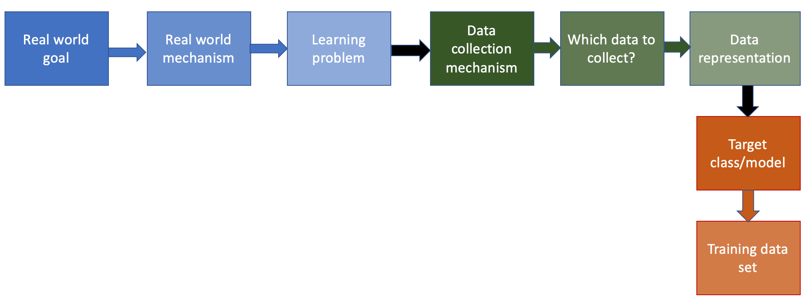
Last Tuesday

Slide 6
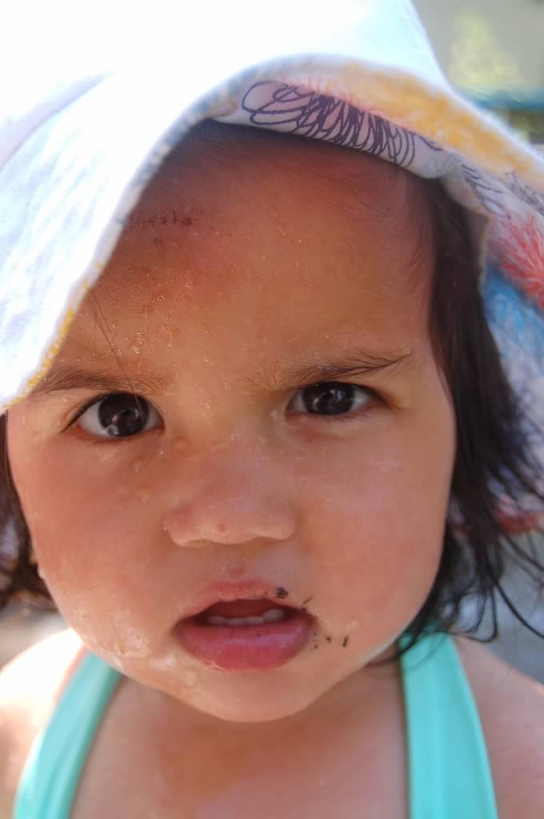
?

Slide 7
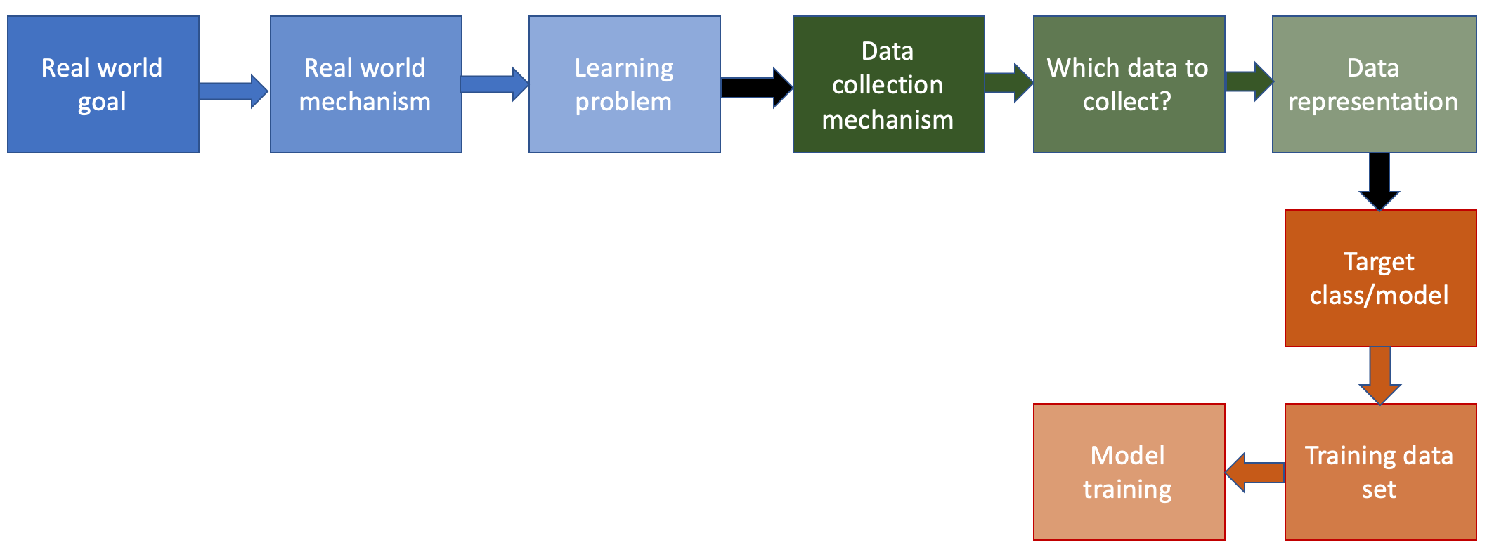
The next step…

Slide 8
Minimize number of mis-classifications
BMI (kg/m²)
10
30
50
90
130
180
220
240
280
6
6
What does the plot look for this class?
5
5
4
4
3
3
2
2
1
1
BMI (kg/m²)
BMI (kg/m²)
10
30
50
90
130
180
220
240
280
10
30
50
90
130
180
220
240
280
0
b*
250
0
b*
250
BMI (kg/m²)
BMI (kg/m²)

Slide 9
The actual “loss” function
Number of corners grows like n^{d}
Only check the corner points!
BMI (kg/m²)
10
30
50
90
130
180
220
240
280
6
6
5
5
4
4
3
3
2
2
1
1
BMI (kg/m²)
BMI (kg/m²)
10
30
50
90
130
180
220
240
280
10
30
50
90
130
180
220
240
280
0
b*
250
0
b*
250
BMI (kg/m²)
BMI (kg/m²)

Slide 10
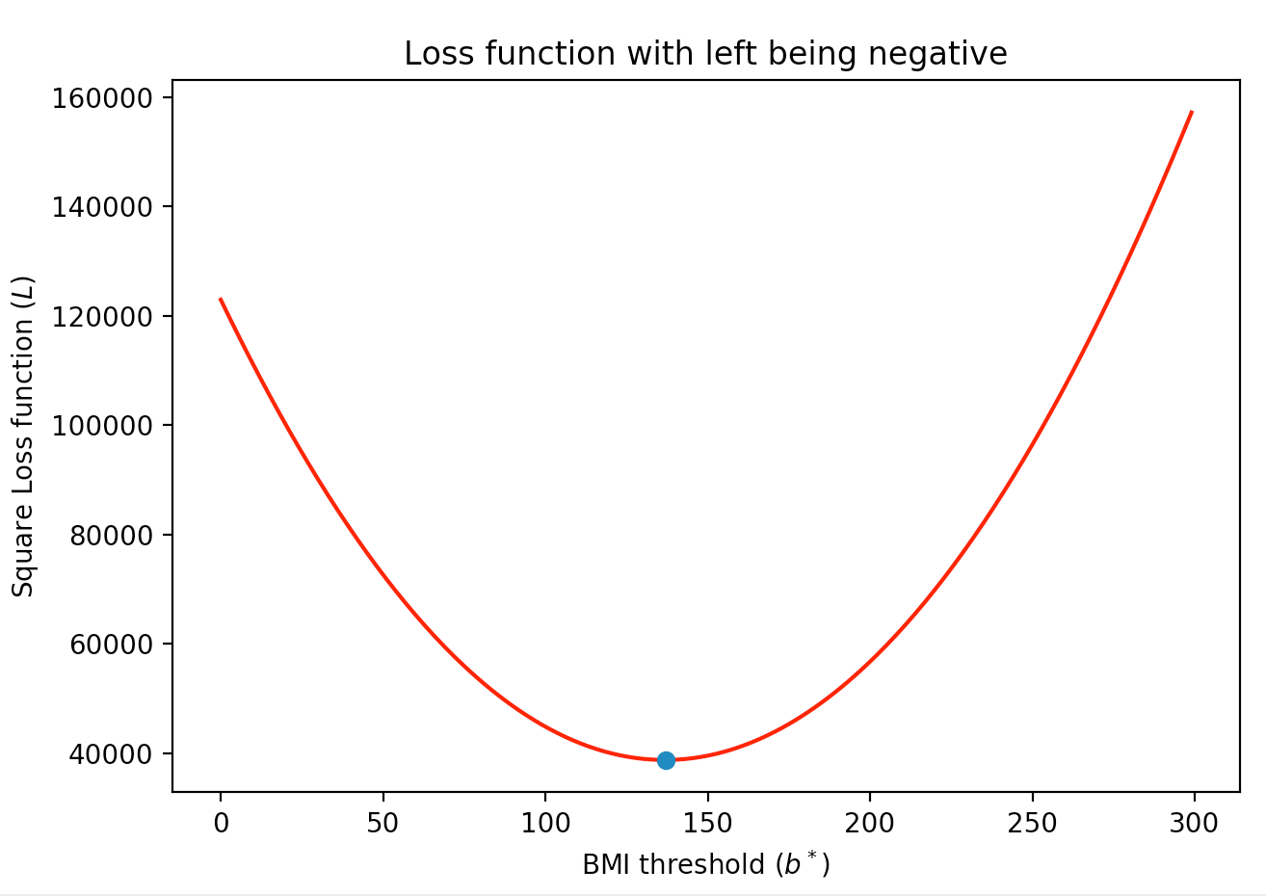
A “better” loss function
BMI (kg/m²)
10
30
50
90
130
180
220
240
280
6
5
4
3
2
1
BMI (kg/m²)
10
30
50
90
130
180
220
240
280
0
b*
250
BMI (kg/m²)

Slide 11
What is a loss function?

Slide 12
Square Loss Function
BMI (kg/m²)
10
30
50
90
130
180
220
240
280

Slide 13
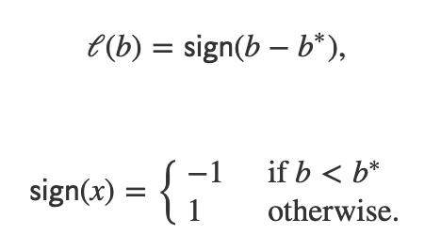
Math behind the square loss function
Linear model
0
b*
250
BMI (kg/m²)

Slide 14
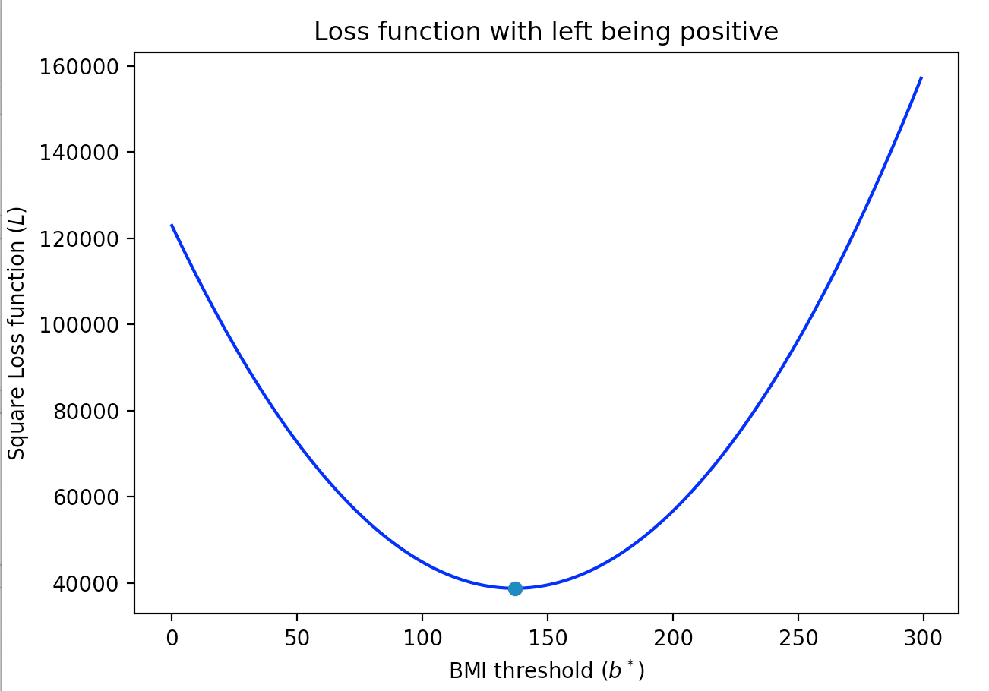
Square loss function
BMI (kg/m²)
10
30
50
90
130
180
220
240
280
0
b*
250
0
b*
250
BMI (kg/m²)
BMI (kg/m²)

Slide 15
?

Slide 16
So did we gain anything here?
Do you know what a half-pipe means in the context of sports?

Slide 17
Towards gradient descent

Slide 18
Where do we get gravity and friction?
Tangent can give two directions
Which direction to take?

Slide 19
Derivative is all you need!

Slide 20
Overall Algorithm

Slide 21
?

Slide 22
When does this work?
Convex loss functions

Slide 23
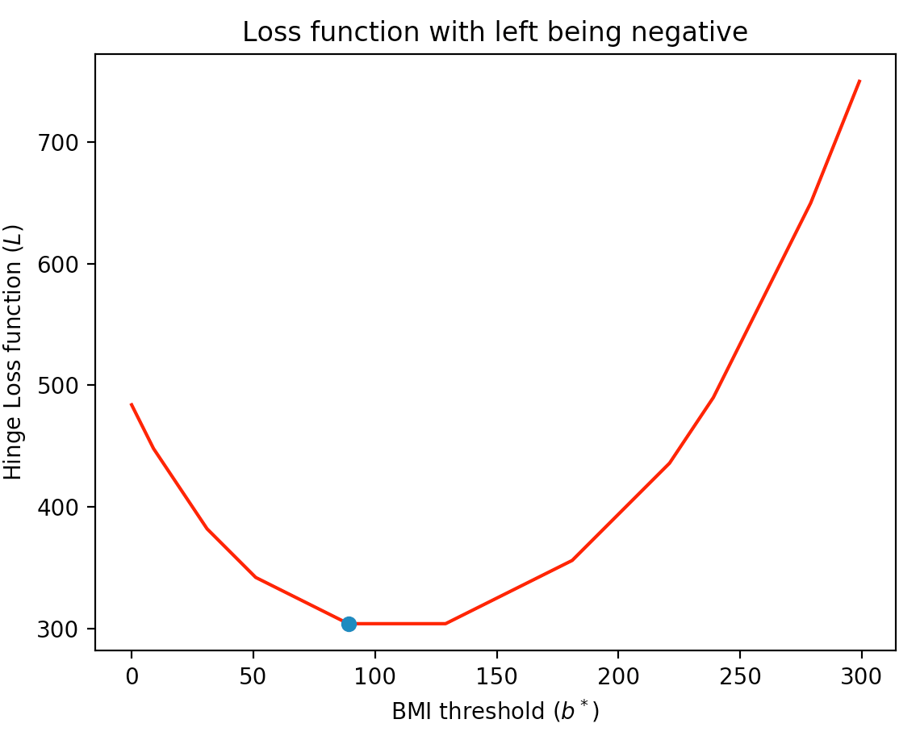
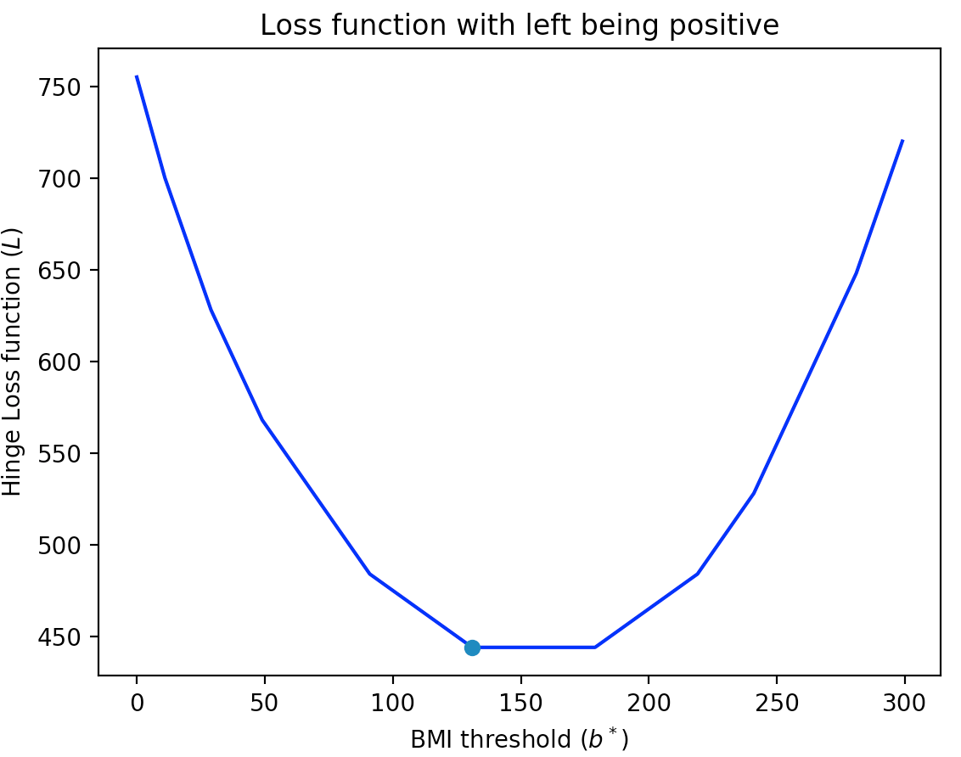
Hinge loss function
Convex functions need not be smooth!
BMI (kg/m²)
10
30
50
90
130
180
220
240
280
0
b*
250
0
b*
250
BMI (kg/m²)
BMI (kg/m²)

Slide 24
What about non-convex loss functions?
700
Loss function
350
150
300
b*

Slide 25
What can go wrong if we run GD?
700
Loss function
350
150
300
b*

Slide 26
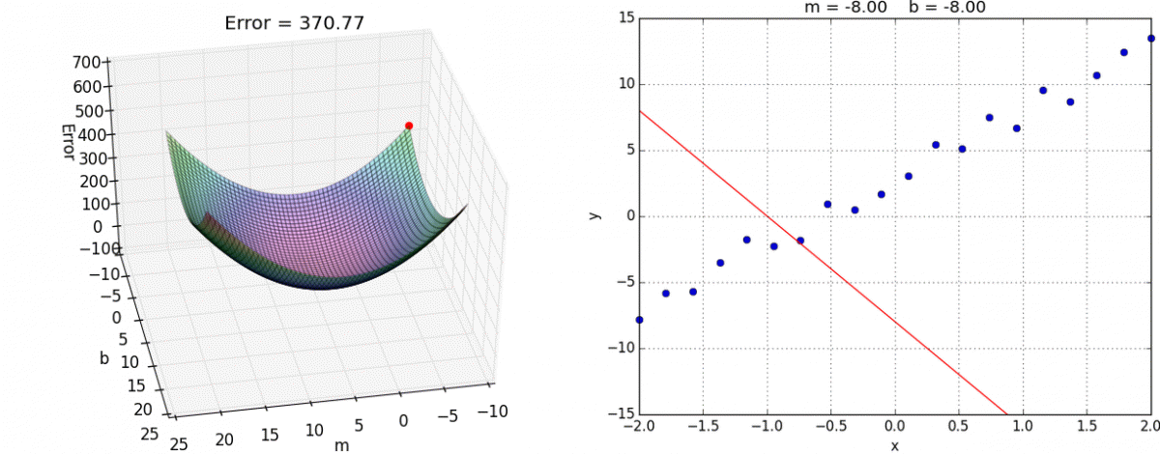
GD on more than one variable
https://alykhantejani.github.io/images/gradient_descent_line_graph.gif

Slide 27
Did we lose something?

Slide 28
Minimize number of mis-classifications
BMI (kg/m²)
10
30
50
90
130
180
220
240
280
6
6
5
5
4
4
3
3
2
2
1
1
BMI (kg/m²)
BMI (kg/m²)
10
30
50
90
130
180
220
240
280
10
30
50
90
130
180
220
240
280
0
b*
250
0
b*
250
BMI (kg/m²)
BMI (kg/m²)

Slide 29
?

Slide 30
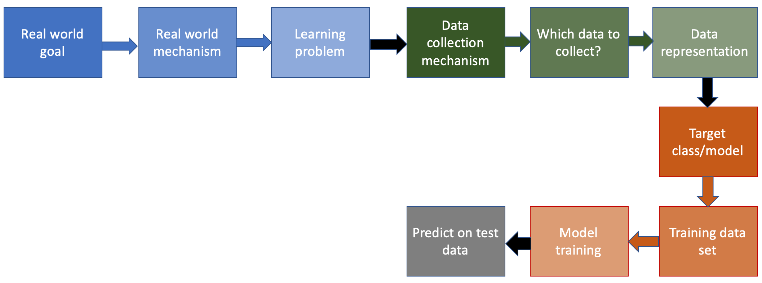
Next step in the ML pipeline
After the break!

Slide 31
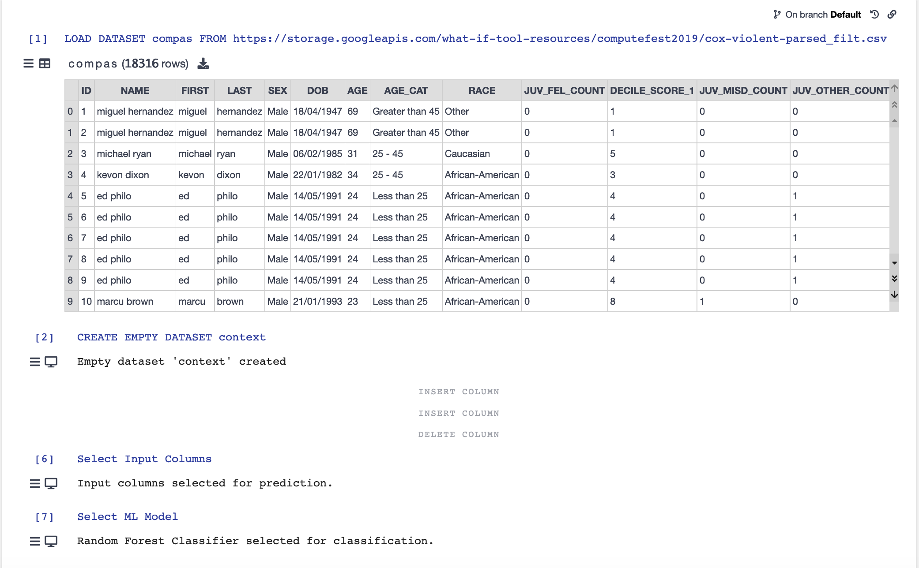
Some Vizier fun!

Slide 32
Vizier exercise
https://gram.cse.buffalo.edu/

Slide 33
Next step in the ML pipeline

Slide 34
Predicting on dataset

Slide 35
Passphrase for today: Kathy Pham
Remote talk this Friday in Davis 230A at 11am

Slide 36
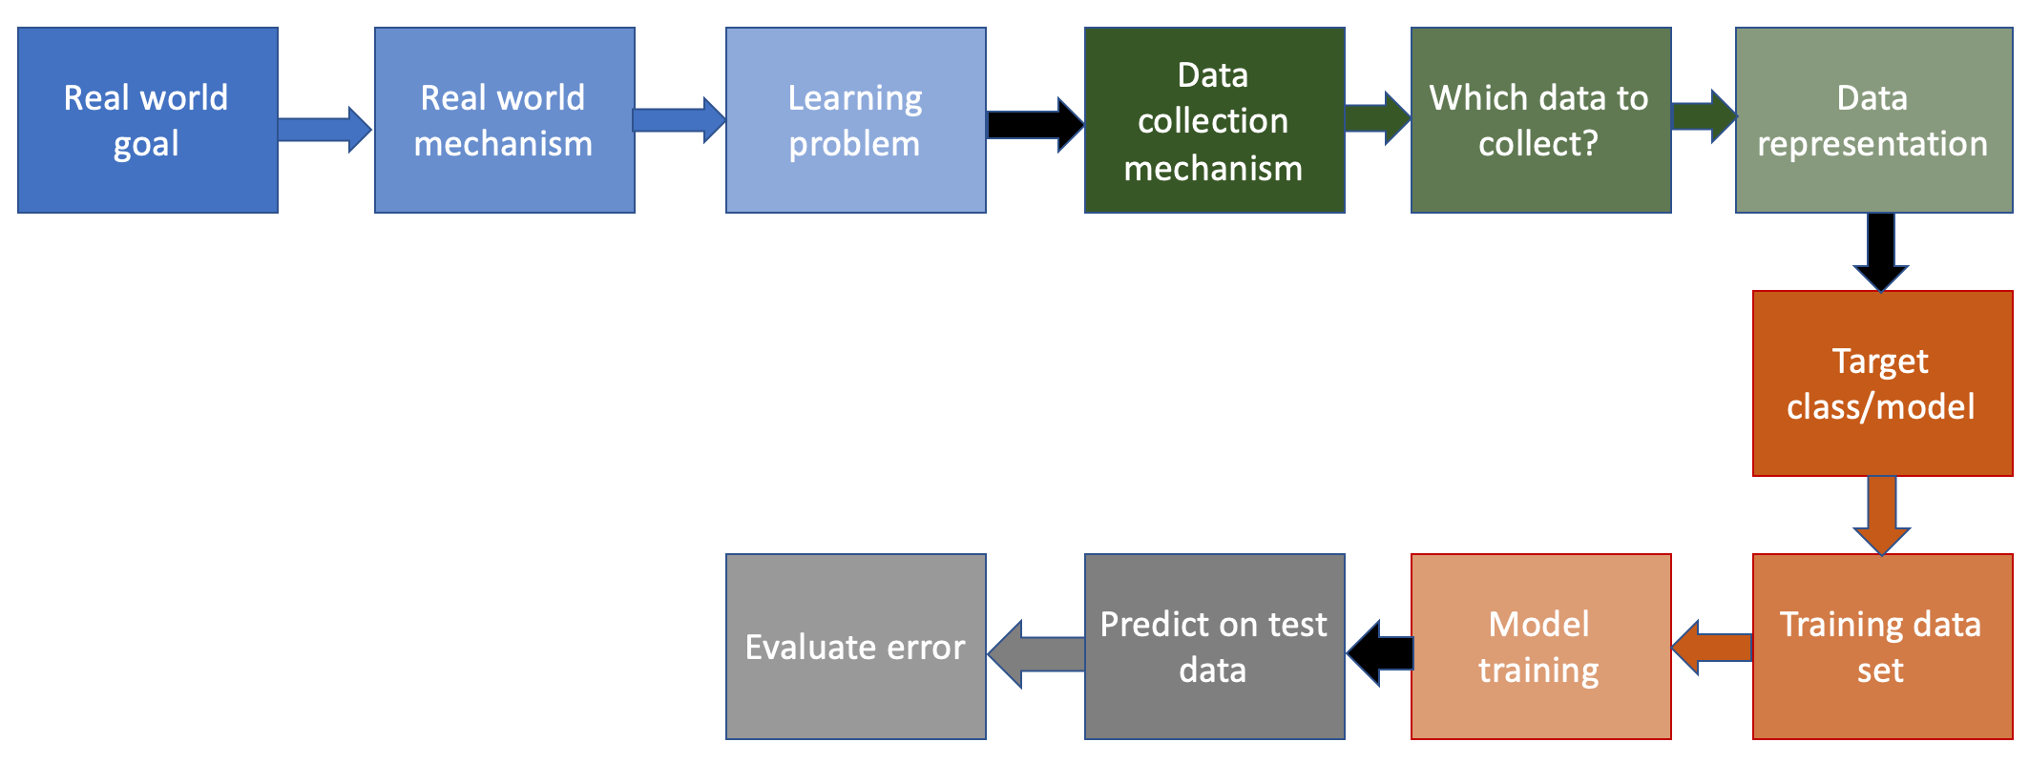
Last step in the ML pipeline!

Slide 37
Using accuracy (# misclassified points)

Slide 38
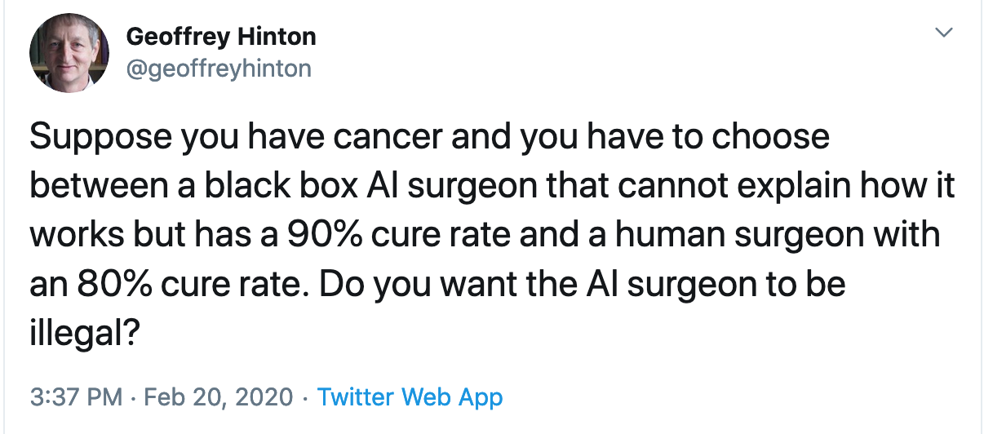
Recent tweet from Geoffrey Hinton
Discuss!

Slide 39
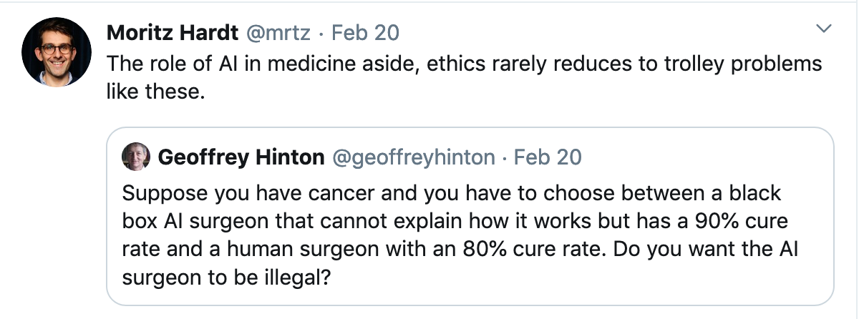
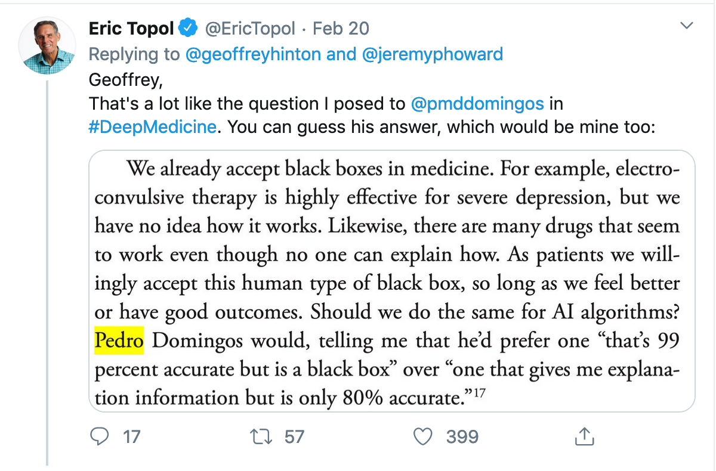
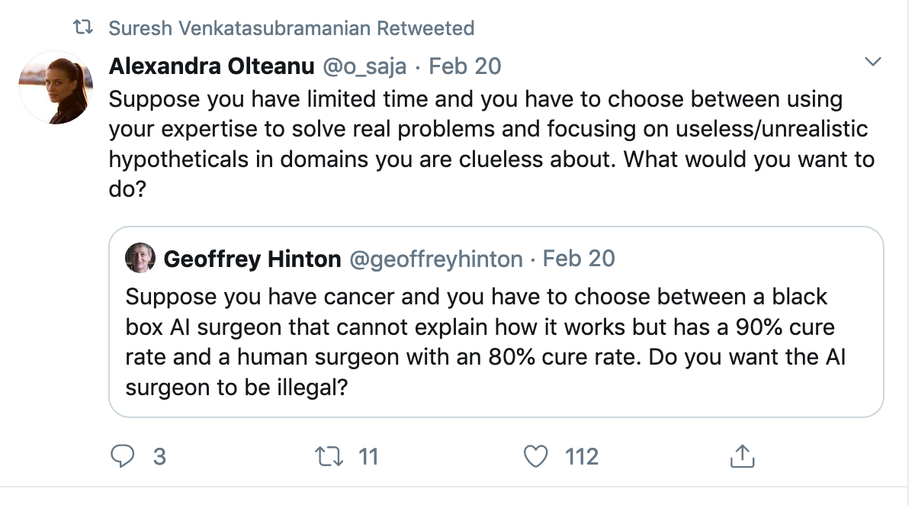
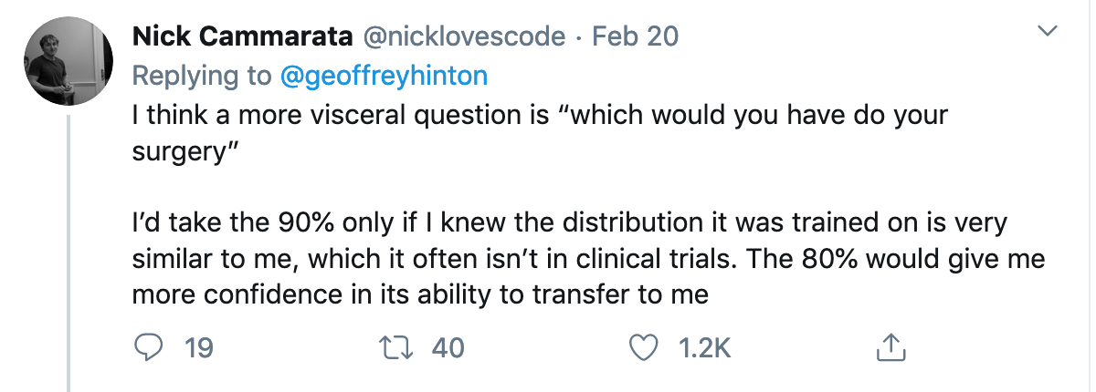
Some twitter responses

