Slide 1
CSE 410
Mar 26, 2020

Slide 2
Paper discussion in 2nd half of class

Slide 3
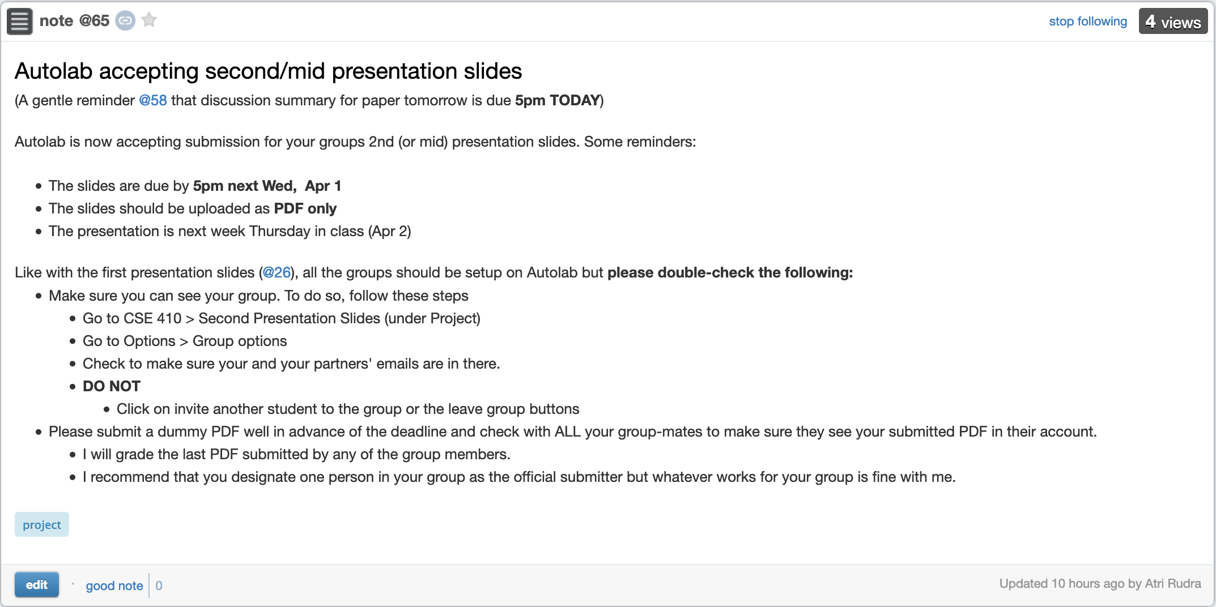
Next Thursday is mid/2nd project presentation

Slide 4
Presentation Order
Multiple Fairness
Teaching tools
Human acceptance

Slide 5
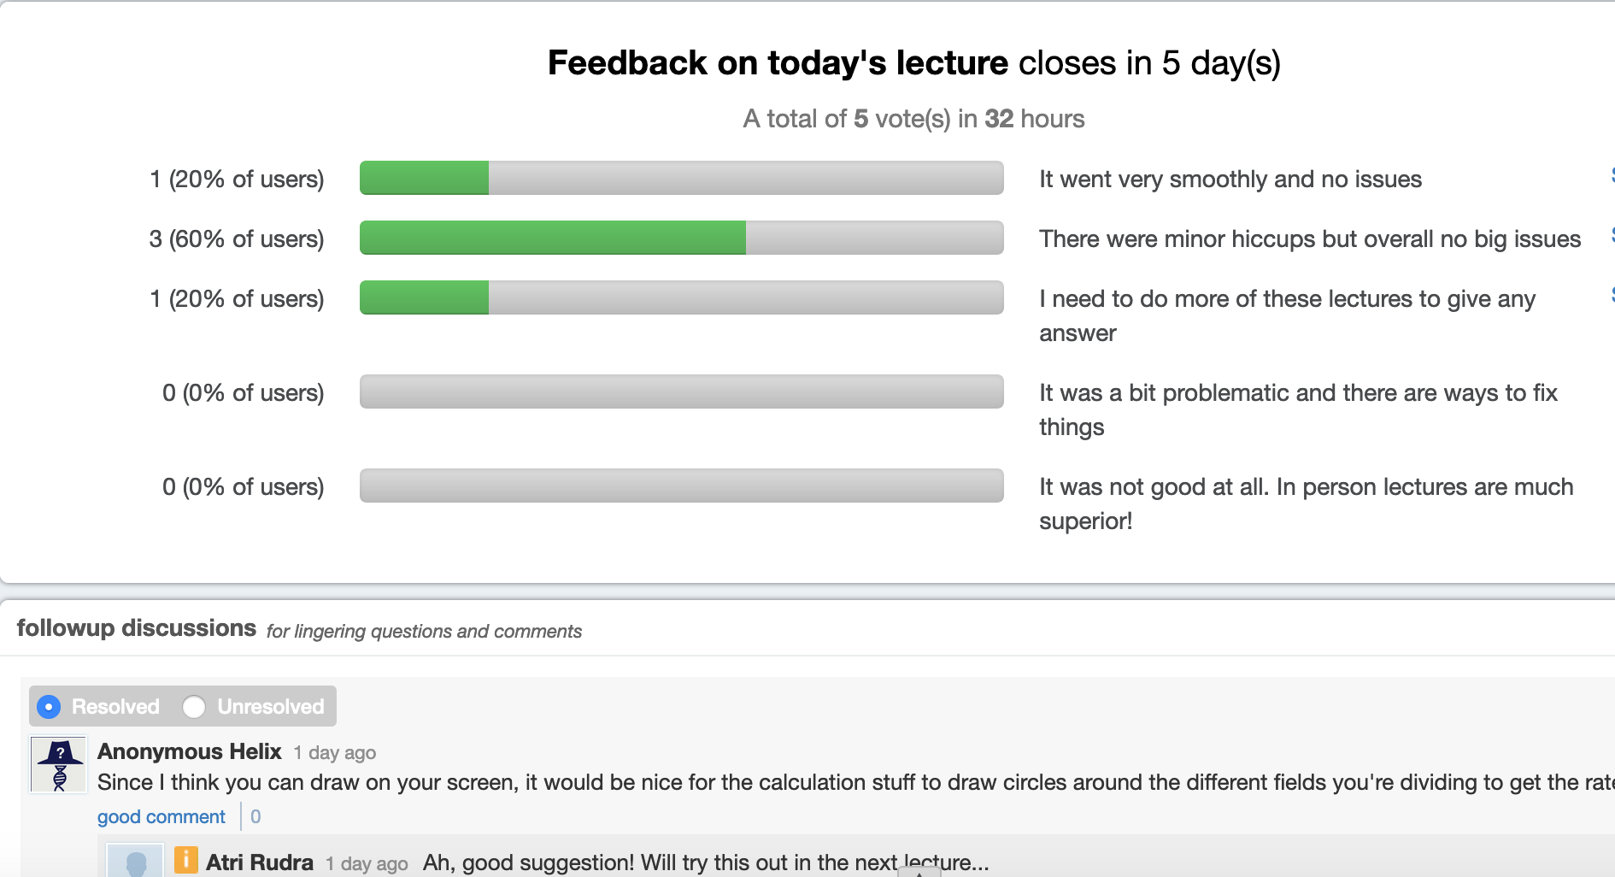
Feedback on Tuesday’s lecture

Slide 6
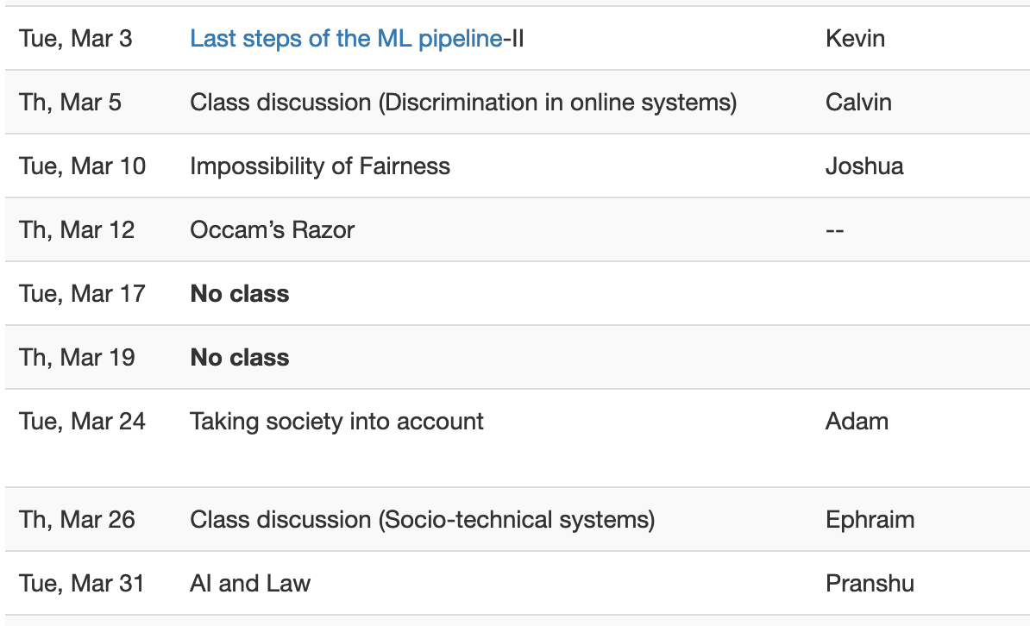
Proof reading schedule fixed

Slide 7
Office hours by appointment

Slide 8
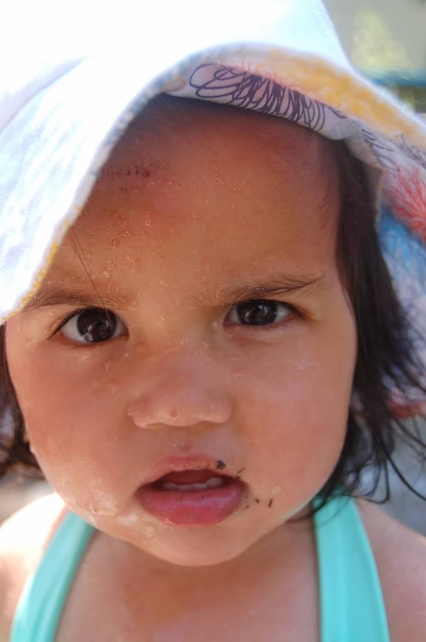
?

Slide 9
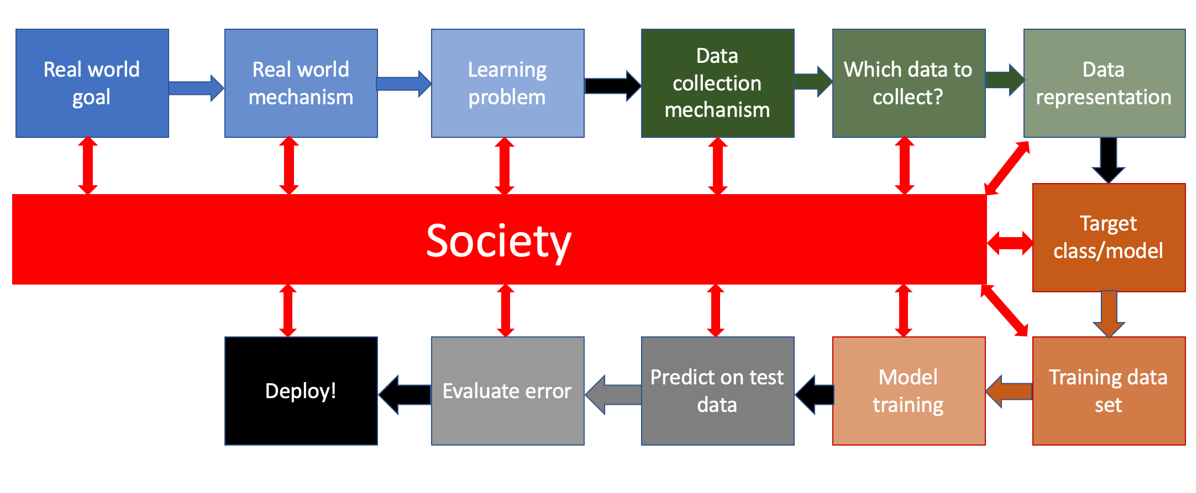
Bringing society back into the picture

Slide 10
Three kinds of bias

Slide 11
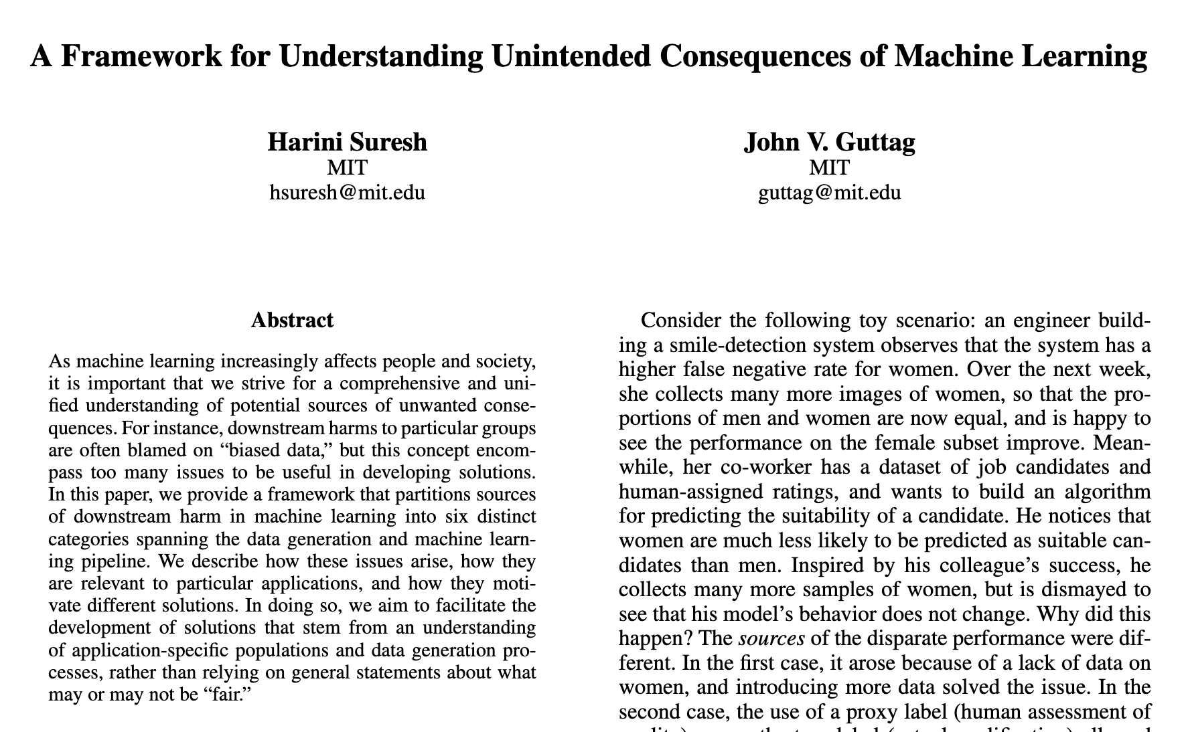
Six categories of bias of the 3rd kind

Slide 12
Historical Bias
Bias ingrained in society
Cannot be avoided even with perfect sampling of the population

Slide 13
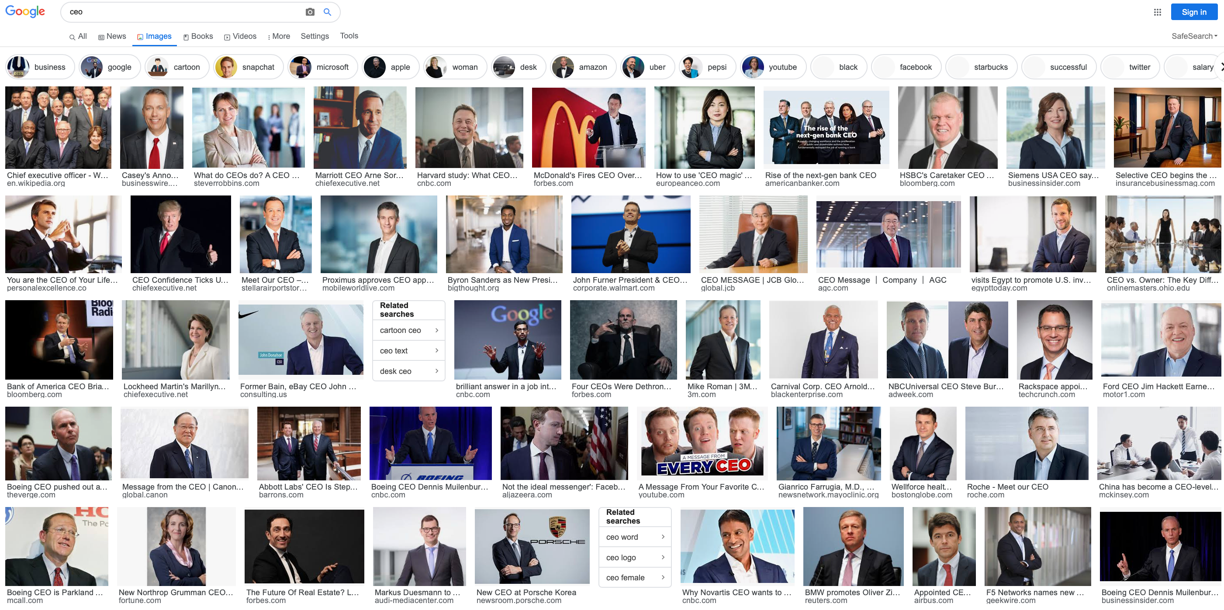
Earlier example: Google Image search “ceo”

Slide 14
There are few women CEOs

Slide 15
Another interesting video

Slide 16
Back to the ML pipeline

Slide 17
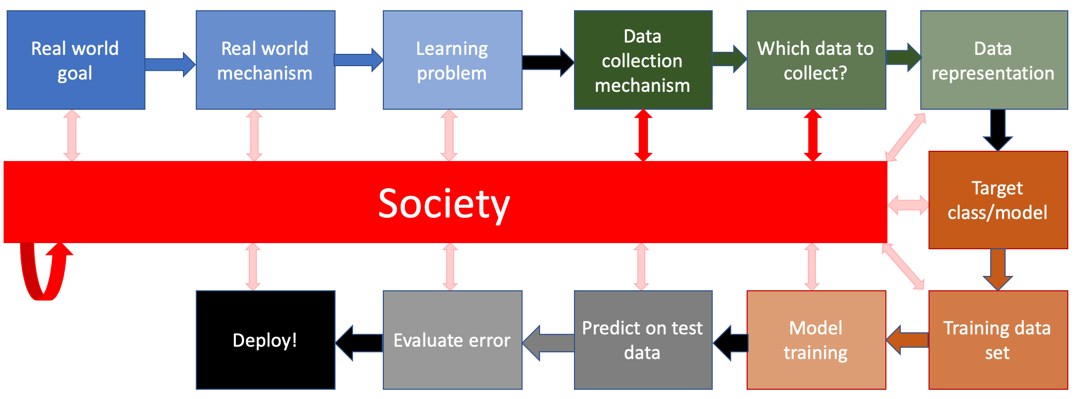
What are the relevant interactions?

Slide 18
How do we handle historical bias?
Discuss!

Slide 19
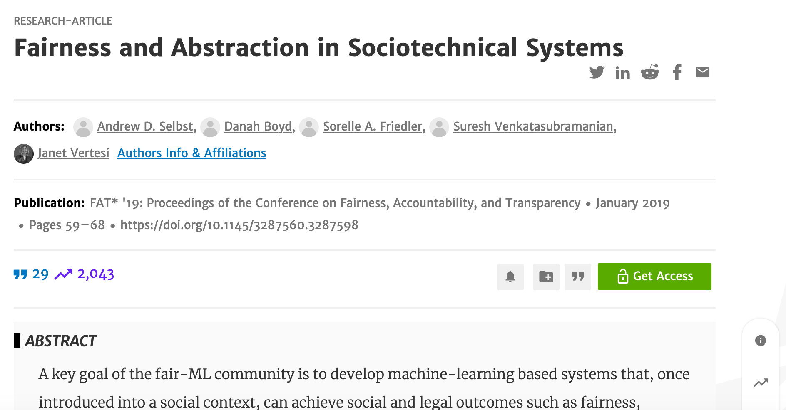
After the break

Slide 20
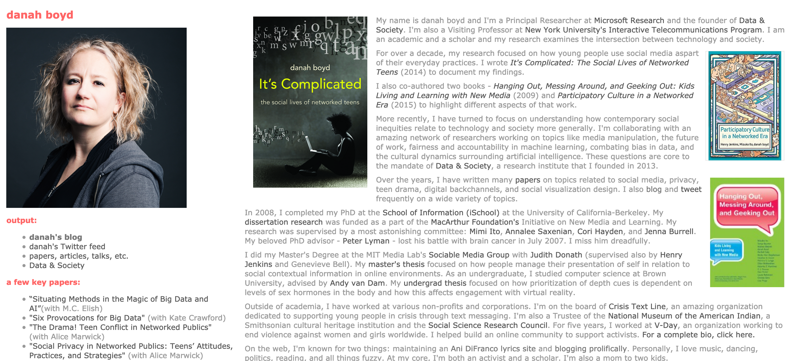
Passphrase for today: danah boyd

Slide 21
Thing to keep in mind
You are expected to participate ☺

Slide 22
Anyone wants to give a summary?

Slide 23
Any question for me?

Slide 24
Anything that surprised you?

Slide 25
Strength(s) of the paper?

Slide 26
Weakness(es) of the paper?

