Slide 1
CSE 410
Jan 30, 2020

Slide 2
Read the syllabus carefully!

Slide 3
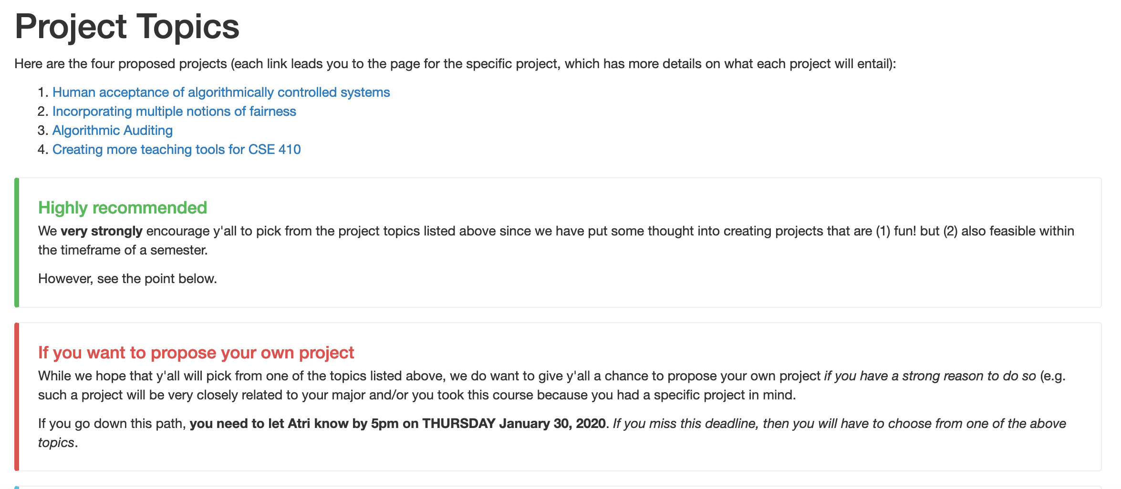
One (potential) project deadline TODAY 5pm

Slide 4
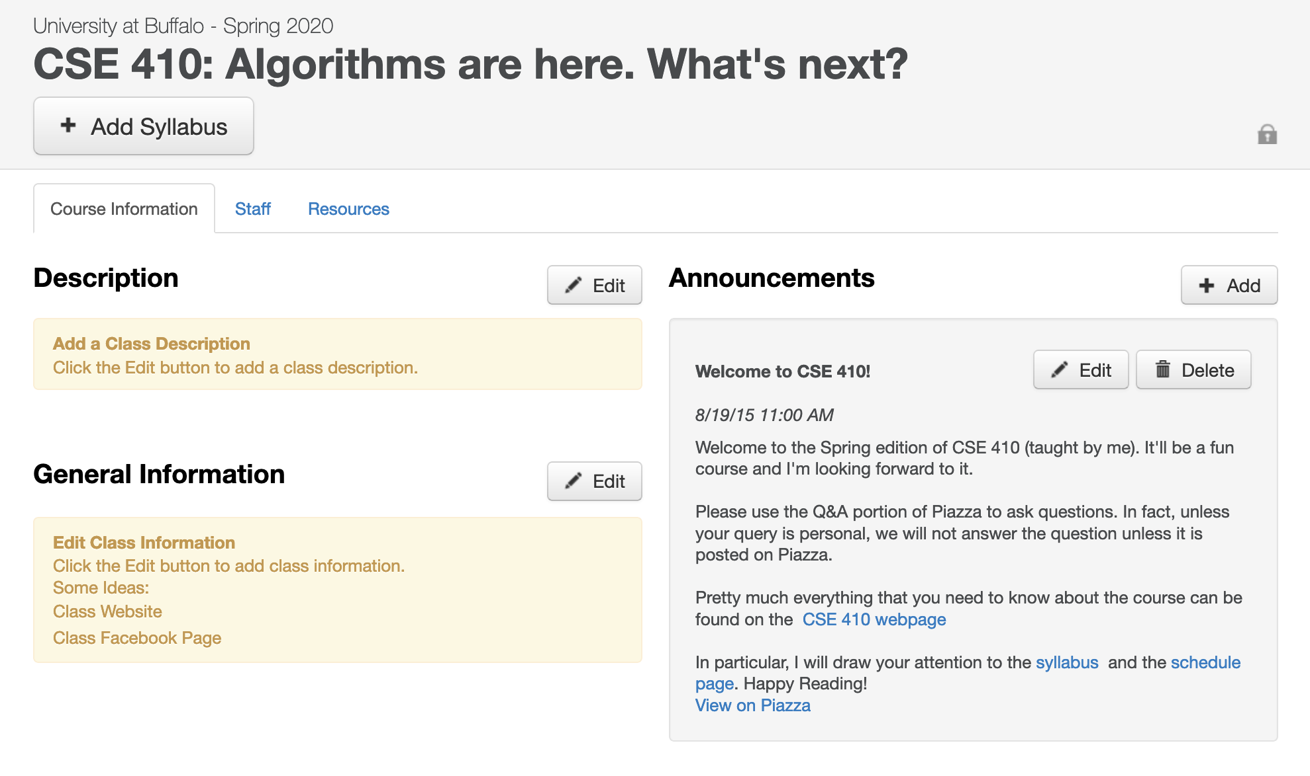
Make sure you are on piazza
https://piazza.com/buffalo/spring2020/cse410/home

Slide 5
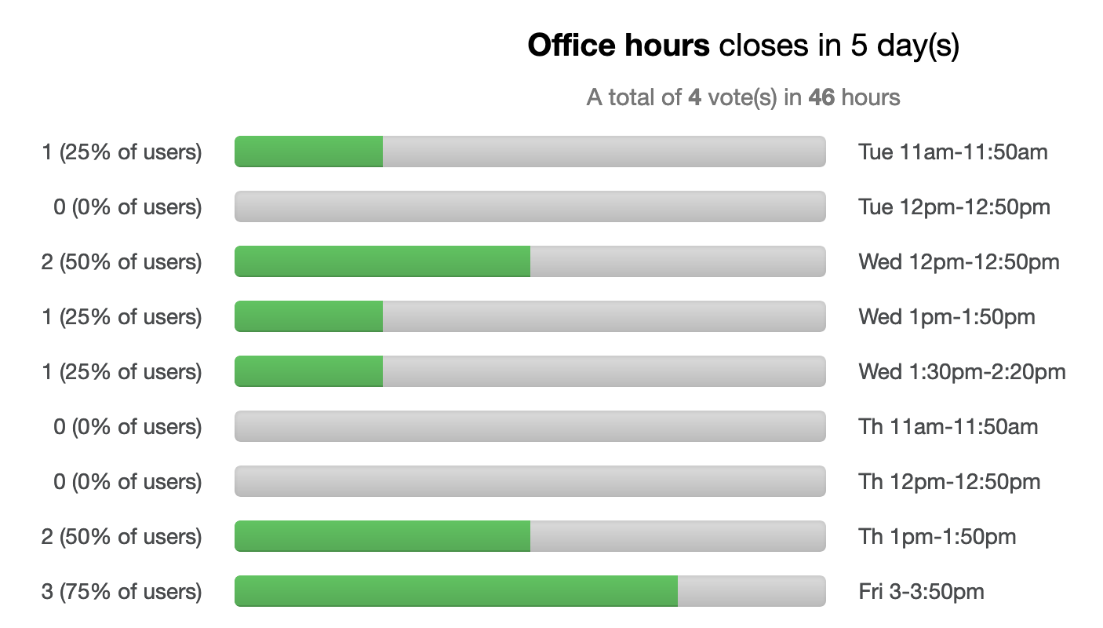
Make sure to vote for the office hour slot
Will finalize OH tomorrow evening

Slide 6
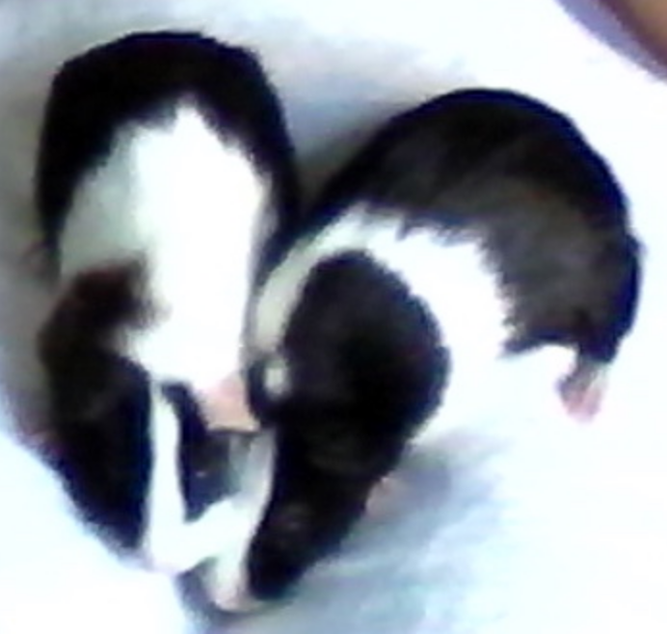
Few things I forgot to mention
If something does not make sense, it’s almost surely my fault!
Feedback is greatly appreciated!

Slide 7
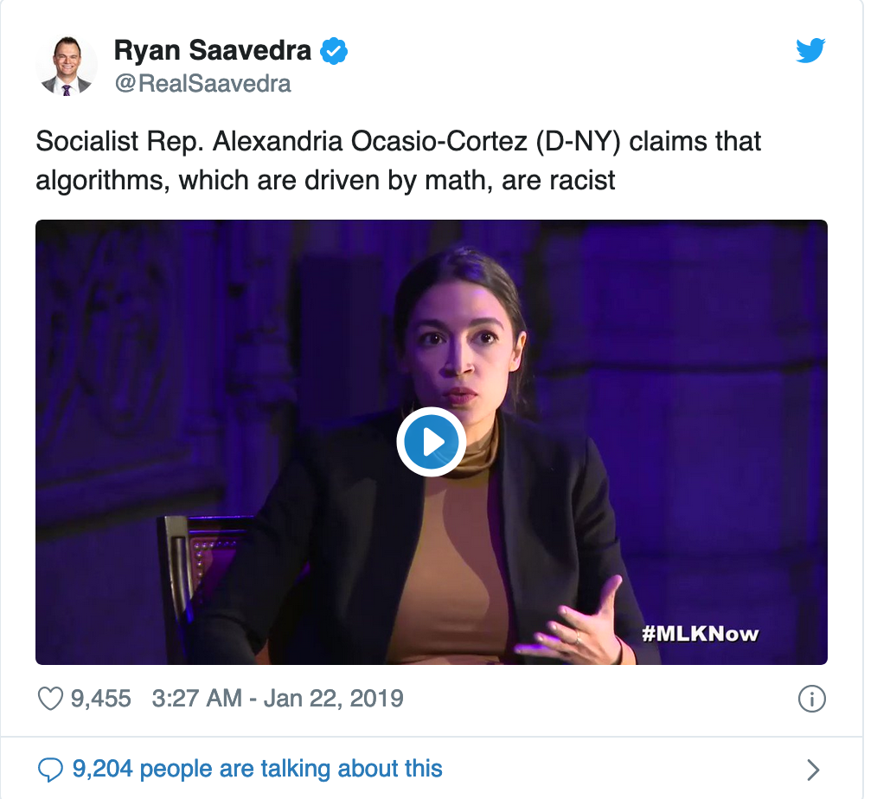
Back to the burning Q
Depends on what you mean by “algorithm”
“Algorithms can be biased”
”Algorithms are based on math
and hence cannot be biased"

Slide 8
Main Steps in Traditional Algorithm Design
Problem Statement
Real world problem
Problem definition
Problem Definition
Precise mathematical def
Algorithm
Algorithm design
“Implementation”
Data Structures
Analysis
Correctness/Run time

Slide 9
Two main points about traditional algorithms
Problem is defined BEFORE algorithm is designed
Can prove algorithm is correct for ALL inputs
One could consider such algorithms not biased

Slide 10
Today
Correct for modern algorithms
“Algorithms can be biased”

Slide 11
Proof reader for today?

Slide 12
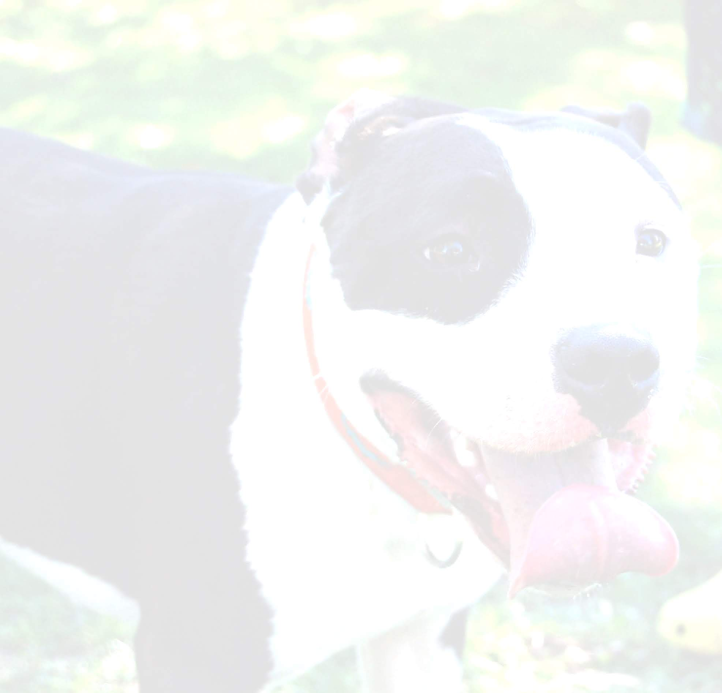
Cat vs. Dogs

Slide 13
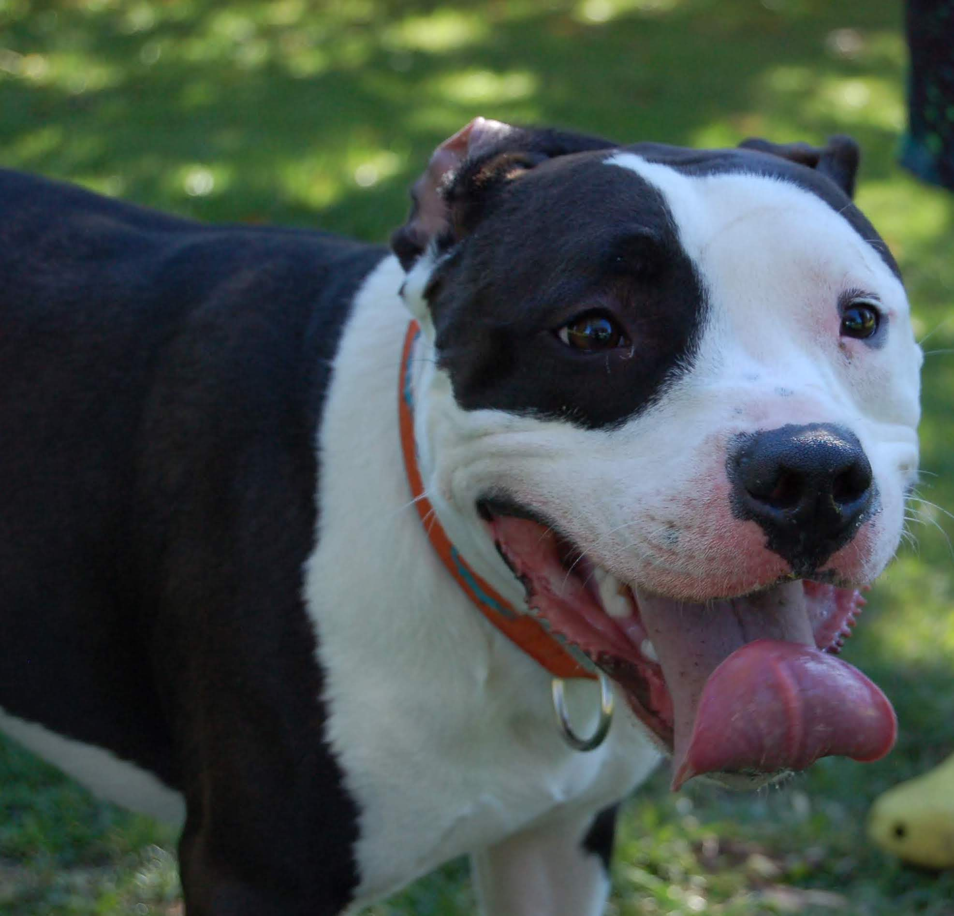
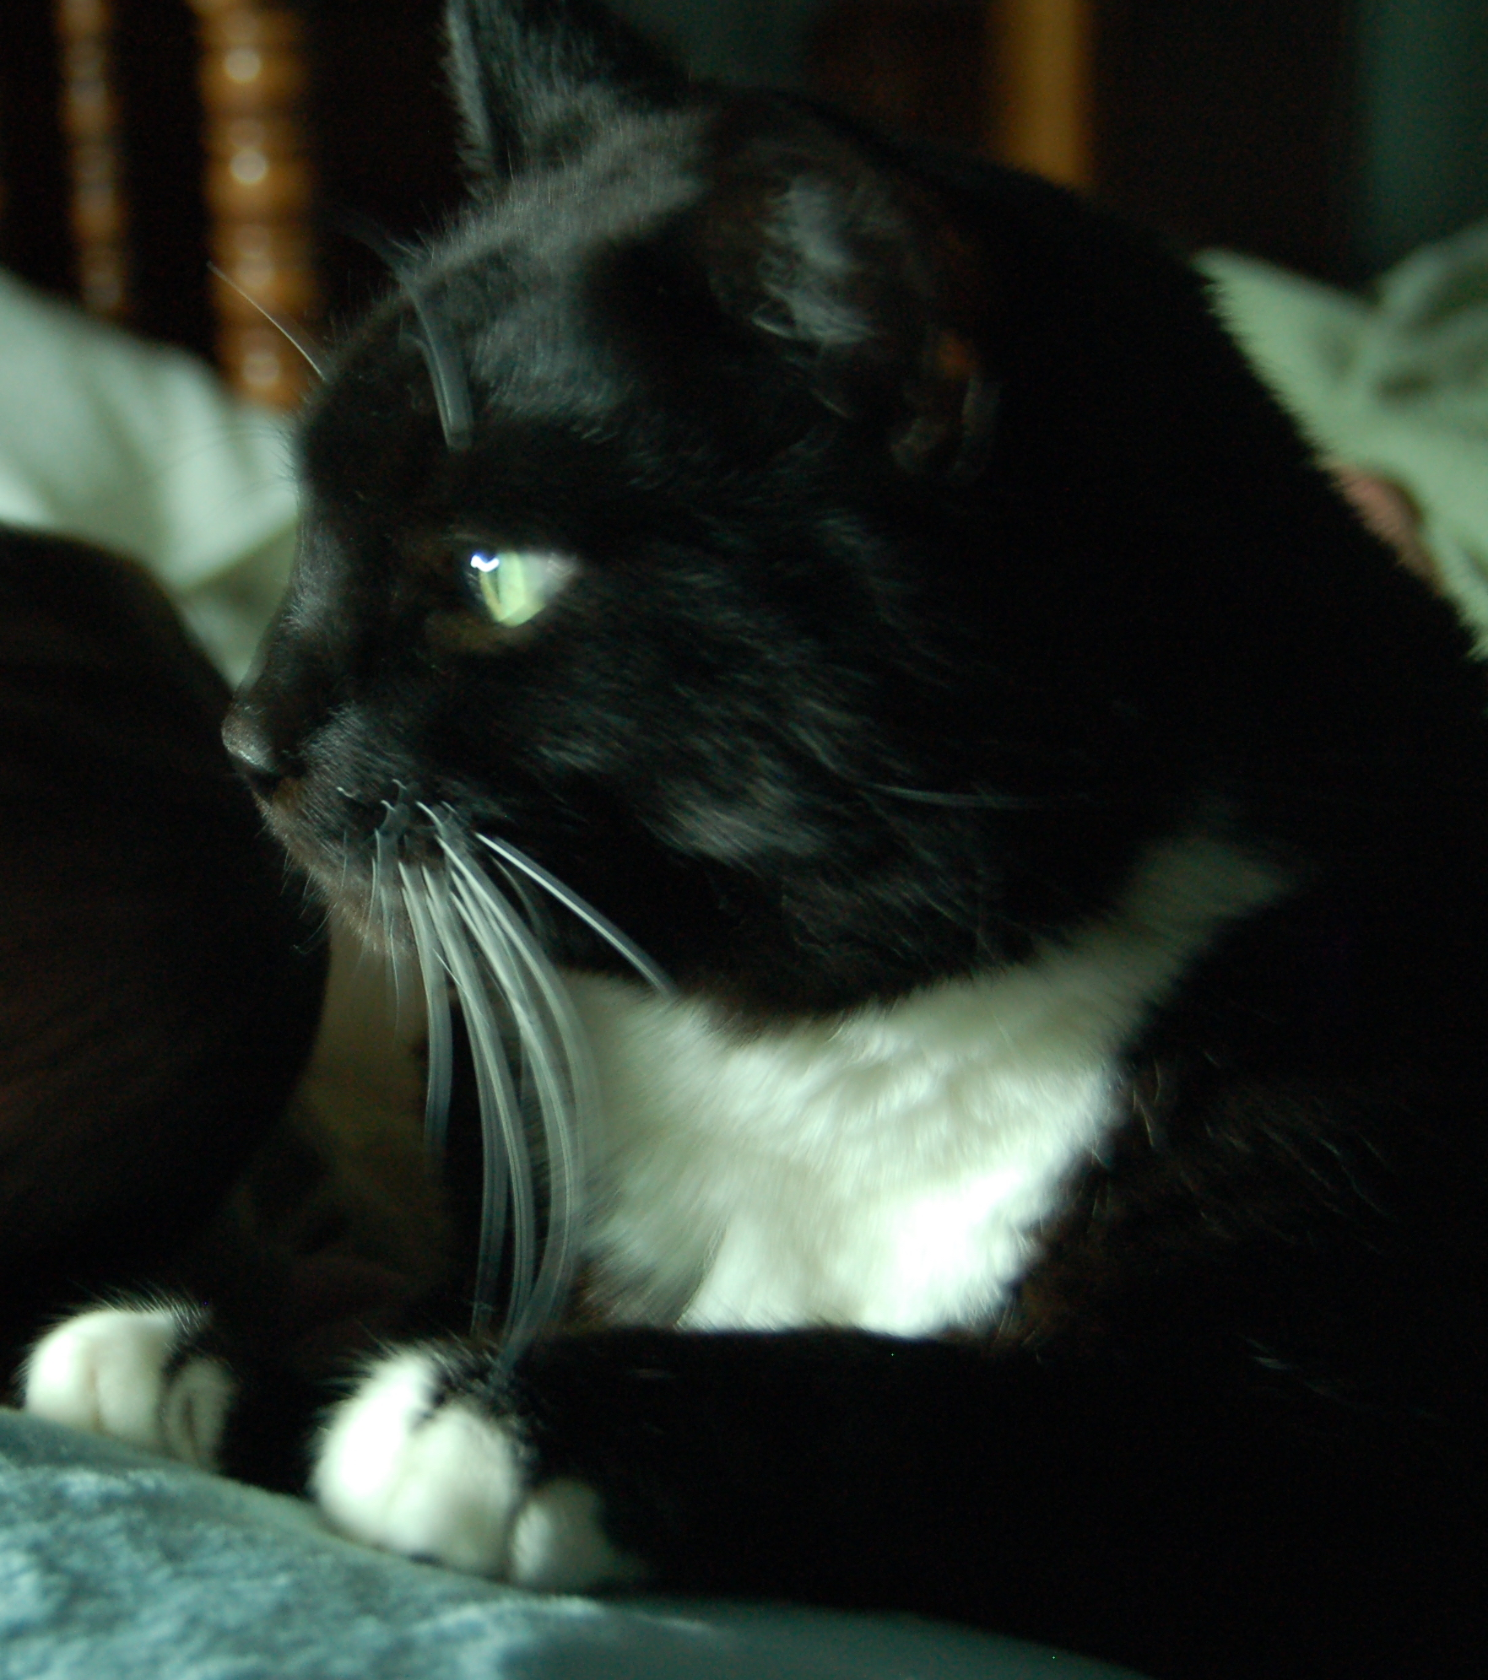
Warren and Billy

Slide 14
How do you ”define” a dog vs cat image?

Slide 15
Google Images has “solved” this problem

Slide 16
How do you ”define” a dog vs cat image?
http://www-student.cse.buffalo.edu/~atri/algo-and-society/support/notes/intro/images/warren.JPG
http://www-student.cse.buffalo.edu/~atri/algo-and-society/support/notes/intro/images/billy.JPG

Slide 17
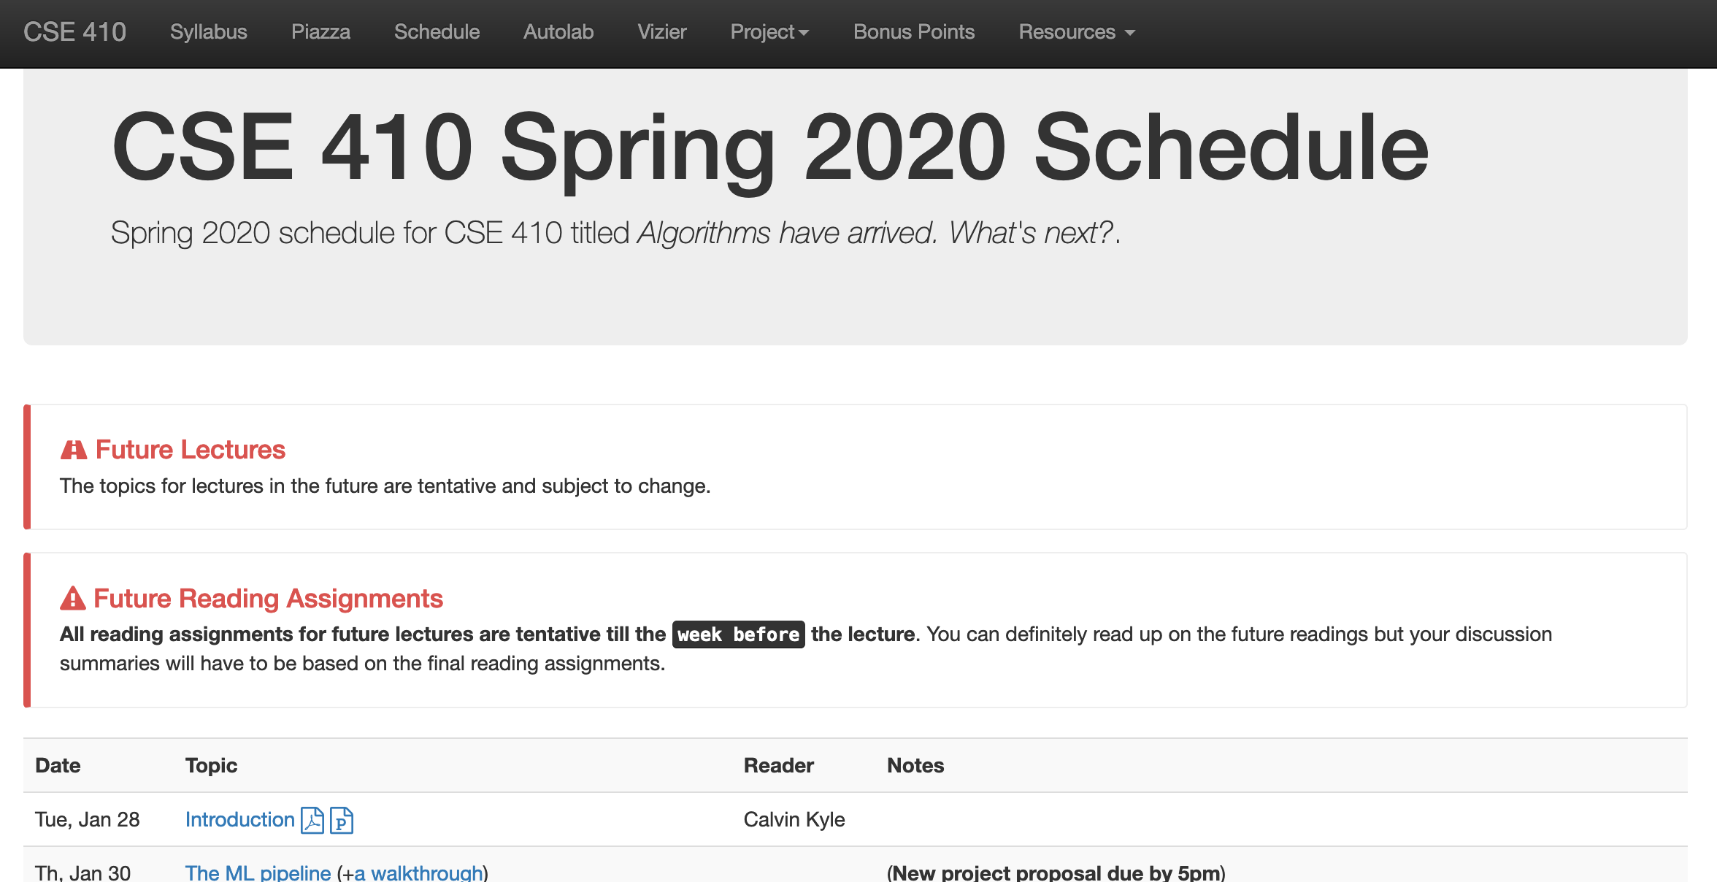
Better way to get to the URL

Slide 18
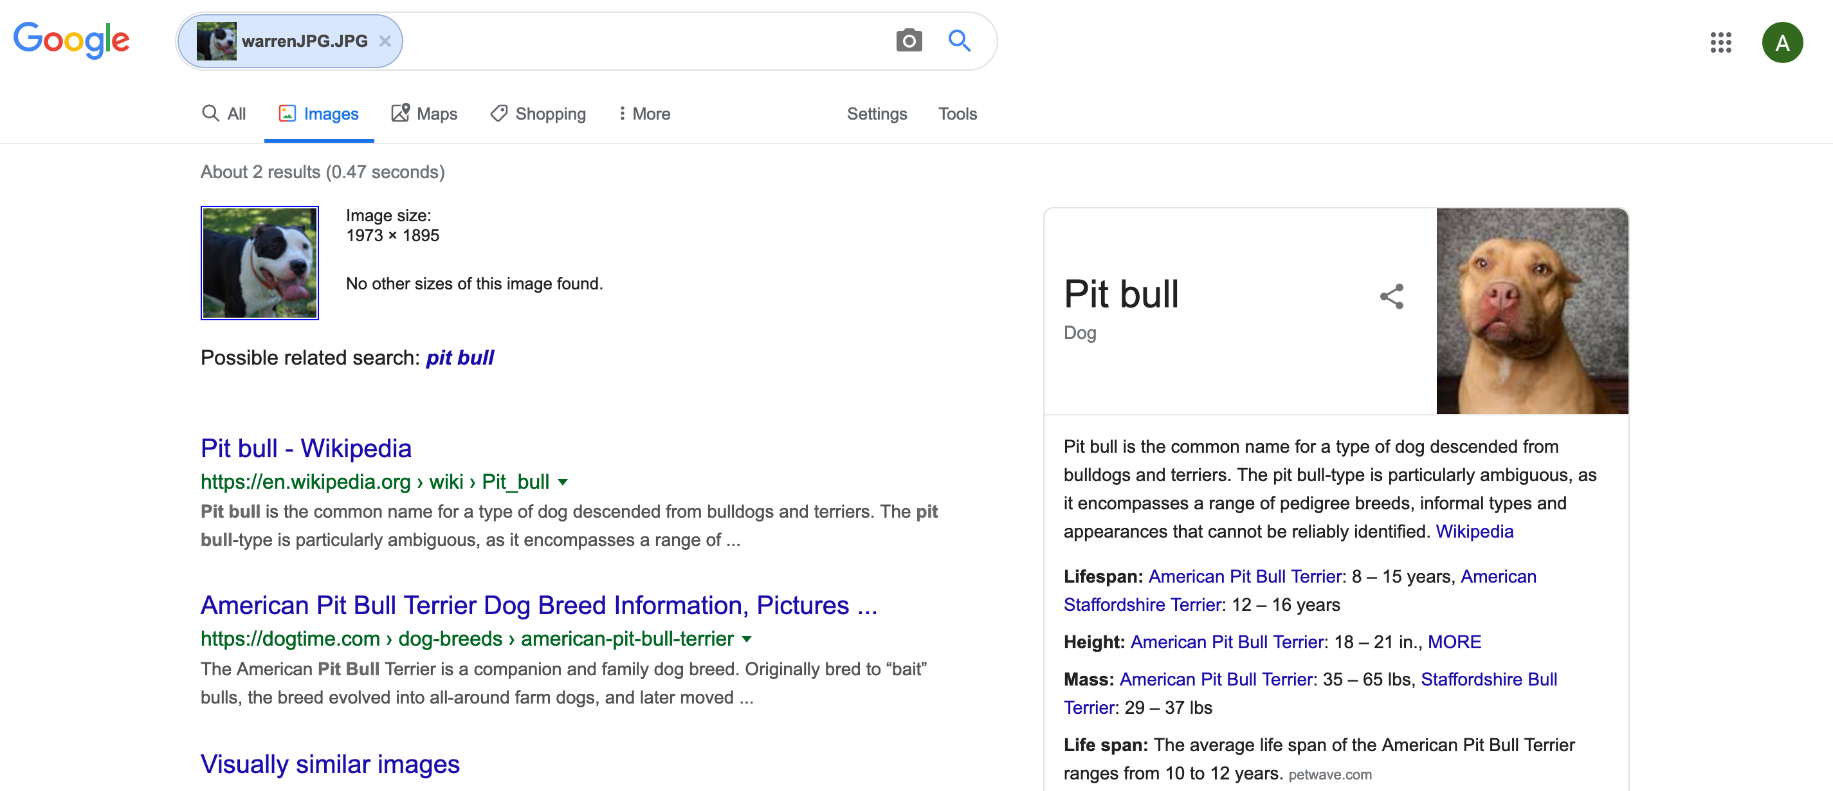
My result for Warren

Slide 19
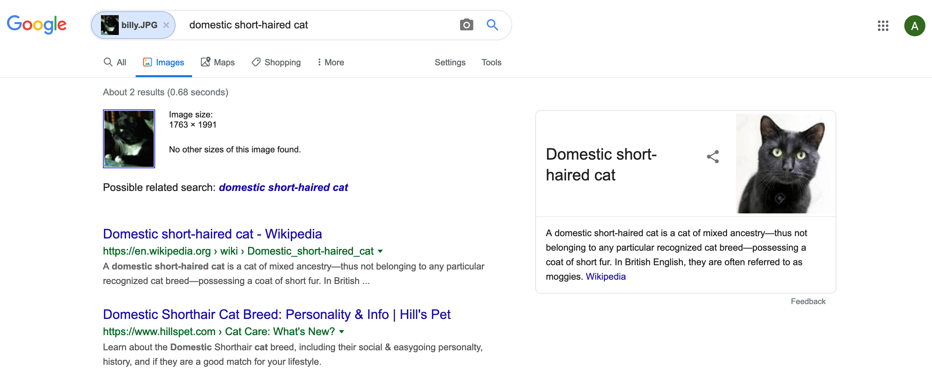
My result for Billy

Slide 20
So cats vs dogs problem solved?

Slide 21
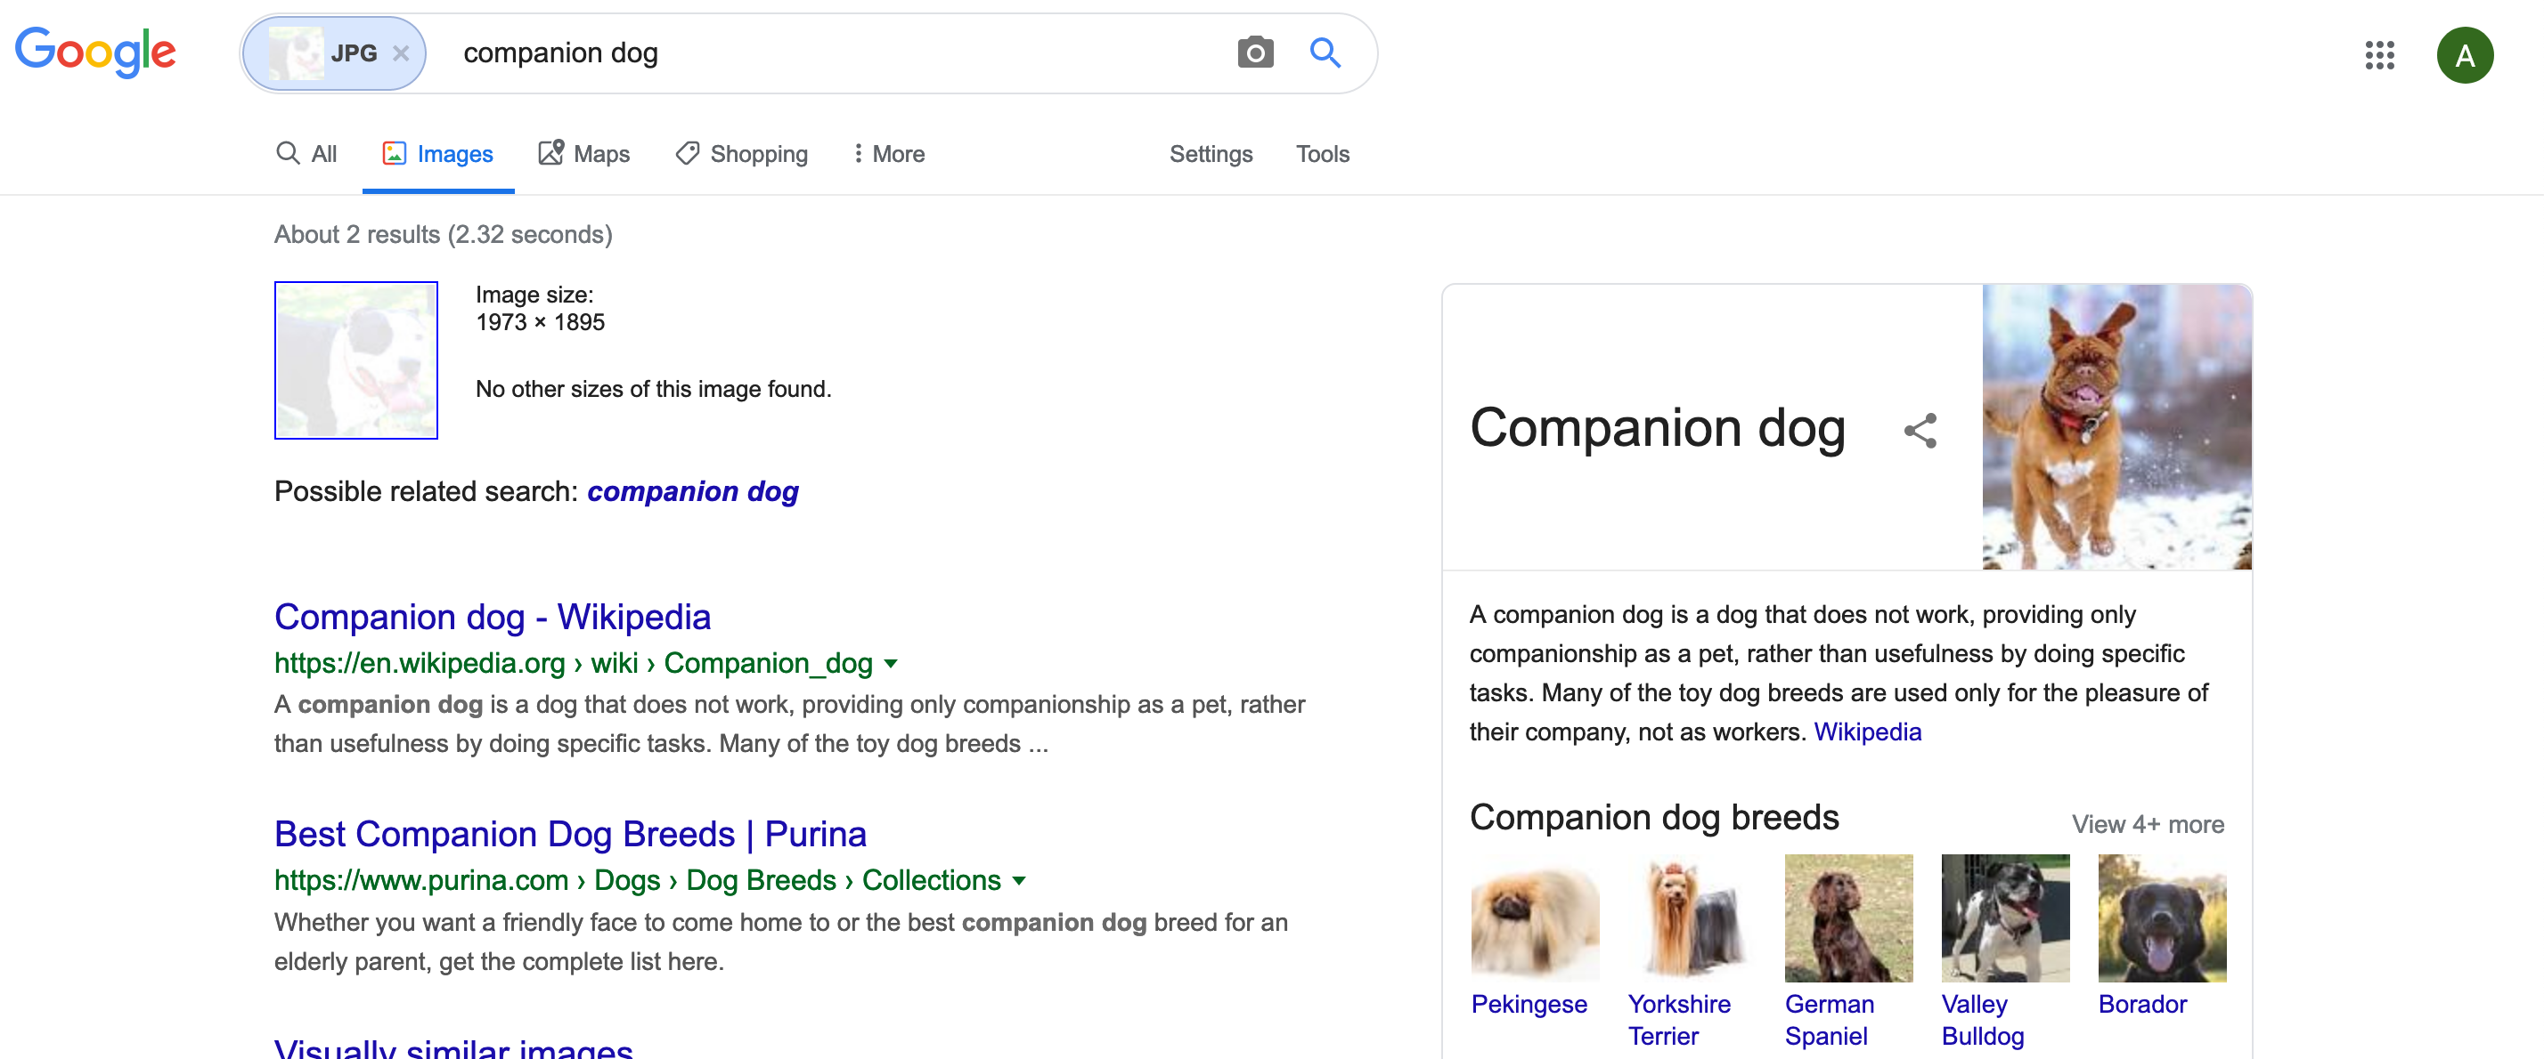
My result for modified Warren

Slide 22
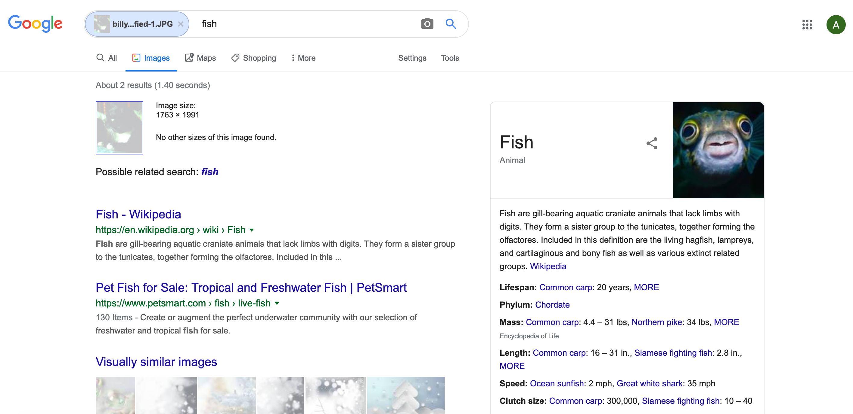
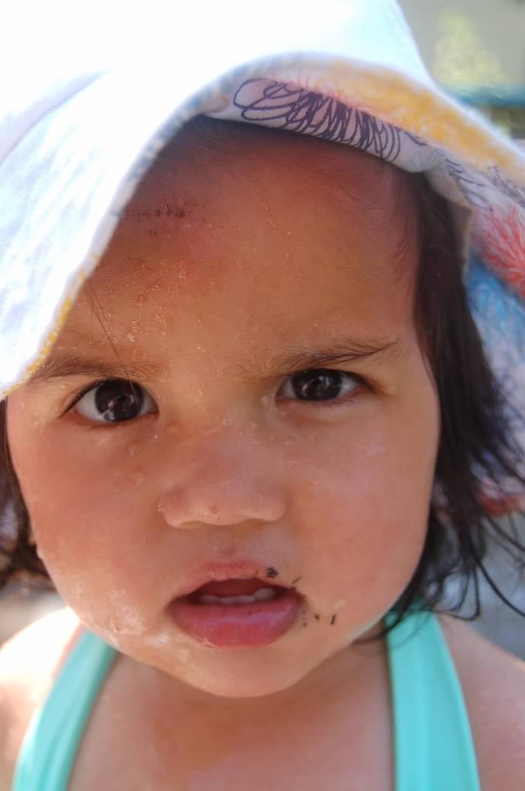
My result for modified Billy
?

Slide 23
Bonus alert! Better modified Warren image?

Slide 24
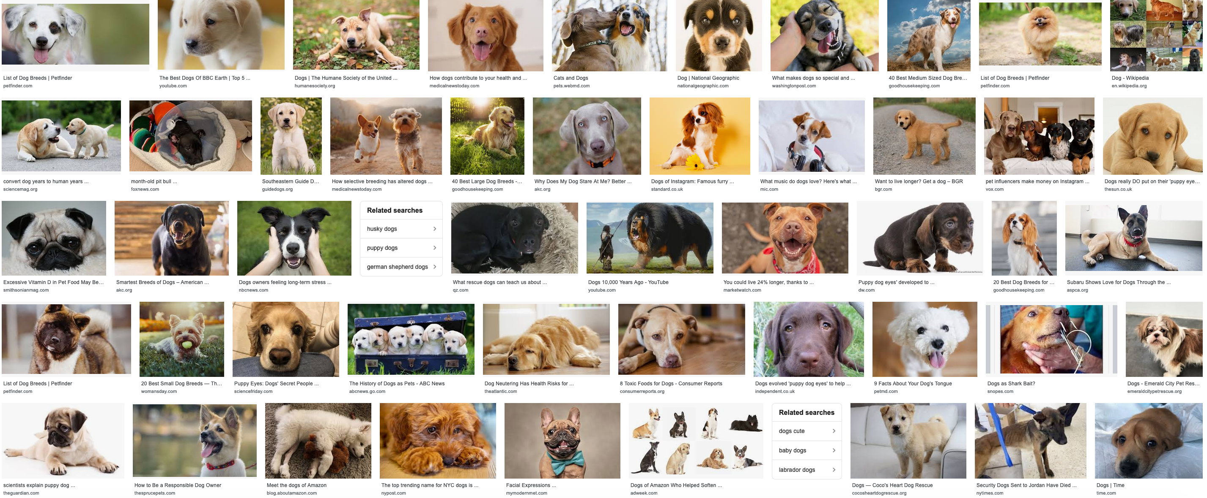
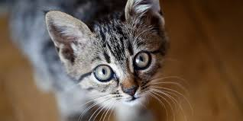
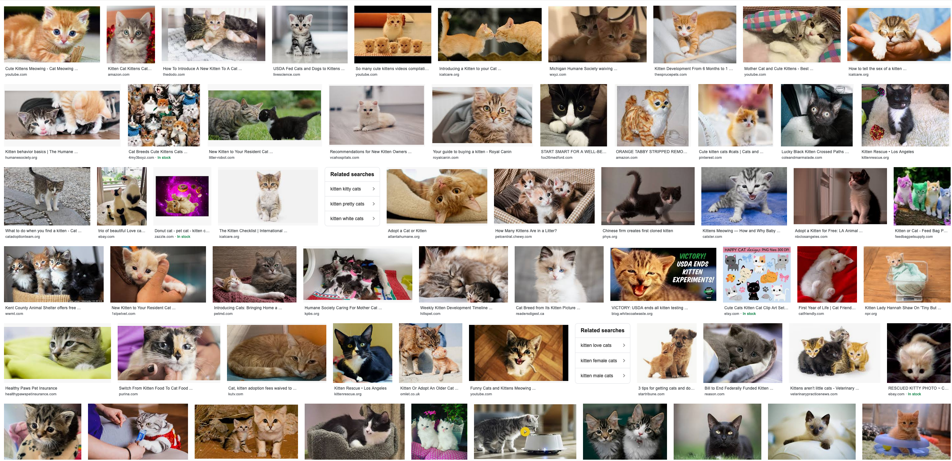
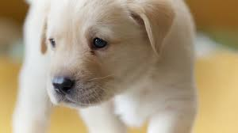
How does Google Images work?
dog
, cat
f
Training
cat
, dog

Slide 25
When a new image comes in
dog
f
cat

Slide 26
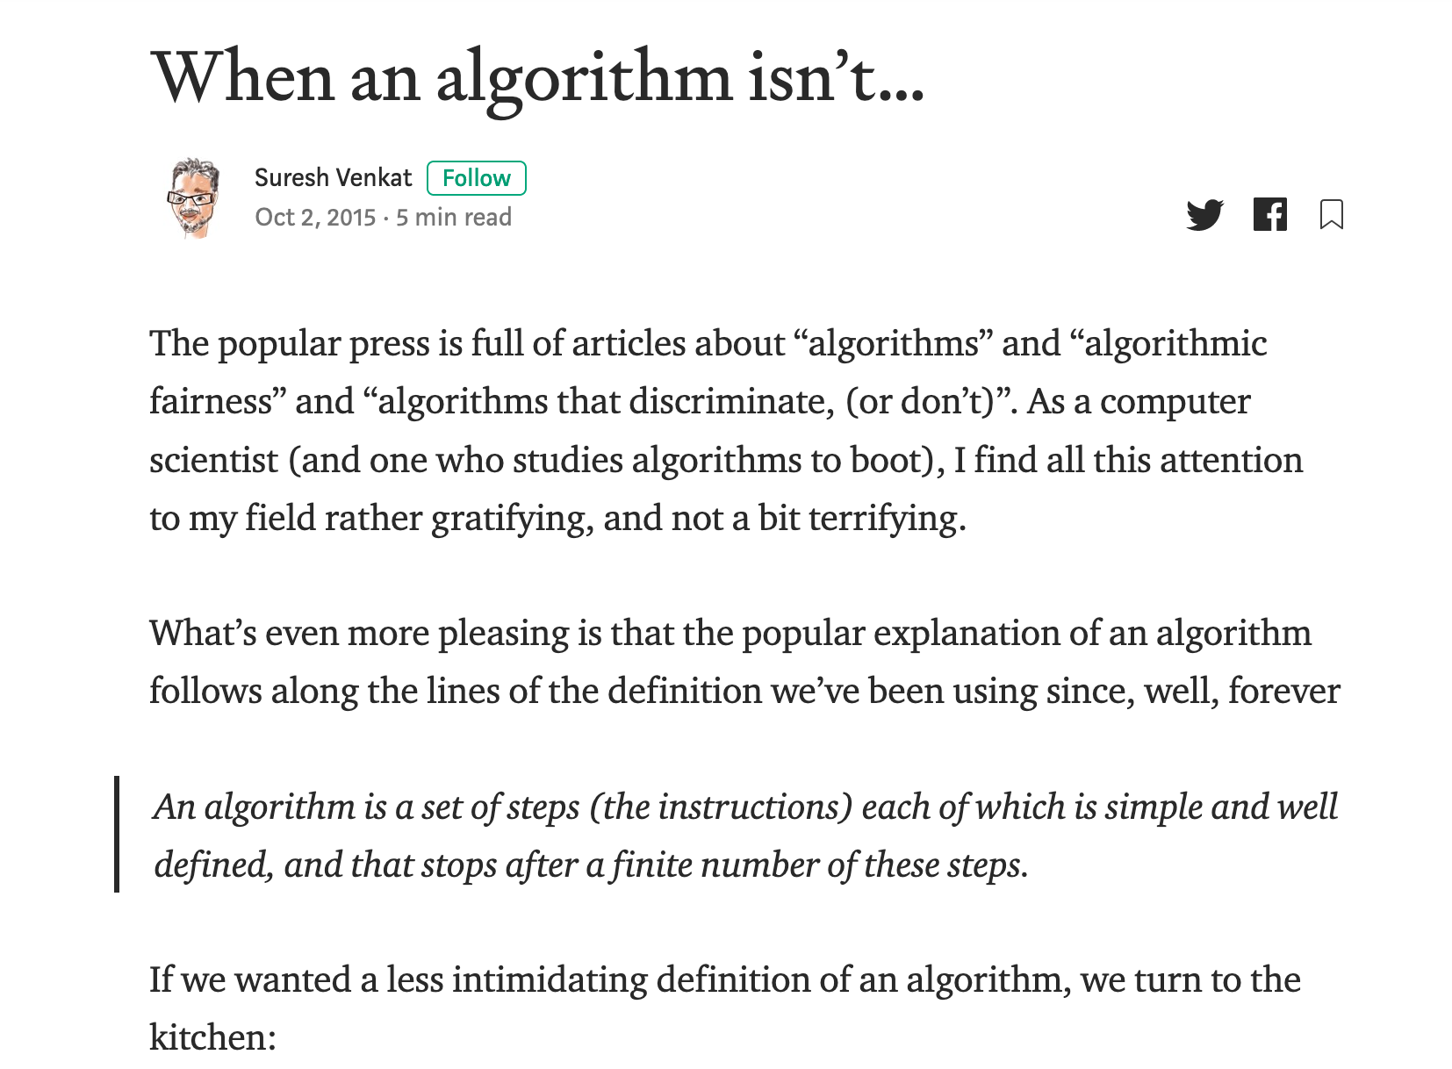
Couple of important points
Google images is learning something but not “our way” of looking at cats vs dogs
There is NO problem/ algorithm divide!
dog
, cat
Training
f
, dog
cat

Slide 27
AOC is right!
Correct for modern algorithms
“Algorithms can be biased”

Slide 28
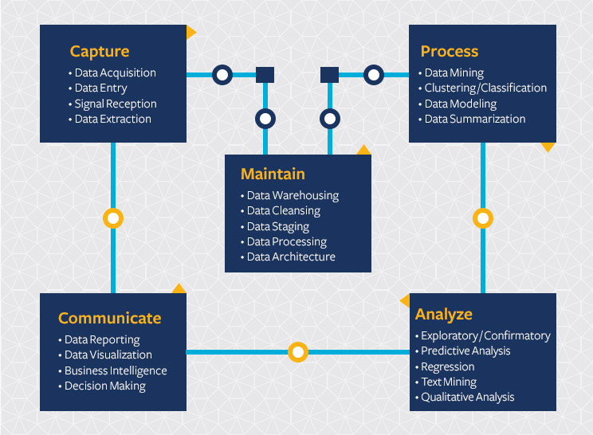
Modern Algorithm = Machine Learning (ML)
Start with a Question
Collect data
Train model
Evaluate model
Deploy!

Slide 29
Back to cats vs. dogs
Start with a Question
Collect data
Train model
Evaluate model
Deploy!
Classify image
as cat or dog
dog
No error,
so great!
dog
, cat
f
f
, dog
cat
cat

Slide 30
?

Slide 31
What is missing from this picture?
Start with a Question
Collect data
Train model
Evaluate model
Deploy!
Society

Slide 32
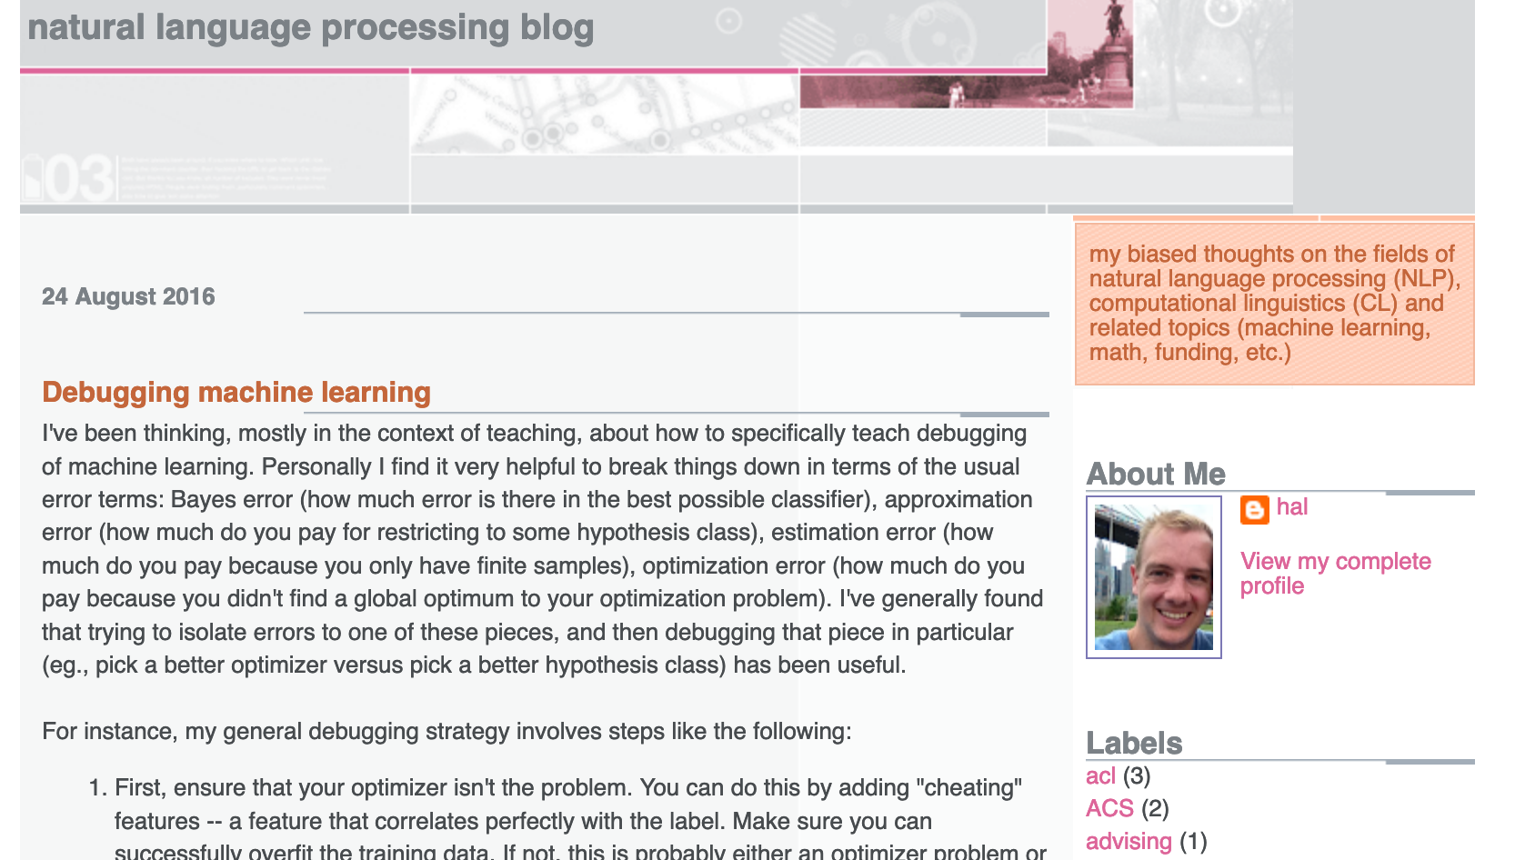
Start with a Question
Collect data
Train model
Evaluate model
Deploy!
Real world goal
Real world mechanism
Learning problem
Data collection mechanism
Which data to collect?
Data representation
Target class/model
Deploy!
Evaluate error
Predict on test data
Model training
Training data set

Slide 33
What is missing?
Real world goal
Real world mechanism
Learning problem
Data collection mechanism
Which data to collect?
Data representation
Society
Target class/model
Deploy!
Evaluate error
Predict on test data
Model training
Training data set

Slide 34
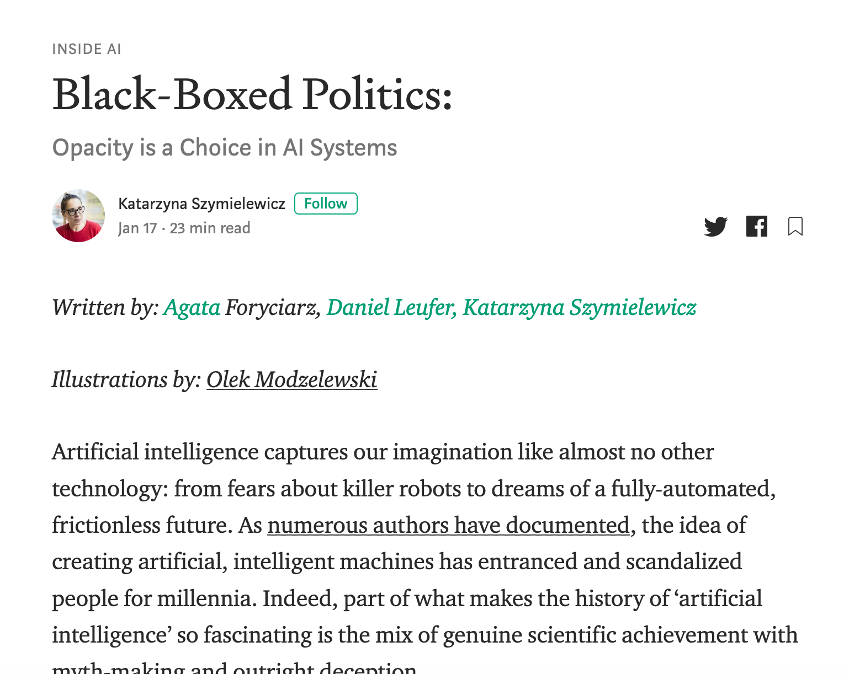
Not the only ML+society pipeline in town

Slide 35
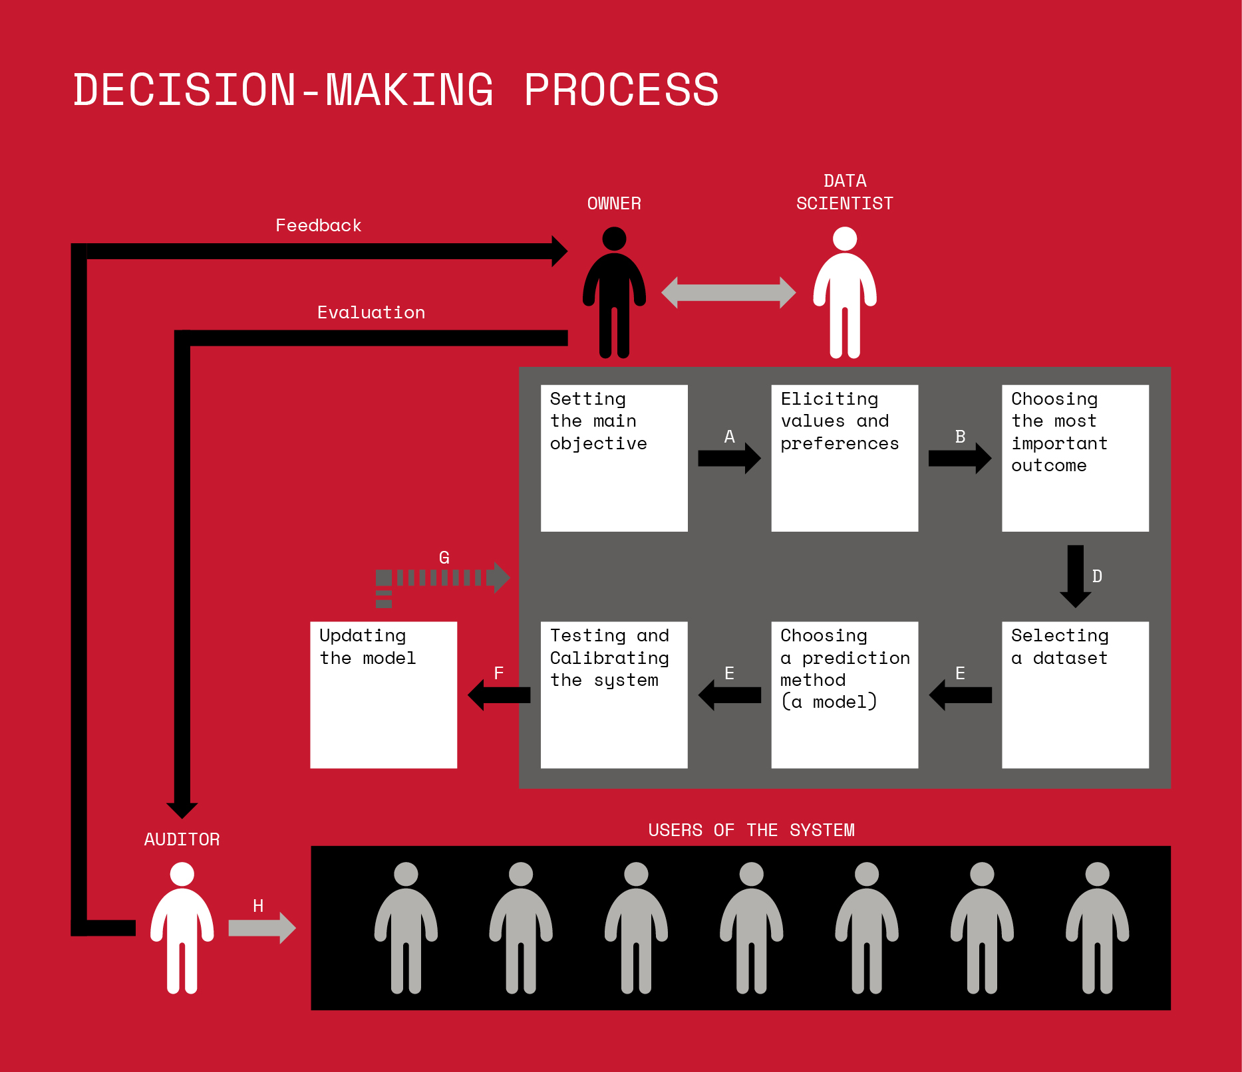
Not the only ML+society pipeline in town

Slide 36
A walkthrough

Slide 37
A walkthrough?
Real world goal
Real world mechanism
Learning problem
Data collection mechanism
Which data to collect?
Data representation
After the break!
Target class/model
Deploy!
Evaluate error
Predict on test data
Model training
Training data set

Slide 38
Next Thursday

Slide 39
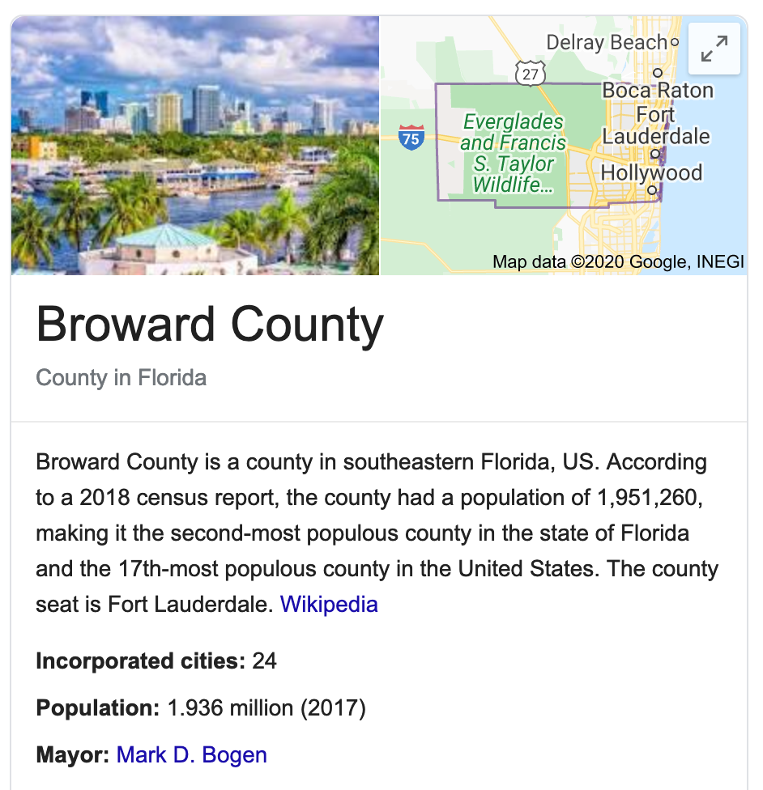
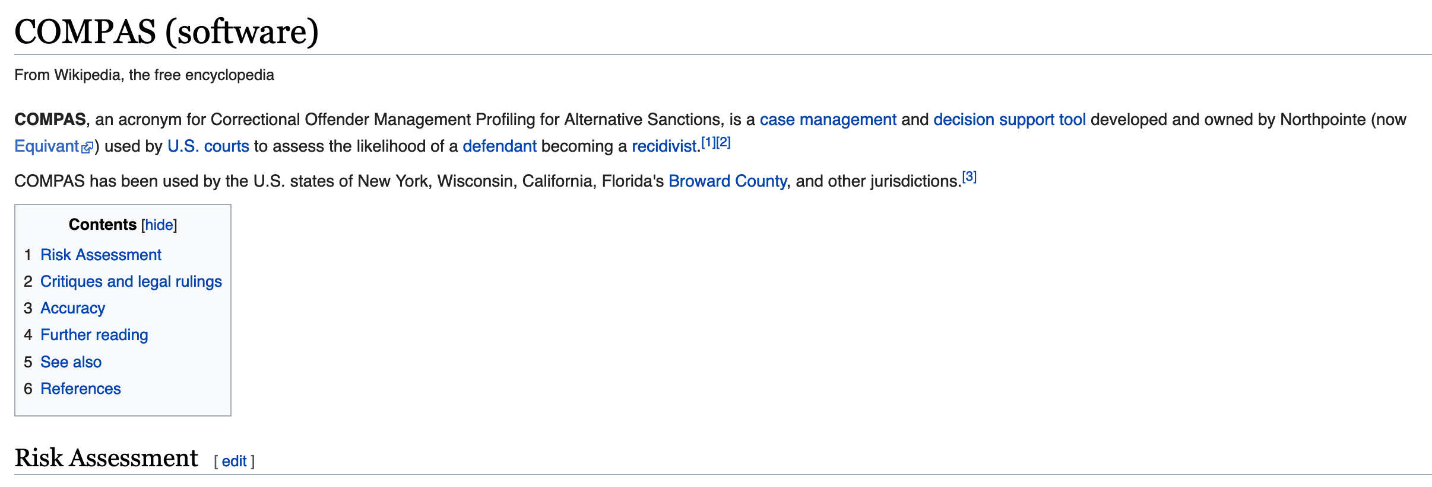
Have you heard of COMPAS?

Slide 40
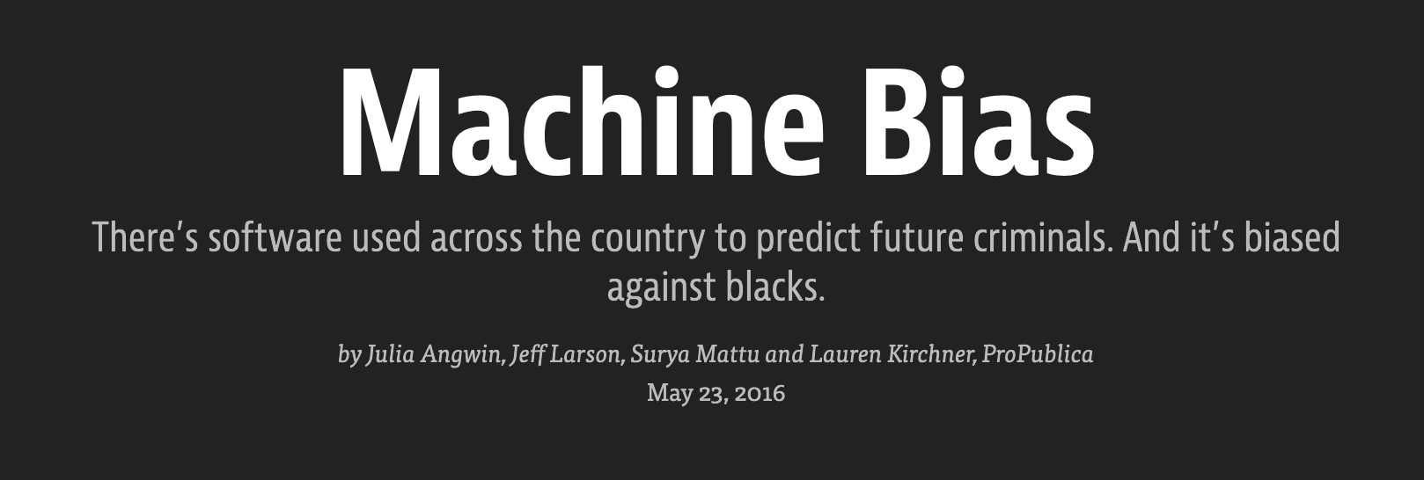

Slide 41
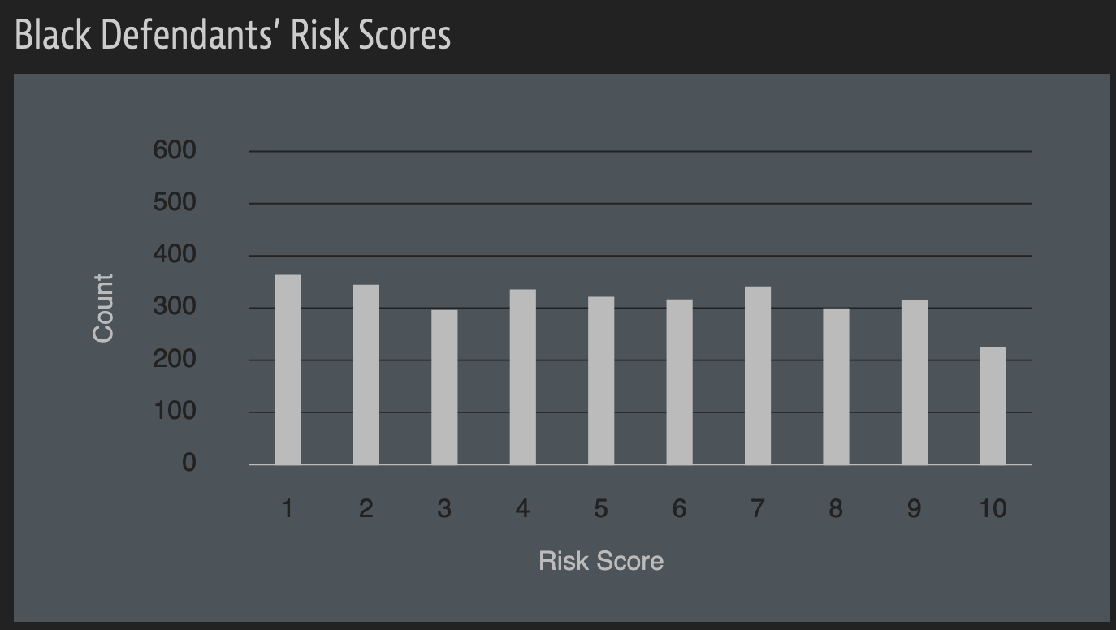
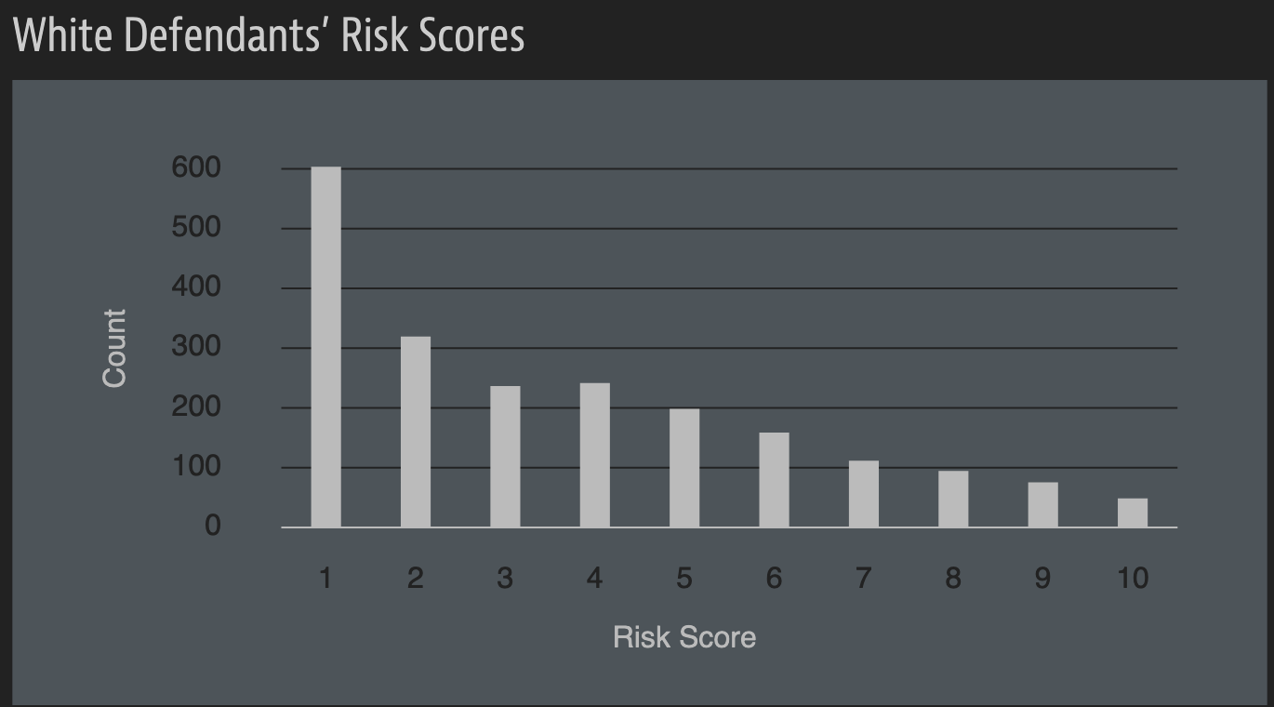
A sample of their result

Slide 42
A rejoinder

Slide 43
?

Slide 44
Pass-phrase for today: Katarzyna Szymielewicz

Slide 45
A walkthrough
Real world goal
Real world mechanism
Learning problem
Data collection mechanism
Which data to collect?
Data representation
Target class/model
Deploy!
Evaluate error
Predict on test data
Model training
Training data set

Slide 46
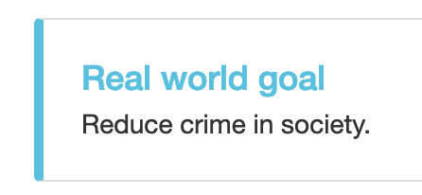
Real world goal
Real world goal

Slide 47
Real world mechanism
Real world goal
Real world mechanism

Slide 48
Learning problem
Target variable might not be obvious in other scenarios!
Real world goal
Real world mechanism
Learning problem

Slide 49
?

Slide 50
Data collection mechanism
Real world goal
Real world mechanism
Learning problem
Data collection mechanism

Slide 51
Which data to collect?
Real world goal
Real world mechanism
Learning problem
Data collection mechanism
Which data to collect?

Slide 52
Data representation
Real world goal
Real world mechanism
Learning problem
Data collection mechanism
Which data to collect?
Data representation

Slide 53
?

Slide 54
Target class/model
Real world goal
Real world mechanism
Learning problem
Data collection mechanism
Which data to collect?
Data representation
Target class/model
dog
Linear models
f
cat

Slide 55
Cartoon of how linear model works
Can you find a “better” line?

Slide 56
Training data set
Real world goal
Real world mechanism
Learning problem
Data collection mechanism
Which data to collect?
Data representation
Target class/model
Training data set

Slide 57
Pick (random) half of the dataset

Slide 58
Model training
Real world goal
Real world mechanism
Learning problem
Data collection mechanism
Which data to collect?
Data representation
Target class/model
Model training
Training data set

Slide 59
?

Slide 60
Predict on test data
Real world goal
Real world mechanism
Learning problem
Data collection mechanism
Which data to collect?
Data representation
Target class/model
Predict on test data
Model training
Training data set

Slide 61
Evaluate error
Real world goal
Real world mechanism
Learning problem
Data collection mechanism
Which data to collect?
Data representation
Target class/model
Evaluate error
Predict on test data
Model training
Training data set

Slide 62
?

Slide 63
Relation to problem statement
Real world goal
Real world mechanism
Learning problem
Data collection mechanism
Which data to collect?
Data representation
Target class/model
Problem independent techniques
Evaluate error
Predict on test data
Model training
Training data set

Slide 64
Next Thursday

