Slide 1
CSE 410
Apr 9, 2020

Slide 2
Bonus Qs graded… finally!

Slide 3
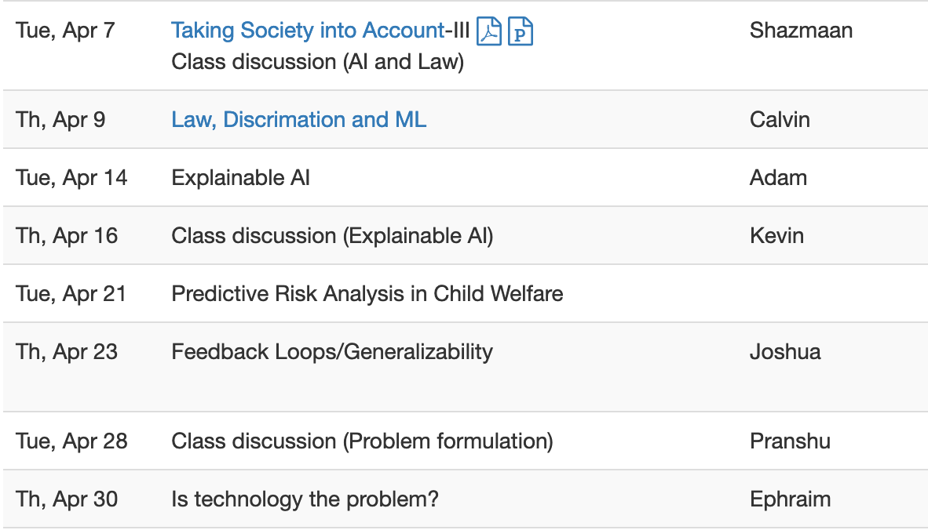
Proof reading schedule fixed for last round

Slide 4
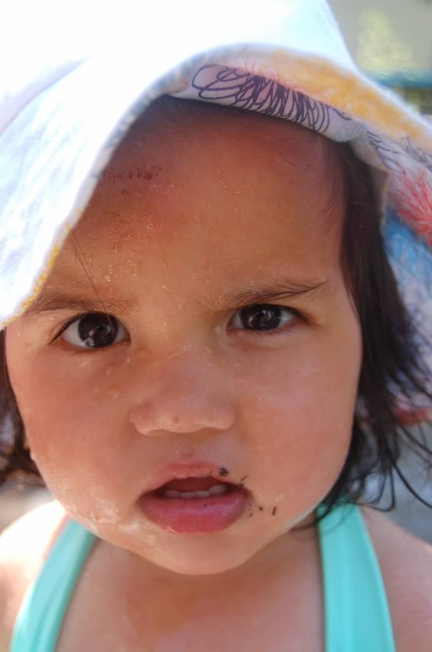
?

Slide 5
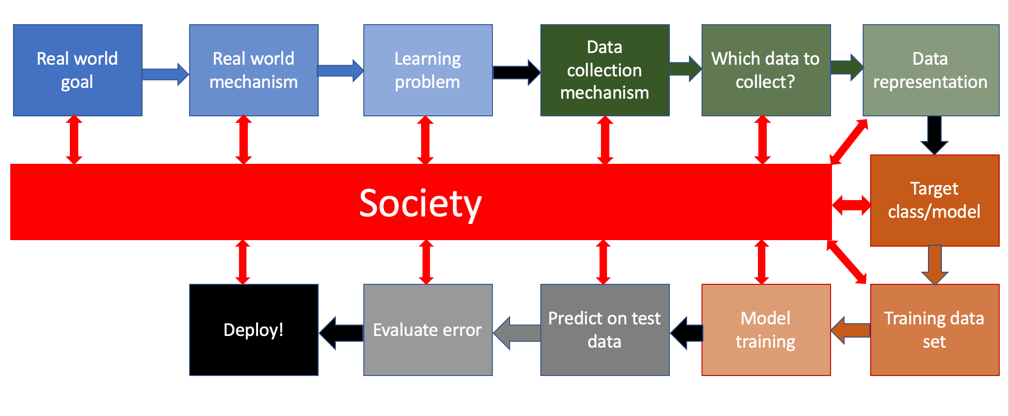
Bringing society back into the picture

Slide 6
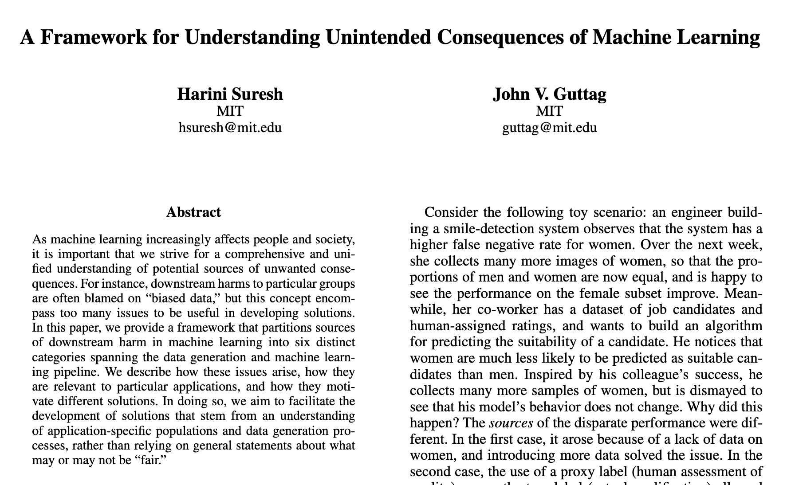
Six categories of bias of the 3rd kind

Slide 7
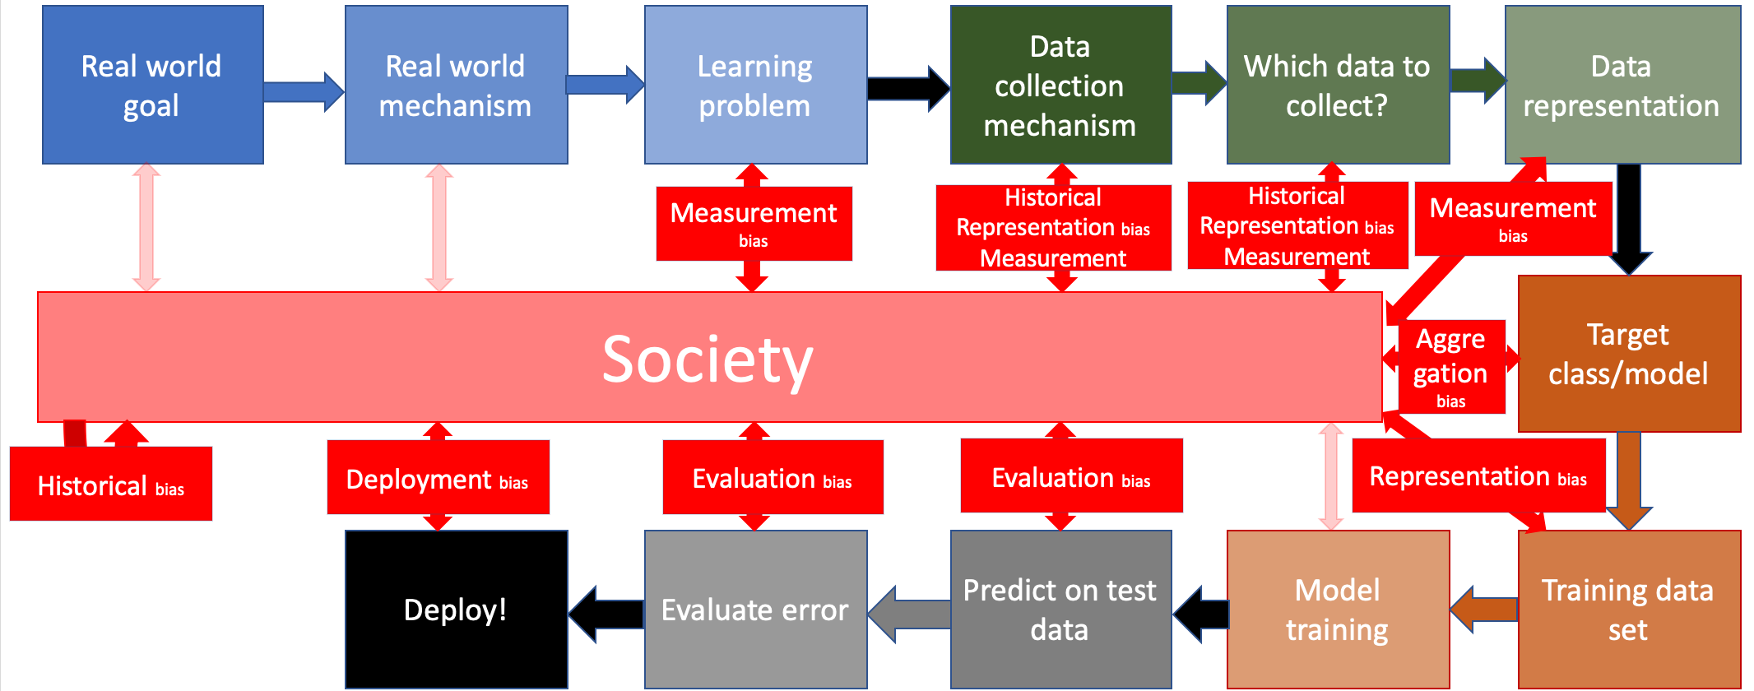
All biases in one place…

Slide 8
?

Slide 9
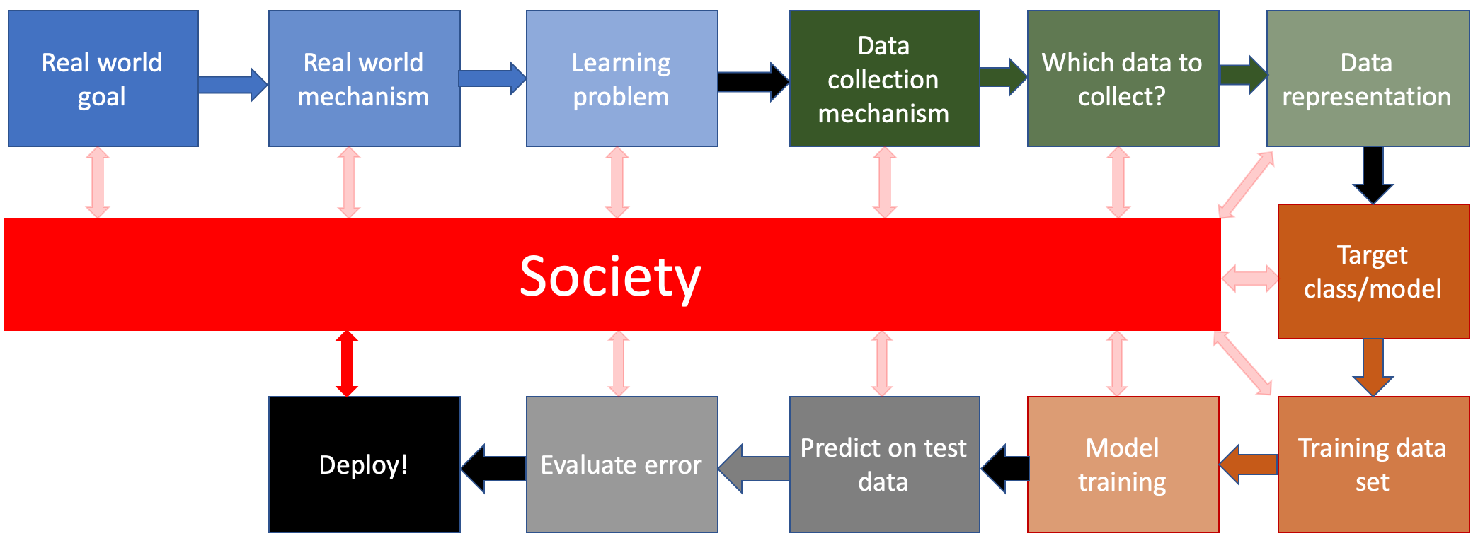
Discrimination and Law

Slide 10
Civil rights act of 1964

Slide 11
Other anti-discrimination laws exist..
We will focus on Title VII in this part of the course

Slide 12
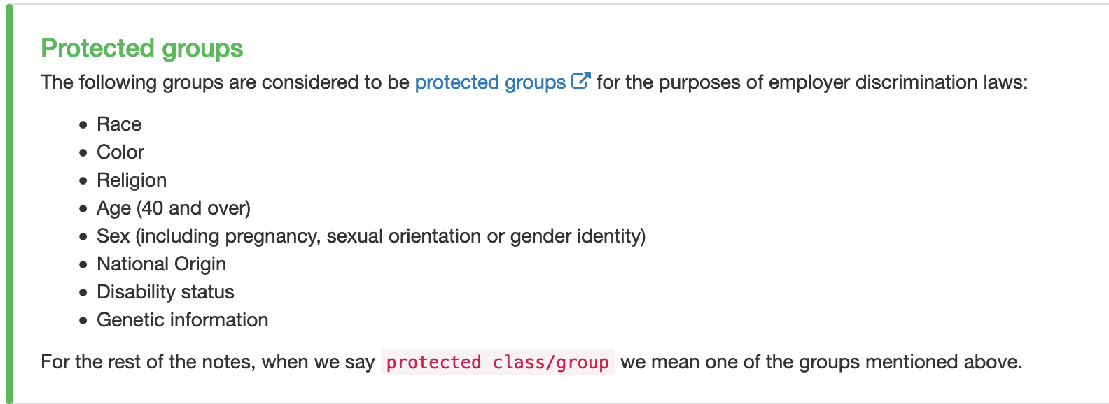
Protected groups/classes

Slide 13
Discrimination can be legal!
Even discrimination against protected class can be legal!

Slide 14
?

Slide 15
Law is not immutable

Slide 16
Title VII

Slide 17
Disparate Treatment

Slide 18
Two kinds of disparate treatment
Formal and intentional

Slide 19
Exercise 1
Discuss!

Slide 20
Exercise 2
Discuss!

Slide 21
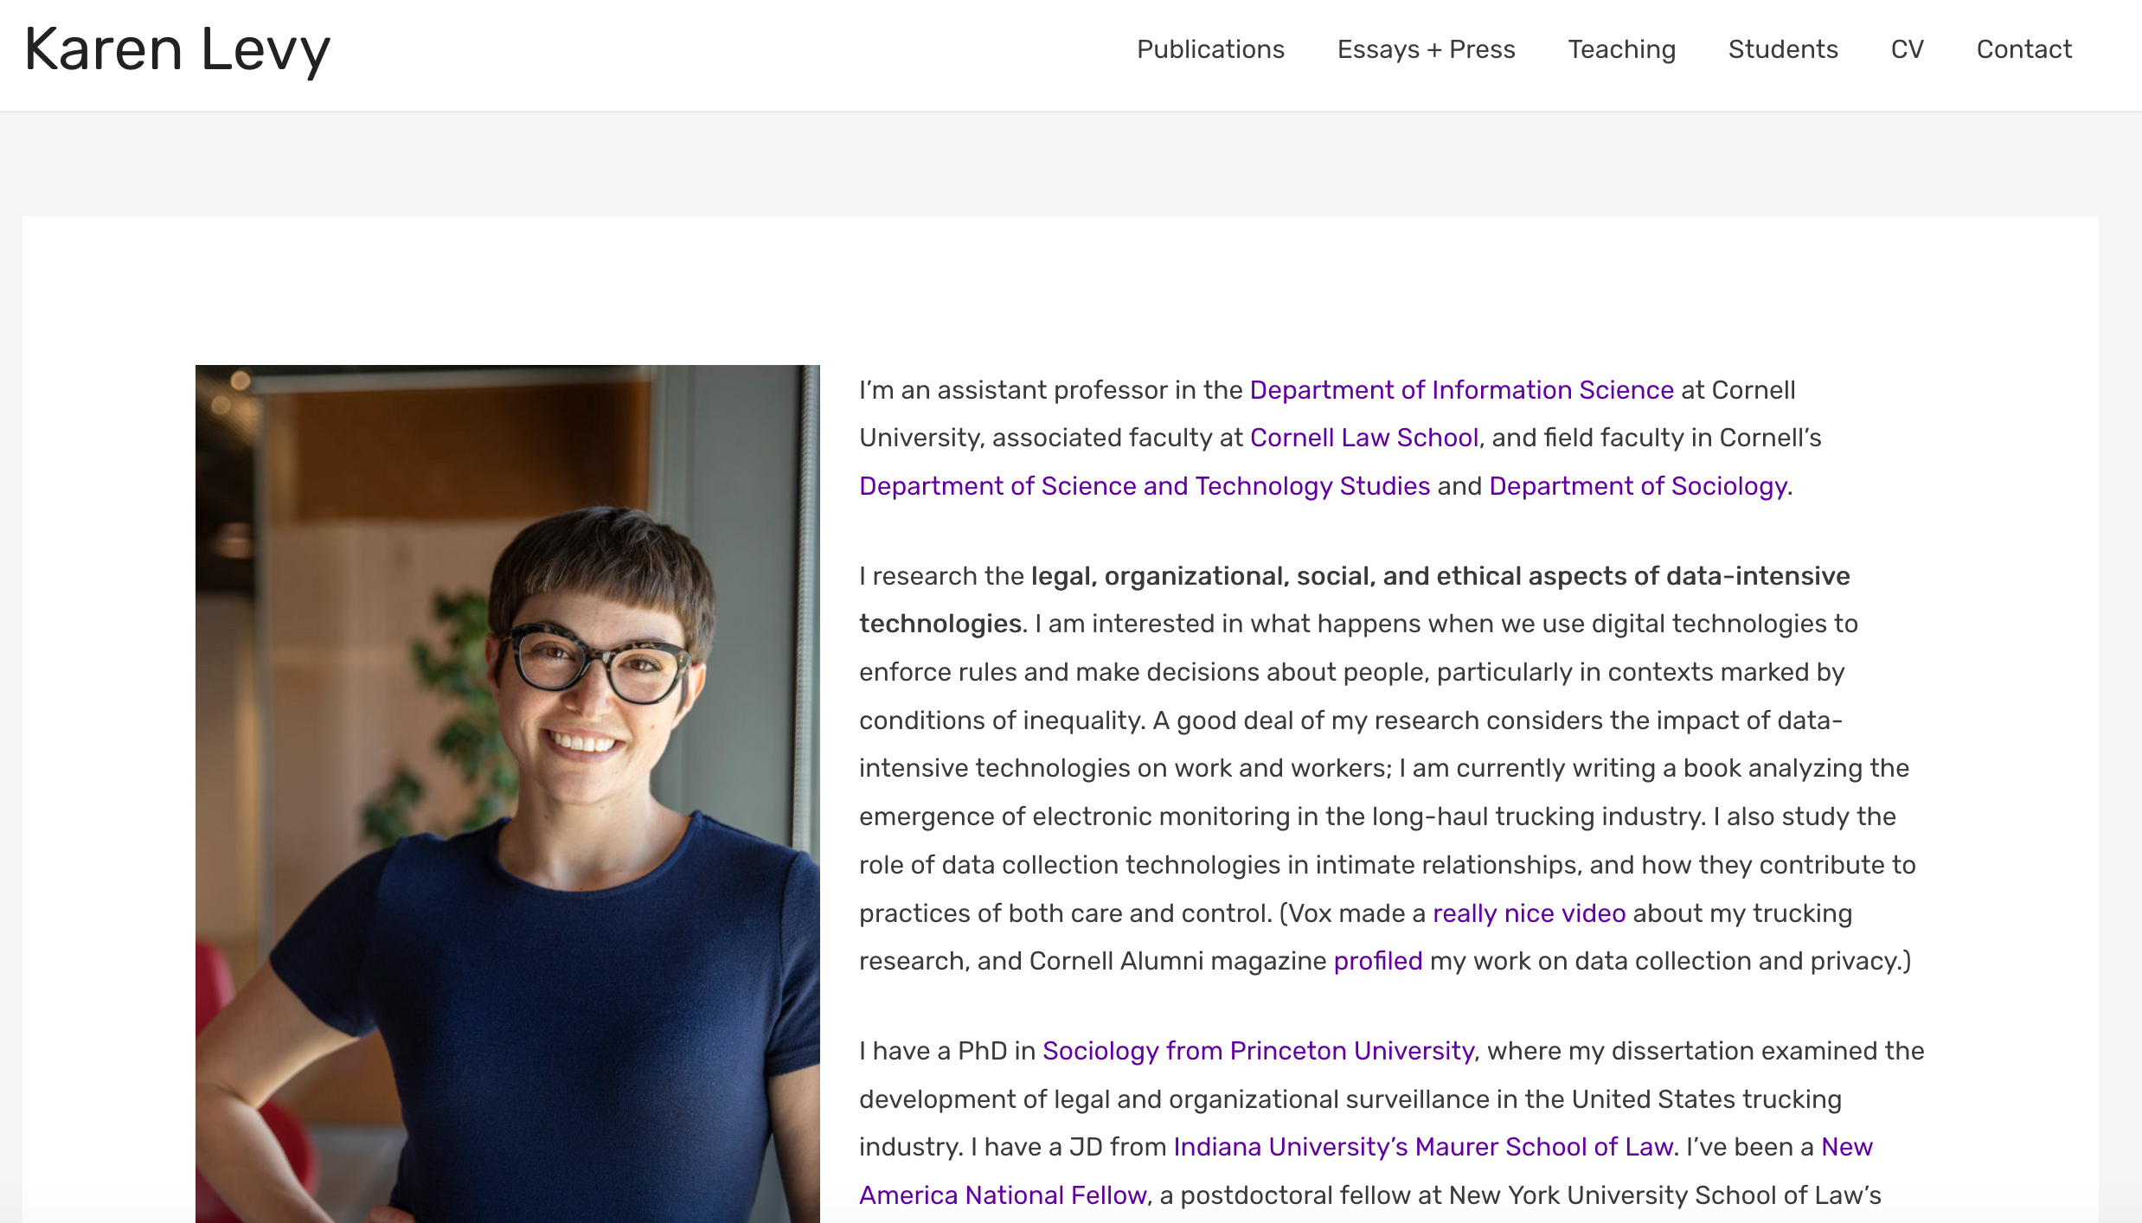
Passphrase for today: Karen Levy

Slide 22
Disparate Impact (Griggs vs. Duke Power Co.)

Slide 23
Disparate Impact

Slide 24
Disparate Impact: Examples

Slide 25
Three steps in a disparate impact step

Slide 26
If there is time….
How would the ML pipeline affect the Disparate treatment and disparate impact cases?

Slide 27
Disparate treatment and ML pipeline
Discuss!

Slide 28
Disparate impact and ML pipeline
Discuss!

