Slide 1
CSE 410
Apr 14, 2020

Slide 2
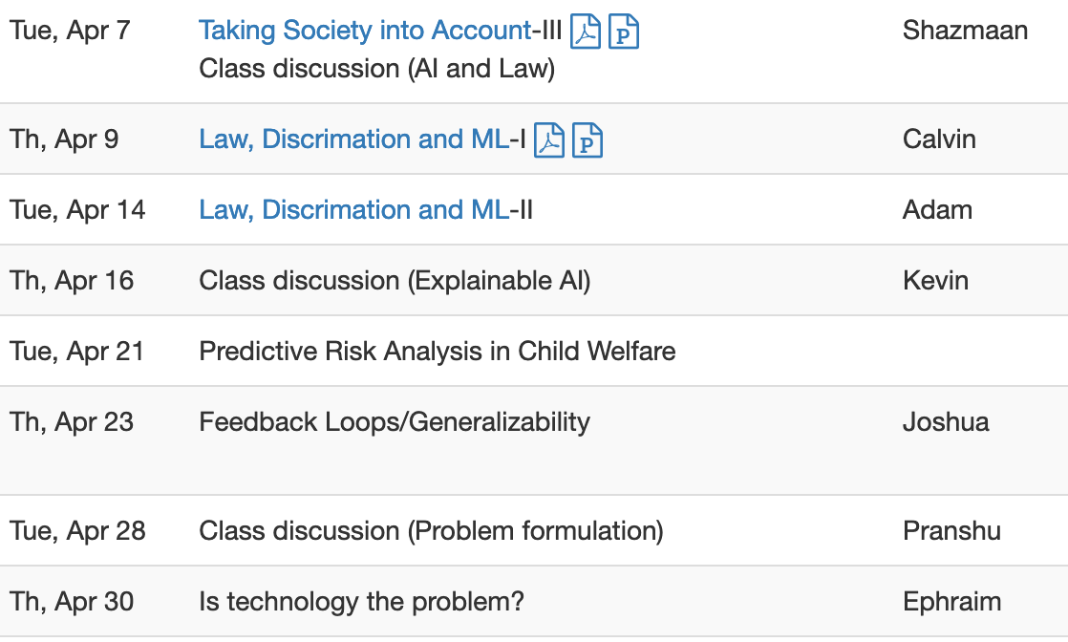
Proof reading schedule fixed for last round

Slide 3
Paper discussion this Thursday

Slide 4
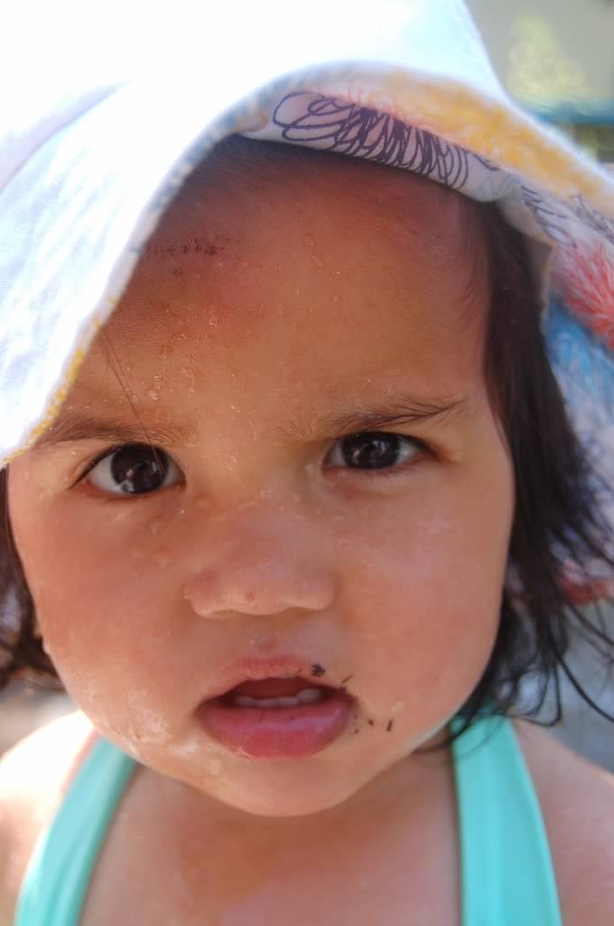
?

Slide 5
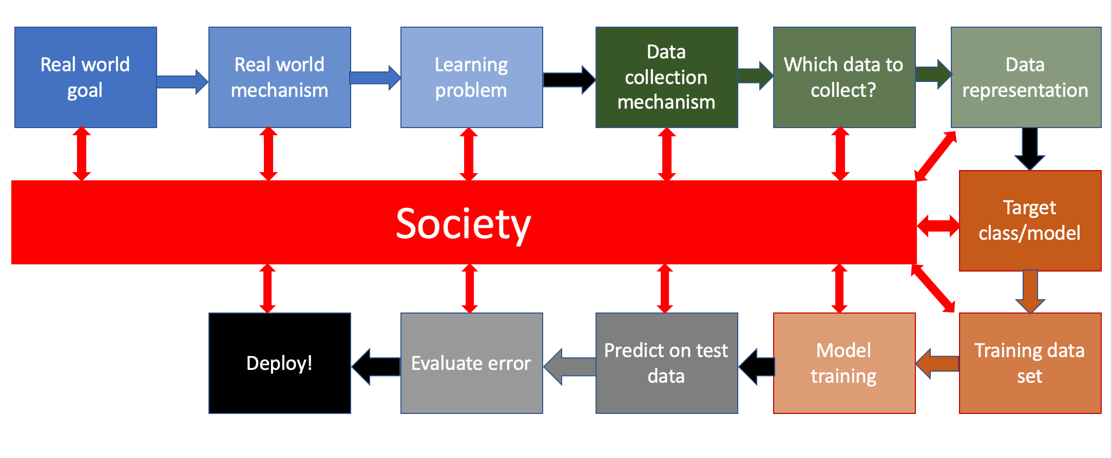
Bringing society back into the picture

Slide 6
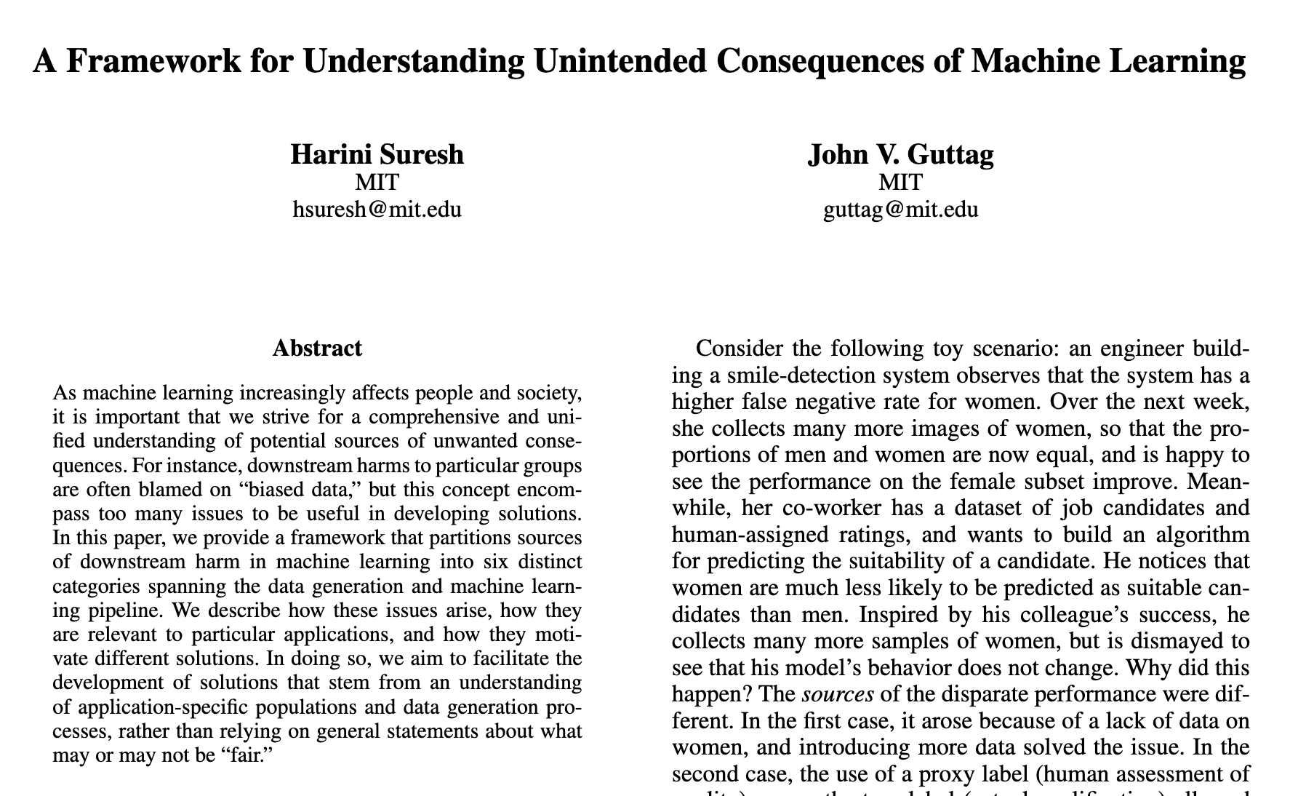
Six categories of bias of the 3rd kind

Slide 7
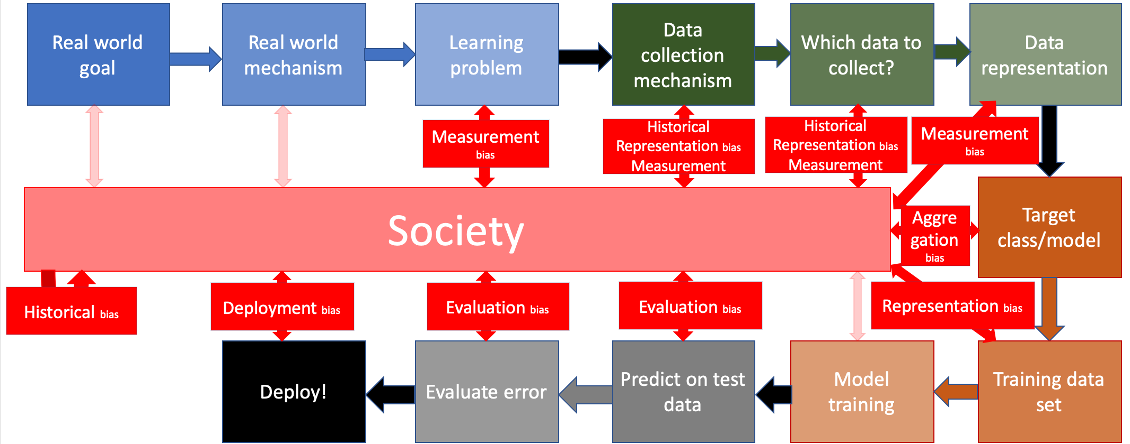
All biases in one place…

Slide 8
?

Slide 9
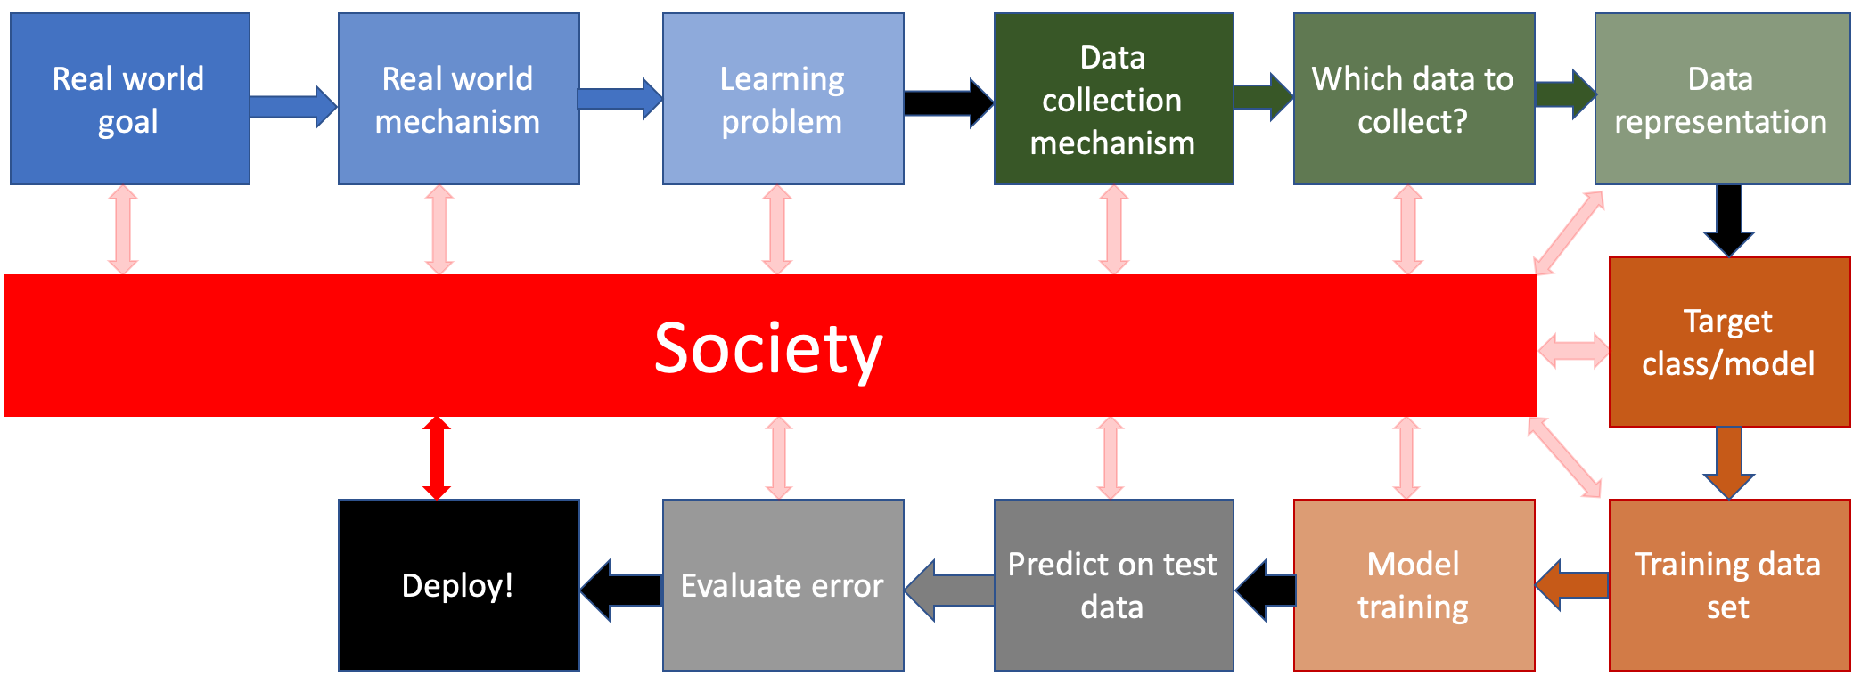
Discrimination and Law

Slide 10
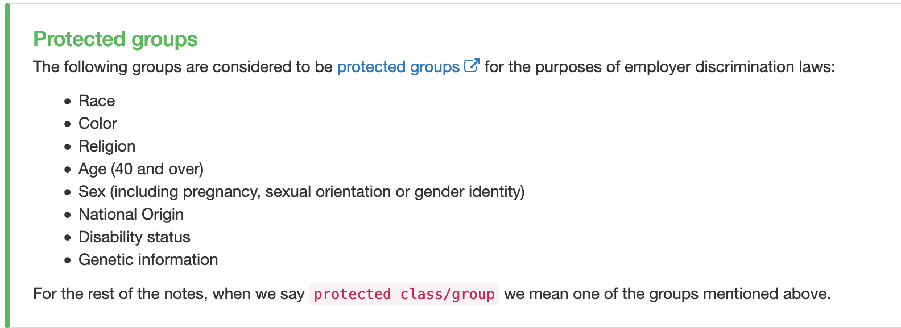
Protected groups/classes

Slide 11
Title VII

Slide 12
Two kinds of disparate treatment
Formal and intentional

Slide 13
?

Slide 14
Disparate Impact

Slide 15
Disparate Impact: Examples

Slide 16
Three steps in a disparate impact step

Slide 17
?

Slide 18
Title VII and ML

Slide 19
Masking

Slide 20
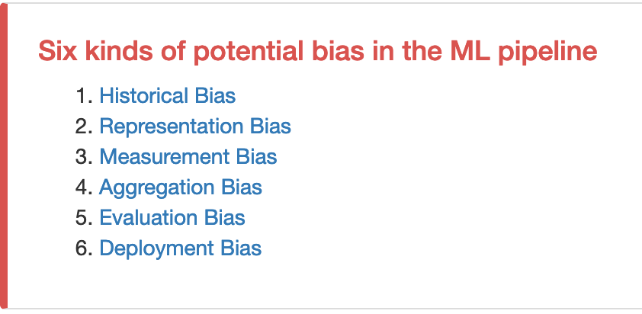
Exercise
Breakout room #1
Breakout room #2
Breakout room #3

Slide 21
Catalog of evils

Slide 22
Catalog of evils

Slide 23
?

Slide 24
Passphrase for today: Deborah Raji

Slide 25
Two kinds of disparate treatment
Formal and intentional

Slide 26
Disparate Treatment and ML
Exercise from last class

Slide 27
Another exercise
Discuss!
Intentional discrimination

Slide 28
Recall: Street Bump

Slide 29
Exercise
Breakout room #2 will be defendant for Breakout room #1 and vice-versa

Slide 30
Applying disparate treatment on model
Discuss!

Slide 31
Conclusion on using disparate treatment

Slide 32
?

Slide 33
Three steps in a disparate impact step

Slide 34
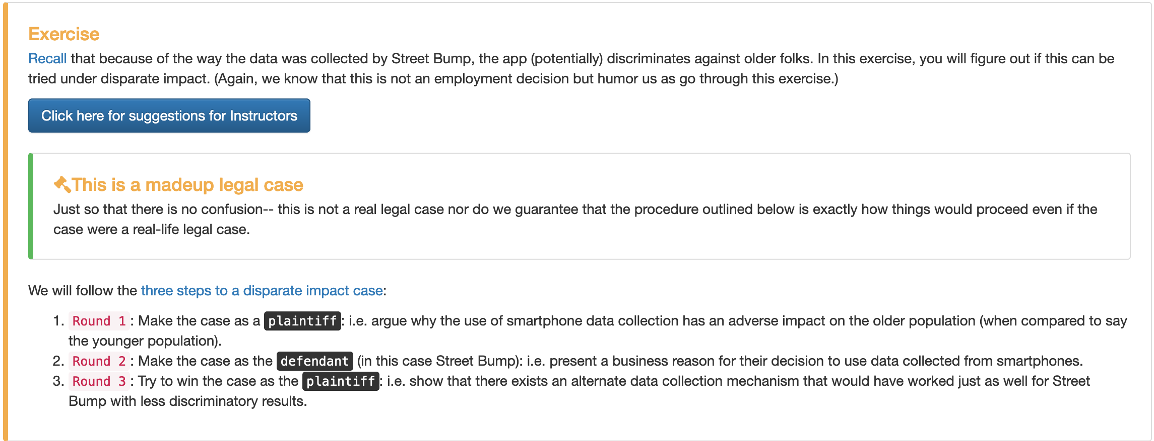
Disparate impact and ML
Breakout room #2 will be defendant for Breakout room #1 and vice-versa

