Slide 1
Melanie Sage, PhD, MSW
University at Buffalo, SUNY School of Social Work
Director, iHeartTech
@melaniesage #swtech

Slide 2
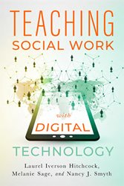
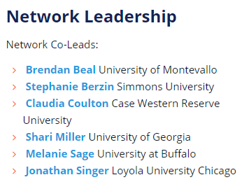
Director/Founder, iHeartTech
The mission of the Institute for Healthy Engagement and Resilience with Technology (iHeartTech) is to discover and disseminate research and best practices related to healthy engagement and resilience with technology, and the productive use of technology for social good and effective delivery of social services.
Chair, husITa
human services Information Technology Association) is an international registered US 501(c) non-profit organization whose mission is to promote the ethical and effective use of information technology for human betterment.
Publishes Journal of Technology in Human Services

Slide 3
How do we harness technology for social good?
(my current social work research)
Ethical practice: how do/how should child welfare workers use technology to inform practice?
Theory building: how do youth in foster care develop digital resilience to inform development of healthy online relationships?
Engagement: What are relational ways for teachers, schools, clinicians, and agencies to harness tech to improve their outcomes?
Broadly: How can technology improve outcomes for youth in foster care?
Notes:
My work

Slide 4
Predictive Analytics in Child Welfare
Landscape, Pilots, Opportunities, Barriers & Future Directions

Slide 5
Landscape of Child Welfare (data impacts)
High caseloads
High workforce turnover
Inconsistent policy and practice
Large disparities in racial outcomes
Inconsistent service access and delivery
States (counties) set most standards
Low data literacy among workers
Lack of evidence-based solutions
Inconsistent data definitions, systems
Unlinked data, out of date data management systems
Reliance on contracted systems- vendors lose interest, systems too expensive to update, agencies create, interoperability, “shadow systems”

Slide 6
Predictive Risk Analytics
Allegheny PA/ New Zealand
NYC (w Kroll)
Eckerd Rapid Safety Feedback (FL, IL, OK, ME, CT, LA, AK, IN, AL)
Predict-Align-Prevent (GPS, Richmond, VA)
Foster/adoptive placement matching (CA)

Slide 7
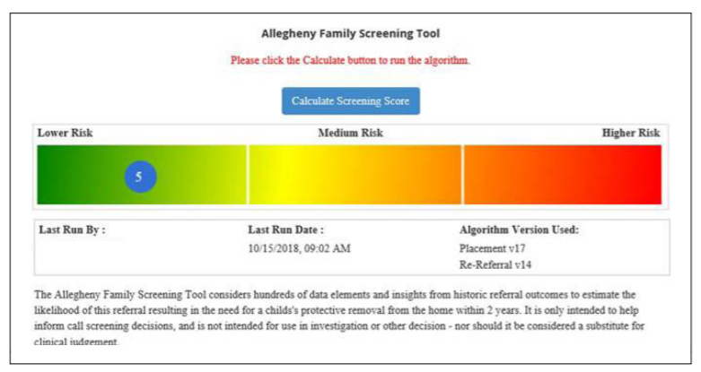
Allegheny County, PA: Predictive Risk Modeling
Uses:
Child welfare records
Jail records
Juvenile probation records
Behavioral health records
Predicts the likelihood that child will come into foster care in the next two years
Screener can override decision
Blind to worker who visits the home

Slide 8
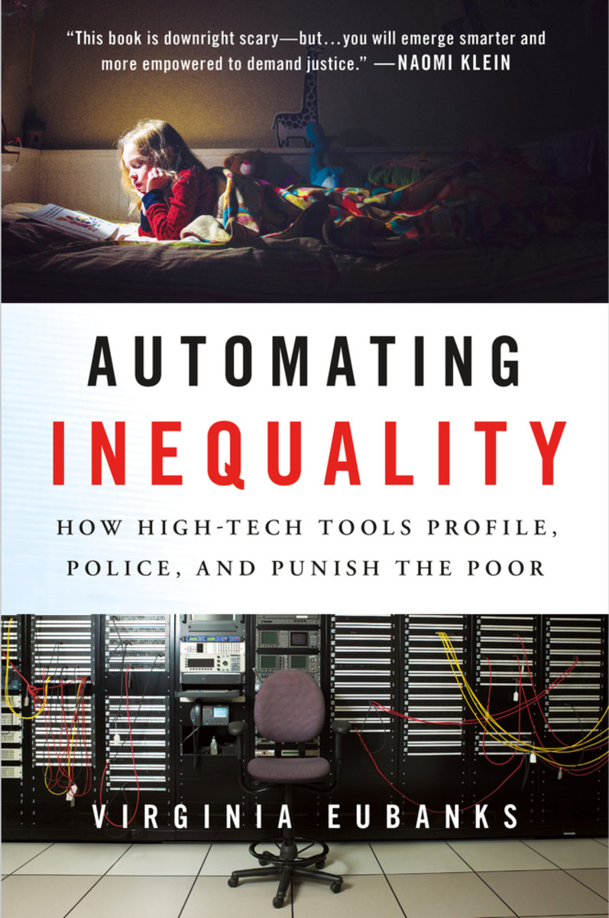
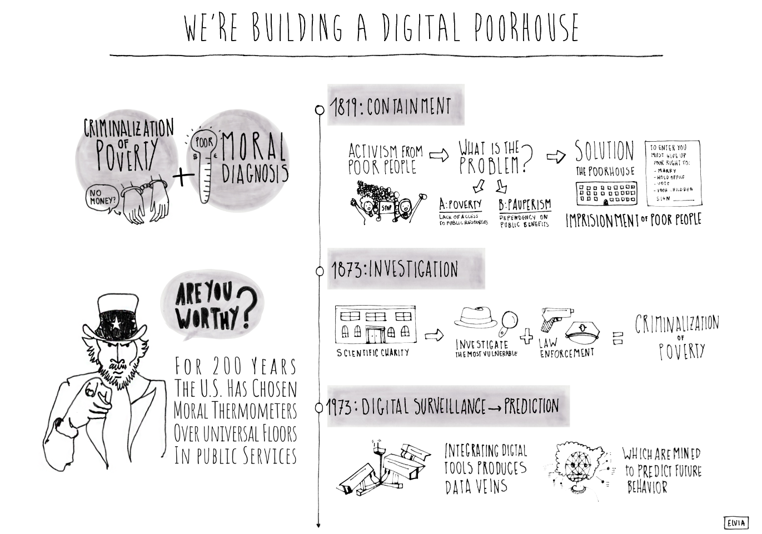
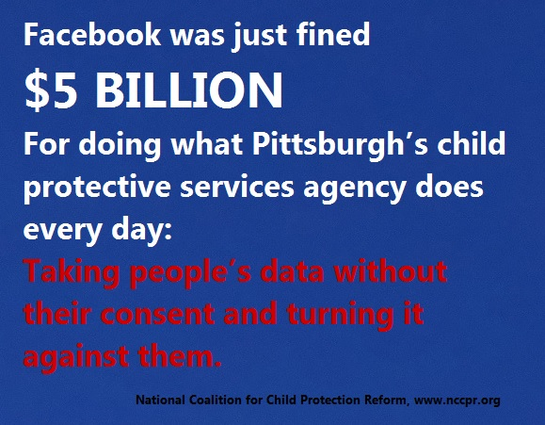

Slide 9
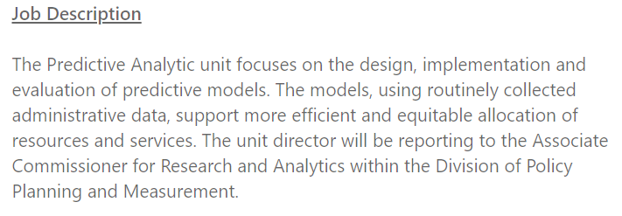
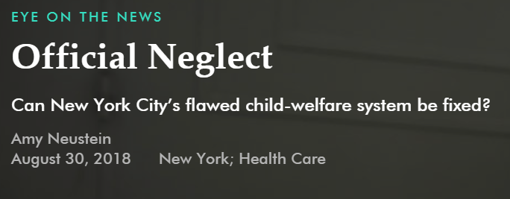
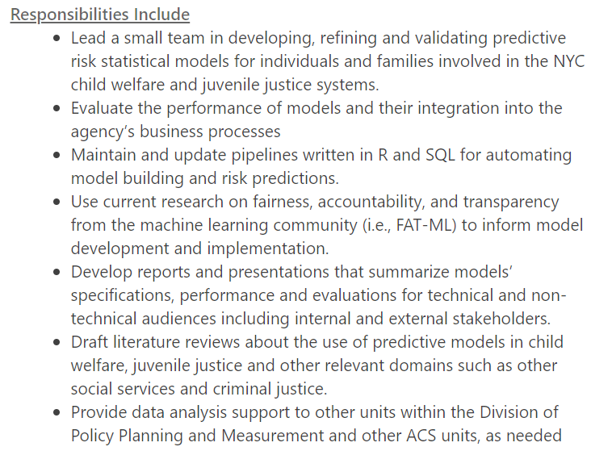
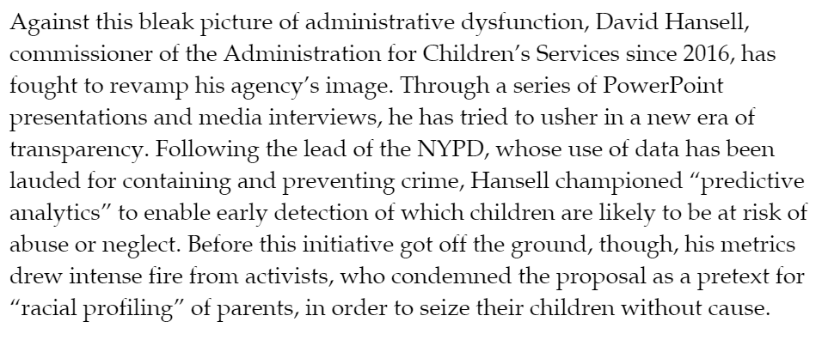
New York City’s effort

Slide 10
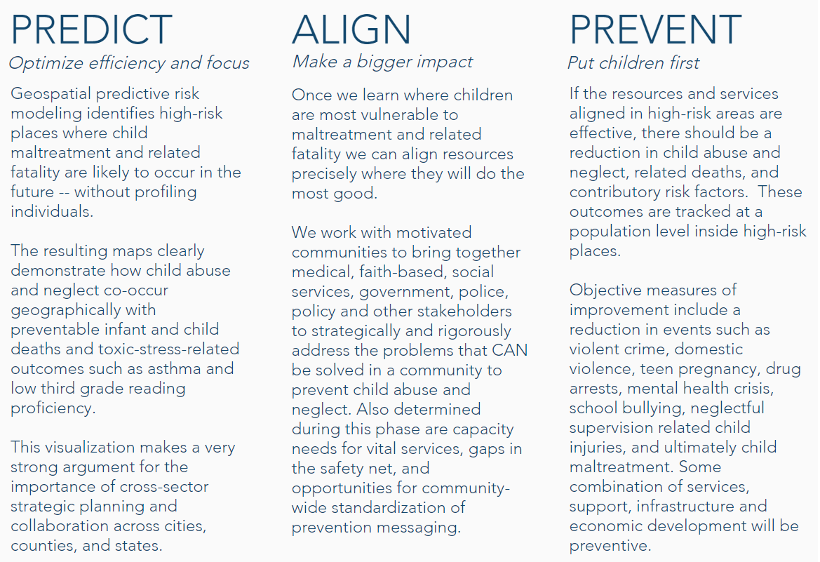
Risk terrain modeling: geospatial data
Aggravated Assaults
Bars & Nightclubs
Murders
Domestic Violence
Drug Crimes
Gang Presence
Prostitution
Poverty
Robberies
Runaways
Dependent variable: Substantiated Cases of Child Maltreatment
It was able to accurately predict 52% of all instances during the subsequent year in only one-tenth of the city’s area that was identified as having the most problematic aggregation of risk factors.
Dyann Daley, MD

Slide 11
Possibilities
Use of data and evidence to make better decisions
Accountability about how decisions are made
Effective use of public dollars/targeted services
Better understandings of the routes to outcomes
Preventative services/move upstream
Build stronger communities (GPS)
More time with clients
Increase “fairness”
Individualized plans/ intervention matching may increase equity

Slide 12
Concerns
Surveillance/civil liberties/confidentiality
Over-surveilling targeted communities
Human bias embedded in data
Bad data (collection, representation)
Service allocation
Stigmatization- often the “predictors” are not correctable
“Black swan” events
Culpability for decision-making
Disproportionate use of public information privileges those with resources
Lack of effective treatment/responses
Black box/lack of transparency in design
Public perceptions/accountability
Allure of objectivity
Useability/Usefulness
Other ways data may bias service delivery
Multiple views of fairness re: outcomes
Notes:
Compared to: redlining, predictive policing,

Slide 13
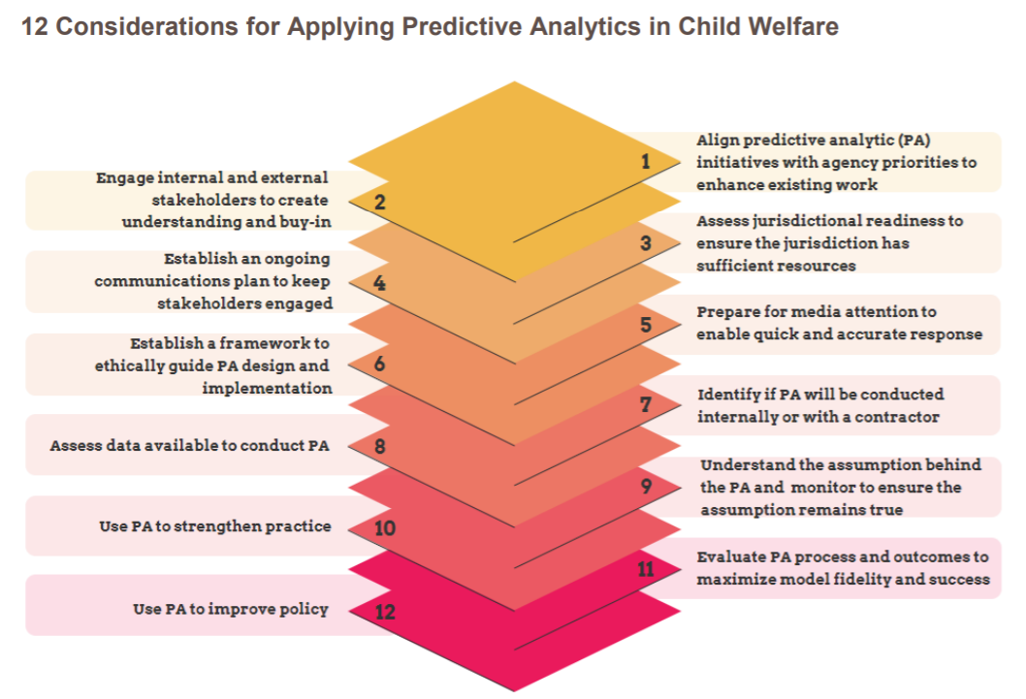
Casey Family Programs
Notes:
https://caseyfamilypro-wpengine.netdna-ssl.com/media/Considerations-for-Applying-Predictive-Analytics-in-Child-Welfare.pdf

Slide 14
Social Science Talk | Computer Science Talk
Data quality concerns | Garbage in, Garbage Out
Over-representation of high risk cases in data | Data is enriched without correcting for oversampling
Data isn’t useful to workers | UX/UI Problems
Goal is to id cases for preventative services | Recommender system
Involve stakeholders in design | Participatory modeling
Systematically identifying concerns | Annotation task
Environment | Sociaotechnical context
Human bias captured in the data | Bias, through various intermediaries, bound up in training data
transparent, accountable, explainable, trustworthy, and fair

Slide 15
Advice if you want to do work like this…
Develop clear research question
Engage stakeholders and advisory group (workers, cs, Social scientists, community)
Assess org readiness and resources
Decide internal/external design
Communication and media plan
Ongoing ethical guidance
Assess data
Examine bias, consider consent issues
Include community-level analytics
Monitor assumptions about data
Past predicts present; data reliable
Develop meaningful reporting Use outcomes to improve practice
Use outcomes to improve policy
Consider usability (UX/UI/practical application)
Informs clinical judgement, not replaces

Slide 16
Current NYTD Fairness Project: Goals
Contribute to foundational computer science knowledge
Develop applied framework (qualitative and computational) for evaluating and carrying out applied PA projects Conceptualize multiple perspectives of fairness so that they can inform algorithms
Inform the field about how to use predictive analytics for policy and practice improvement in child welfare
Youth aging out of foster care- can we develop a fair recommender system?
With focus on ethical considerations and impact on most vulnerable

Slide 17
National Youth in Transition (NYTD) Datasets
Assist youth in transitioning to adulthood- youth characteristics and services offered since 2010
Required by states- report every 6 months: ages 17, 19, 21
Links by child ID to AFCARS measures
Demographics, services, outcomes (financial self-sufficiency, education, homelessness, parenting, drug tx, incarceration, and health insurance)
Participation rates by states vary (25%-60%)

Slide 18
Social work questions:
How do we better target preventative services to those who most need them?
How do we get child welfare agencies and stakeholders to trust and adopt Predictive Analytics?
How can PA inform organizational policy and practice?
Computer science questions:
How do we develop a framework (qualitative and computational) that accounts for bias in data?
Can we computationally model and systematically adjust for multiple perspectives of fairness?

Slide 19
Complicated things to figure out:
How do we build equity into an algorithm? Is it just (or legal) to use race as a factor to target services that improve equity?
How do we balance perceived fairness with algorithmic predictions?
How do we balance clinical wisdom and the recommender system in ways that promote accountability?
How do we avoid recommendations that fuel bias?
Do the benefits outweigh the risks? msage@buffalo.edu

Slide 20
Should we use predictive analytics to make decisions about who comes into foster care? What are possible definitions of “fairness” in service delivery to foster youth??

Slide 21
Resources
Considerations for Implementing Predictive Analytics in Child Welfare.(2018) Casey Families.
Predictive Analytics in Child Welfare: An Introduction for Administrators and Policy Makers. (2017). USDHHS.
Using Predictive Analytics to Improve Outcomes in Child Welfare. (2018). Chapin Hall.
Principles for Predictive Analytics in Child Welfare. (2017). NCCD.
Developing Predictive Risk Models to Support Child Maltreatment Hotline Screening Decisions. 2019. Allegheny County Department of Human Services.

Slide 22
Short Bibliography
Church, C. E., & Fairchild, A. J. (2017). In Search of a Silver Bullet: Child Welfare's Embrace of Predictive Analytics. Juvenile and Family Court Journal, 68(1), 67-81.
Cuccaro-Alamin, S., Foust, R., Vaithianathan, R., & Putnam-Hornstein, E. (2017). Risk assessment and decision making in child protective services: Predictive risk modeling in context. Children and Youth Services Review, 79, 291-298.
Gillingham, P., & Graham, T. (2017). Big Data in Social Welfare: The Development of a Critical Perspective on Social Work's Latest “Electronic Turn”. Australian Social Work, 70(2), 135-147.
Lanier, P., Rodriguez, M., Verbiest, S., Bryant, K., Guan, T., & Zolotor, A. (2019). Preventing Infant Maltreatment with Predictive Analytics: Applying Ethical Principles to Evidence-Based Child Welfare Policy. Journal of Family Violence, 1-13.
Russell, J. (2015). Predictive analytics and child protection: Constraints and opportunities. Child abuse & neglect, 46, 182-189.
Russell, J., & Macgill, S. (2015). Demographics, policy, and foster care rates; A Predictive Analytics Approach. Children and Youth Services Review, 58, 118-126.
Schwartz, I. M., York, P., Nowakowski-Sims, E., & Ramos-Hernandez, A. (2017). Predictive and prescriptive analytics, machine learning and child welfare risk assessment: The Broward County experience. Children and Youth Services Review, 81, 309-320.

