Slide 1
CSE 410
Feb 4, 2020

Slide 2
Read the syllabus carefully!

Slide 3
Office hours Fridays 3:30-4:20pm

Slide 4
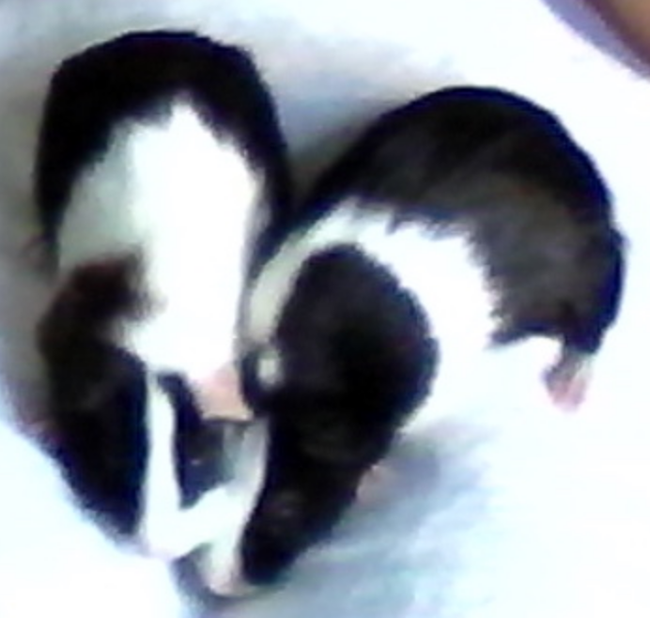
As I mentioned last lecture
If something does not make sense, it’s almost surely my fault!
Feedback is greatly appreciated!

Slide 5
Due in the next couple of days
Wed 5pm: Discussion summary on Autolab
Th 5pm: Project choices due (via Google form)

Slide 6
Autolab accepting discussion summaries

Slide 7
Proof reader volunteer?

Slide 8
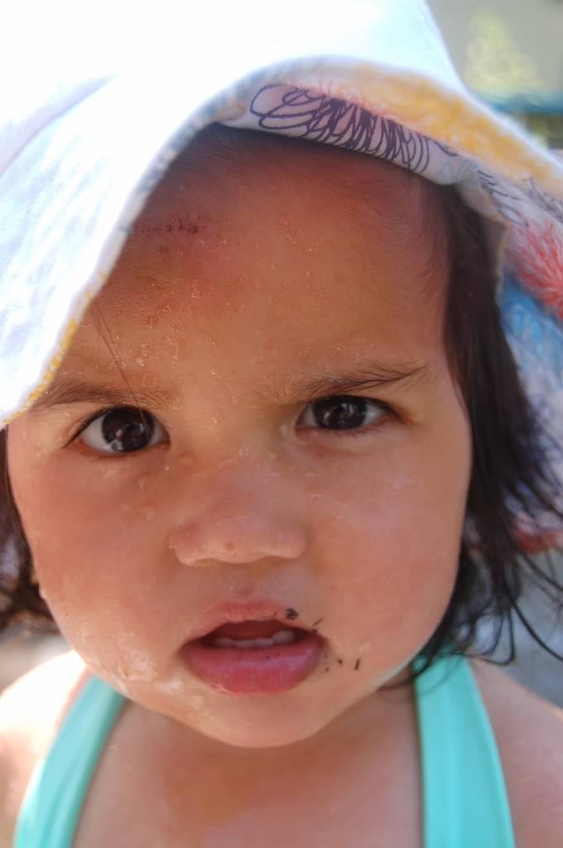
?

Slide 9
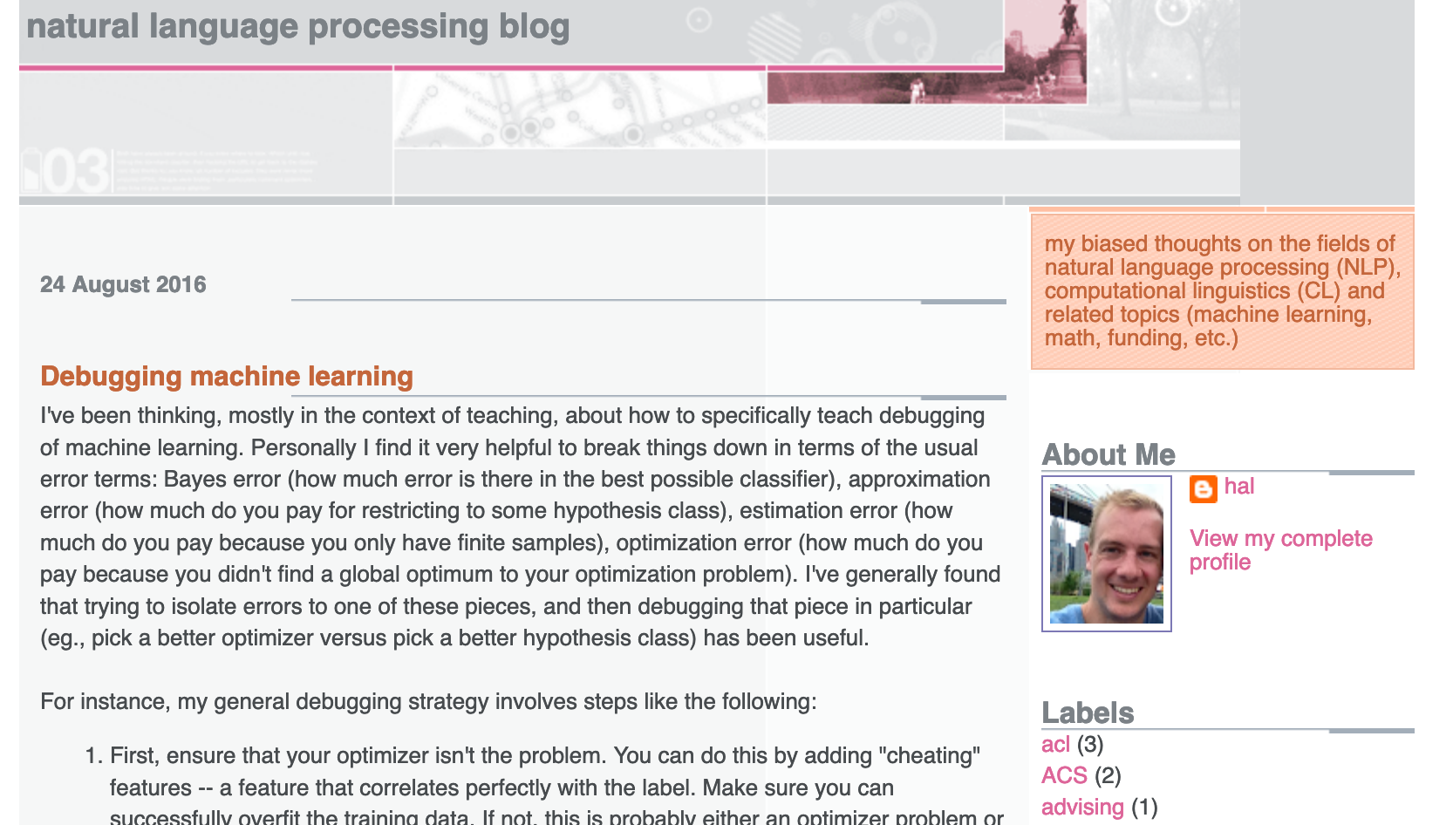
Start with a Question
Collect data
Train model
Evaluate model
Deploy!
Real world goal
Real world mechanism
Learning problem
Data collection mechanism
Which data to collect?
Data representation
Target class/model
Deploy!
Evaluate error
Predict on test data
Model training
Training data set

Slide 10
Putting society back in
Real world goal
Real world mechanism
Learning problem
Data collection mechanism
Which data to collect?
Data representation
Society
Target class/model
Deploy!
Evaluate error
Predict on test data
Model training
Training data set

Slide 11
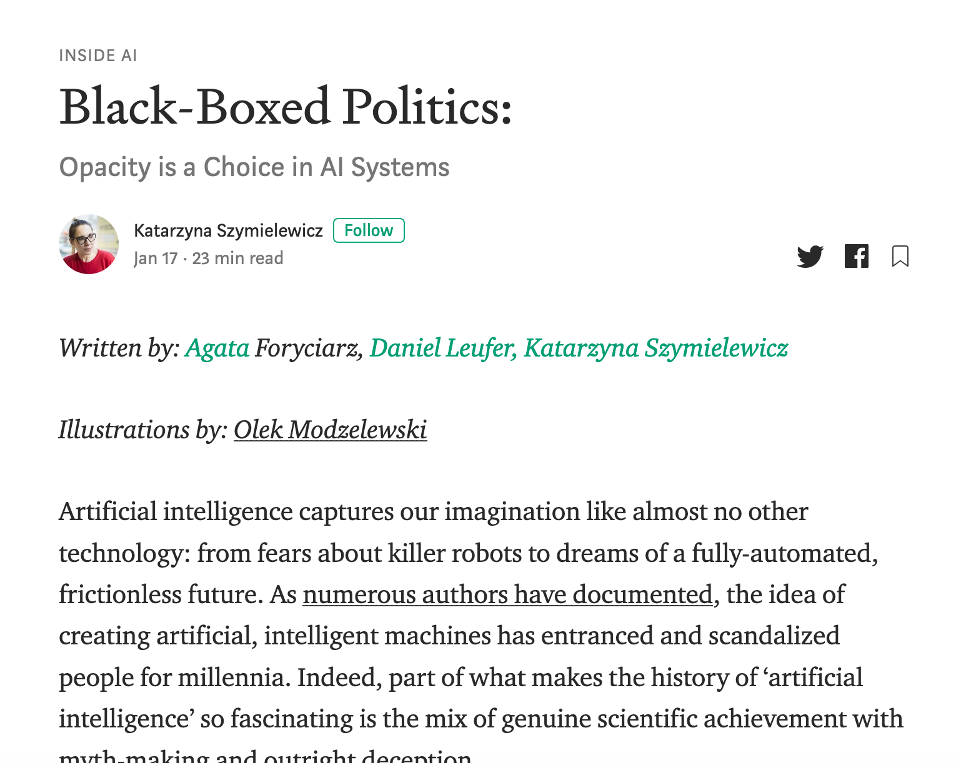
Not the only ML+society pipeline in town

Slide 12
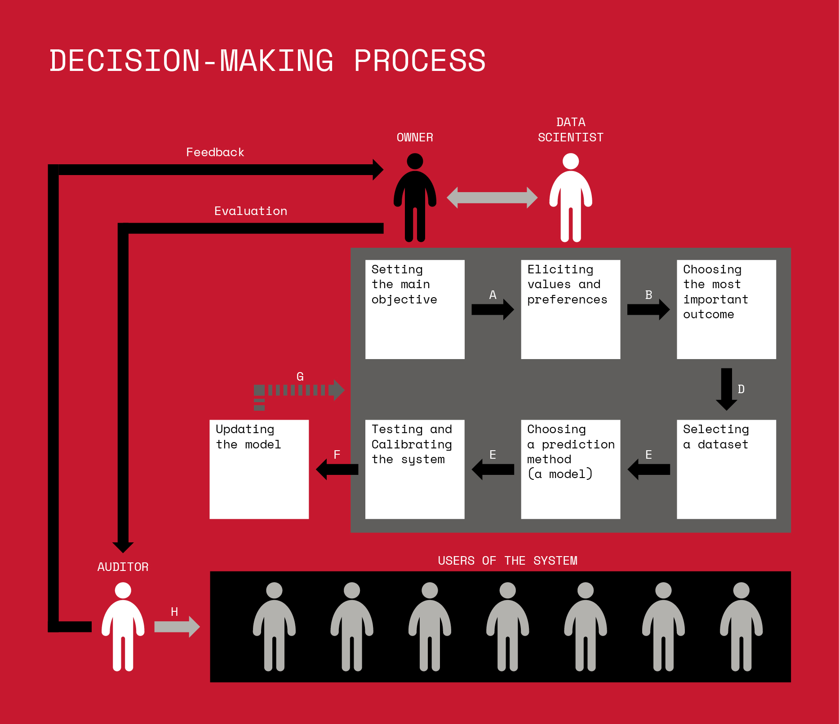
Not the only ML+society pipeline in town

Slide 13
A walkthrough

Slide 14
Walkthrough from last time
Real world goal
Real world mechanism
Learning problem
Data collection mechanism
Which data to collect?
Data representation
Target class/model
Deploy!
Evaluate error
Predict on test data
Model training
Training data set

Slide 15
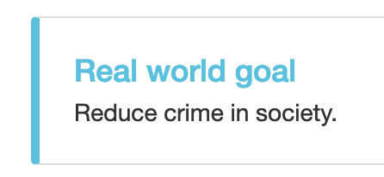
Real world goal
Real world goal

Slide 16
Real world mechanism
Real world goal
Real world mechanism

Slide 17
Learning problem
Target variable might not be obvious in other scenarios!
Real world goal
Real world mechanism
Learning problem

Slide 18
Data collection mechanism
Real world goal
Real world mechanism
Learning problem
Data collection mechanism

Slide 19
Which data to collect?
Real world goal
Real world mechanism
Learning problem
Data collection mechanism
Which data to collect?

Slide 20
Data representation
Real world goal
Real world mechanism
Learning problem
Data collection mechanism
Which data to collect?
Data representation

Slide 21
?

Slide 22
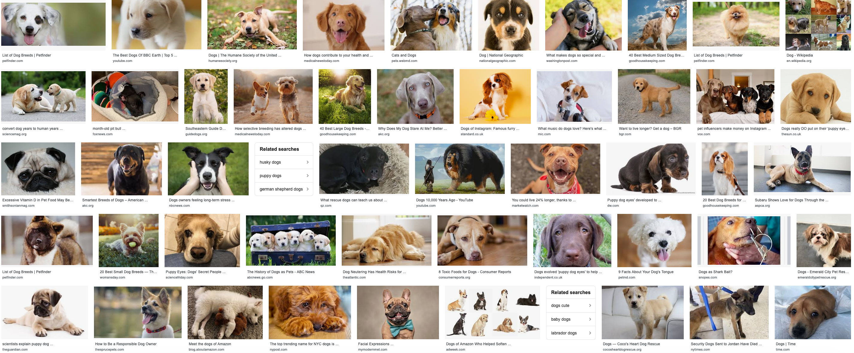
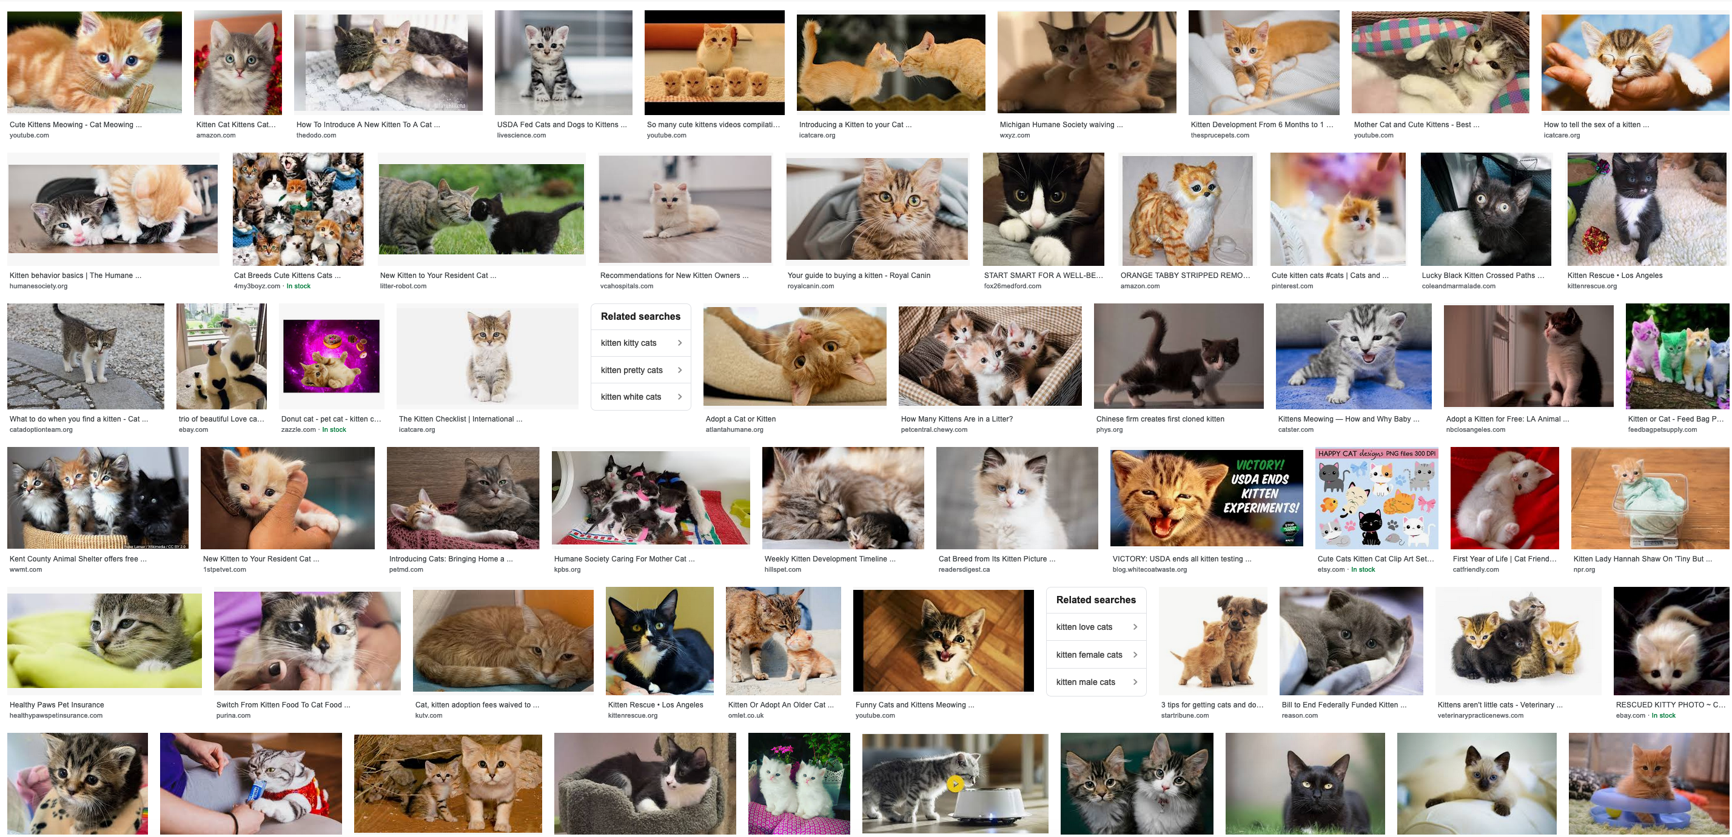
Target class/model
Real world goal
Real world mechanism
Learning problem
Data collection mechanism
Which data to collect?
Data representation
Target class/model
dog
Linear models
f
cat

Slide 23
Cartoon of how linear model works
Can you find a “better” line?

Slide 24
Training data set
Real world goal
Real world mechanism
Learning problem
Data collection mechanism
Which data to collect?
Data representation
Target class/model
Training data set

Slide 25
Pick (random) half of the dataset

Slide 26
Model training
Real world goal
Real world mechanism
Learning problem
Data collection mechanism
Which data to collect?
Data representation
Target class/model
Model training
Training data set

Slide 27
?

Slide 28
Predict on test data
Real world goal
Real world mechanism
Learning problem
Data collection mechanism
Which data to collect?
Data representation
Target class/model
Predict on test data
Model training
Training data set

Slide 29
Evaluate error
Real world goal
Real world mechanism
Learning problem
Data collection mechanism
Which data to collect?
Data representation
Target class/model
Evaluate error
Predict on test data
Model training
Training data set

Slide 30
?

Slide 31
Relation to problem statement
Real world goal
Real world mechanism
Learning problem
Data collection mechanism
Which data to collect?
Data representation
Target class/model
Problem independent techniques
Evaluate error
Predict on test data
Model training
Training data set

Slide 32
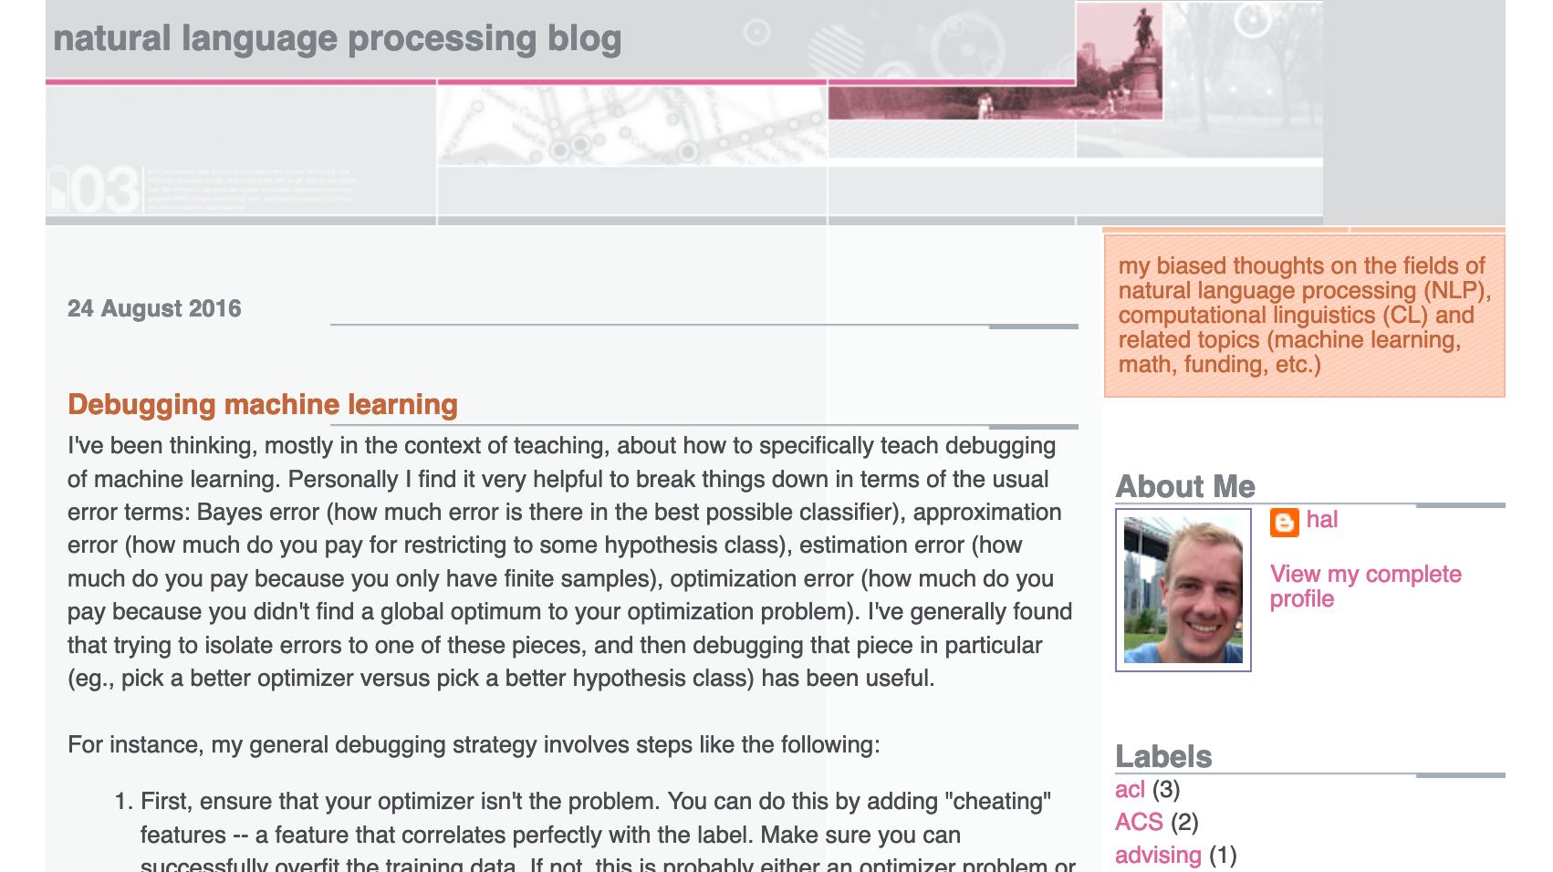
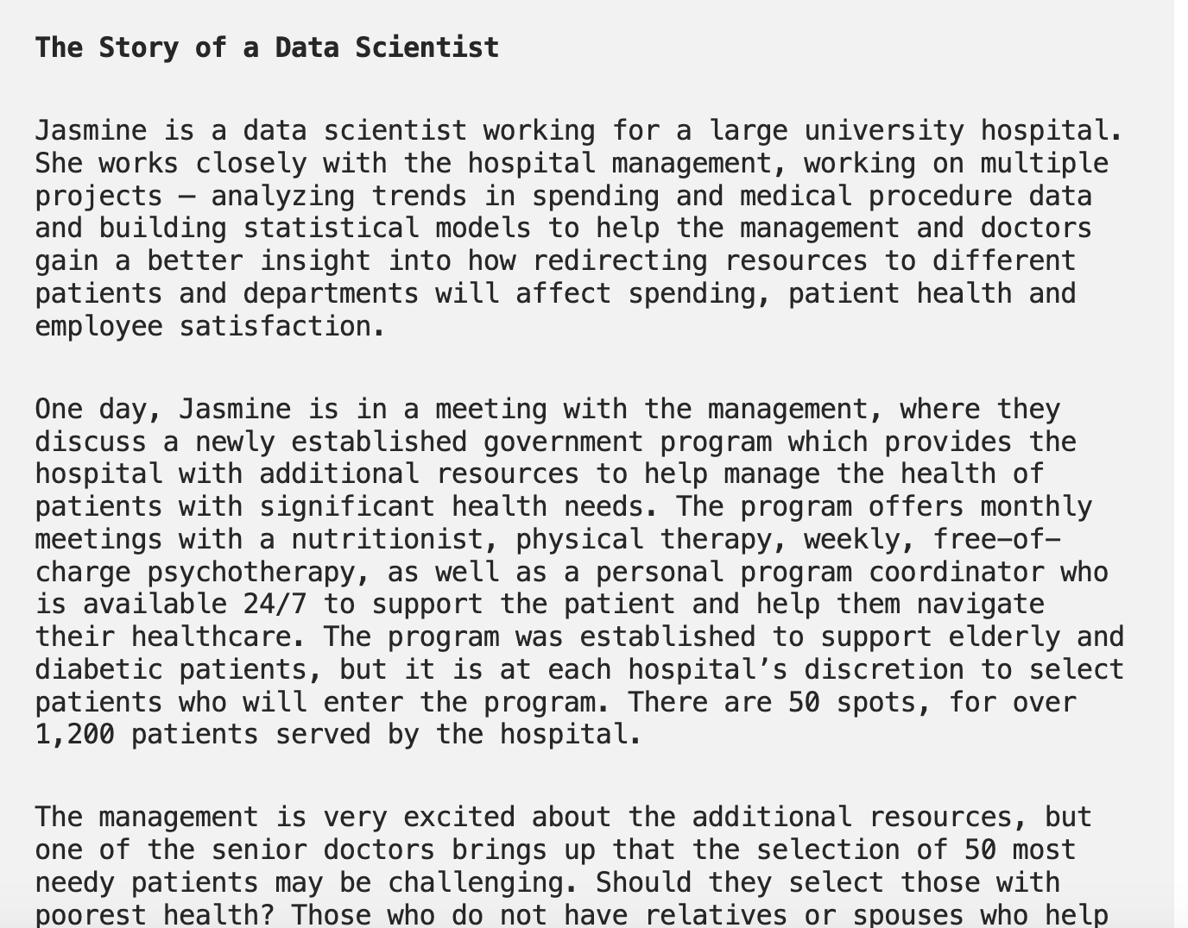
Three problems to consider
Ad display example
Hospital trying to utilize new govt program
Third example: YOU decide!

Slide 33
Real world goal
Real world goal

Slide 34
Real world goal: Your choice
Real world goal
Improve user experience for Stampede buses: 1
Figure out which laptop to buy?: 3
Figure out where to live as a student: 3
Figure out how to improve student’s class experience: 2
Improve students’ success in getting scholarships: 4
Improve on-campus parking: 3
Figure out how to improve instructor’s class experience: 2

Slide 35
Real world goal: General thoughts
Real world goal
This step generally done at higher management level
Translating this into something concrete needs remaining steps

Slide 36
?

Slide 37
Real world mechanism
Real world goal
Real world mechanism
After the break

Slide 38
Real world mechanism
Real world goal
Real world mechanism

Slide 39
Real world mechanism: Your choice
Real world goal
Real world mechanism
Improve students’ success in getting external scholarships
Improve student access to mentor (to help with the application process): 4
Improve student awareness of existing scholarships: 4
Identify students who are likely to win a scholarship
Motivate students to actually apply: 2
Make it easier to get scholarships: 4

Slide 40
Real world mechanism: General thoughts
Is improving ad display the best option?
Real world goal
Real world mechanism
ALWAYS question if the mechanism captures well the real life goal
Doctors vs. management in Example 2
There can be competing/incompatible mechanisms
CONVENIENCE trap!

Slide 41
?

Slide 42
Pass phrase for today: Kate Crawford

Slide 43
Learning problem
Real world goal
Real world mechanism
Learning problem

Slide 44
Learning problem: Your choice
Real world goal
Real world mechanism
Learning problem
Identify students who are likely to win a scholarship
Predict which students will win scholarships (to max total scholarships): 5
Figure out what makes a student competitive
Determine which students are interested in applying: 3
Predict which students will win prestigious scholarships: 3

Slide 45
Learning problem: General thoughts
Real world goal
Real world mechanism
Learning problem
Decide NOT to use learning
Use of proxies for the real target variable
Some has to decide between competing target variables
Choosing the learning problem can have big consequence!
Convenience trap

Slide 46
?

Slide 47
Data collection mechanism
Real world goal
Real world mechanism
Learning problem
Data collection mechanism

Slide 48
Data collection mechanism: Your choice
Real world goal
Real world mechanism
Learning problem
Data collection mechanism

Slide 49
Data collection mechanism: general thoughts
Real world goal
Real world mechanism
Learning problem
Data collection mechanism
Concept/distribution drift
Privacy can be a concern

Slide 50
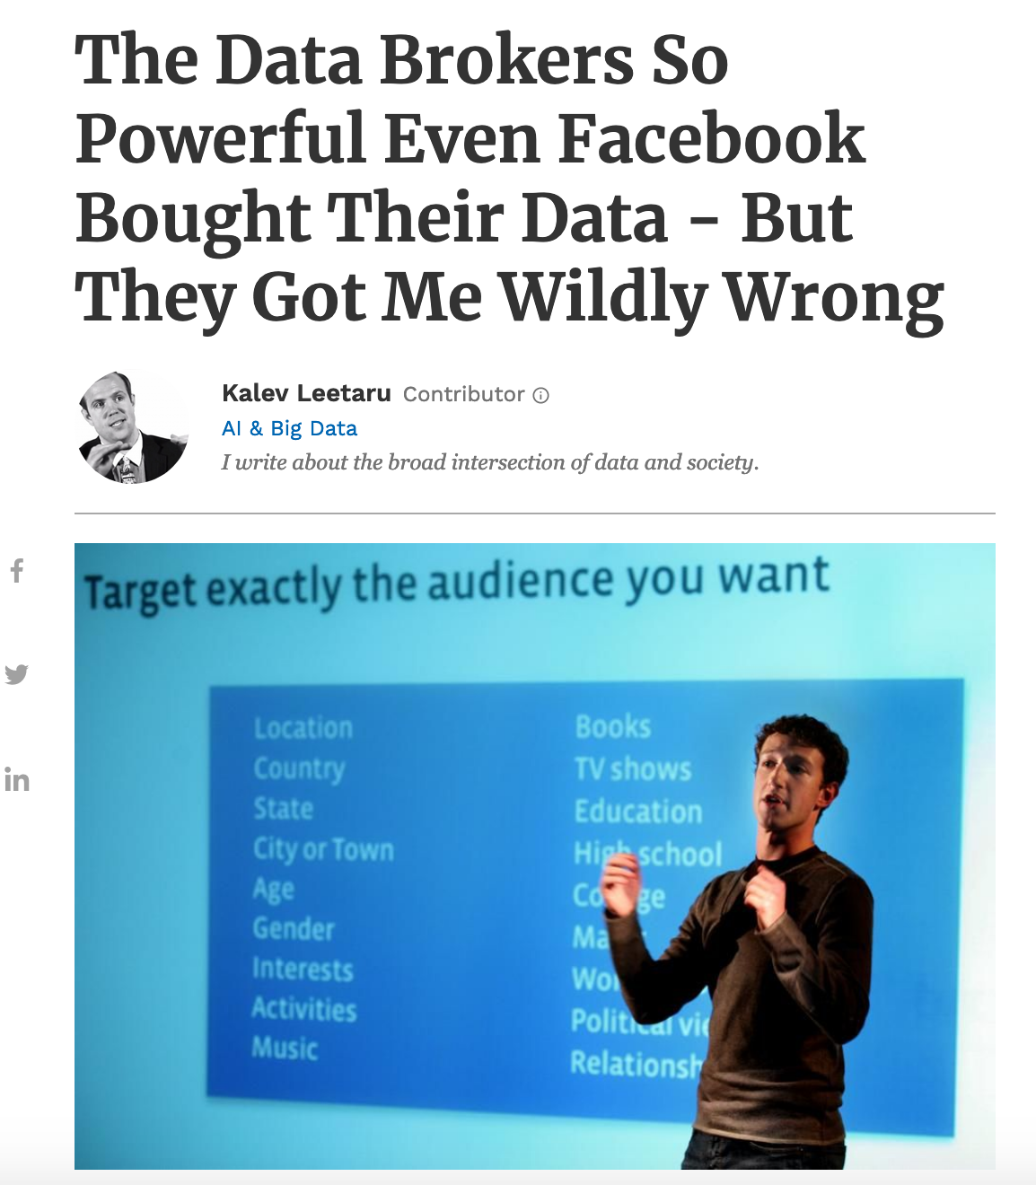
Data collection mechanism: Data doesn’t exist
Real world goal
Real world mechanism
Learning problem
Data collection mechanism
Potential issues?
Use 3rd party data brokers

Slide 51
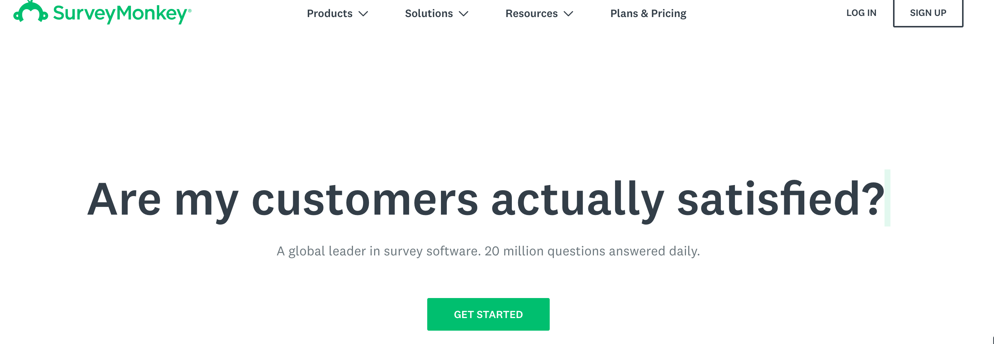
Data collection mechanism: Data doesn’t exist
Real world goal
Real world mechanism
Learning problem
Data collection mechanism
Run surveys
Potential issues?

Slide 52
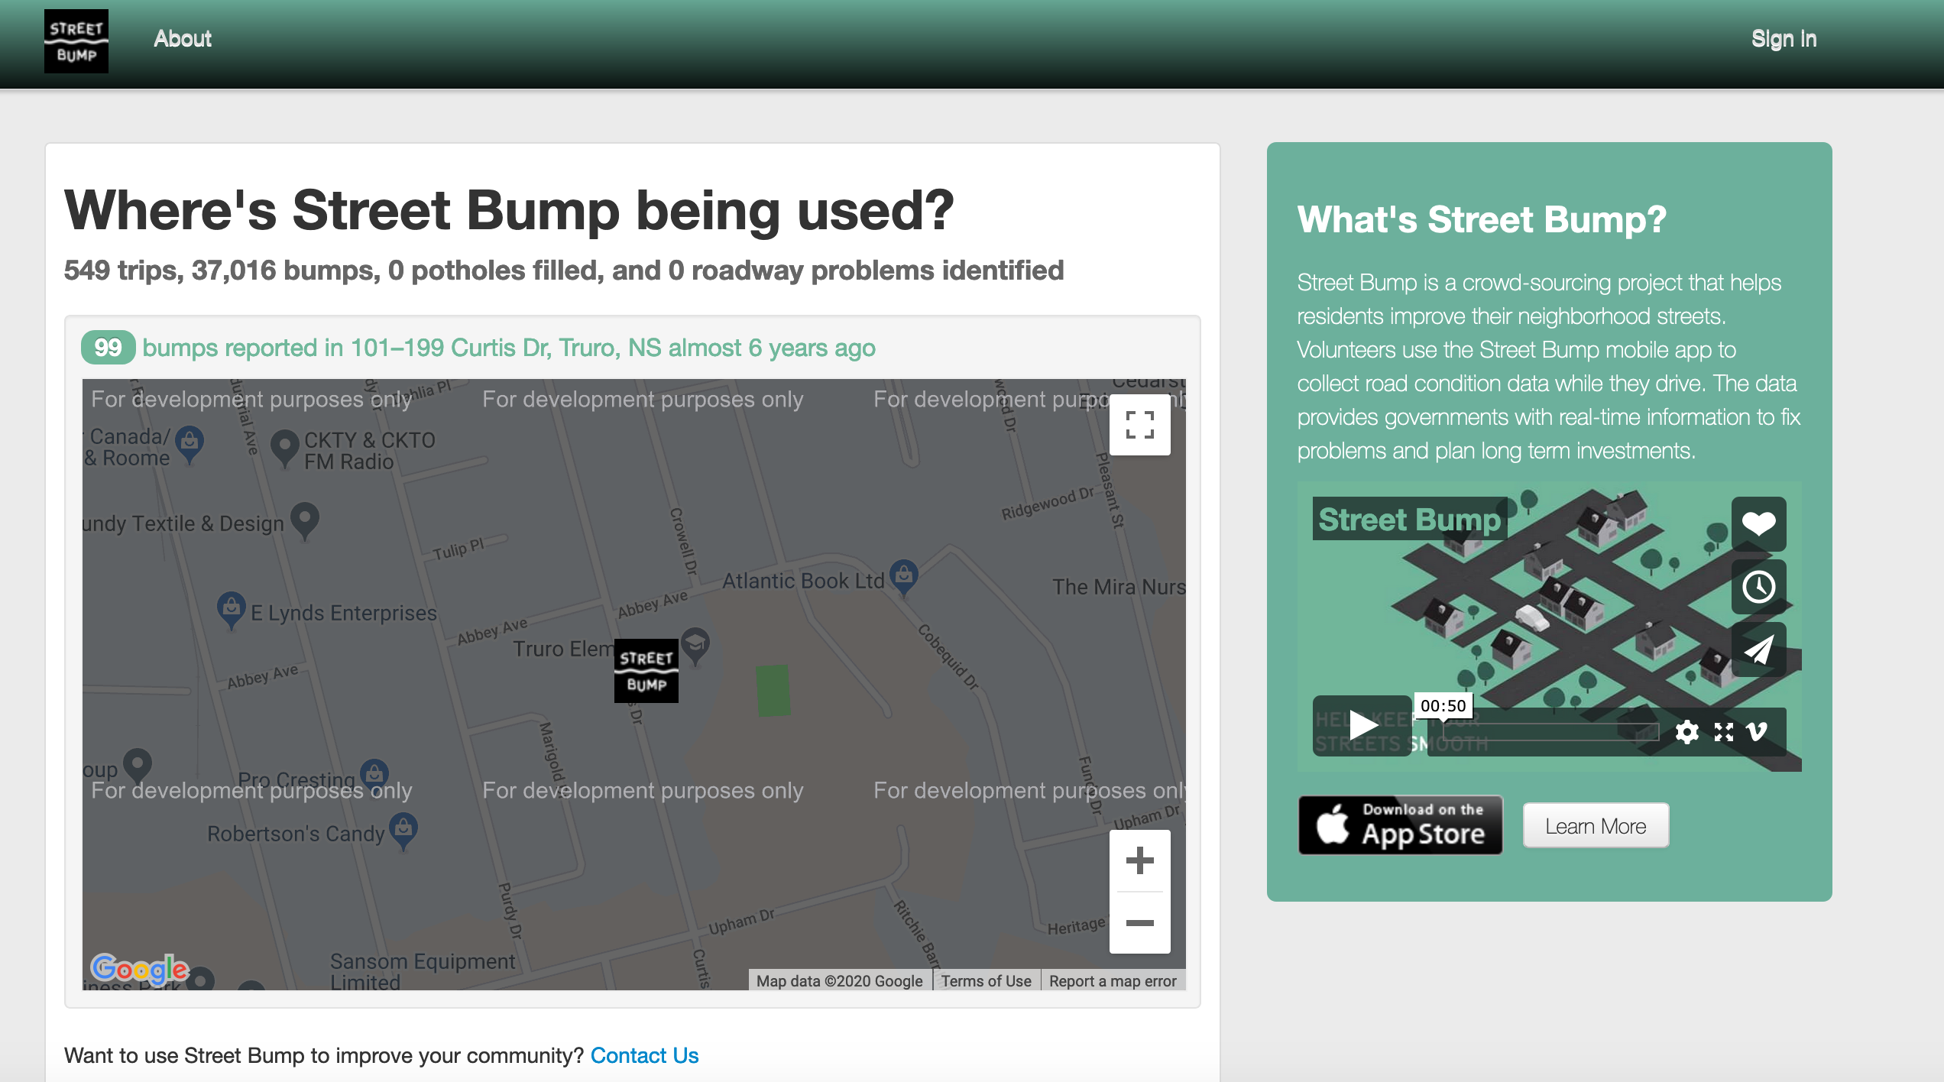
Data collection mechanism: Data doesn’t exist
Real world goal
Real world mechanism
Learning problem
Data collection mechanism
Collect data from smartphone
Potential issues?

Slide 53
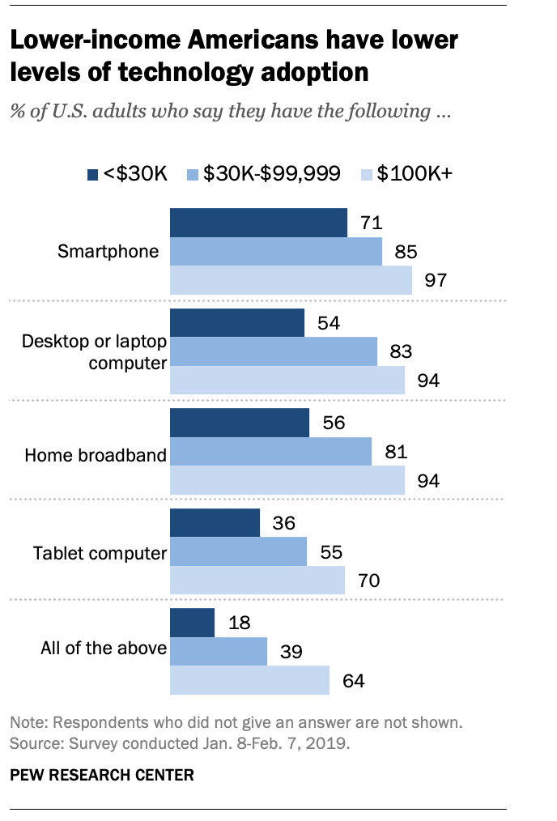
The smartphone blind-spot
Many of us in CSE assumes that ”everyone”
has smartphones

Slide 54
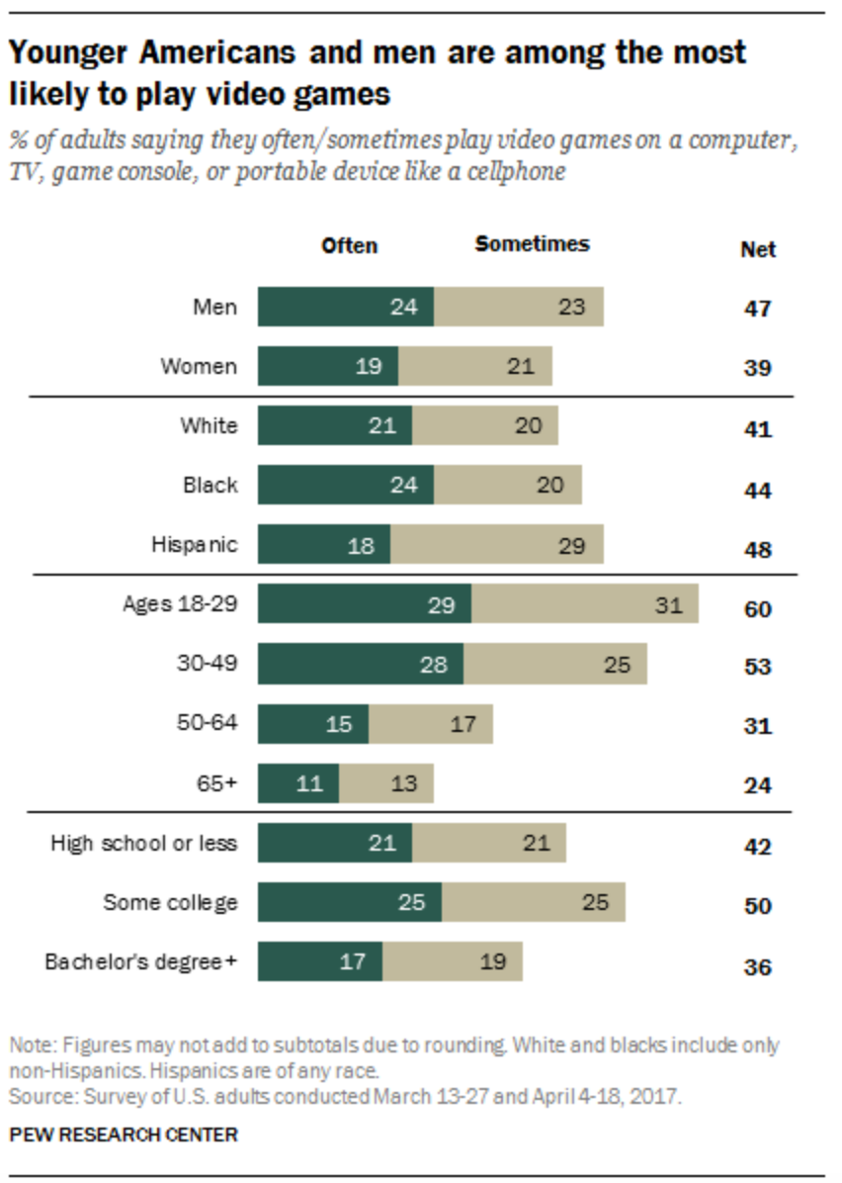
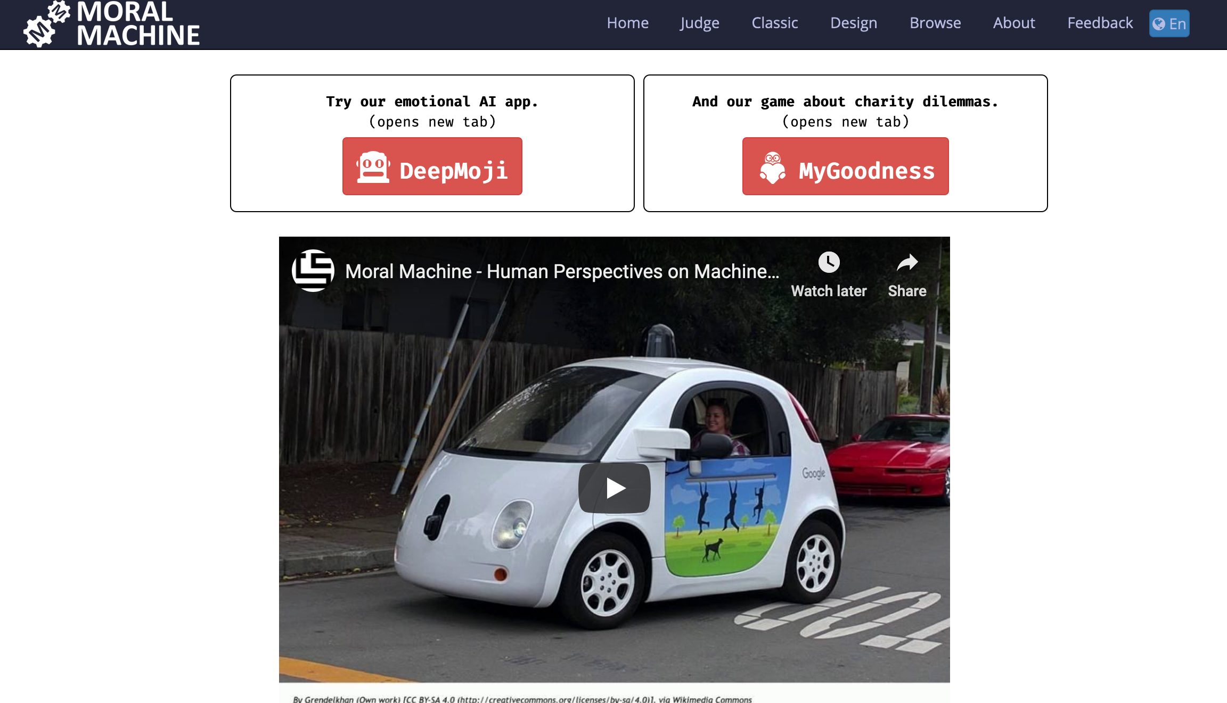
Data collection mechanism: Data doesn’t exist
Real world goal
Real world mechanism
Learning problem
Data collection mechanism
Online video games
Potential issues?

Slide 55
?

Slide 56
Which data to collect?
Real world goal
Real world mechanism
Learning problem
Data collection mechanism
Which data to collect?

Slide 57
Which data to collect?: Your choice
Real world goal
Real world mechanism
Learning problem
Data collection mechanism
Which data to collect?

Slide 58
Which data to collect?: General thoughts
Real world goal
Real world mechanism
Learning problem
Data collection mechanism
Which data to collect?
Expense might determine what gets collected
Time to finish a survey also has implications
Other restrictions, e.g. from an IRB

Slide 59
?

Slide 60
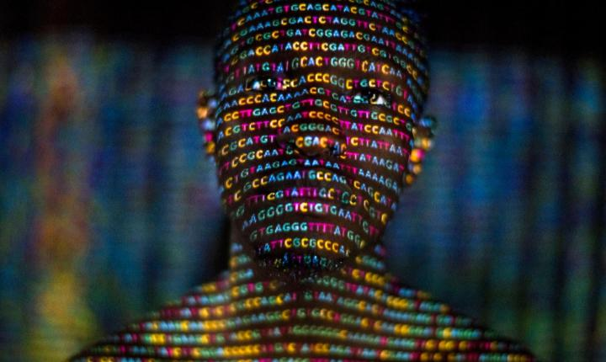
Data representation
Real world goal
Real world mechanism
Learning problem
Data collection mechanism
Which data to collect?
Data representation
https://www.history101.com/april-14-2003-the-human-genome-project-completed/

Slide 61
Data representation
Real world goal
Real world mechanism
Learning problem
Data collection mechanism
Which data to collect?
Data representation

Slide 62
Data representation: Your choice
Real world goal
Real world mechanism
Learning problem
Data collection mechanism
Which data to collect?
Data representation

Slide 63
Data representation: General thoughts
Real world goal
Real world mechanism
Learning problem
Data collection mechanism
Which data to collect?
Data representation
Categorical data

