Slide 1
CSE 410
Feb 11, 2020

Slide 2
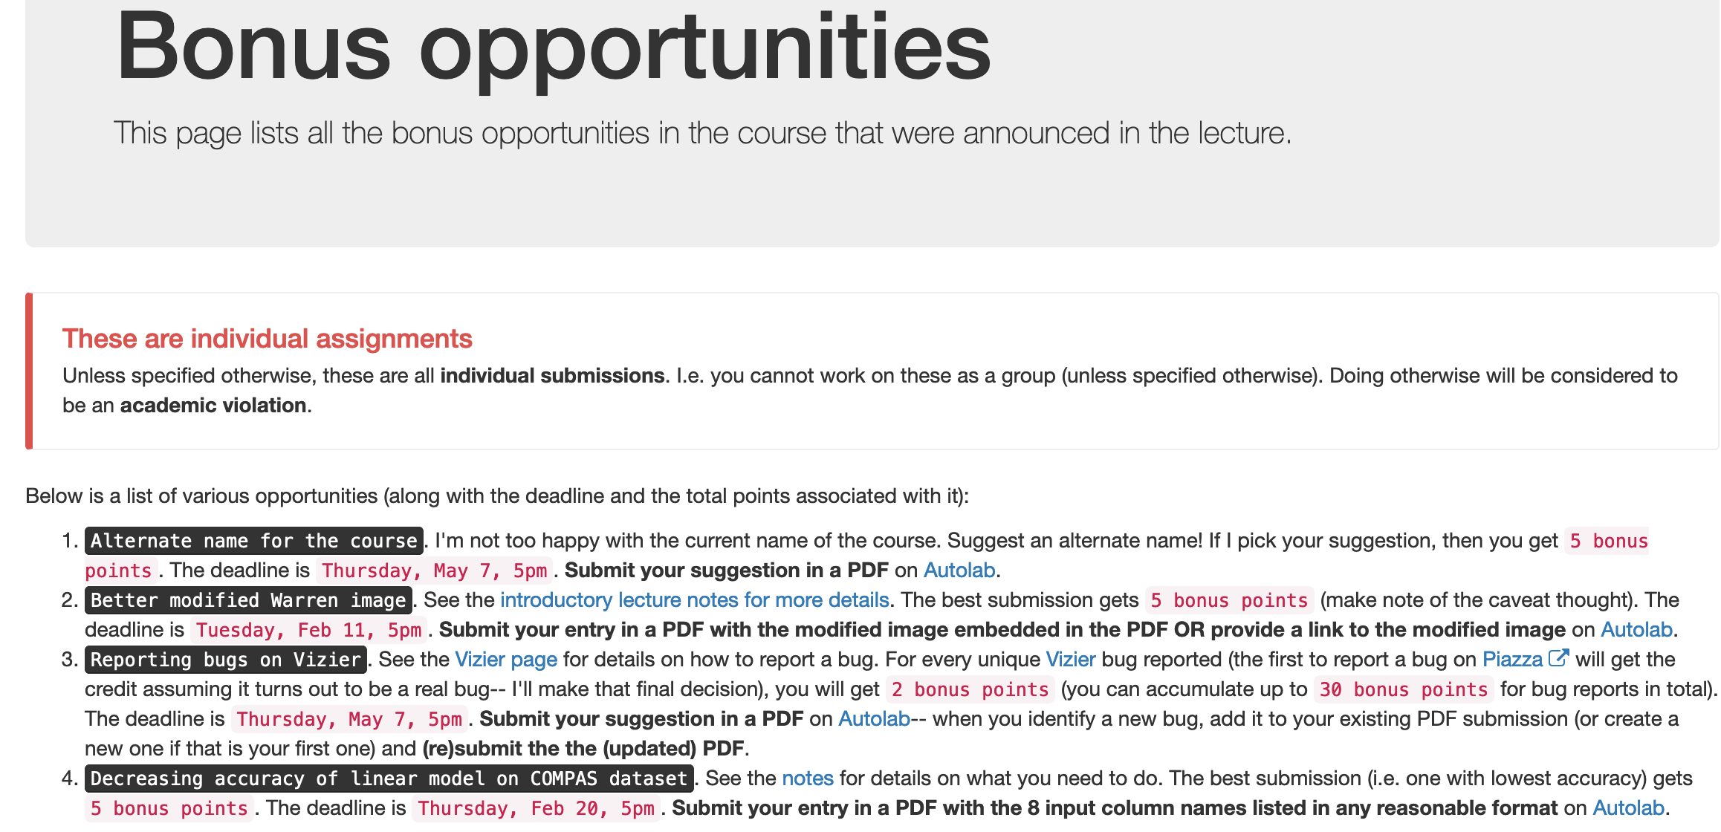
One bonus opportunity deadline TODAY

Slide 3
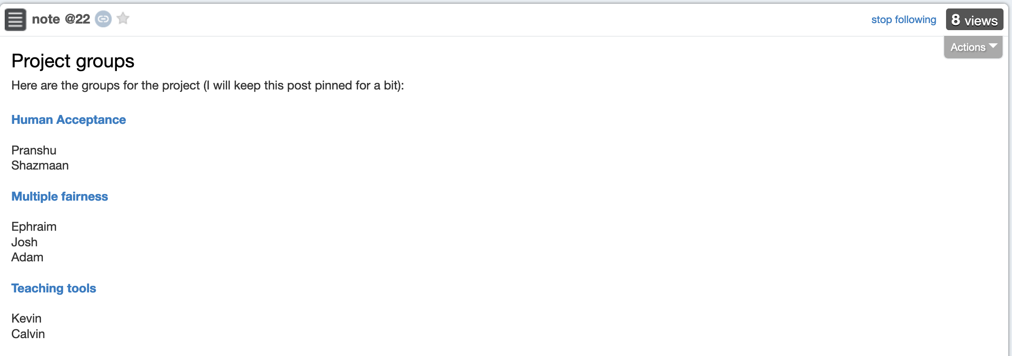
Project groups formed

Slide 4
Due TOMORROW

Slide 5
Proof reader volunteer?

Slide 6
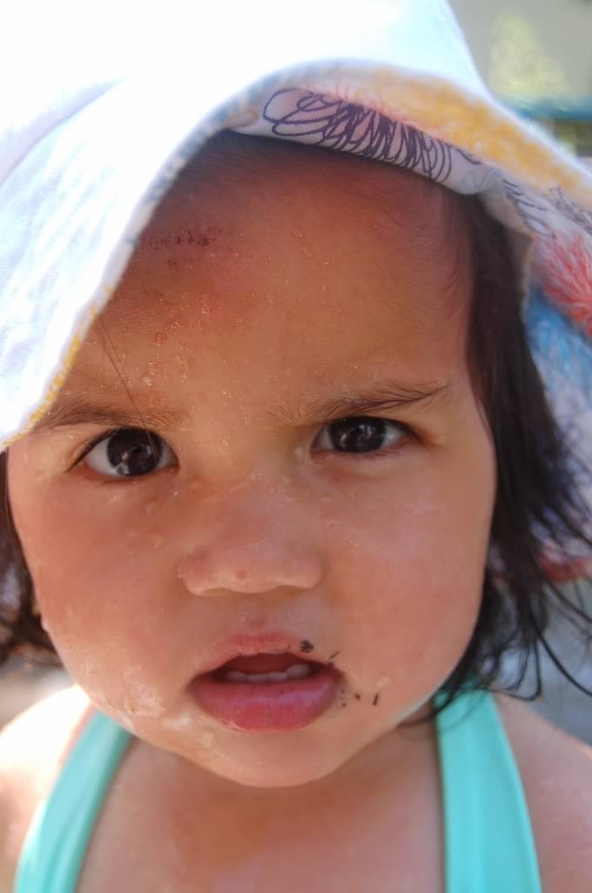
?

Slide 7
Data collection mechanism: general thoughts
Real world goal
Real world mechanism
Learning problem
Data collection mechanism
Concept/distribution drift
Privacy can be a concern

Slide 8
Which data to collect?: General thoughts
Real world goal
Real world mechanism
Learning problem
Data collection mechanism
Which data to collect?
Expense might determine what gets collected
Time to finish a survey also has implications
Other restrictions, e.g. from an IRB

Slide 9
Data representation: General thoughts
Real world goal
Real world mechanism
Learning problem
Data collection mechanism
Which data to collect?
Data representation
Categorical data

Slide 10
?

Slide 11
Vizier exercise
https://gram.cse.buffalo.edu/

Slide 12
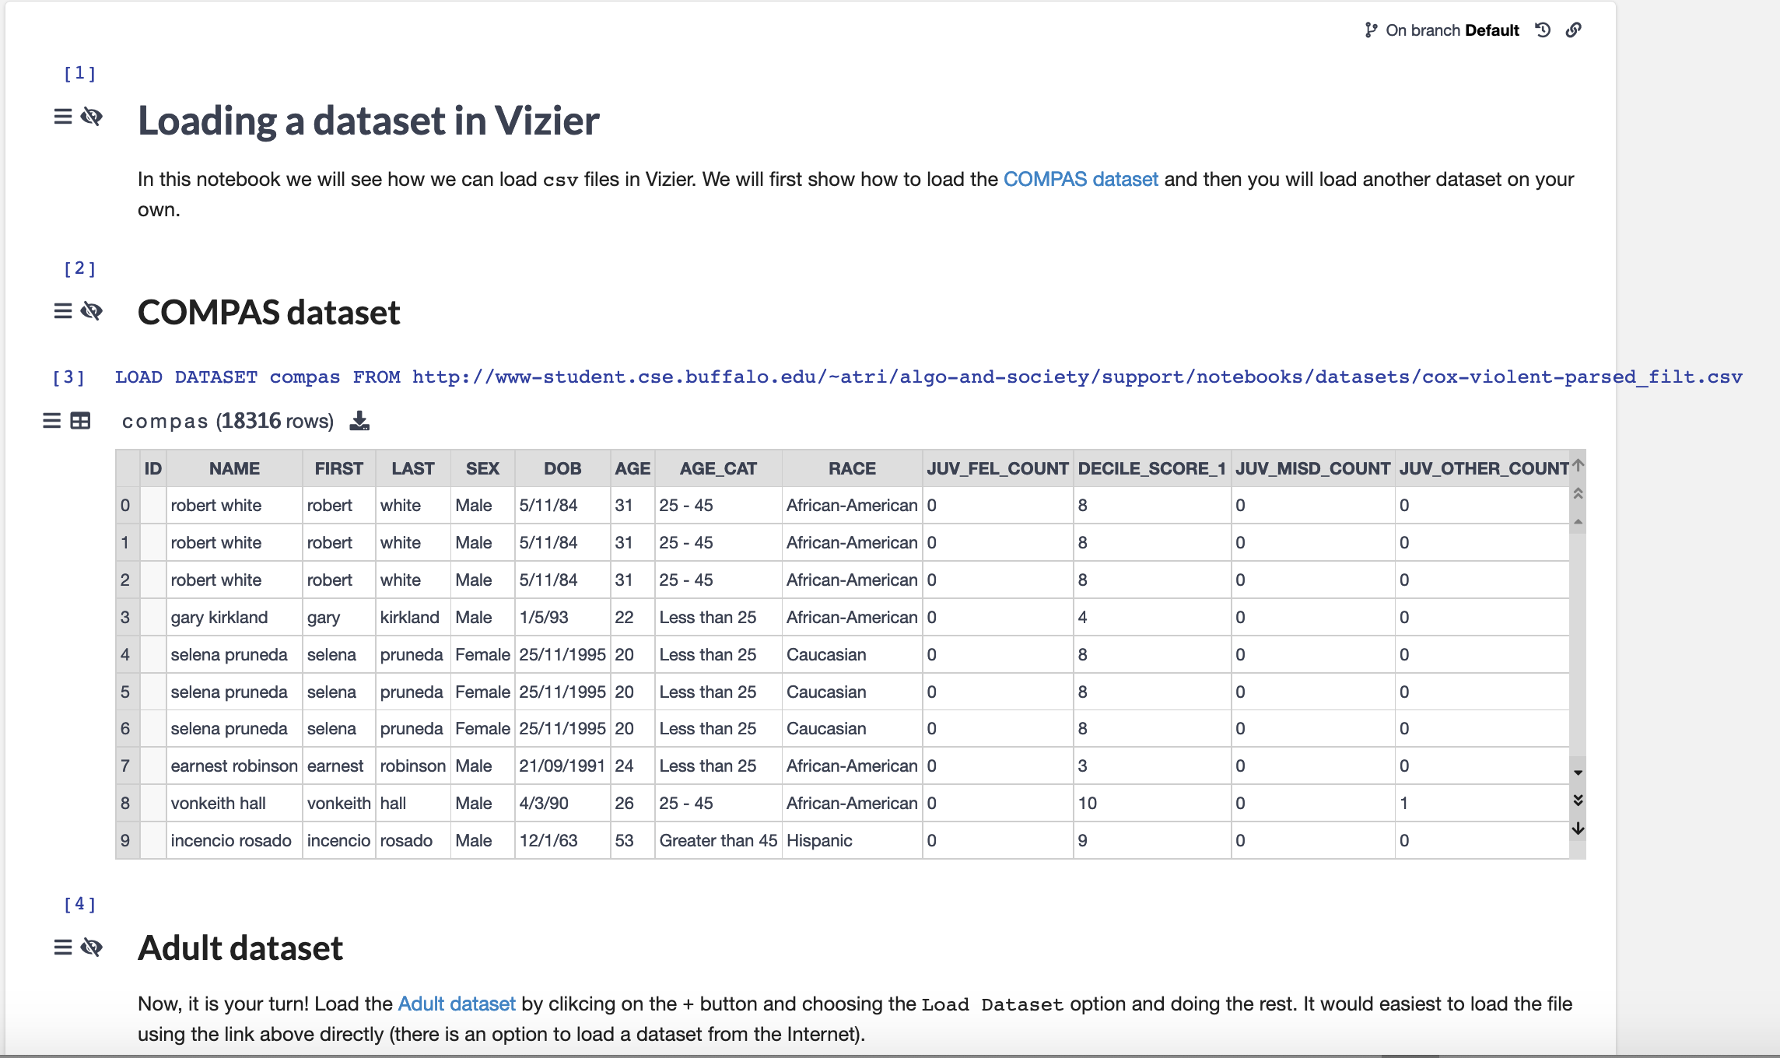
Familiarize yourself with it (and do the Ex.)

Slide 13
?

Slide 14
Another Vizier exercise
https://gram.cse.buffalo.edu/
Bonus point opportunity!

Slide 15
?

Slide 16
ML model classes

Slide 17
Restrict to two input variables
700
Predict risk of heart disease
Weights (kgs)
350
150
300
Height (cms)

Slide 18
For example…
700
Weights (kgs)
350
80
150
180
300
Height (cms)

Slide 19
Does every human get their unique point?
700
Discuss!
Weights (kgs)
350
80
150
180
300
Height (cms)

Slide 20
Need more dimensions
Weights (kgs)
700
350
80
Height (cms)
40
150
180
300
150
Age (years)

Slide 21
?

Slide 22
Focus on binary classification

Slide 23
What is a model?
A ”curve”/function that labels every point either as positive (blue) or negative (yellow)
The line “defines” the model. Almost…
700
350
150
300

Slide 24
The colors can be flipped!
700
Weights (kgs)
350
150
300
Height (cms)

Slide 25
Can go beyond linear models: why not?
700
700
Weights (kgs)
Weights (kgs)
350
350
150
300
150
300
Height (cms)
Height (cms)

Slide 26
It can get crazier…
700
700
Weights (kgs)
Weights (kgs)
350
350
150
300
150
300
Height (cms)
Height (cms)

Slide 27
And crazier!
700
700
Weights (kgs)
Weights (kgs)
350
350
150
300
150
300
Height (cms)
Height (cms)

Slide 28
?

Slide 29
Model class is independent from earlier steps

Slide 30
Is one model enough?
700
Weights (kgs)
350
150
300
Height (cms)

Slide 31
The earlier linear model works!
700
Weights (kgs)
350
150
300
Height (cms)

Slide 32
What if the labels are flipped?
700
Weights (kgs)
350
150
300
Height (cms)

Slide 33
The earlier linear model is terrible!
700
Weights (kgs)
350
150
300
Height (cms)

Slide 34
But the solution here is simple!
Is one linear model and its “complement” enough for all dataset?
700
Weights (kgs)
350
150
300
Height (cms)

Slide 35
700
700
700
700
700
700
350
350
350
350
350
350
150
300
150
300
150
300
150
300
150
300
150
300
700
700
700
700
700
700
350
350
350
350
350
350
150
300
150
300
150
300
150
300
150
300
150
300
700
700
700
700
700
700
350
350
350
350
350
350
150
300
150
300
150
300
150
300
150
300
150
300

Slide 36
We need a class of models
After the break
Q1: Will linear models be enough for all datasets?
Q2: How should we define the class of linear models?

Slide 37
Can a linear model explain any of these?
700
700
700
700
350
350
350
350
150
300
150
300
150
300
150
300
700
700
700
700
350
350
350
350
150
300
150
300
150
300
150
300
More complex models

Slide 38
Can a finite list of linear models work?
How would you search among the infinitely many linear models (say in model training)?
Need to include ALL infinitely many linear models

Slide 39
Does there always exist non-linear model?
NO: model training will not work

Slide 40
?

Slide 41
Pass phrase for today: Fei-Fei Li

Slide 42
What properties should a model class have?
Discuss!
Are these properties enough?

Slide 43
Other desirable properties

Slide 44
?

Slide 45
Linear models in more detail
Assume only ONE input variable

Slide 46
Body-Mass Index

Slide 47
Moving from 2 variables to 1
700
Weights (kgs)
350
0
25
250
BMI (kg/m²)
80
150
180
300
Height (cms)

Slide 48
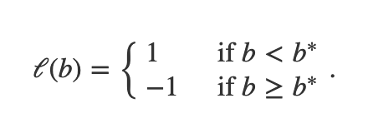
Linear model for one variable
b
b
0
b*
0
b*
Why is this enough?

Slide 49
Can one variable linear model be of any use?
0
30
250
BMI (kg/m²)

Slide 50
Parsimonious representation
Infinitely many possible values for b* !!!
How many parameters do we need to determine a linear model?
b
0
b_{i}
b_{i+1}
How many distinct values of b* must be considered?
b*

Slide 51
Efficient model training
Given n choices for b*, what is an algorithm to compute optimal linear model?
About n² steps
b*
b
0
b_{i}
b_{i+1}
Update error values in constant steps?

Slide 52
Other properties
Efficient prediction?
Expressivity?
Explainability?

