Slide 1
CSE 410
Feb 13, 2020

Slide 2
In-class meeting
Last 30-40 mins of the lecture (more likely 30 than 40)

Slide 3
Proof reader volunteer?
Adam

Slide 4
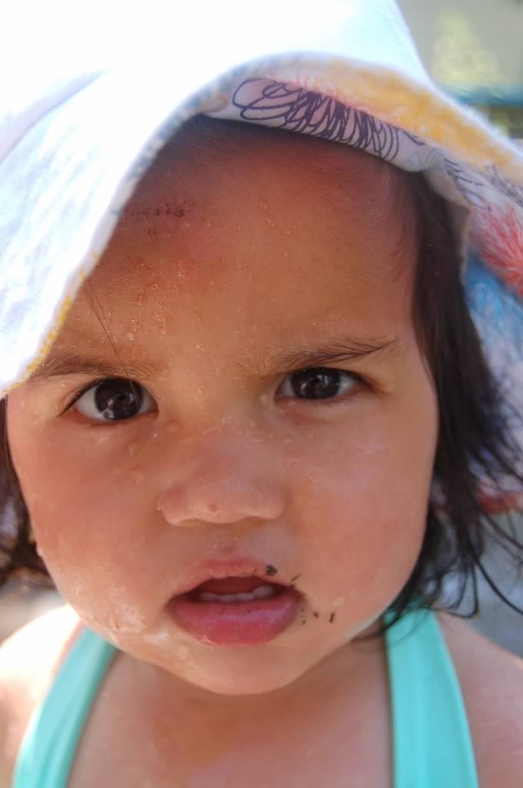
?

Slide 5
What properties should a model class have?
Are these properties enough?

Slide 6
Other desirable properties

Slide 7
?

Slide 8
Linear models in more detail
Assume only ONE input variable

Slide 9
Body-Mass Index

Slide 10
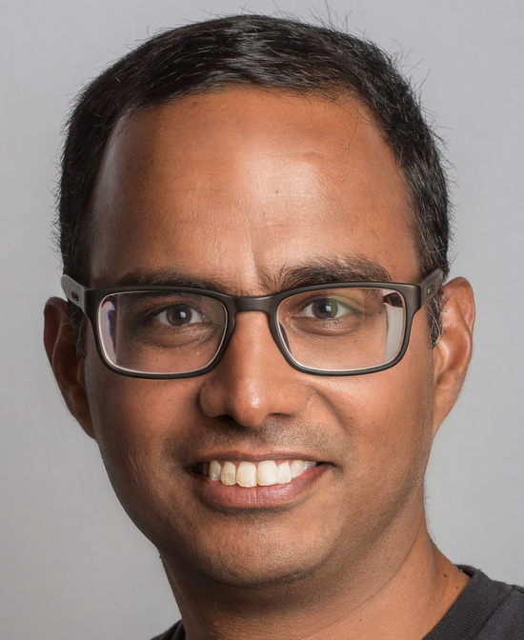
Moving from 2 variables to 1
700
Weights (kgs)
350
0
25
250
BMI (kg/m²)
80
150
180
300
Height (cms)

Slide 11
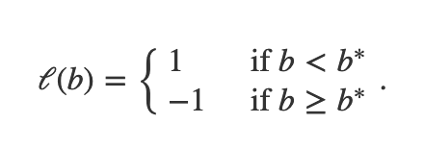
Linear model for one variable
b
b
0
b*
0
b*
Why is this enough?

Slide 12
Can one variable linear model be of any use?
0
30
250
BMI (kg/m²)

Slide 13
Parsimonious representation
Infinitely many possible values for b* !!!
How many parameters do we need to determine a linear model?
b
0
b_{i}
b_{i+1}
How many distinct values of b* must be considered?
b*

Slide 14
?

Slide 15
Efficient model training
Given n choices for b*, what is an algorithm to compute optimal linear model?
About n² steps
b*
b
0
b_{i}
b_{i+1}
Update error values in constant steps?

Slide 16
Other properties
Efficient prediction?
Expressivity?
Explainability?

Slide 17
?

Slide 18
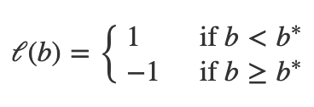
Linear model in two variables
700
Natural generalization to 2 vars?
Weights (kgs)
350
150
300
Height (cms)

Slide 19
Is this a linear model?
700
Weights (kgs)
350
150
300
Height (cms)

Slide 20
Back to the real linear model
700
Weights (kgs)
350
150
300
Height (cms)

Slide 21
Intercept: parameter c
700
Weights (kgs)
350
c
c
150
300
Height (cms)

Slide 22
Slope: parameter m
700
Weights (kgs)
350
300*m
150
300
Height (cms)

Slide 23
We now have identified the line!
Total number of parameters?
700
Weights (kgs)
Weights (kgs)
350
300m
c
150
300
Height (cms)

Slide 24
Efficient model training

Slide 25
Other properties
Efficient prediction?
Expressivity?
More than two variables?
Explainability?

Slide 26
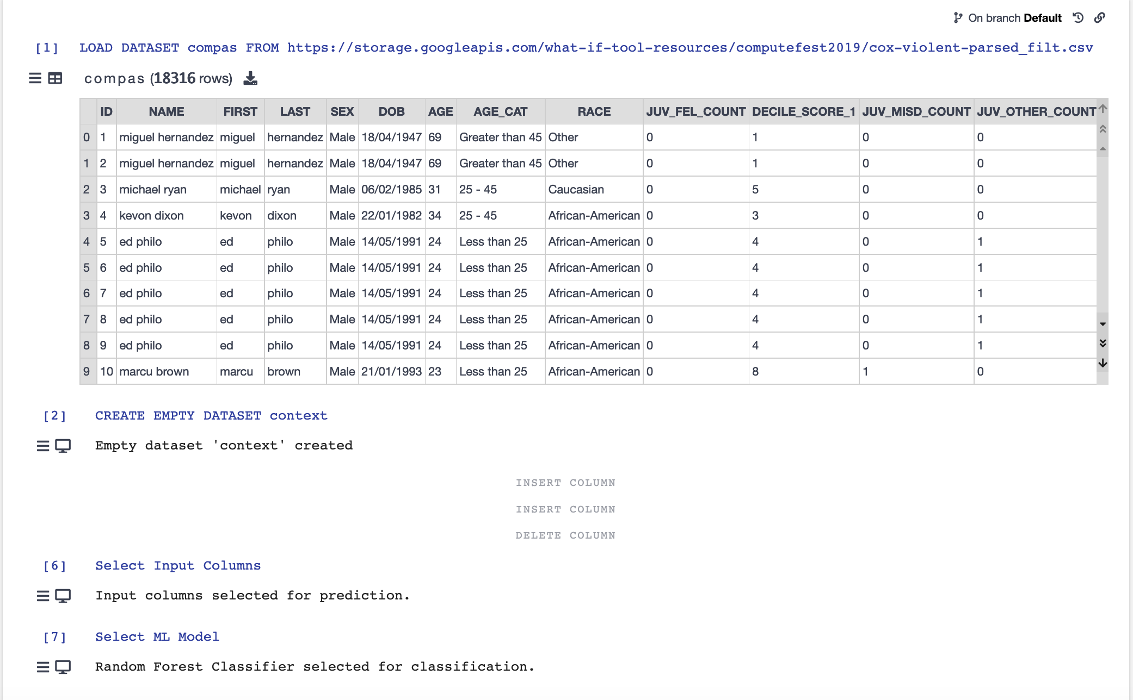
More Vizier fun!
After the break

Slide 27
Vizier exercise
https://gram.cse.buffalo.edu/

Slide 28
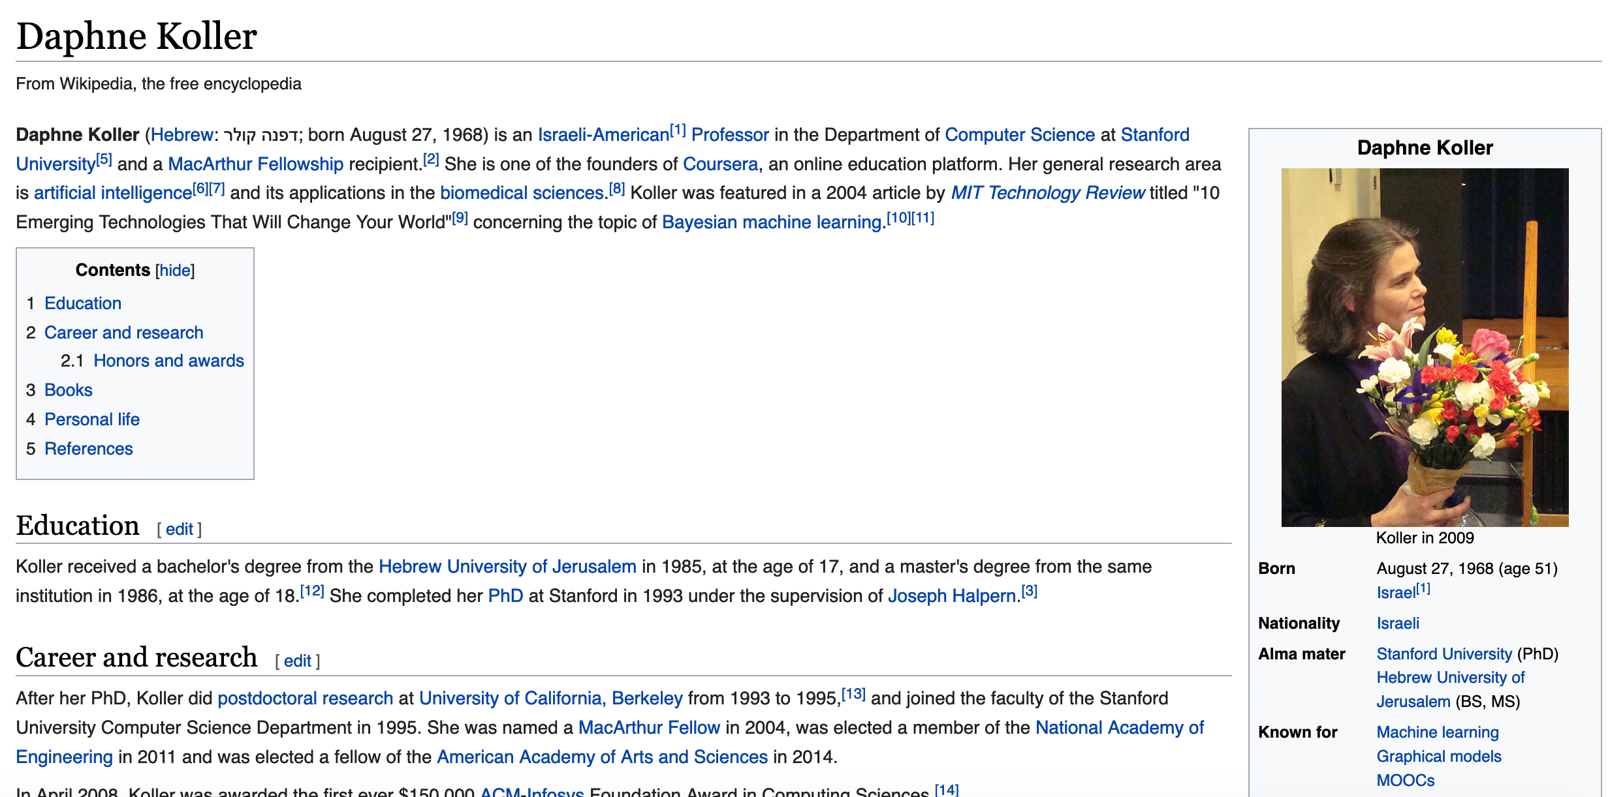
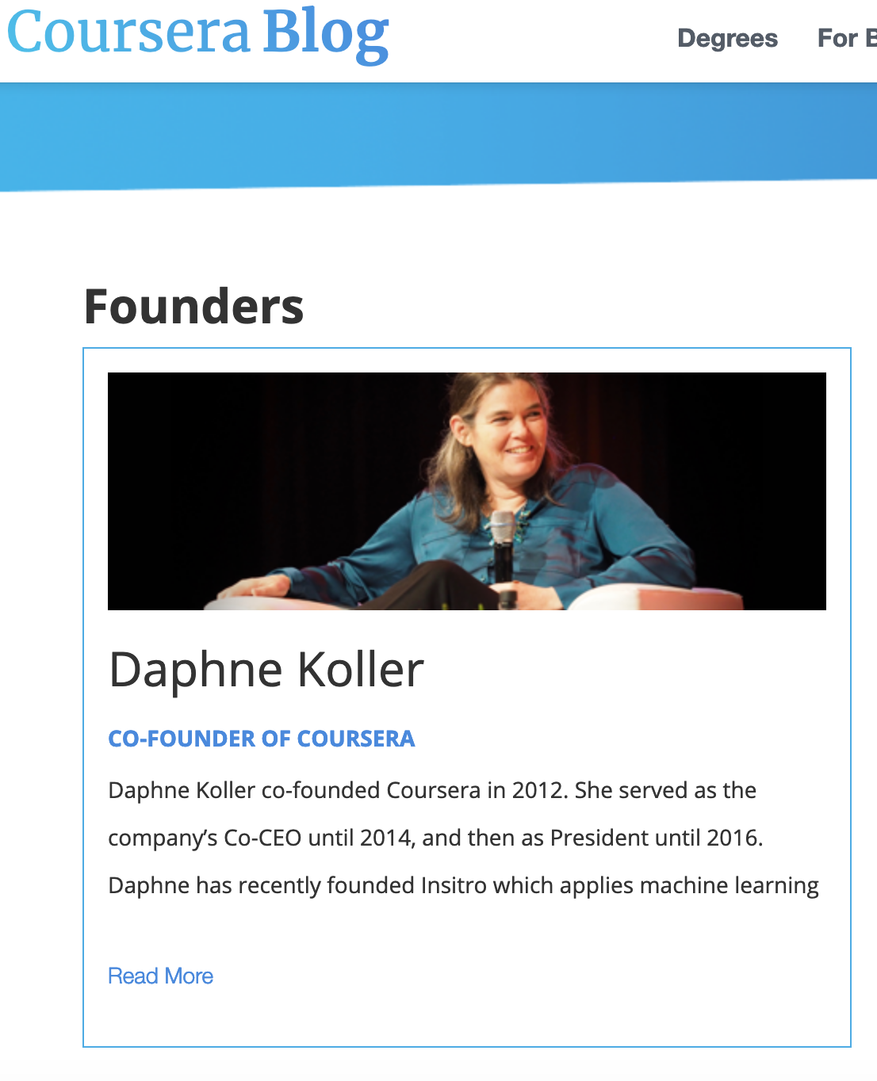
Today’s pass phrase: Daphne Koller

Slide 29
Meeting order
Human acceptance
Multiple fairness
Teaching tools

