Slide 1
CSE 410
Feb 25, 2020

Slide 2
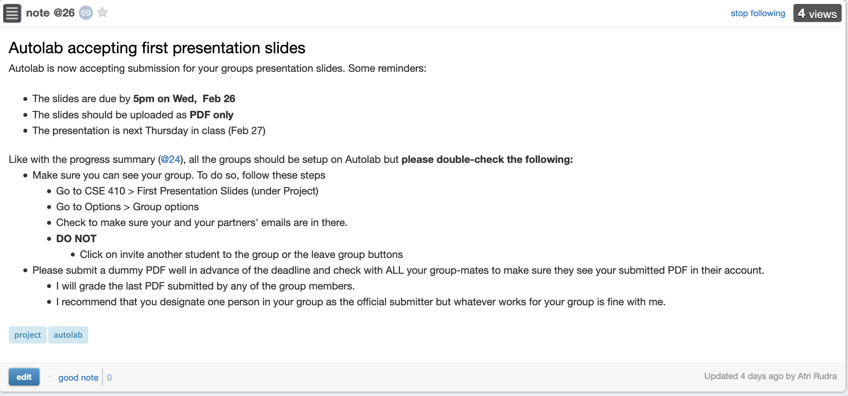
First in-class presentation this Thursday
Slides due by 5pm TOMORROW

Slide 3
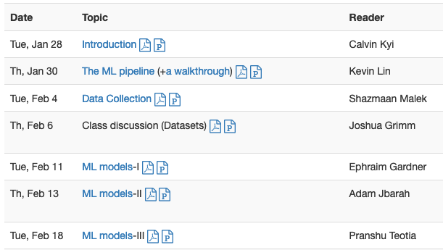
Proof reader volunteer

Slide 4
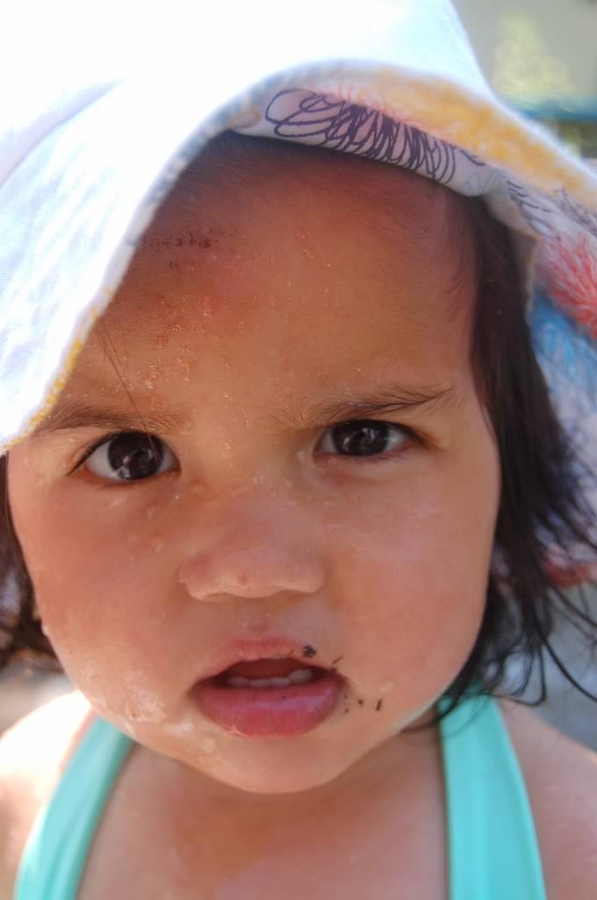
?

Slide 5
We are in the model class step

Slide 6
What properties should a model class have?

Slide 7
Other desirable properties

Slide 8
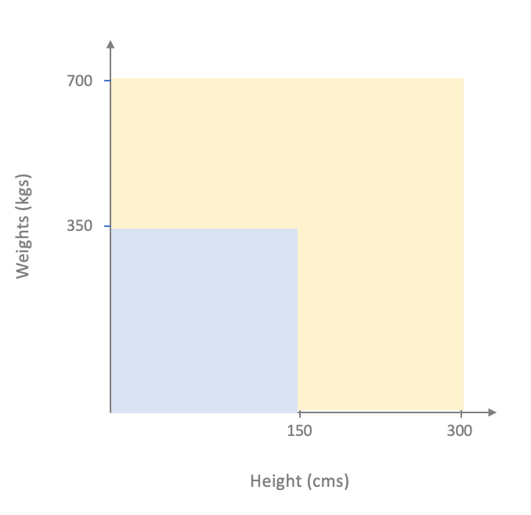
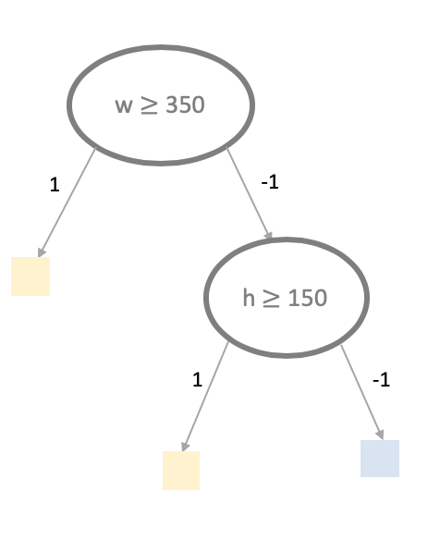
Models so far

Slide 9
?

Slide 10
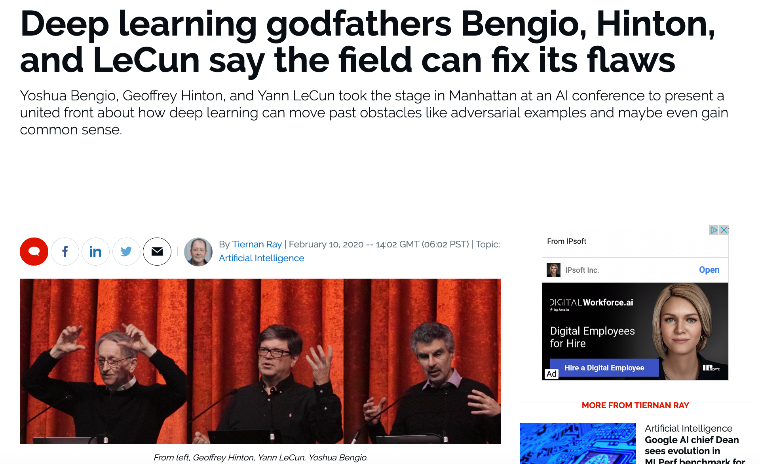
Last model class: Neural networks (NNs)

Slide 11
Away from the hype: non-deep NNs

Slide 12
NN Idea 1: Transform the underlying space
700
700
Transform
Weights (kgs)
Weights (kgs)
350
350
150
300
150
300
Height (cms)
Height (cms)

Slide 13
NN Idea 2: Apply linear model AFTER transform
700
700
700
Transform
Apply Linear model
Weights (kgs)
350
Weights (kgs)
Weights (kgs)
350
350
150
300
150
300
150
300
Height (cms)
Height (cms)
Height (cms)

Slide 14
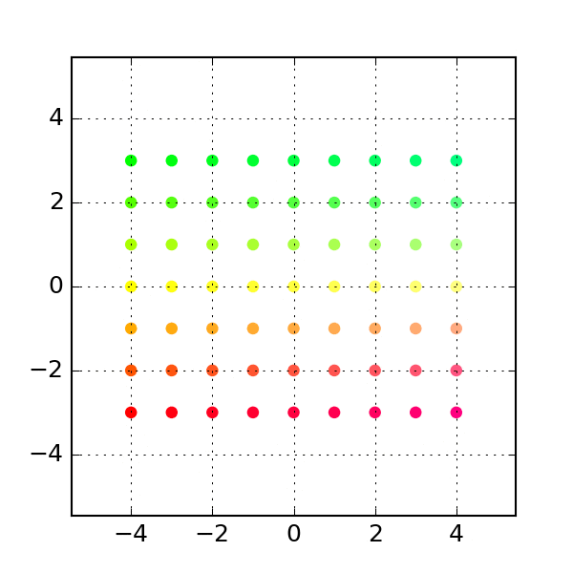
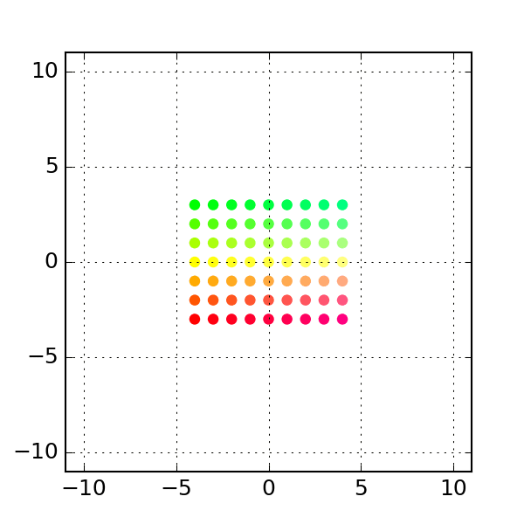
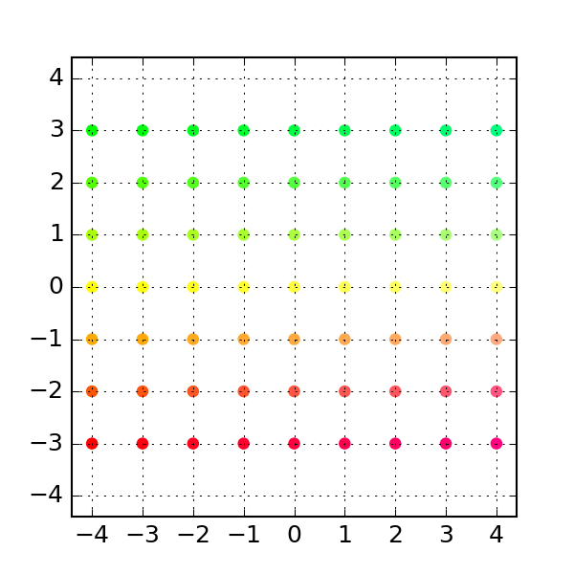
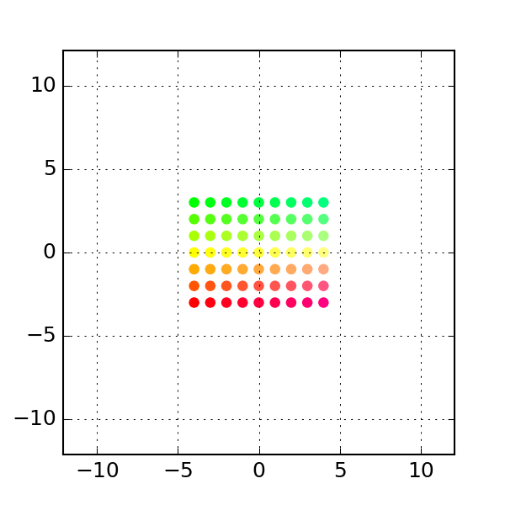
Whither the transforms?
One possibility: Linear transforms
Rotation
Shear
Permutation
General Linear
https://dododas.github.io/linear-algebra-with-python/posts/16-12-29-2d-transformations.html

Slide 15
Current overall scheme
700
700
700
Linear Transform
Apply Linear model
Weights (kgs)
350
Weights (kgs)
Weights (kgs)
350
350
150
300
150
300
150
300
Height (cms)
Height (cms)
Height (cms)

Slide 16
Linear transforms* are invertible
700
700
Inverse Transform
Weights (kgs)
Weights (kgs)
350
350
150
300
150
300
Height (cms)
Height (cms)
700
700
Inverse Transform
Weights (kgs)
350
Weights (kgs)
350
150
300
Height (cms)
150
300
Height (cms)

Slide 17
?

Slide 18
NN Idea 1’: Use a non-linear transform
700
700
Linear Transform
Weights (kgs)
Weights (kgs)
350
350
150
300
150
300
Height (cms)
Height (cms)

Slide 19
NN Idea 1’: Use a non-linear transform
700
700
ReLU
Weights (kgs)
Weights (kgs)
350
350
Replace neg values by 0
150
300
150
300
Height (cms)
Height (cms)

Slide 20
Bunch of values get zeroed out!
700
Weights (kgs)
350
150
300
Height (cms)

Slide 21
Let’s apply linear model to transformed space
700
Weights (kgs)
350
150
300
Height (cms)

Slide 22
Did we gain over linear models?
700
700
Weights (kgs)
Weights (kgs)
350
350
150
YES
300
150
300
Height (cms)
Height (cms)

Slide 23
Reminder # 1
700
Weights (kgs)
350
150
300
Height (cms)

Slide 24
Reminder # 2
700
Weights (kgs)
350
150
300
Height (cms)

Slide 25
Did we gain over linear models?
700
700
Weights (kgs)
Weights (kgs)
350
350
Why are they different?
150
300
150
300
Height (cms)
Height (cms)

Slide 26
What is really happening….
700
700
Weights (kgs)
Weights (kgs)
350
350
150
300
150
300
Height (cms)
Height (cms)

Slide 27
Side by side comparison
Non-linear map
700
700
Weights (kgs)
Weights (kgs)
350
350
150
300
150
300
Height (cms)
Height (cms)

Slide 28
?

Slide 29
An exercise to do at home (if you so choose)

Slide 30
What is so “deep” about this?
700
700
700
700
Weights (kgs)
Weights (kgs)
350
Weights (kgs)
Weights (kgs)
350
350
350
150
300
150
300
150
300
150
300
Height (cms)
Height (cms)
Height (cms)
Height (cms)
Apply Linear model
Linear Transform
ReLU

Slide 31
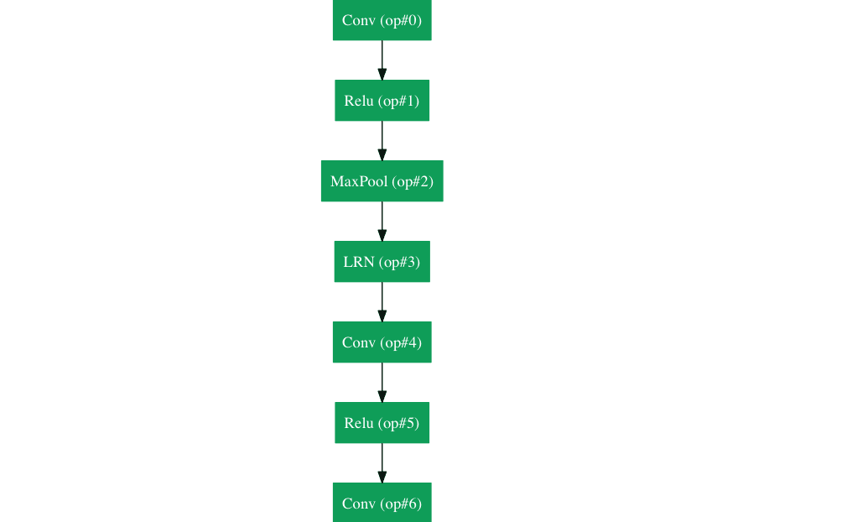
Use many non-linear transforms!

Slide 32
Desired properties of NNs

Slide 33
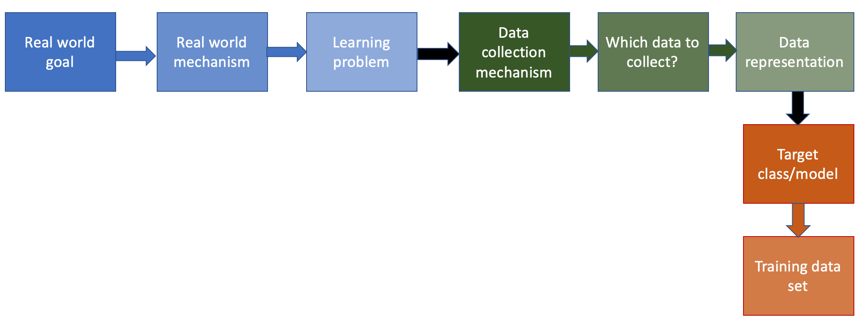
Finally to next step in the ML pipeline!
After the break

Slide 34
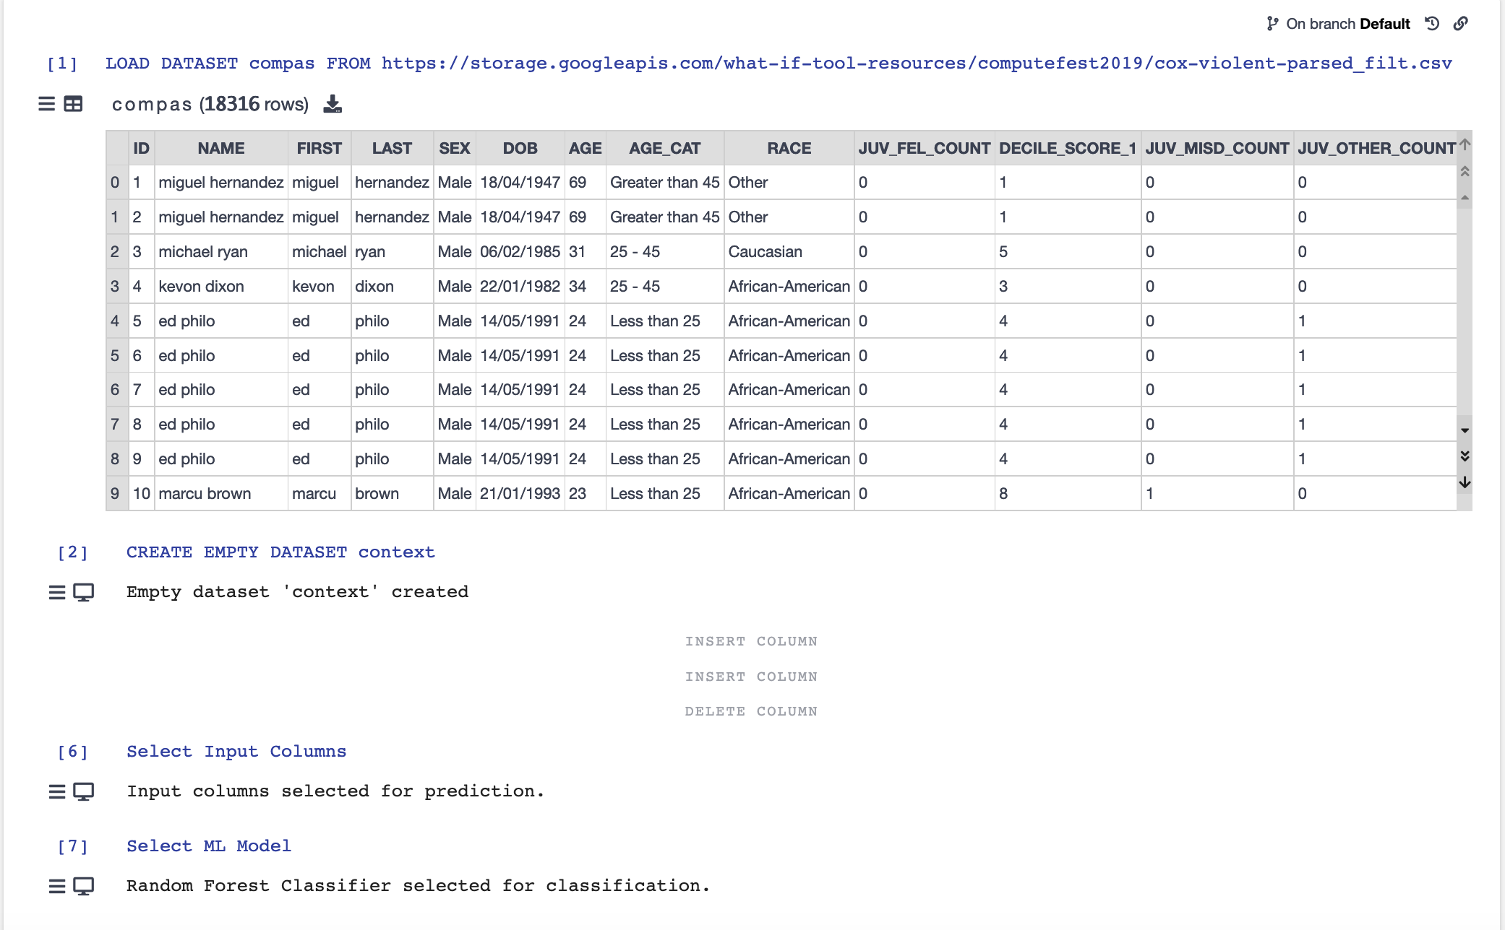
Some Vizier fun!

Slide 35
Vizier exercise
https://gram.cse.buffalo.edu/

Slide 36
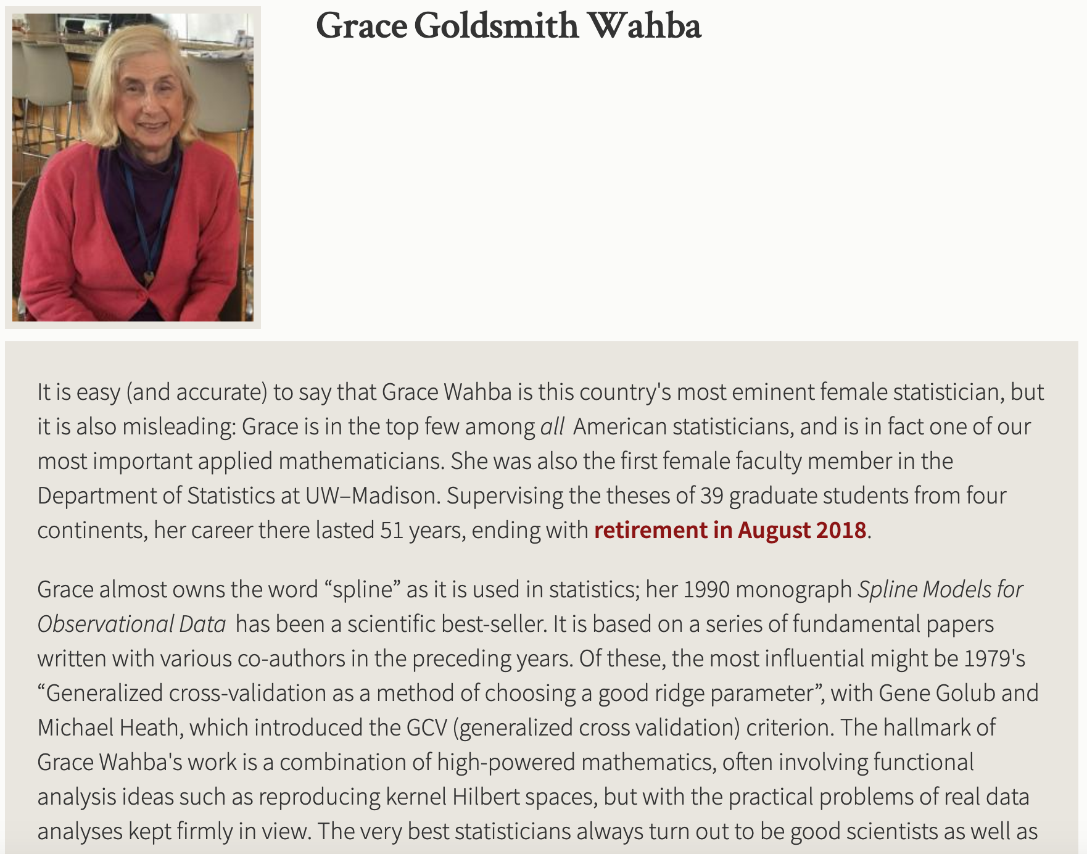
Passphrase for today: Grace Wahba

Slide 37
Choosing the training dataset

Slide 38
?

Slide 39
Training dataset = entire dataset?
700
Weights (kgs)
350
150
300
Height (cms)

Slide 40
A more realistic dataset
700
Weights (kgs)
350
150
300
Height (cms)

Slide 41
We can only collect part of the ground truth
What if we had access to the entire ground truth?
700
Weights (kgs)
350
150
300
Height (cms)

Slide 42
This is our dataset
700
Weights (kgs)
350
150
300
Height (cms)

Slide 43
Let’s find the optimal linear model
What is an optimal linear model?
700
Weights (kgs)
350
150
300
Height (cms)

Slide 44
Going back to the entire ground truth
700
700
Weights (kgs)
Weights (kgs)
350
350
150
300
150
300
Height (cms)
Height (cms)

Slide 45
What if we had a true random sample?
What is the catch?

Slide 46
Which subset to pick? Choice 1
700
700
Weights (kgs)
Weights (kgs)
350
350
150
300
150
300
Height (cms)
Height (cms)

Slide 47
Optimal linear model for Choice 1
700
Weights (kgs)
350
150
300
Height (cms)

Slide 48
Choice 2 for subset
700
700
Weights (kgs)
350
Weights (kgs)
350
150
300
150
300
Height (cms)
Height (cms)

Slide 49
Optimal linear model for Choice #2
700
Weights (kgs)
350
150
300
Height (cms)

Slide 50
How do we pick the “best” subset?
700
700
Weights (kgs)
Weights (kgs)
350
350
150
300
150
300
Height (cms)
Height (cms)

Slide 51
Answer: we don’t (or can’t)!

Slide 52
Beyond random training dataset

Slide 53
Some Vizier fun!
If we have time!

