Slide 1
Career Services
259 Capen Hall

Slide 2
Career Services
How we can help you.
STEM UP Fair
What’s new!
Career Services Resources

Slide 3

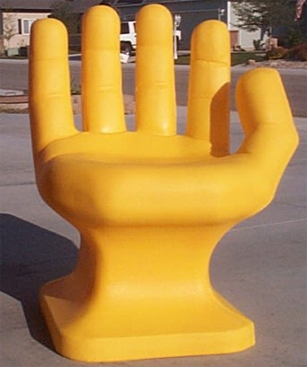
Career Services Resources
Individual Career Counseling
Express Career Consult
Resume, Cover letter, & Linkedin profile reviews
Practice Interviews
Bullseye powered by Handshake
  Internship & job postings
  On-campus & off-campus jobs
On-Campus Recruiting
Career & Job Fairs – STEM Up Fair!
Connection (Networking) events & web portal
Resources on the Career Services Website

Slide 4
Quiz Question
When does the recruiting season start for engineering candidates?

Slide 5
Options
A) March (Spring semester)
B) April (Spring semester)
C) September (Fall semester)
D) December (Fall semester)
ANSWER: C) September

Slide 6

STEM UP Fair
Is Coming

Slide 7
Do you know the date
for the
STEM UP Fair
this year?

Slide 8
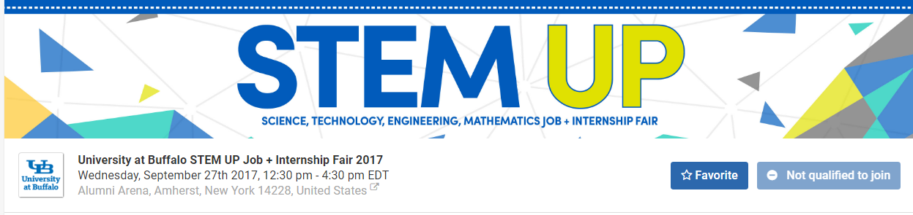
STEM UP Job & Internship Fair
Wednesday, September 27, 2017
Alumni Arena
12:30 pm – 4:30 pm
Dress Code in effect.
Bring resumes!

Slide 9
BULLSEYE
Powered by Handshake

Slide 10
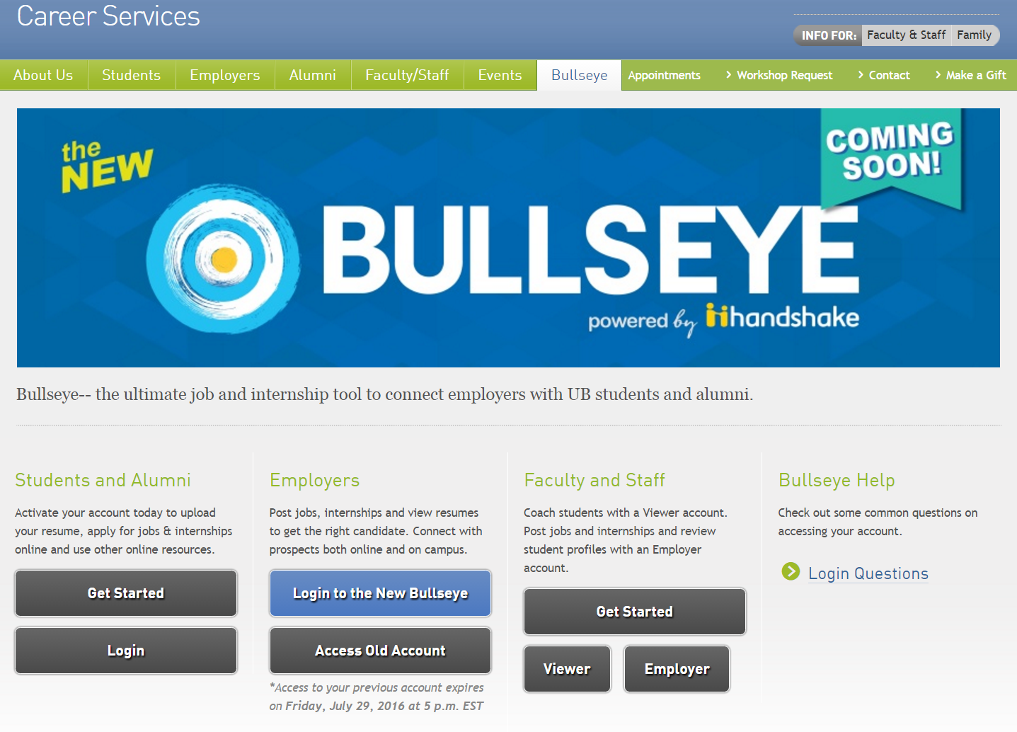

Slide 11
What’s new!
In Bullseye powered by Handshake

Slide 12



Tap the desk if you’ve had an experience with…

Slide 13
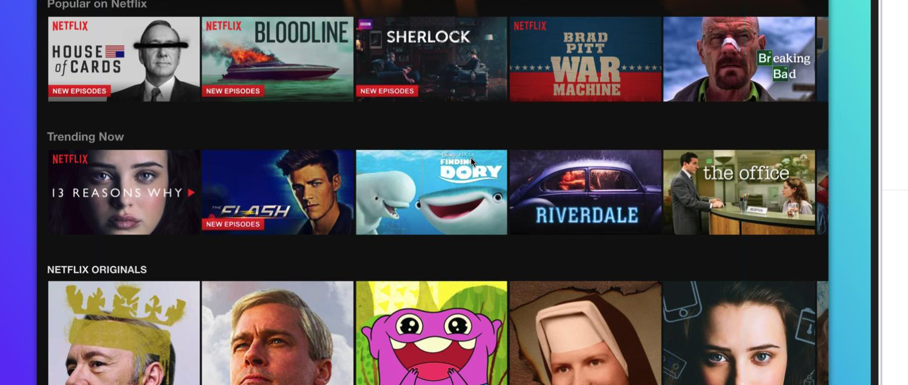
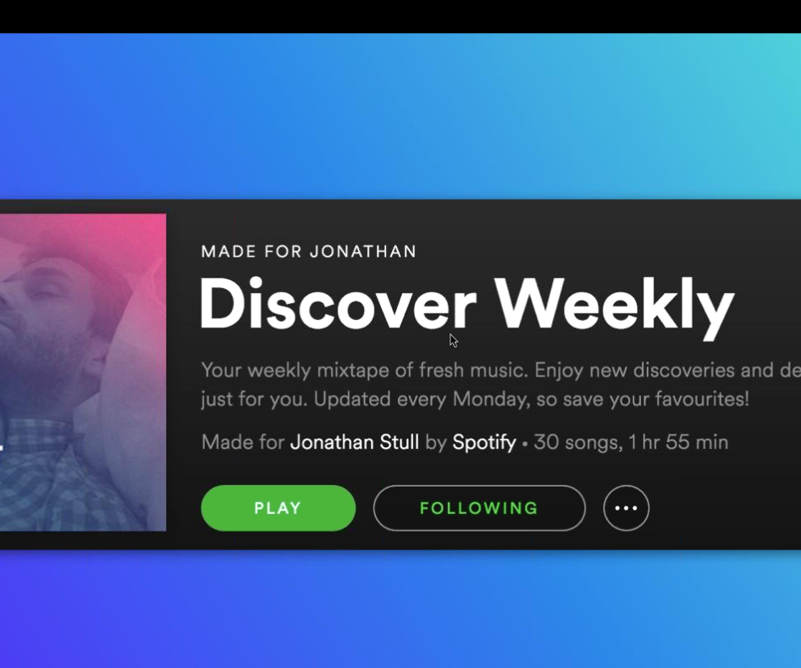
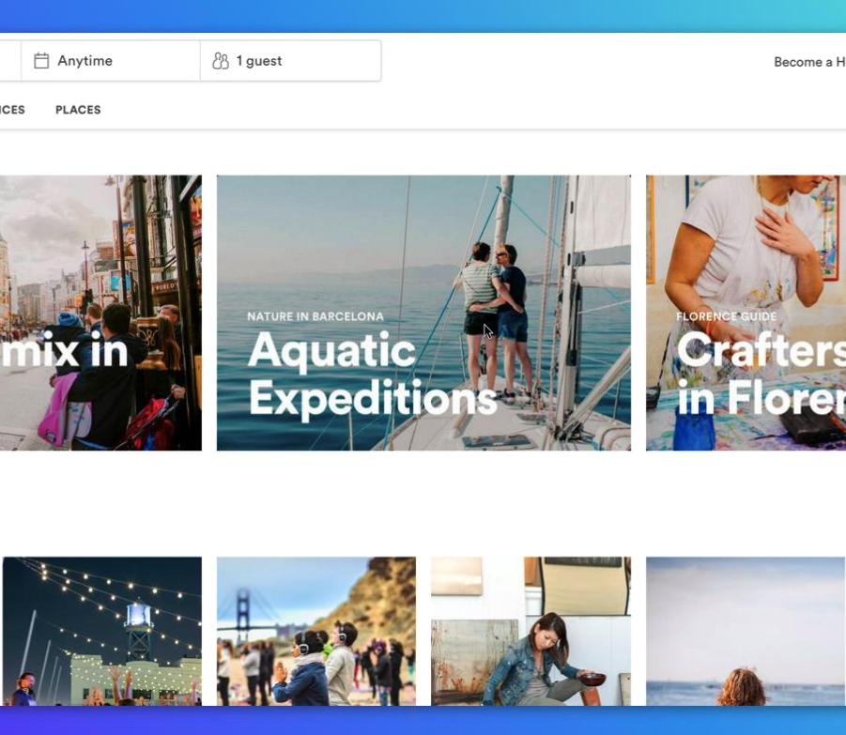
What do Netflix, Spotify, Airbnb and Bullseye powered by Handshake all have in common?
They each offer you personalized recommendations and collections.

Slide 14
The new interface…

Slide 15
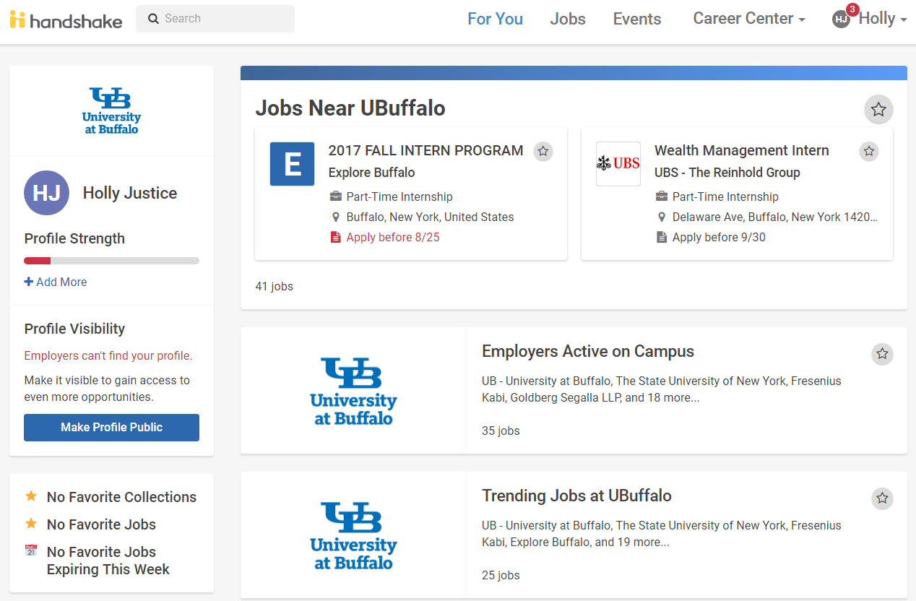

Slide 16
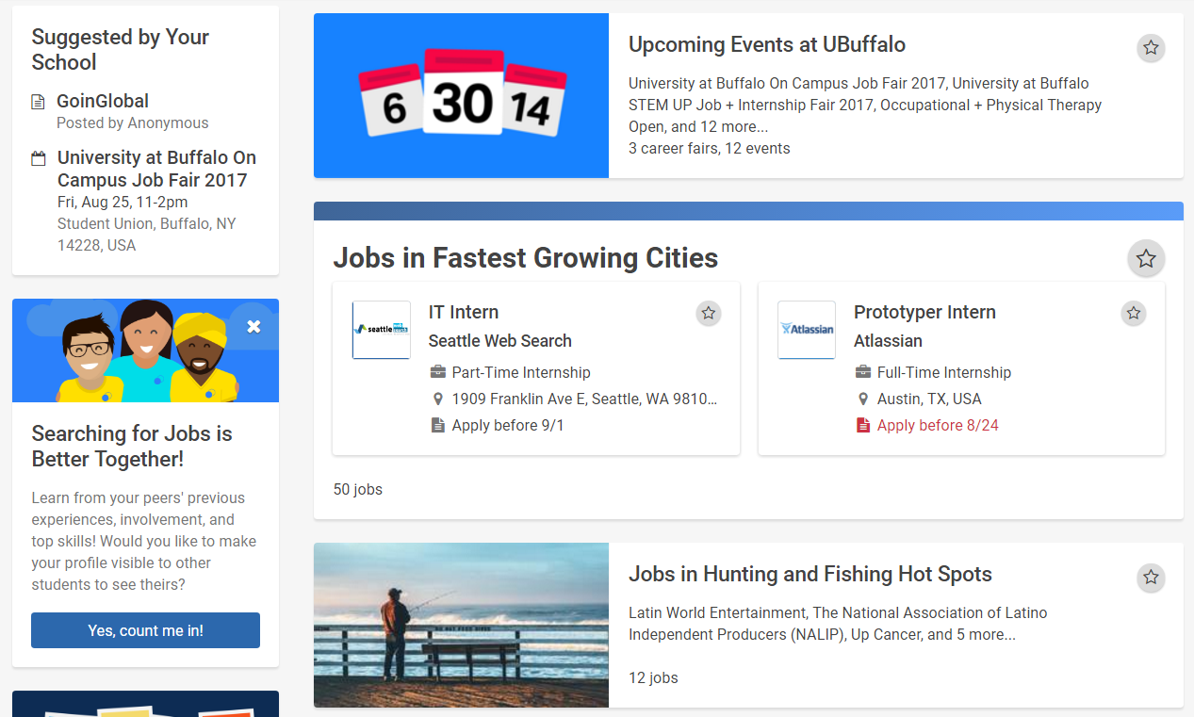

Slide 17
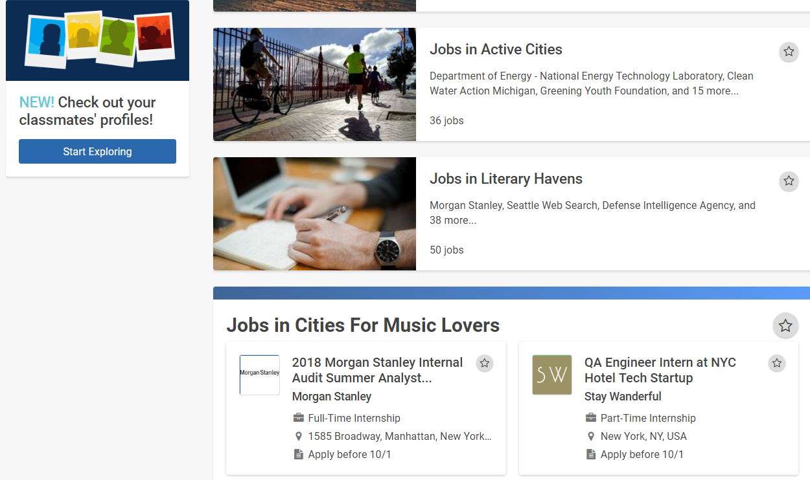

Slide 18
How to use BULLSEYE
Powered by handshake

Slide 19
Top 3 Actions Steps For You Right Now!
Complete your profile in the new Bullseye powered by Handshake
Make your profile public
Get your resume critiqued and then upload to the new Bullseye powered by Handshake

Slide 20
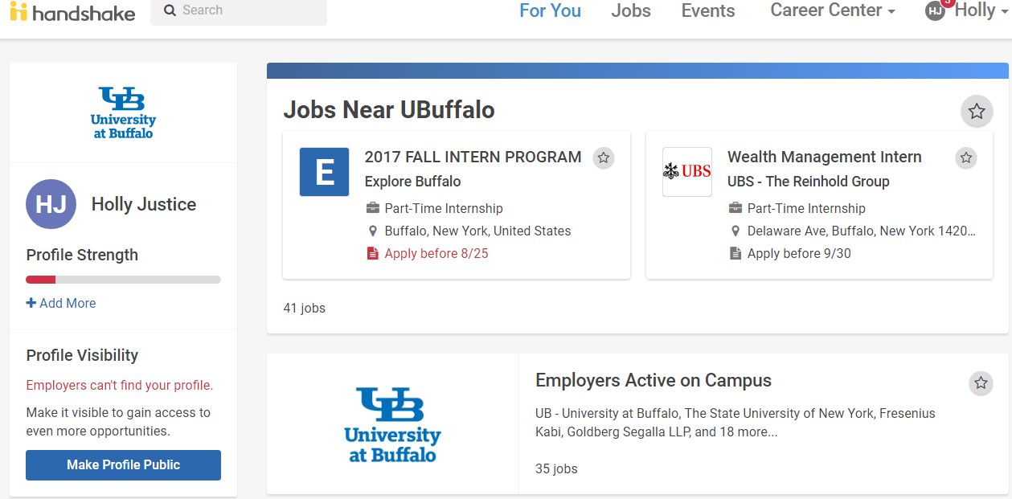

Slide 21
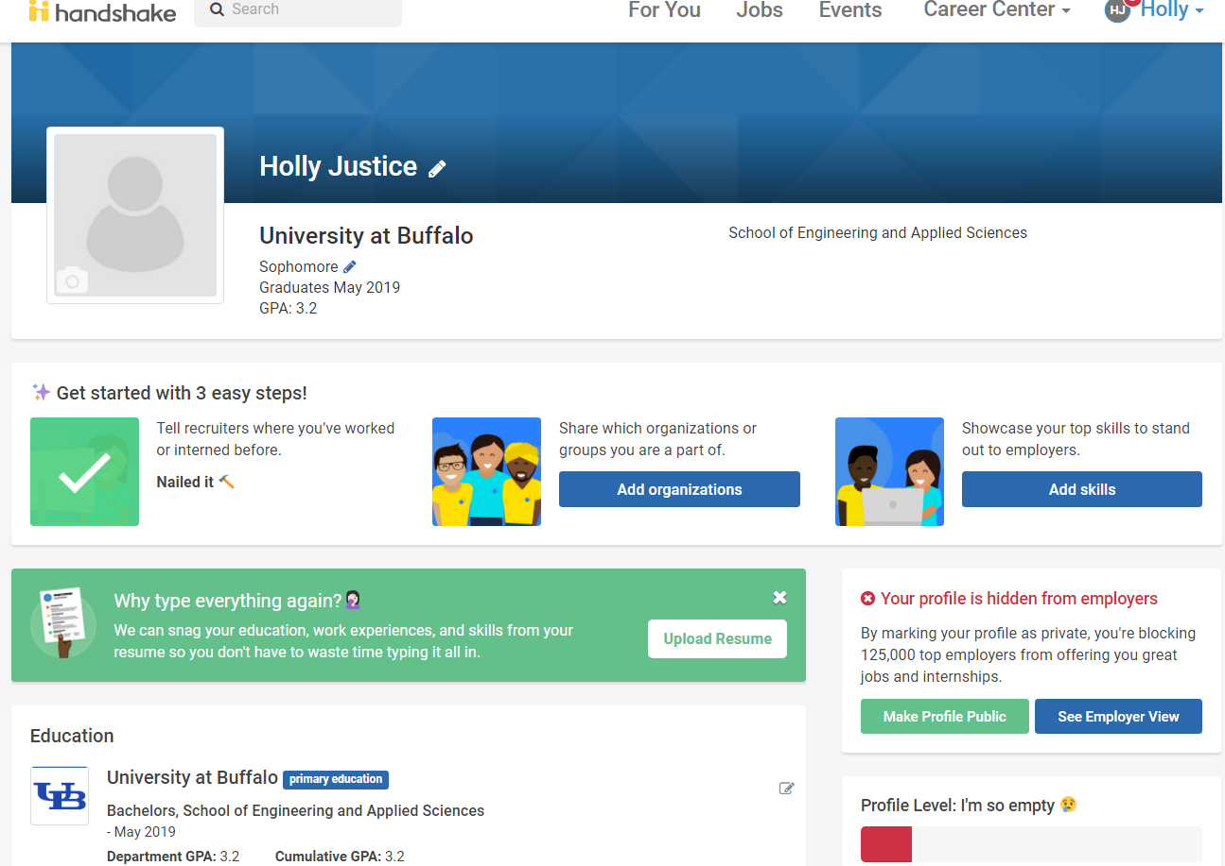

Slide 22
Your classmates profiles

Slide 23
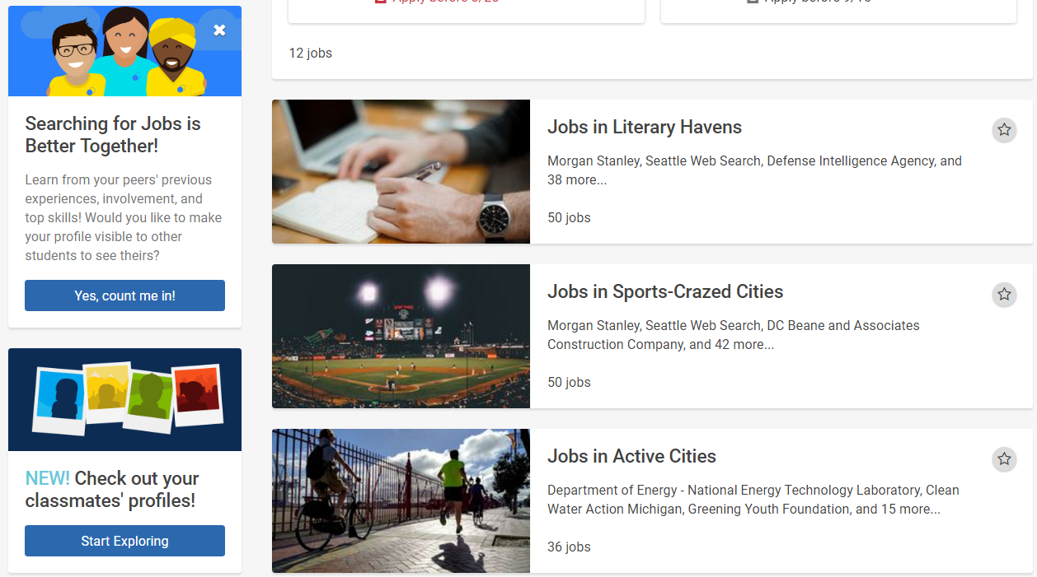

Slide 24
UB Career SERVICES
Resources & Services

Slide 25
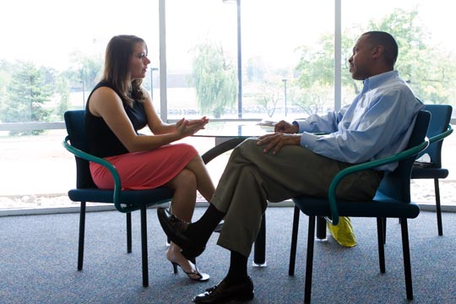
Career Services Resources
Individual Career Counseling
Express Career Consult
Resume, Cover letter, & Linkedin profile reviews
Practice Interviews
Bullseye powered by Handshake
  Internship & job postings
  On-campus & off-campus jobs
On-Campus Recruiting
Career & Job Fairs – STEM Up Fair!
Connection (Networking) events & web portal
Resources on the Career Services Website

Slide 26
Individual Career Counseling
Discuss your personal career plans and how to achieve them
    Job
    Graduate School
    Volunteer / Service
    Becoming an Entrepreneur
    Other
Resume creation & review
Cover letter creation & review
Linkedin profile creation & review
Internship & Job search strategies
How to make connections
Preparing for an interview
Strategies for career fairs

Slide 27

Individual Career Counseling
One on one meeting
An hour long appointment.
*NEW*
  To schedule your Career Counseling appointment log on to “BullsEye powered by Handshake”

Slide 28

Express Career Consult
One on one meeting
20 minute, same day appointment
Monday – Friday 10:00am-4:00pm
Call 716-645-2231 or walk-in to the office (259 Capen Hall) to make an appt.
Great for
  Resume reviews, cover letter reviews,
  Linkedin Profile reviews,
  Basic internship/job search strategies

Slide 29
MAKING CONNECTIONS

Slide 30
Making connections
Use the UB Career Connector Network to make a connection with alumni
Attend Road Trip to NYC event in January
  Includes
    Employer Site Visits
    Career Conversation – big networking night!
    Coffee Chats with Alumni
Leverage your Linkedin profile

Slide 31
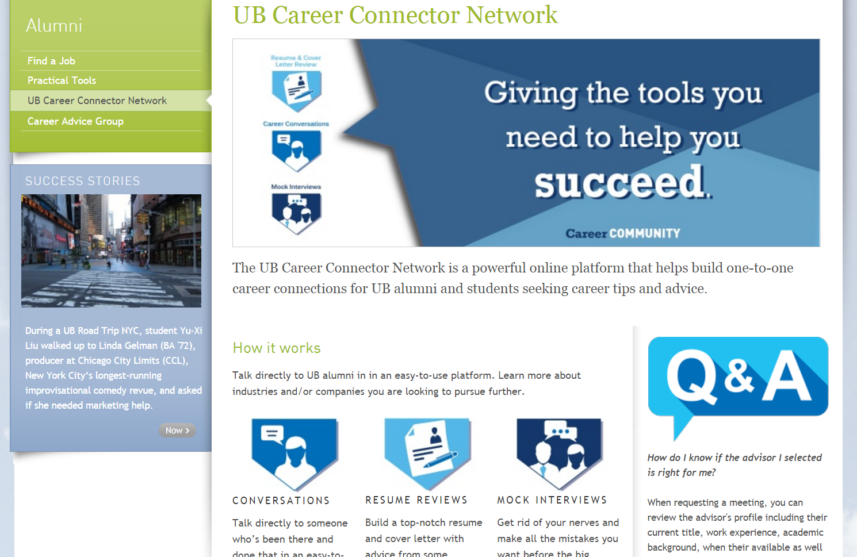

Slide 32
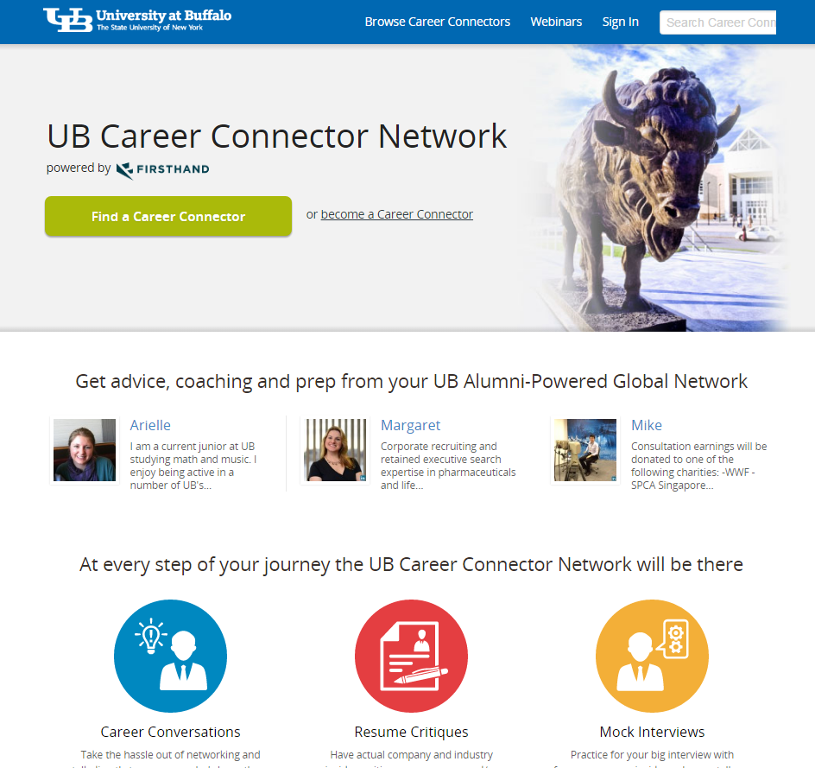

Slide 33
Internship & Job Search Strategies

Slide 34
Strategies
Strategy 1:
  Apply online, Career Fairs, On-Campus Interviewing
Strategy 2:
  Connection – Networking

Slide 35
How Career services can help – Strategy 1
Strategy 1:
  Apply online using the BullsEye system
  Career Fairs – attend STEM UP
  On-Campus Interviewing – apply for opportunities through the BullsEye system

Slide 36
How Career services can help – Strategy 2
Strategy 2: Connection – Networking
  ‘Meet the Employer’ sessions
  Career Conversations networking events with alumni
  “On the Road” employer site visits

Slide 37
How Career services can help
Strategy 1:
  Apply online using the BullsEye system
  Career Fairs – attend STEM UP
  On-Campus Interviewing – apply for opportunities through the BullsEye system
Strategy 2: Connection – Networking
  ‘Meet the Employer’ sessions
  Career Conversations networking events with alumni
  “On the Road” employer site visits

Slide 38
One more resource for you!

Slide 39
Set your ideas in motion
Class Presentation | Fall 2016

Slide 40
Entrepreneurship. That’s What We Do.
We help UB students, faculty, staff and alumni turn their research and ideas into businesses
  Open to all students regardless of discipline or degree program
Just have an idea?
  We’ll help you flesh out initial concepts and understand the roadmap to execution
Already formed a company?
  We can help overcome obstacles as you look to grow and scale your business
Just curious?
  Participate in events, join the online community, or sign up for free mentorship

Slide 41
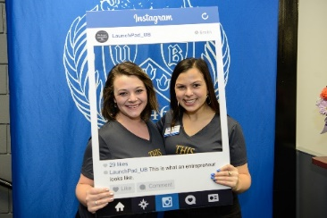


How Do We Make It Happen?
Support to Campus Community
Connect the Entrepreneurship Dots on-campus
Access + Entry for WNY Business + Startup Community

Slide 42




















We’re All Over The Country (And Ireland Too).

Slide 43
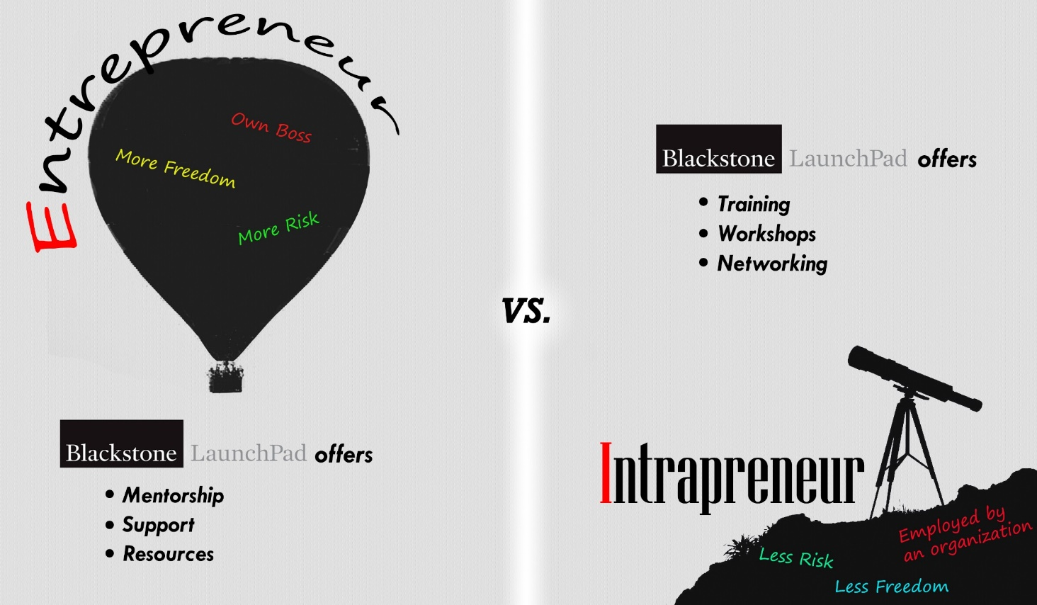
Think Like An Innovator And Entrepreneur.

Slide 44
Intra-pre-what?
Many students do not self-identify as entrepreneurs
They may feel their technical skills are not easily transferrable to a business setting, or consider themselves “too introverted” to start a business
The same skills needed by entrepreneurs apply to intrapreneurs: the ability to think “outside the box” and develop something new within a larger organization
Here at Blackstone LaunchPad, we have developed training and workshops to identify problems and show how your discipline can contribute to a solution

Slide 45

Empowering Women Through Entrepreneurship.
Blackstone LaunchPad is partnering with campus clubs and initiatives to host a series of workshops and discussions to inspire and empower women leaders to be our next innovators, entrepreneurs, makers, and creators
Students will be encouraged to attend as many or as few seminars as they want
Those that attend four or more will receive a certificate of completion

Slide 46
Workshops Offered Multiple Times This Semester.
The Power of Networking
Creative Problem Solving + Idea Generation
Pitch Your Idea
How to Start a Start-up
Revenue Models + Customer Validation
How I Failed and Failed Forward
Storytelling
* For full listing and up-to-date info, look at the events on our Facebook page
Intellectual Property + Strategic Planning
Non-profit and Social Entrepreneurship
Your Personal Brand
The Power of Influence + Negotiations
Teamwork + Meeting Facilitation Skills
Working in Diverse Teams
Decision Making + Project Implementation Tools

Slide 47


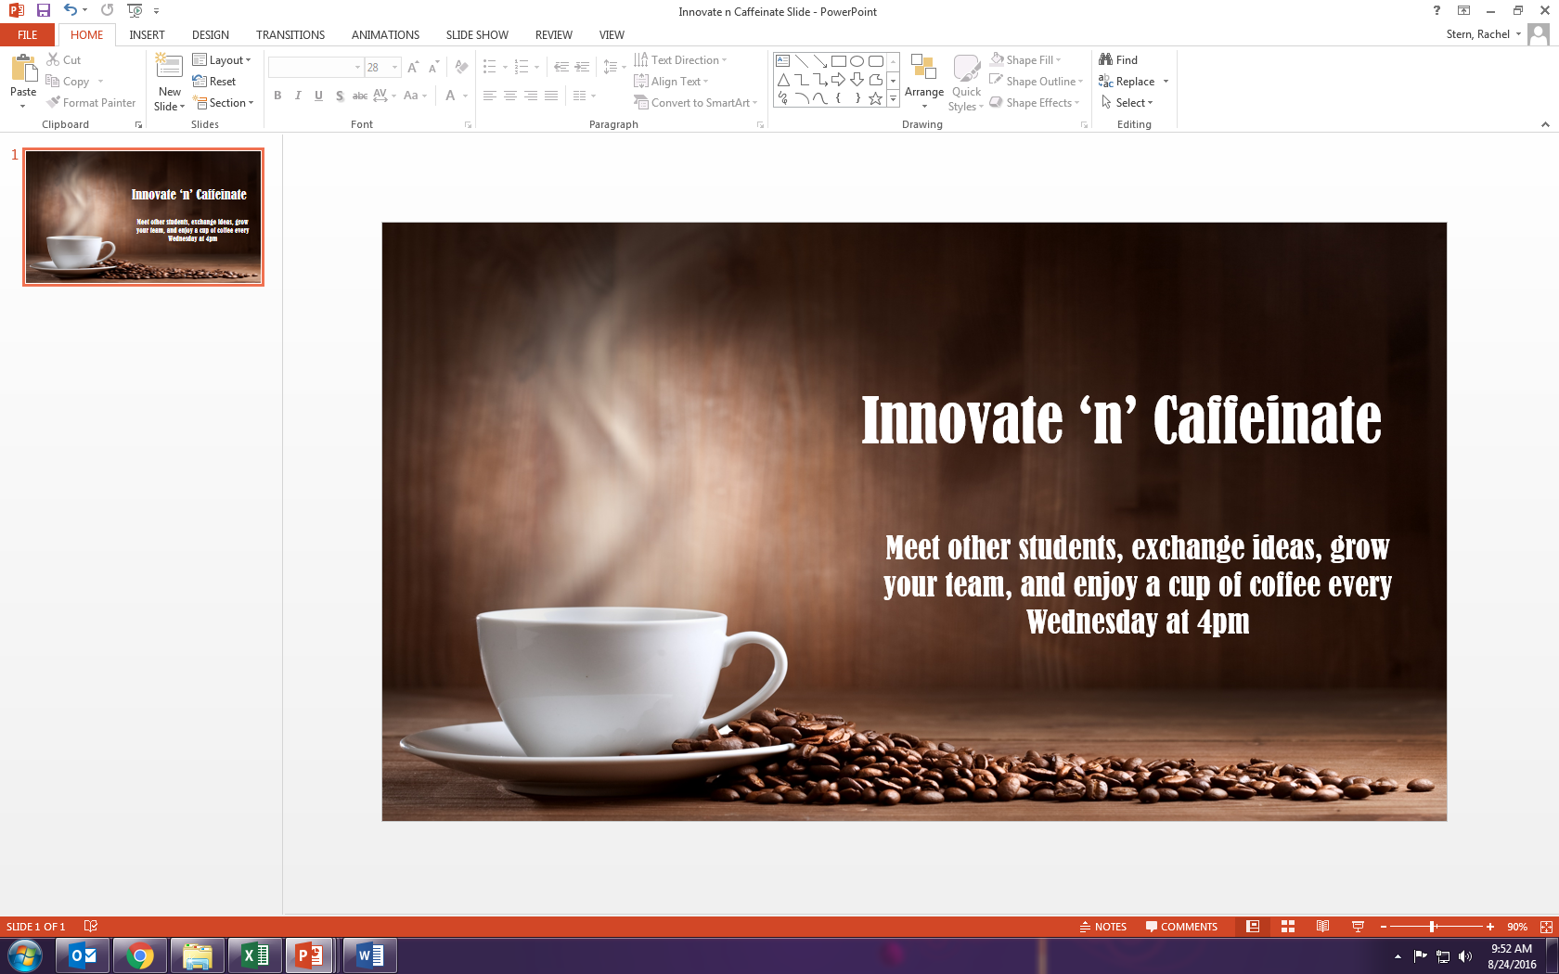
Plus We Have Fun Weekly Events.

Slide 48

WHO’S NEXT?
Enter the Panasci Technology Entrepreneurship Competition
for your chance to win
First Place
$25,000 cash plus in-kind
services valued at $27,000
Second Place
$10,000
Full Schedule
mgt.buffalo.edu/panasci
Questions?
Email mgt-cel@buffalo.edu
or call 716-885-5715
Full schedule available at mgt.buffalo.edu/panasci

Slide 49

eLAB: The Entrepreneurship Lab
SPRING 2017 ♦ MGO493/695 ♦ 3 CREDITS ♦ OPEN TO ALL STUDENTS
Do you want to turn an idea into a successful business?
eLab can help you understand the process of creating a startup and gain experience in starting a new venture.
Top teams participating in the eLab course will be awarded fellowships of at least $5,000, space at the UB Office of Science, Technology Transfer and Economic Outreach and other professional services.
Several eLab student teams have won top awards in the UB Pitch Competition, Regional Business Plan Competition and Panasci Technology Entrepreneurship Competition.
Details
Apply online at mgt.buffalo.edu/elab by Friday, November 11 at 5:00PM
Participation limited to 20 teams (50 students)
Questions? Contact mgt-cel@buffalo.edu or call 716-885-5715
"[eLab] is so practical and applicable to what I’m doing as an
entrepreneur that I can’t imagine any student with a startup not taking the course. It has given me information, support, connections and the push I needed.”
- April LoTempio, MBA Student

Slide 50
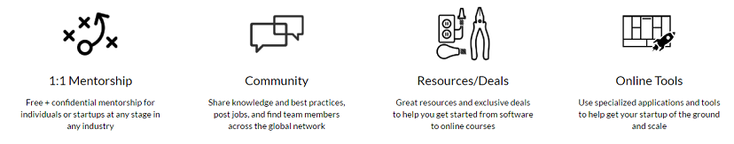
Ventureboard Is Our Online Platform.
www.blackstonelaunchpad.org
Students can schedule coaching meetings, share their progress, find teammates, and access resources

Slide 51



Set Your Ideas In Motion!
Blackstone LaunchPad at University at Buffalo
220 Student Union
North Campus
716-645-8111
launchpadub@buffalo.edu
Get started today:
www.blackstonelaunchpad.org

Slide 52


Slide 53
Thank you!

Slide 54
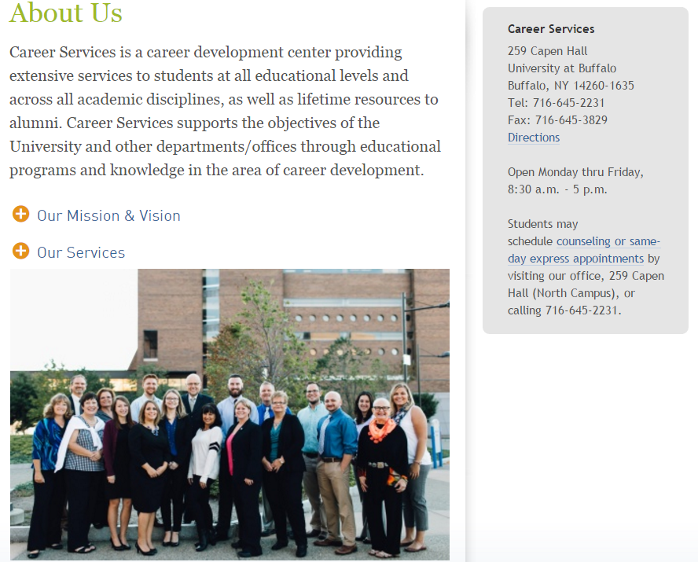

Slide 55
Thank you, again!

