Slide 1
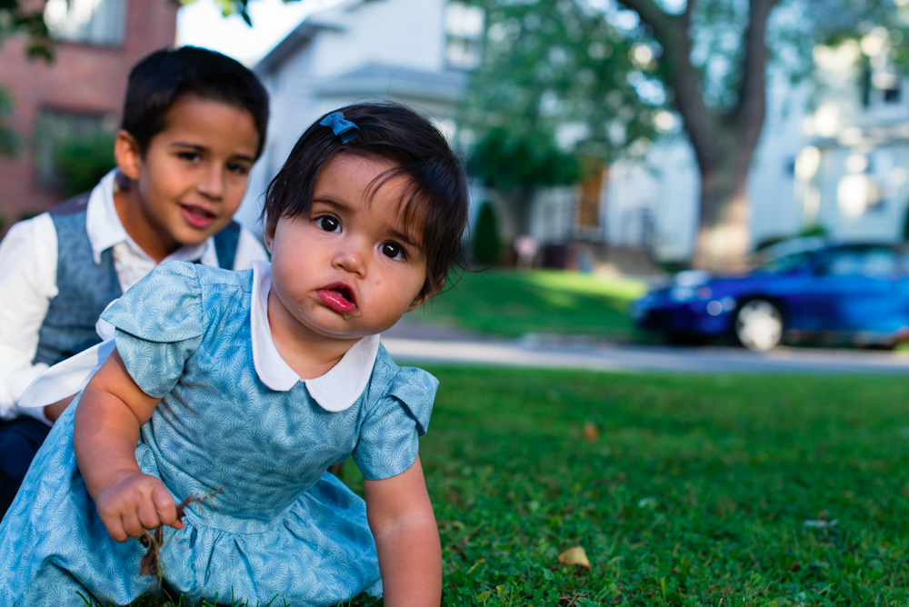
Welcome
to
CSE 331

Slide 2
Let’s do some introductions
http://www.zazzle.com/warning_teaching_assistant_bag-149882665435161818

Slide 3
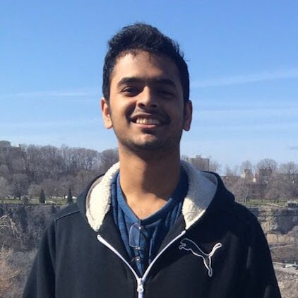
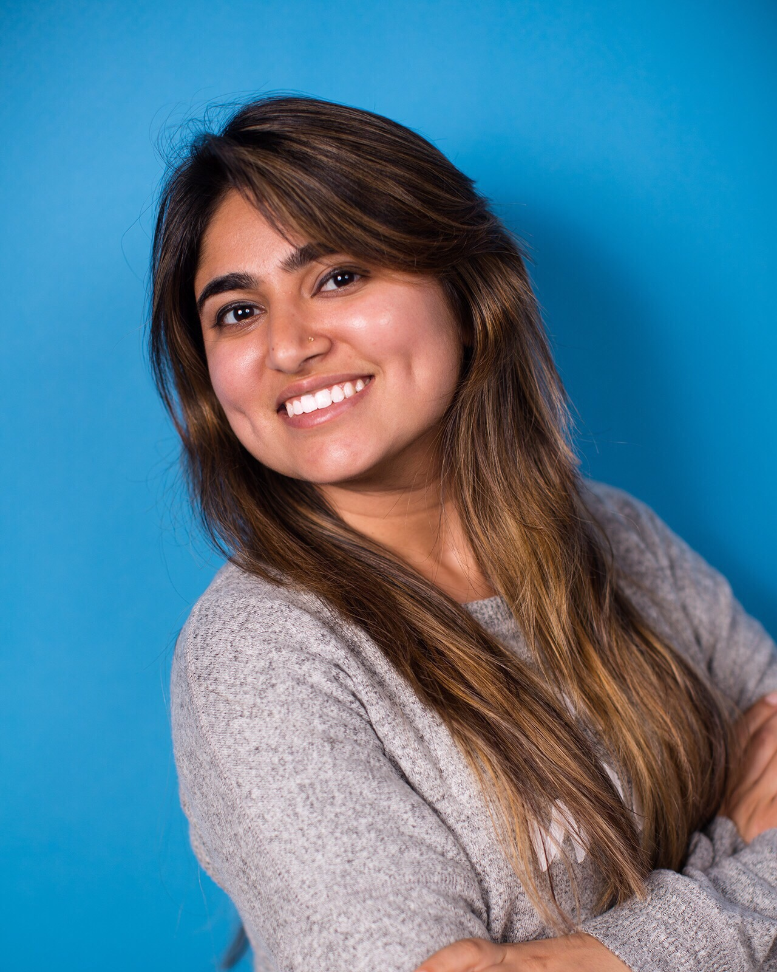
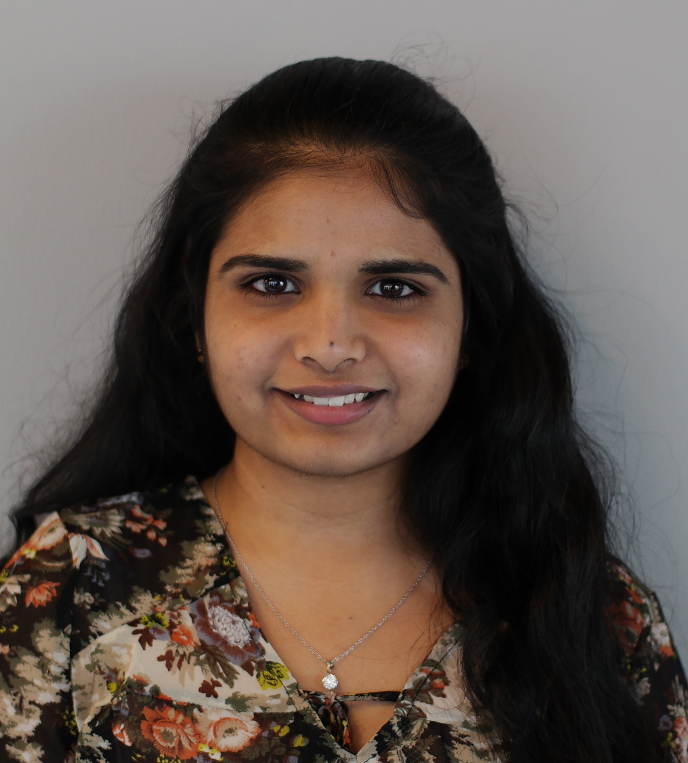
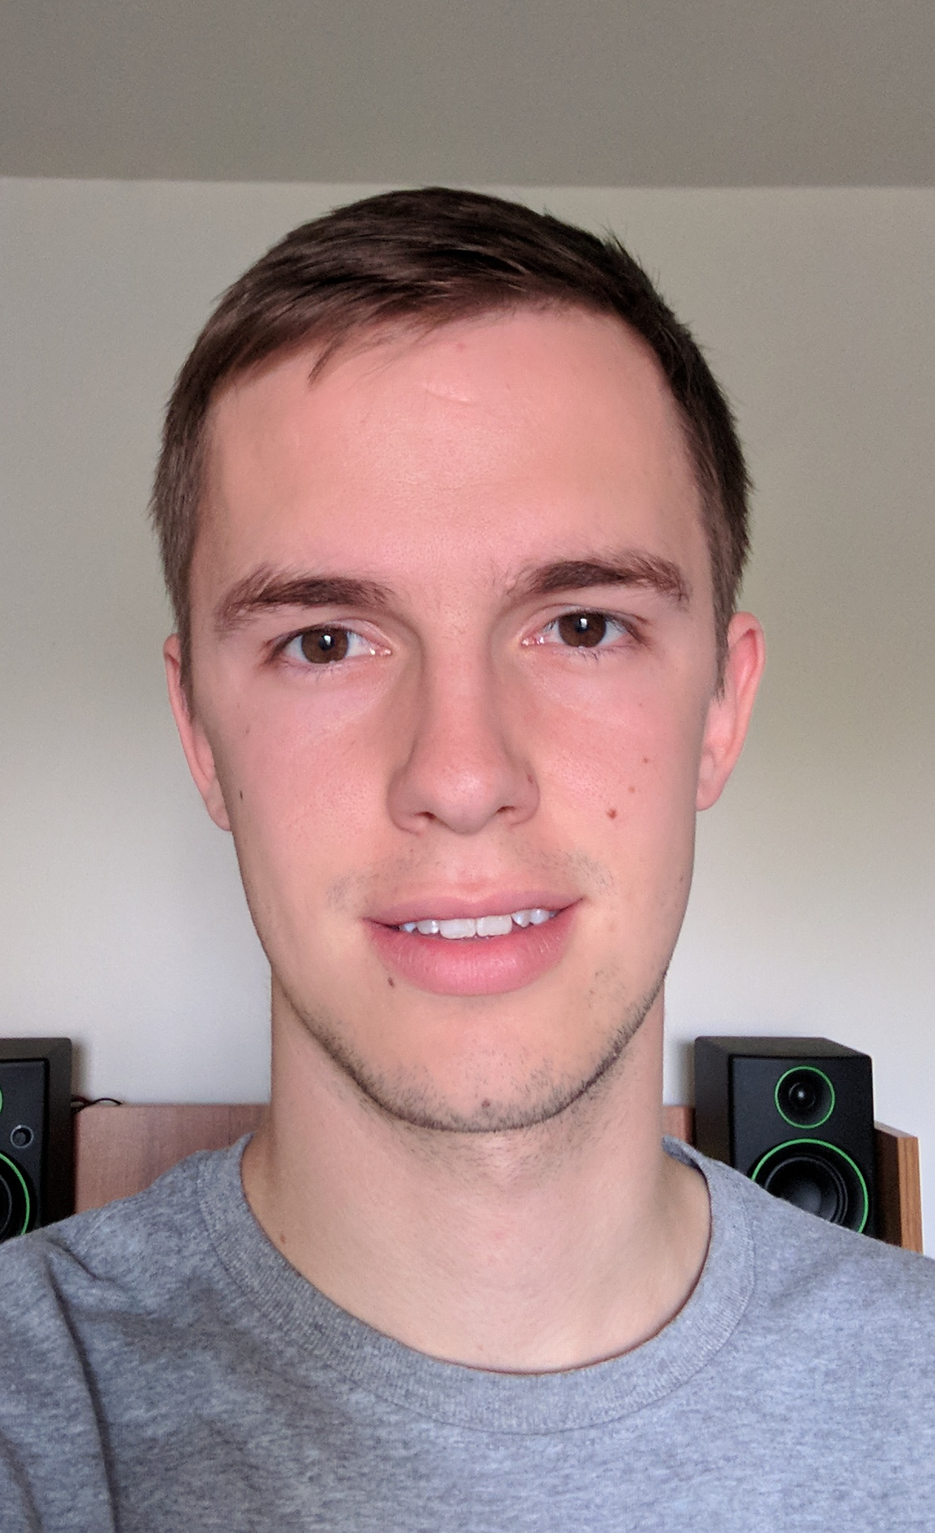
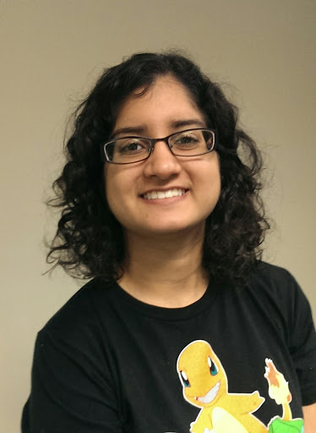
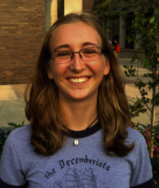
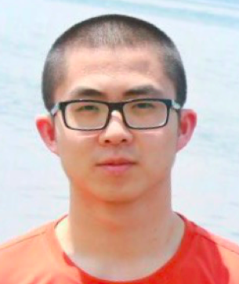
TAs first
Anand
Aishani
Adhish
Sravanika
Katie
Dhruv
Kevin
Simran
Emily
Zhenkang

Slide 4
Lectures will be videotaped
http://www.imdb.com/title/tt0363510/mediaviewer/rm2499681792

Slide 5
About Me
Atri Rudra
atri@buffalo.edu
Office: 319 Davis
Office hours: Mon, 3:30-4:20pm; Wed 2:00-2:50pm
OH starts today

Slide 6
Contact us all at
Or use piazza!
cse-331-staff@buffalo.edu
TAs will not respond to individual emails (except for re-grading requests)

Slide 7
Handouts for today
Syllabus (online)
Homework Policy document (online)
Homework 0 (online)

Slide 8
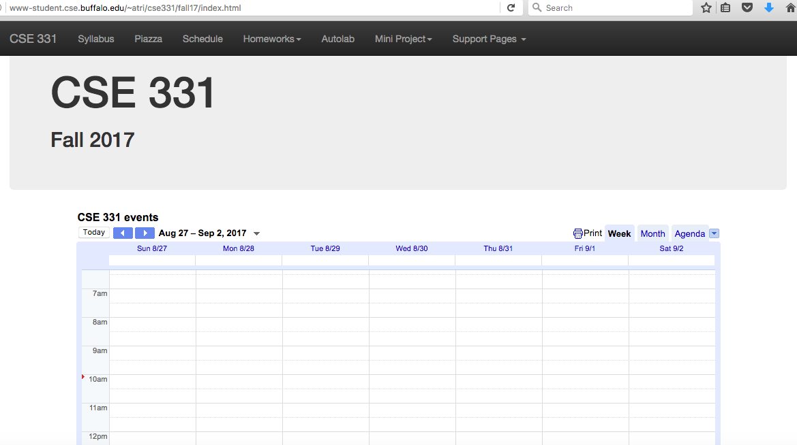
One Stop Shop for the Course
http://www-student.cse.buffalo.edu/~atri/cse331/fall17/index.html

Slide 9
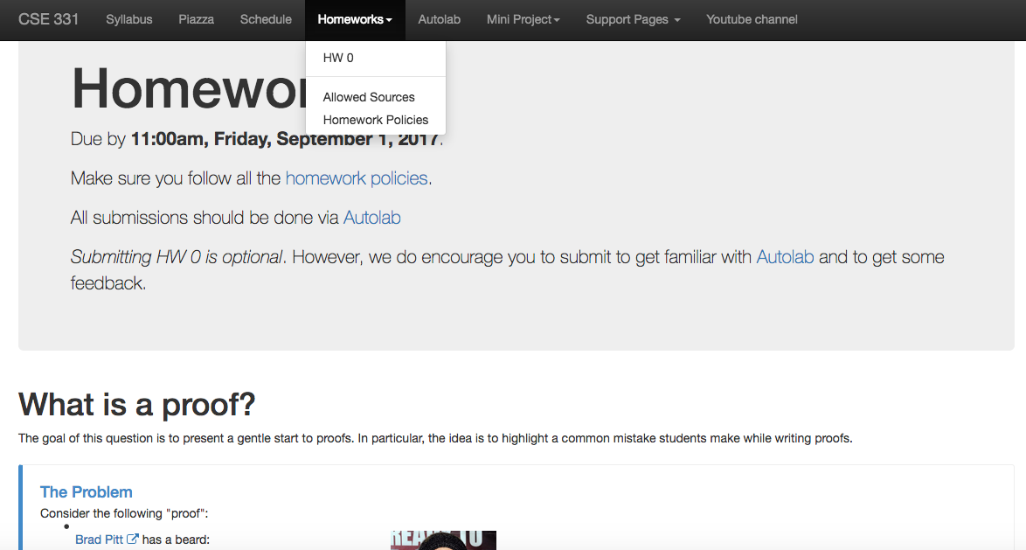
Homework 0 (Optional)
Due: this Friday

Slide 10
Three things to remember
WORK HARD!
DO NOT CHEAT!
READ CAREFULLY!

Slide 11
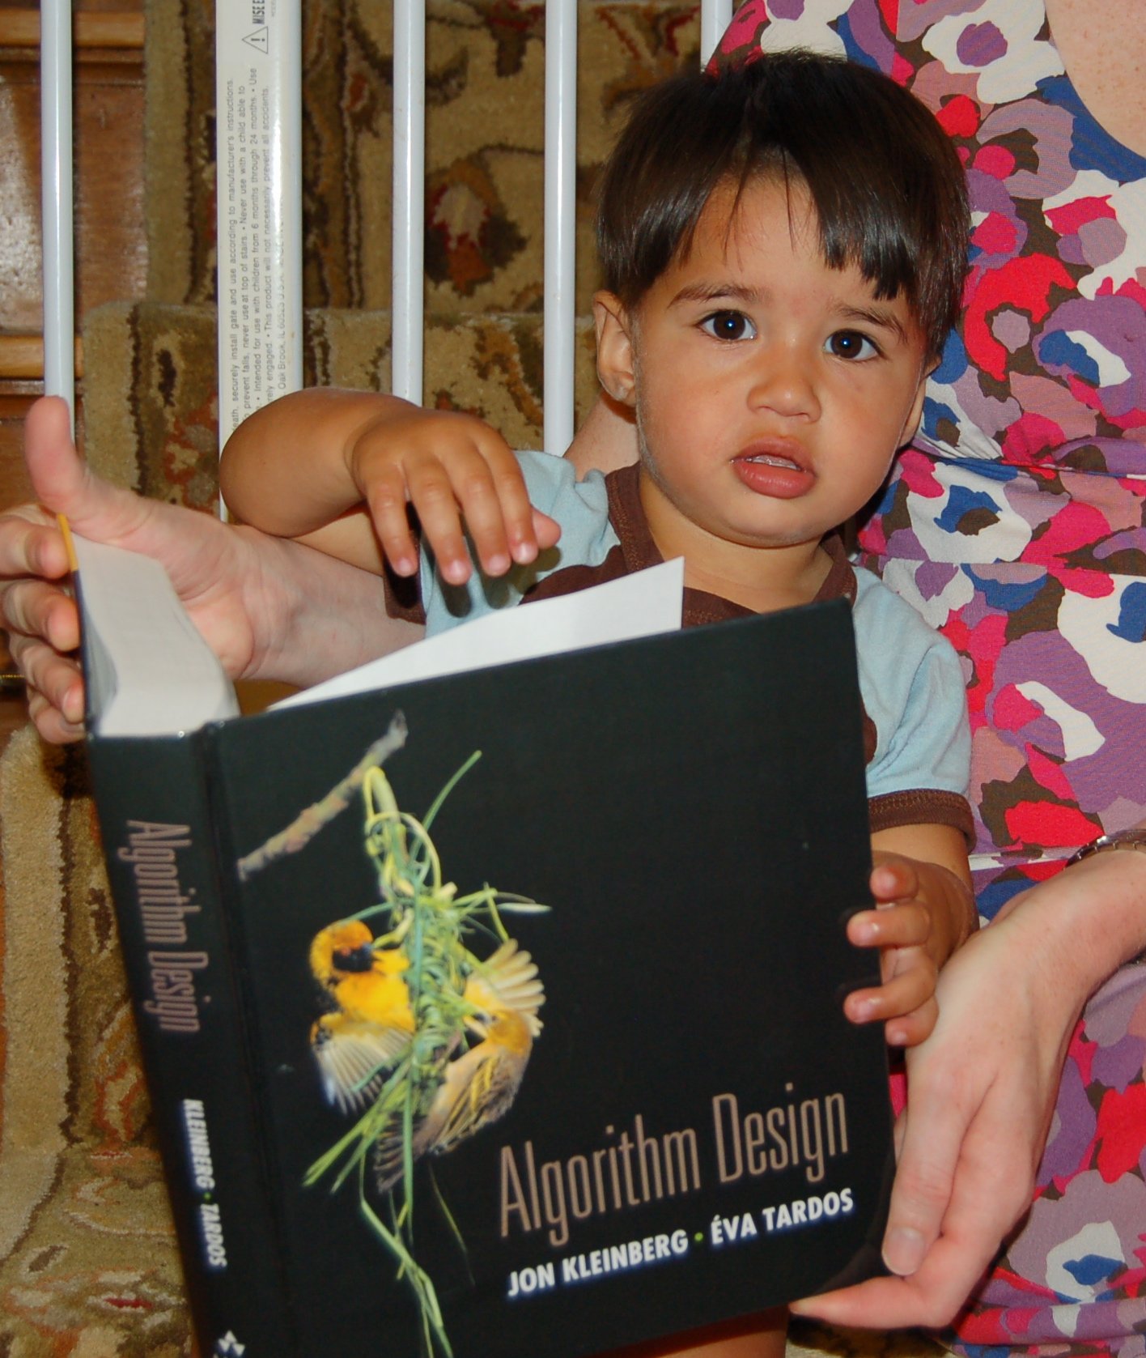
Wait.. What???
Make sure you follow submission
instructions
Two most common ways of losing points
Make sure you read problem
statements carefully

Slide 12
Academic Dishonesty
All your submissions must be your own work
Penalty:
Minimum: An grade reduction in course
Possible: F (or higher penalty) if warranted
YOUR responsibility to know what is cheating, plagiarism etc.
If not sure, come talk to me
Excuses like “I have a job,” “This was OK earlier/in my country,” “This course is hard,” etc. WON’T WORK
I DO NOT HAVE ANY PATIENCE WITH ANY CHEATING :
YOU WILL GET A GRADE REDUCTION IN THE COURSE
FOR YOUR FIRST MISTAKE

Slide 13
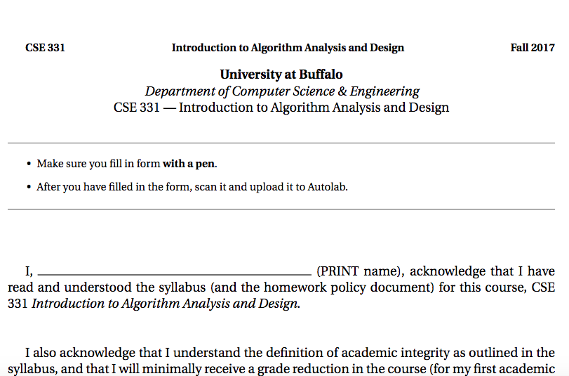
Read the syllabus CAREFULLY!
No graded material will be handed back till you submit a signed form!

Slide 14
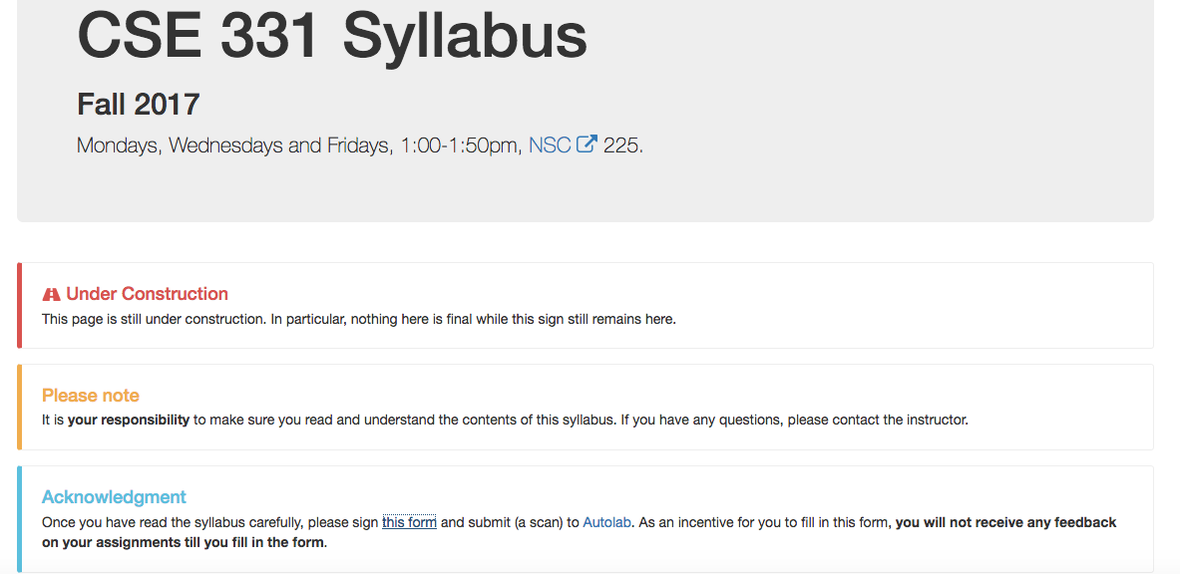
Where to find the form

Slide 15
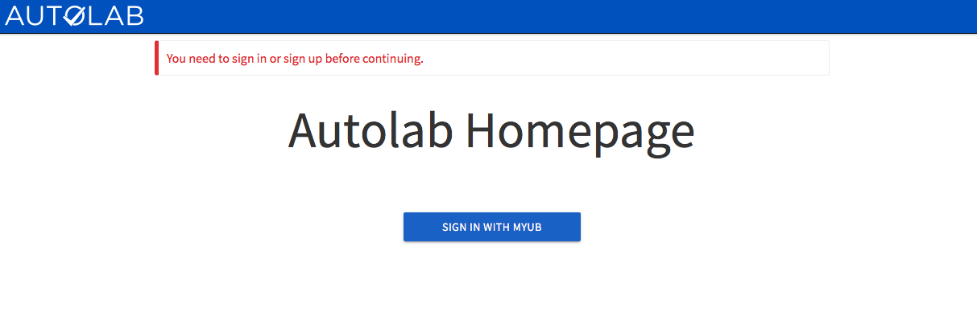
Autolab
https://autograder.cse.buffalo.edu/

Slide 16
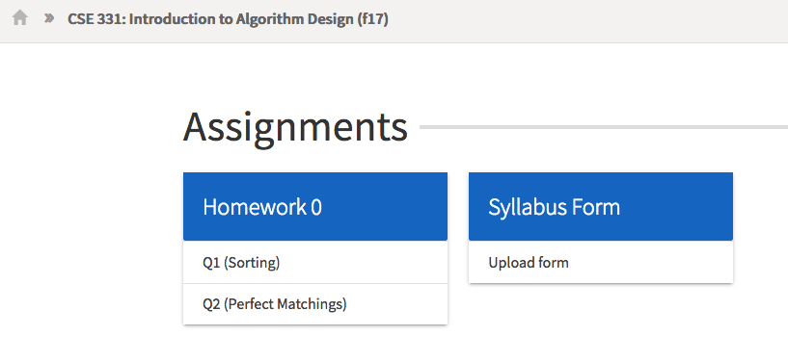
You can submit the following now
If you were registered by 9pm on Sunday, Aug 27 you should be on Autolab

Slide 17
Grading break-down

Slide 18
Pre-requisites
Required (officially)
CSE 250, CSE 191 and MTH 142
At least a C-
Required (for practical purposes)
Comfort with proofs
Willingness to work hard!

Slide 19
Disabilities
Information included in the syllabus
In short, let me know and consult with Office of Disability Services

Slide 20
Preferred Name
If you prefer using name diff from UB records
Let me know and we’ll make a note of it.

Slide 21
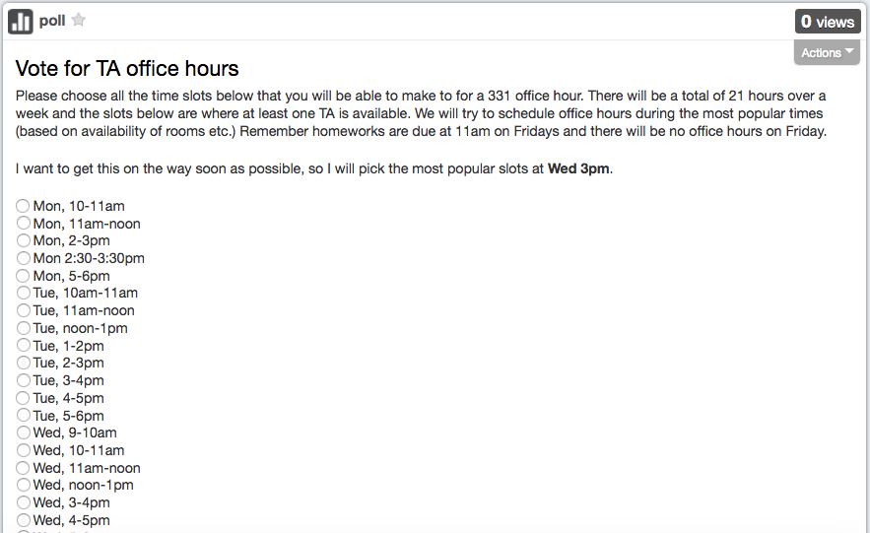
TA Office hours
YOU decide!

Slide 22
Recitations
Are on for this week!
RECITATIONS

Slide 23
Exams
Mid term (two parts)
Mon, Oct 16 and Wed, Oct 18, 2017. Usual place and time.
Final exam
Fri, Dec 15, 2017. NSC 225, noon-2:30pm

Slide 24
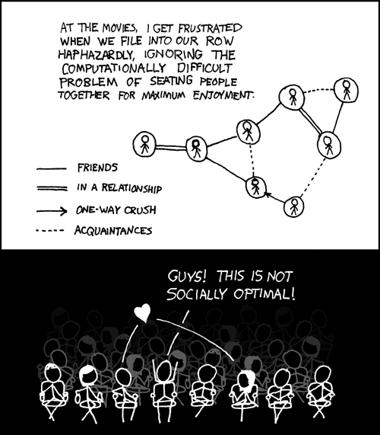
This course: how to solve problems!
http://xkcd.com/173/

Slide 25
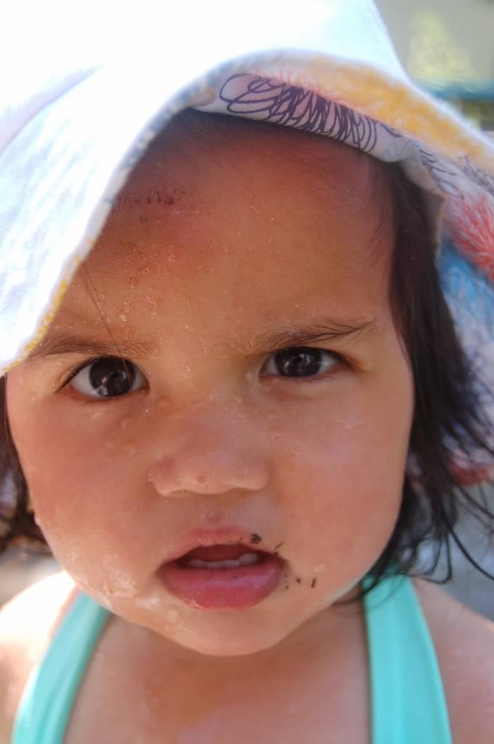
Why should I care ?

Slide 26
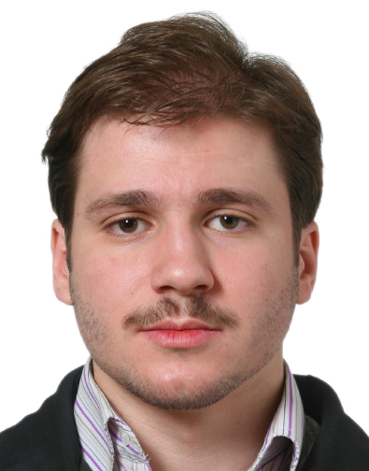
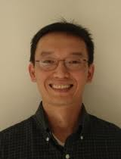
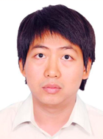
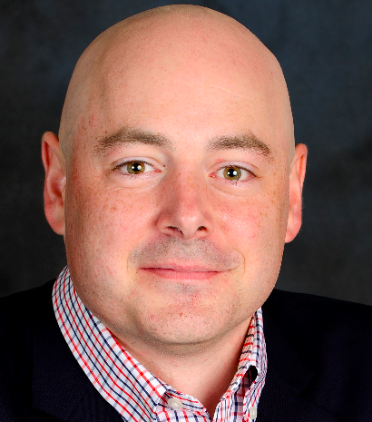
Combining Shadows to Understanding the network

Slide 27
The key technical problem
Given the three projections, what is the largest size of the original set of points?

Slide 28
Detecting Communities

Slide 29
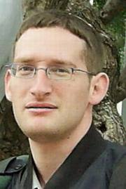
Conquering Shadows to Conquering the Internet
Algorithmically compute the missing set

Slide 30
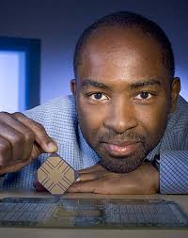
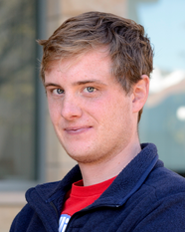
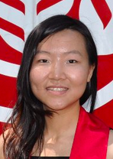
The proof is in the performance
>
10x faster
Better algorithm with little hacking will beat a worse algorithm with tons of hacking

Slide 31
The key technical problem
Highly trivial: 4³ = 64
Still trivial: 4² = 16
Correct answer: 4^{1.5} = 8

Slide 32
If detecting communities is not for you

Slide 33
From someone who got a Google job
“You can let your algorithms class know that the phone interviews are essentially like a difficult algorithms test.
Lots of data structures, specifying the algorithm, analyzing the
run time and space requirements... And all on the phone and
you're supposed to talk through your thought process.”

Slide 34
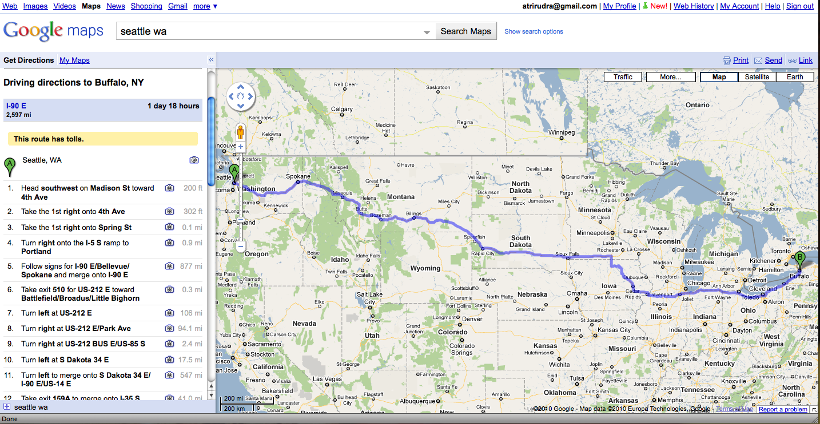
Why care about algorithms?
Driving directions

Slide 35
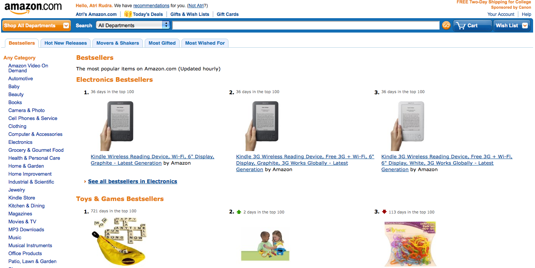
Why care about algorithms?
Computing Bestsellers on the fly

Slide 36
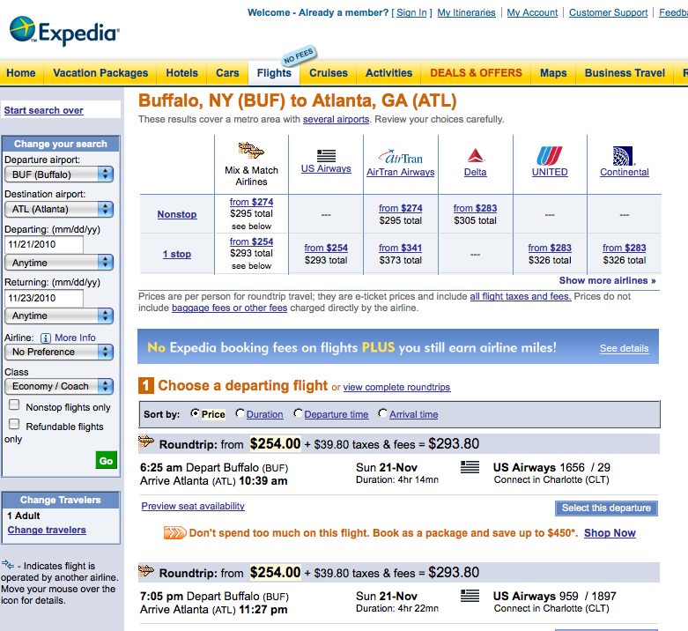
Why care about algorithms?
Booking cheapest air tickets

Slide 37
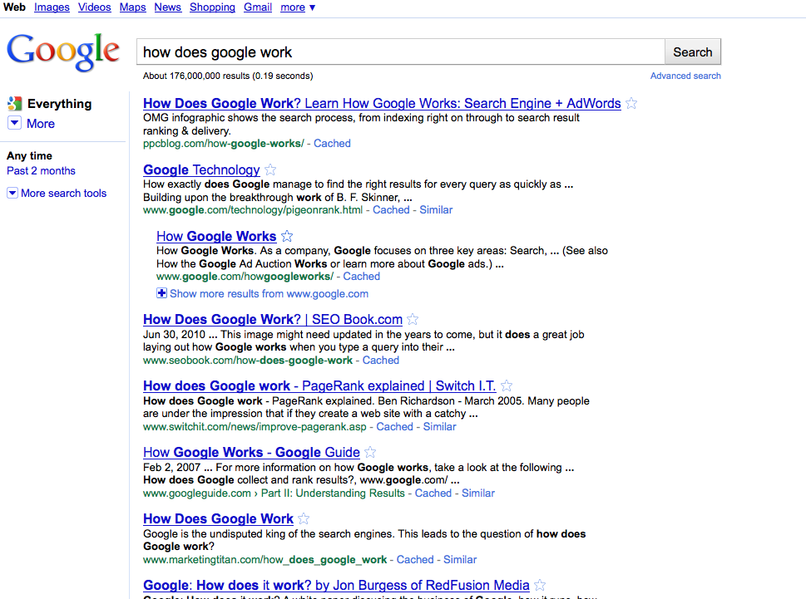
Why care about algorithms?
Google searches

Slide 38
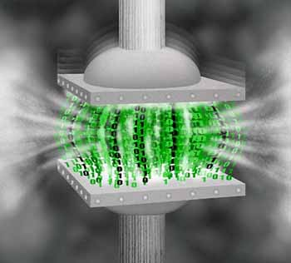
Why care about algorithms?
http://www.di.ens.fr/~cherniav/teaching.html
Data compression

Slide 39
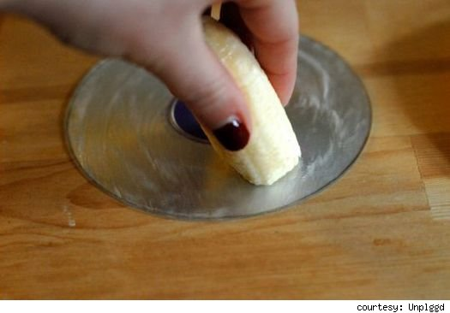
Why care about algorithms?
http://www.switched.com/2010/02/11/fix-dvd-scratches-using-a-banana-and-toothpaste/
Error correction

Slide 40
(And I could) go on…
http://www.movieposter.com/poster/MPW-33672/Titanic.html

Slide 41
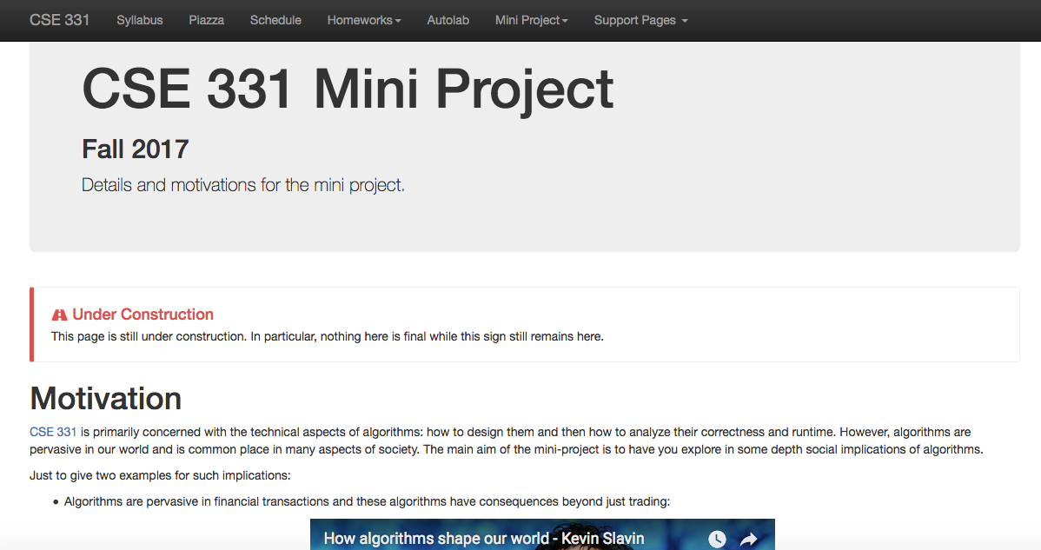
Find out for yourself
Mini project: Video on social impact of algorithm. Groups of size = 3

Slide 42
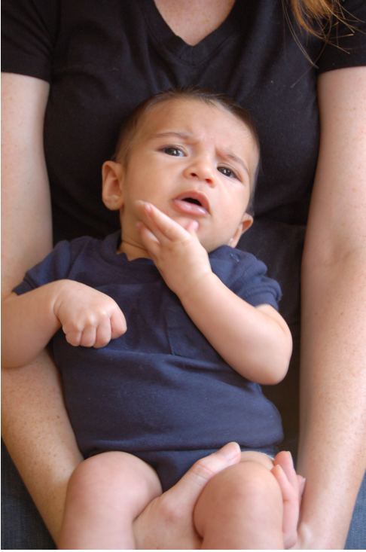
Questions/Comments?

Slide 43
Now about the course
IT’LL BE

Slide 44
We’ll do loads of
s
http://www.impawards.com/2005/proof.html
Writing down your thought process formally and precisely!

Slide 45
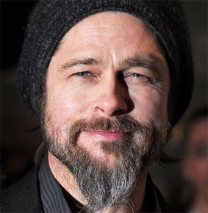
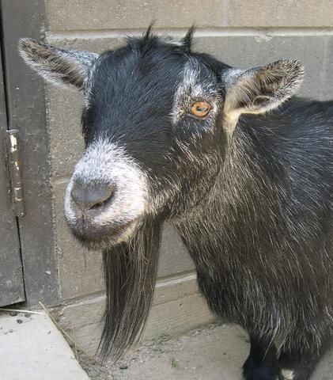
The language of proofs
Brad Pitt had a beard
waleg.com
Every goat has a beard
animaldiversity.org
Hence, Brad Pitt is a goat.

Slide 46
Why do proofs?
Makes you think logically about problems and solutions
From a friend who works on Google Maps:
Proving that the algorithm I am implementing is correct helps me
identify corner cases

Slide 47
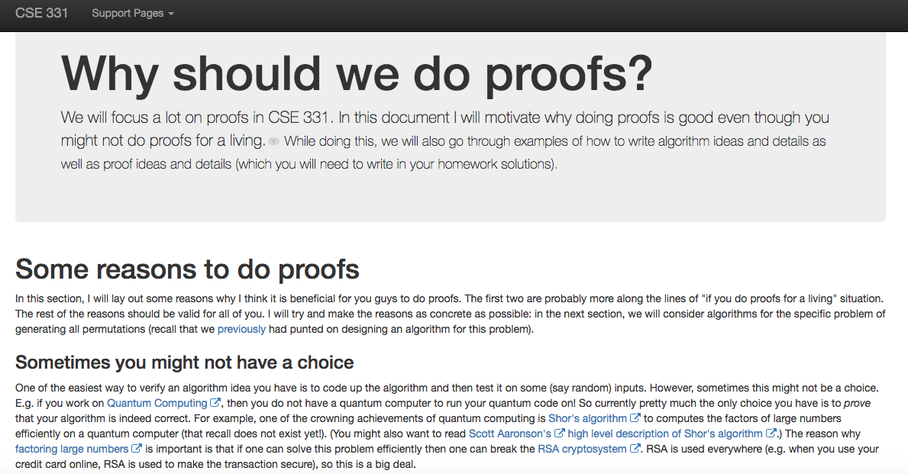
http://www-student.cse.buffalo.edu/~atri/cse331/support/proofs/index.html

Slide 48
A common complaint
Your examples in class look nothing
like HW questions.

Slide 49
True because….
zazzle.com

Slide 50
False because…
HWs and exams will test your
understanding of the material

Slide 51
To get an A in the class
Have to get at least 90.0000000000000000000000%
Rest graded on the curve

Slide 52
A cautionary tale…
When I was an undergrad
Took algorithms as a sophomore
Understood all the lectures
Did not study outside of lectures
(We had no homeworks)
Did decent on the mid-term
Nearly flunked the finals
Got a C

Slide 53
Questions/Comments?

Slide 54
How we will make 331
RIDING

Slide 55
What we’ll strive to do
Help you with your questions and/or doubts
If need be, email us for time outside of regular office hours

Slide 56
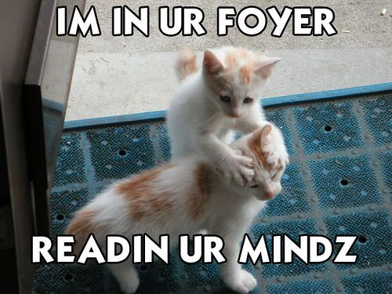
We’re not mind readers

Slide 57
If you need it, ask for help

Slide 58
More chances to recover
Lowest three HW scores will be dropped
If you do better on the final exam than the mid-term exam
then only final exam score will count

Slide 59
Follow the Textbook

Slide 60
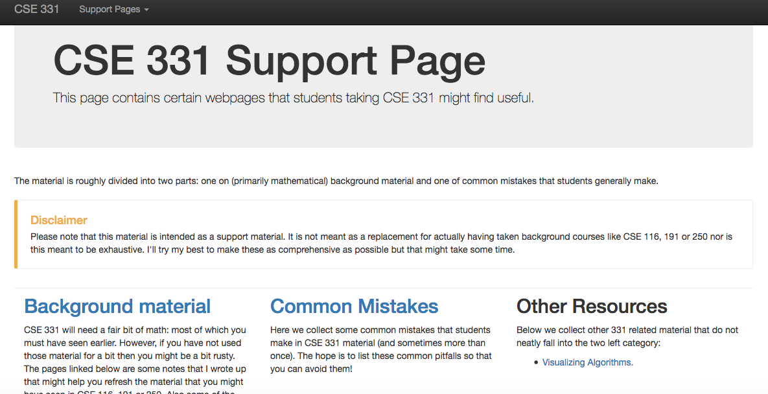
http://www-student.cse.buffalo.edu/~atri/cse331/support/index.html

Slide 61
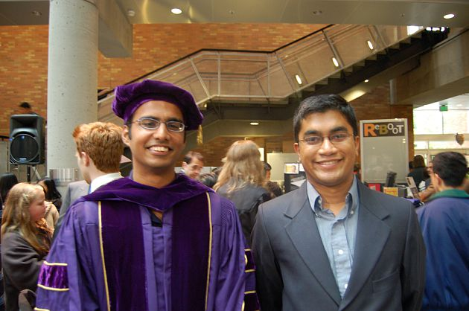
The cautionary tale has asilver lining…
Ph.D. in algorithms/complexity
C in undergrad algorithms

Slide 62
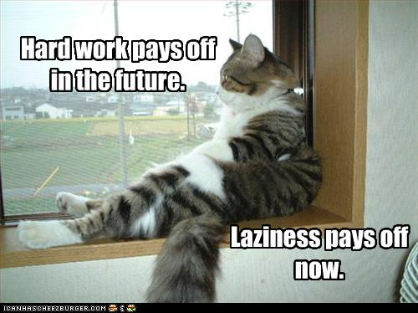
The only way to do well is to work hard

