Slide 1
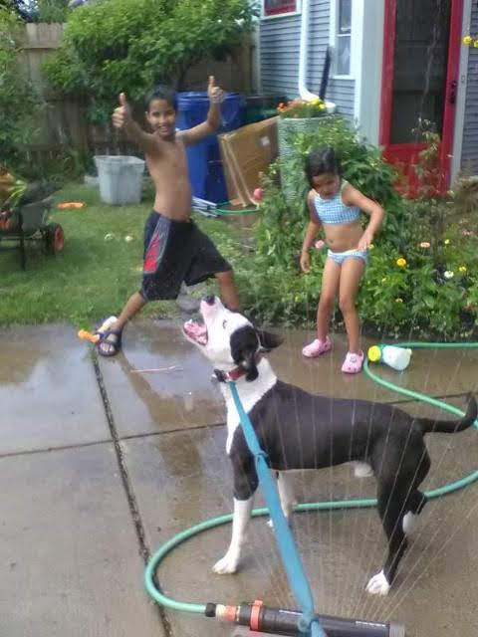
Welcome to HON 214
.. of Computing in Society

Slide 2
Introduction format
Name
Major
Your year
Where are you from?
Why are you in this course?

Slide 3
I’ll go first
Atri Rudra
Faculty member in CSE
This is my 12th year at UB
Buffalo
(I grew up in India)
Because I’m teaching the course

Slide 4
Akash
Kiran
Warren

Slide 5
Your turn
Name
Major
Your year
Where are you from?
Why are you in this course?

Slide 6
My office hours
Thursdays 2:00-3:20pm (Capen 106 C)
(These are open to ALL honors college students)

Slide 7
Three things to remember
ATTEND, WEEKLY REPORTS, MINI PROJECT!
DO NOT CHEAT!
READ CAREFULLY!

Slide 8
Academic Dishonesty
All your submissions must be your own work
Penalty:
F grade in course
YOUR responsibility to know what is cheating, plagiarism etc.
If not sure, come talk to me
Excuses like “I have a job,” “This was OK earlier/in my country,” “This course is hard,” etc. WON’T WORK
I DO NOT HAVE ANY PATIENCE WITH ANY CHEATING :
YOU WILL GET AN F GRADE IN THE COURSE
FOR YOUR FIRST MISTAKE

Slide 9
Accessibility Resources
Information included in the syllabus
In short, let me know and consult with Accessibility Resources

Slide 10
Preferred Name
If you prefer using name diff from UB records
Let me know and we’ll make a note of it.

Slide 11
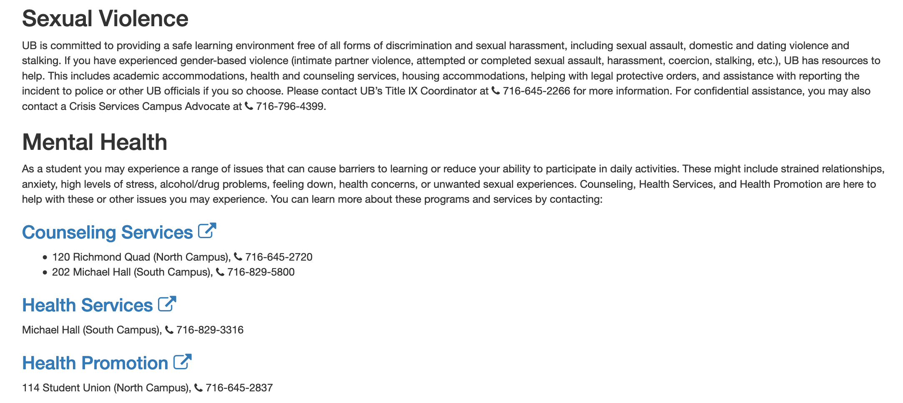
Critical Campus Resources

Slide 12
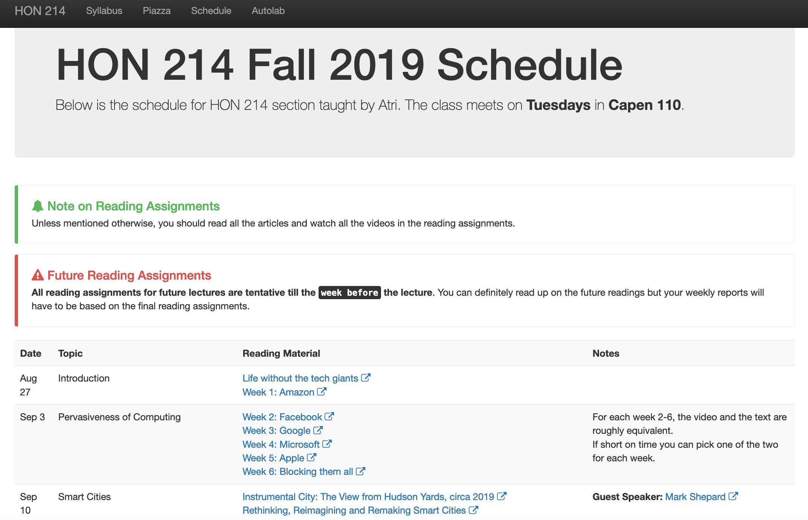
One Stop-shop for the course
http://www-student.cse.buffalo.edu/~atri/hon214/fall19/

Slide 13
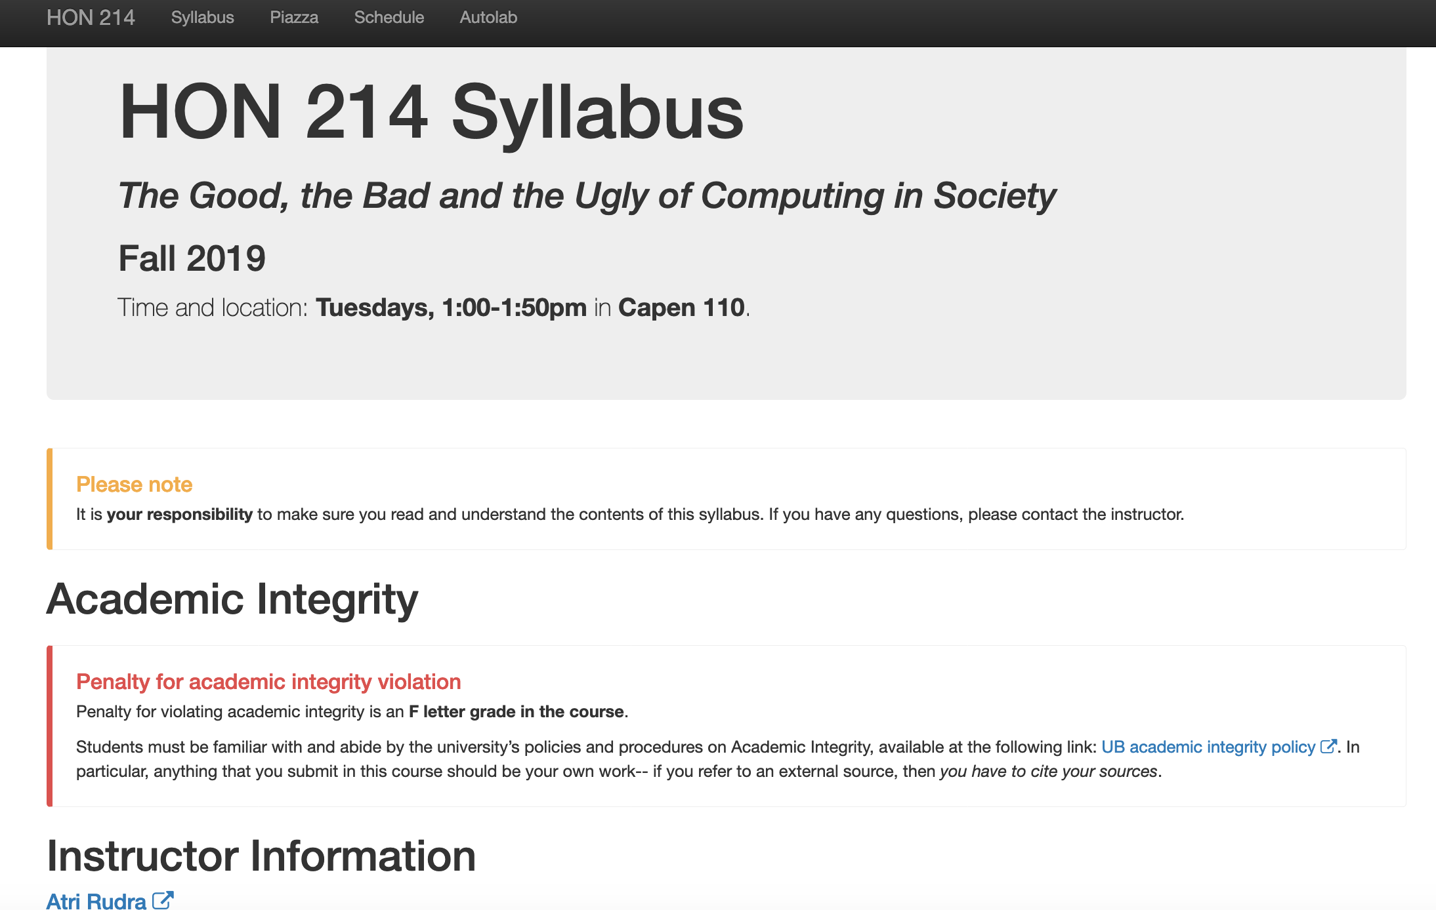
Read the syllabus carefully!

Slide 14
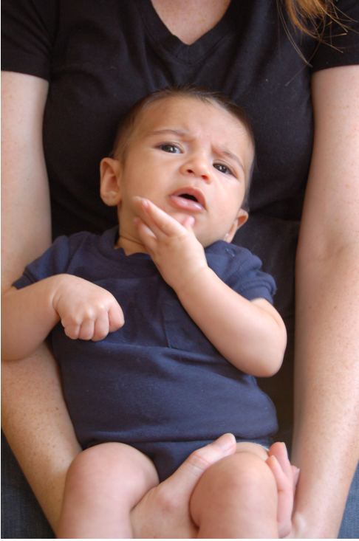
Questions/Comments?

Slide 15
Grading Policy

Slide 16
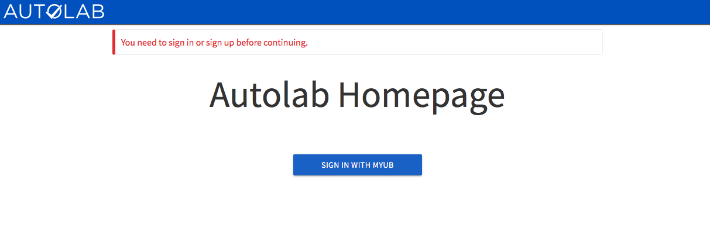
Attendance on Autolab
https://autograder.cse.buffalo.edu/

Slide 17
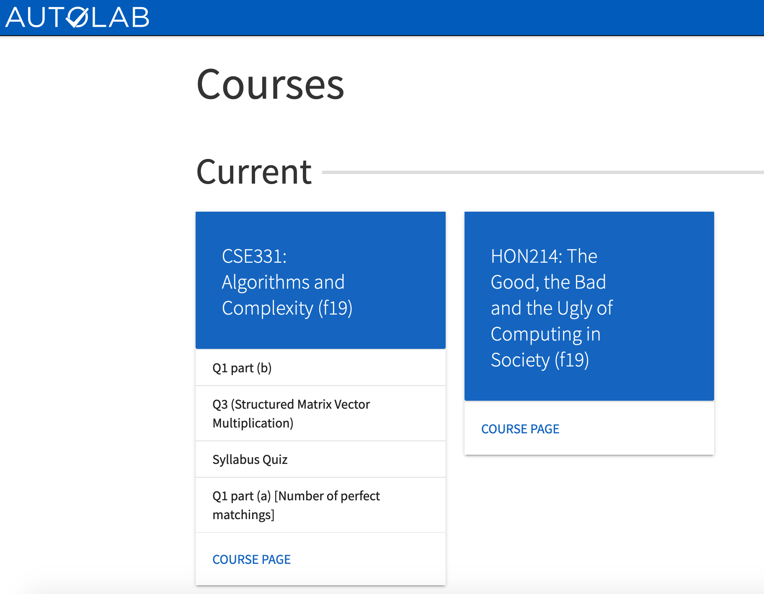
This is what you should see when you login

Slide 18
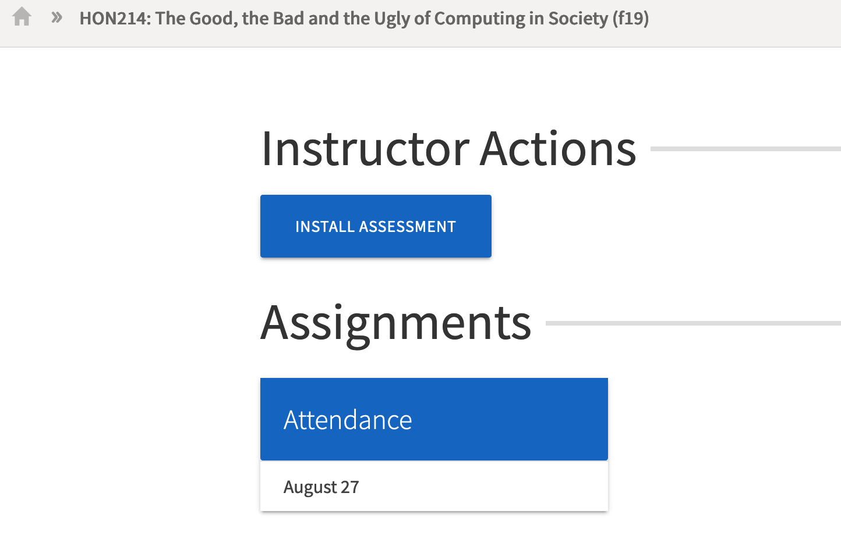
You should see a link for attendance

Slide 19
You need to enter a pass-phrase

Slide 20
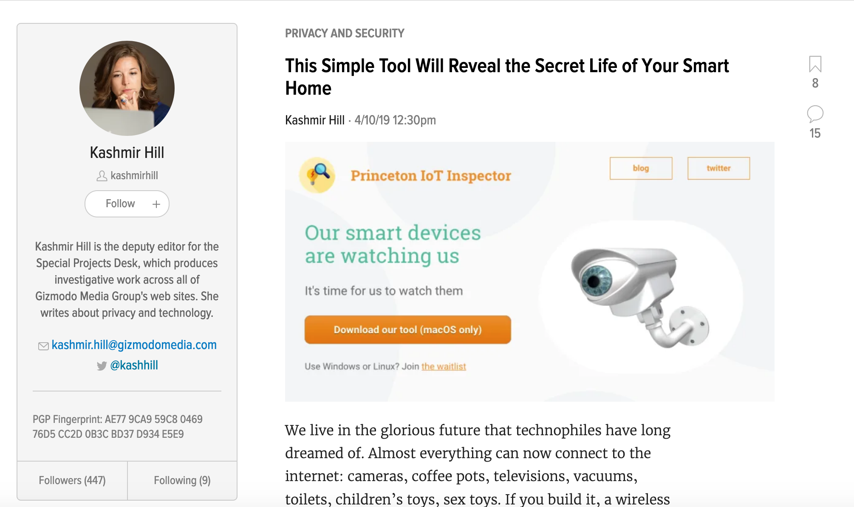
Pass-phrase for today: Kashmir Hill

Slide 21
Questions/Comments?

Slide 22
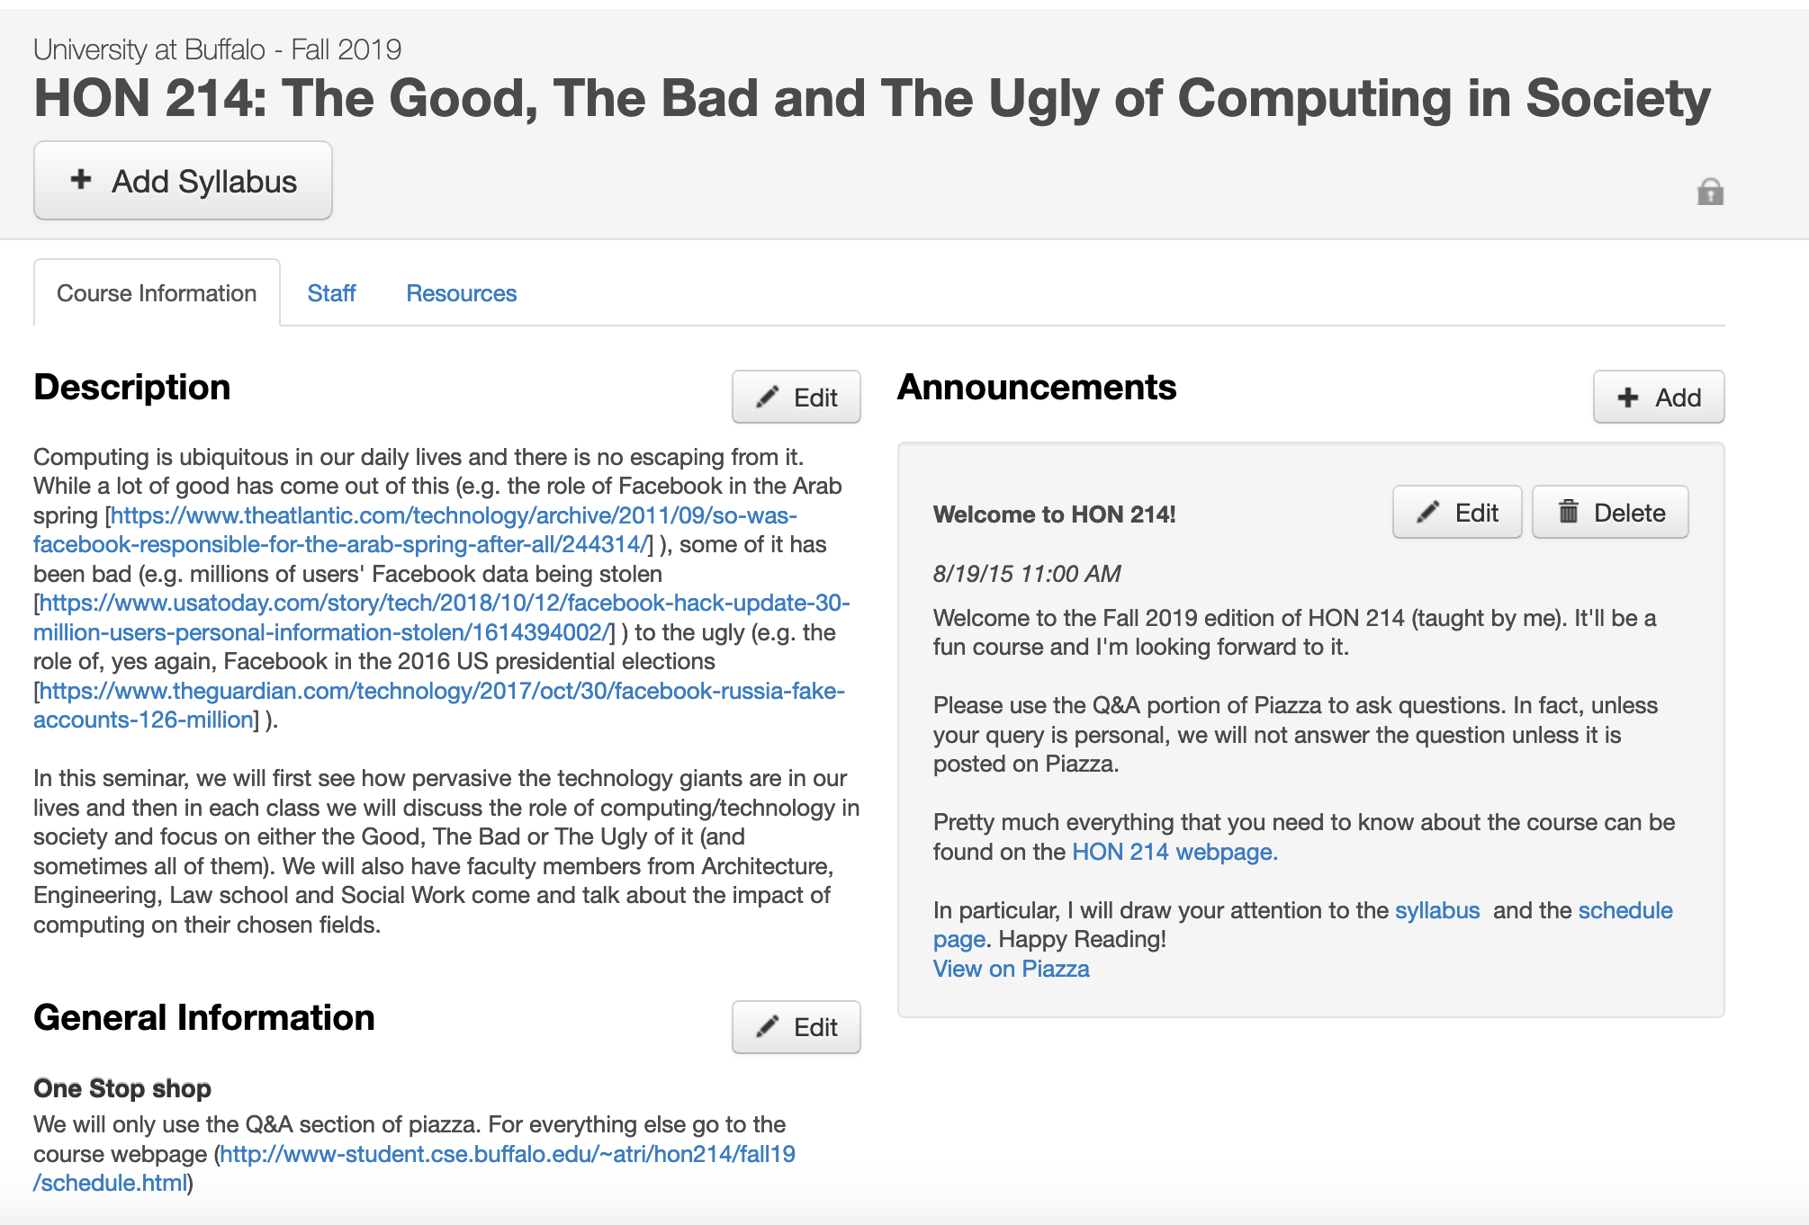
Make sure you are on piazza
https://piazza.com/buffalo/fall2019/hon214

Slide 23
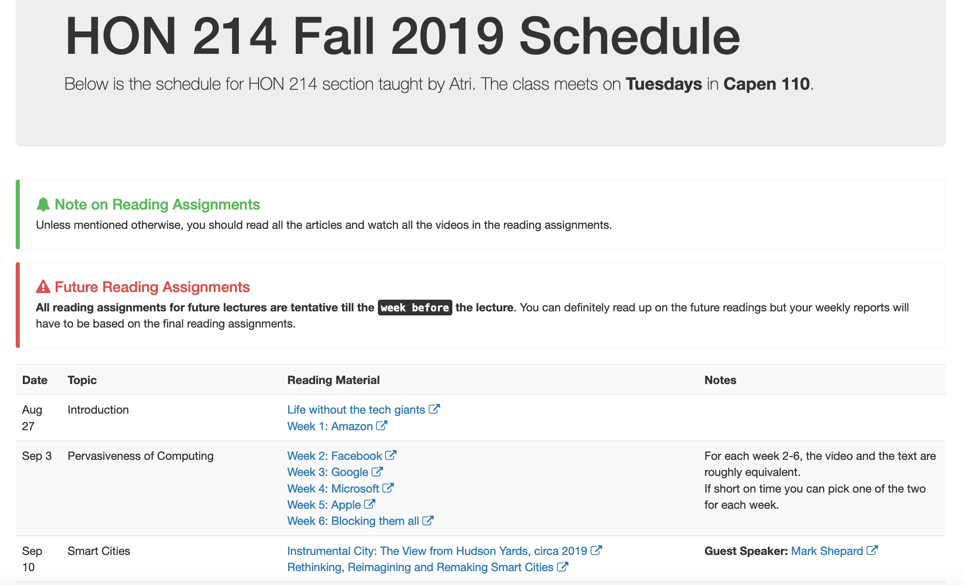
Reading Assignments on schedule page

Slide 24
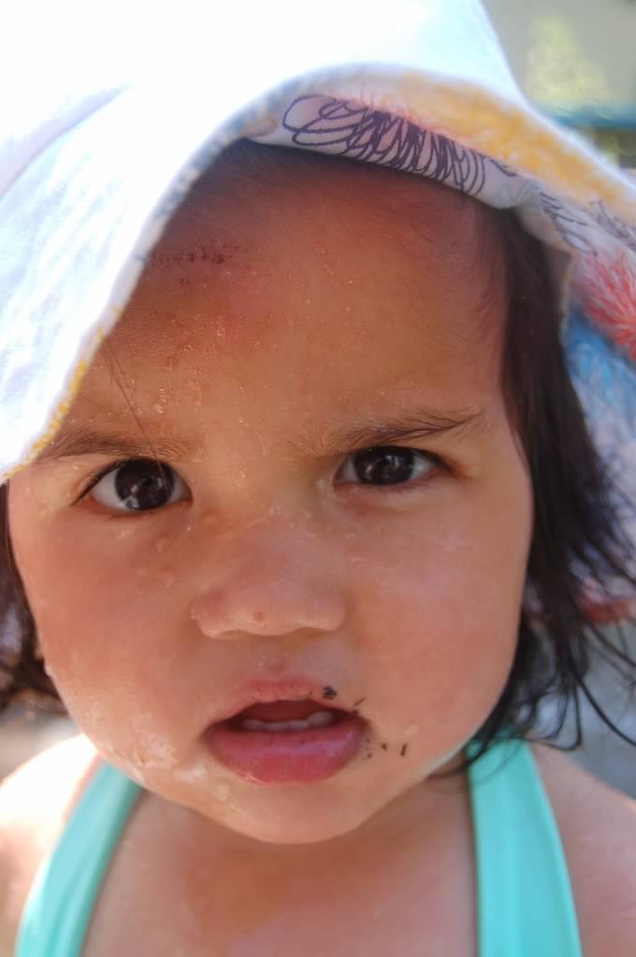
Why this seminar?

Slide 26
Structure of class
Before class: Submit your weekly report on reading material for the lecture
Due by 5PM ON MONDAY BEFORE LECTURE
In the class
First ~30 mins: presentation/ video watching
Remaining ~20 mins: Discussion on the topic

Slide 27
Discussions could get heated
Disagree with what someone SAID NOT who you think they ARE

Slide 28
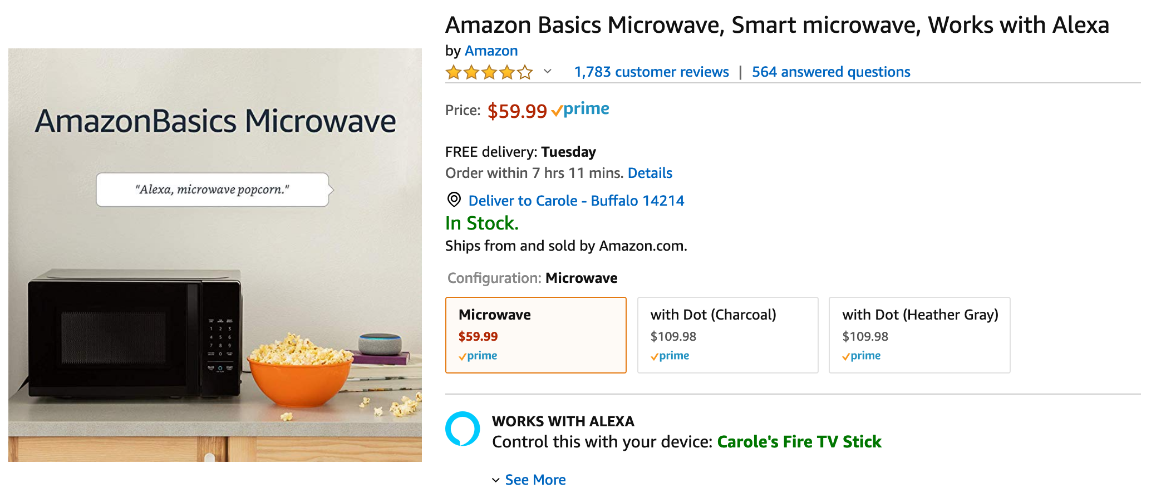
Same principle replace “race” by other topic

Slide 29
When you disagree with someone
First, pause to see if you understand WHAT they are saying
Then, try to understand WHY they are saying it
ALWAYS ask for clarifications to make sure you are not missing something

Slide 30
Questions/Comments?

Slide 31
Today’s video

Slide 32
Reading for next week

