Slide 1
HON 214
September 24, 2019

Slide 2
Weekly report for today graded

Slide 3
Cold Calling

Slide 4
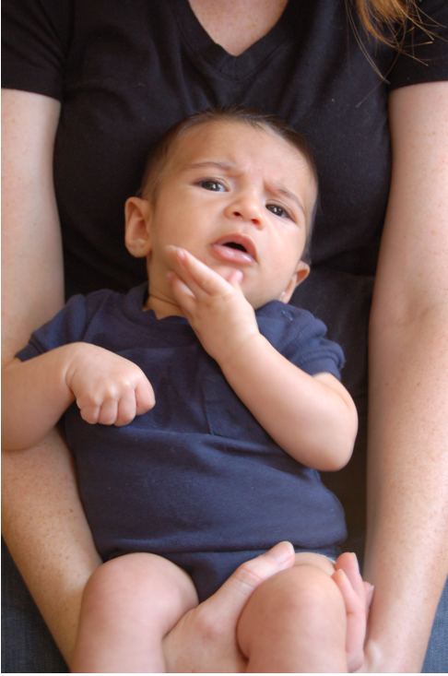
Questions/Comments?

Slide 5
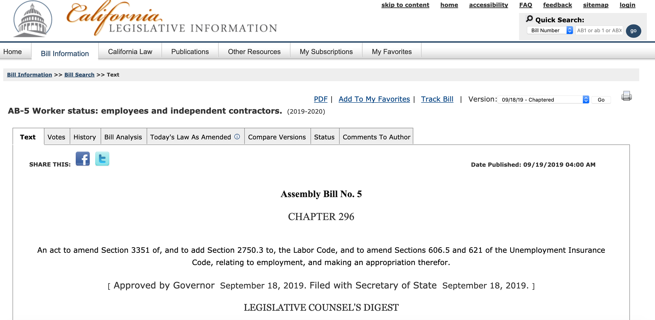
Today’s agenda
Had you read a bill before?

Slide 6
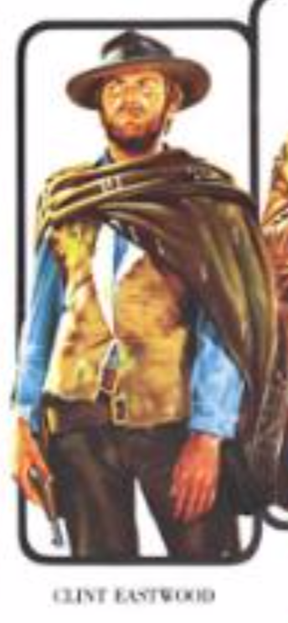
Things to keep in mind
Any technical questions for me?
Anything that surprised you?
What is the good here?
What is the bad here?
What is the ugly here?

Slide 7
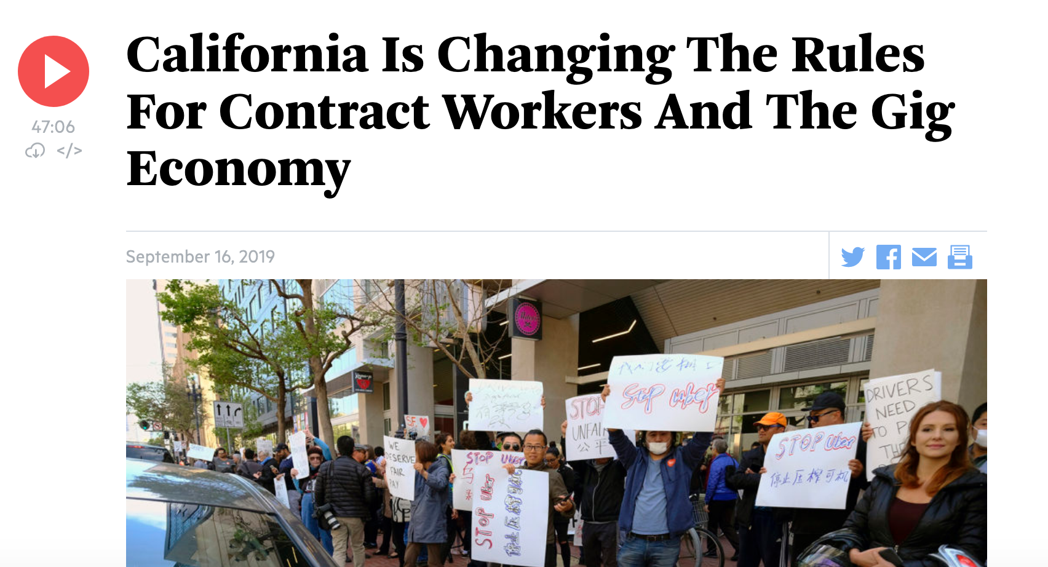
https://www.wbur.org/onpoint/2019/09/16/california-labor-ab5-gig-economy-contract-workers

Slide 8
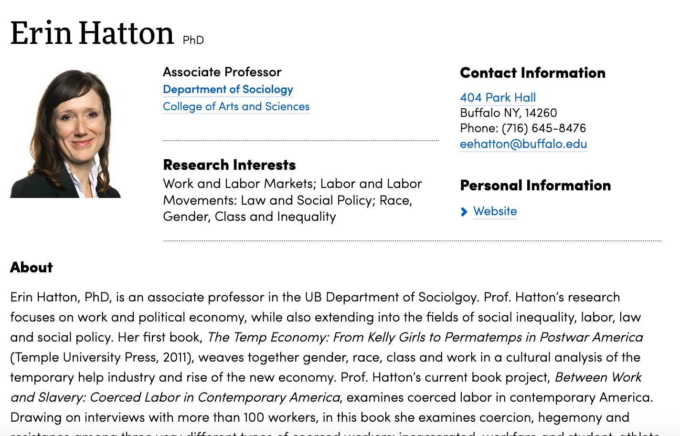
Pass-phrase for today: Erin Hatton

Slide 9
Discuss
Any technical questions for me?
Anything that surprised you?
What is the good here?
What is the bad here?
What is the ugly here?

Slide 10
Reading for next week

