Slide 1
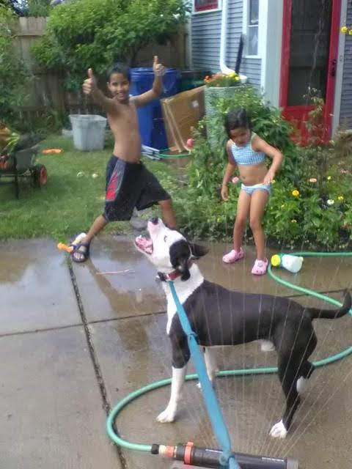
Welcome to
CSE 440/441/540
ML and Society

Slide 2
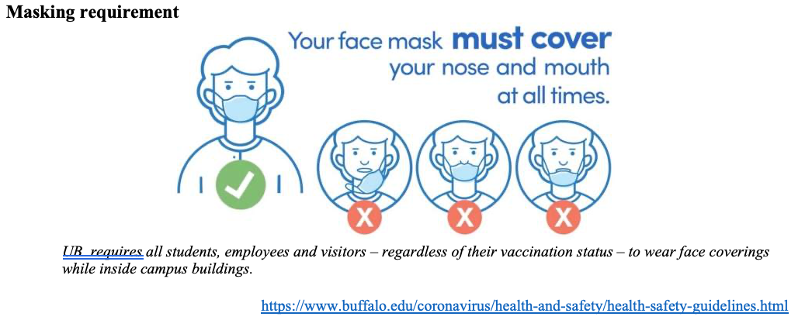
Please have a face mask on

Slide 3
Introduction format
Preferred Name
One very boring thing about you
Why did you pick this class? Be honest!
What do you know about ML? Be honest!
What do you hope to learn in this course?

Slide 4
I’ll go first
Atri
This is my 15th year at UB
Because I’m teaching the course
Actually not much (I can fake it though!)
Hope to get fresh perspectives from y’all!

Slide 5
Akash
Kiran
Warren

Slide 6
Your turn
Preferred Name
One very boring thing about you
Why did you pick this class? Be honest!
What do you know about ML? Be honest!
What do you hope to learn in this course?

Slide 7
My office hours
Tuesdays: 2-2:50pm (in-person)
(There’ll be OH today)

Slide 8
Things to remember
ATTEND, SUBMIT ALL THINGS ON TIME!
DO NOT CHEAT!
READ CAREFULLY!
Take care of yourself!
Be respectful of your classmates!

Slide 9
Academic Dishonesty
All your submissions must be your own work
Penalty:
Minimum: An grade reduction in course
Possible: F (or higher penalty) if warranted
YOUR responsibility to know what is cheating, plagiarism etc.
If not sure, come talk to me
Excuses like “I have a job,” “This was OK earlier/in my country,” “This course is hard,” etc. WON’T WORK
I DO NOT HAVE ANY PATIENCE WITH ANY CHEATING :
YOU WILL GET A GRADE REDUCTION IN THE COURSE
FOR YOUR FIRST MISTAKE

Slide 10
Accessibility Resources
Information included in the syllabus
In short, let me know and consult with Accessibility Resources

Slide 11
Preferred Name
If you prefer using name diff from UB records
Let me know and we’ll make a note of it.

Slide 12
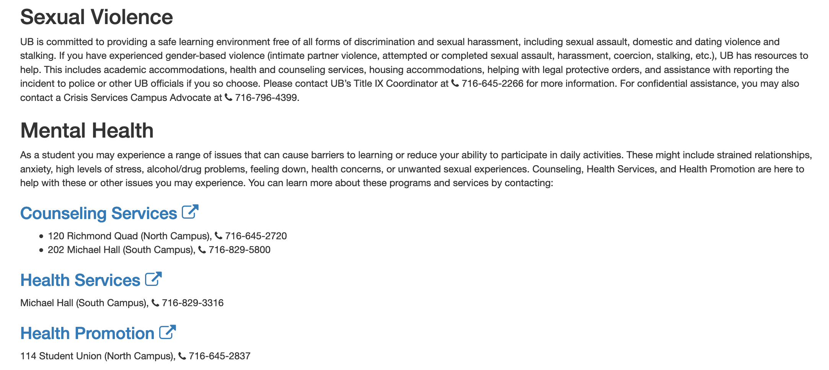
Critical Campus Resources

Slide 13
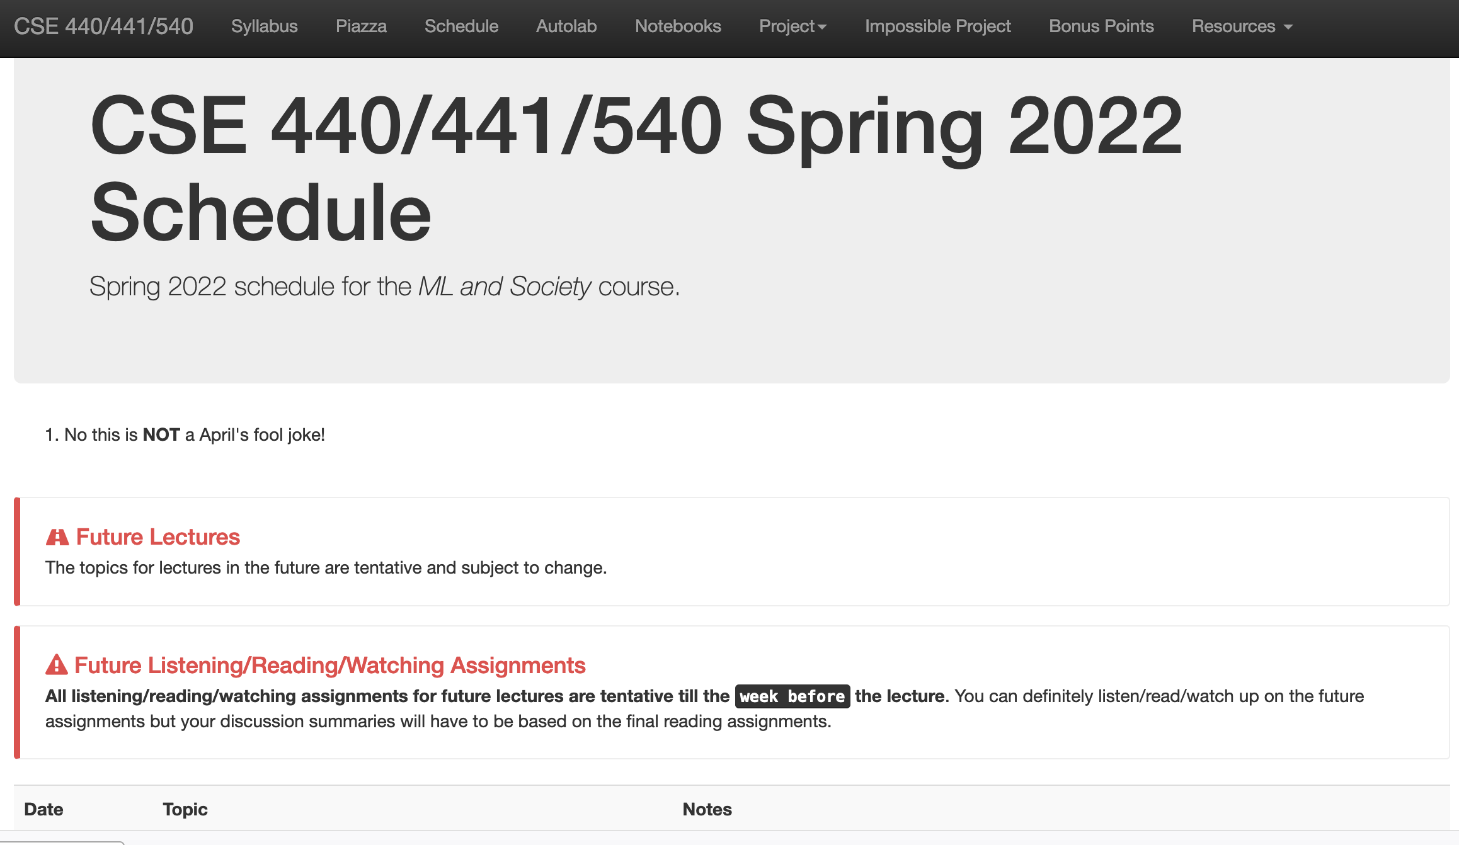
One Stop-shop for the course
http://www-student.cse.buffalo.edu/~atri/ml-and-soc/spr22/index.html

Slide 14
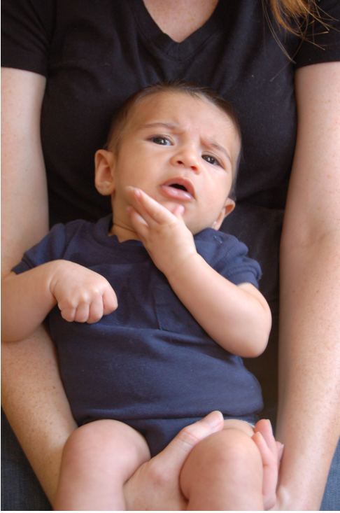
Questions/Comments?

Slide 15
More course logistics in 2nd half of today

Slide 16
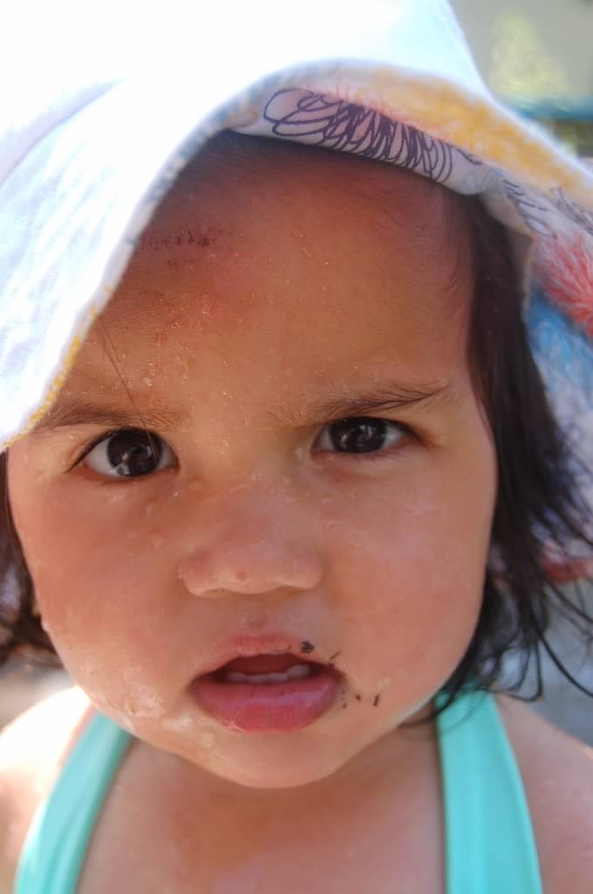
Why this course?

Slide 17
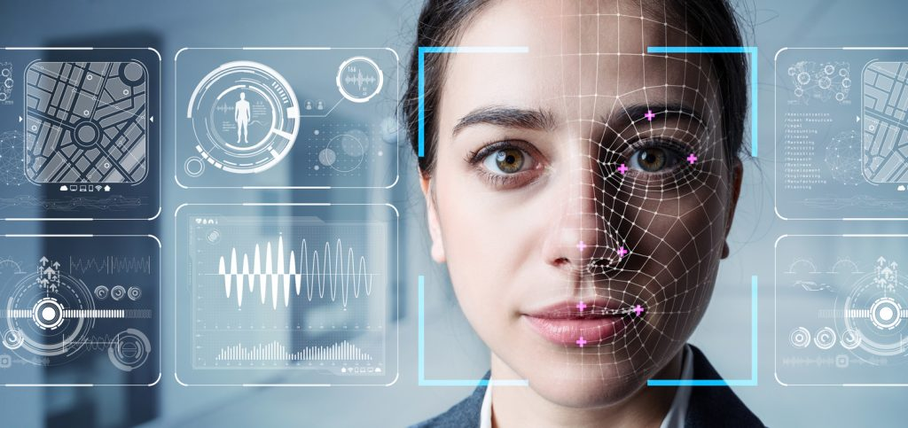
Slide by Kenny Joseph

Slide 19
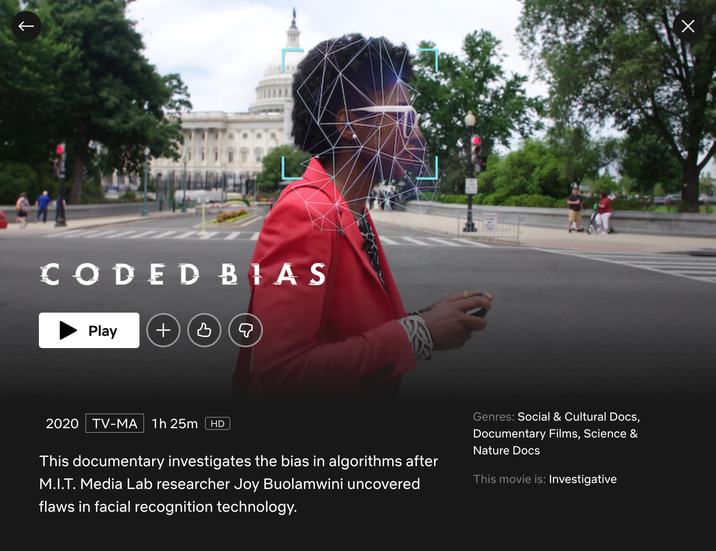

Slide 20
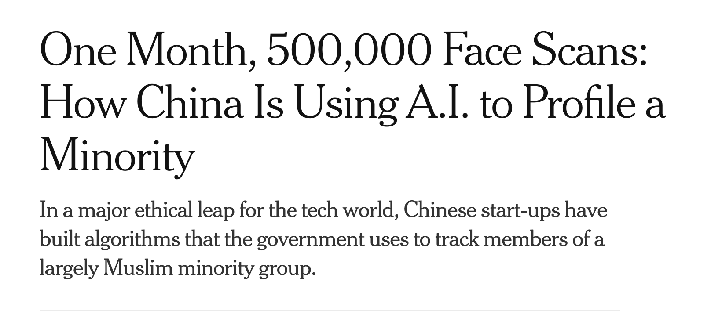
Slide by Kenny Joseph

Slide 21
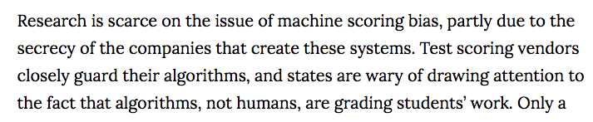
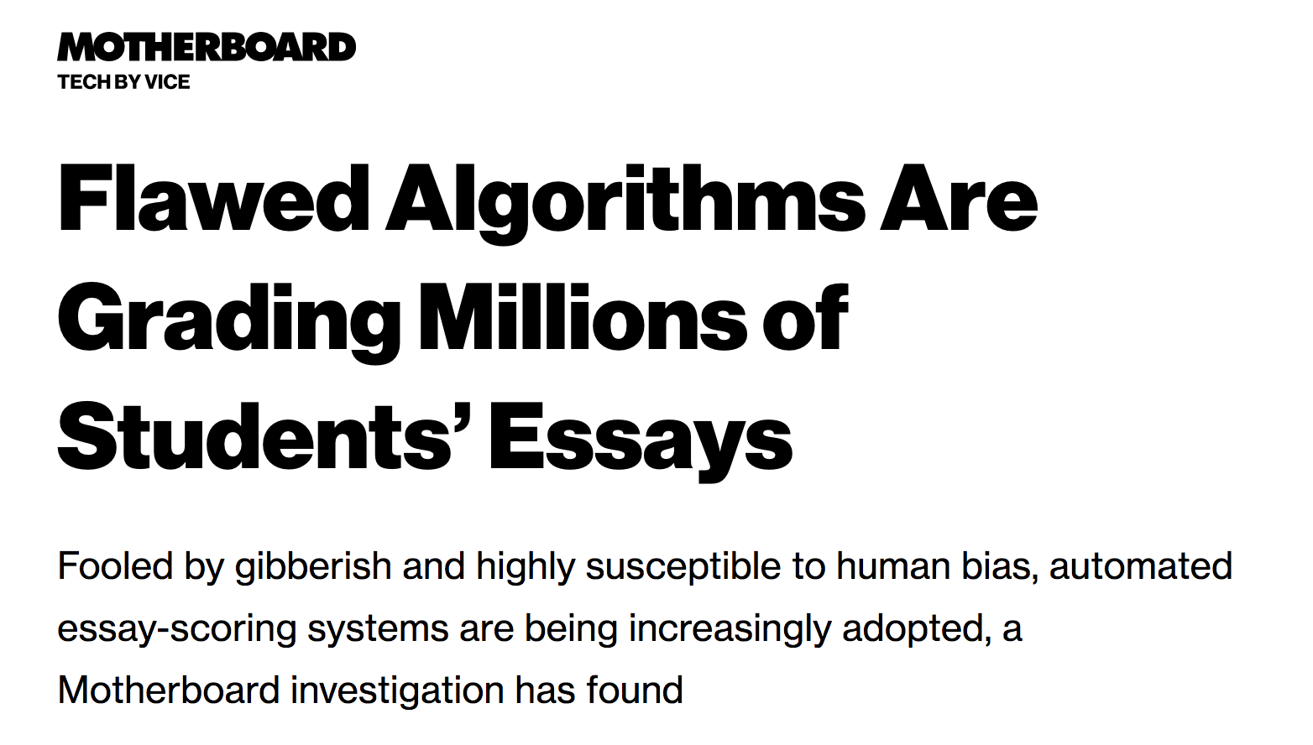
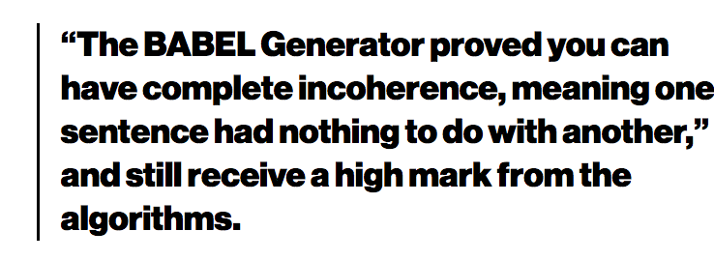
Slide by Kenny Joseph

Slide 22
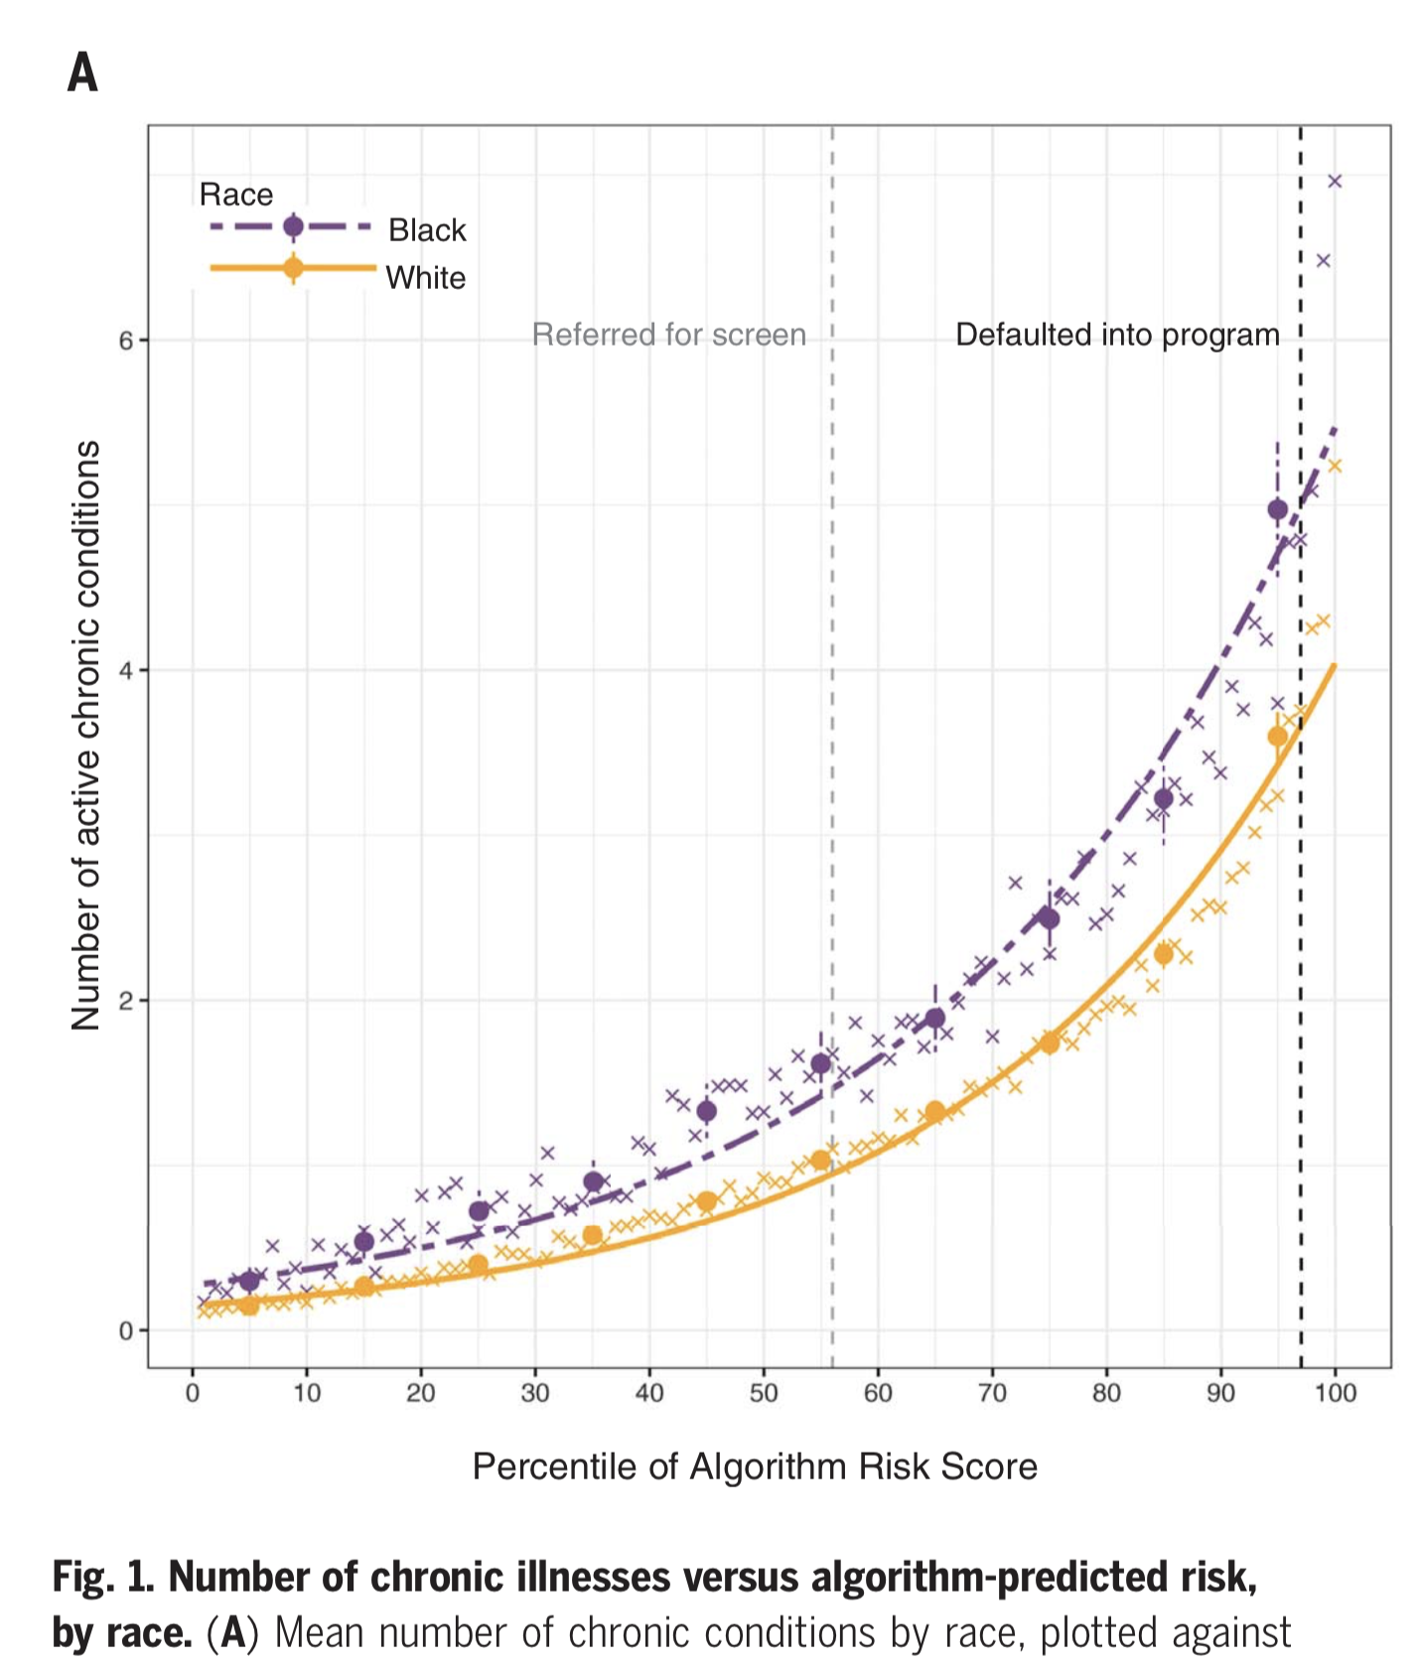
Slide by Kenny Joseph
Obermeyer, Z., Powers, B., Vogeli, C., & Mullainathan, S. (2019). Dissecting racial bias in an algorithm used to manage the health of populations. Science, 366(6464), 447–453. https://doi.org/10.1126/science.aax2342

Slide 23
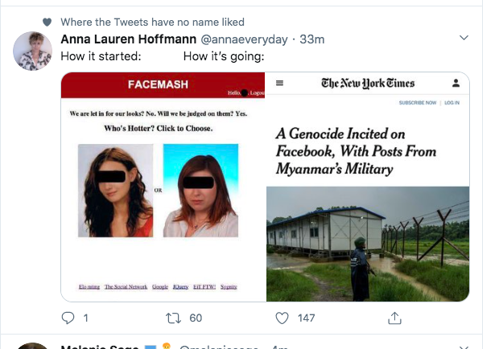
Slide by Kenny Joseph

Slide 24
What’s going on? Let’s dive in!

Slide 25
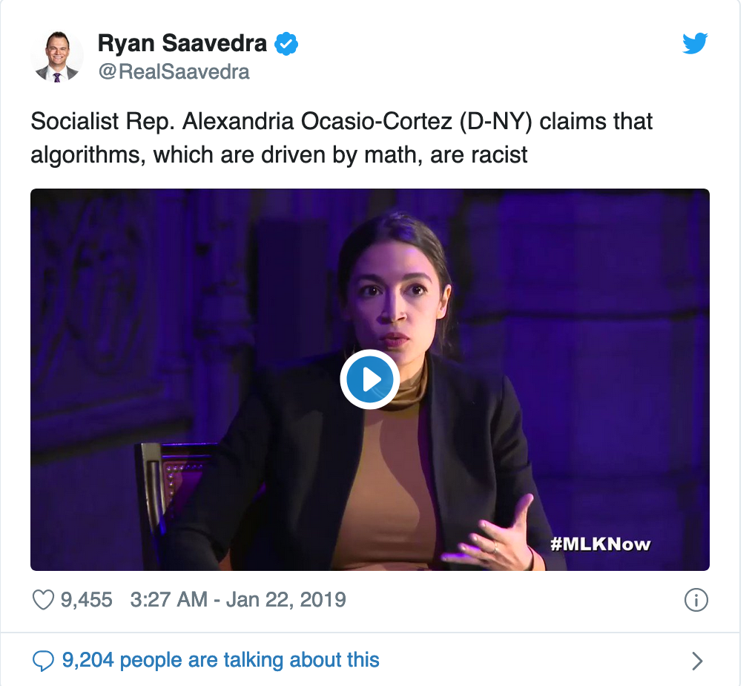
There was immediate push-back

Slide 26
Before we go into who is right…
Disagree with what someone SAID NOT who you think they ARE

Slide 27
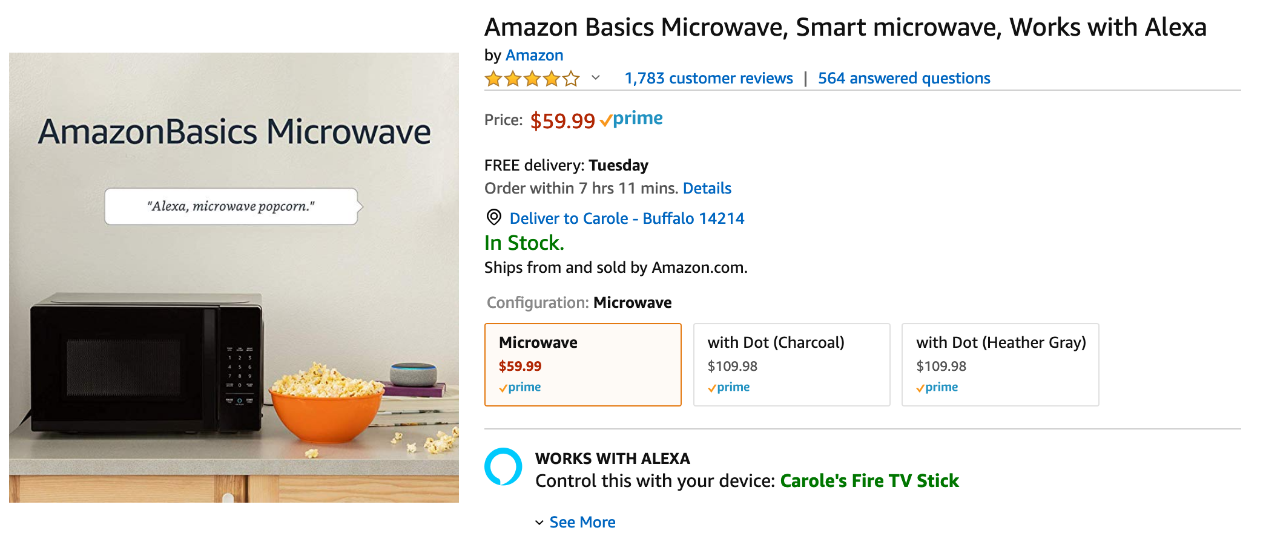
Same principle replace “race” by other topic

Slide 28
When you disagree with someone
First, pause to see if you understand WHAT they are saying
Then, try to understand WHY they are saying it
ALWAYS ask for clarifications to make sure you are not missing something

Slide 29
Questions/Comments?

Slide 30
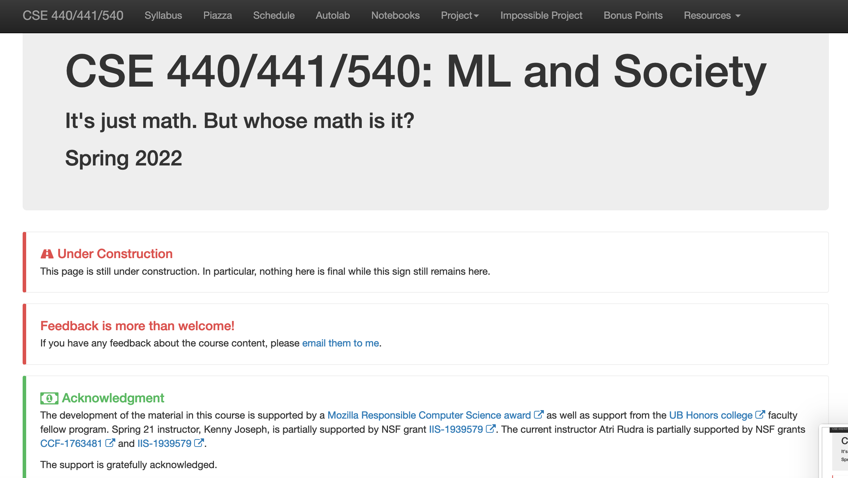
One Stop-shop for the course
http://www-student.cse.buffalo.edu/~atri/ml-and-soc/spr22/index.html

Slide 31
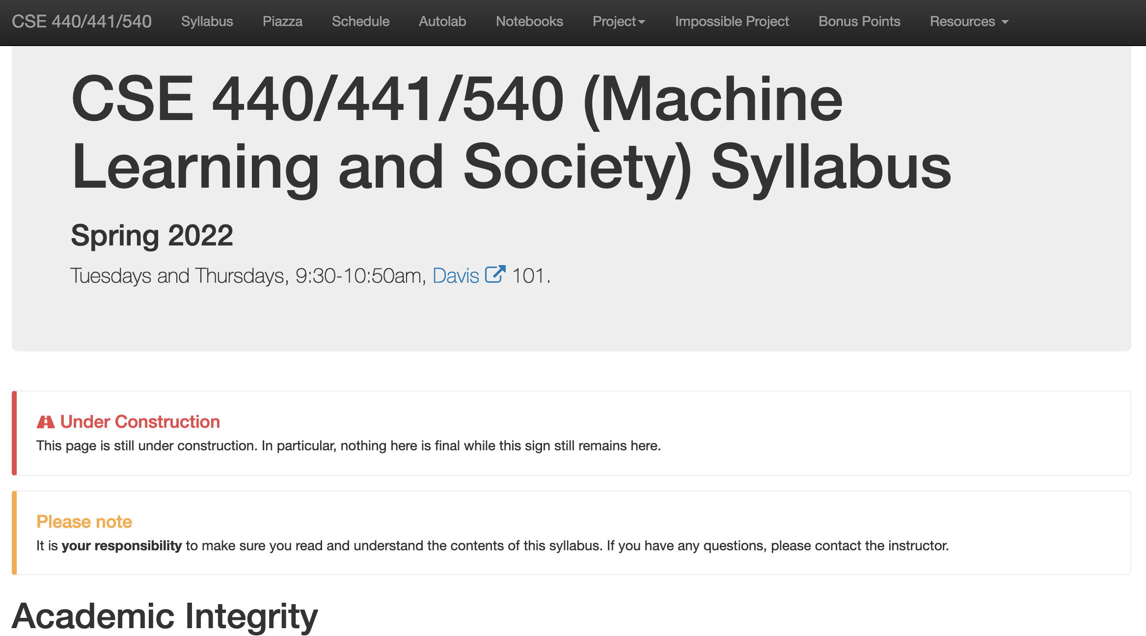
Read the syllabus carefully!

Slide 32
Questions/Comments?

Slide 33
Grading Policy

Slide 34
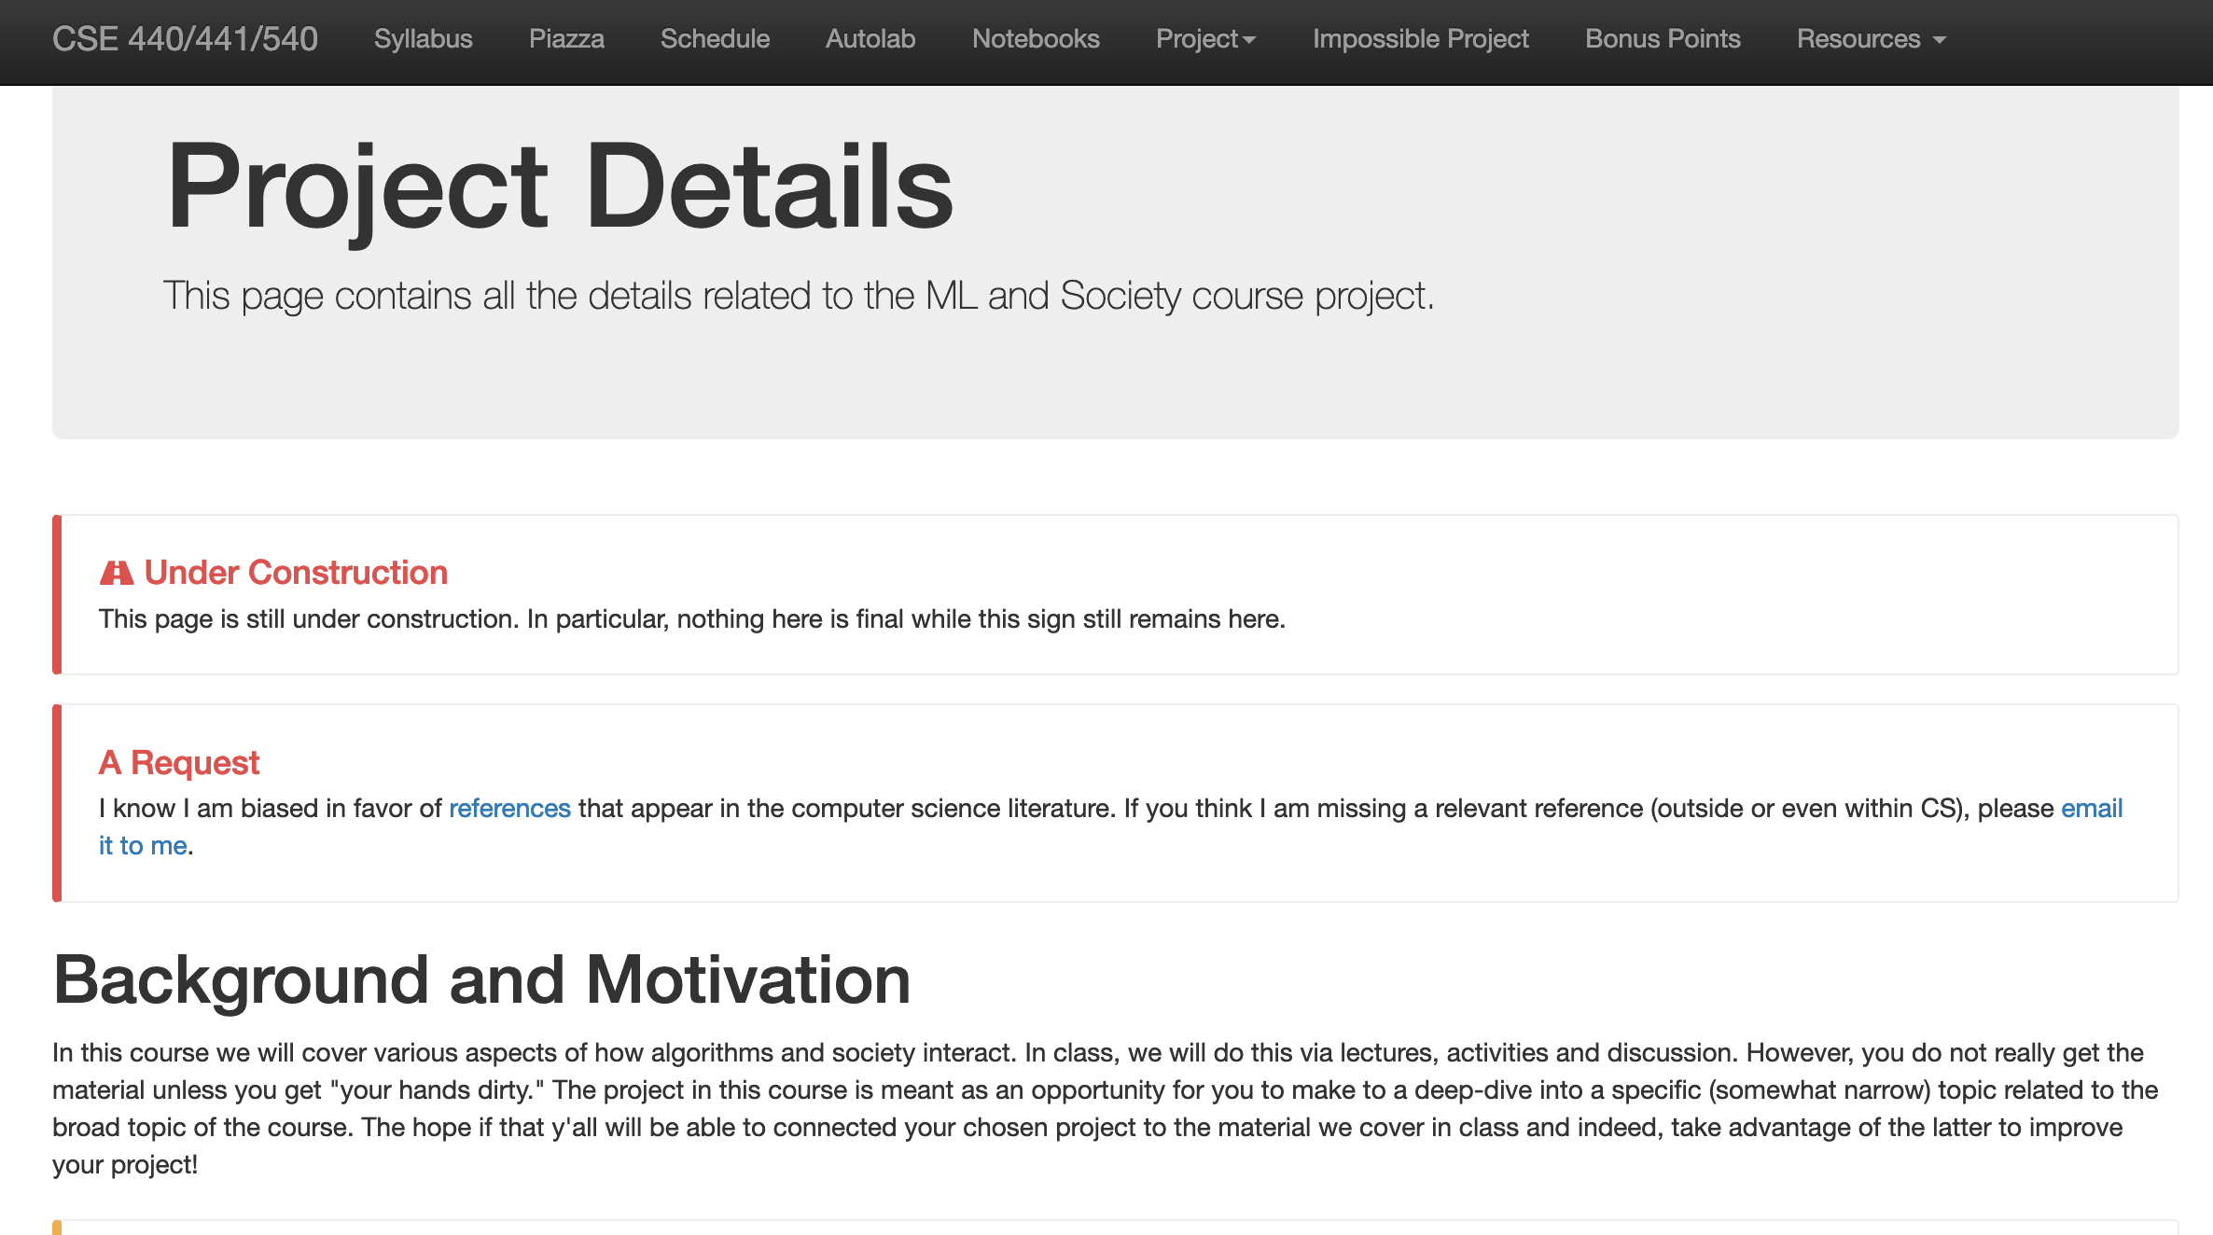
Project
Different expectation from CSE majors vs non-majors

Slide 35
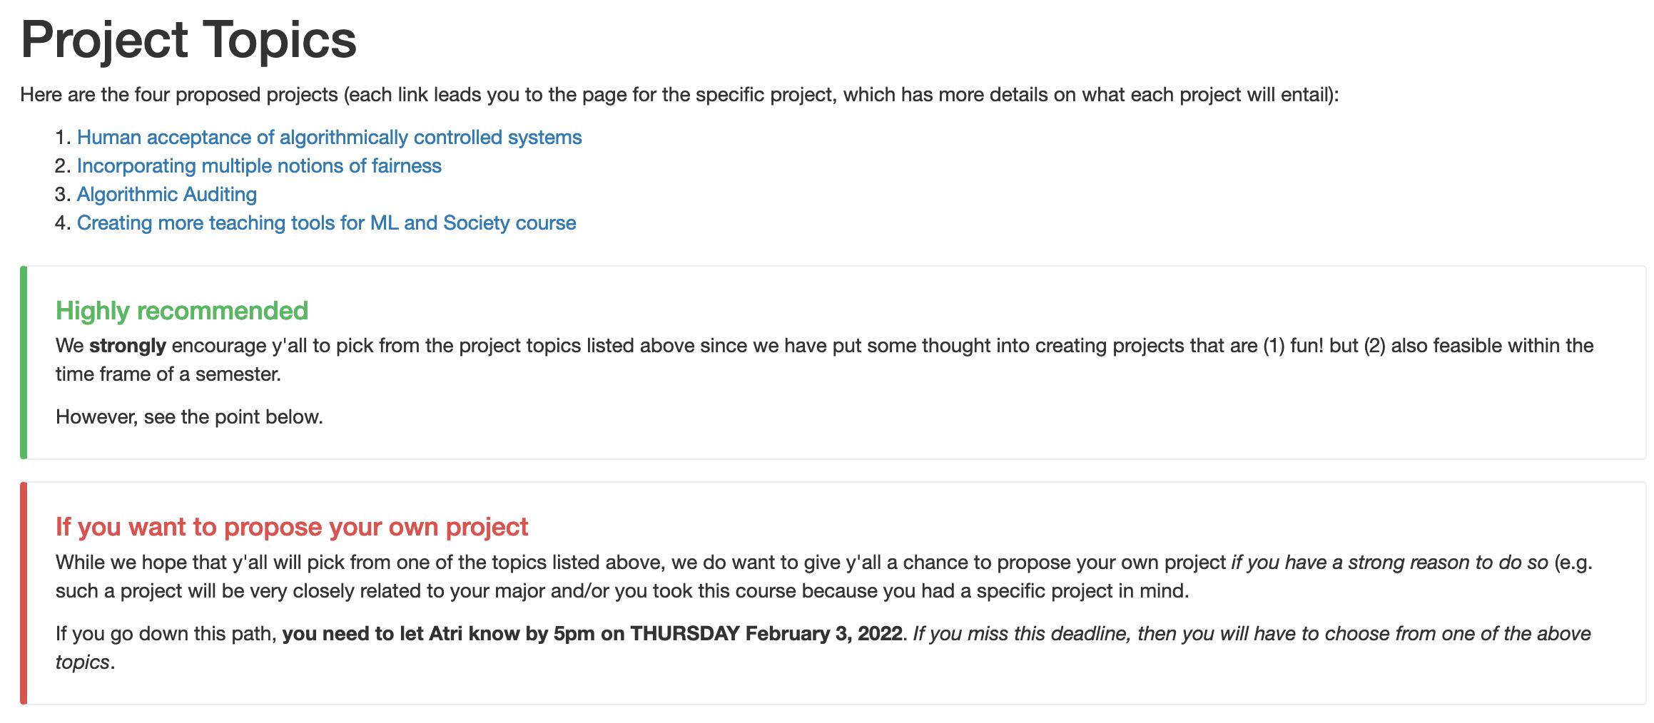
One (potential) project deadline THIS Th

Slide 36
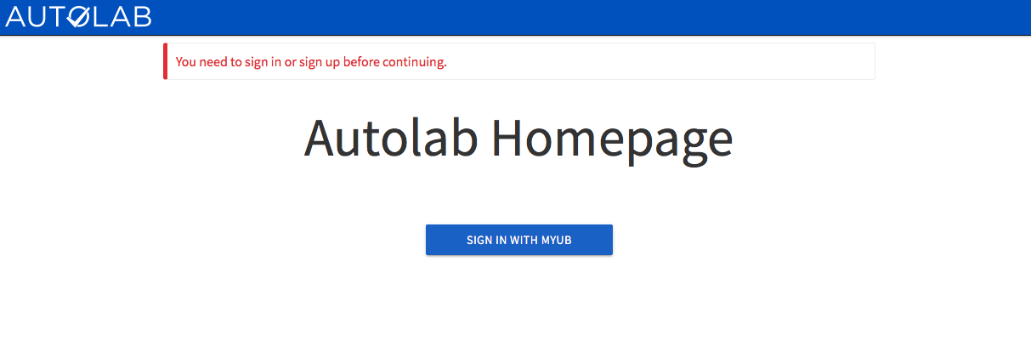
Attendance on Autolab
https://autograder.cse.buffalo.edu/

Slide 37
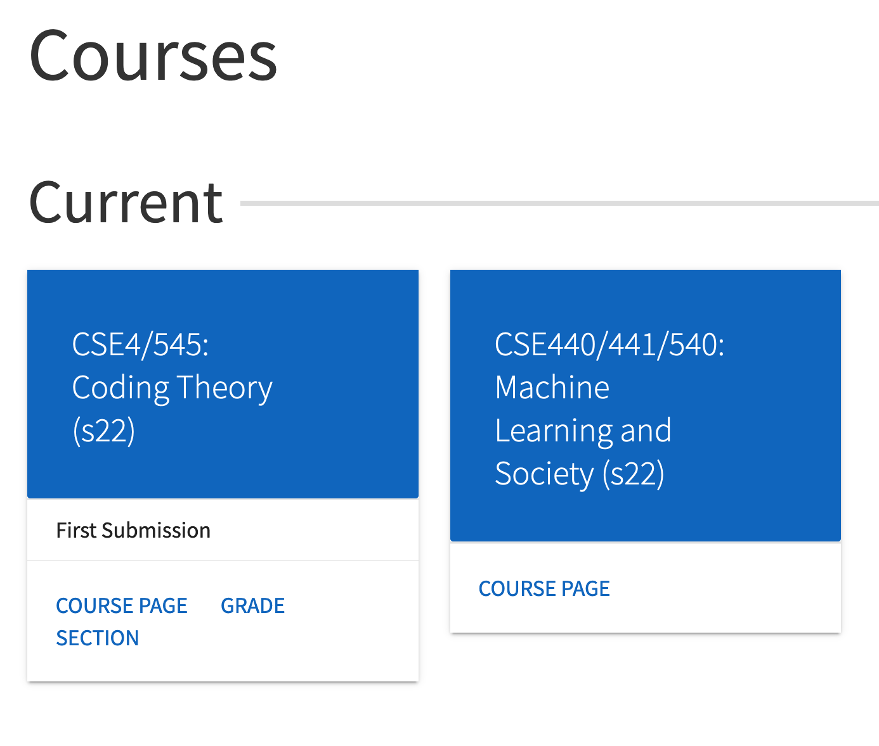
This is what you should see when you login

Slide 38
You should see a link for attendance

Slide 39
You need to enter a pass-phrase

Slide 40
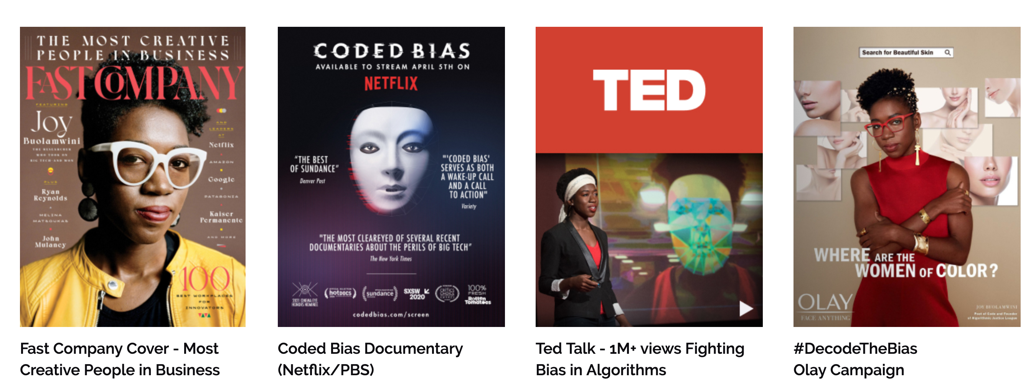
Pass-phrase for today: Joy Buolamwini

Slide 41
Time for a break!

Slide 42
Who does my machine learning model serve?
How do I know?
What can I do about it?
Slide by Kenny Joseph

Slide 43
The CSE 199 Ideal – Get folks to understand…
Computing for, in, and ideally, with and by society
Slide by Kenny Joseph

Slide 44
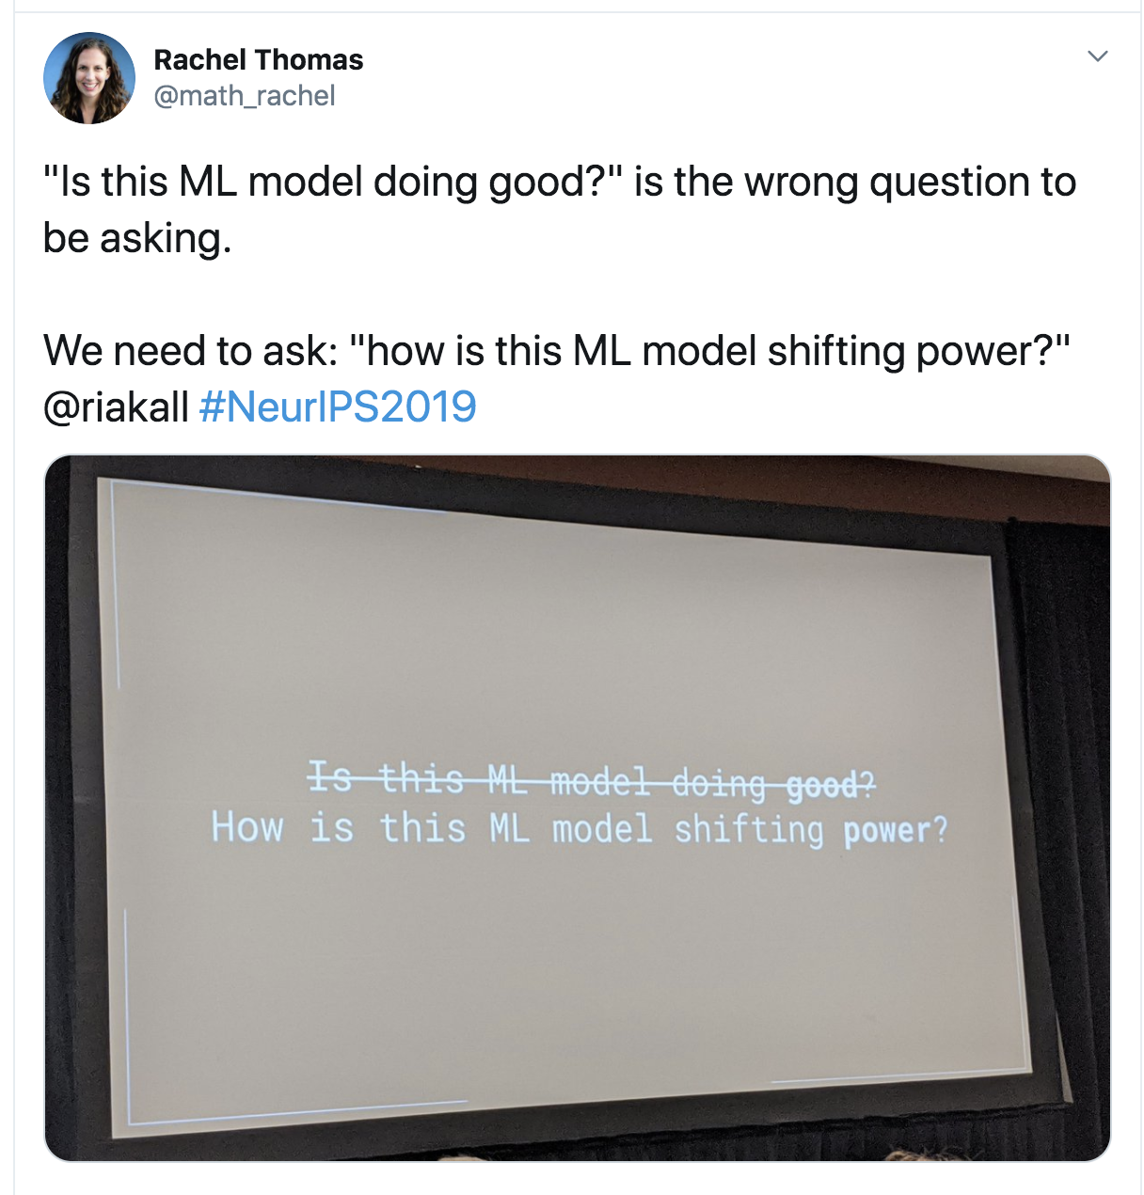
We’re past CSE 199 now
It will not be sufficient in this course to understand that “ML is biased” or that it can be “used for good”
We will focus on why ML is biased, what “social good” means, and how to really build technology for, in, and with/by society
Slide by Kenny Joseph

Slide 45
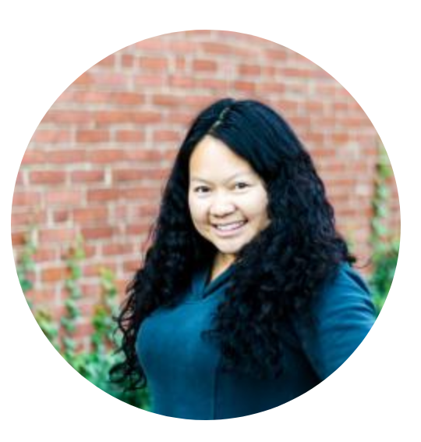
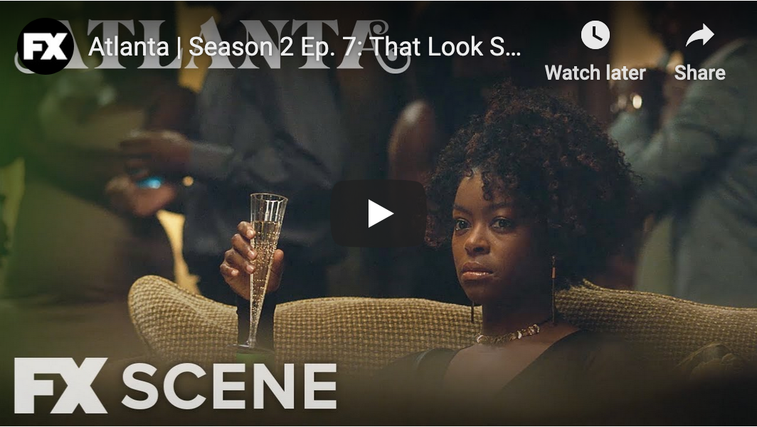
Back to Algorithms and Bias….
Thanks to..
Jenny Korn

Slide 46
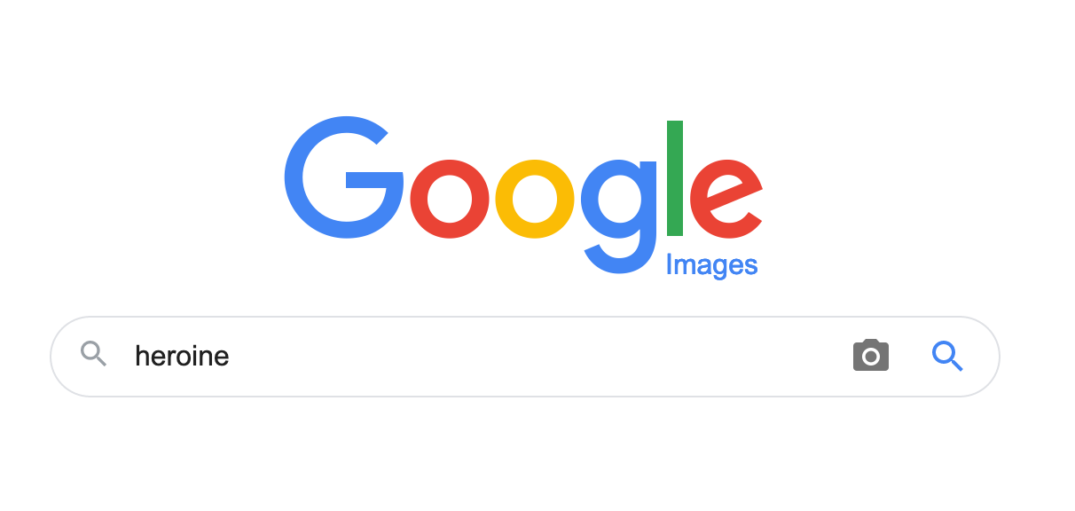
Search #1: heroine

Slide 47
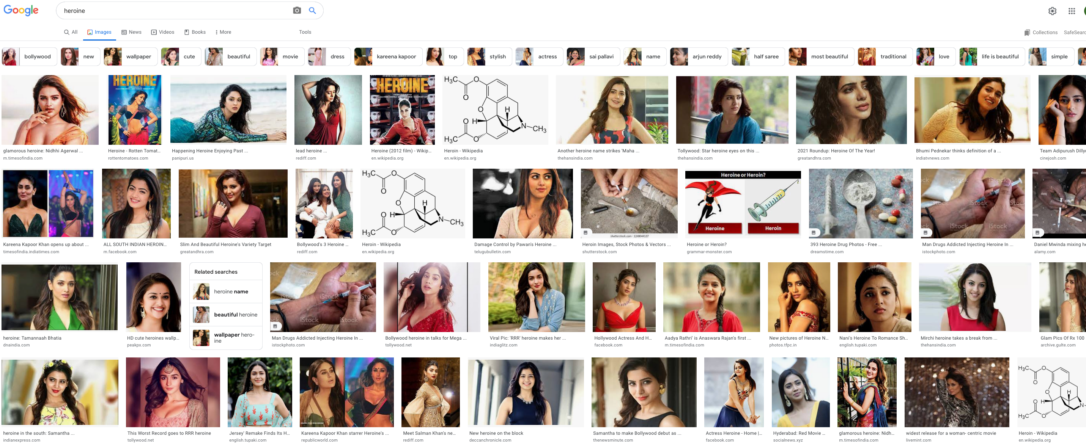
My search results
Notice any pattern?

Slide 48
Search #2: attractive woman

Slide 49
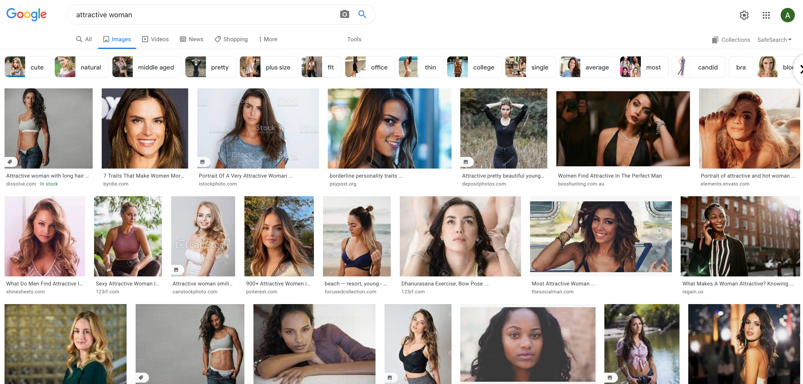
My search results
Notice any pattern?

Slide 50
Search 3: attractive man

Slide 51
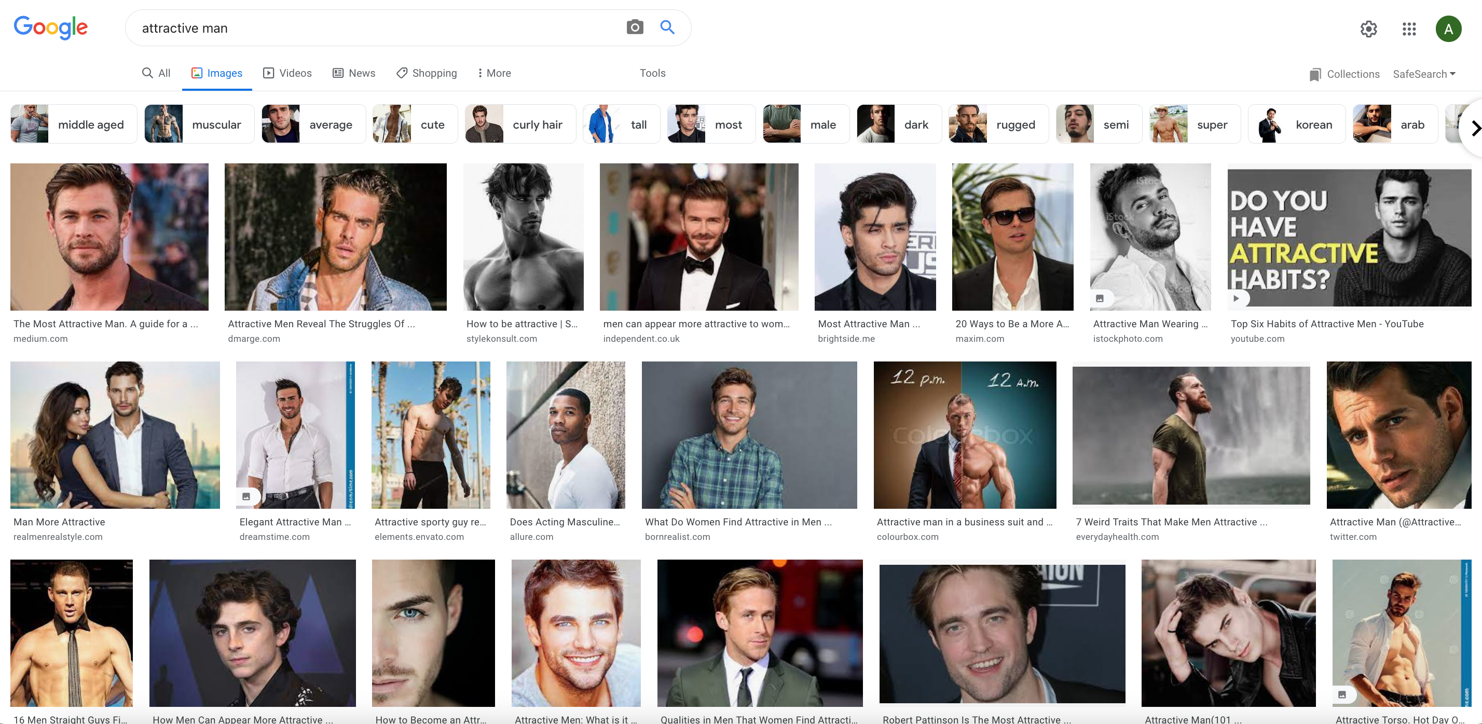
My search results

Slide 52
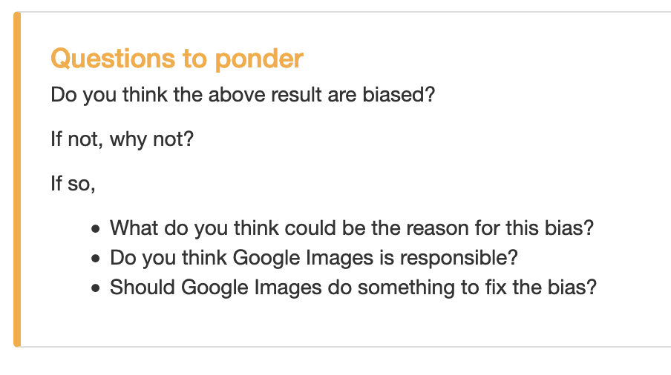
Questions to ponder

Slide 53
Search #4: ceo

Slide 54
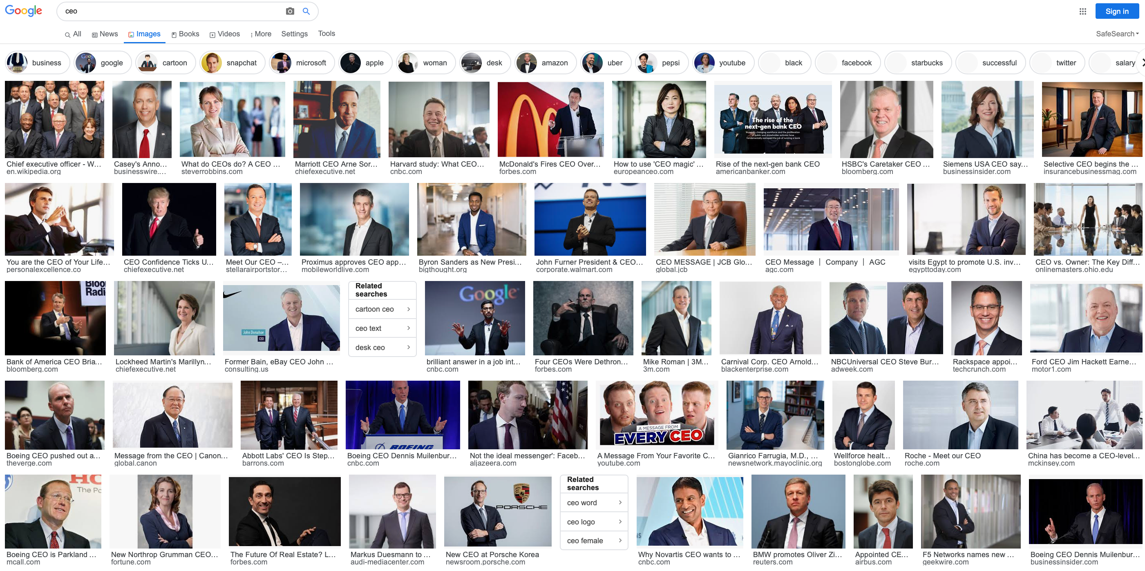
My search results (Spring 2020)

Slide 55
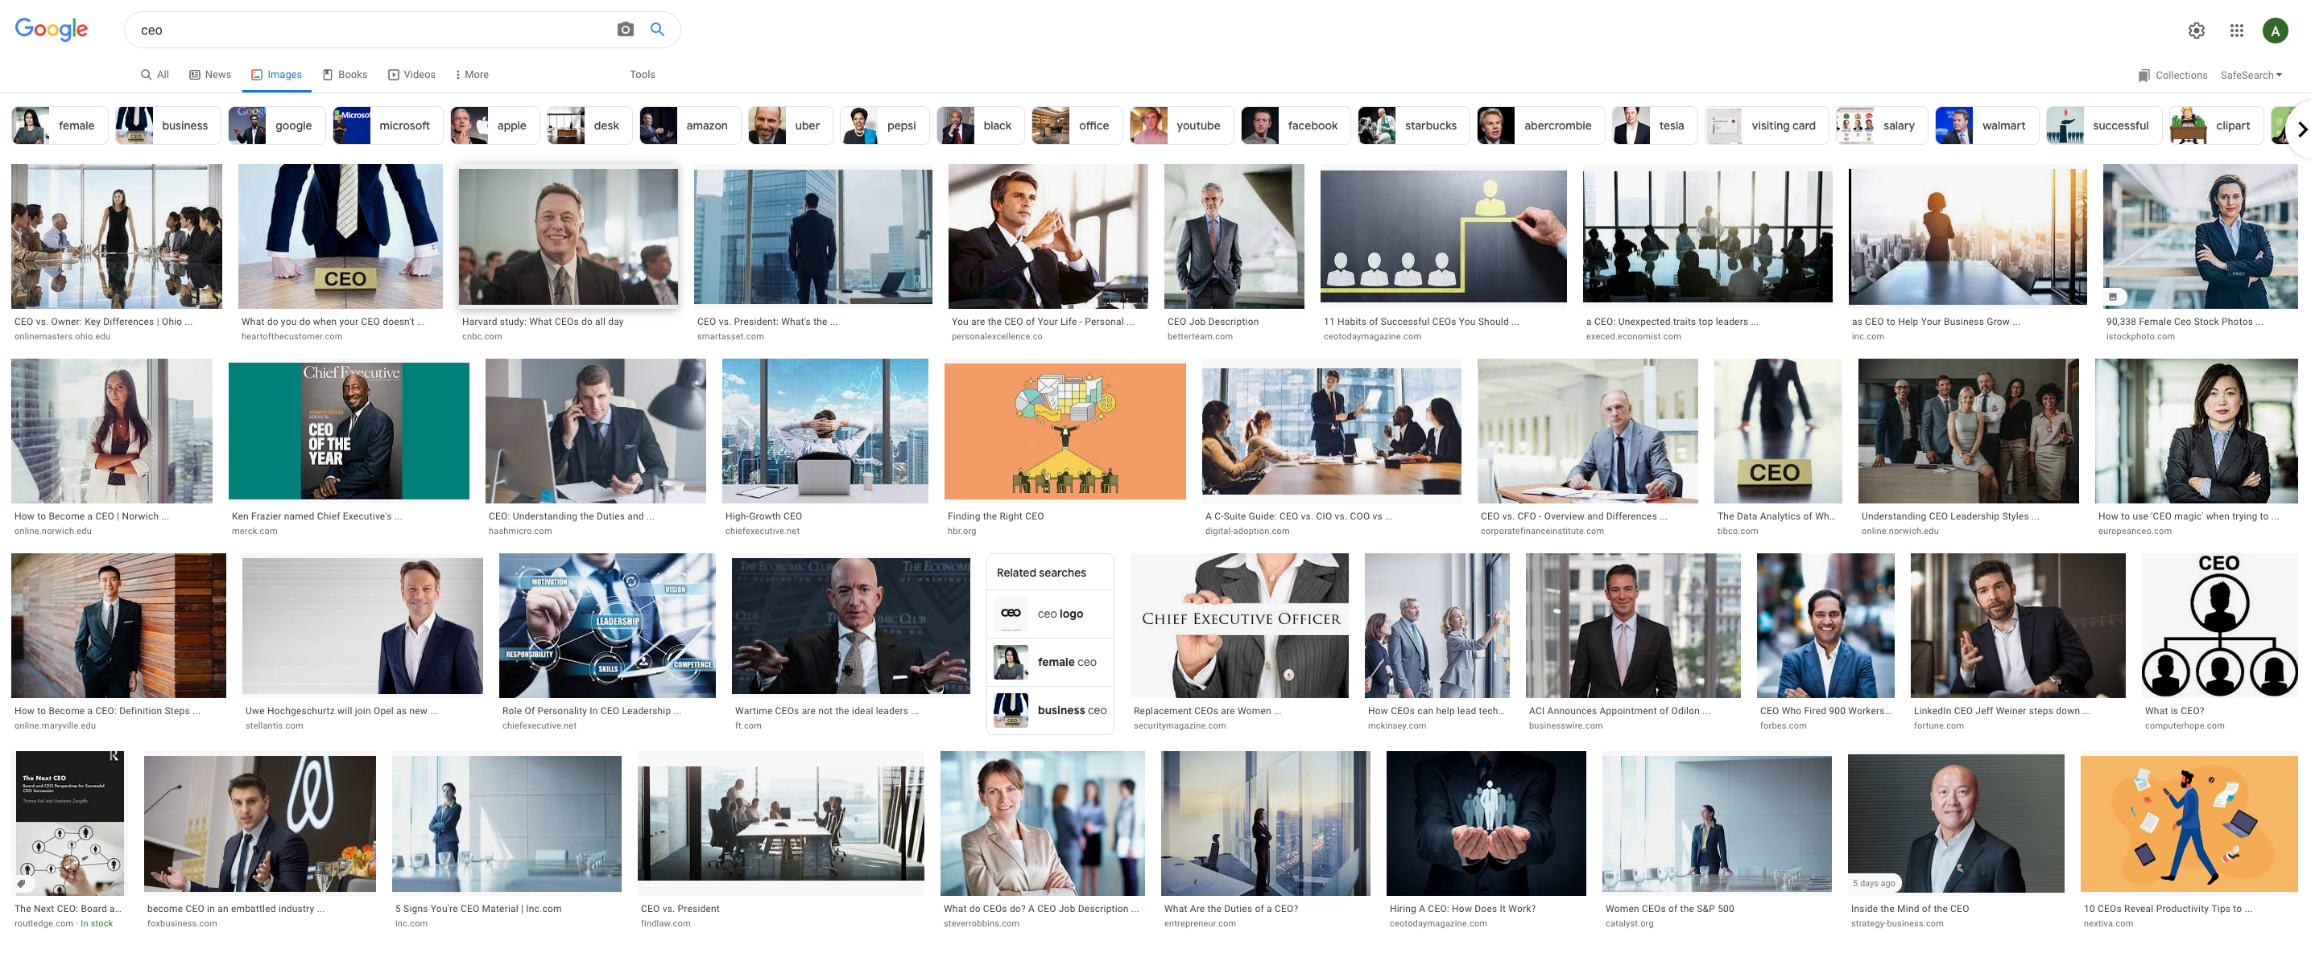
My search results (Spring 2022)

Slide 56
Search #5: beautiful woman

Slide 57
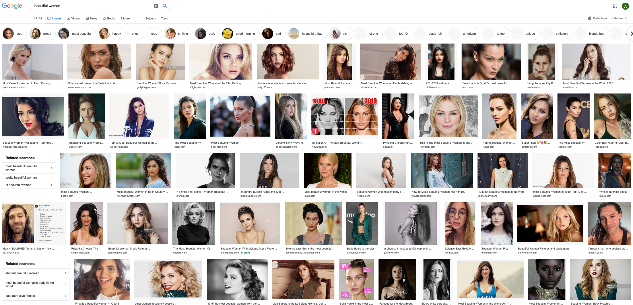
My search results (Spring 2020)

Slide 58
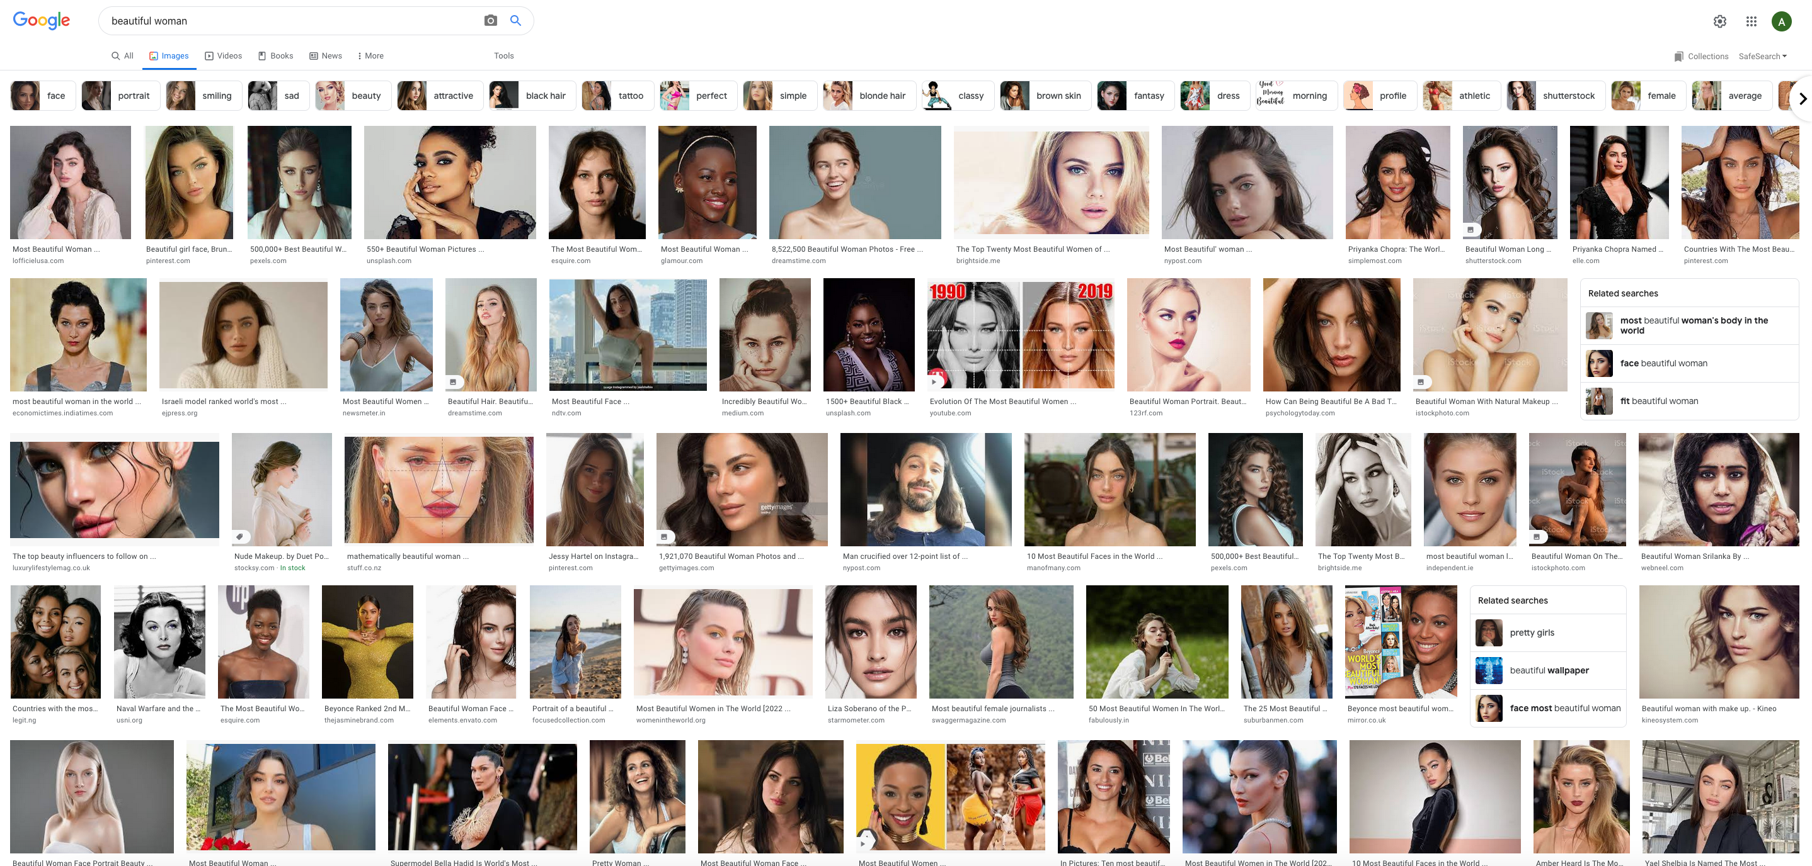
My search results (Spring 2022)

Slide 59
Questions/Comments?

