Slide 1
ML and Society
Mar 8, 2022

Slide 2
Discussion Summaries due tomorrow
By 5pm on Autolab

Slide 3
Delay in Impossible Project deets

Slide 4
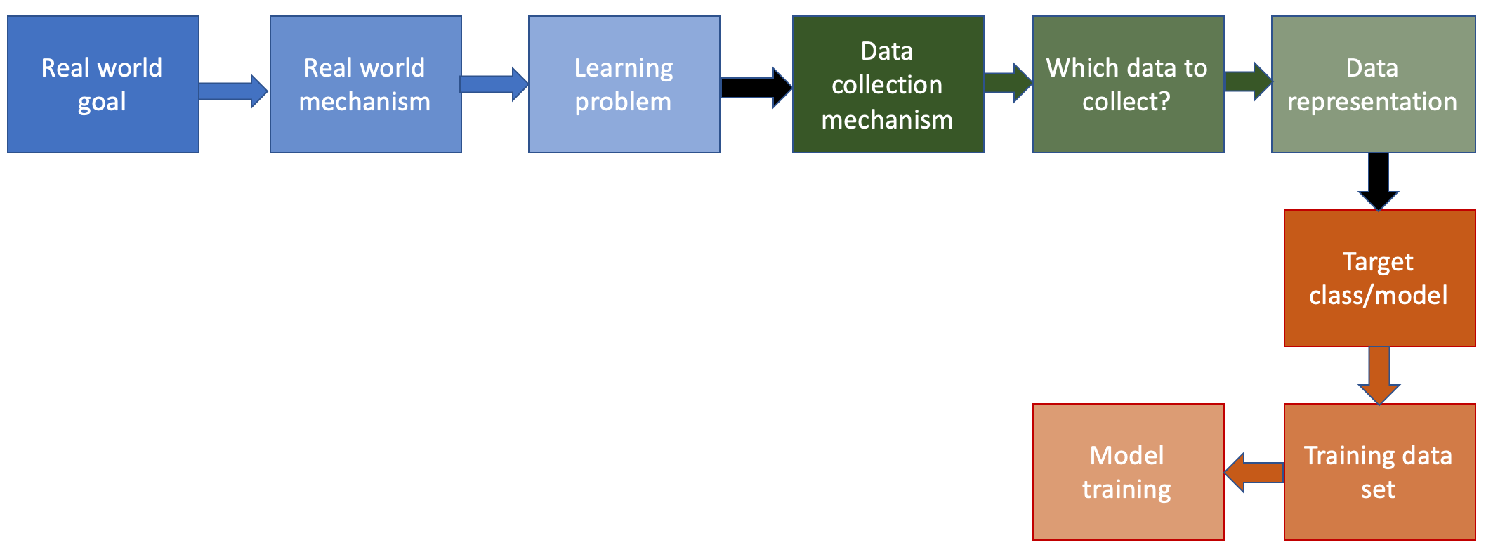
Where we left off last Tue…

Slide 5
?

Slide 6
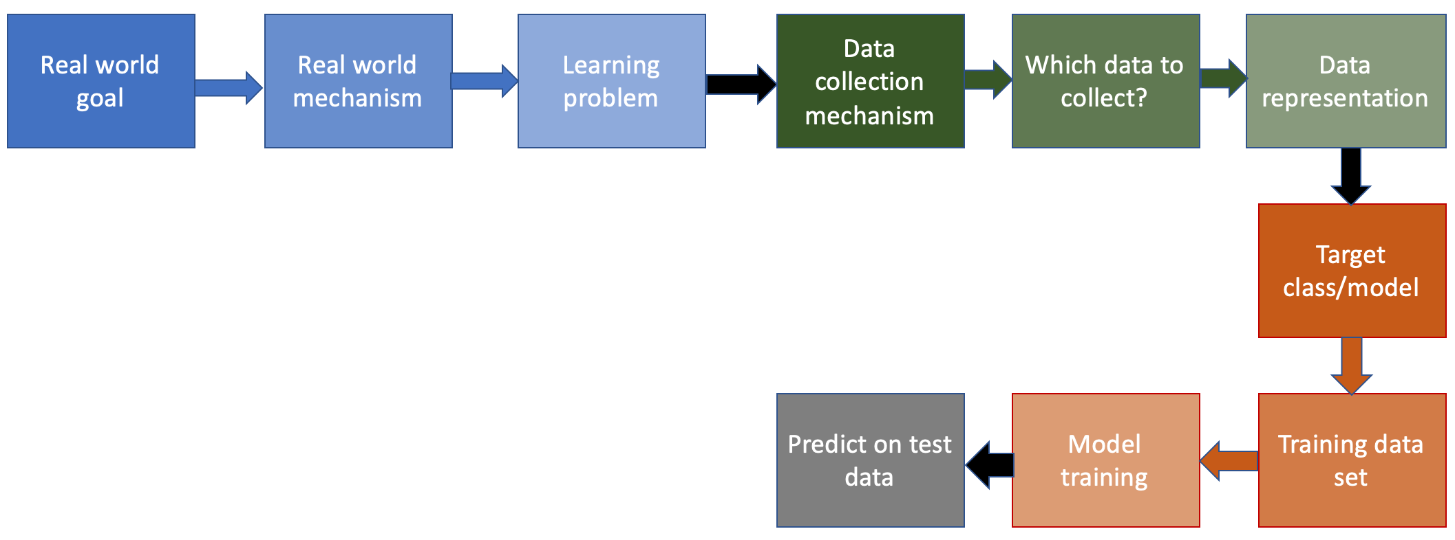
Next step in the ML pipeline

Slide 7
Predicting on dataset

Slide 8
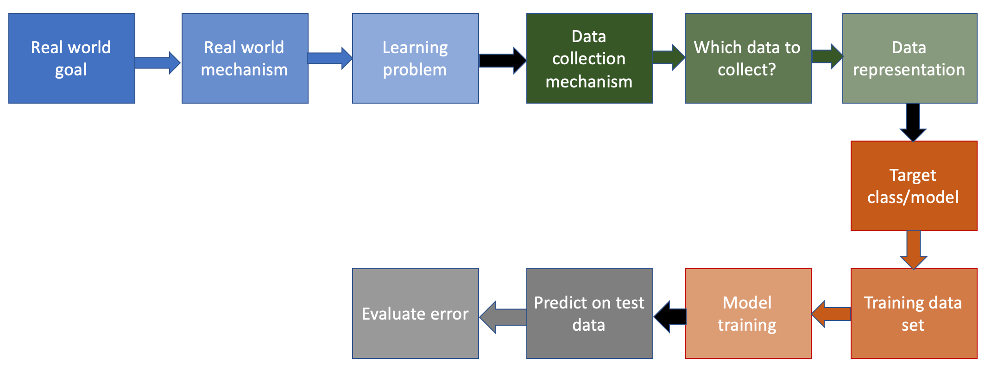
Last step in the ML pipeline!

Slide 9
Using accuracy (# misclassified points)

Slide 10
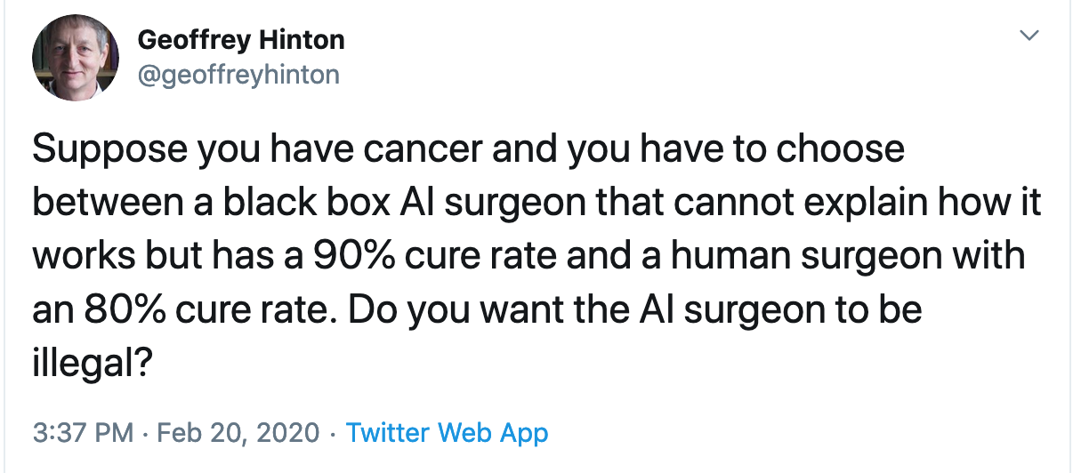
Feb 2020 tweet from Geoffrey Hinton
Discuss!

Slide 11
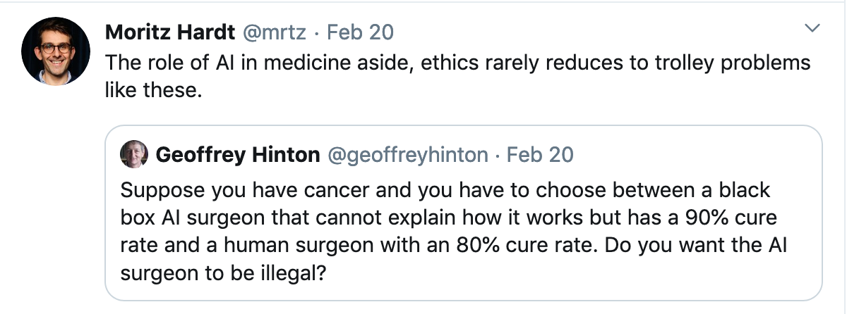
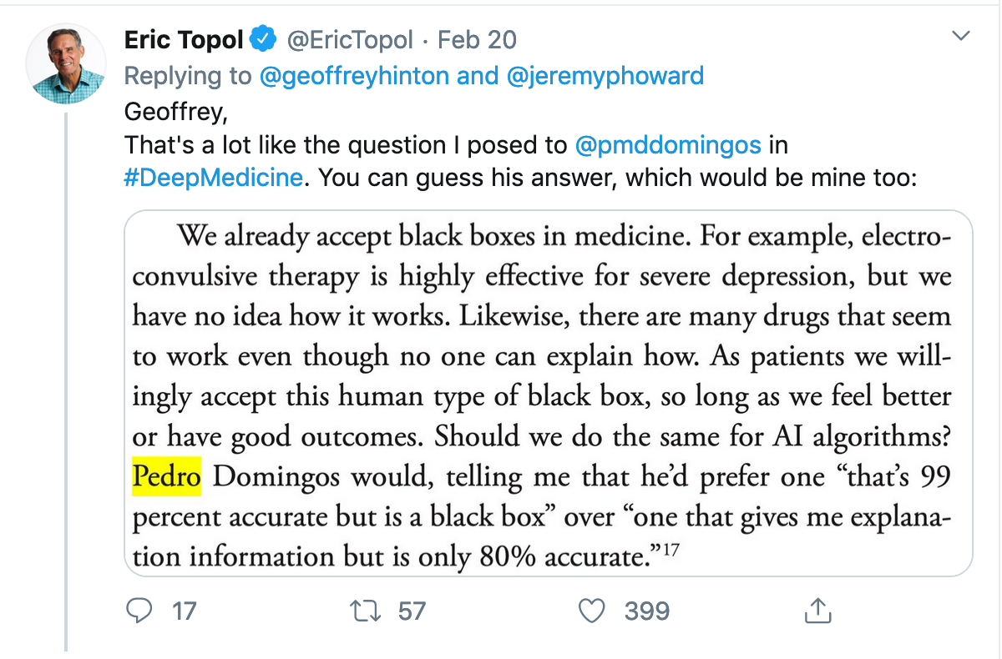
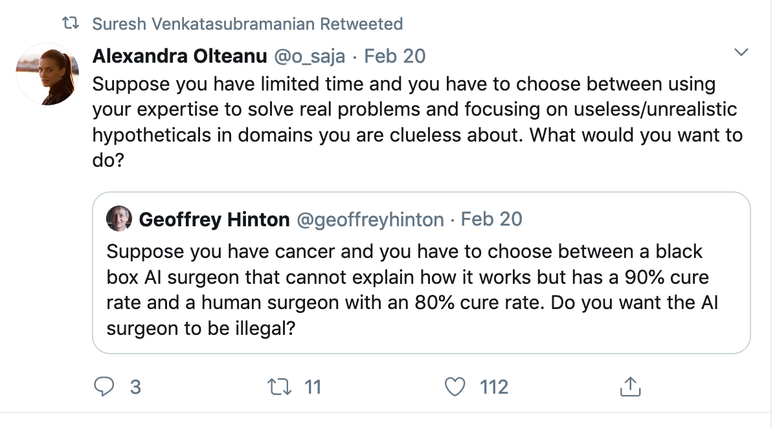
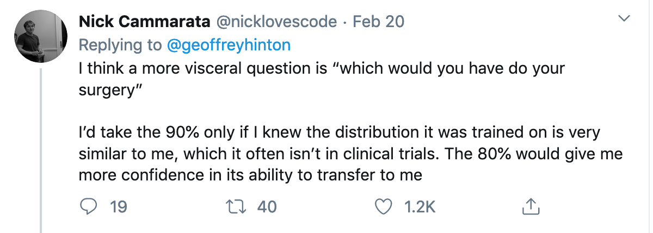
Some twitter responses

Slide 12
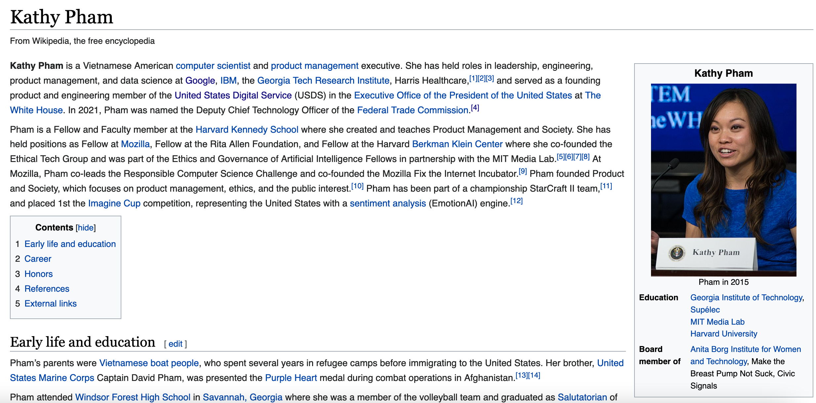
Passphrase for today: Kathy Pham

Slide 13
Preview of Seeing White…

