Slide 1
ML and Society
Mar 15, 2022

Slide 2
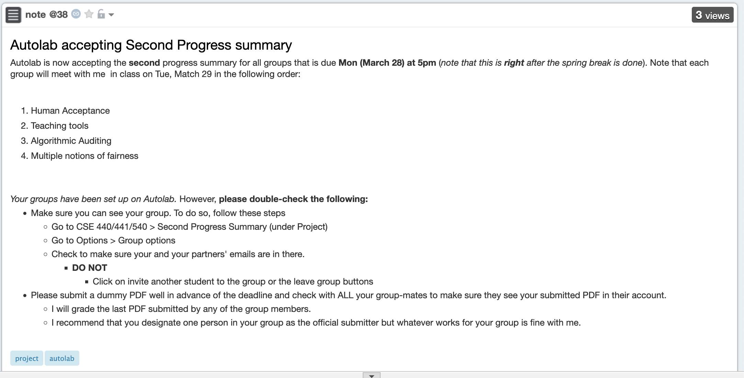
2nd discussion summary due right after break

Slide 3
Grading a bit delayed…

Slide 4
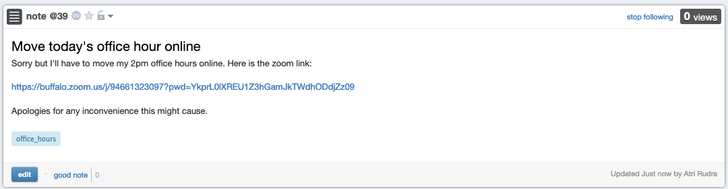
Office hour today online

Slide 5
A blanket acknowledgement/thanks
Thanks to Kenny Joseph for allowing me to use his slides

Slide 6
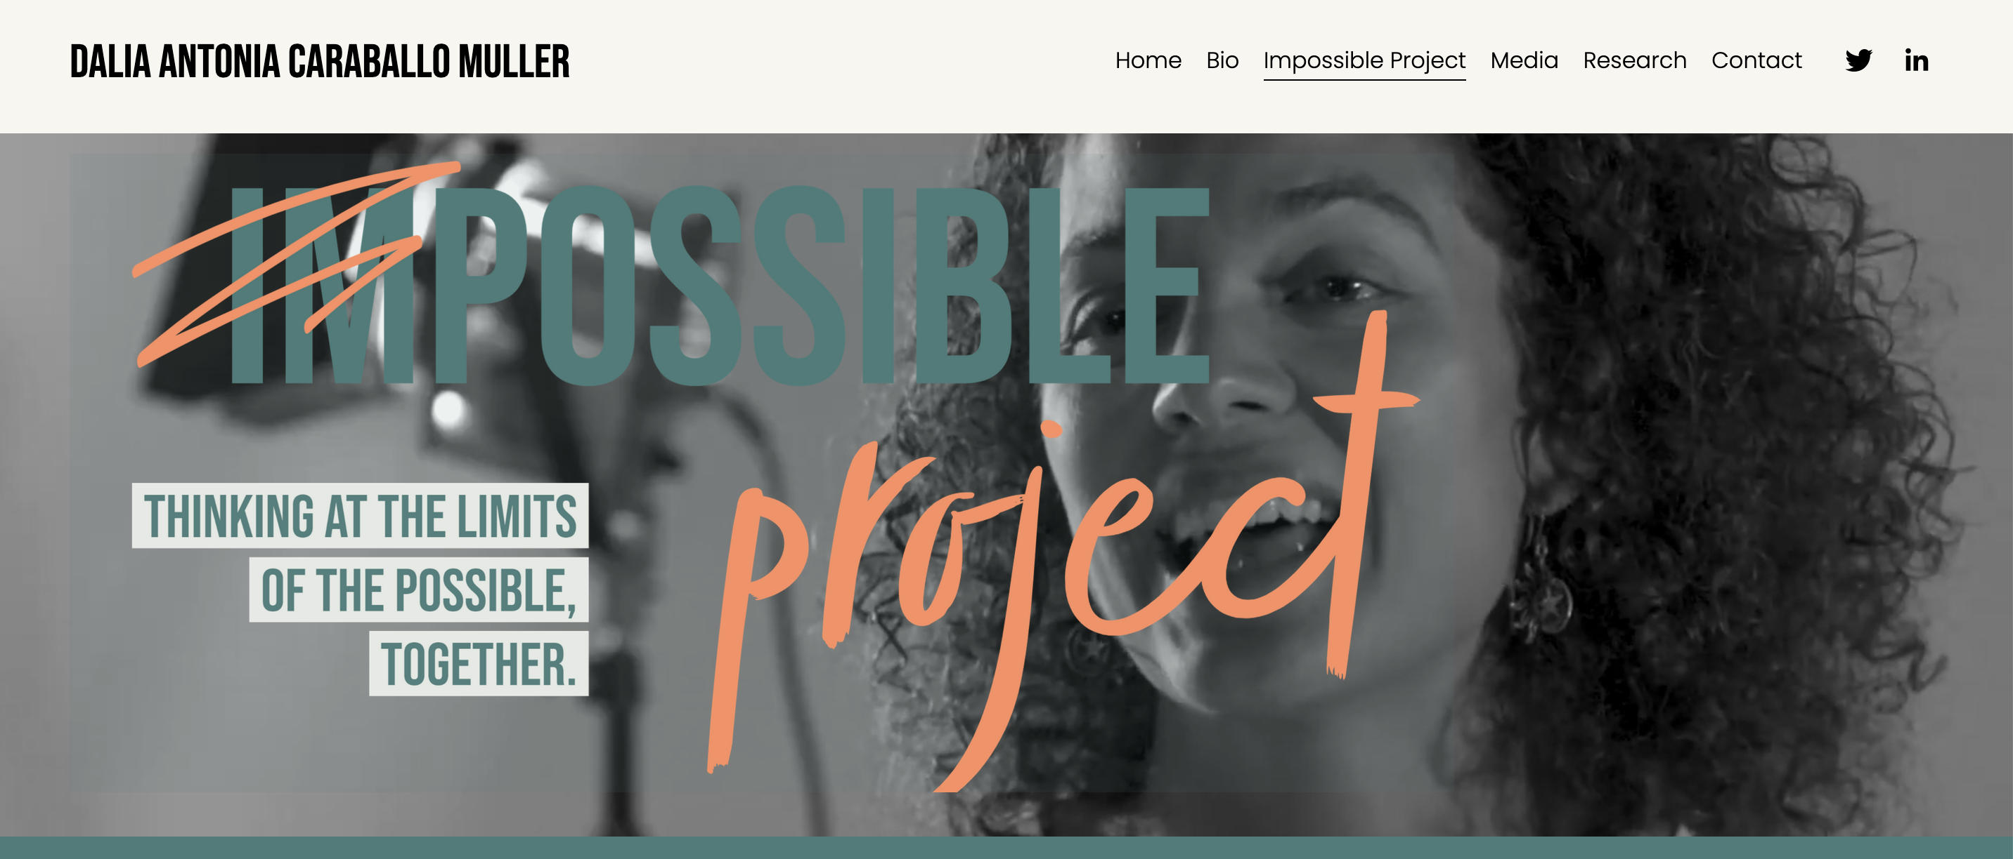
Impossible Project!

Slide 7

What is Impossible Project?

Slide 8
Few more introductions
Dr. Kimberly Boulden
Mikaela Hastings
Maungo (Botsalano) Makgabo

Slide 9
Why Impossible Project in this course?
Real world goal
Real world mechanism
Learning problem
Data collection mechanism
Which data to collect?
Data representation
Society
Target class/model
Deploy!
Evaluate error
Predict on test data
Model training
Training data set

Slide 10
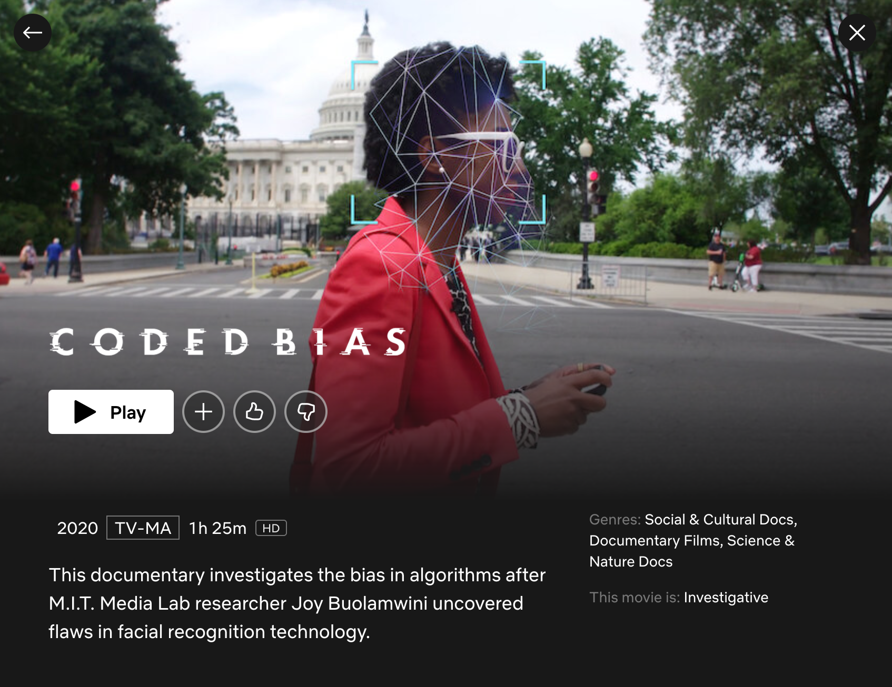
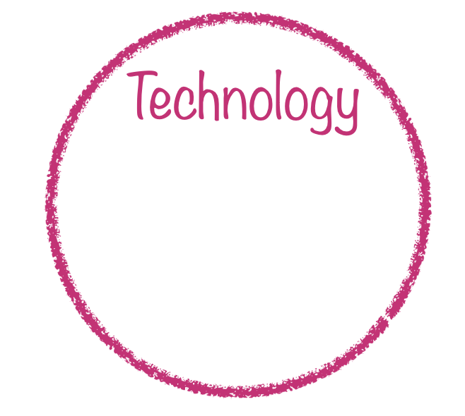

Slide 11
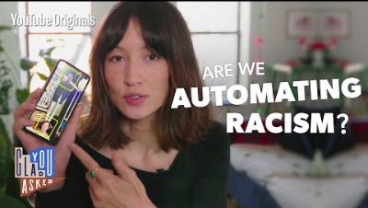
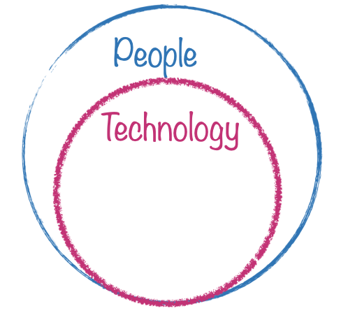
Are we automating racism?

Slide 12
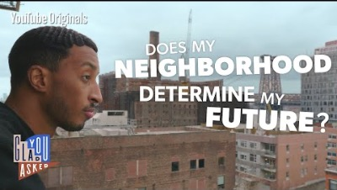
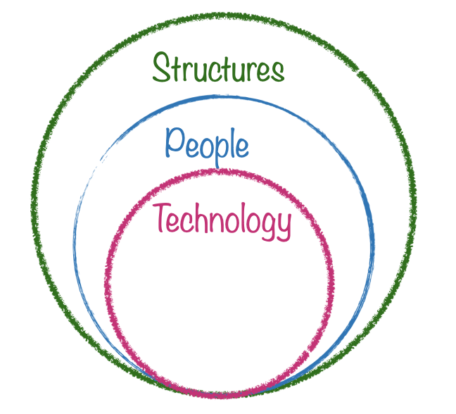
Housing segregation

Slide 13
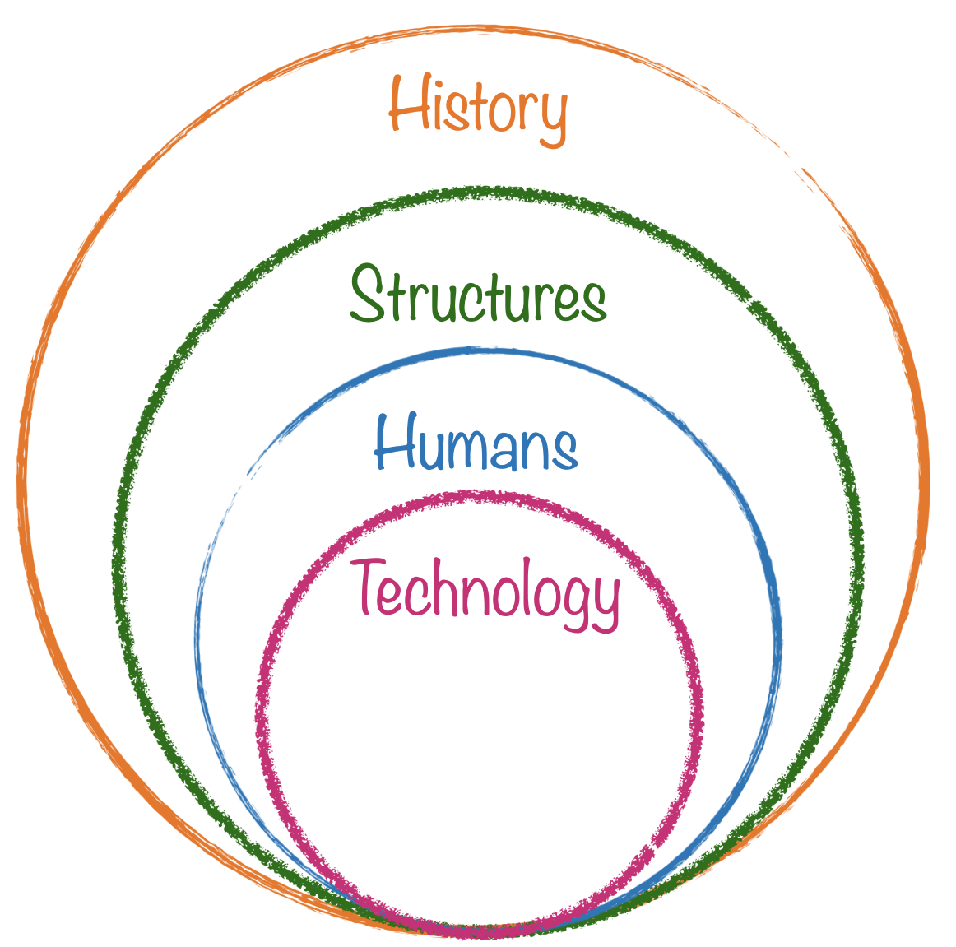

Historical context..

Slide 14
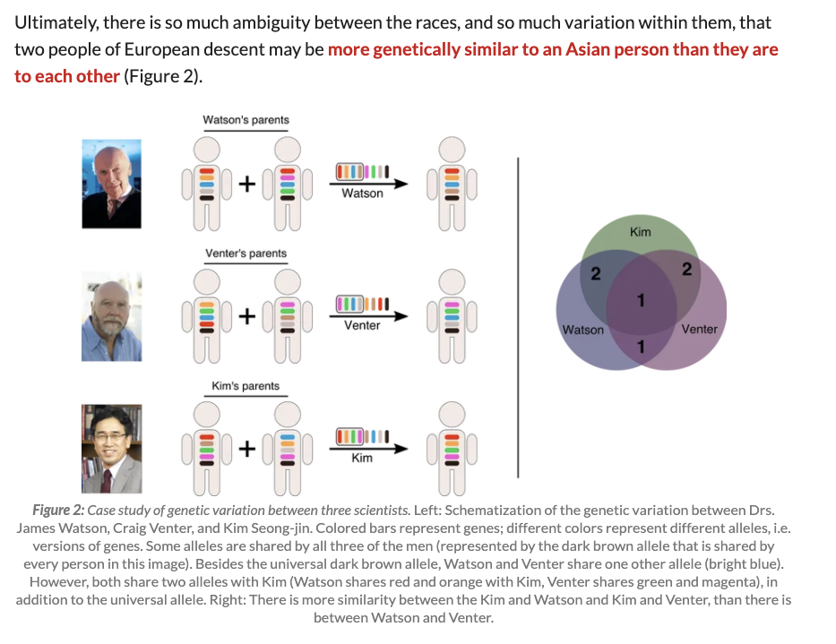
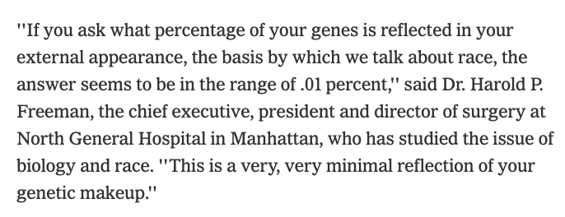
What is race?
Biologically speaking, race isn’t actually anything
https://www.nytimes.com/2000/08/22/science/do-races-differ-not-really-genes-show.html
https://sitn.hms.harvard.edu/flash/2017/science-genetics-reshaping-race-debate-21st-century/

Slide 15
So, what is it, then? Where did race come from?

Slide 16
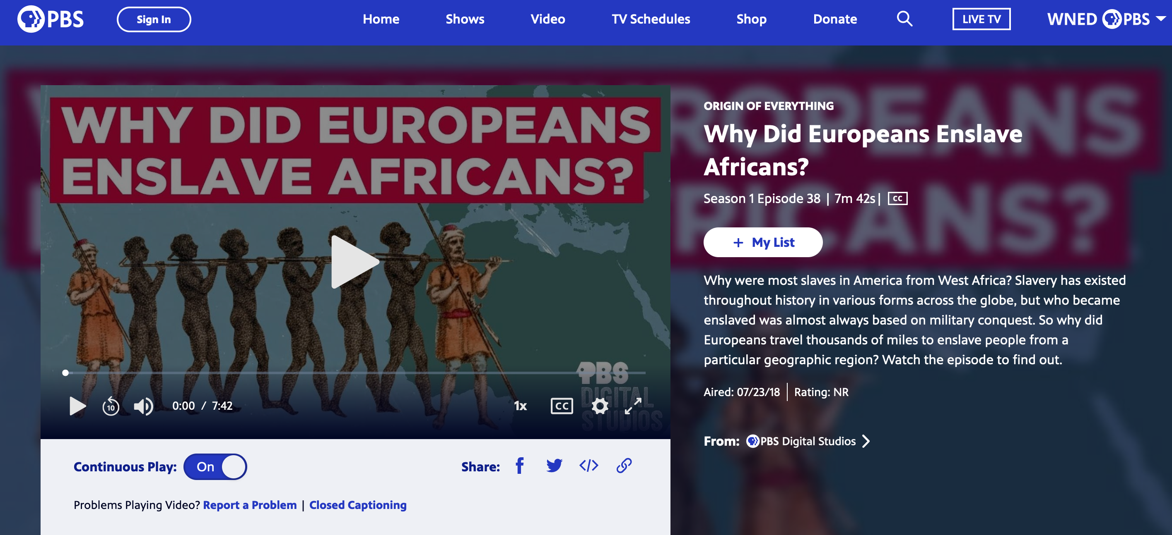
On Shreya’s Question…

Slide 17
What is racism?
  Something is racist if it creates a lasting, structural advantage or disadvantage in power along racial lines
Ray, V. (2019). A theory of racialized organizations. American Sociological Review
Kendi, I. X. (2019). How to be an antiracist. One world

Slide 18
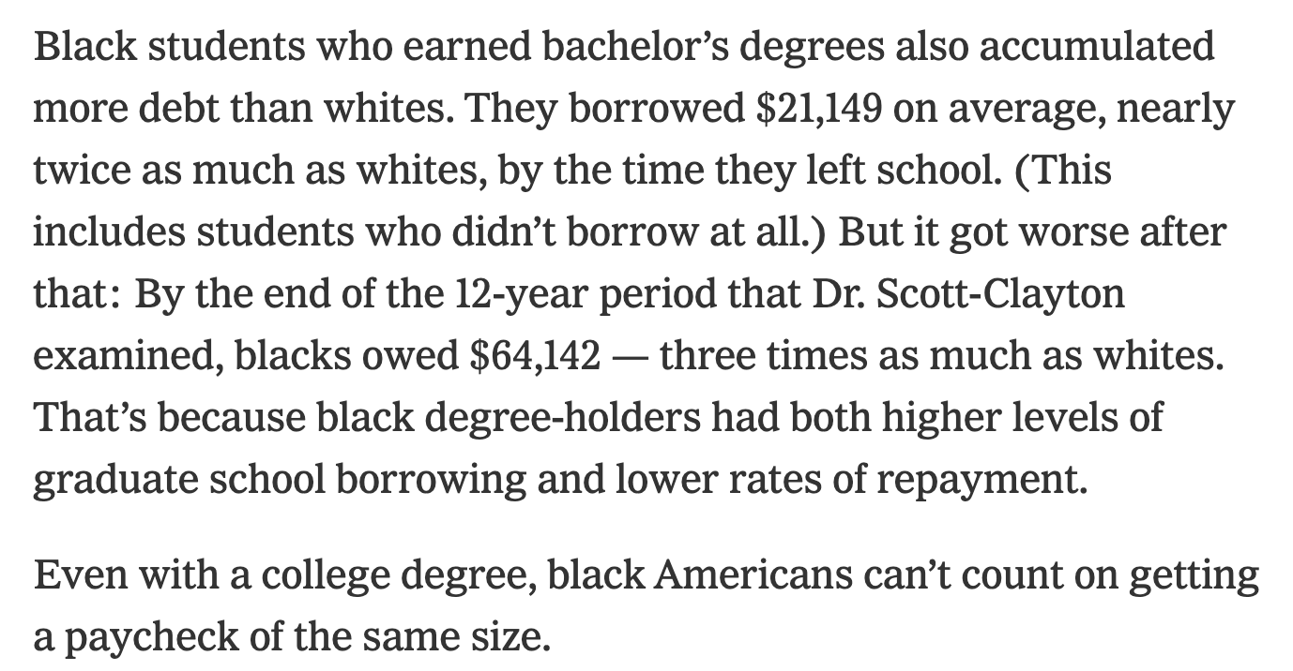
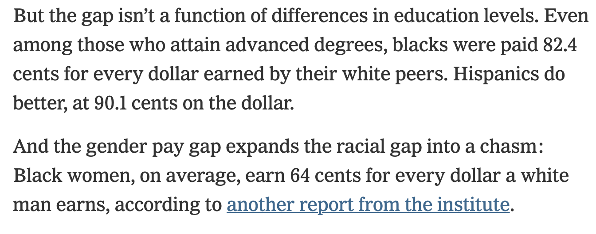
Why anti-Black racism?
Statistically, it is the biggest form of power inequality in the U.S.
https://www.nytimes.com/2020/06/09/your-money/race-income-equality.html

Slide 19
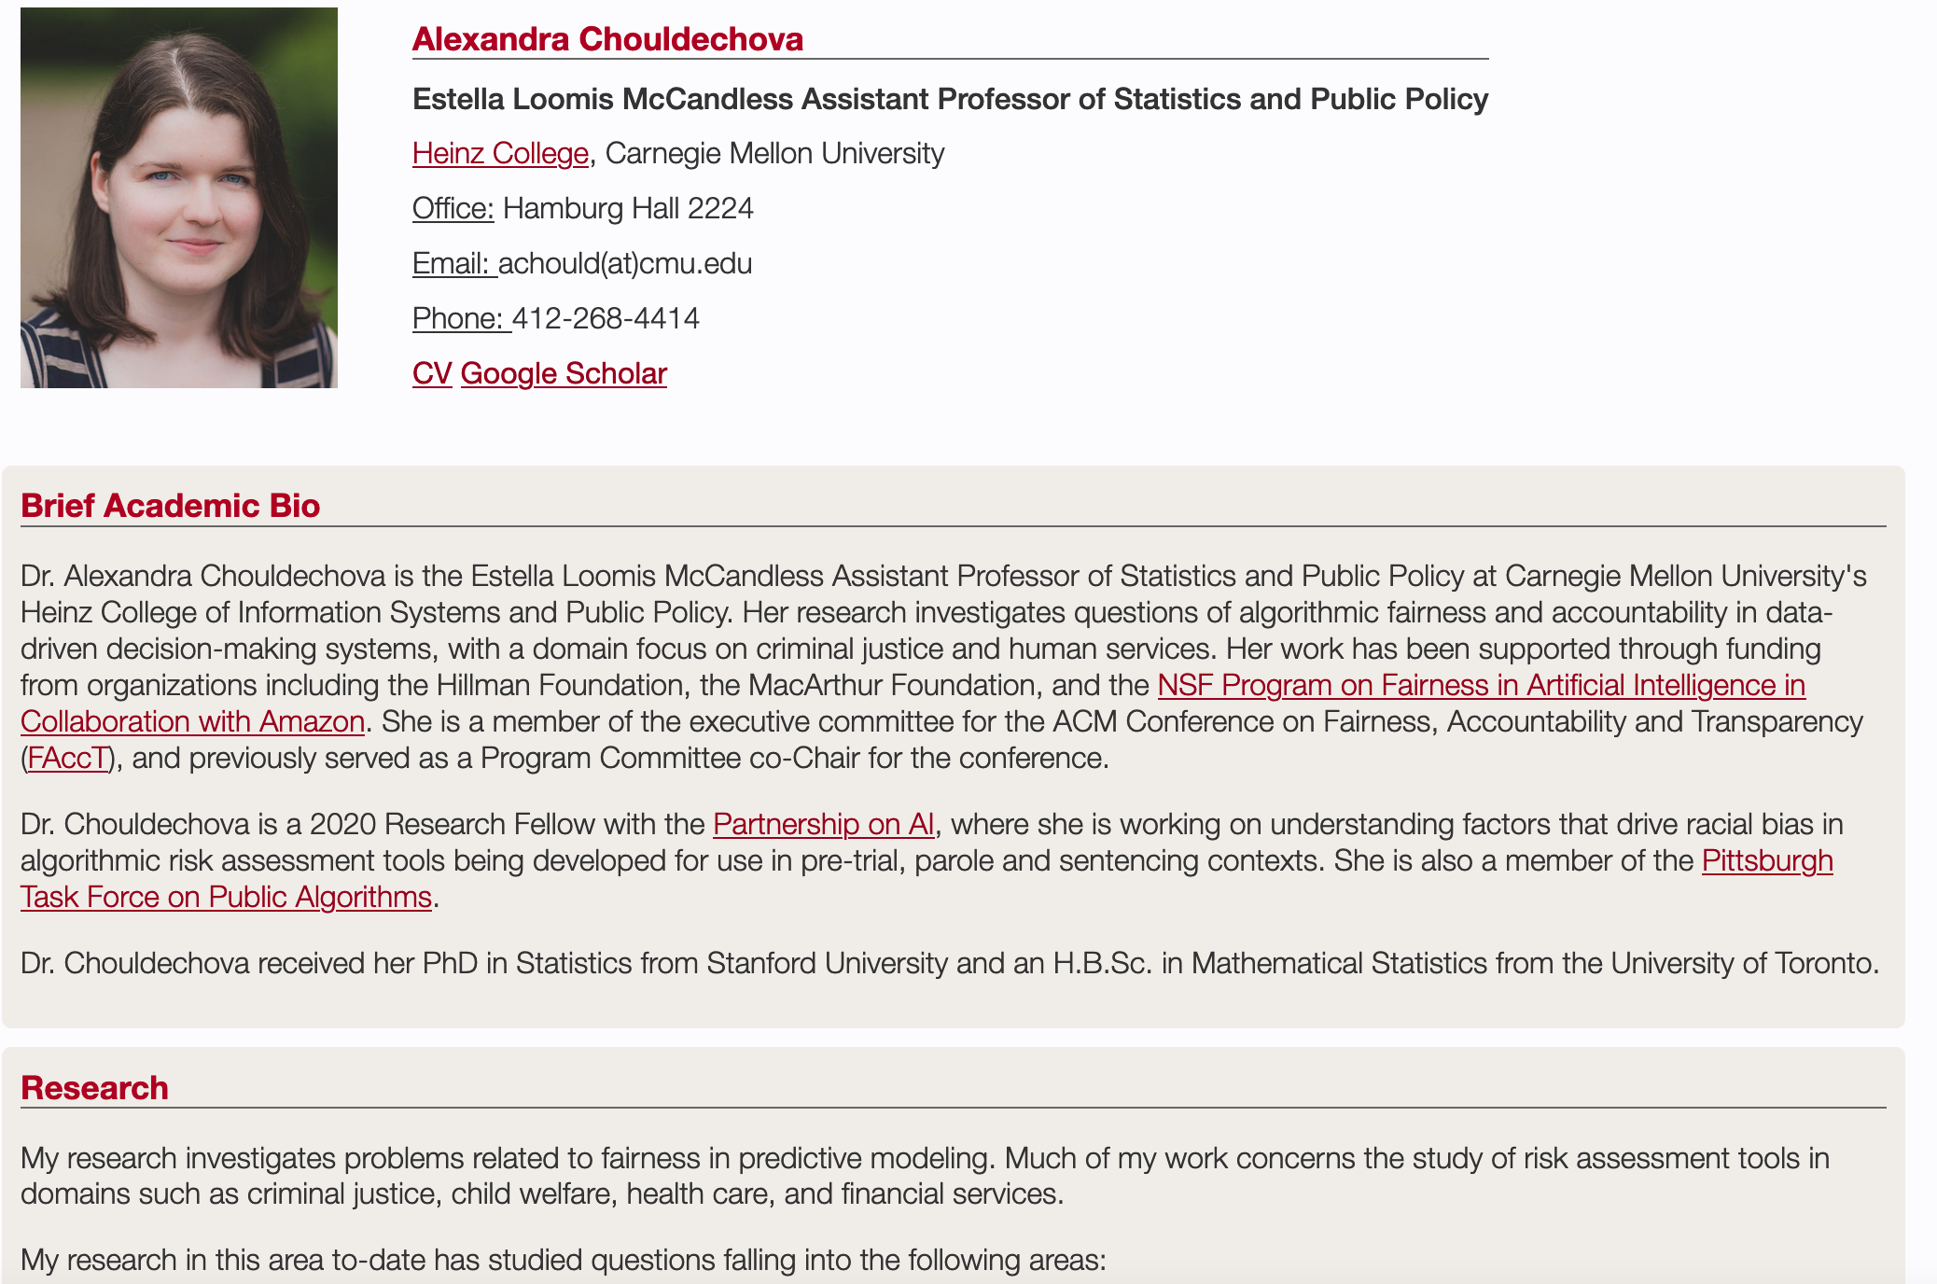
Passphrase for today: Alexandra Chouldechova

Slide 20
A case study

Slide 21
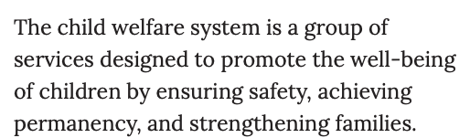
What is child welfare?
https://www.childwelfare.gov/pubpdfs/cpswork.pdf

Slide 22







If substantiated, the youth is taken into care
Youth are reported to CPS
The call is screen in (or not)
If screened in, the call is investigated. The investigation can result in substantiation (or not)
The youth’s case is then periodically reinvestigated
https://www.childwelfare.gov/pubpdfs/cpswork.pdf

Slide 23
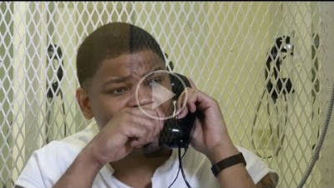
State care of another kind

Slide 24
Every year, 20,000 youth age out of foster care

Slide 25
20% will have been homeless at least once (5.7% gen. pop.)

Slide 26
66.2% will not go to college.
(41% gen. pop.)

Slide 27
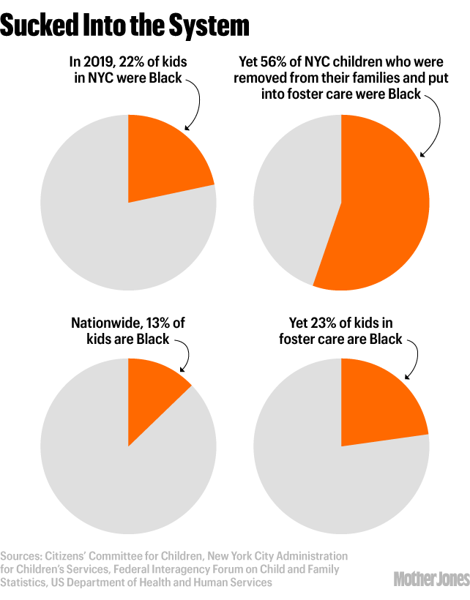
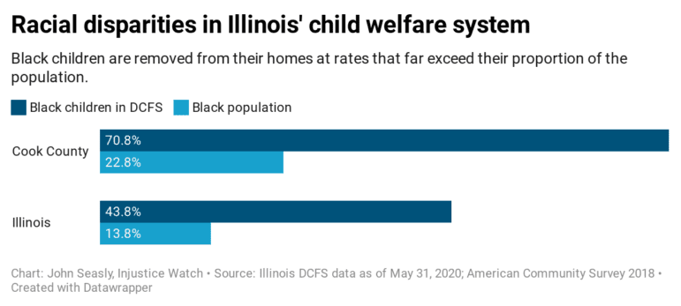

Slide 28
Summary thus far
No one wants to be in the child welfare system
  Experts agree that the goal should be to get people back with their families
  People involved suffer
  Life outcomes for people who stay in it are terrible
Black people are over-represented in the child welfare system

Slide 29
Why are Black youth over-represented?
Two possible reasons
Need/Risk (Black parents have less money to support children)
Discrimination/Bias (Black families are over-policed within Child Welfare)

Slide 30
Why are Black youth over-represented?
Two possible reasons
Need/Risk (Black parents have less money to support children)
Discrimination/Bias (Black families are over-policed within Child Welfare)

Slide 31
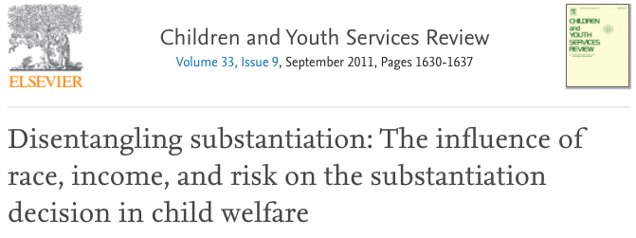
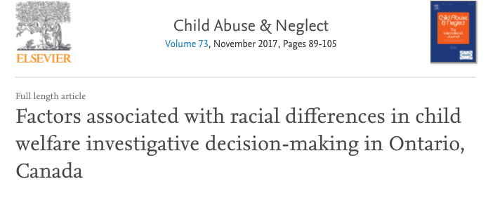
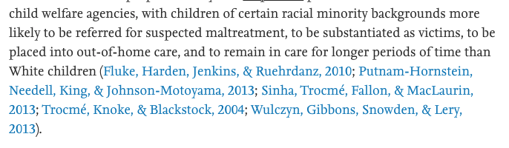
“when also controlling for caseworker perceptions of risk, race emerges as the stronger explanatory factor."

Slide 32
What might we do?
If substantiated, the youth is taken into care
Youth are reported to CPS
The call is screen in (or not)
If screened in, the call is investigated. The investigation can result in substantiation (or not)
The youth’s case is then periodically reinvestigated
https://www.childwelfare.gov/pubpdfs/cpswork.pdf

Slide 33

What might we do?
If substantiated, the youth is taken into care
Youth are reported to CPS
The call is screen in (or not)
If screened in, the call is investigated. The investigation can result in substantiation (or not)
The youth’s case is then periodically reinvestigated
https://www.childwelfare.gov/pubpdfs/cpswork.pdf

Slide 34
What data would you use?
Proxy:
  Use outcomes from substantiation phase, not screening phase
  Idea: Probably more accurate, less biased

Slide 35
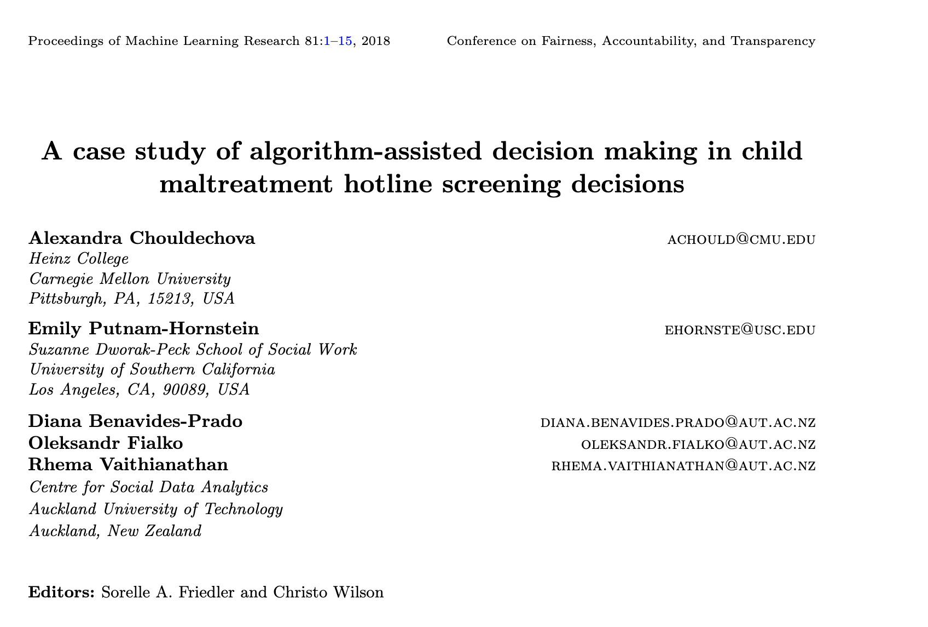
Paper by Chouldechova et al.

Slide 36
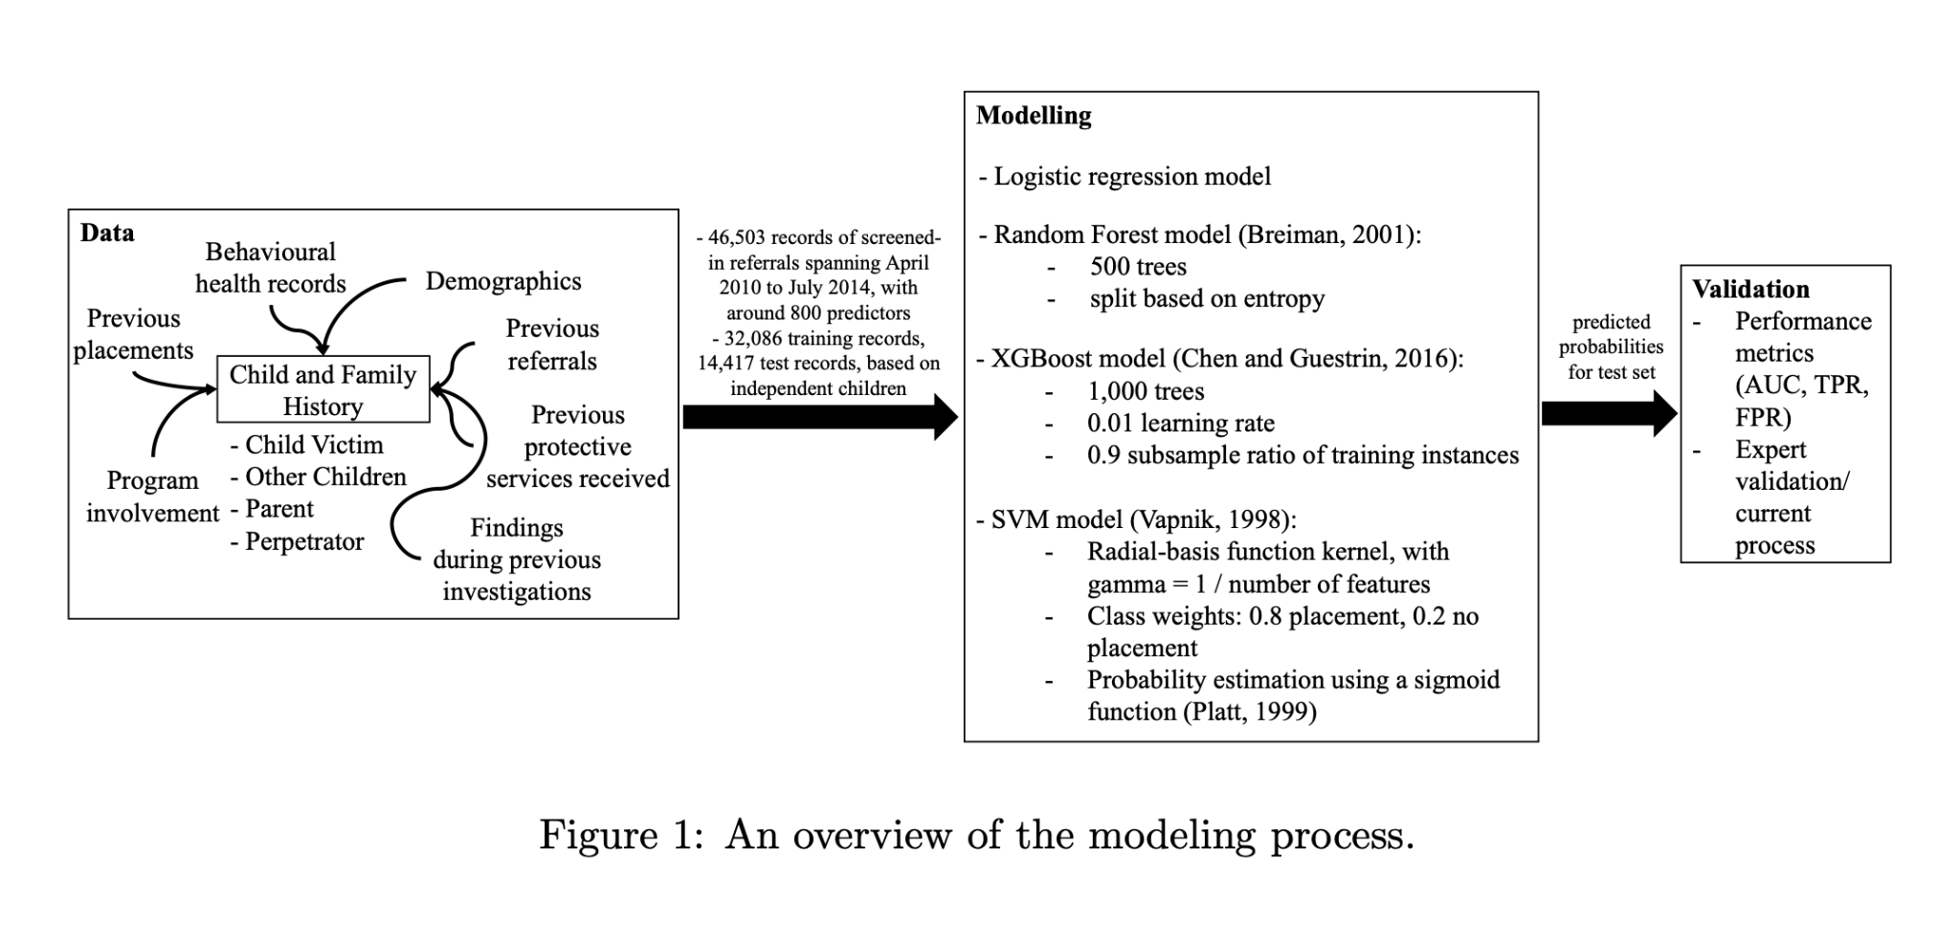

Slide 37
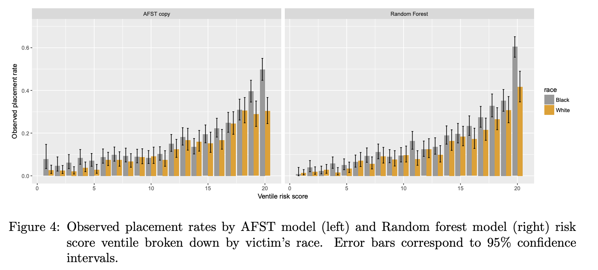
Notes:
Screened-in referrals that score a 20 on the AFST ventile scale are observed to result in placement in 50% of cases involving Black children and only 30% of cases involving White children. That is, at the highest ventile, the model appears to overestimate risk for White children compared to Black children. Put differently, a White child who scores 20 on the AFST has comparable placement risk to a Black child who scores 18.

Slide 38
Why (were there racial disparities in the algorithm’s risk scores)?
A: Because the algorithm developers chose a proxy variable that had racial bias.
Notes:
Tech often is created with the intention of solving a problem, and yet there are many examples of it exacerbating or causing new, worse problems than those it set out to solve.
This is because technology does not exist in a vacuum, but within a social, political, and historical context. This means that technology is never neutral, and that it can never on it's own solve a problem.

Slide 39
Why was the underlying proxy variable racially biased?
A: Because the people who made the decisions that informed the proxy variable did so in a racially biased way
Notes:
Tech often is created with the intention of solving a problem, and yet there are many examples of it exacerbating or causing new, worse problems than those it set out to solve.
This is because technology does not exist in a vacuum, but within a social, political, and historical context. This means that technology is never neutral, and that it can never on it's own solve a problem.

Slide 40
Two really good reasons not to stop here.
Not all (many?) case workers hold explicit racial biases
Individuals can perform actions that increase racial inequality without “being racist”
(so can technology…)

Slide 41
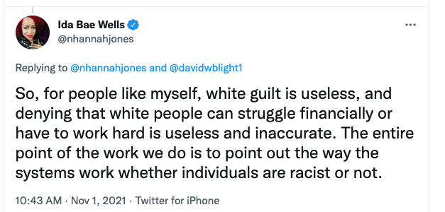
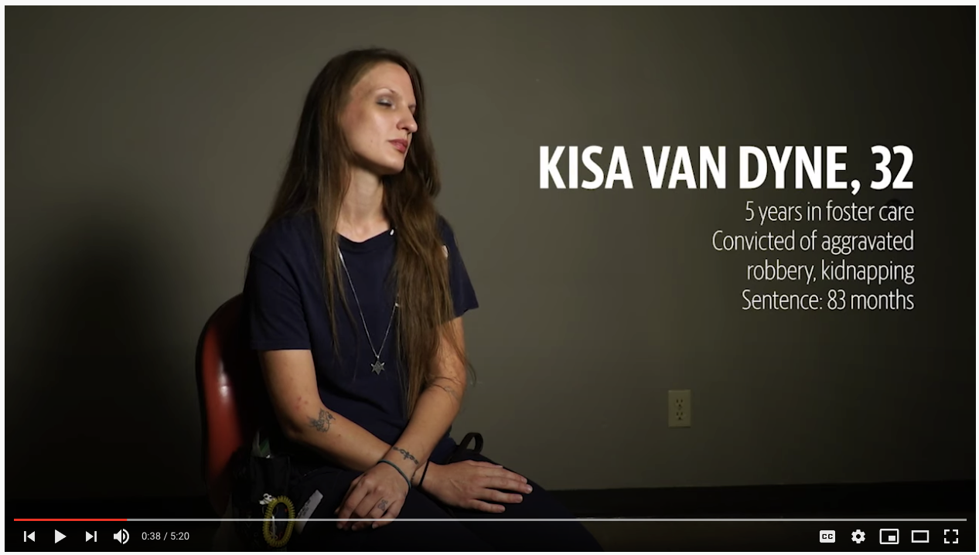
https://twitter.com/nhannahjones/status/1455184081793306627

Slide 42
Why did the people make racially biased decisions?
A: Because case workers are bad, racist people
A: Because racial biases and discrimination are built into our society at a structural level
Notes:
Tech often is created with the intention of solving a problem, and yet there are many examples of it exacerbating or causing new, worse problems than those it set out to solve.
This is because technology does not exist in a vacuum, but within a social, political, and historical context. This means that technology is never neutral, and that it can never on it's own solve a problem.

Slide 43

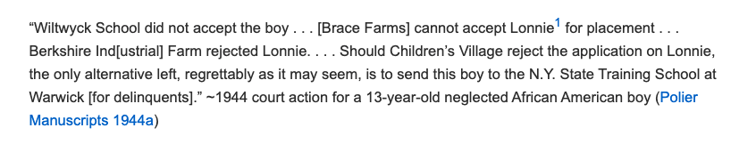
But at the same moment that minorities were included in positions of power in the courts, African American children disproportionately entered the system as delinquents rather than as dependent or neglected (Trost 2005; Ward 2012).
https://journals.sagepub.com/doi/full/10.1177/0003122420911062

Slide 44
Why are racial bias and discrimination built into our society at a structural level?
A: Because American society has historically favored White Americans, relative to Black Americans, and structural racism is reproduced over time
Notes:
Tech often is created with the intention of solving a problem, and yet there are many examples of it exacerbating or causing new, worse problems than those it set out to solve.
This is because technology does not exist in a vacuum, but within a social, political, and historical context. This means that technology is never neutral, and that it can never on it's own solve a problem.

Slide 45
Why are Black youth over-represented?
Two possible reasons
Need/Risk (Black parents have less money to support children)
Discrimination/Bias (Black families are over-policed within Child Welfare)

Slide 46
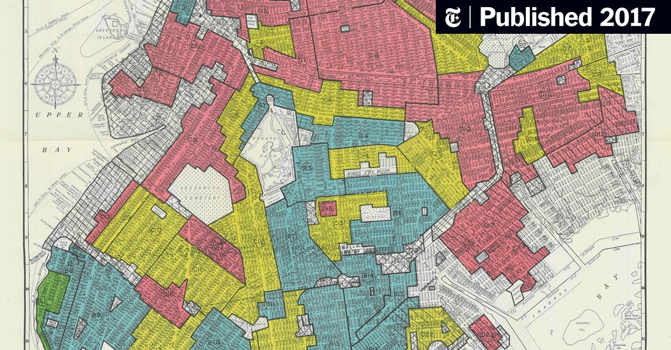
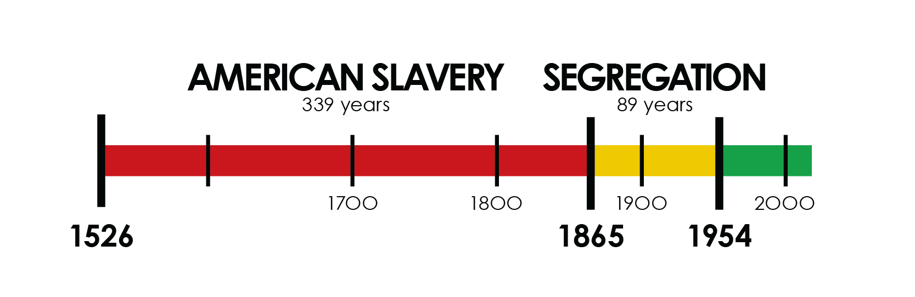

Slide 47
OK.
This seems bad.
What can we do about it?

Slide 48
The Impossible Project:
Making Computing Antiracist

Slide 49
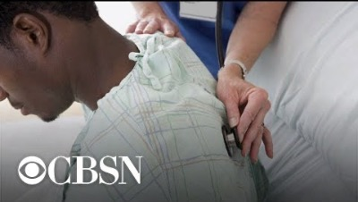
The case study

Slide 50
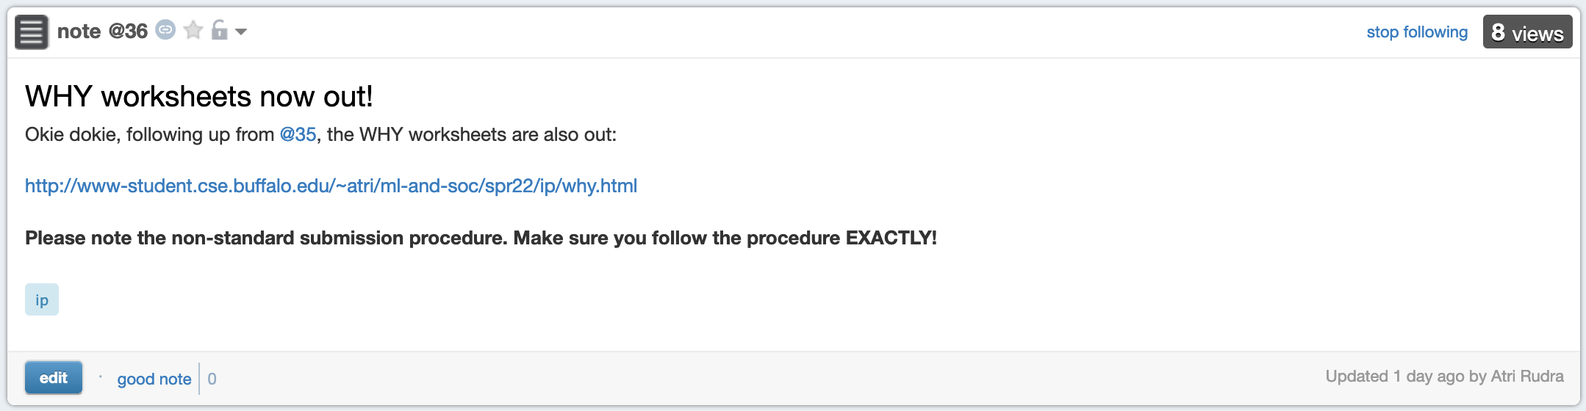
WHY worksheet due tomorrow 5pm

