Slide 1
ML and Society
Mar 17, 2022

Slide 2
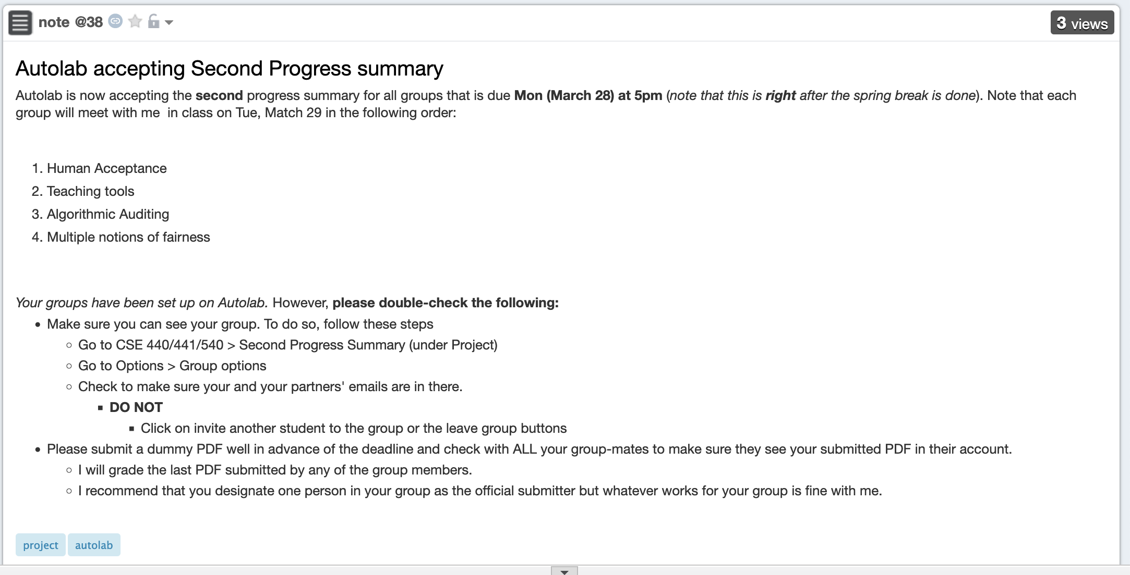
2nd discussion summary due right after break

Slide 3
Overview of your answers

Slide 4
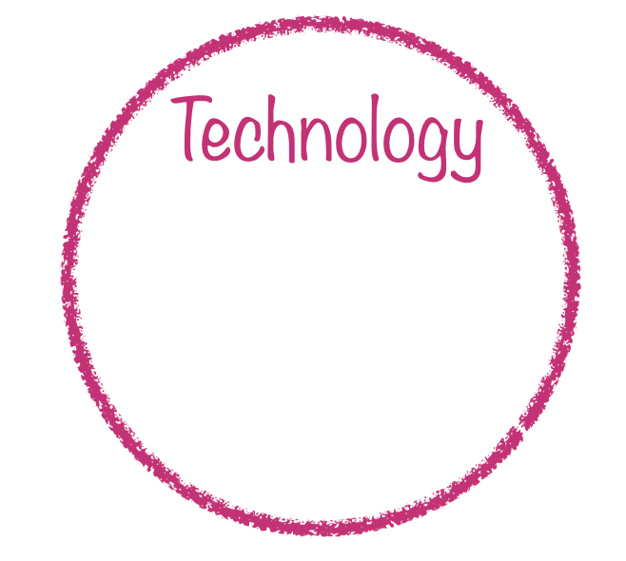
Why (were there racial disparities in the algorithm’s recommendation)?
A: Because the algorithm developers chose a proxy variable that had racial bias.
Notes:
Tech often is created with the intention of solving a problem, and yet there are many examples of it exacerbating or causing new, worse problems than those it set out to solve.
This is because technology does not exist in a vacuum, but within a social, political, and historical context. This means that technology is never neutral, and that it can never on it's own solve a problem.

Slide 5
In this course think beyond proxy variable
Real world goal
Real world mechanism
Learning problem
Data collection mechanism
Which data to collect?
Data representation
Target class/model
Deploy!
Evaluate error
Predict on test data
Model training
Training data set

Slide 6
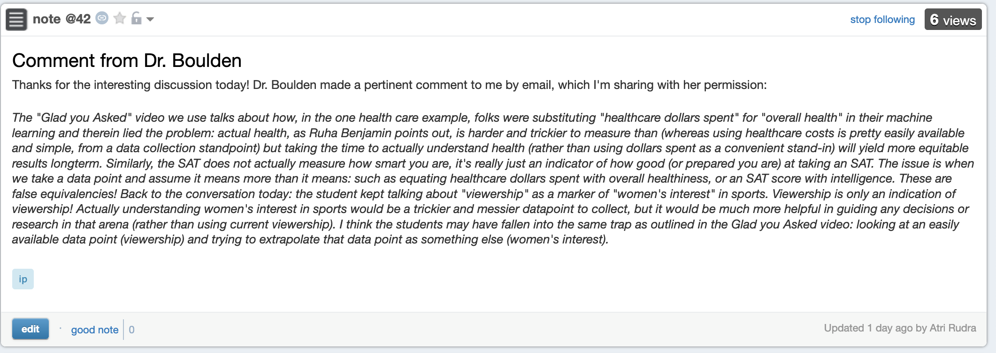
But still on proxy variables

Slide 7
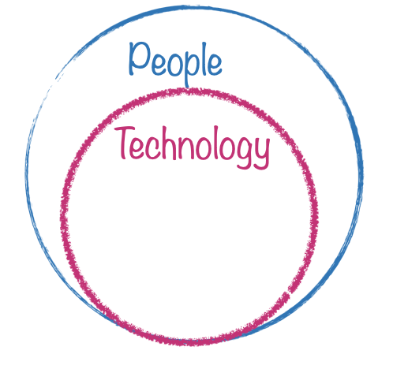
Why was the underlying proxy variable racially biased?
A: Because the people who made the underlying decisions did so in a racially biased way
Notes:
Tech often is created with the intention of solving a problem, and yet there are many examples of it exacerbating or causing new, worse problems than those it set out to solve.
This is because technology does not exist in a vacuum, but within a social, political, and historical context. This means that technology is never neutral, and that it can never on it's own solve a problem.

Slide 8
It is a widely known fact that there exists racial inequality within the health care system. Specifically, black people are often barred from health services due to its expensive cost, which artificially lowers the cost of care for black patients. Since the algorithm uses cost as the proxy variable, it creates this illusion that black patients do not need as much medical care.
I understand the underlying decisions that people made as a reference to the doctors and nurses whose decisions about their patients were used as the input data to compute the algorithm. Since their decisions were racially biased, the same translates into the algorithm.
Clearly there is vested self interest and a conflict of interest when united healthcare designs an algorithm
that predicts cost.
This quote from the news story covering the original publication highlights the long history of racially disparate
healthcare. This is further exacerbated by inequality in access created by the lower socioeconomic status and
opportunities afforded to people of color as a result of structural racism. While the original creators of the
algorithm may not have had racist intentions, their failure to consider historical context led to deeply racist outcomes.

Slide 9
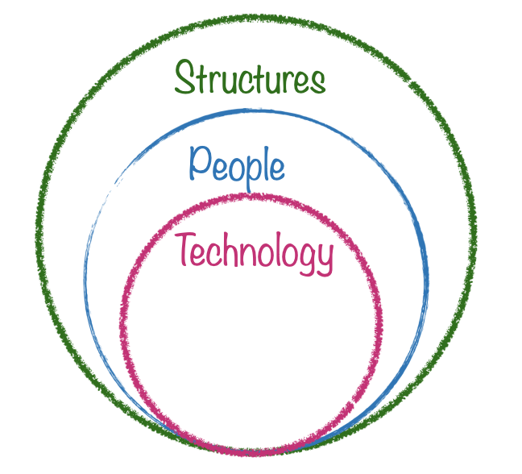
Why did these people make racially biased decisions?
A: Because racial biases and discrimination are built into our society at a structural level
Notes:
Tech often is created with the intention of solving a problem, and yet there are many examples of it exacerbating or causing new, worse problems than those it set out to solve.
This is because technology does not exist in a vacuum, but within a social, political, and historical context. This means that technology is never neutral, and that it can never on it's own solve a problem.

Slide 10
Starting from birth, till getting a job and beyond that, a white person is given more priority than a same aged black person
with same qualifications. Why? Because it is built into our society at a structural level.
Due to income inequality, black families cannot afford health insurance. This goes to show how the fundamental institutions
are racially biased, and it perpetuates across other institutions, even if it is through indirect means.
This textbook case is an excellent example of how racism is structural, rather than an individual failure. Individual doctors
and nurses may not be personally bigoted, but inequality is deeply engrained in the entire practice of medicine.
Only awareness of that knowledge and active efforts to change it can be considered anti-racist, interpersonal equality
on an individual level does nothing to change this status quo.

Slide 11
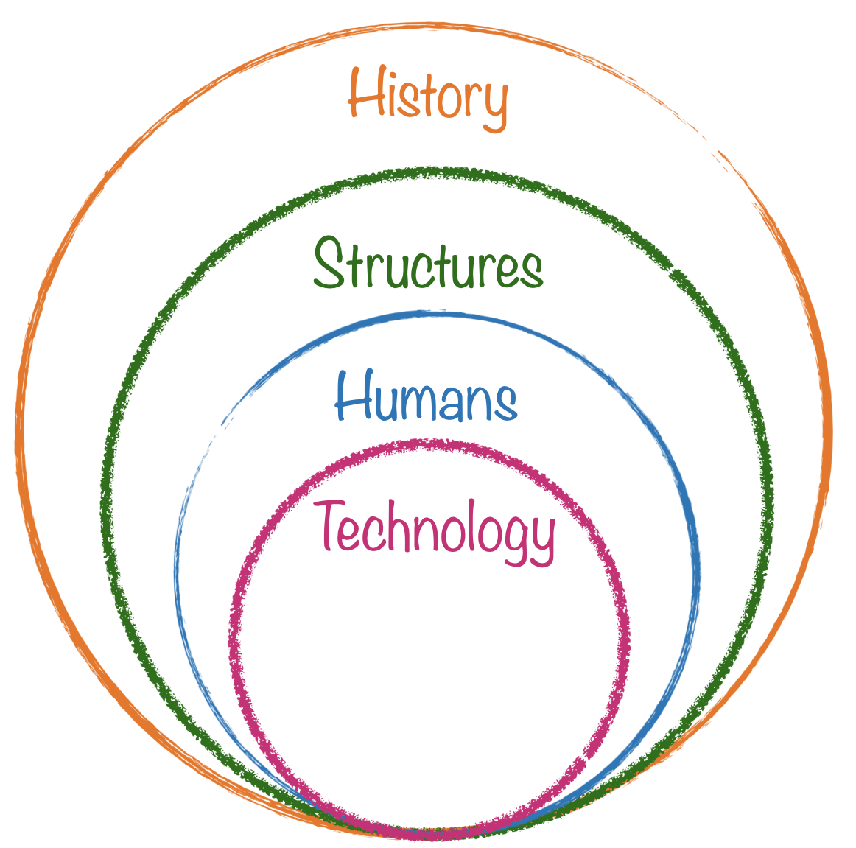
Why are racial bias and discrimination built into our society at a structural level?
A: Because American society has been historically unequal and discriminatory, and structural racism is reproduced over time
Notes:
Tech often is created with the intention of solving a problem, and yet there are many examples of it exacerbating or causing new, worse problems than those it set out to solve.
This is because technology does not exist in a vacuum, but within a social, political, and historical context. This means that technology is never neutral, and that it can never on it's own solve a problem.

Slide 12
Time by time we see that blacks were neglected, given a lower stature enslaved by whites, forced to live in redlining areas,
purposefully were denied the rights to social security or citizenship or were not allowed to own a property.
These structural inequality and structural racism made the young white children believe that blacks were always
inferior and were treated like an animal. These reasons say that due to bad historical decisions made by American
society built racial discrimination into the society at a structural level.
These movements were largely target at Black Americans, and created this system of distrust against the medical system
for the Black folks. This trickled down to modern society where many Black people are wary of the medical system,
and would refrain from seeking medical help, such as with the COVID vaccine.
This brief quote is one of many examples from the Vox video of how the medical establishment is largely built on a
foundation of discrimination and racism. Many medical discoveries and advancements were made at the expense
of enslaved people, and conversely medicine was used to rationalize slavery. This deep intertwining of racism and
healthcare still greatly effects modern day outcomes across racial lines, and is necessary context to build more
equitable algorithms in healthcare
Because at that time segregation existed and the prices for the neighborhood varied depending how populated they
were with black people or white people. That's why HOLC was created to grade the neighborhood when there was
segregation existed and white people paid more to live in a better neighborhood for the better future and the redlining
created and black people started to suffer in the different way that they never imagined.

Slide 13
Comments from your mentors

Slide 14
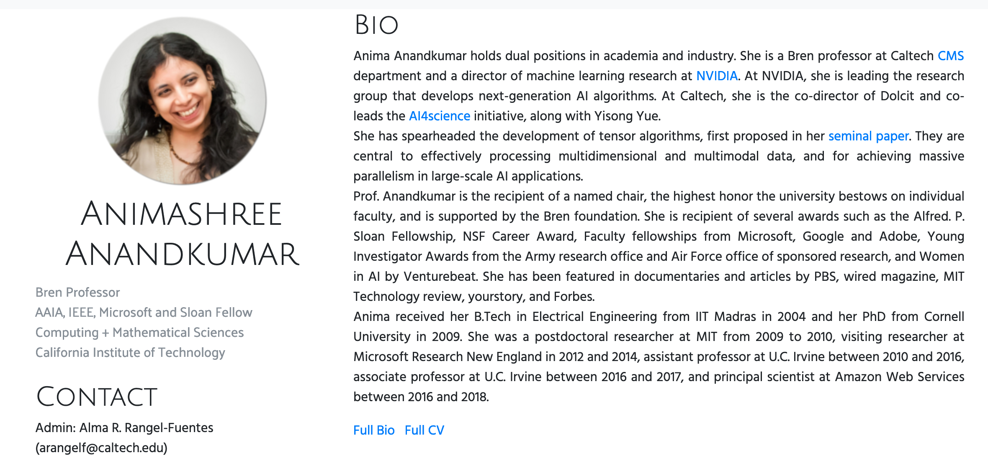
Passphrase for today: Anima Anandkumar

Slide 15
Few comments

Slide 16
People vs. Structure vs. History
How do individuals contribute to racist outcomes?
What are the current structures in society that lead to racist outcomes?
How does history explain the current
racist structures in place?

Slide 17
Let’s discuss!

Slide 18
The WHY worksheet

Slide 19
The HOW worksheet

Slide 20
HOW worksheet is out

