Slide 1
ML and Society
Mar 29, 2022

Slide 2
In-class meeting order

Slide 3
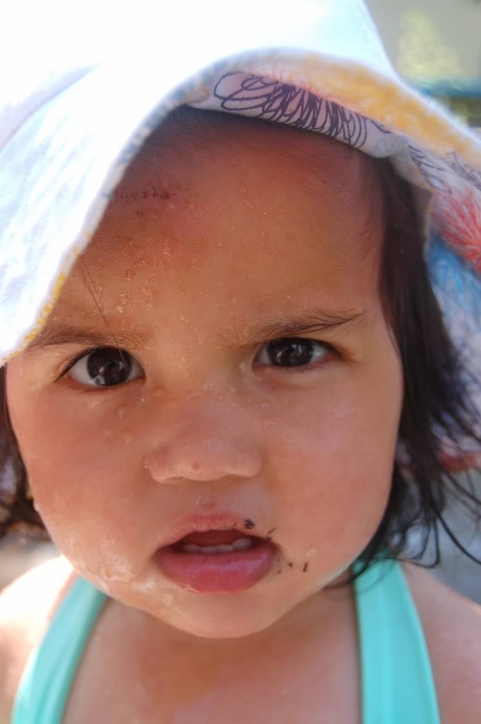
?

Slide 4
Passphrase for today: Sorelle Friedler

Slide 5
In-class meeting order

