Slide 1
ML and Society
Mar 31, 2022

Slide 2
Done with ML pipeline
Real world goal
Real world mechanism
Learning problem
Data collection mechanism
Which data to collect?
Data representation
Society
Target class/model
Deploy!
Evaluate error
Predict on test data
Model training
Training data set

Slide 3
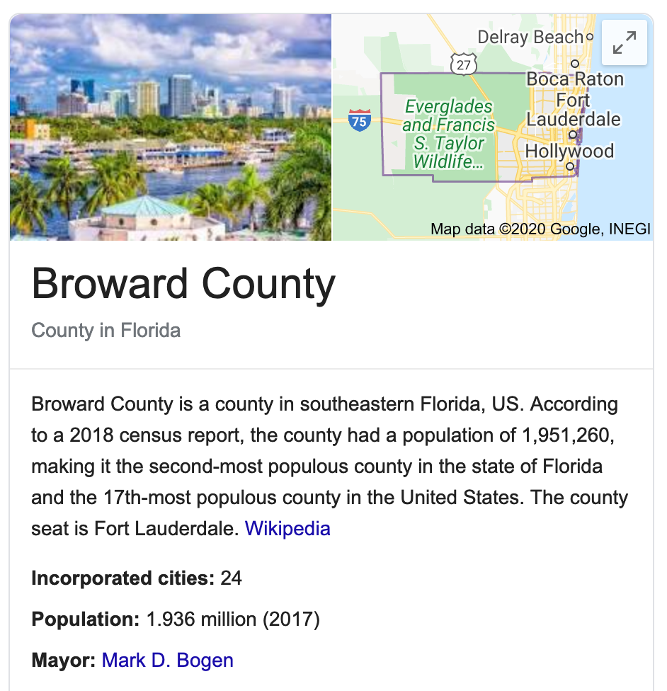
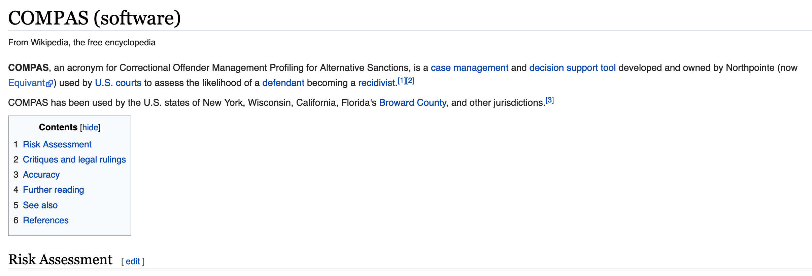
Do you remember COMPAS?

Slide 4
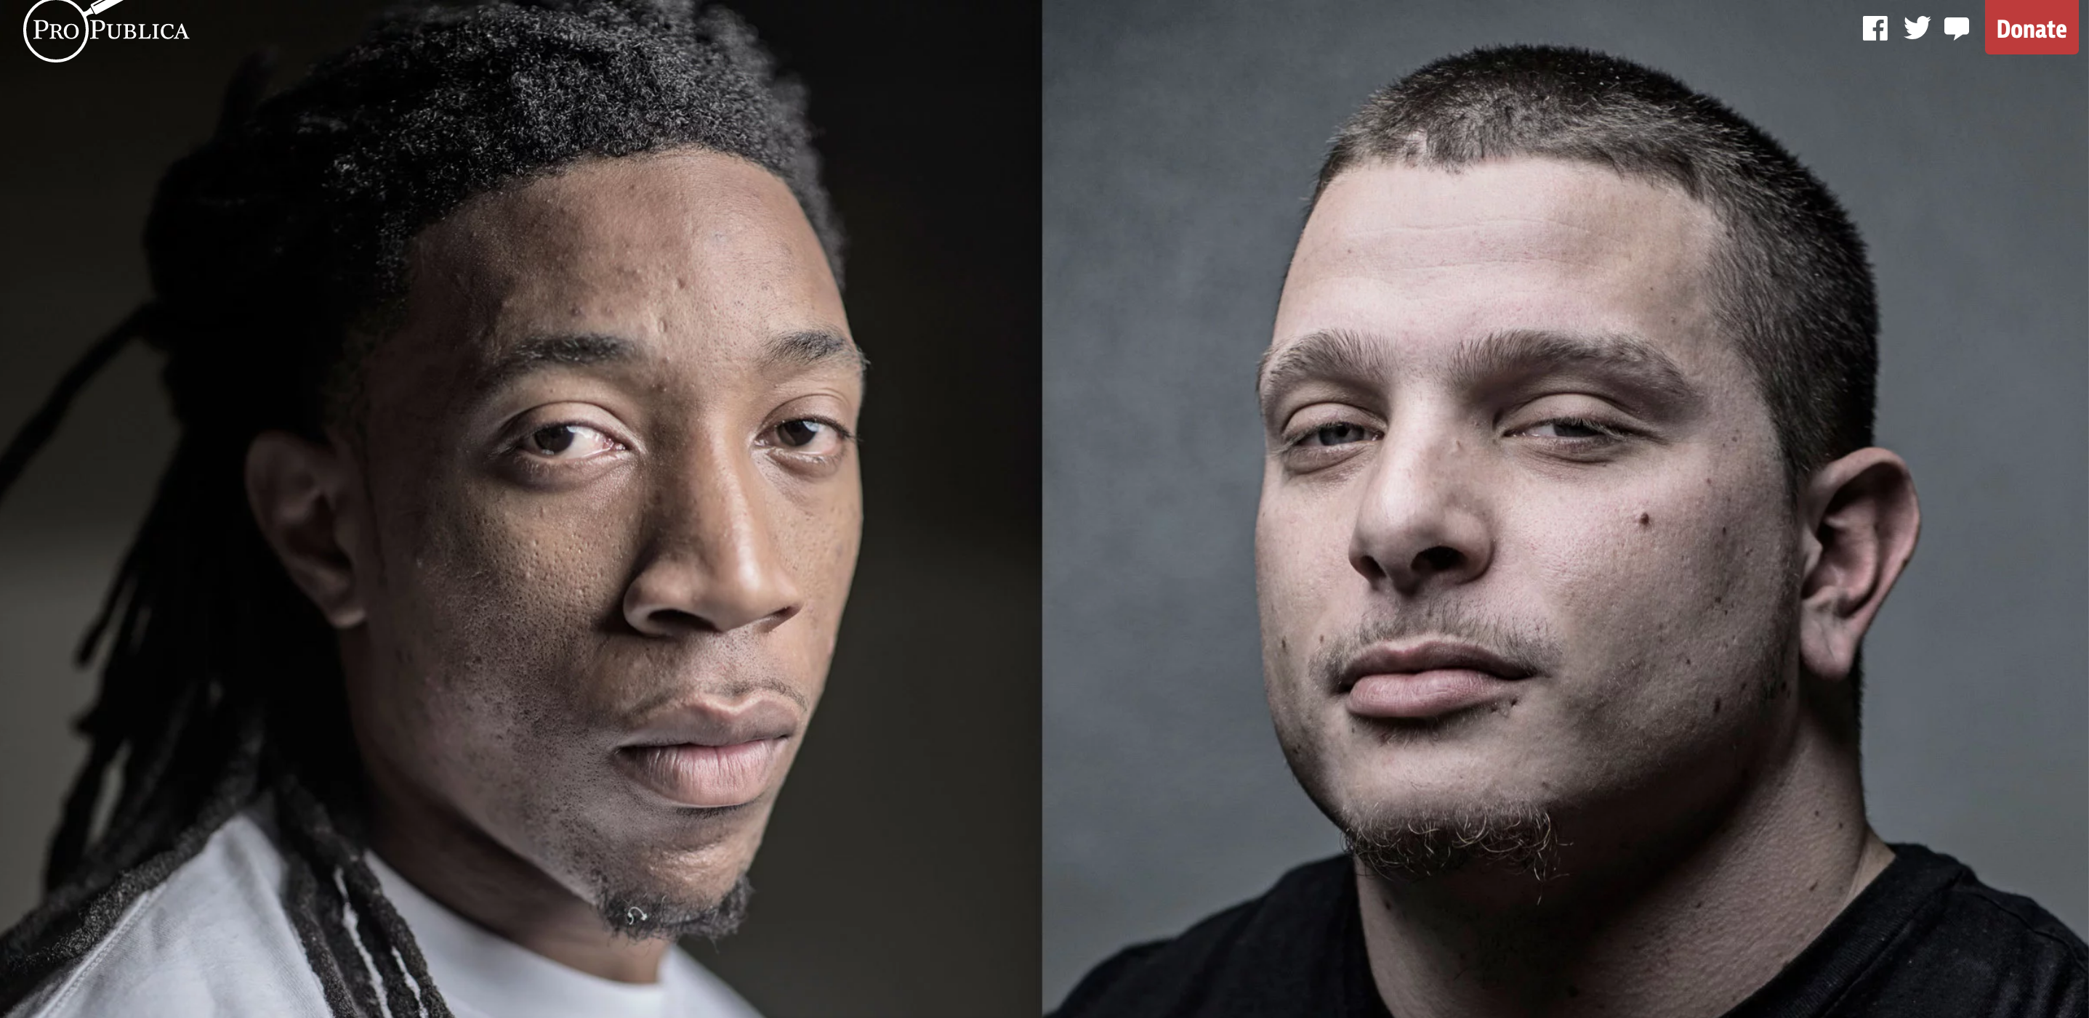
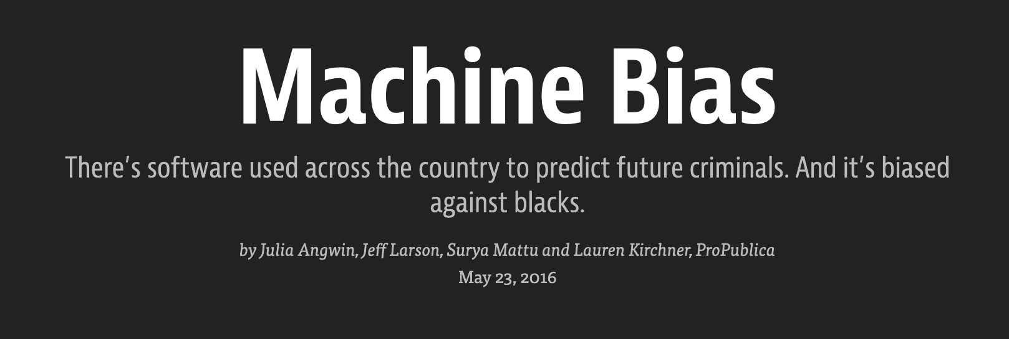

Slide 5
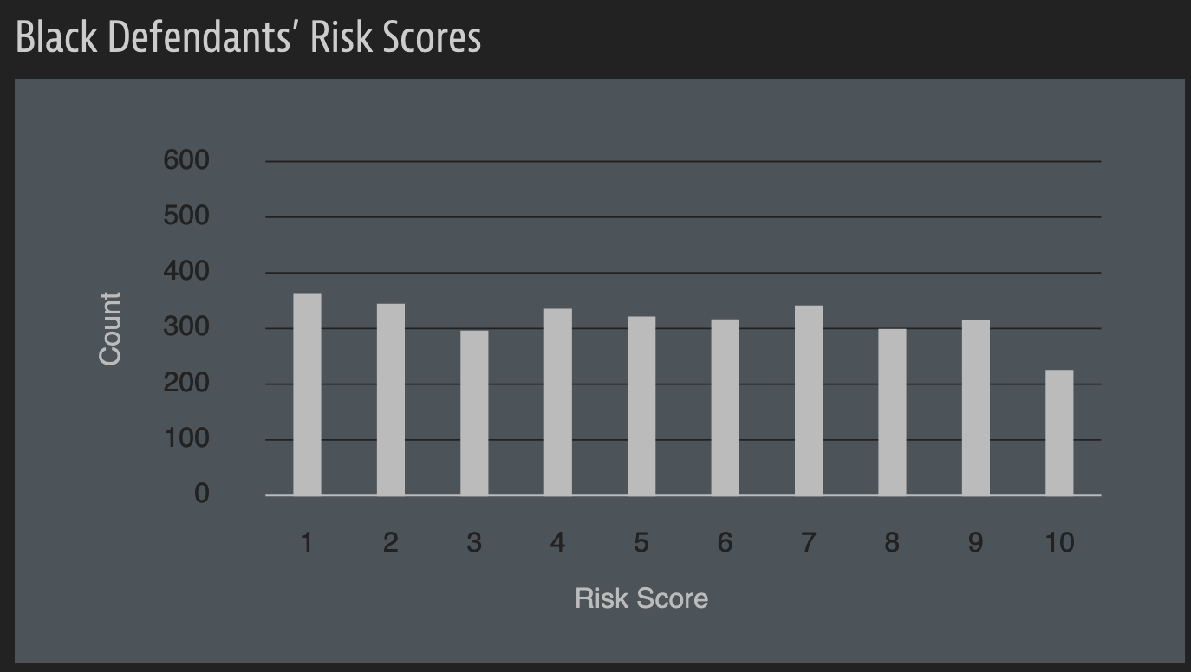
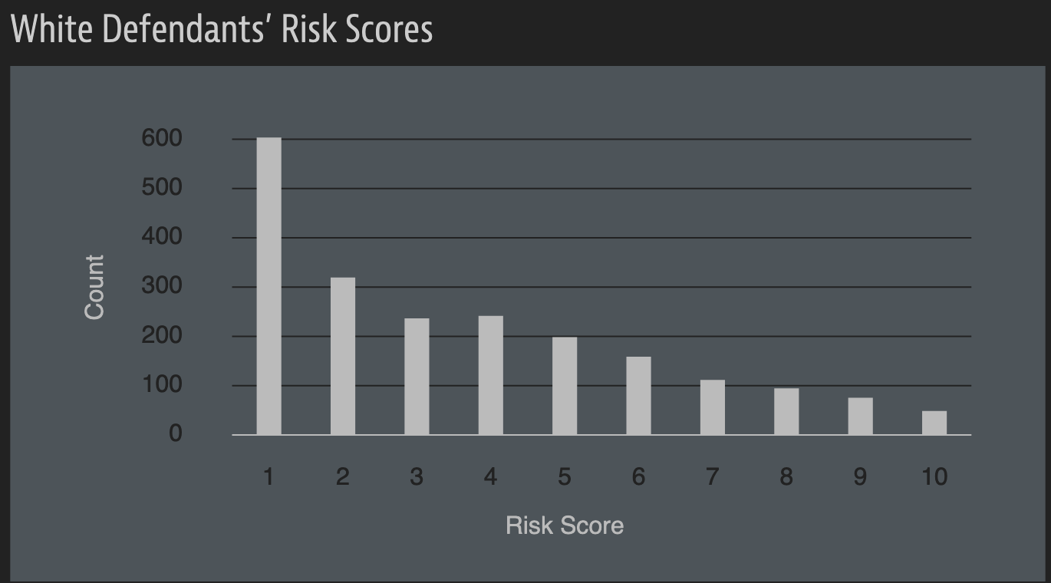
A sample of their result

Slide 6
A rejoinder

Slide 7
What is fair? Take-1
Individual Fairness

Slide 8
What is fair? Take-2
Equality/ Group Fairness

Slide 9
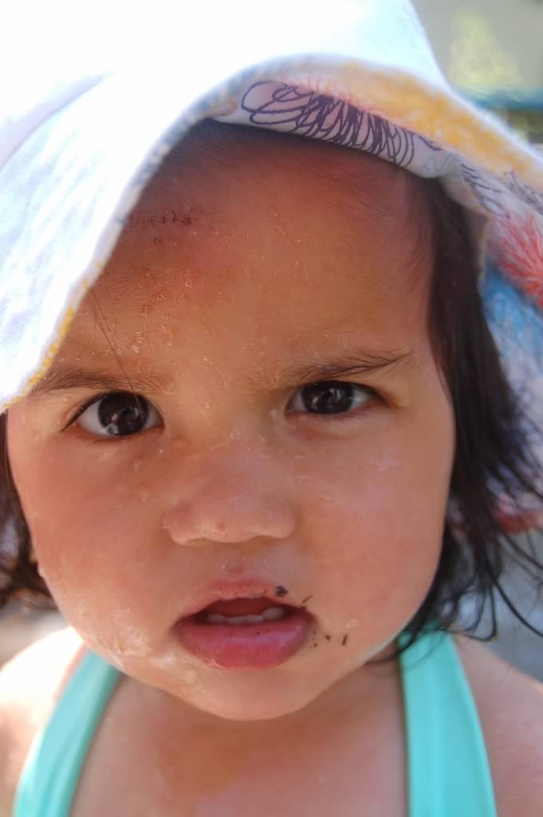
?

Slide 10
Very limited coverage

Slide 11
Will we get the definition of fairness?

Slide 12
What about bias?

Slide 13
?

Slide 14
Going beyond # correctly classified points
Points are NOT 2D!
Y= 1
Y= -1

Slide 15
Binary classifier output
S = 1
S = -1

Slide 16
“Confusion matrix”
S = 1
S = -1
Y= 1
21
21
21
21
Y= -1

Slide 17
True Positive rate
S = 1
S = -1
Y= 1
21
TPR =
21
21
21
Y= -1
TPR?

Slide 18
False Negative Rate (FNR)
S = 1
S = -1
Y= 1
21
21
FNR =
21
21
Y= -1
FNR?

Slide 19
False Positive Rate (FPR)
S = 1
S = -1
Y= 1
21
FPR =
21
21
21
Y= -1
FPR?

Slide 20
True Negative Rate (TNR)
S = 1
S = -1
Y= 1
21
21
TNR =
21
21
Y= -1
TNR?

Slide 21
TPR + FNR = 1
+
=
1
S = 1
S = -1
Y= 1
Y= -1

Slide 22
FPR + TNR = 1
+
=
1
S = 1
S = -1
Y= 1
Y= -1

Slide 23
?

Slide 24
Positive Predictive Value (PPV)
S = 1
S = -1
PPV =
Y= 1
21
21
21
21
Y= -1
PPV?

Slide 25
?

Slide 26
Back to fairness

Slide 27
Why statistical parity across groups?

Slide 28
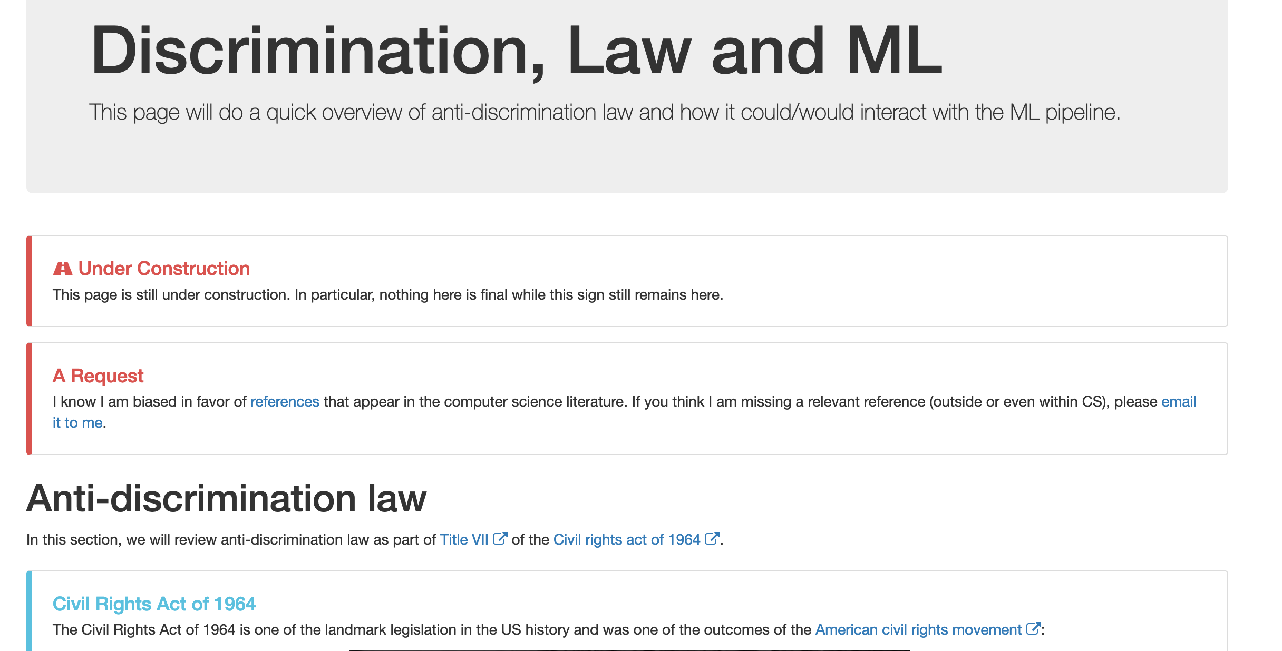
Notes on ML and law

Slide 29
Rates for groups
S = 1
S = -1
S = 1
S = -1
Y= 1
Y= 1
Y= -1
Y= -1
b
w
S = 1
S = -1
Y= 1
21
21
21
21
Y= -1

Slide 30
FPR and FNR for groups
Calculate the rates
S = 1
S = -1
Y= 1
FPR_{b} =
FPR_{w} =
Y= -1
b
S = 1
S = -1
FNR_{b} =
FNR_{w} =
Y= 1
Y= -1
w

Slide 31
PPV for groups
Calculate the values
PPV_{b} =
PPV_{w} =
S = 1
S = -1
S = 1
S = -1
Y= 1
Y= 1
Y= -1
Y= -1
b
w

Slide 32
?

Slide 33
Finally, the formal fairness definitions

Slide 34
Exercise!
S = 1
S = -1
S = 1
S = -1
Y= 1
Y= 1
Y= -1
Y= -1
b
w

Slide 35
Passphrase for today: danah boyd

Slide 36
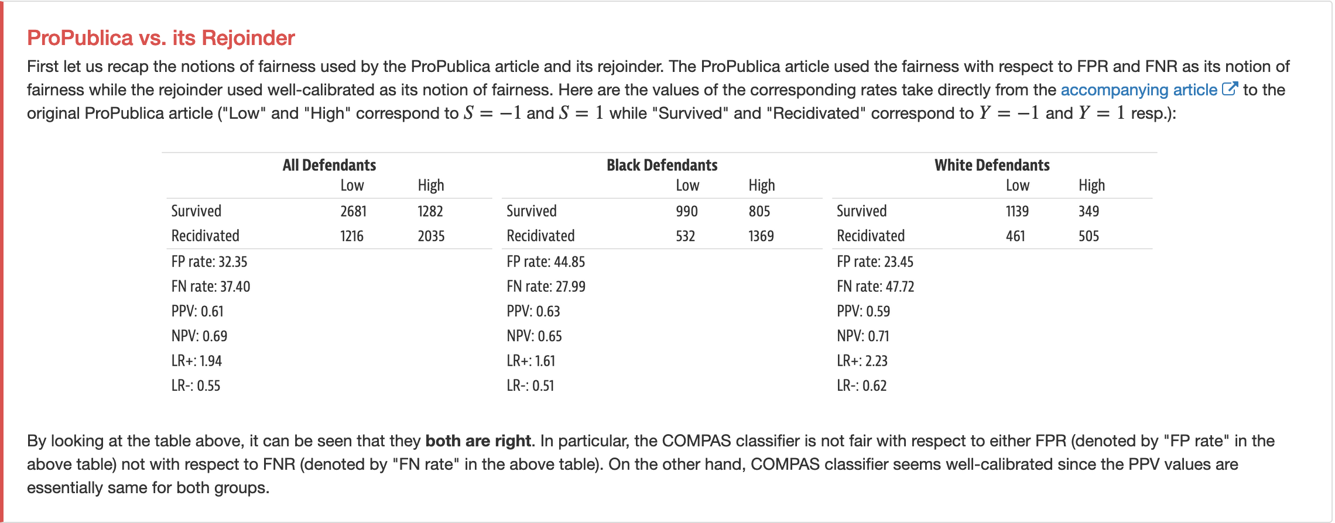
Connecting back to COMPAS story

Slide 37
?

Slide 38
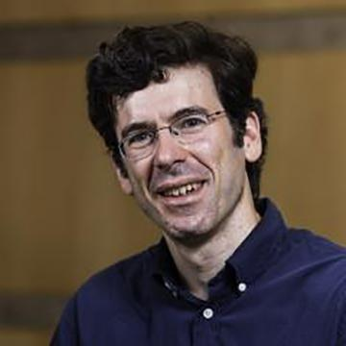
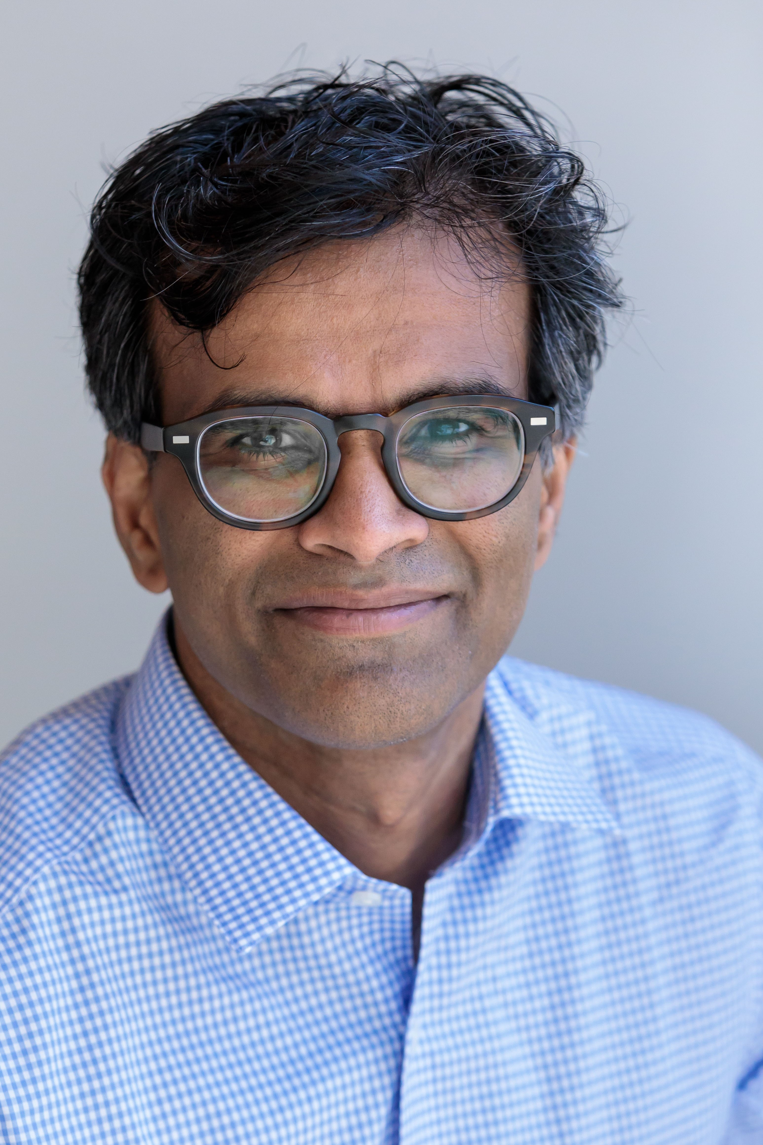
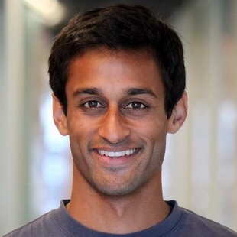
Perhaps COMPAS can be improved?

Slide 39
FNR_{b} = FNR_{w} = 1/2
S = 1
S = -1
S = 1
S = -1
x
x
y
y
Y= 1
Y= 1
Y= -1
Y= -1
b
w

Slide 40
FPR_{b} = FPR_{w} = 1/2
S = 1
S = -1
S = 1
S = -1
Y= 1
Y= 1
z
z
u
u
Y= -1
Y= -1
b
w

Slide 41
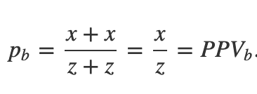
Overall situation
What are PPV_{b} and PPV_{w}?
S = 1
S = -1
S = 1
S = -1
x
x
y
y
Y= 1
Y= 1
z
z
u
u
Y= -1
Y= -1
b
w
When is PPV_{b} = PPV_{w}?

Slide 42
Argue the general case!
S = 1
S = -1
S = 1
S = -1
(1-p)$∙$x
p$∙$x
(1-p)$∙$y
p$∙$y
Y= 1
Y= 1
q$∙$z
(1-q)$∙$z
q$∙$u
(1-q)$∙$u
Y= -1
Y= -1
b
w

Slide 43
?

Slide 44
Get around the impossibility result?

Slide 45
Why should we care fairness wrt FNR and FPR

Slide 46
?

Slide 47
What if we only care about one fairness def?

Slide 48
Shortcomings of group fairness

Slide 49
Fairness gerrymandering

Slide 50
Consider this situation
Man
Woman
Black
White

Slide 51
FNR and FPR of various groups?
Man
Woman
Black
White

Slide 52
Individual Fairness

