Slide 1
ML and Society
Apr 5, 2022

Slide 2
Discussion summaries graded

Slide 3
Bonus Q finally graded!

Slide 4
In-class discussion

Slide 5
Thing to keep in mind
You are expected to participate ☺

Slide 6
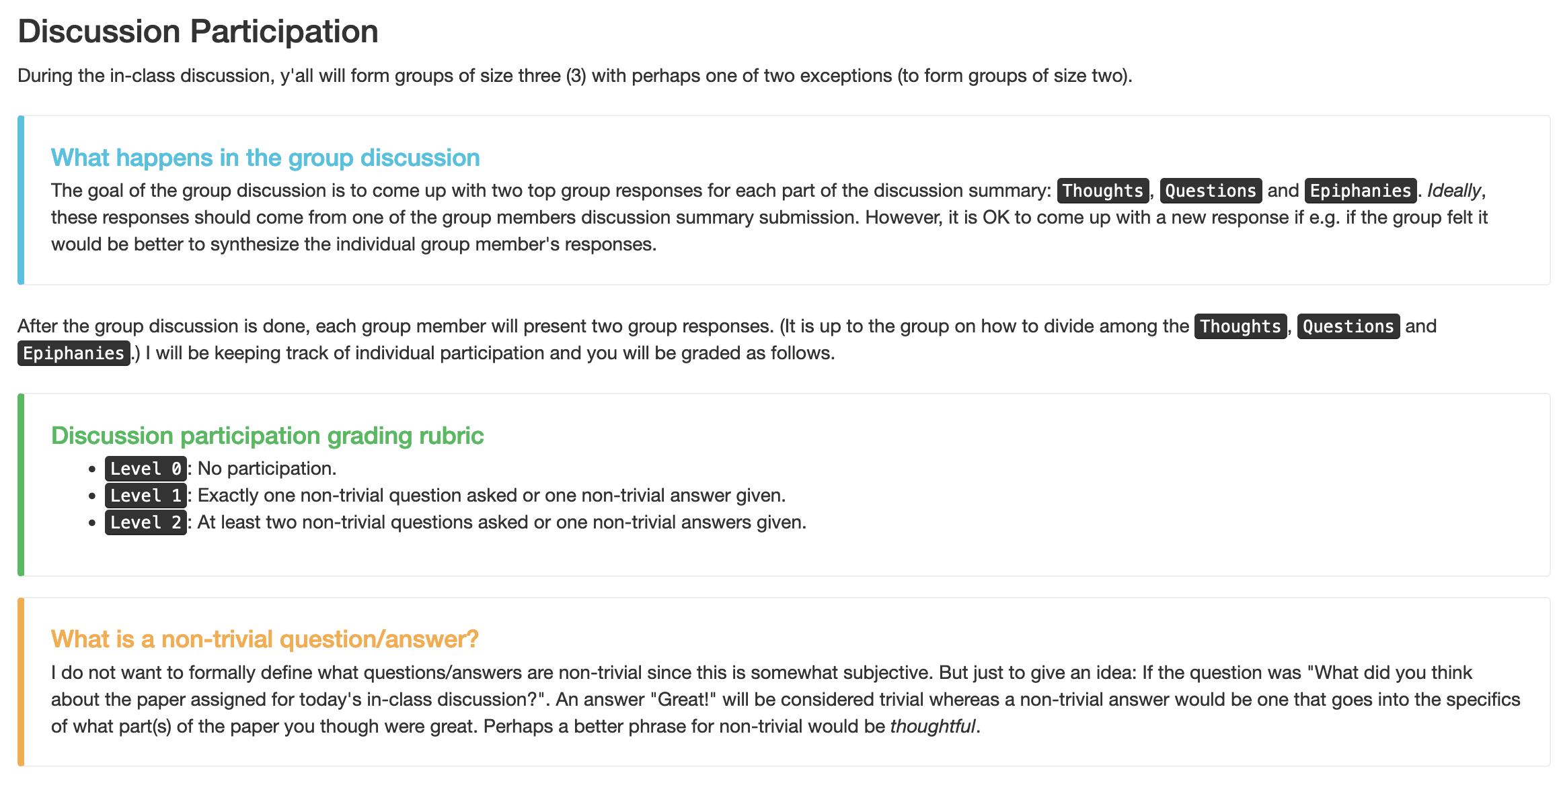
First form groups and discuss your answers

Slide 7
Discuss!

Slide 8
Thoughts

Slide 9
Passphrase for today: Maria Rodriguez

Slide 10
Questions + Epiphanies

