Slide 1
ML and Society
Apr 7, 2022

Slide 2
Order of presentations
Teaching tools
Algorithmic Auditing
Multiple fairness
Human Acceptance
Around 15 mins per group (presentation + <= 5 mins Q&A)

Slide 3
Teaching tools

Slide 4
Algorithmic Auditing

Slide 5
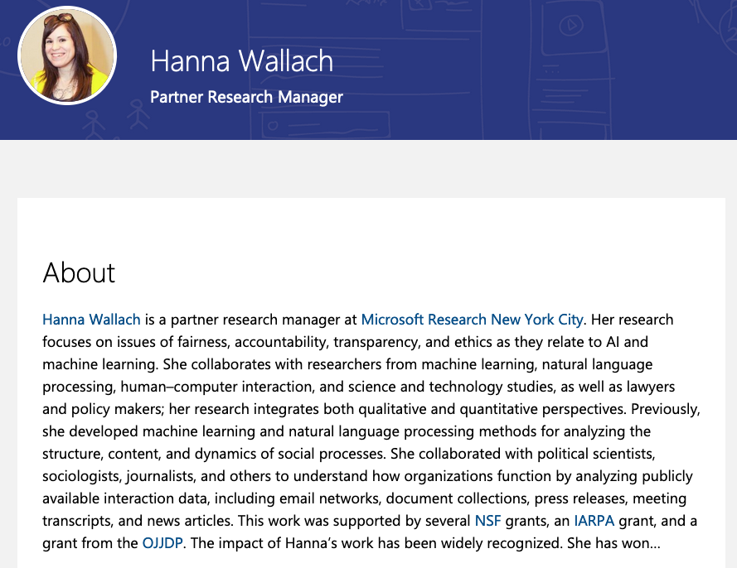
Passphrase for today: Hanna Wallach

Slide 6
Multiple fairness

Slide 7
Human Acceptance

