Slide 1
ML and Society
Apr 12, 2022

Slide 2
Discussion Summary for Thursday

Slide 3
Today’s OH

Slide 4
What is bias?

Slide 5
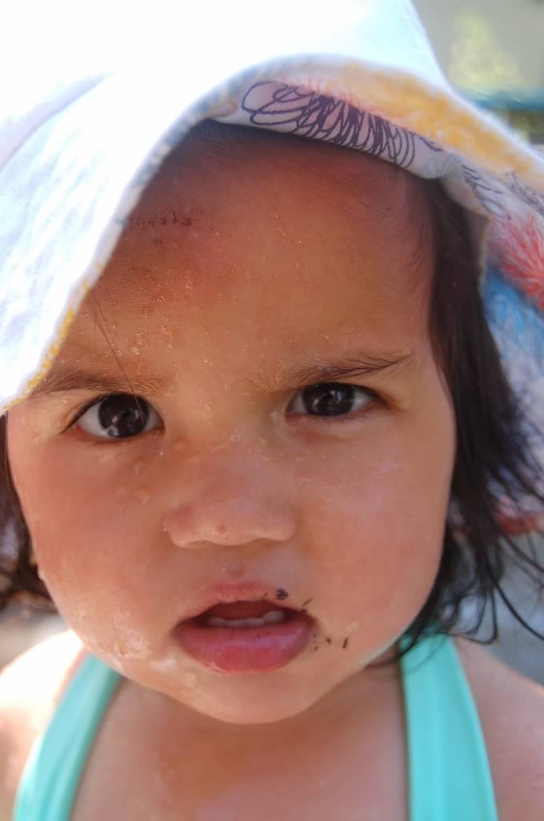
?

Slide 6
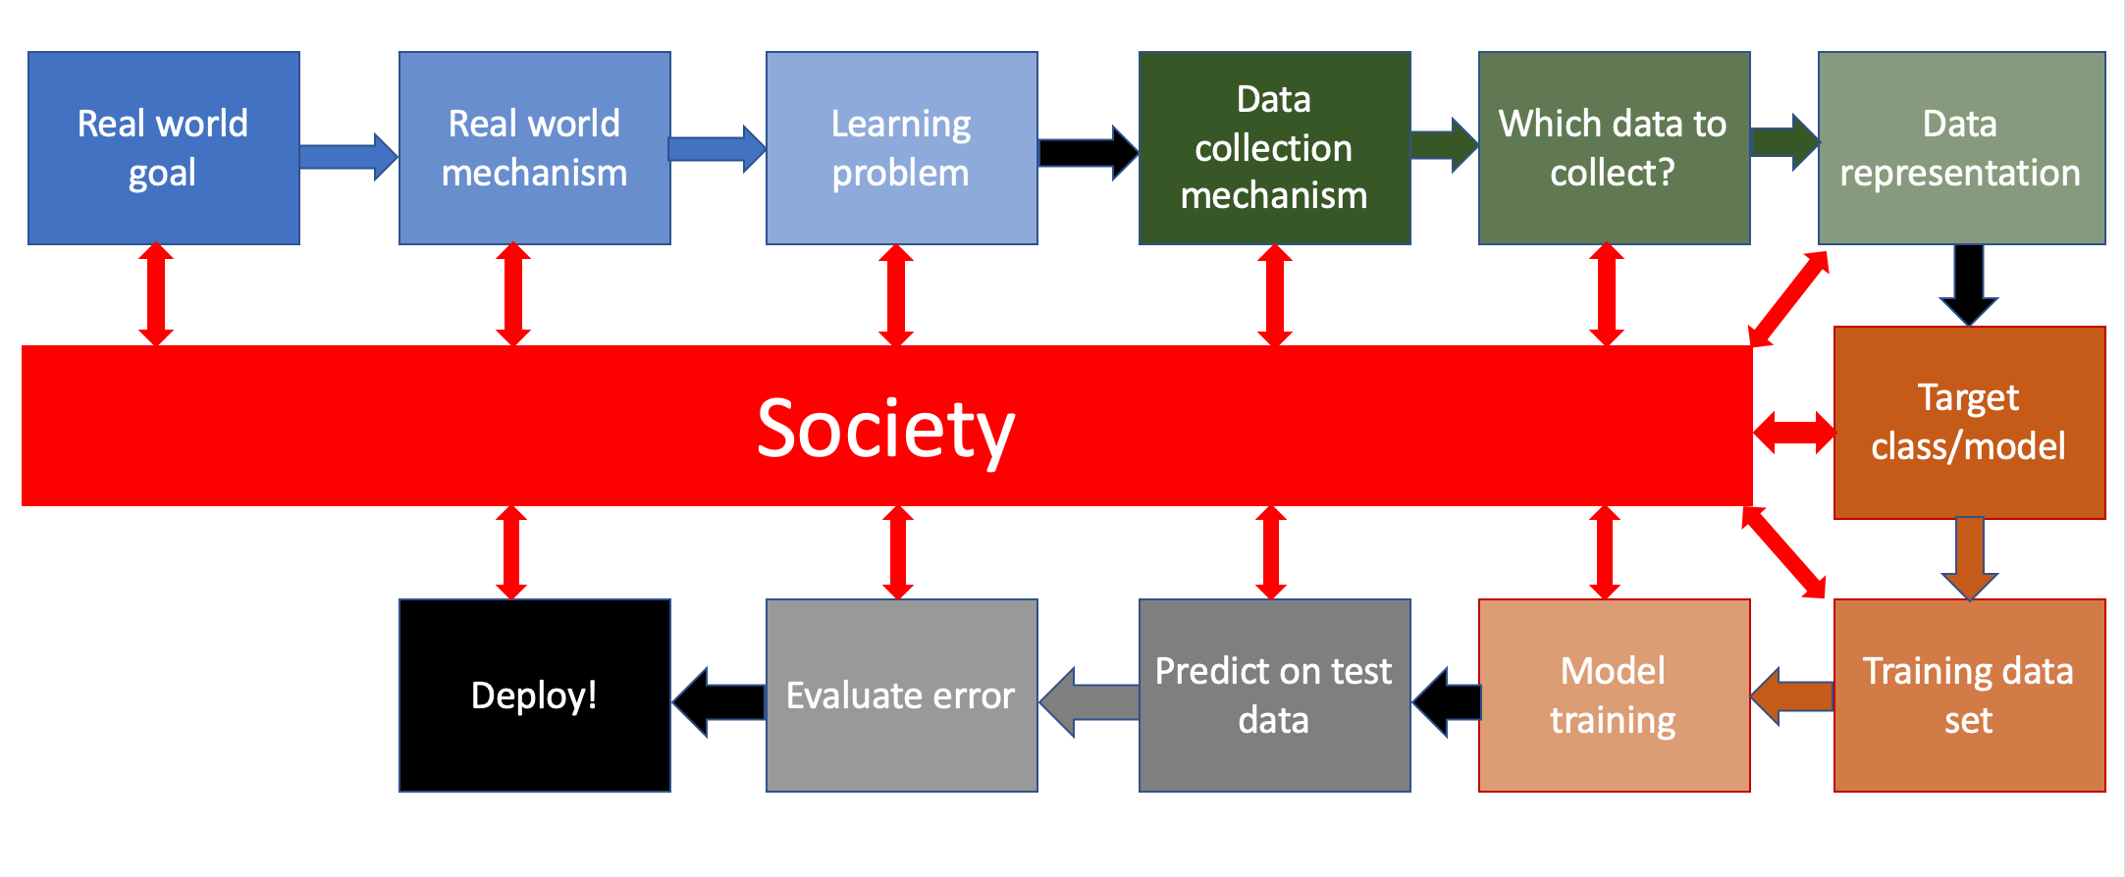
Bringing society back into the picture

Slide 7
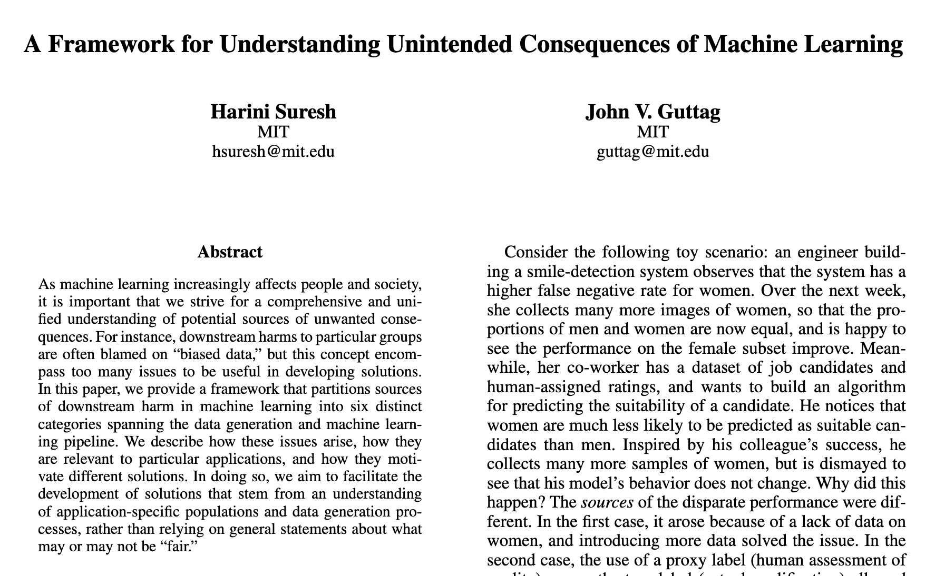
Six categories of bias of the 3rd kind

Slide 8
Historical Bias
Bias ingrained in society
Cannot be avoided even with perfect sampling of the population

Slide 9
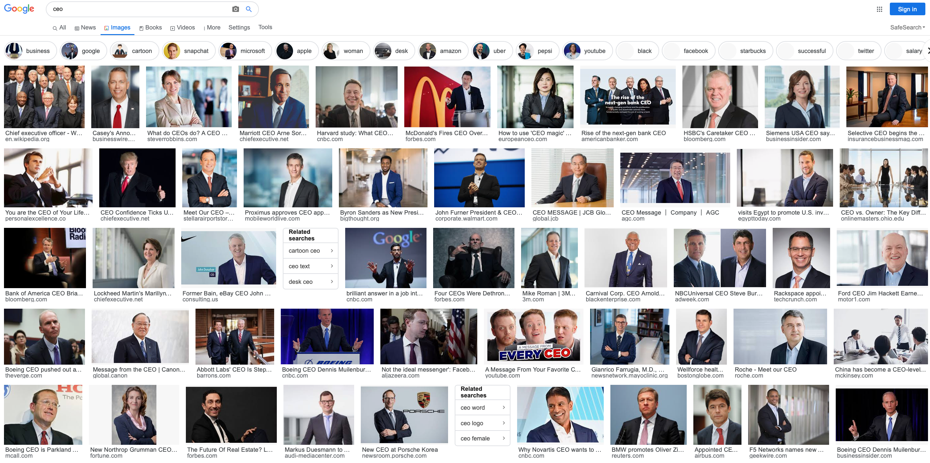
Earlier example: Google Image search “ceo”

Slide 10
There are few women CEOs

Slide 11
Another interesting video

Slide 12
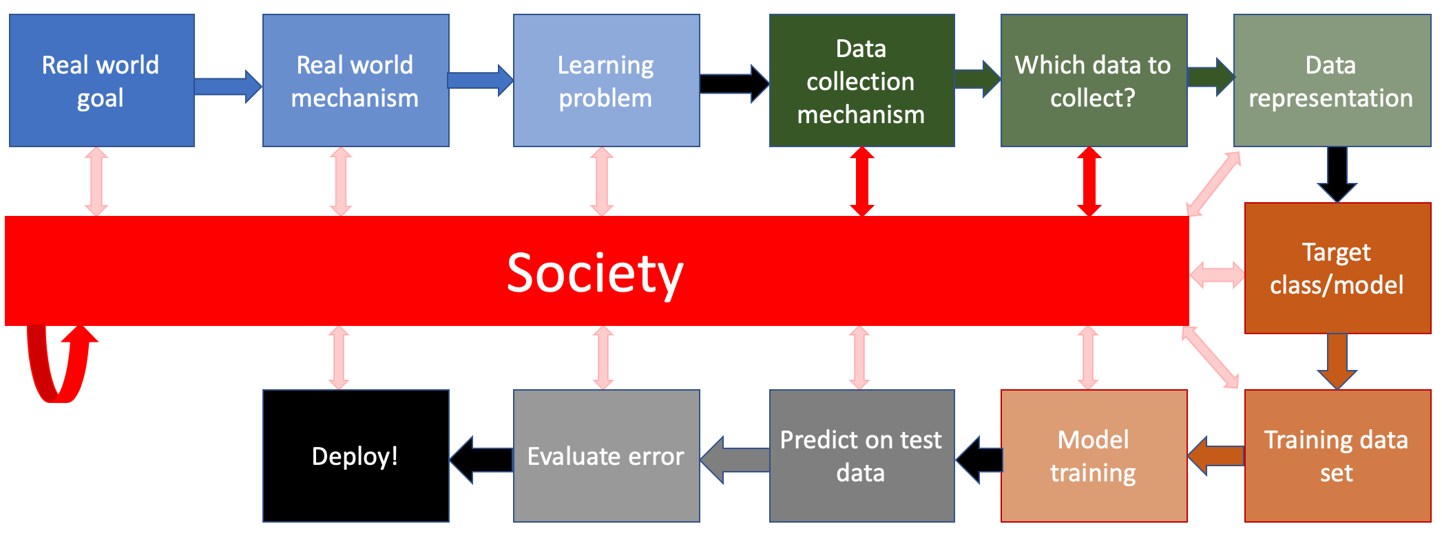
What are the relevant interactions?

Slide 13
How do we handle historical bias?
Discuss!

Slide 14
?

Slide 15
Representation bias
Certain section(s) of population excluded in your dataset

Slide 16
Reason #1: Data collection method excludes

Slide 17
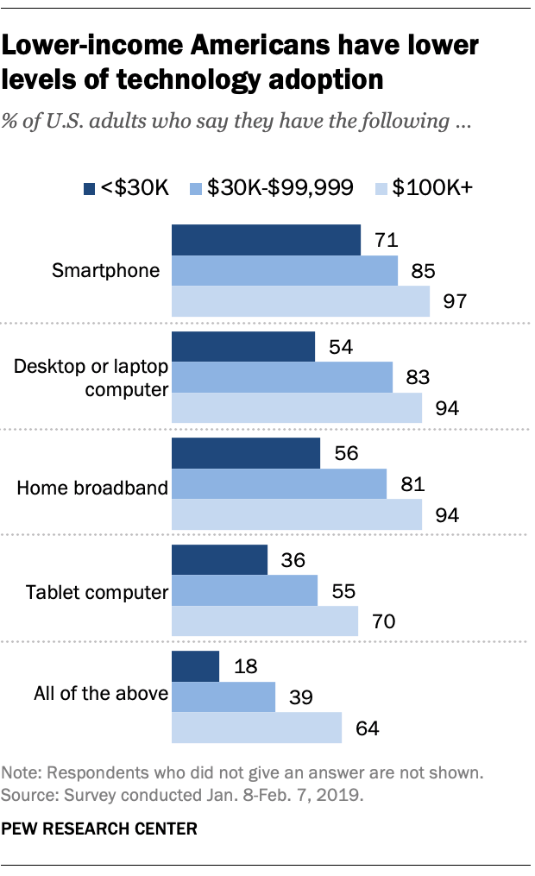
Who is being excluded here?

Slide 18
Acknowledgement: Kate Crawford

Slide 19
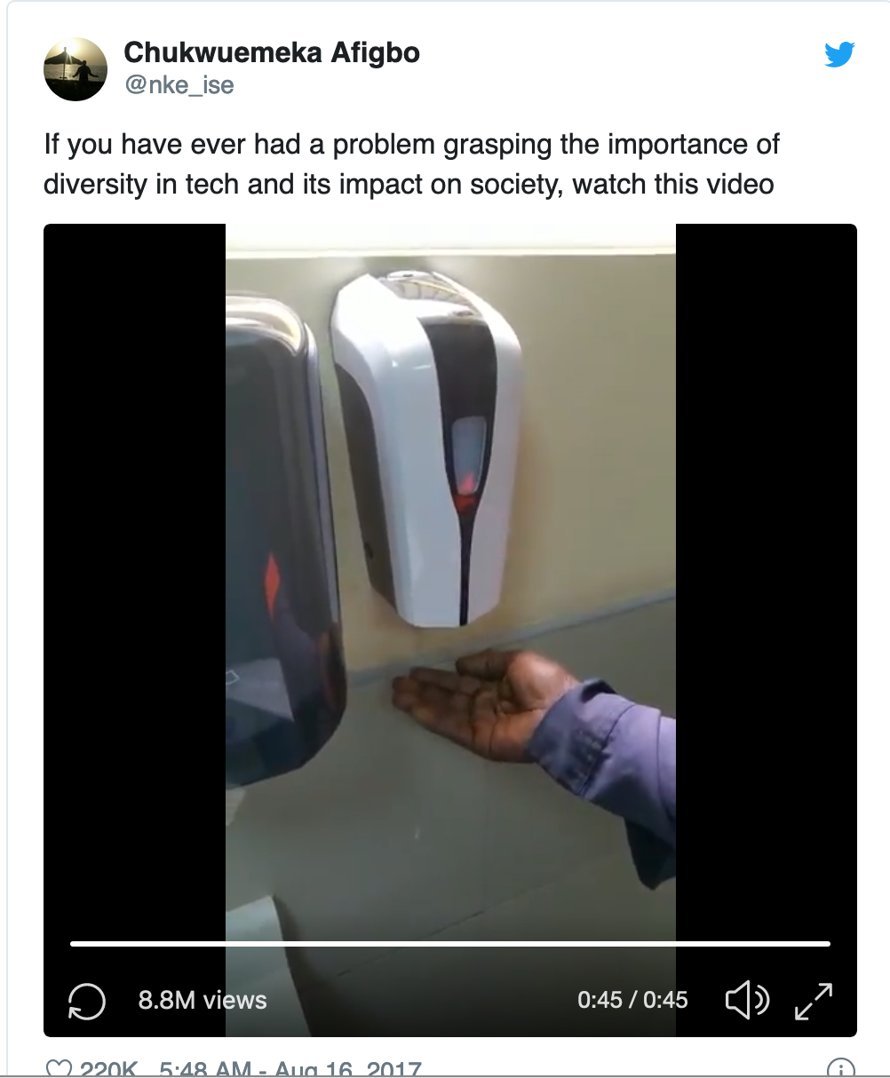
Reason #2: training data is not representative

Slide 20
Not specific to Machine Learning per se…
Do you know what a camera/film roll is?

Slide 21
Camera rolls had an issue…

Slide 22
Representative ex. for representation bias

Slide 23
Back to the ML pipeline

Slide 24
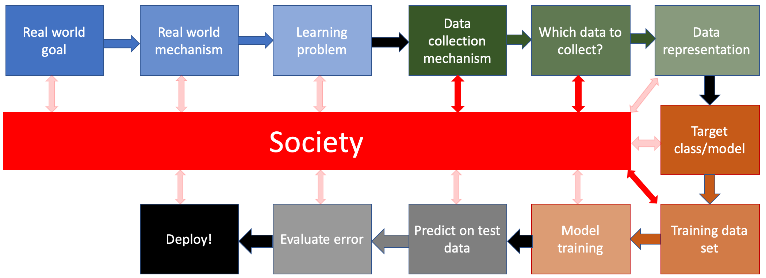
What are the relevant interactions?

Slide 25
?

Slide 26
How do we handle representation bias?
Discuss!

Slide 27
Measurement bias
Using a proxy variable instead of the “real” variable

Slide 28
Reason #1: Prevalence of proxy differs in grps

Slide 29
Another example

Slide 30
Reason #2: proxy is an over-simplification

Slide 31
Example: Predictive policing

Slide 32
Back to the ML pipeline

Slide 33
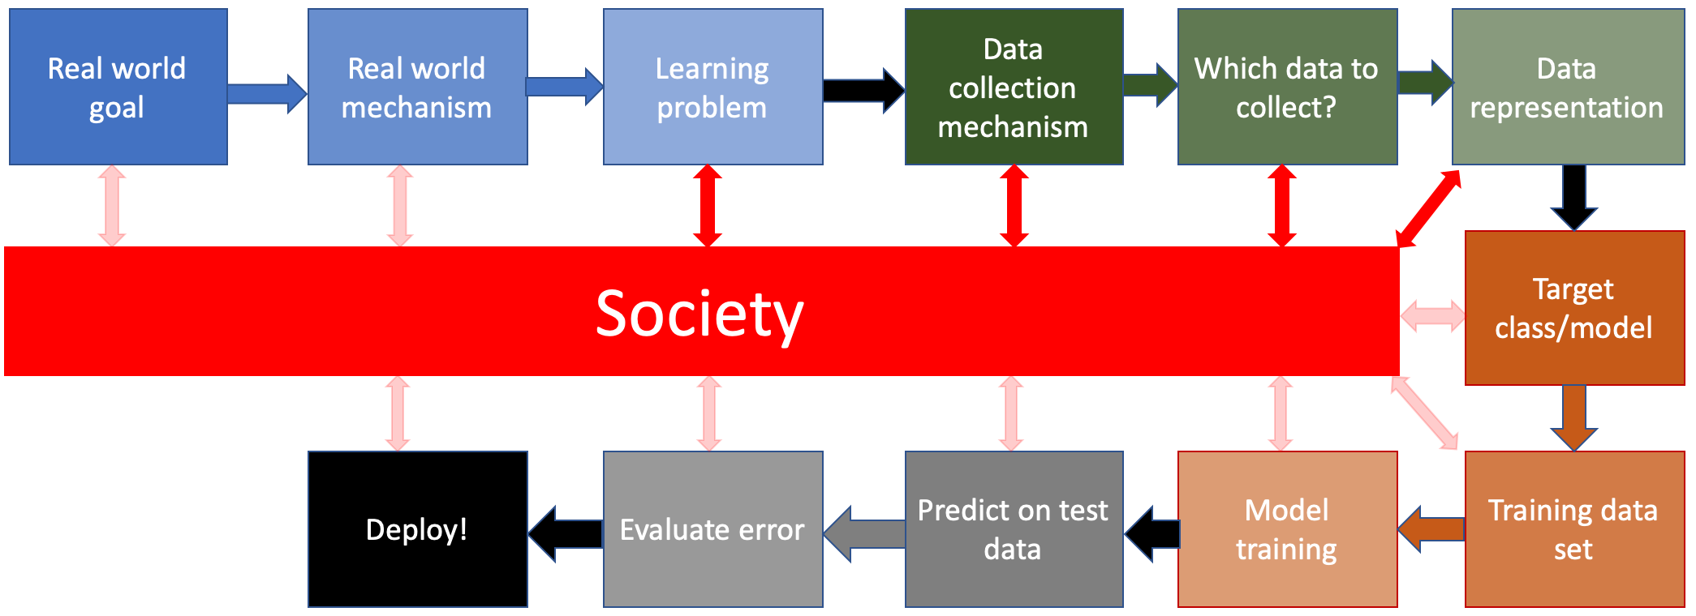
What are the relevant interactions?

Slide 34
?

Slide 35
How do we handle measurement bias?
Discuss!

Slide 36
Passphrase for today: Danielle Citron

