Slide 1
ML and Society
Feb 3, 2022

Slide 2
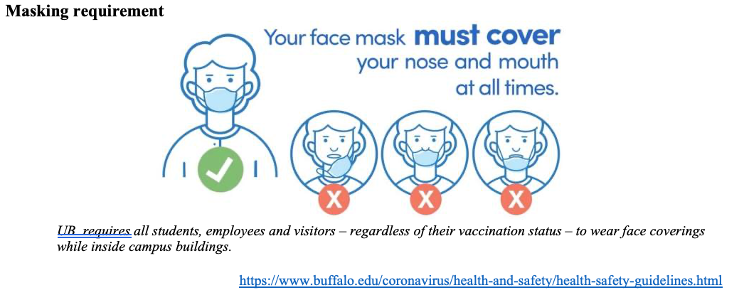
Please have a face mask on

Slide 3
Who does my machine learning model serve?
How do I know?
What can I do about it?

Slide 4
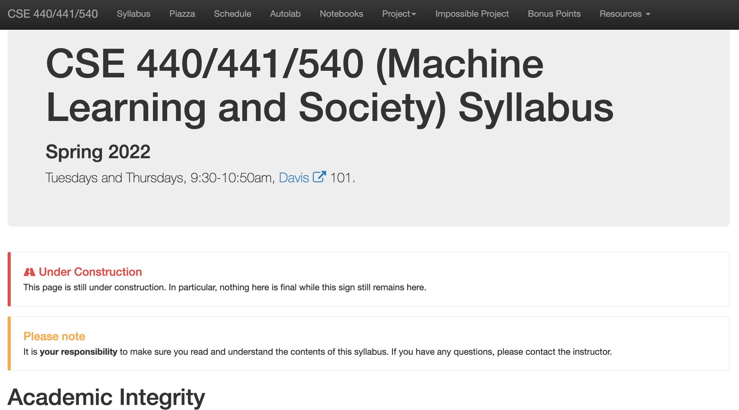
Read the syllabus carefully!

Slide 5
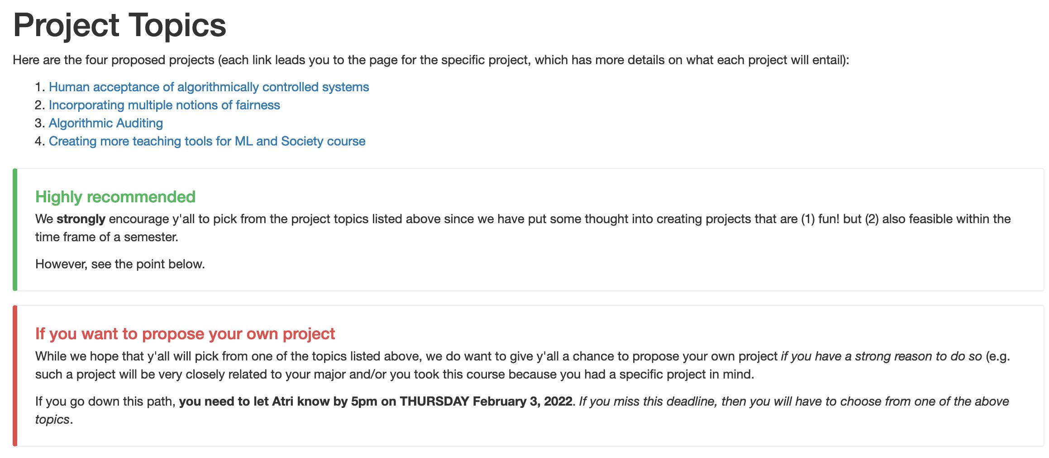
One (potential) project deadline TODAY 5pm!

Slide 6
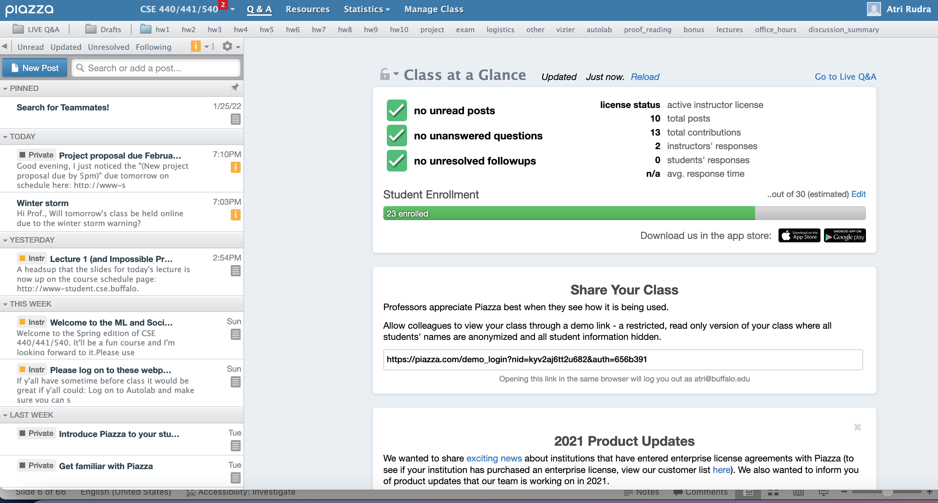
Make sure you are on piazza

Slide 7
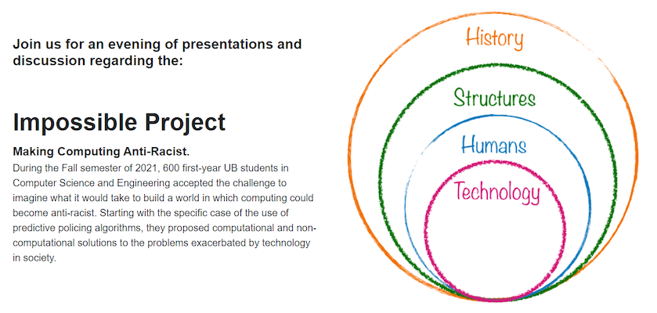
Impossible Project event

Slide 8
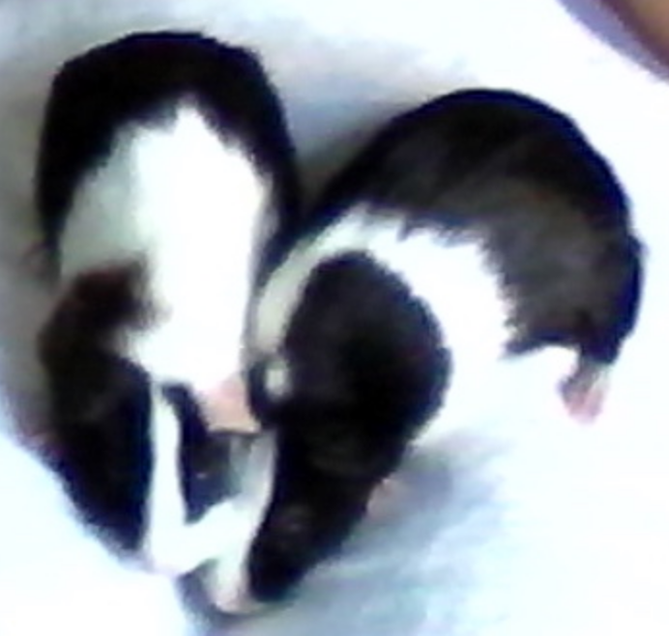
Few things I forgot to mention
If something does not make sense, it’s almost surely my fault!
Feedback is greatly appreciated!

Slide 9
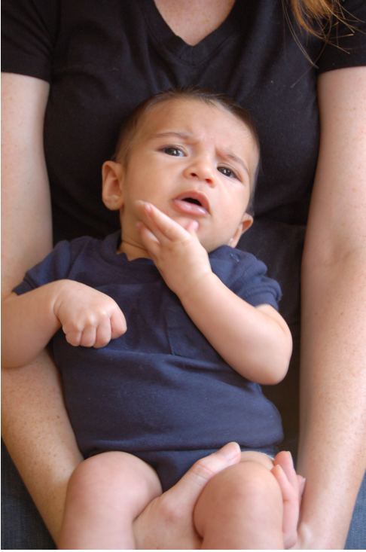
Questions/Comments?

Slide 10
Let’s move to Google translate

Slide 11
Translation job# 1
She is a doctor
He is a nurse

Slide 12
Hit translate once…

Slide 13
Hit translate one more time!
Notice anything?

Slide 14
Translation job# 2
She is a mathematician
He is a dancer

Slide 15
Hit translate once…

Slide 16
Hit translate one more time!
Notice anything?

Slide 17
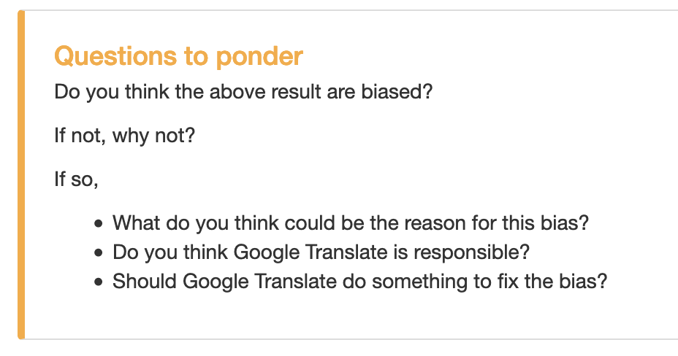
Questions to ponder

Slide 18
Questions/Comments?

Slide 19
Why does this matter?

Slide 20
Questions/Comments?

Slide 21
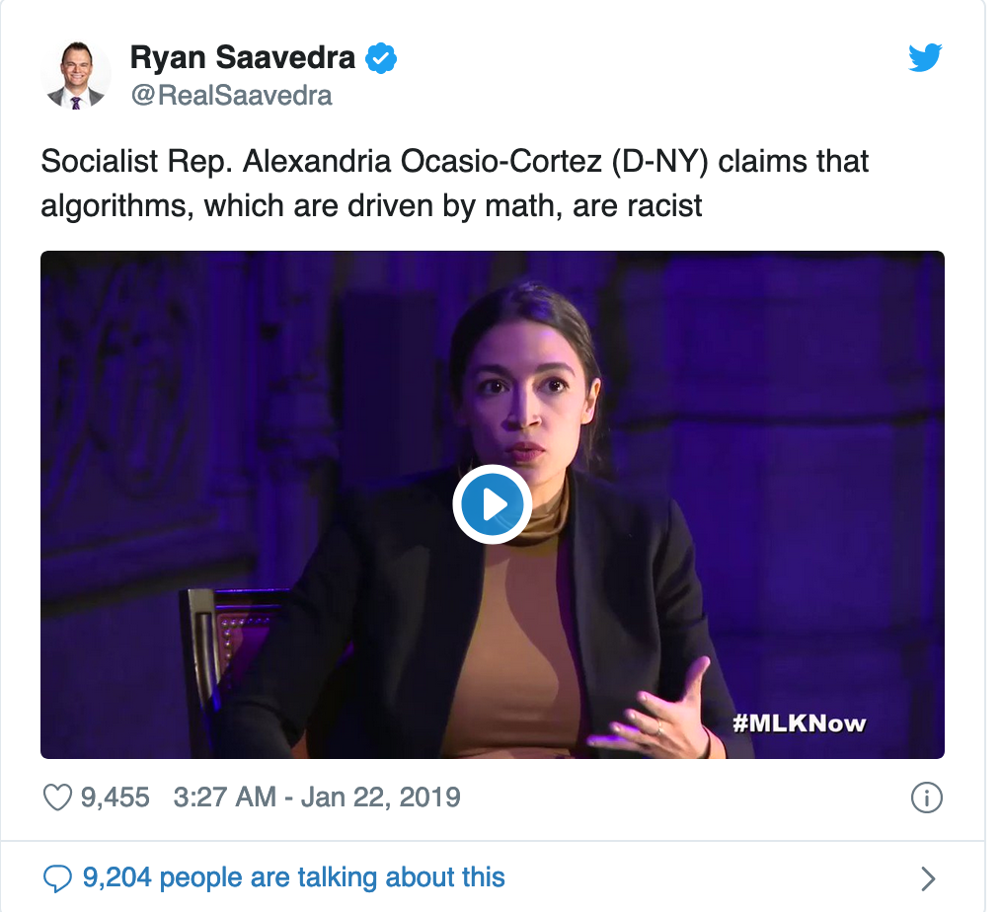
So who is right?
Depends on what you mean by “algorithm”
“Algorithms can be biased”
”Algorithms are based on math
and hence cannot be biased"

Slide 22
Main Steps in Traditional Algorithm Design
Problem Statement
Real world problem
Problem definition
Problem Definition
Precise mathematical def
Algorithm
Algorithm design
“Implementation”
Data Structures
Analysis
Correctness/Run time

Slide 23
Two main points about traditional algorithms
Though really you would wrong there as well since the problem statement itself could be biased..
Problem is defined BEFORE algorithm is designed
Can prove algorithm is correct for ALL inputs
One could consider such algorithms not biased

Slide 24
Today
Correct for modern algorithms
“Algorithms can be biased”

Slide 25
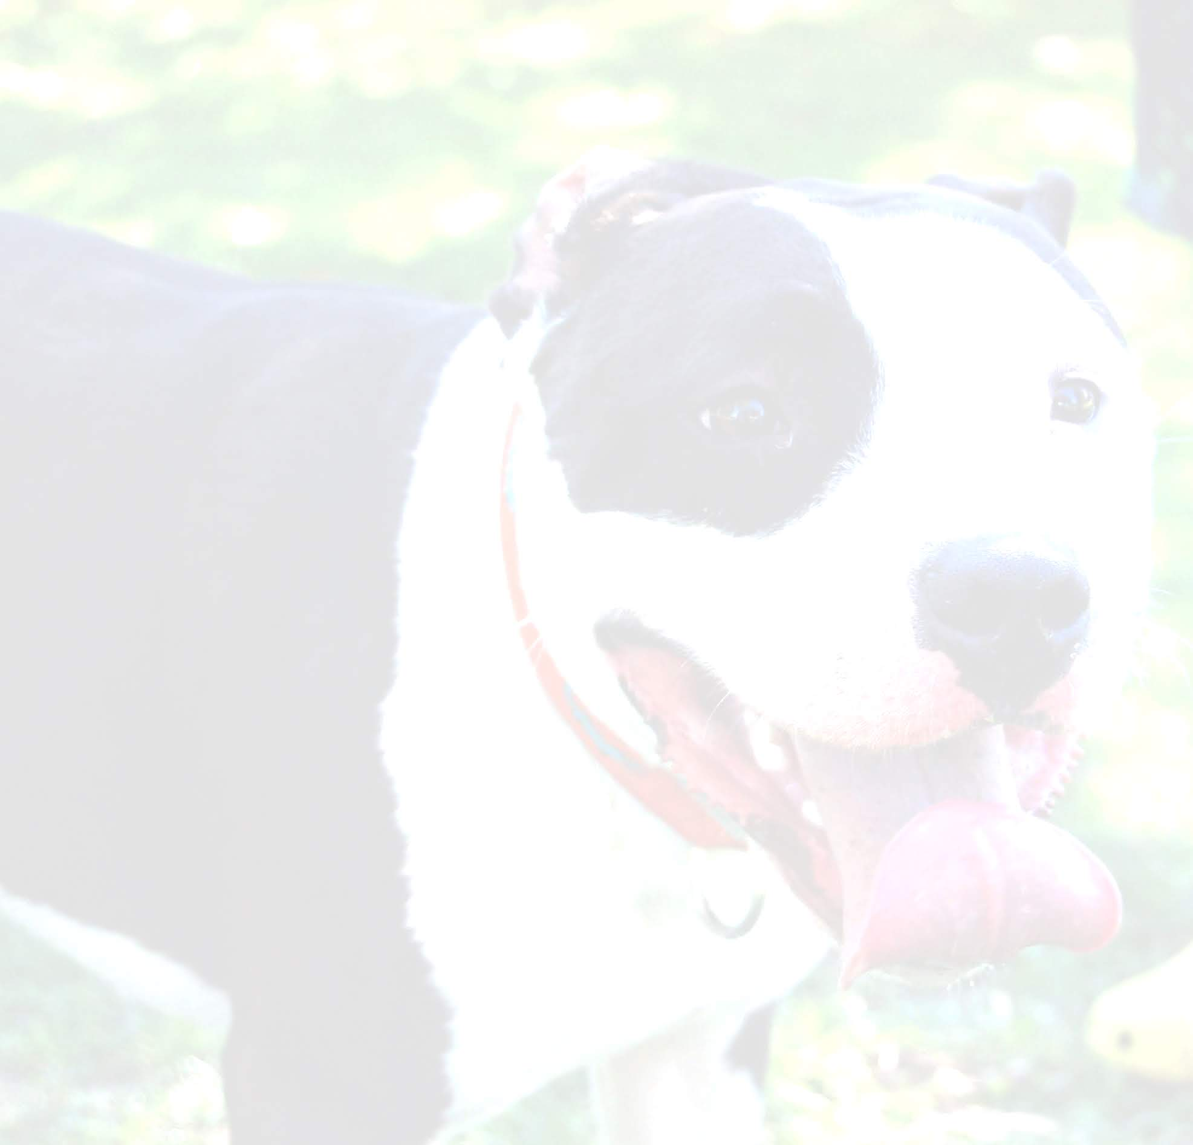
Cat vs. Dogs

Slide 26
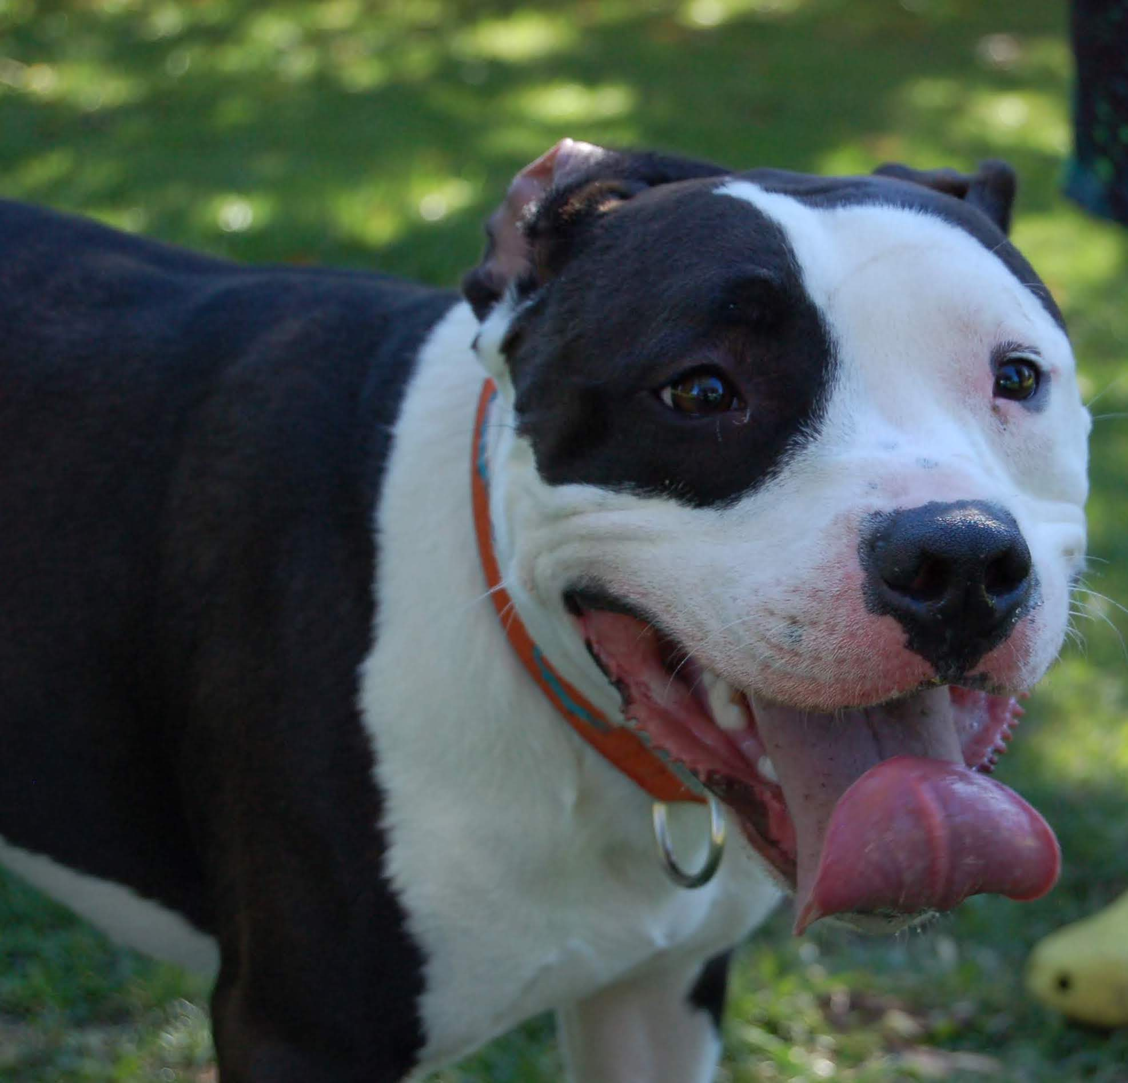
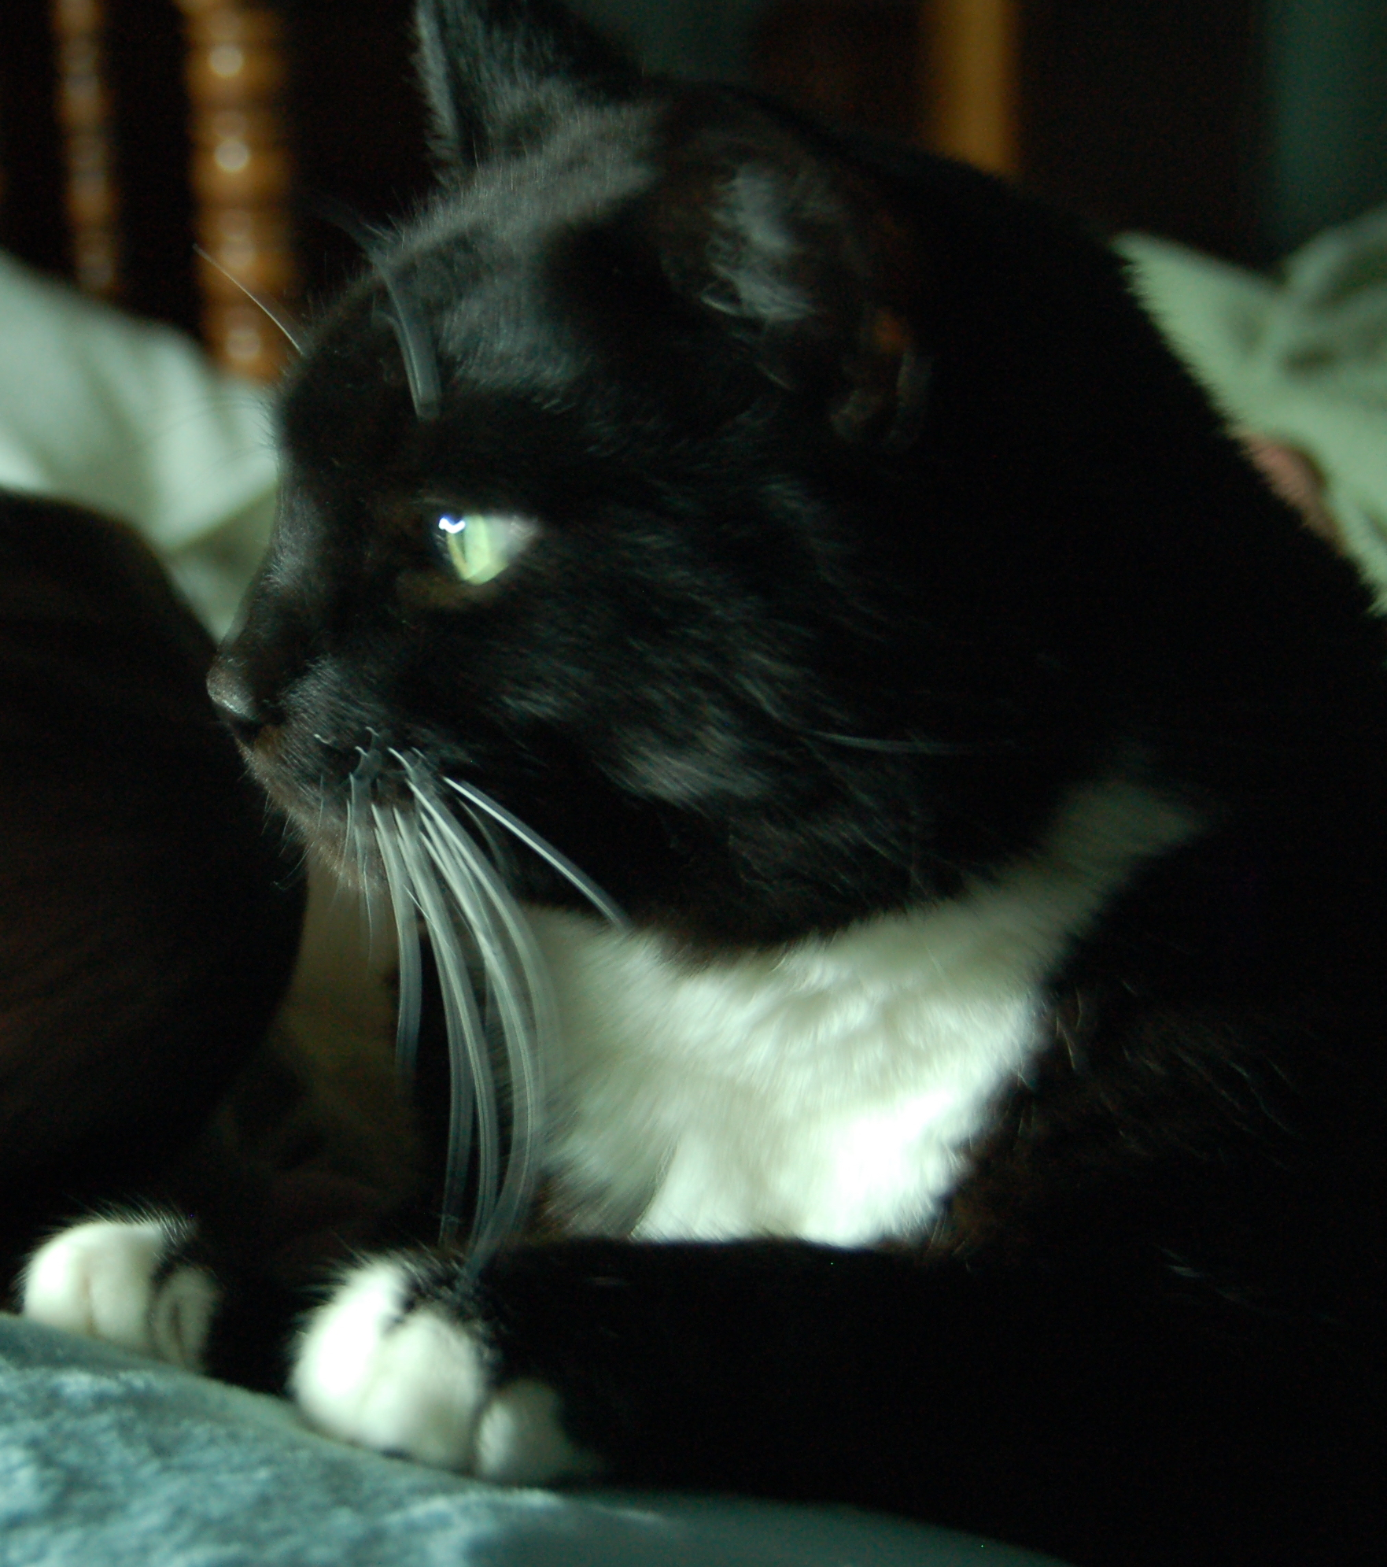
Warren and Billy

Slide 27
How do you “define” a dog vs cat image?

Slide 28
Google Images has “solved” this problem

Slide 29
How do you “define” a dog vs cat image?
http://www-student.cse.buffalo.edu/~atri/algo-and-society/support/notes/intro/images/warren.JPG
http://www-student.cse.buffalo.edu/~atri/algo-and-society/support/notes/intro/images/billy.JPG

Slide 30
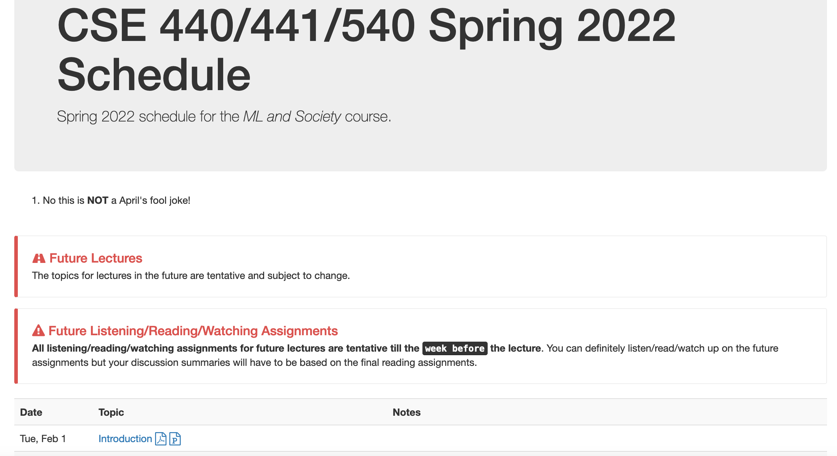
Better way to get to the URL

Slide 31
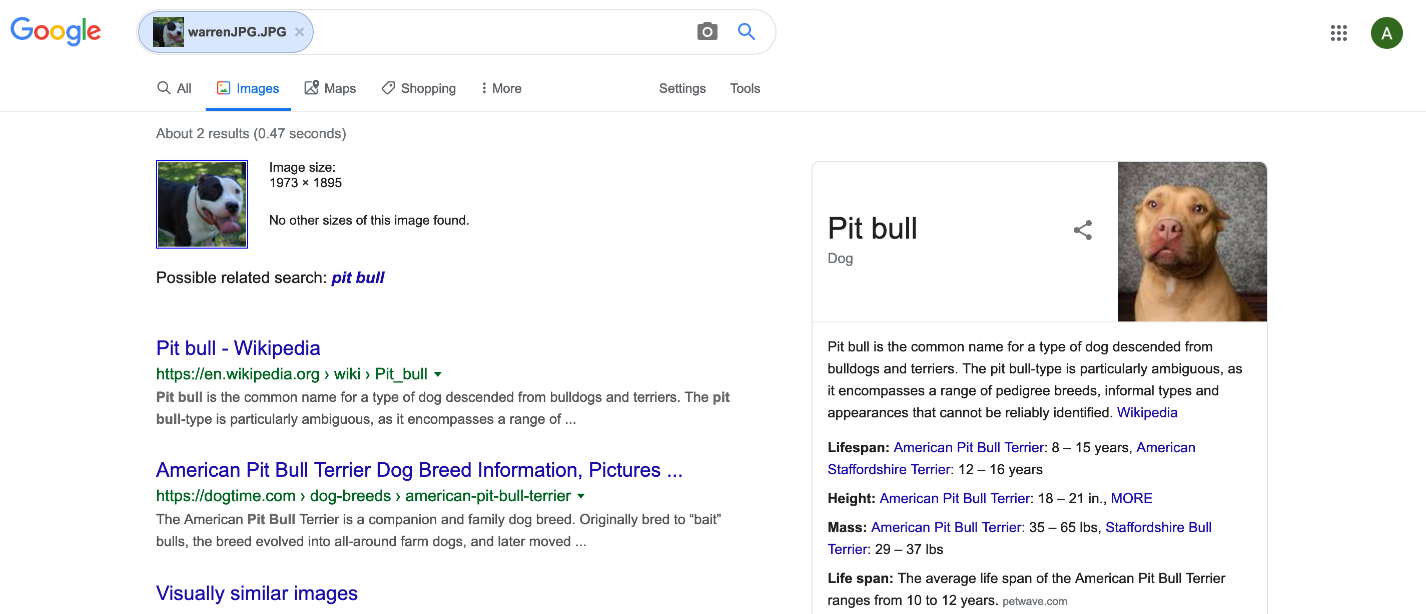
My result for Warren (Spring 20)

Slide 32
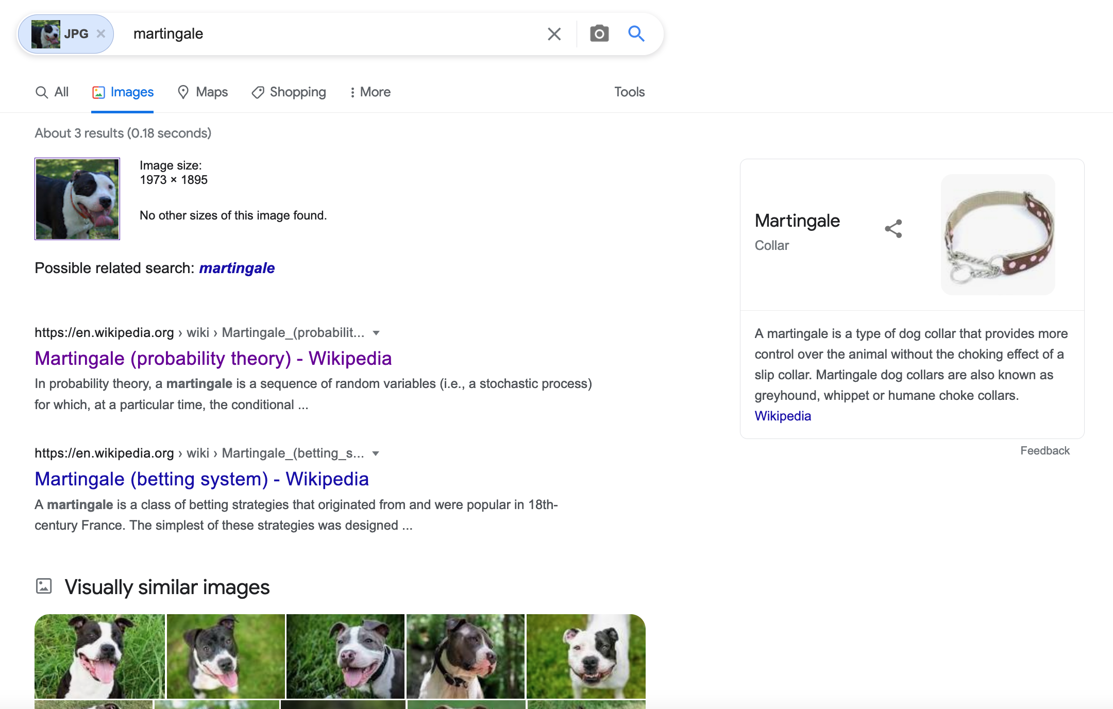
My result for Warren (Spring 22)

Slide 33
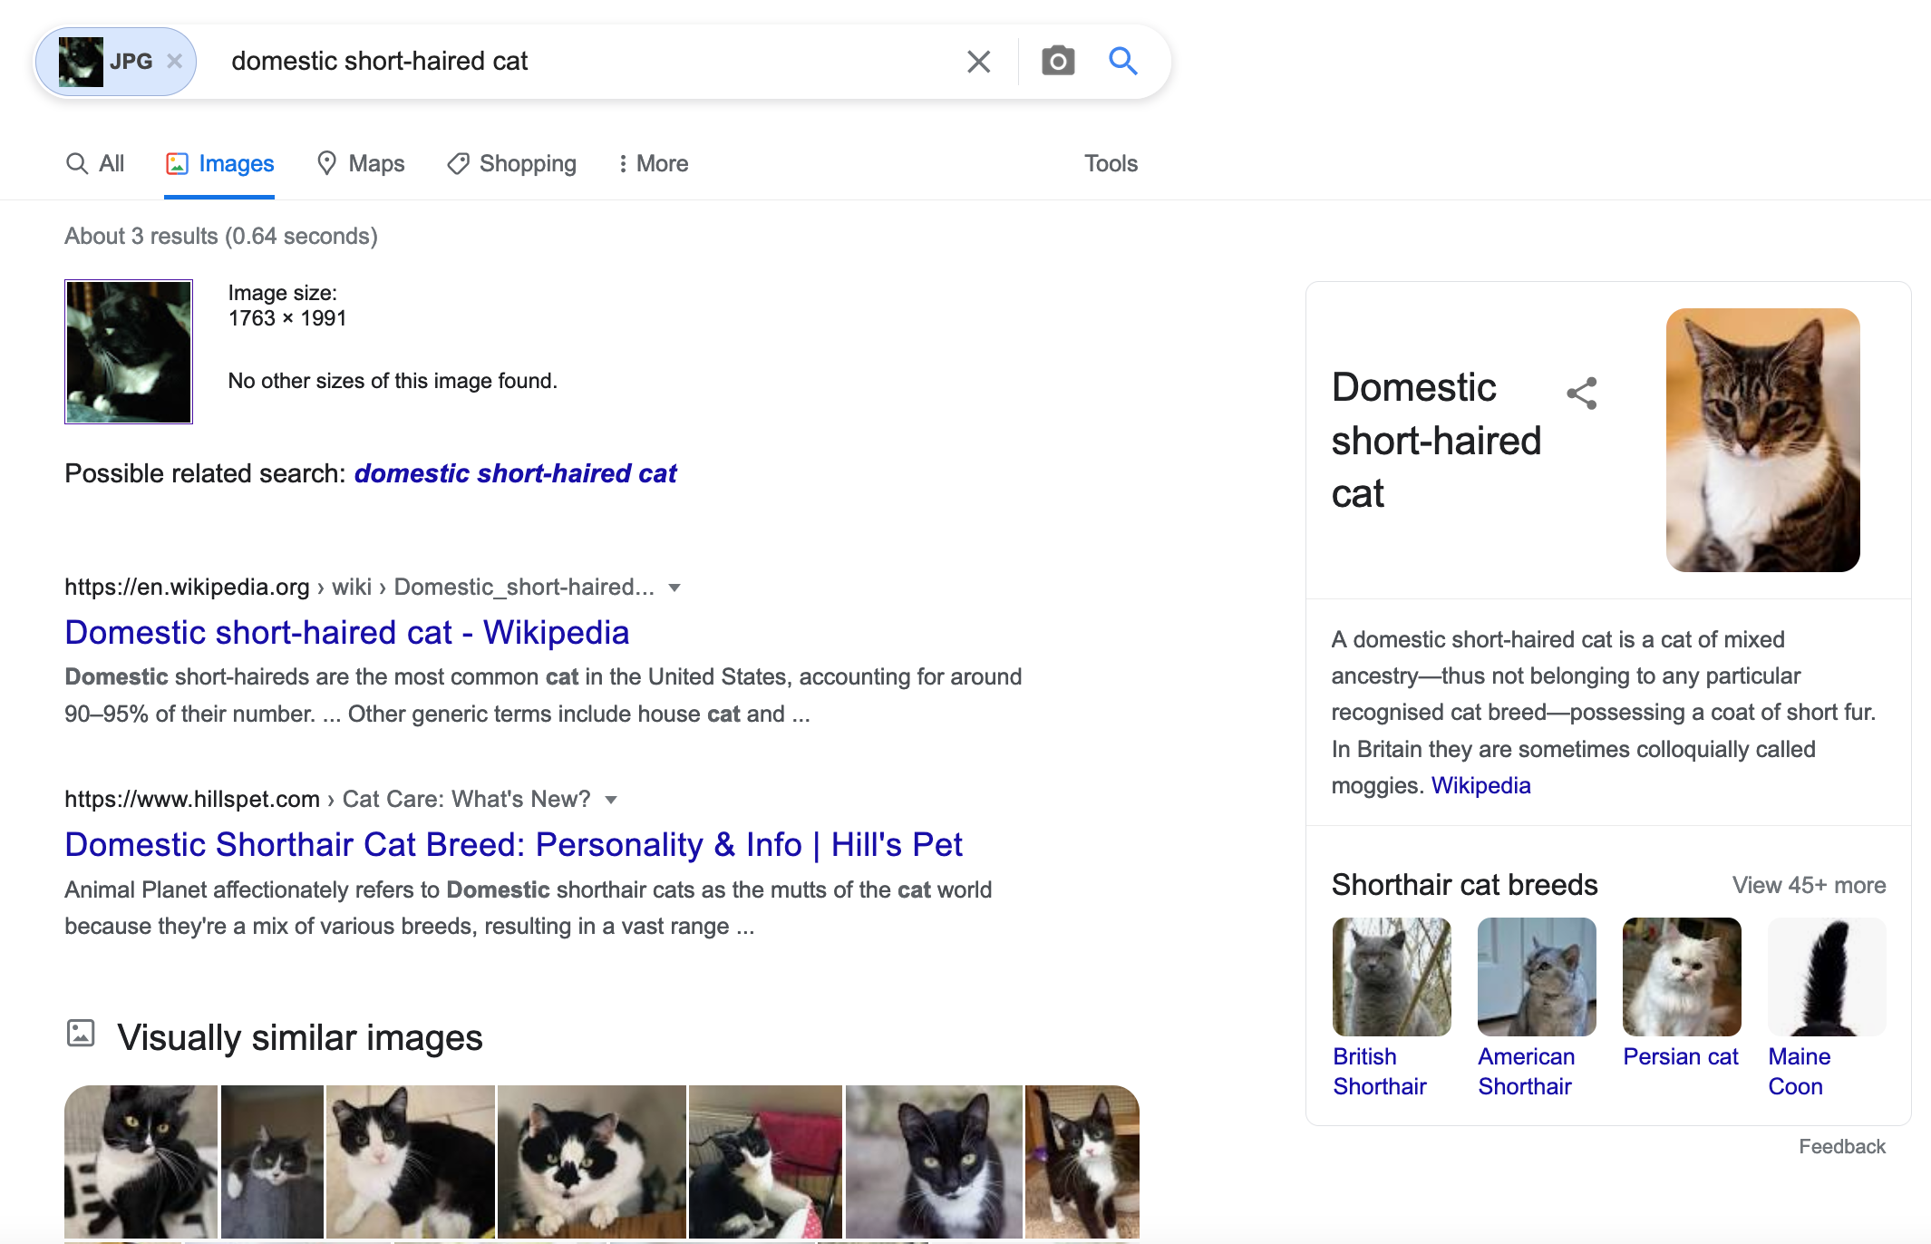
My result for Billy

Slide 34
So cats vs dogs problem solved?

Slide 35
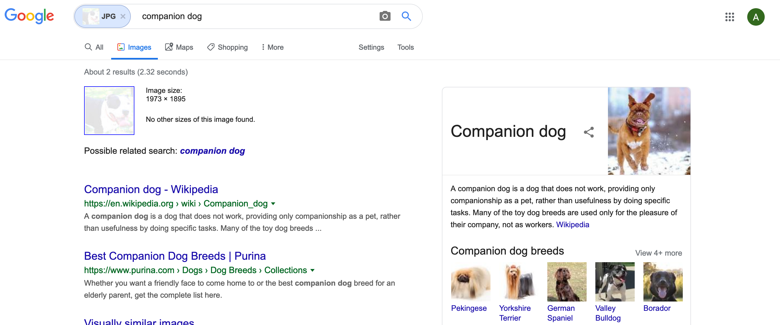
My result for modified Warren (Spring 20)

Slide 36
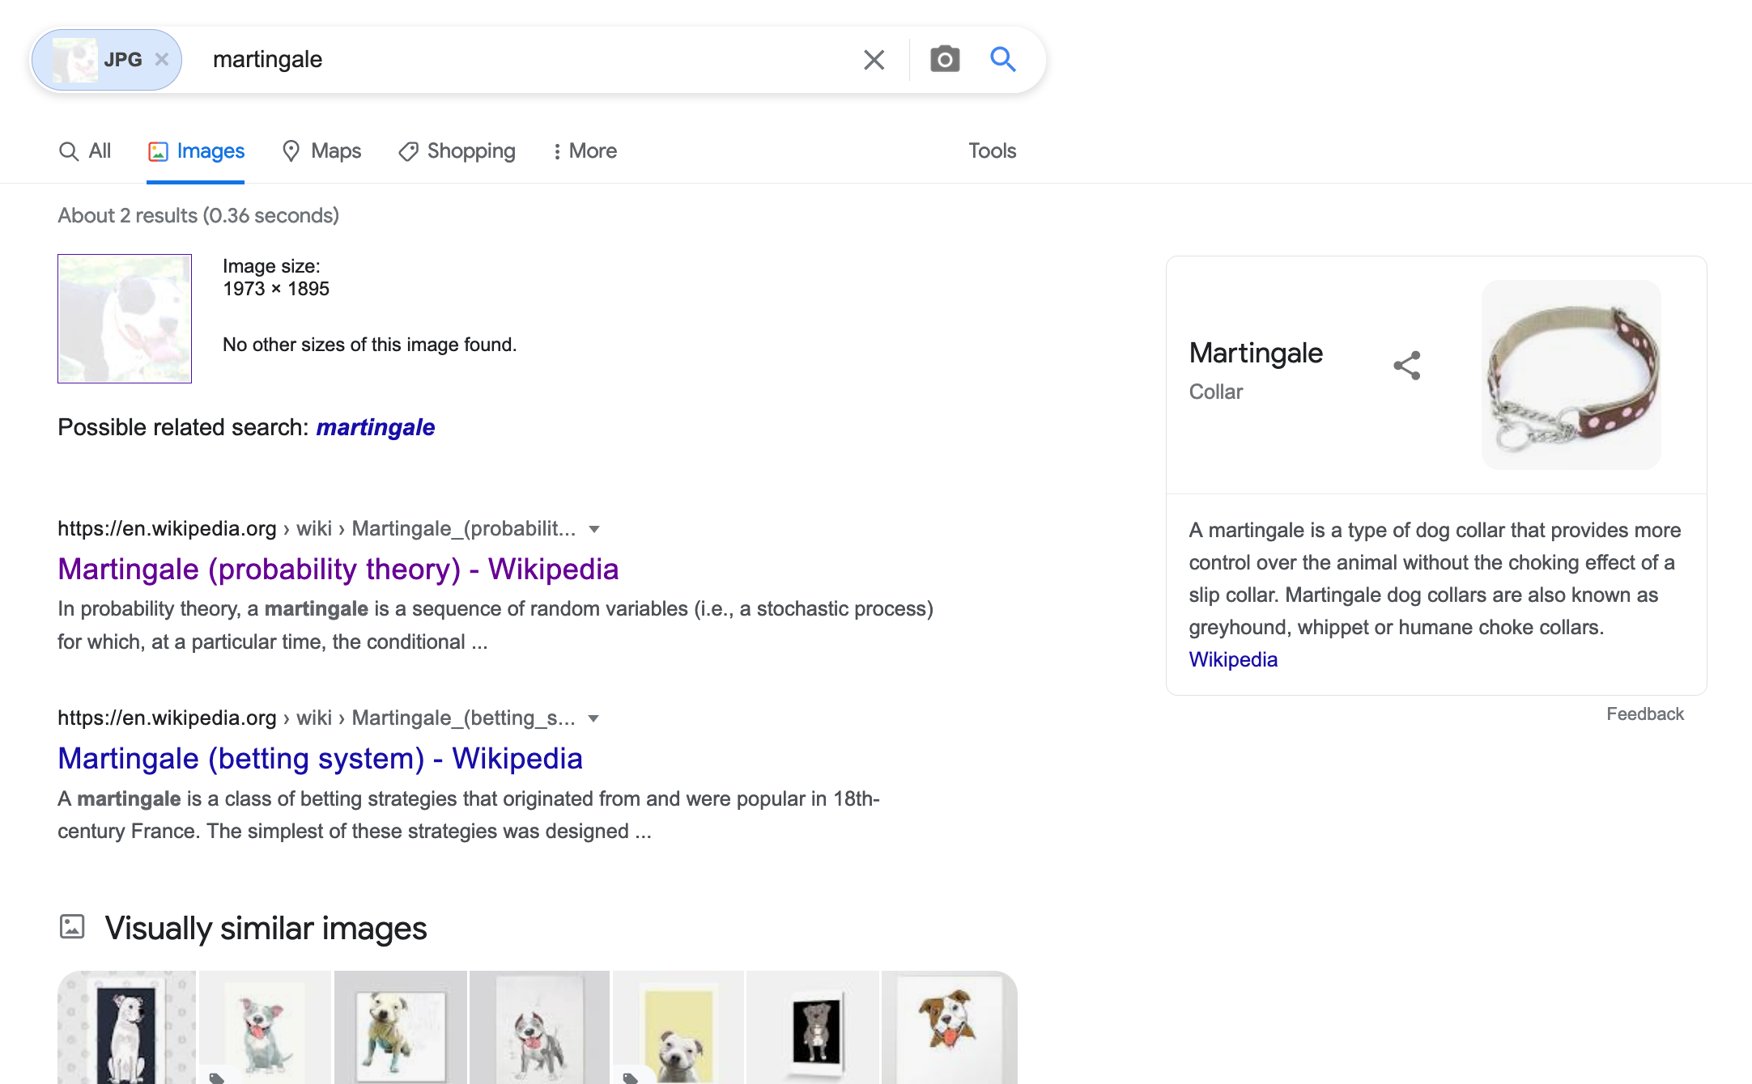
My result for modified Warren (Spring 22)

Slide 37
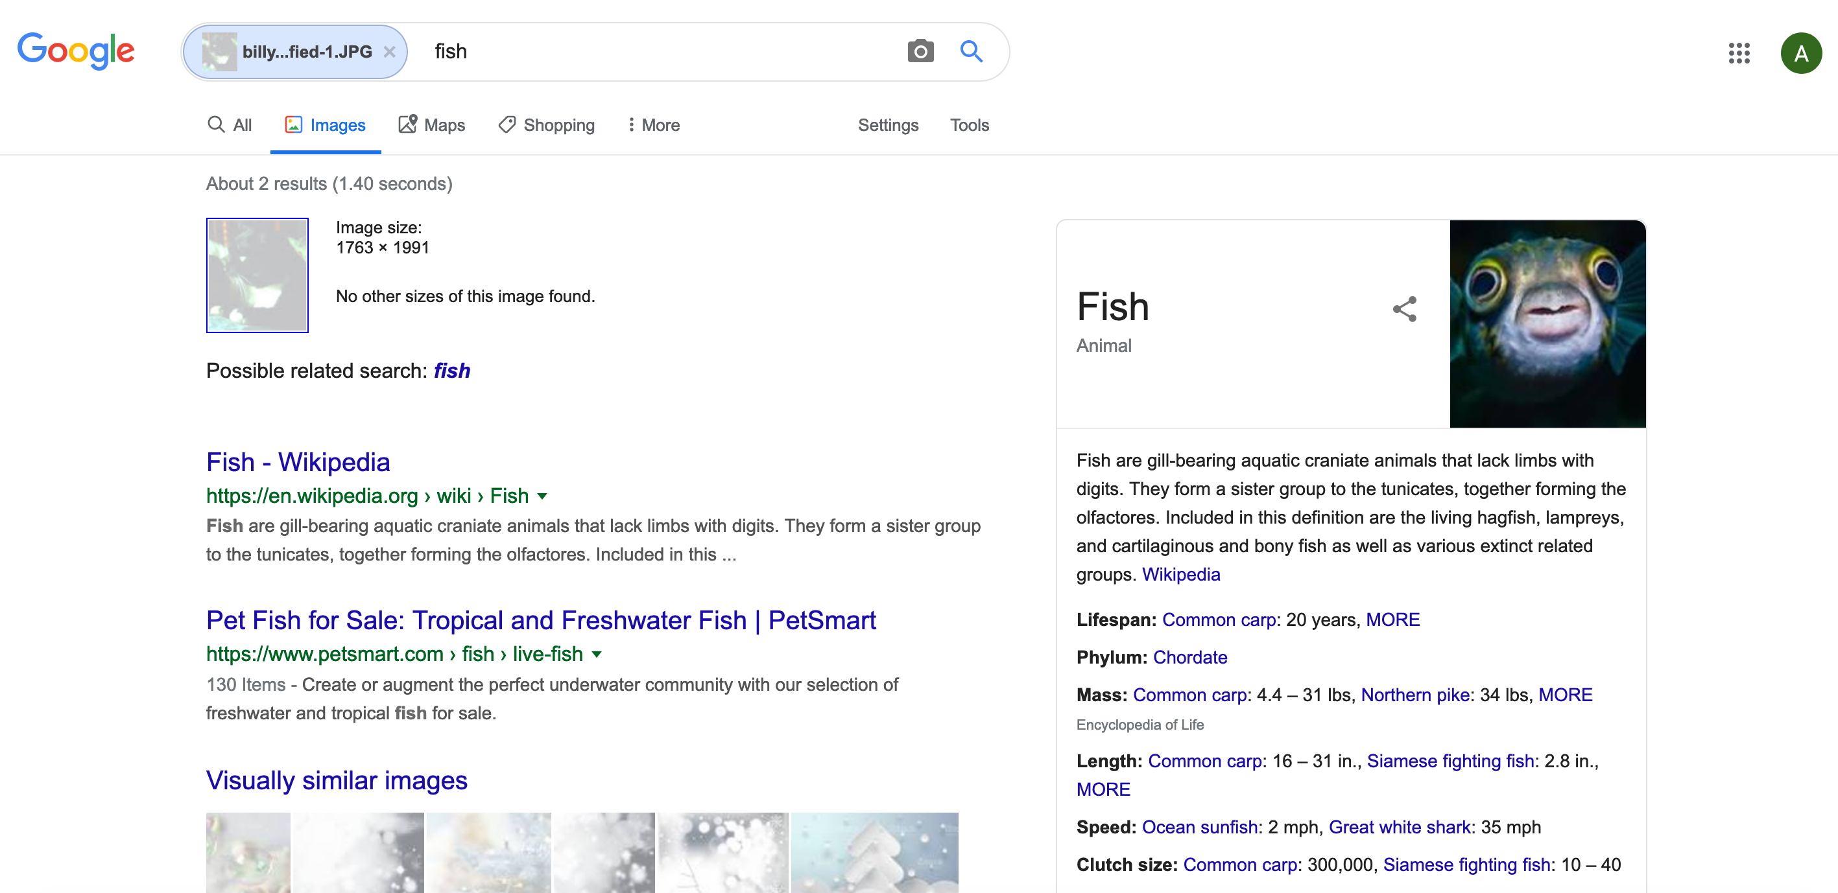
My result for modified Billy (Spring 20)

Slide 38
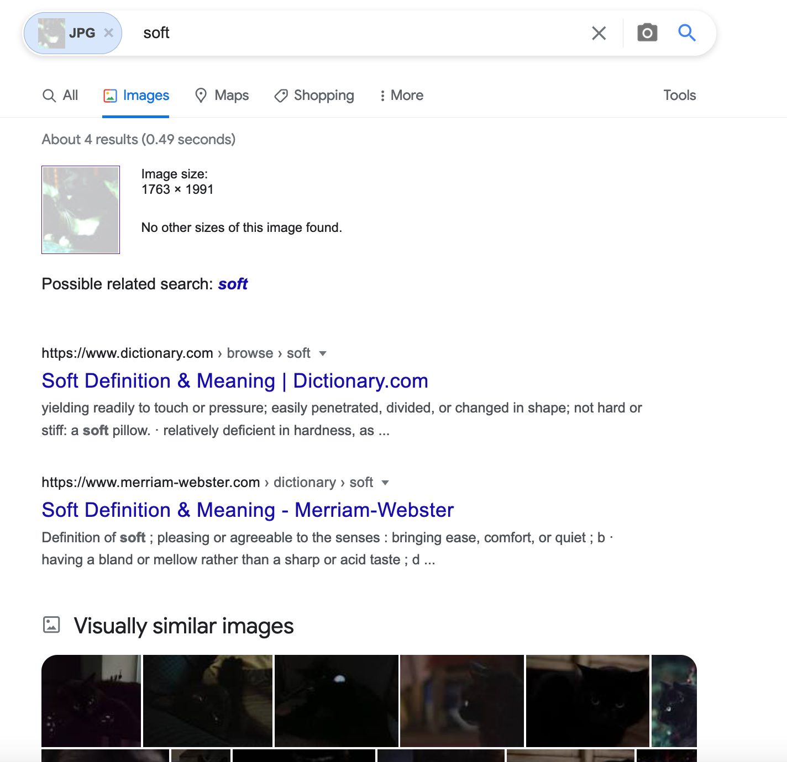
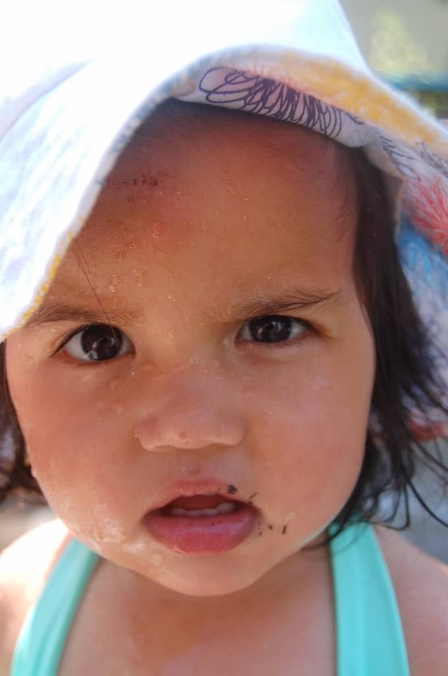
My result for modified Billy
?

Slide 39
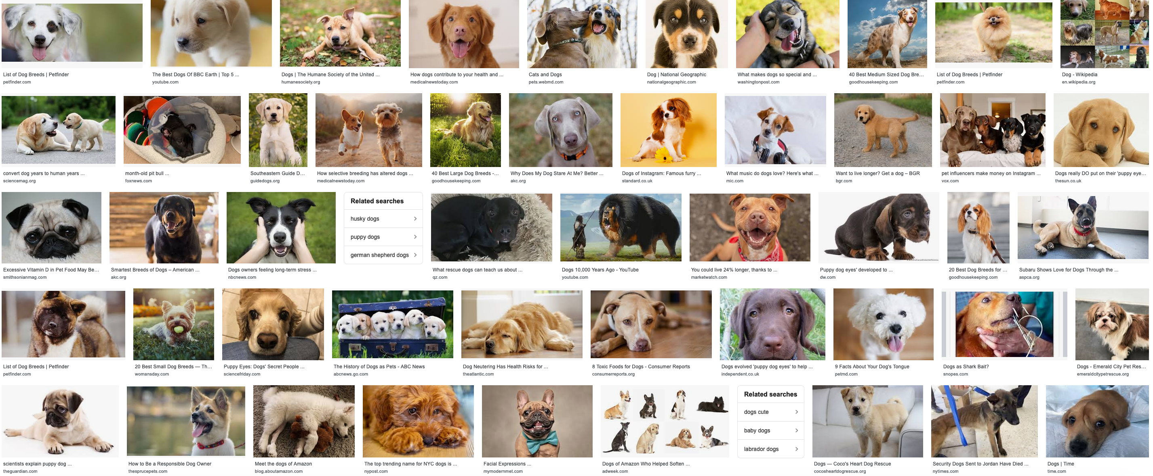
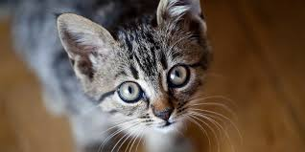
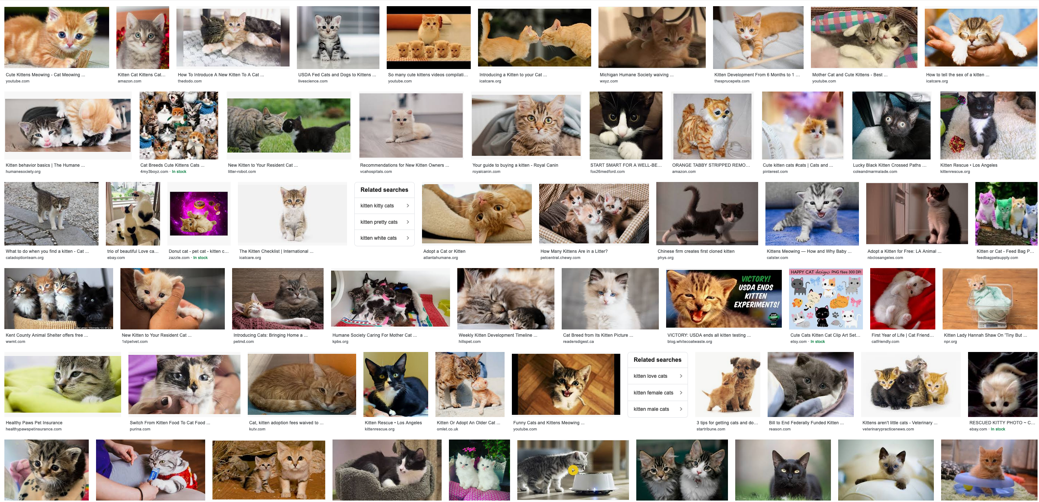
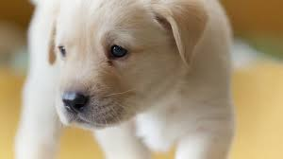
How does Google Images work?
dog
, cat
f
Training
cat
, dog

Slide 40
When a new image comes in
dog
f
cat

Slide 41
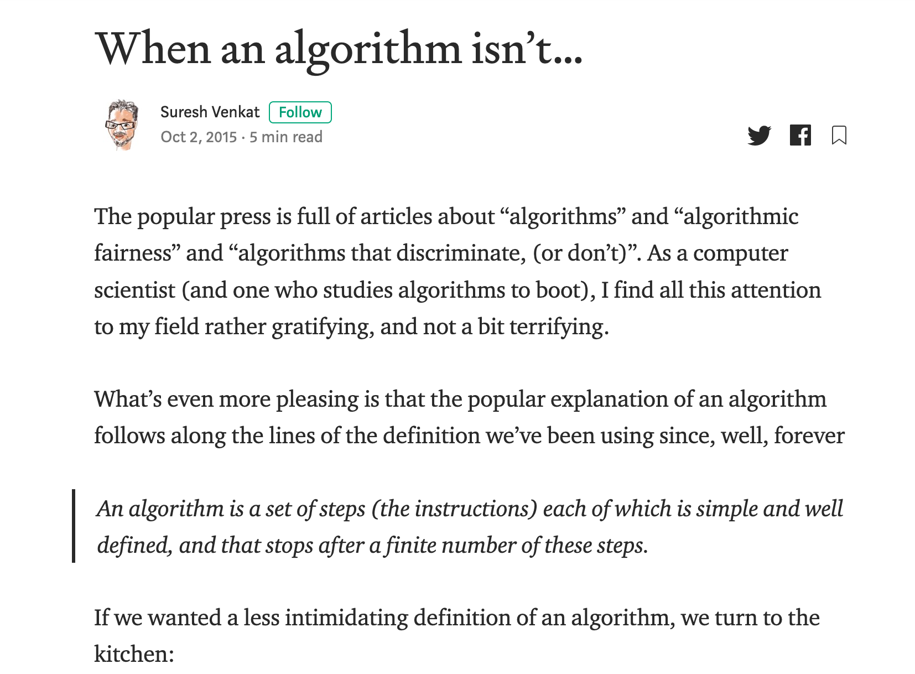
Couple of important points
Google images is learning something but not “our way” of looking at cats vs dogs
There is NO problem/ algorithm divide!
dog
, cat
Training
f
, dog
cat

Slide 42
AOC is right!
Correct for modern algorithms
“Algorithms can be biased”

Slide 43
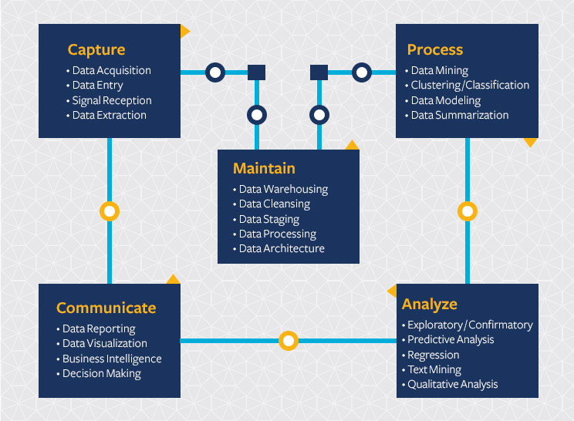
Modern Algorithm = Machine Learning (ML)
Start with a Question
Collect data
Train model
Evaluate model
Deploy!

Slide 44
The Machine Learning Pipeline
And/or some data
Train the model
?
Start with a question
Engineer the system for production use
Build a model
Evaluate the model
Slide by Kenny Joseph

Slide 45
Back to cats vs. dogs
Start with a Question
Collect data
Train model
Evaluate model
Deploy!
Classify image
as cat or dog
dog
No error,
so great!
dog
, cat
f
f
, dog
cat
cat

Slide 46
?

Slide 47
What is missing from this picture?
Start with a Question
Collect data
Train model
Evaluate model
Deploy!
Society

Slide 48
A real view of the ML Pipeline
Real world machine learning can be awesome, but there are a lot of gotchas and
?
Slide by Kenny Joseph

Slide 49
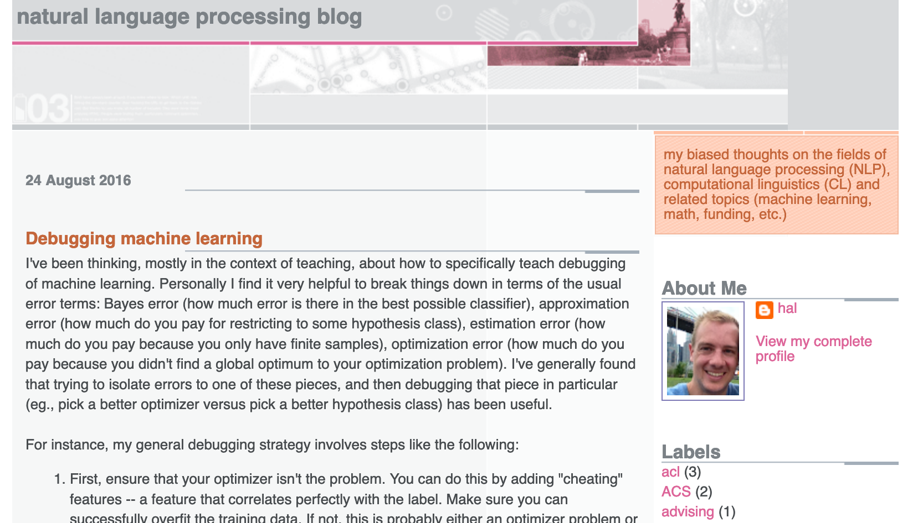
Start with a Question
Collect data
Train model
Evaluate model
Deploy!
Real world goal
Real world mechanism
Learning problem
Data collection mechanism
Which data to collect?
Data representation
Target class/model
Deploy!
Evaluate error
Predict on test data
Model training
Training data set

Slide 50
What is missing?
Real world goal
Real world mechanism
Learning problem
Data collection mechanism
Which data to collect?
Data representation
Society
Target class/model
Deploy!
Evaluate error
Predict on test data
Model training
Training data set

Slide 51
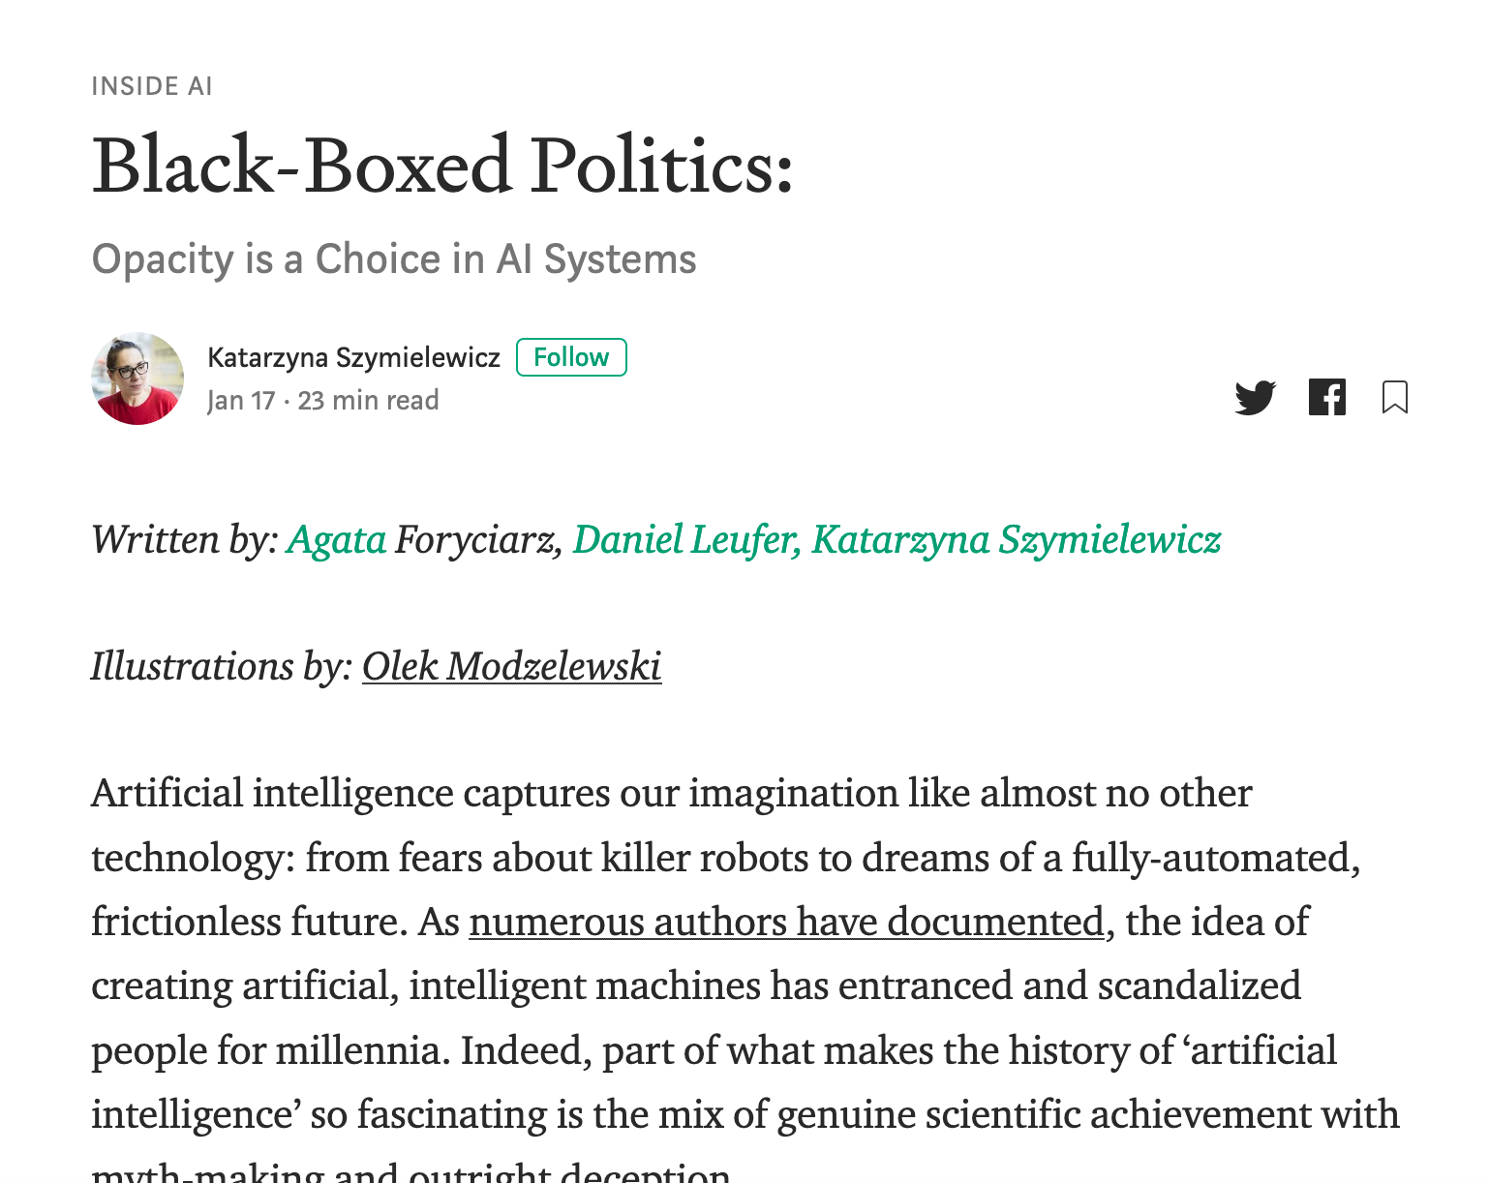
Not the only ML+society pipeline in town

Slide 52
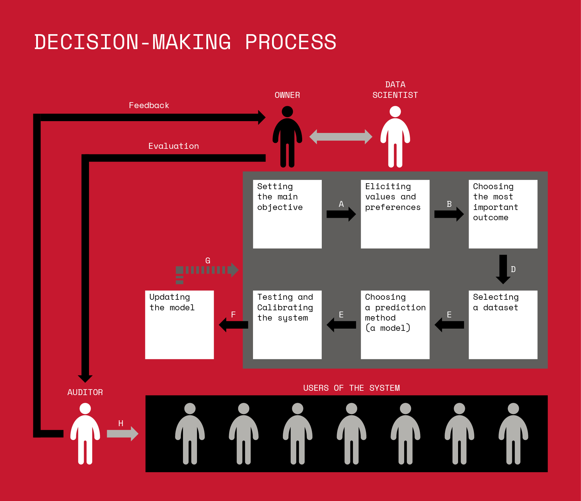
Not the only ML+society pipeline in town

Slide 53
A walkthrough

Slide 54
Pass-phrase for today: Katarzyna Szymielewicz

Slide 55
A walkthrough?
Real world goal
Real world mechanism
Learning problem
Data collection mechanism
Which data to collect?
Data representation
After the break!
Target class/model
Deploy!
Evaluate error
Predict on test data
Model training
Training data set

Slide 56
Next Thursday

Slide 57
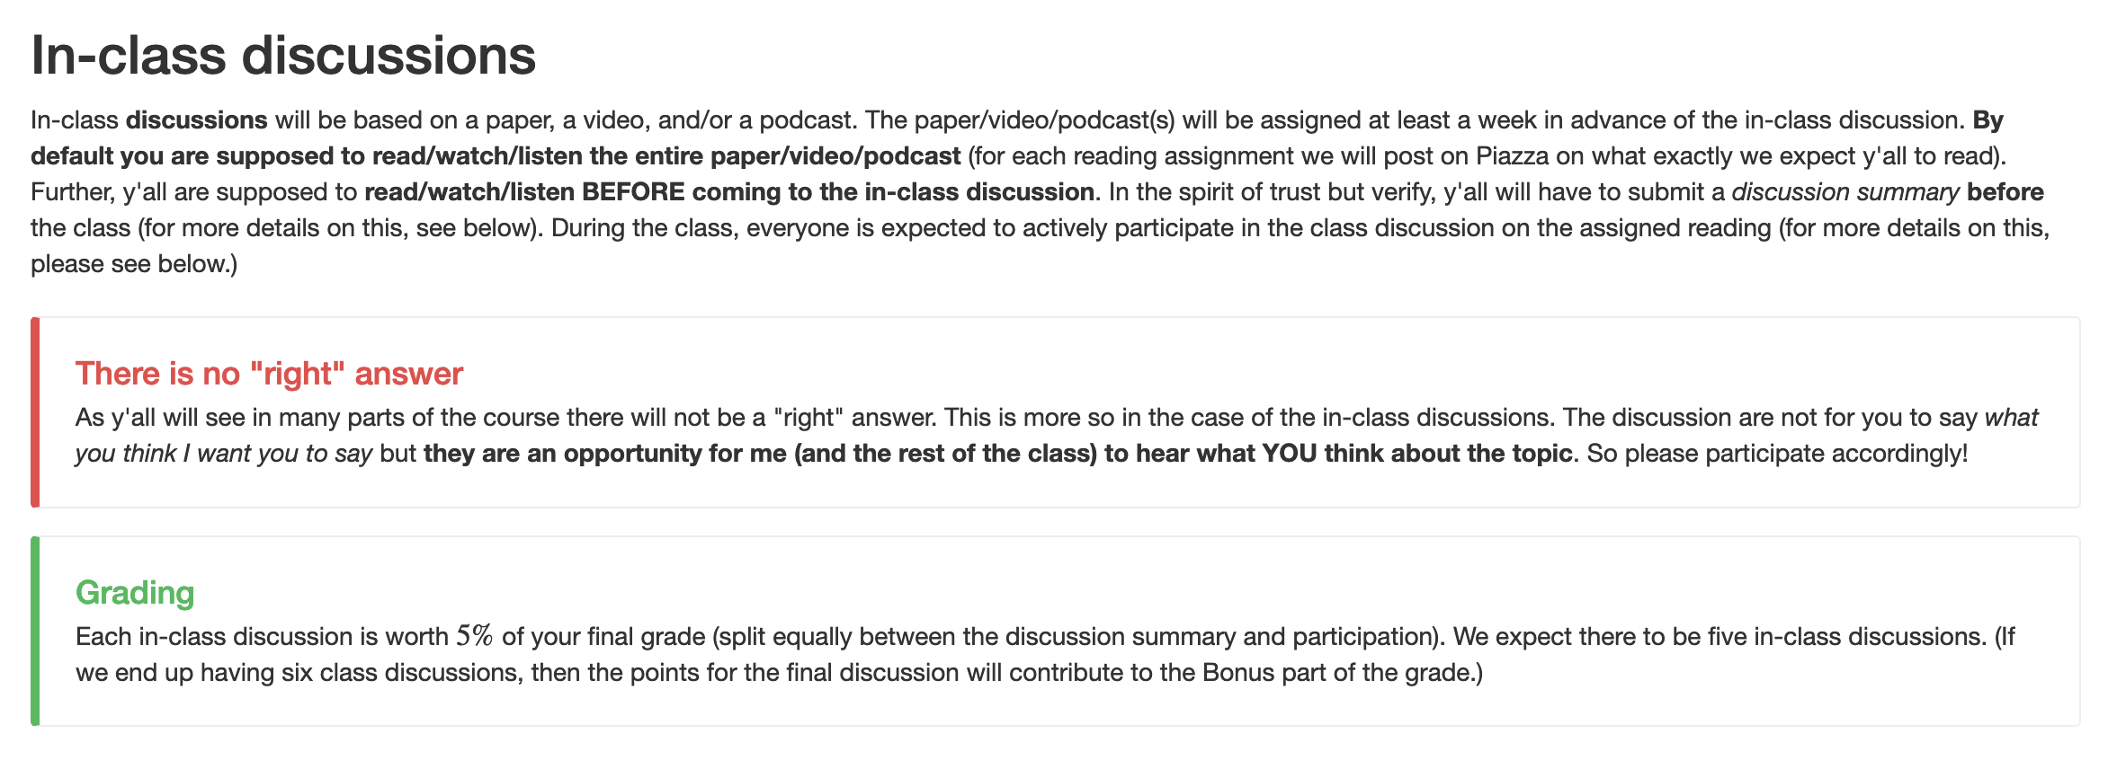
Discussion Summary

Slide 58
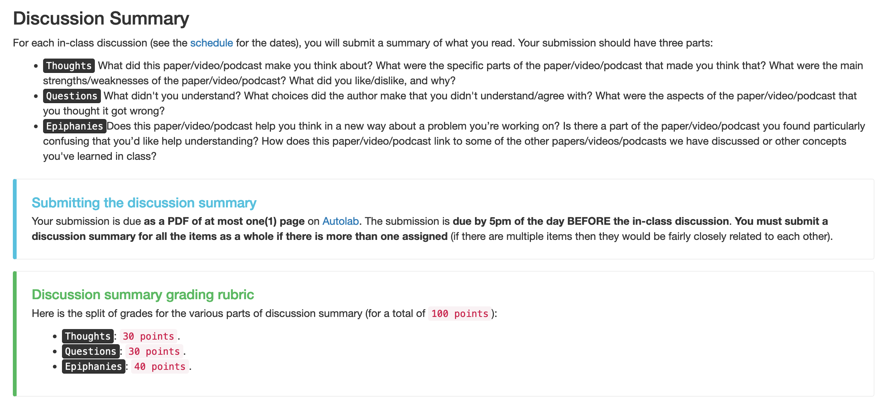
What goes into a discussion summary?

Slide 59
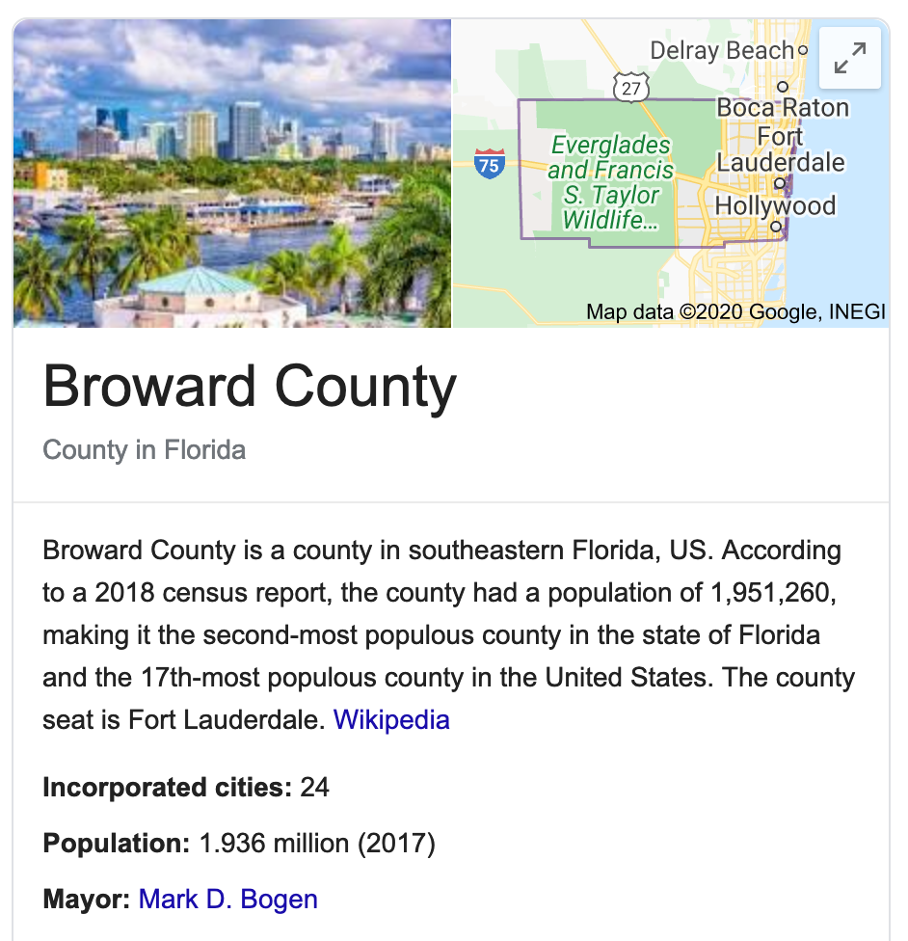
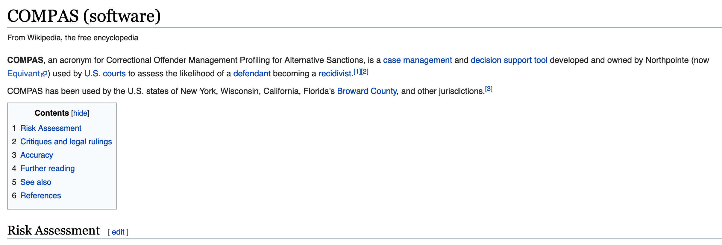
Have you heard of COMPAS?

Slide 60
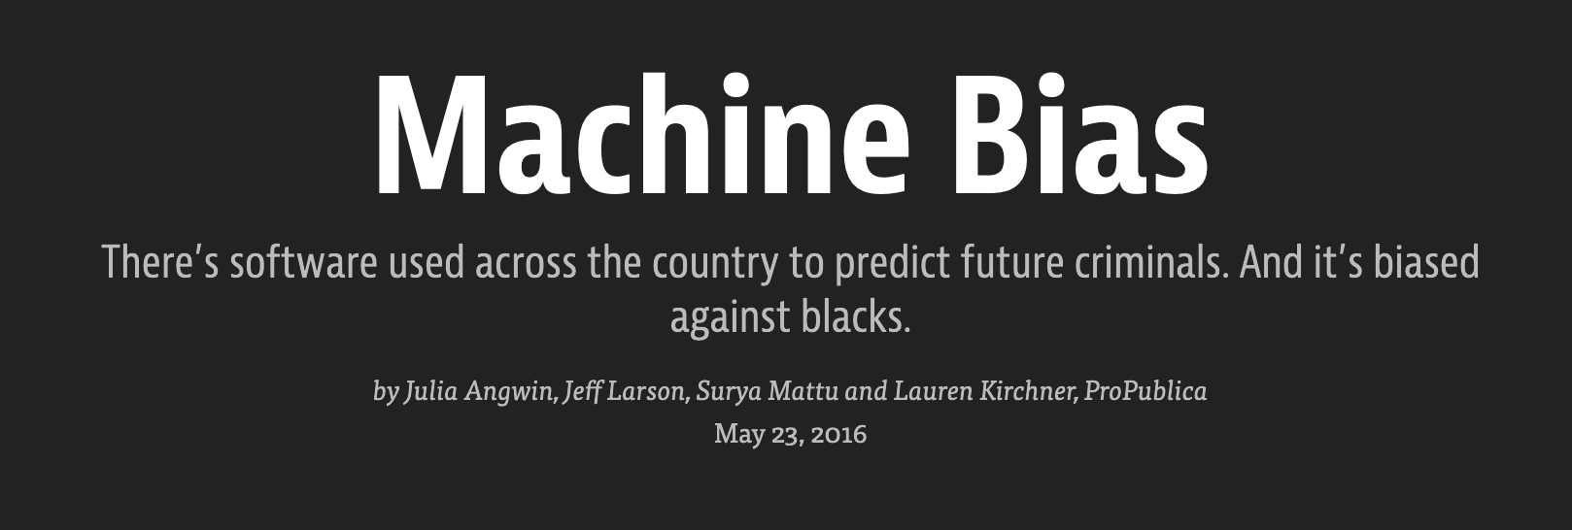

Slide 61
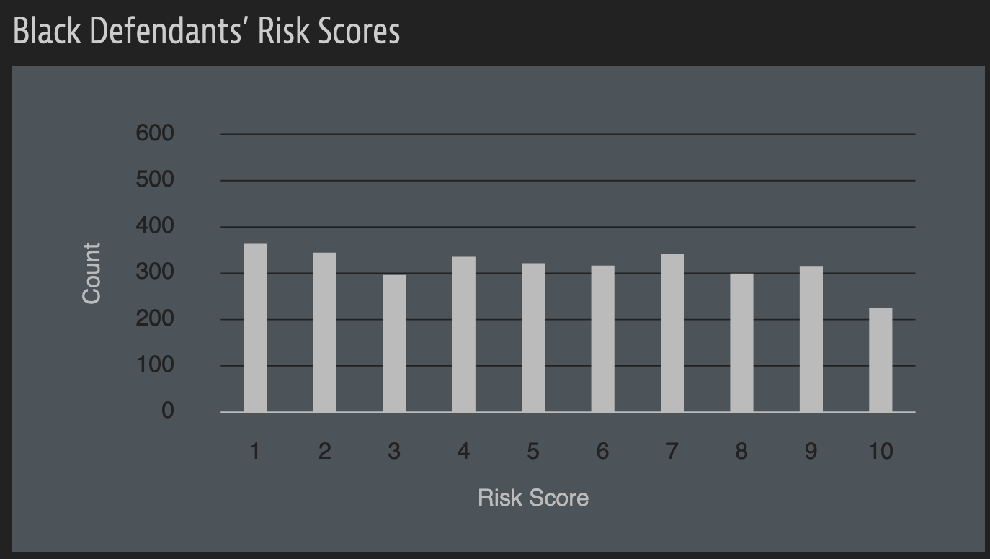
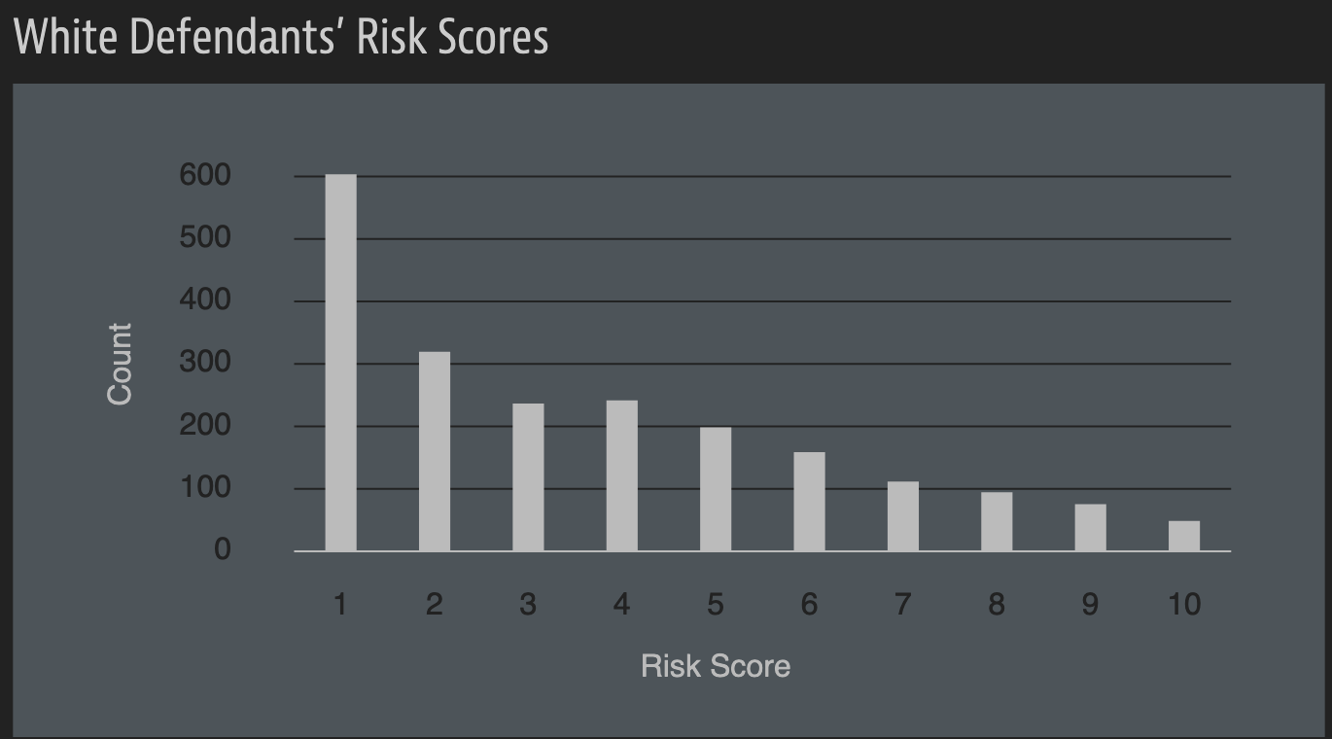
A sample of their result

Slide 62
A rejoinder

Slide 63
?

