Slide 1
ML and Society
Apr 14, 2022

Slide 2
Discussion summaries graded

Slide 3
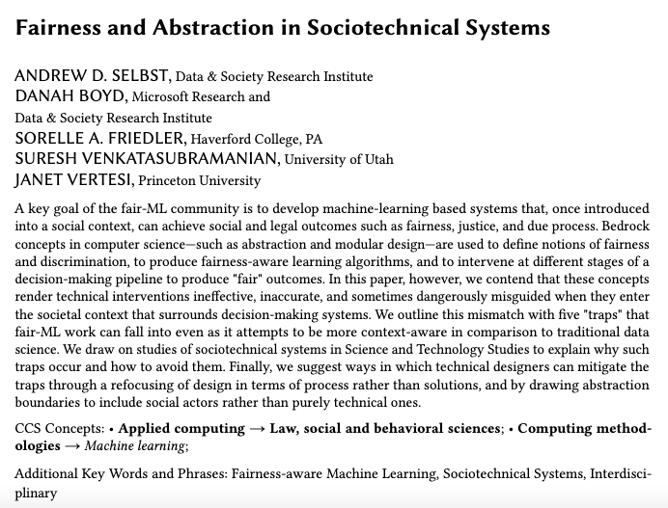
In-class discussion

Slide 4
Thing to keep in mind
You are expected to participate ☺

Slide 5
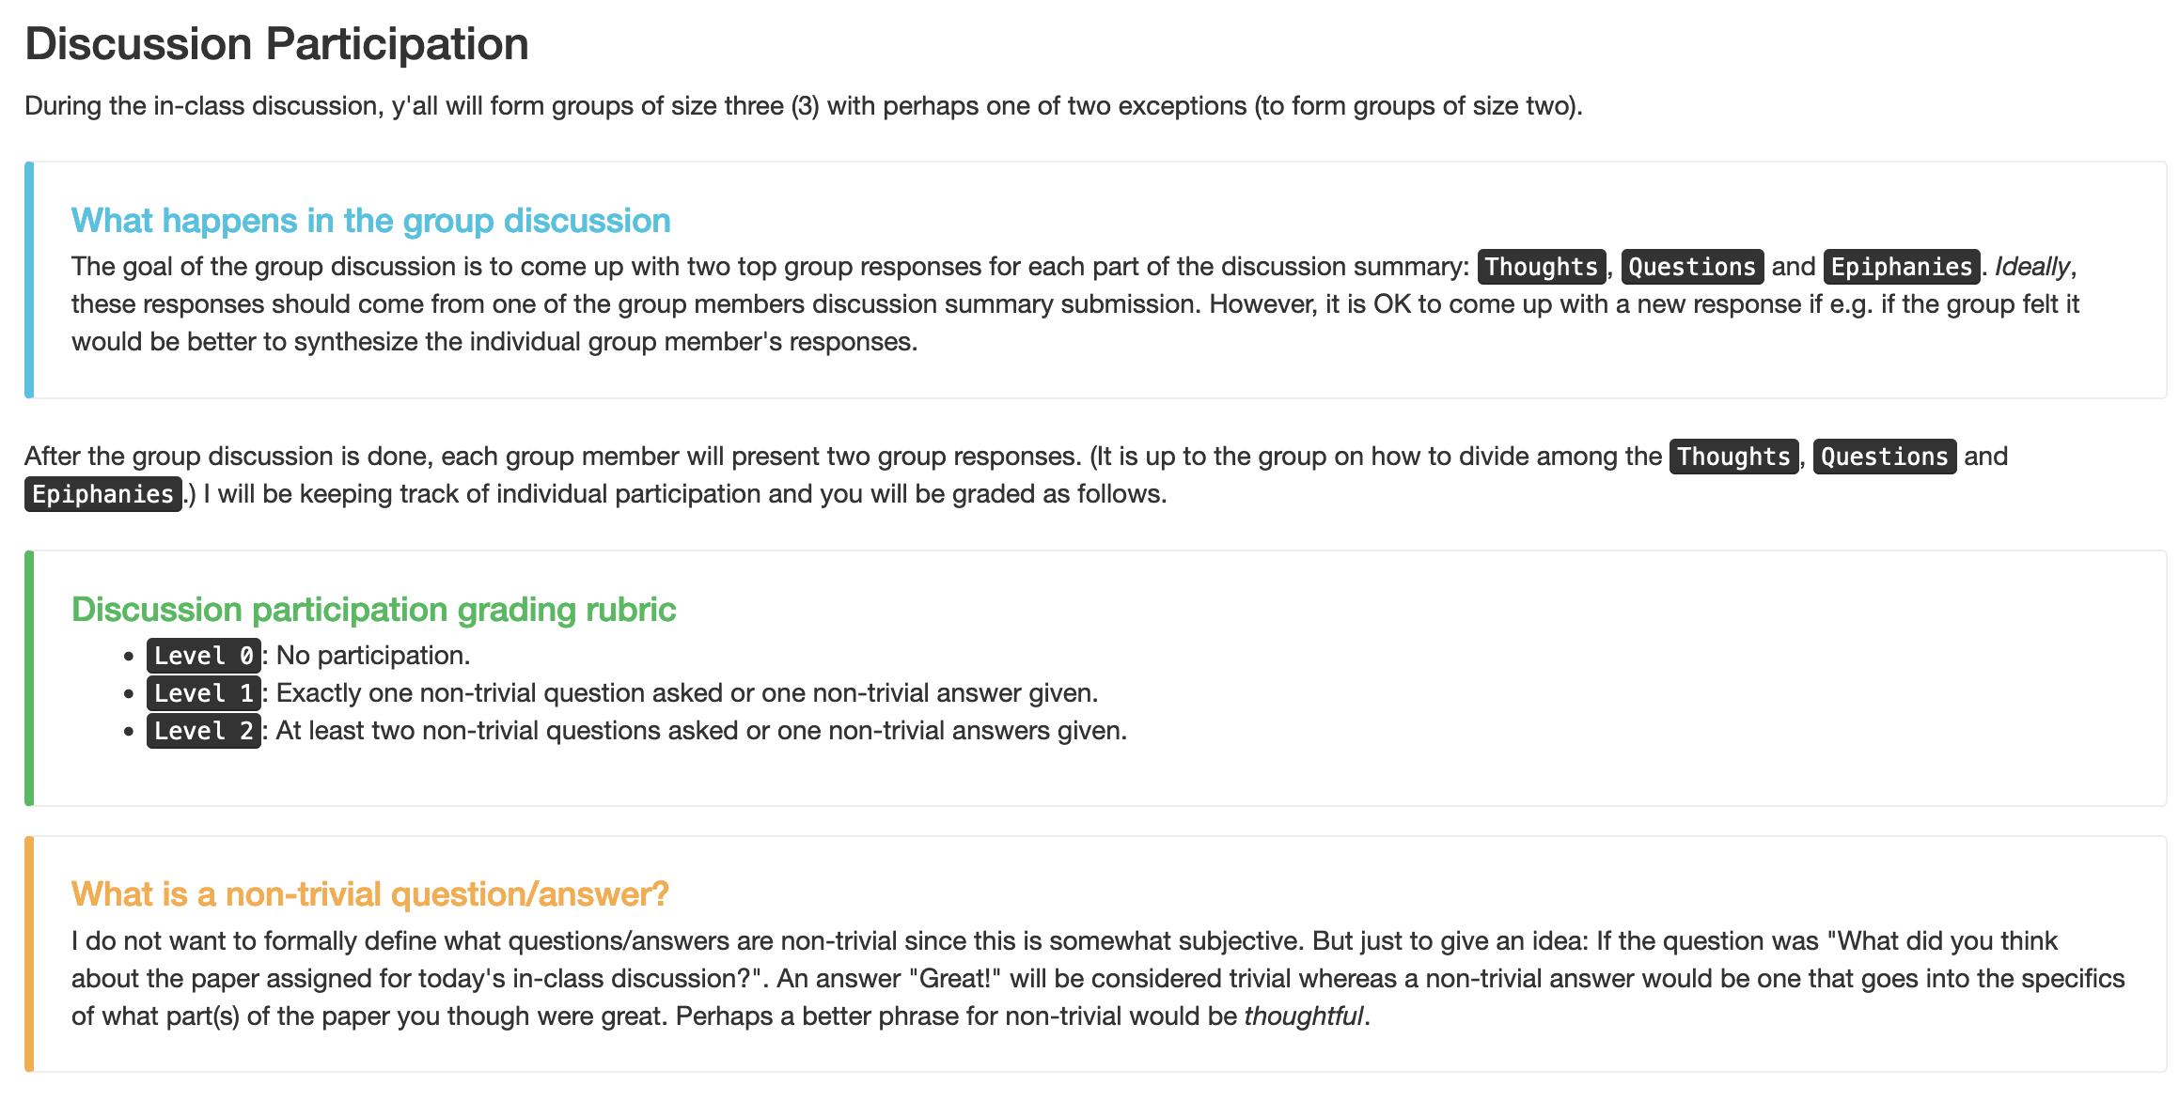
First form groups and discuss your answers

Slide 6
Discuss!

Slide 7
Thoughts

Slide 8
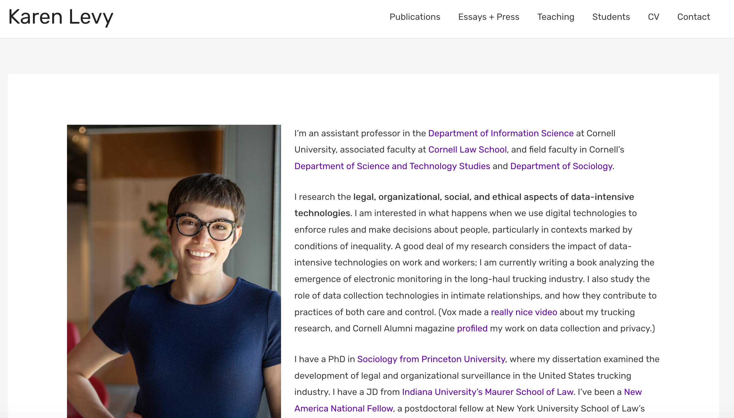
Passphrase for today: Karen Levy

Slide 9
Questions + Epiphanies

