Slide 1
ML and Society
Apr 19, 2022

Slide 2
What is bias?

Slide 3
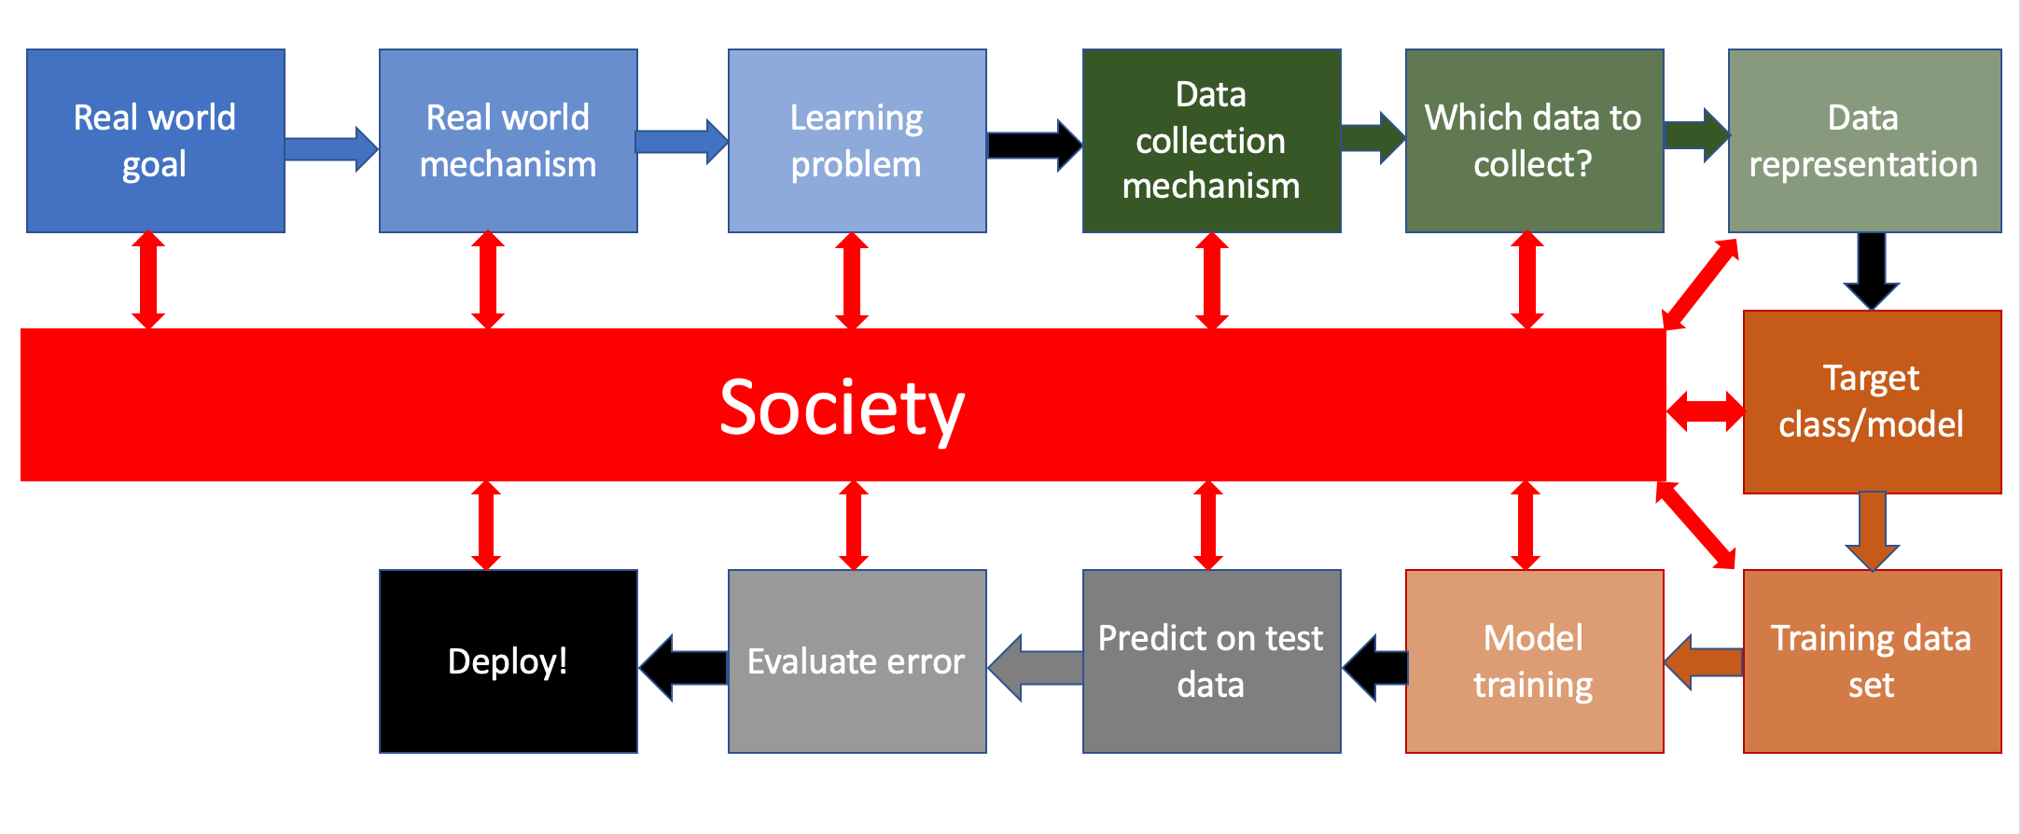
Bringing society back into the picture

Slide 4
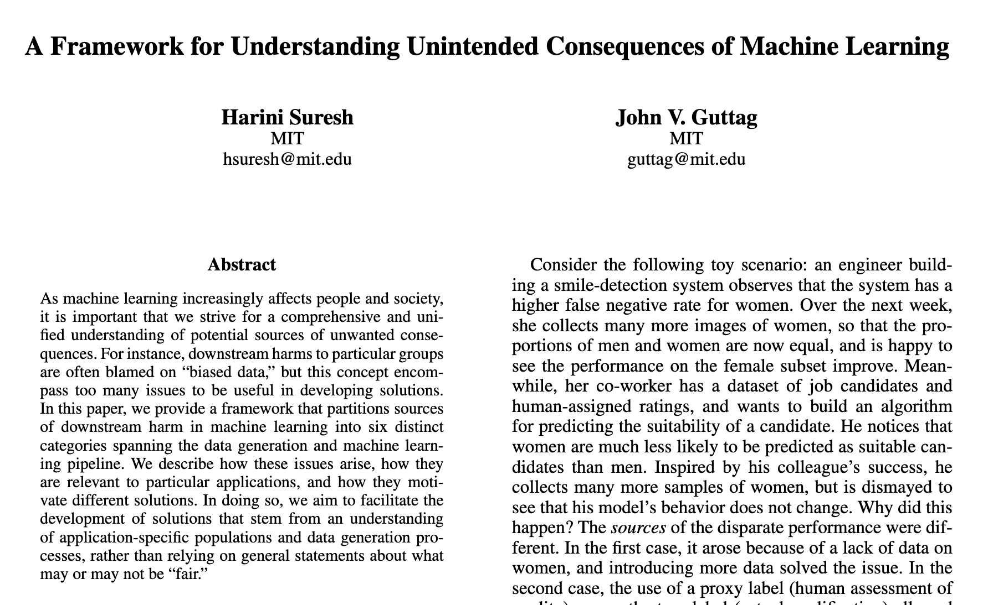
Six categories of bias of the 3rd kind

Slide 5
Historical Bias
Bias ingrained in society
Cannot be avoided even with perfect sampling of the population

Slide 6
Representation bias
Certain section(s) of population excluded in your dataset

Slide 7
Measurement bias
Using a proxy variable instead of the “real” variable

Slide 8
?

Slide 9
Aggregation bias
Use a single model where prevalence changes based on groups

Slide 10
Consider an example
700
350
150
300

Slide 11
Two linear models vs. one linear model
700
700
350
350
150
300
150
300

Slide 12
Back to the ML pipeline

Slide 13
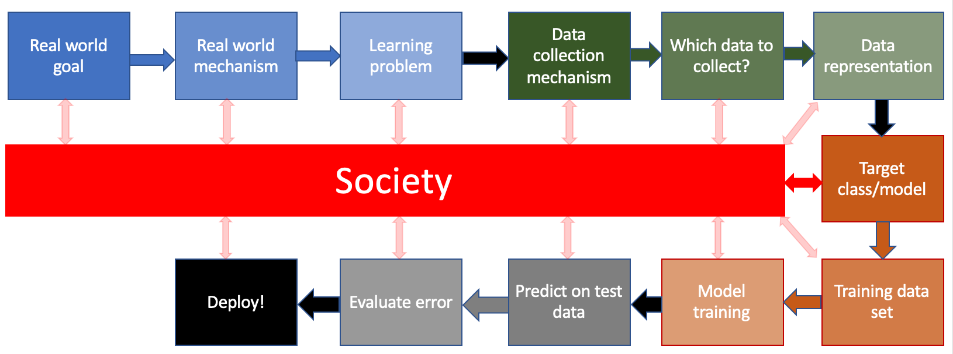
What are the relevant interactions?

Slide 14
?

Slide 15
How do we handle aggregation bias?
Discuss!

Slide 16
Evaluation bias
Reason #1: Training to the benchmark

Slide 17
Reason #2: Using a single accuracy number

Slide 18
Back to the ML pipeline

Slide 19
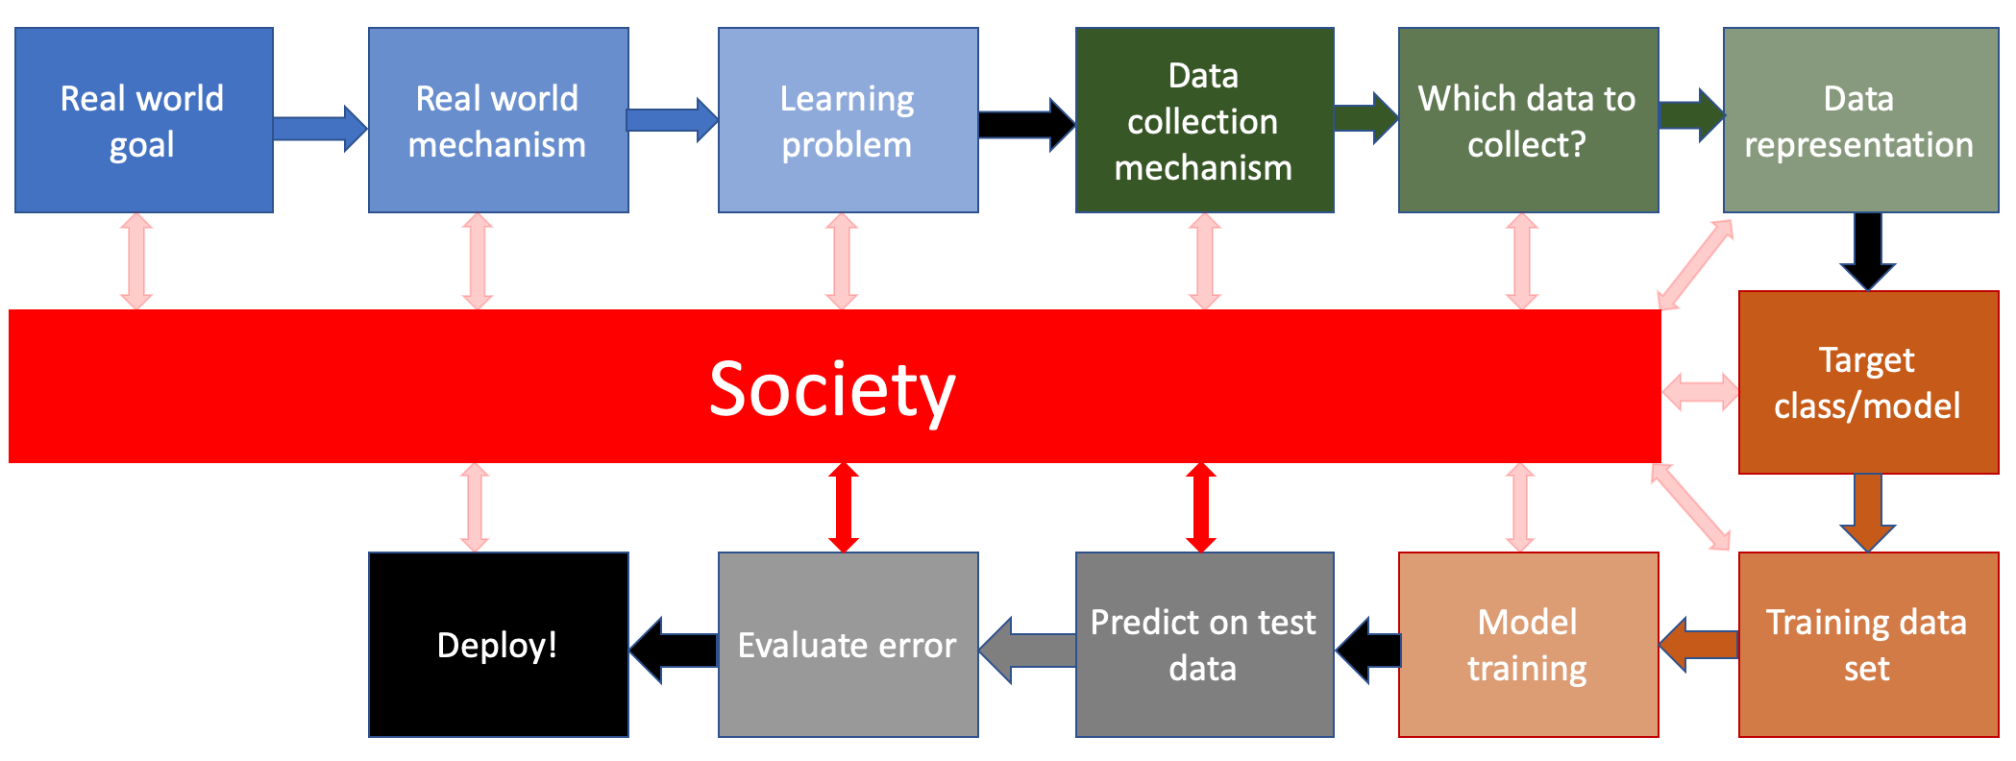
What are the relevant interactions?

Slide 20
?

Slide 21
How do we handle evaluation bias?
Discuss!

Slide 22
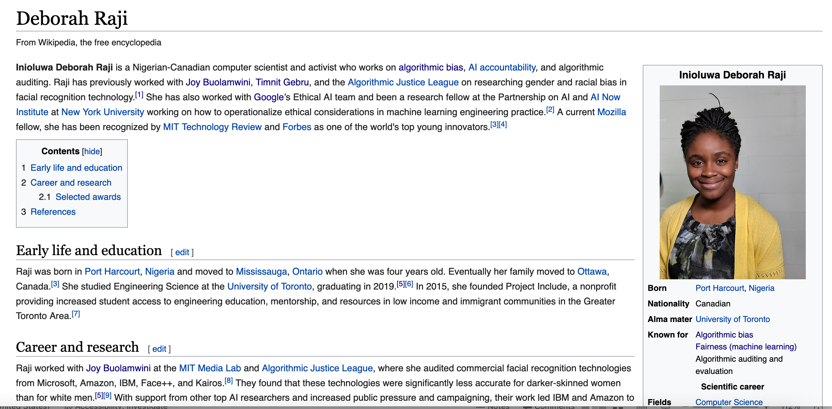
Passphrase for today: Deborah Raji

Slide 23
Deployment bias
ML pipeline used in a way it was not designed for

Slide 24
More examples

Slide 25
Back to the ML pipeline

Slide 26
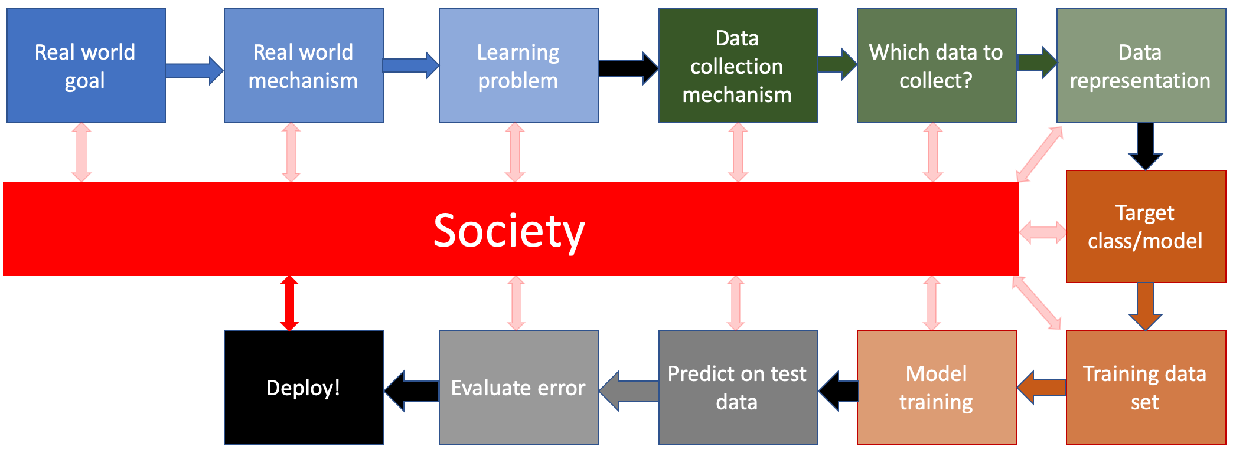
What are the relevant interactions?

Slide 27
?

Slide 28
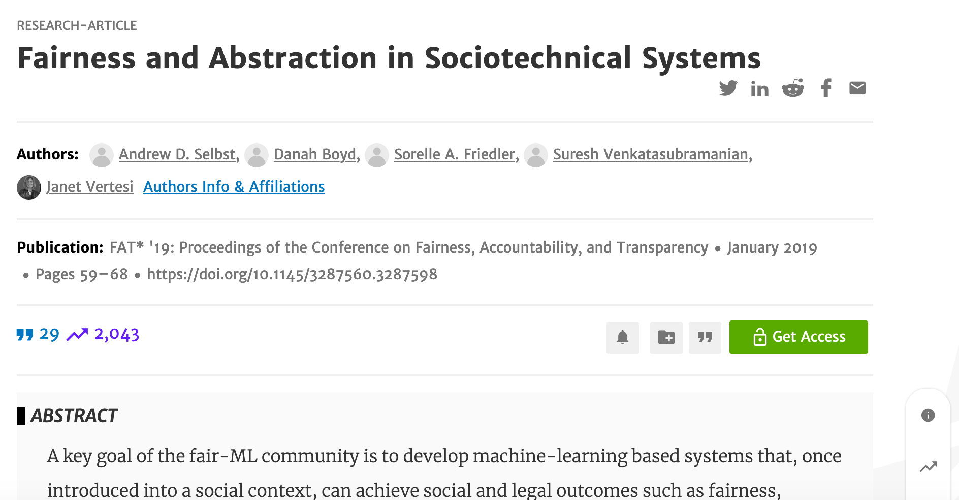
How do we handle deployment bias?
Discuss!

Slide 29
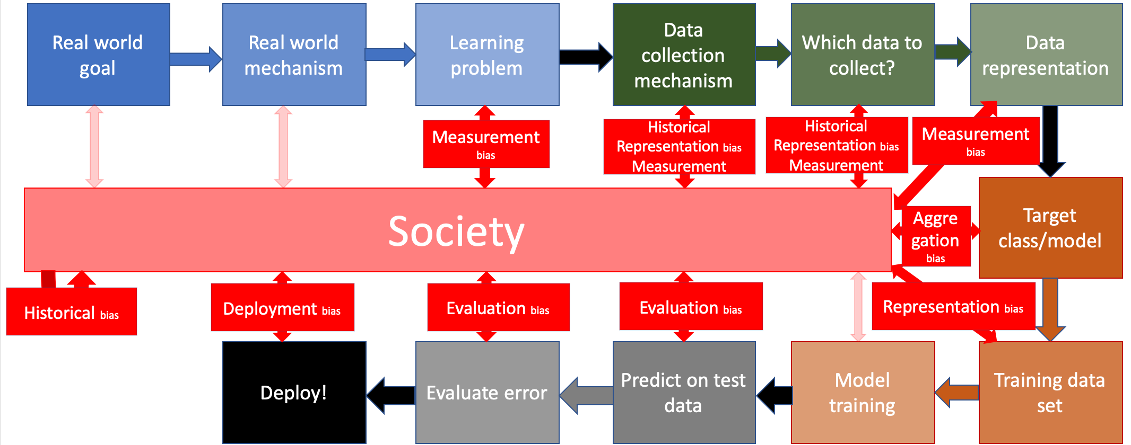
All biases in one place…

Slide 30
Exercise

