Slide 1
ML and Society
Apr 21, 2022

Slide 2
Discussion summaries graded

Slide 3
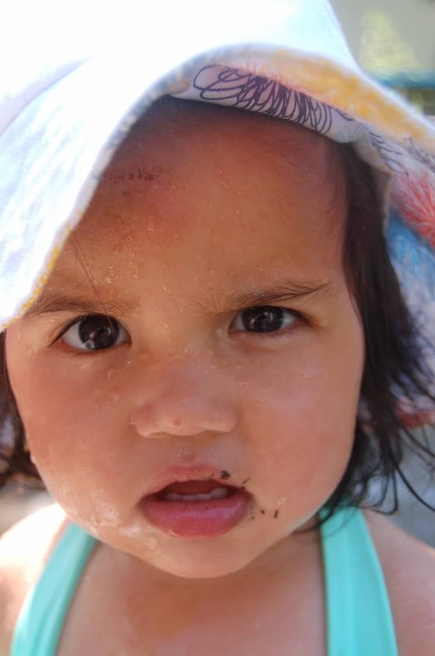
?

Slide 4
What is a feedback loop
Real world goal
Real world mechanism
Learning problem
Data collection mechanism
Which data to collect?
Data representation
Measurement
bias
Historical bias
Measurement
Historical bias
Measurement
Measurement bias
Society
Target class/model
Historical bias
Representation bias
Deploy!
Evaluate error
Predict on test data
Model training
Training data set

Slide 5
The “loop” in feedback loop
Real world goal
Real world mechanism
Learning problem
Data collection mechanism
Which data to collect?
Data representation
Measurement
bias
Historical bias
Measurement
Historical bias
Measurement
Measurement bias
Society
Target class/model
Historical bias
Representation bias
Deploy!
Evaluate error
Predict on test data
Model training
Training data set

Slide 6
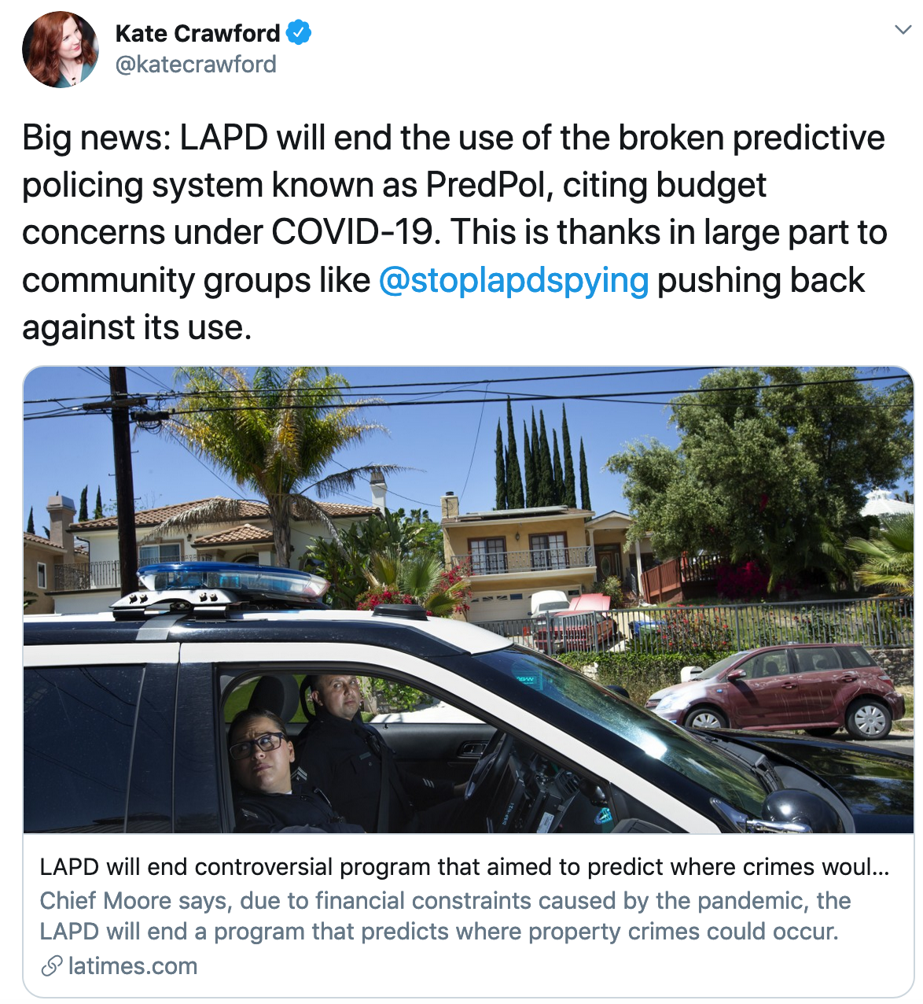
This happened last time I taught the course..

Slide 7
?

Slide 8
Do feedback loops exist?
How do we “prove” that feedback loops can exist in predictive policing?
Simulation results
Theoretical modeling results

Slide 9
A simulation result

Slide 10
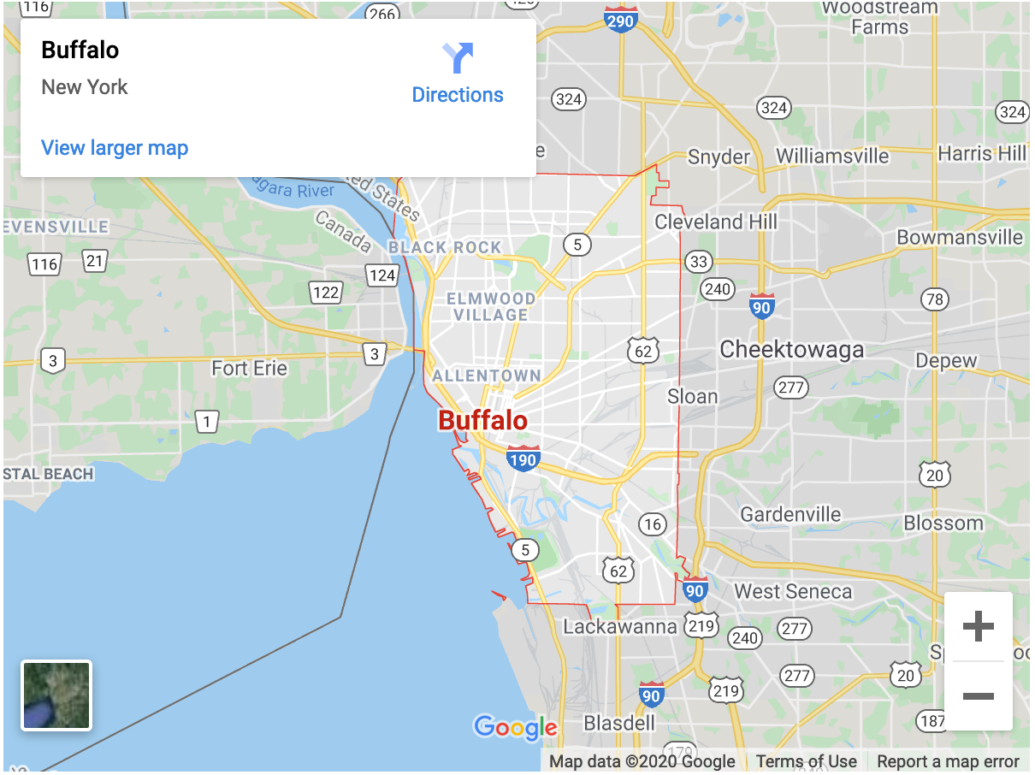
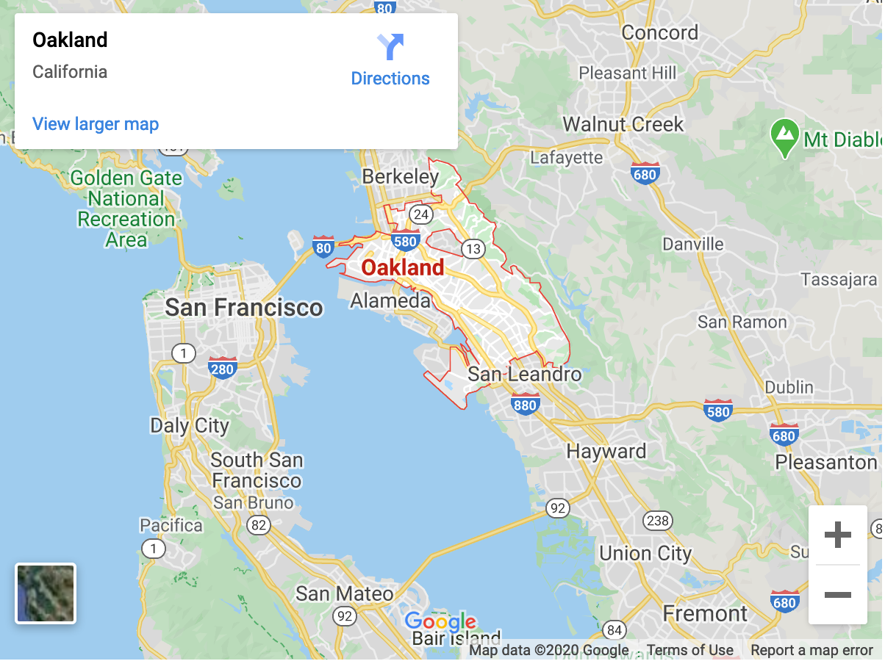
How would you run this simulation?
Step 1: Pick a city
Run predpol on historical crime data and see if there is indeed a feedback loop

Slide 11
Step 2: Pick a crime type
Drug related crimes

Slide 12
Access to predpol?

Slide 13
Questions we want answered

Slide 14
?

Slide 15
Initial state question

Slide 16
Actual drug use data?
Go door to door and ask in each household in Buffalo about their drug usage

Slide 17
Exercise: figure out “ground truth”!

Slide 18
?

Slide 19
Back to initial state question

Slide 20
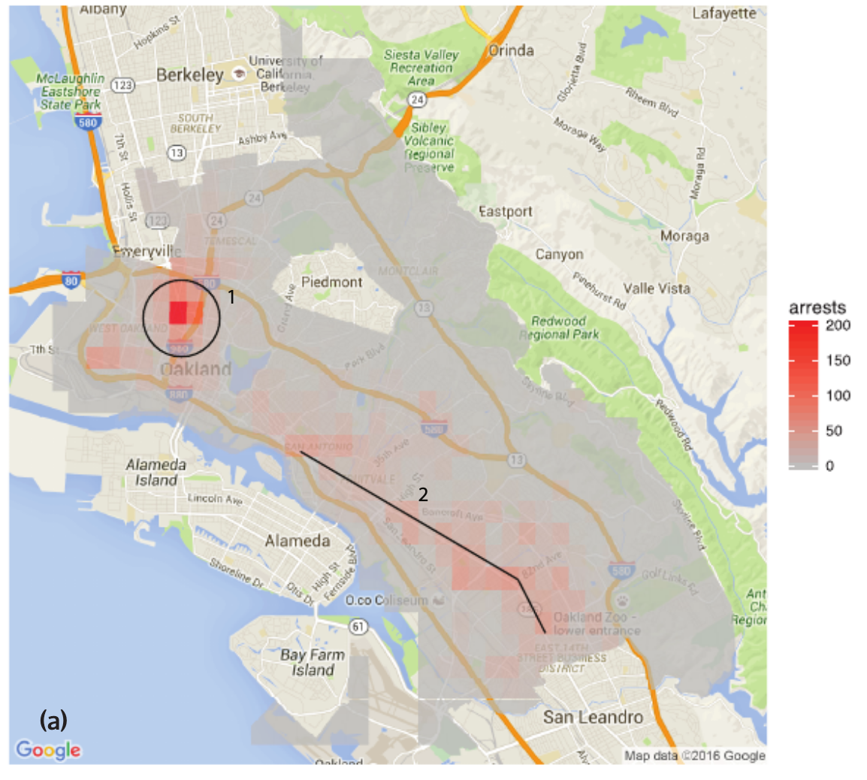
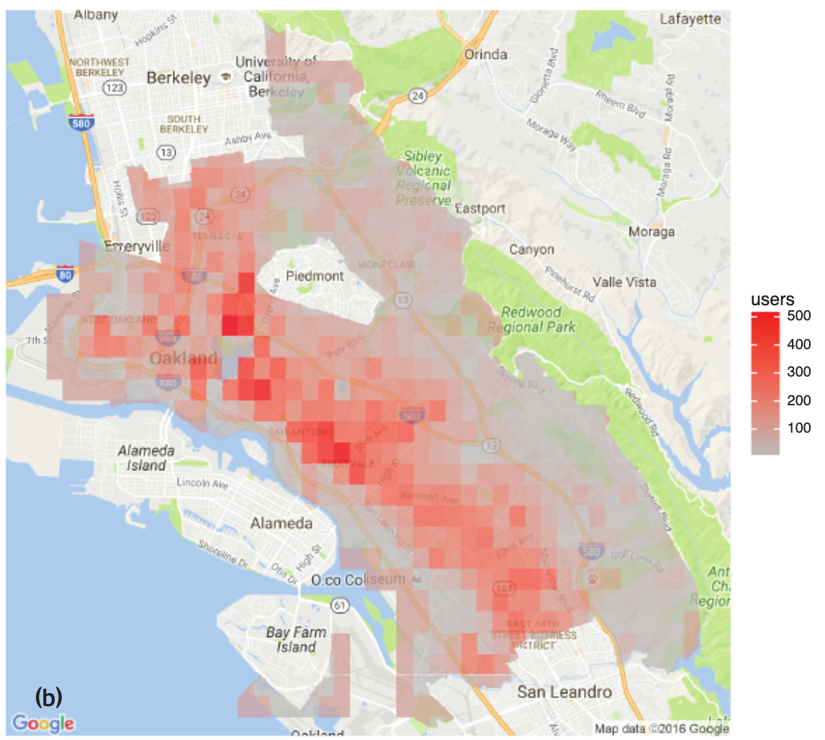
Lum and Isaac results: arrests vs ground truth
Figures taken from the Lum and Isaac paper

Slide 21
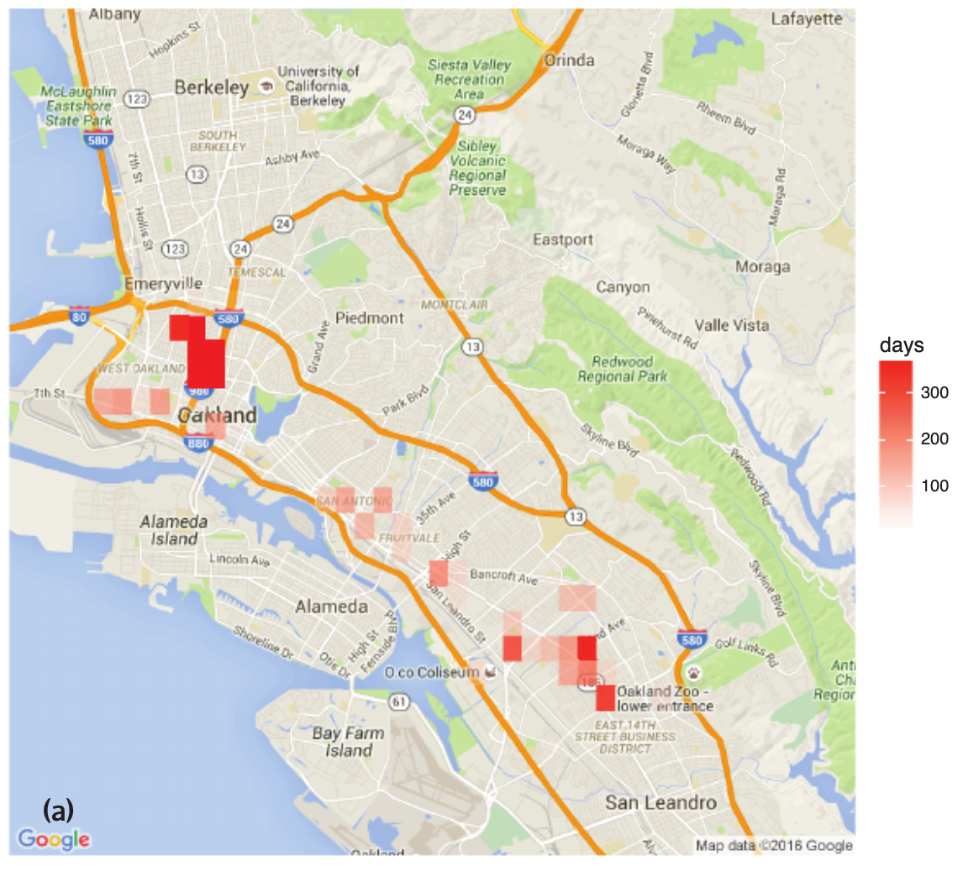
Lum and Isaac result: predpol output
Figures taken from the Lum and Isaac paper

Slide 22
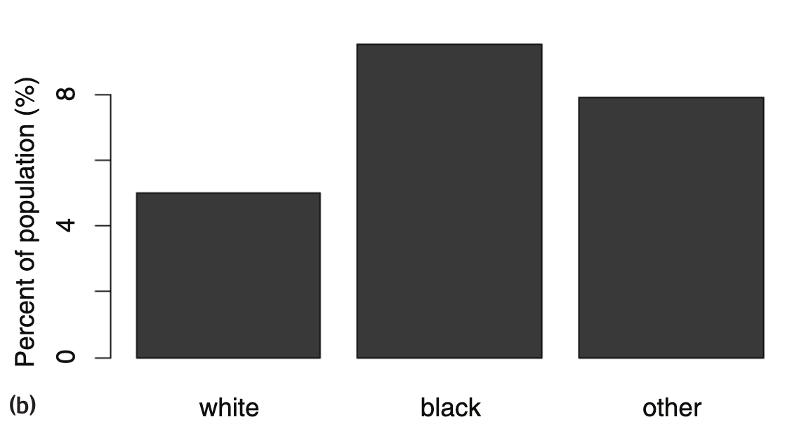
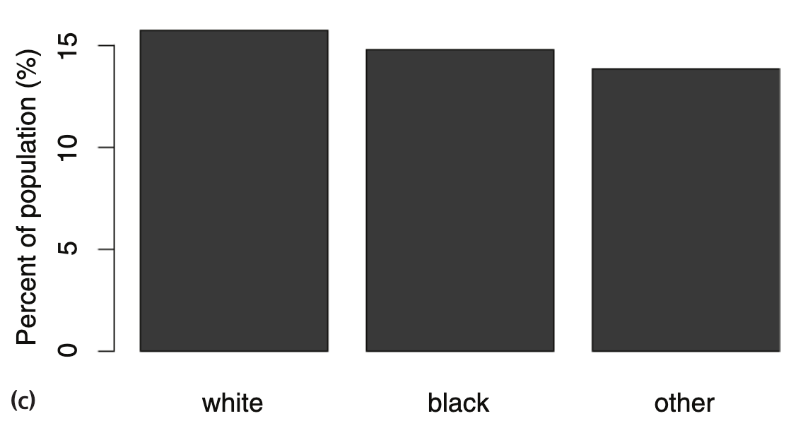
Lum and Isaac result
Figures taken from the Lum and Isaac paper

Slide 23
Back to feedback loop state question

Slide 24
Now really back to the Q

Slide 25
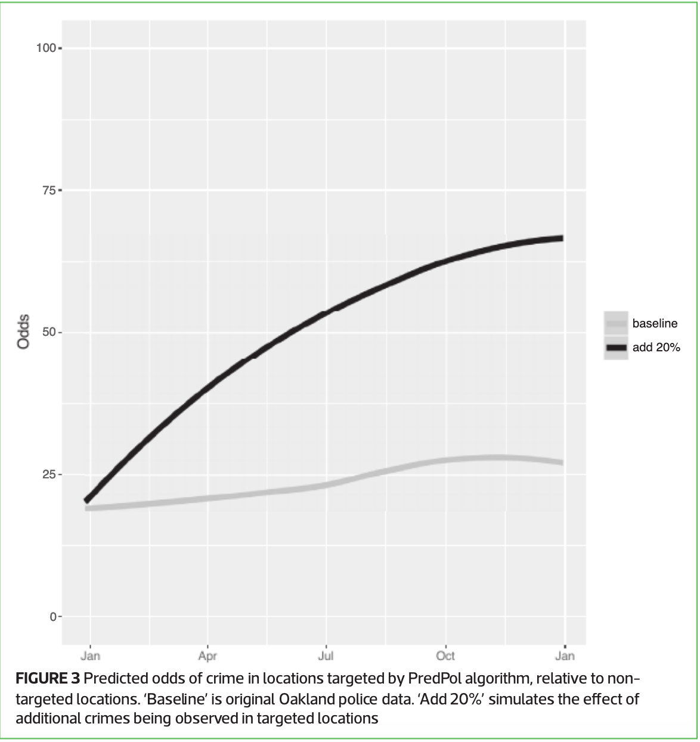
Lum and Isaac result (20% increase)
Figure taken from the Lum and Isaac paper

Slide 26
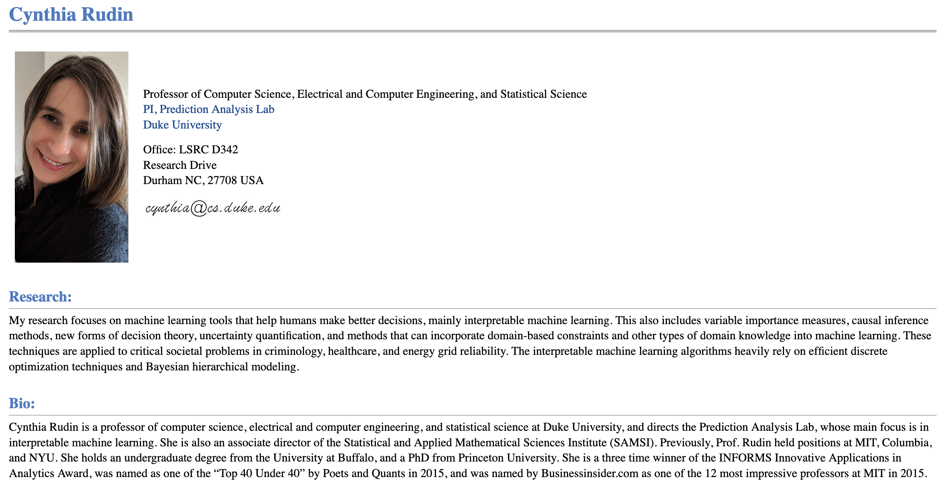
Passphrase for today: Cynthia Rudin

Slide 27
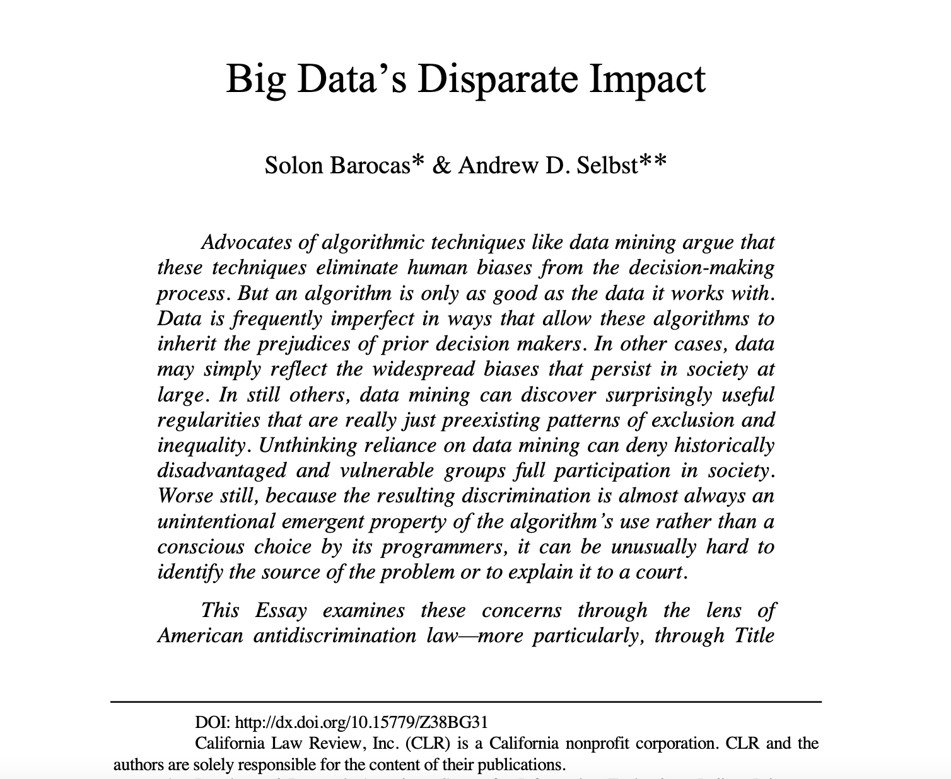
In-class discussion

Slide 28
Thing to keep in mind
You are expected to participate ☺

Slide 29
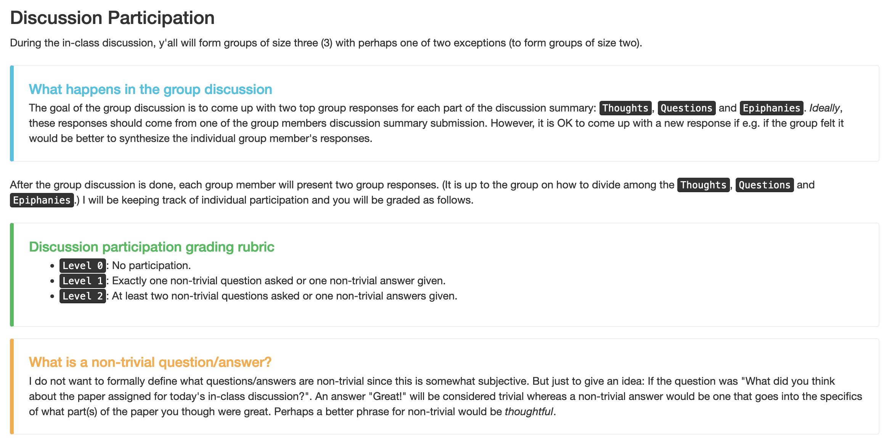
First form groups and discuss your answers

Slide 30
Discuss!

Slide 31
Thoughts

Slide 32
Questions + Epiphanies

Slide 33
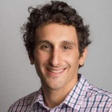
Guest lecture on Tuesday: Kenny Joseph
There will be attendance!

