Slide 1
ML and News and Elon Musk and who owns our public spaces
Kenneth (Kenny) Joseph
Notes:
as no one has ever said before, if you want to get out of the cold, come on down to Buffalo

Slide 2
Hi
I am Kenny
I use computational methods to study people, and use people to study computational methods
Most of my 20s was spent studying Twitter, with a heavy focus on how people use it to get information and express their biases (I know, yikes)

Slide 3
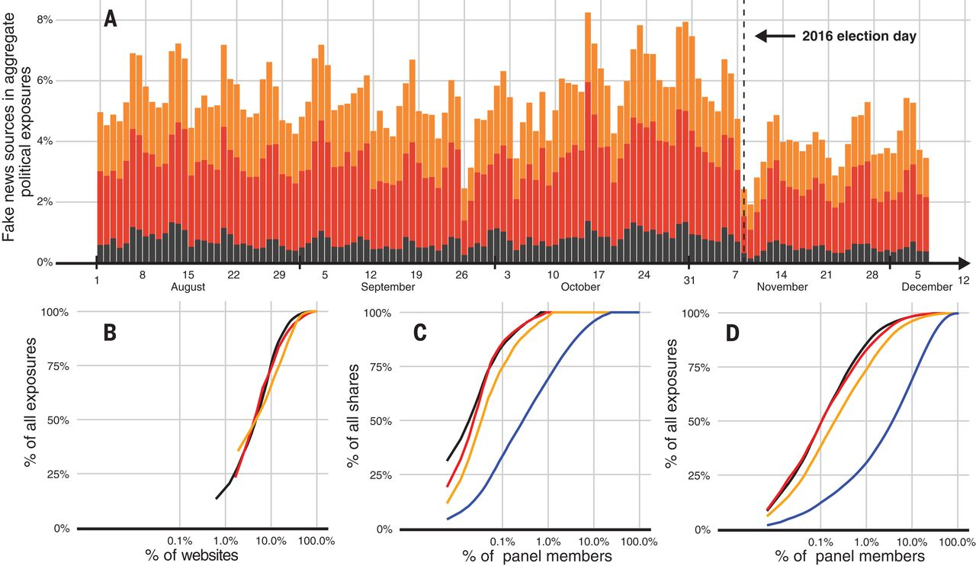

Slide 4
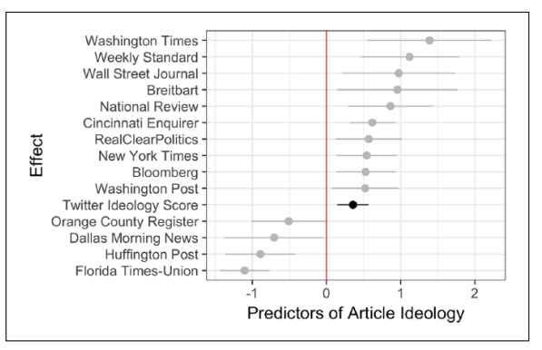

Slide 5
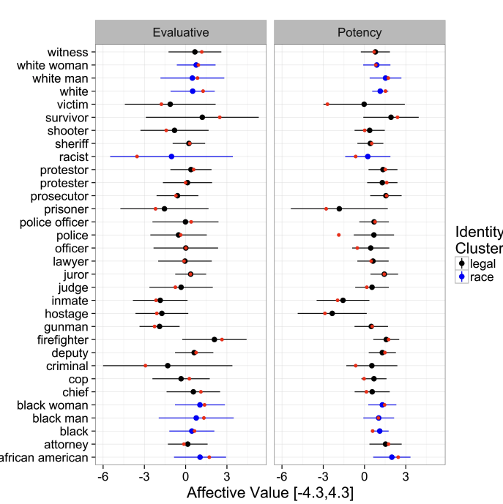

Slide 6
Some things to discuss
(Why) should you care about Twitter?
How do you think ML plays a role in these different scenarios?
Do you think ML matters more than other things? If so, why? If not, what matters more?

Slide 7
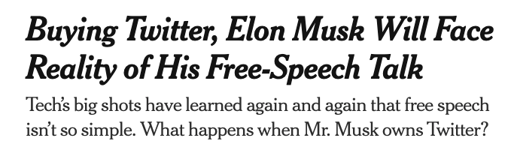

Slide 8
Task #0 Today
Hop into groups
10 minute discussion, 1 minute presentation
  What does free speech mean?
  What do you think free speech looks like on Twitter?
  Where can “free speech” go wrong?
  Which platform do you think is closest to “free speech”? How is that working out?

Slide 9
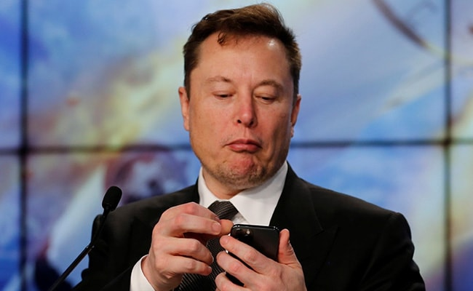
Task #1 today
I am a startup tycoon. I therefore know everything and can solve all problems with the maths and VC funding
Someone has told me that news is biased
I have decided to solve this problem.
I hire your team to build an unbiased news site (“Elon Twitter”)

Slide 10
Task (cont.)
Form teams
You have 20 minutes to step through the ML pipeline to:
  Create a machine learning model that determines whether or not a particular piece of news is biased (or how it is biased, or how biased it is)
  Determine how to use that algorithm to produce a set of 15 news articles that are shared via a list-serv to paying customers every morning
  Develop a 1-3 minute pitch for your approach and why it will work

Slide 11
Some considerations
I’m being deliberately vague about what “bias” is. But you may want to consider:
  Political leaning
  Spatial distribution
  Gender
  Topical content
  Source of the article
  Content of the article
  …
Not restricted to the US!
Some examples you might think about
  https://knowherenews.com/
  …

Slide 12
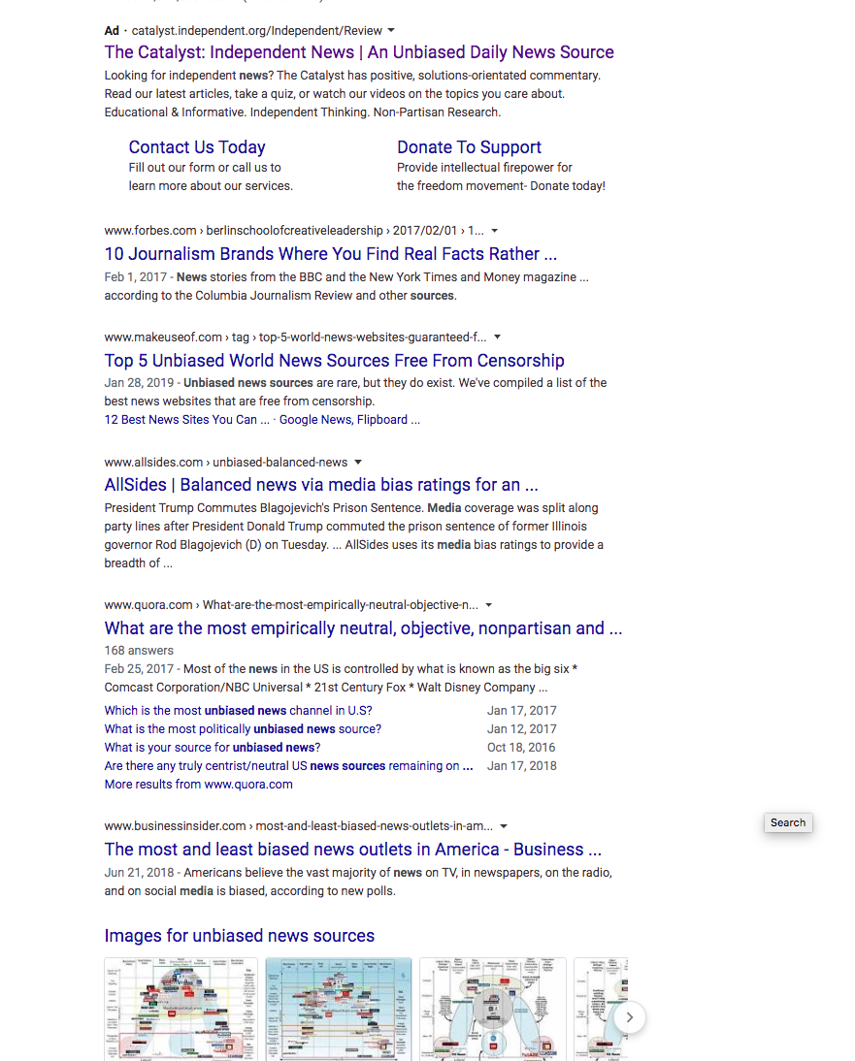

Slide 13
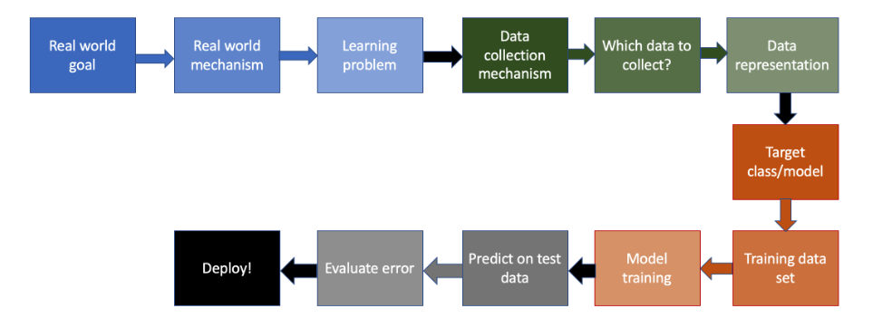

Slide 14
News, Truth and Bias
Bias exists everywhere in the media, but in two forms
  Reporting bias – media organizations can be biased in the news that they produce
  Content bias – media organizations can be biased in the way that they cover
Bias is different than falsification, or “fake news”
But
  Who gets to decide what is worth covering, and what isn’t?
  Is it even possible to cover “everything”? Would anyone come to your site?
  Who gets to be the arbitrator of truth? The platform?
Also – the idea of “unbiased news” is relatively new
Notes:
he notion that reporters should possess Olympian objectivity is relatively recent. In the nineteenth century, most newspapers were explicitly linked to a particular political party and the economic interests of the publisher. In California during the Gold Rush, for example, the San Francisco Alta California was the enemy of Democratic governor John Bigler, whose press champion was the Stockton Republican.

Slide 15
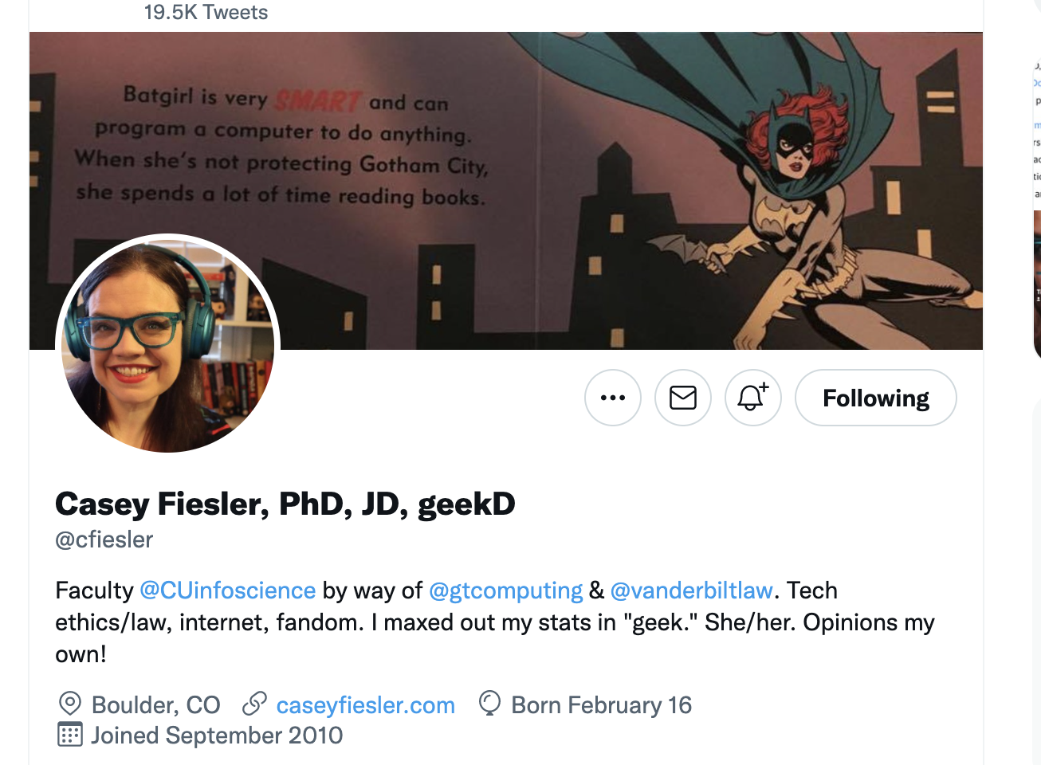

Slide 16
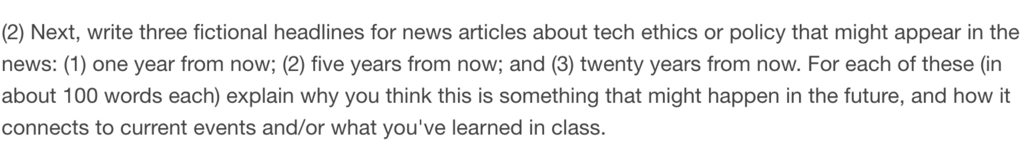
Task #2 – Future thinking on News Media Tech

Slide 17
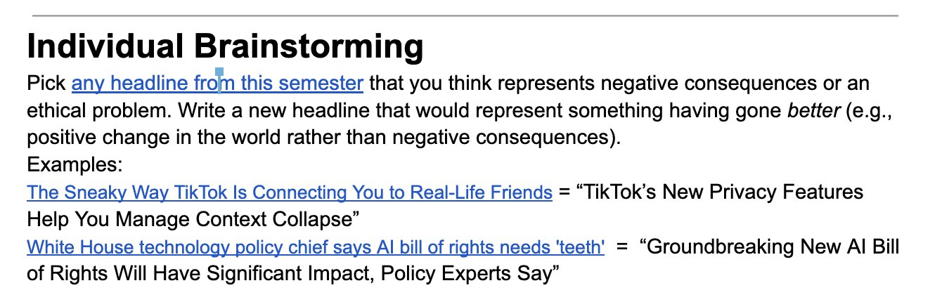
Task #2 (cont.)
What needs to happen for this to change?

