Slide 1
ML and Society
May 10, 2022

Slide 2
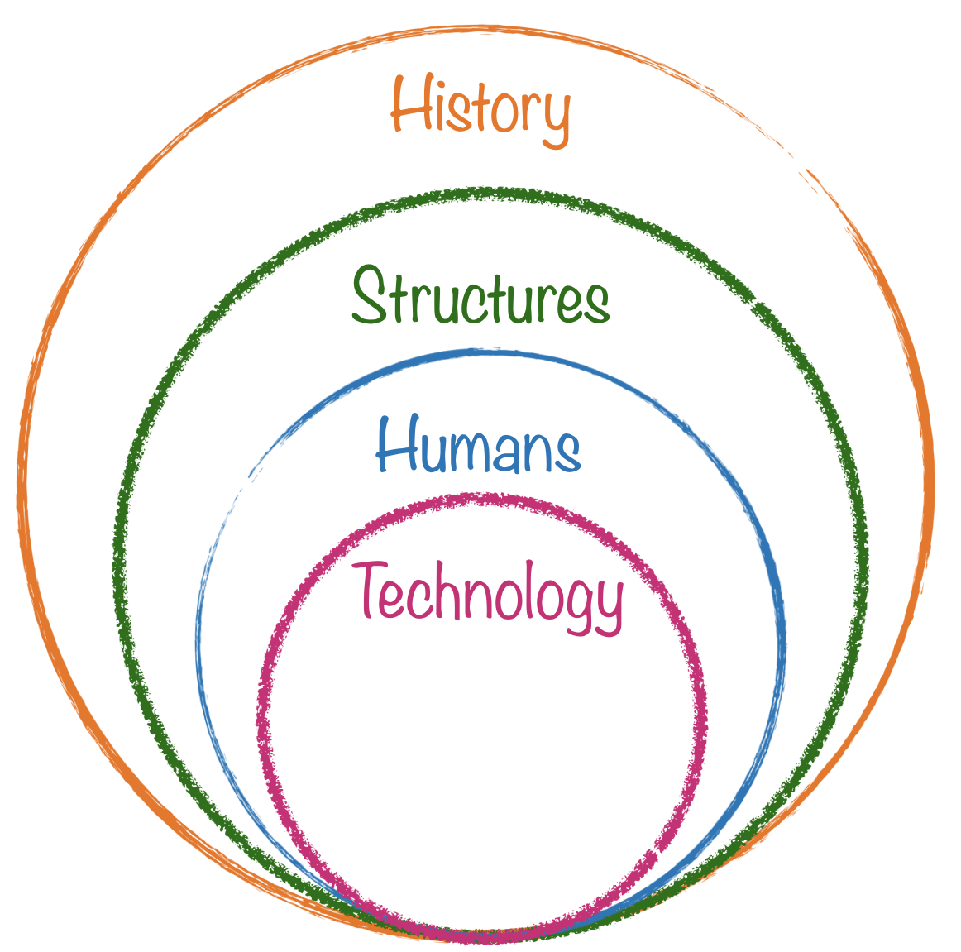
The HOW worksheet

Slide 3
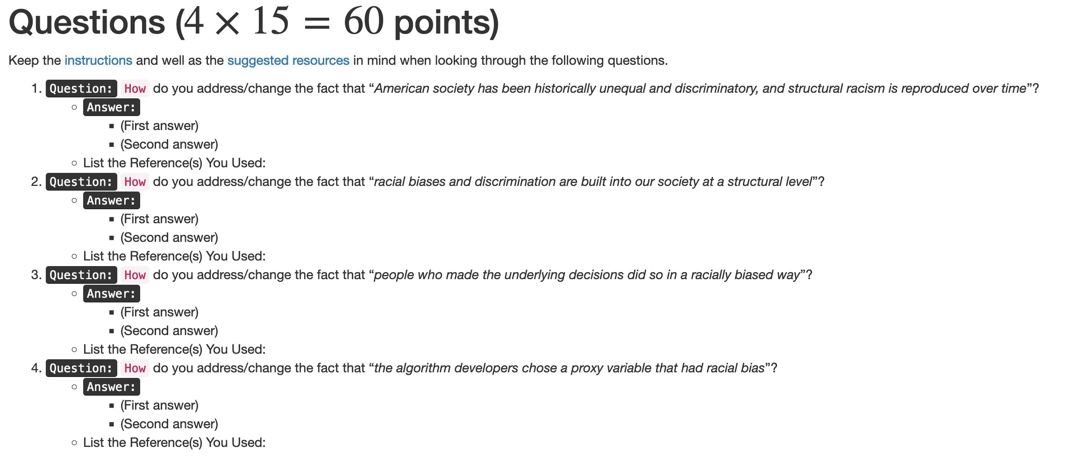
Discuss your HOW solutions! [16 minutes]

Slide 4
Discuss solving racism worksheets! [16 minutes]

Slide 5
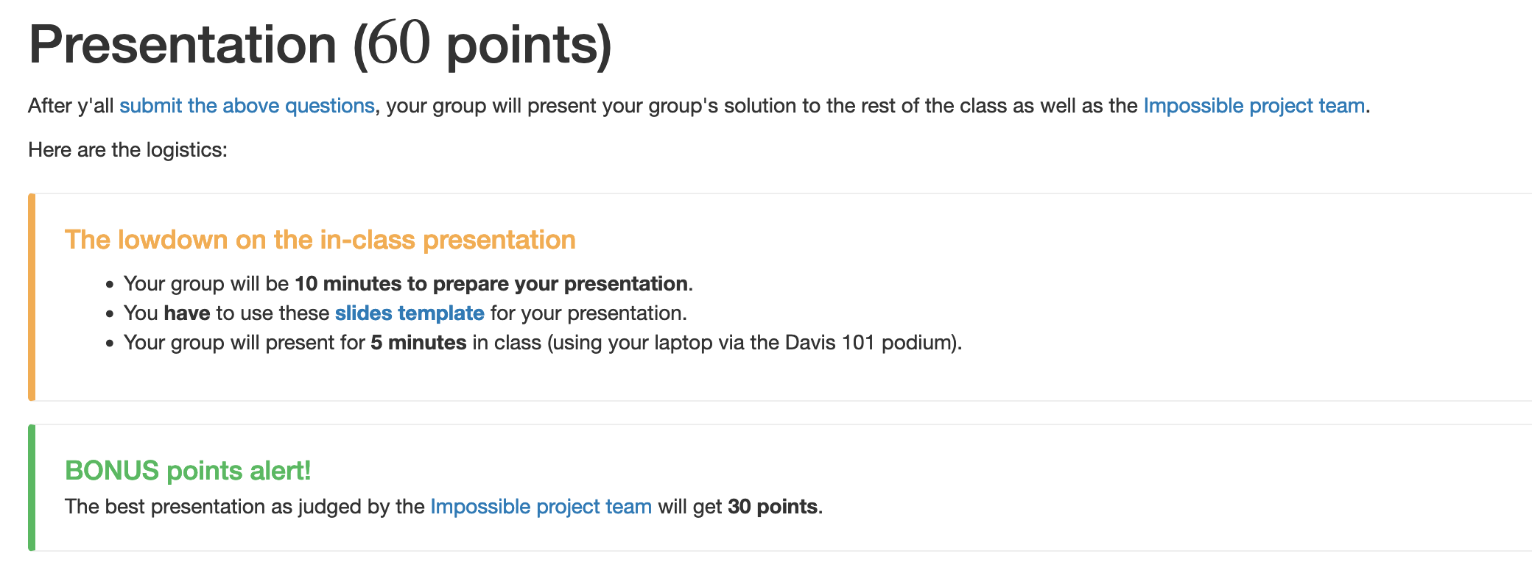
Create your presentations [10 mins]

Slide 6
Now present… (4 X 4 = 16 mins)
Multiple notions of fairness
Human Acceptance
Teaching tools
Algorithmic Auditing

Slide 7
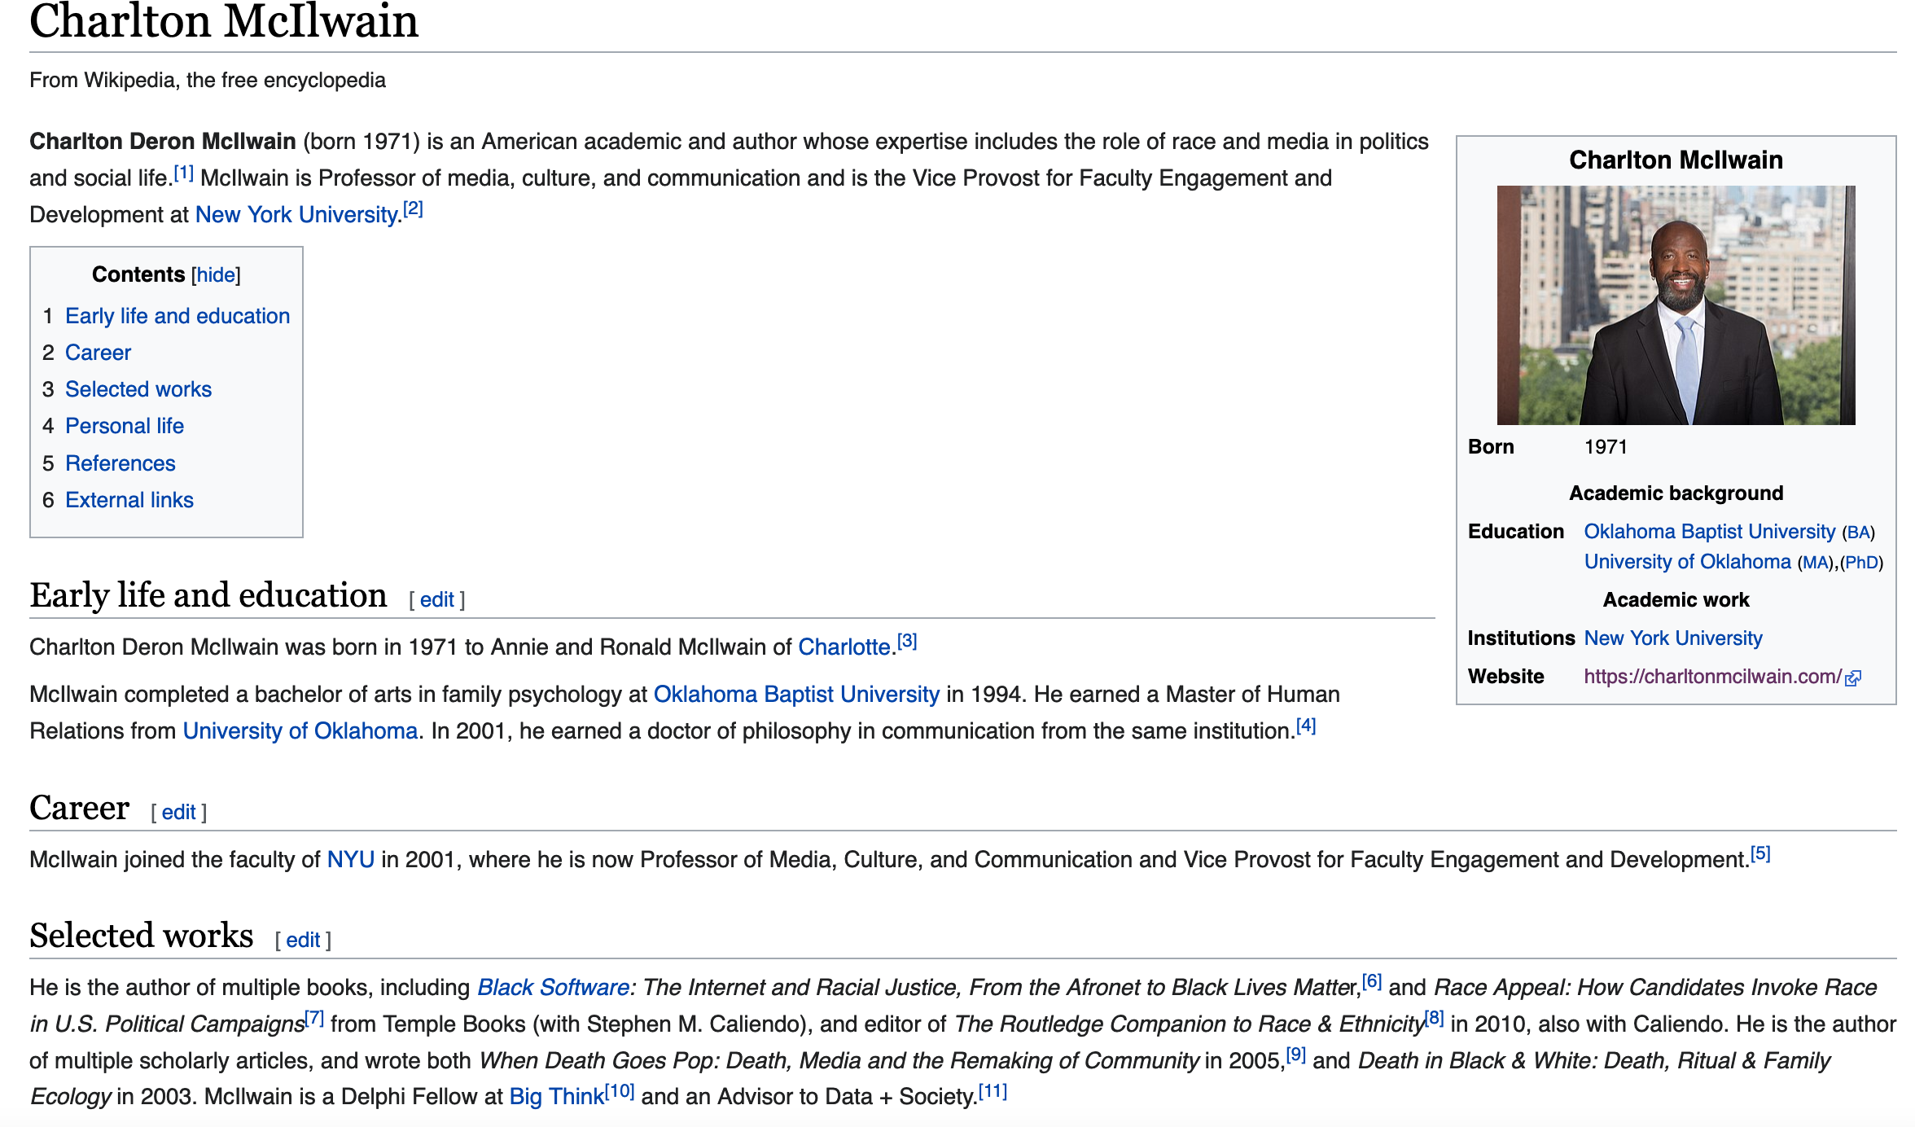
Passphrase for today: Charlton McIlwain

Slide 8
Announcing the winner!

