Slide 1
ML and Society
Feb 8, 2022

Slide 2
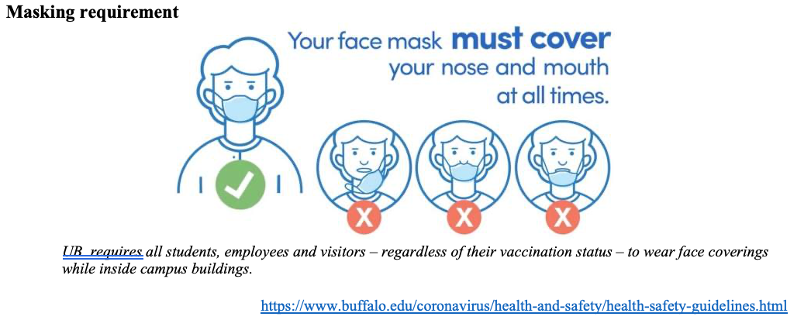
Please have a face mask on

Slide 3
Who does my machine learning model serve?
How do I know?
What can I do about it?

Slide 4
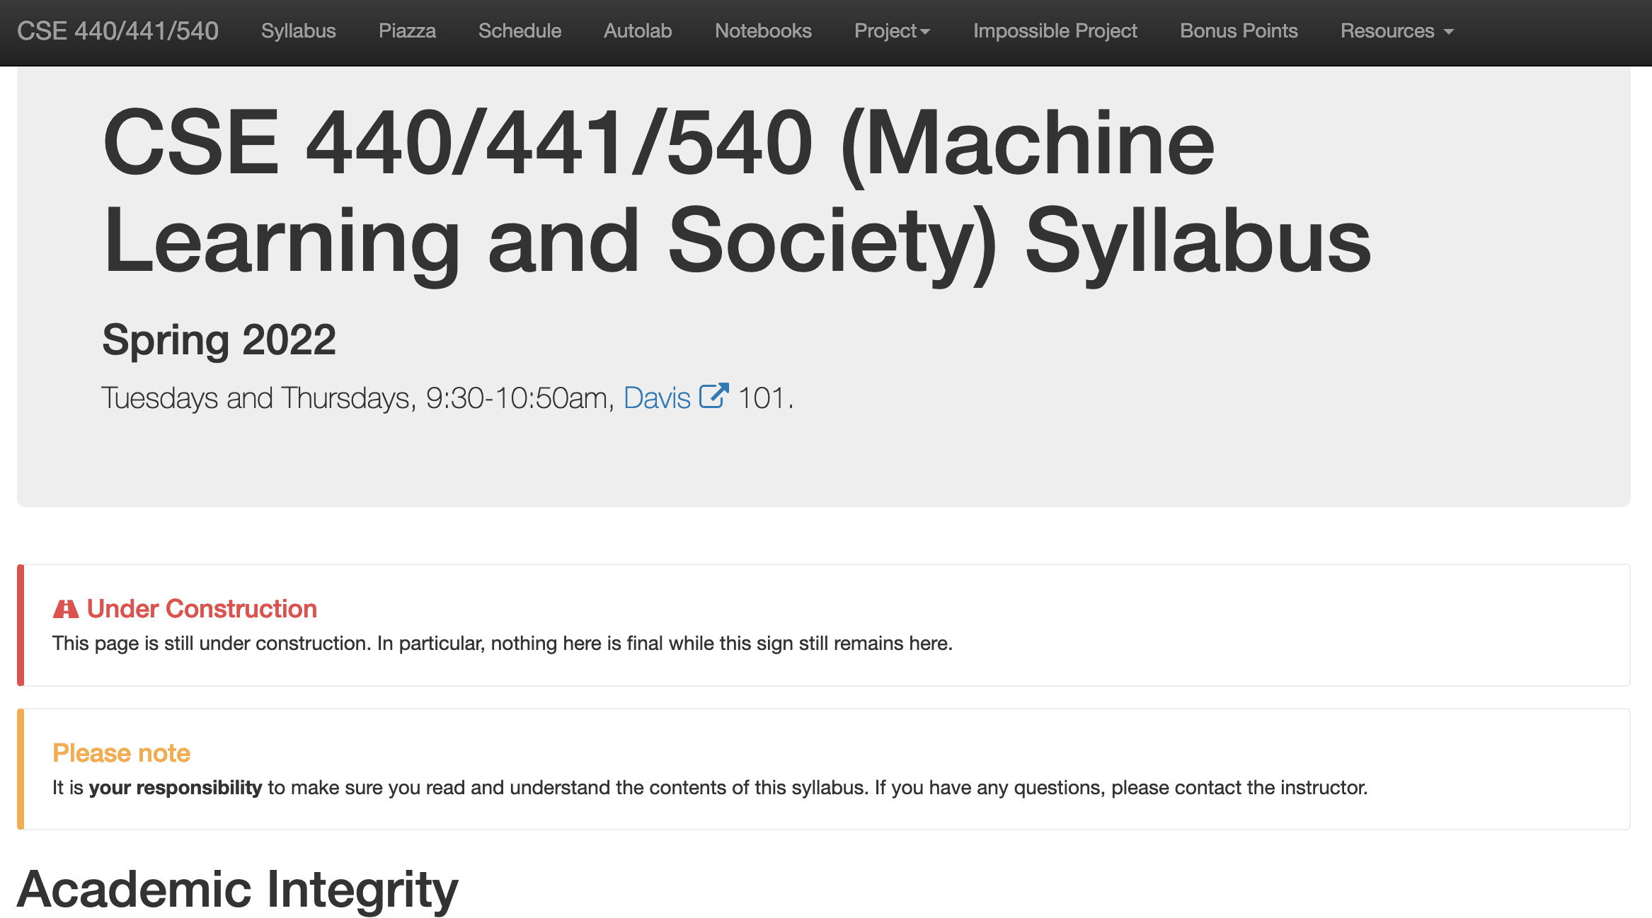
Read the syllabus carefully!

Slide 5
Due in the next couple of days
Wed 5pm: Discussion summary on Autolab
Th 5pm: Project choices due (via Google form)

Slide 6
Autolab accepting discussion summaries

Slide 7
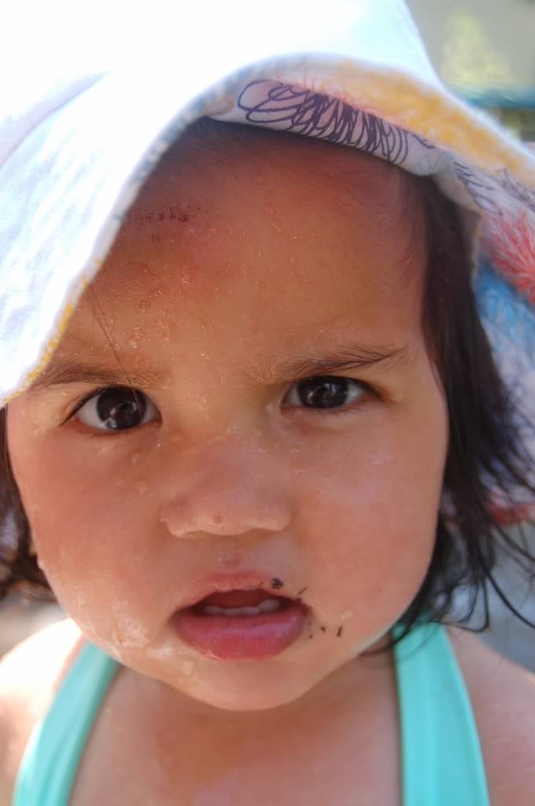
?

Slide 8
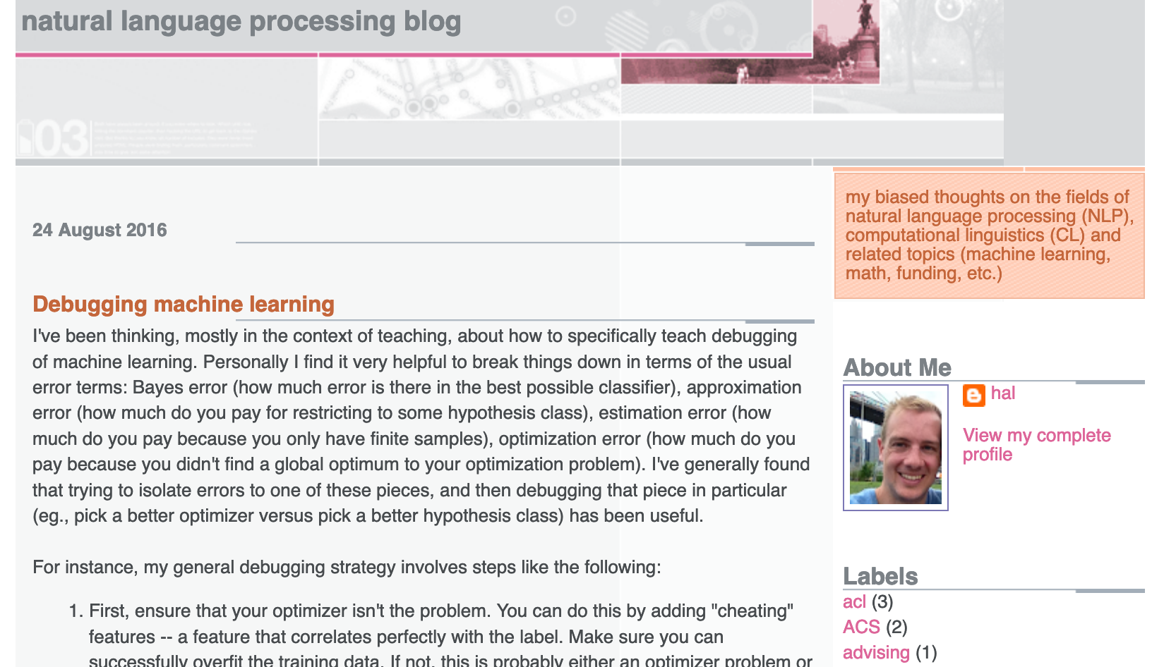
Start with a Question
Collect data
Train model
Evaluate model
Deploy!
Real world goal
Real world mechanism
Learning problem
Data collection mechanism
Which data to collect?
Data representation
Target class/model
Deploy!
Evaluate error
Predict on test data
Model training
Training data set

Slide 9
Putting society back in
Real world goal
Real world mechanism
Learning problem
Data collection mechanism
Which data to collect?
Data representation
Society
Target class/model
Deploy!
Evaluate error
Predict on test data
Model training
Training data set

Slide 10
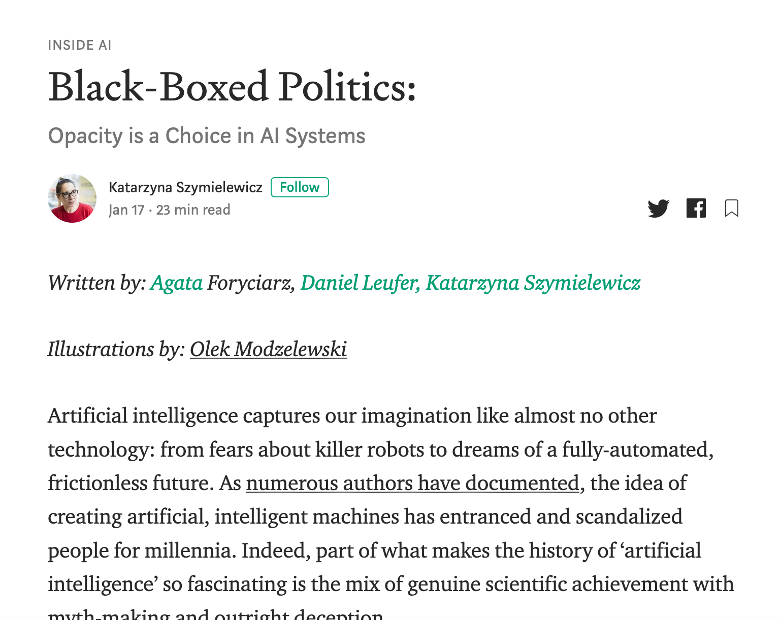
Not the only ML+society pipeline in town

Slide 11
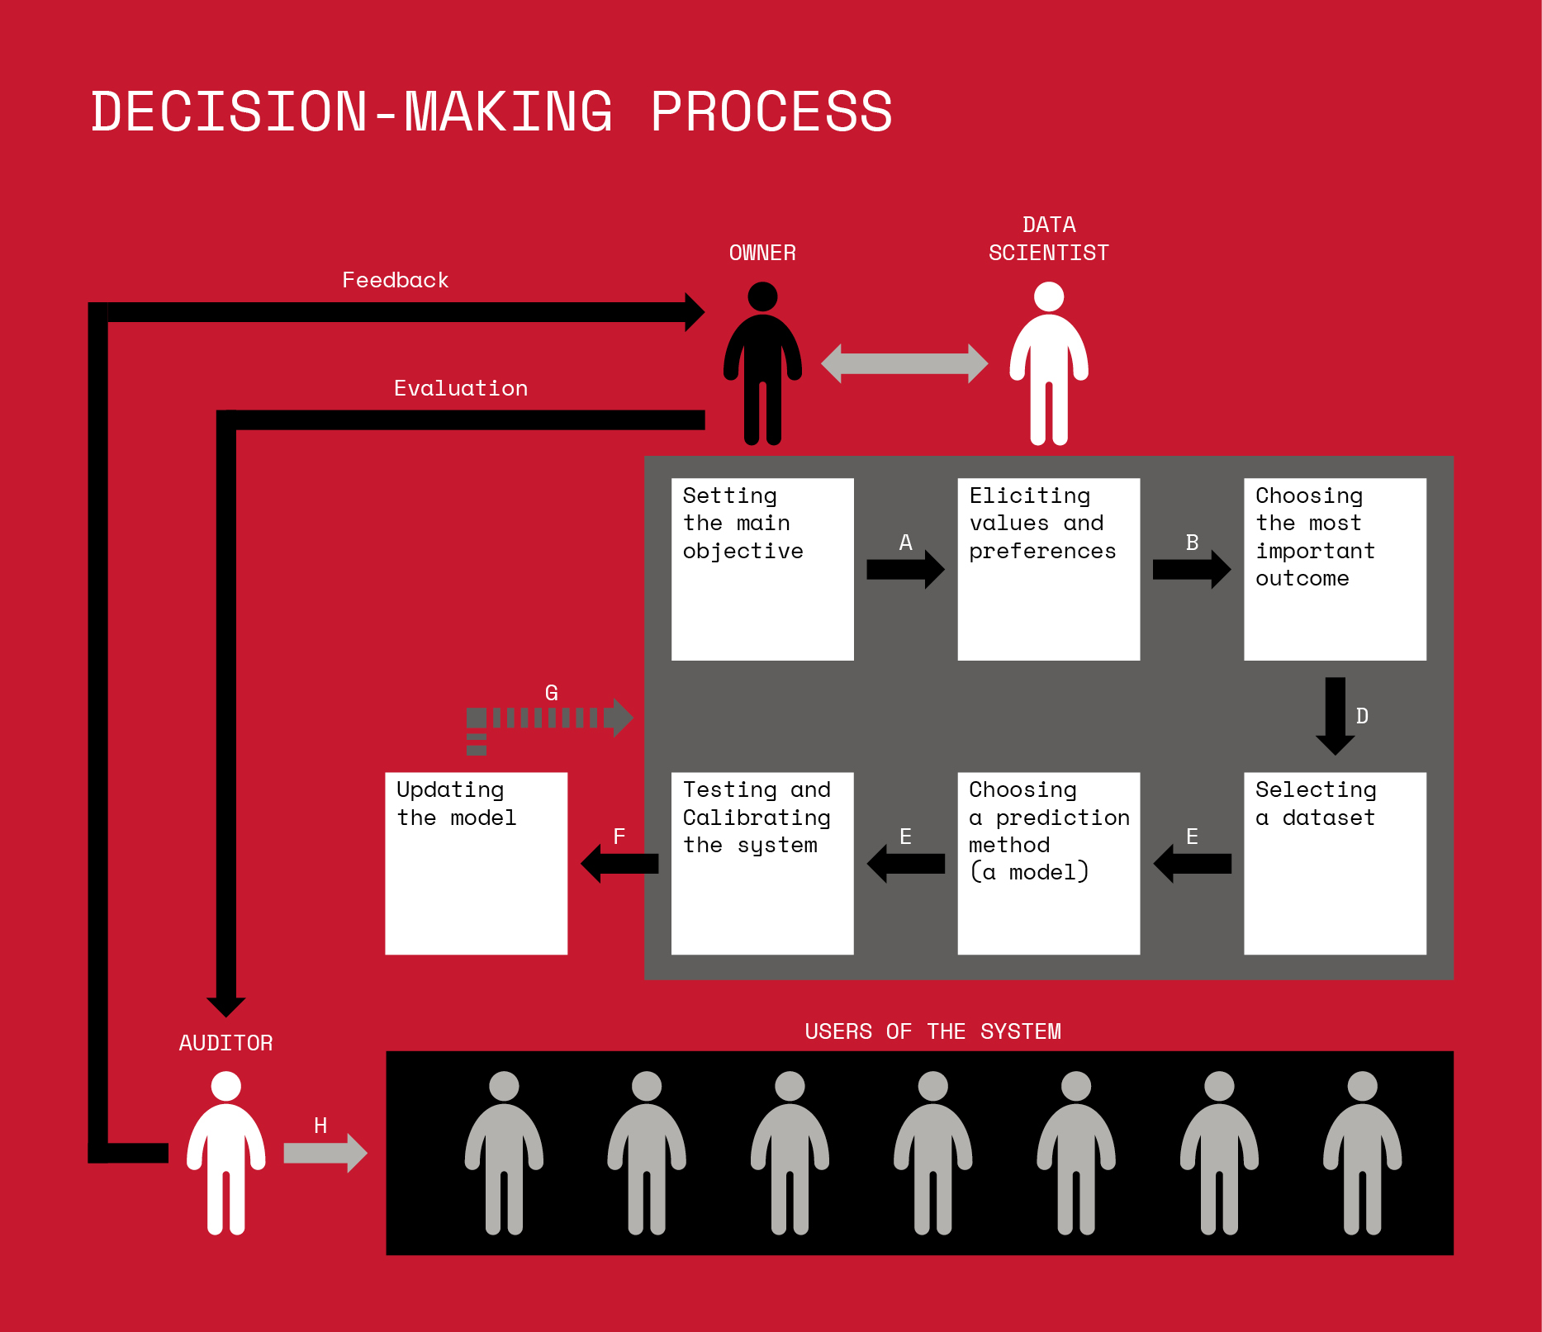
Not the only ML+society pipeline in town

Slide 12
A walkthrough

Slide 13
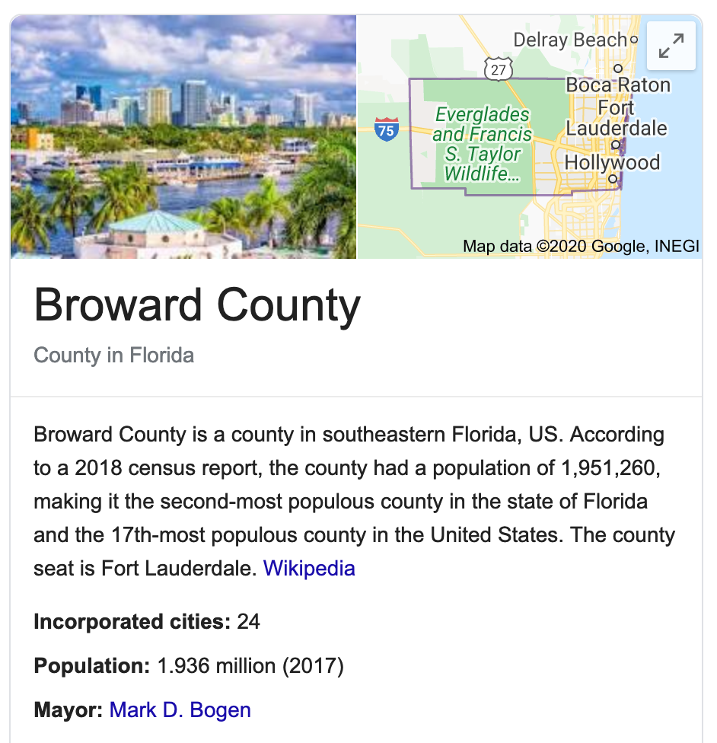
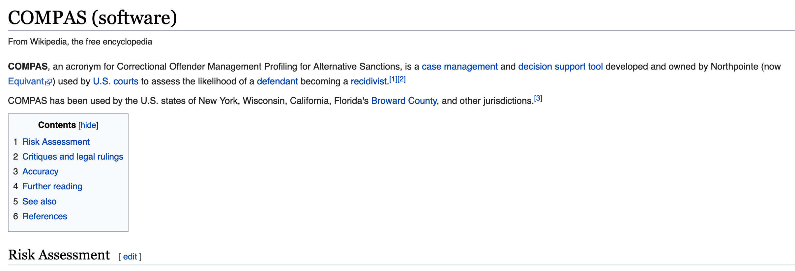
Have you heard of COMPAS?

Slide 14
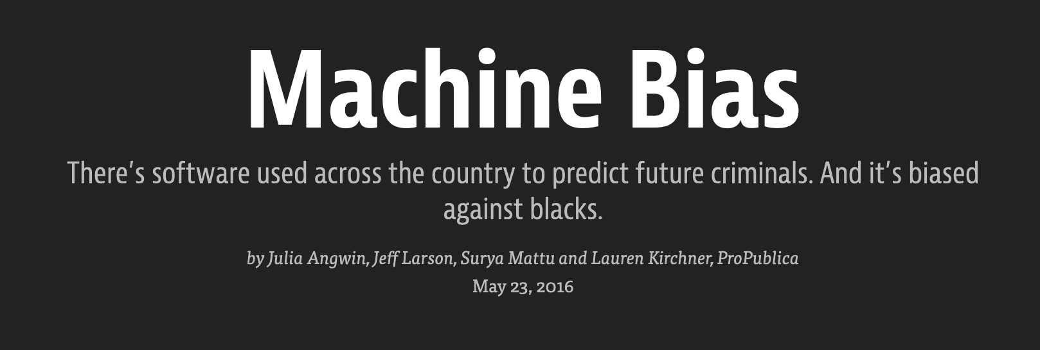

Slide 15
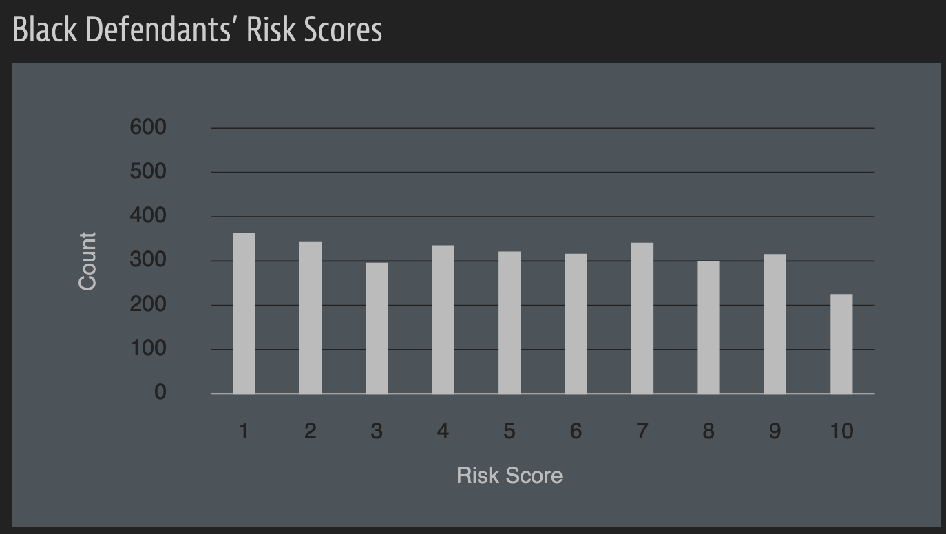
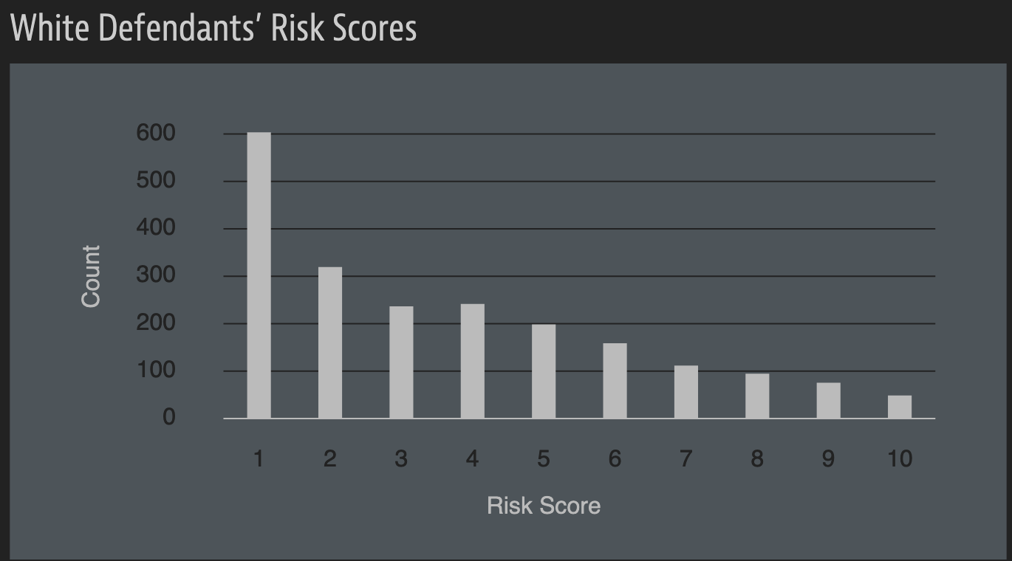
A sample of their result

Slide 16
A rejoinder

Slide 17
?

Slide 18
A walkthrough
Real world goal
Real world mechanism
Learning problem
Data collection mechanism
Which data to collect?
Data representation
Target class/model
Deploy!
Evaluate error
Predict on test data
Model training
Training data set

Slide 19
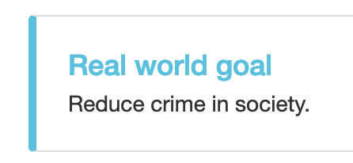
Real world goal
Real world goal

Slide 20
Real world mechanism
Real world goal
Real world mechanism

Slide 21
Learning problem
Target variable might not be obvious in other scenarios!
Real world goal
Real world mechanism
Learning problem

Slide 22
?

Slide 23
Data collection mechanism
Real world goal
Real world mechanism
Learning problem
Data collection mechanism

Slide 24
Which data to collect?
Real world goal
Real world mechanism
Learning problem
Data collection mechanism
Which data to collect?

Slide 25
Data representation
Real world goal
Real world mechanism
Learning problem
Data collection mechanism
Which data to collect?
Data representation

Slide 26
?

Slide 27
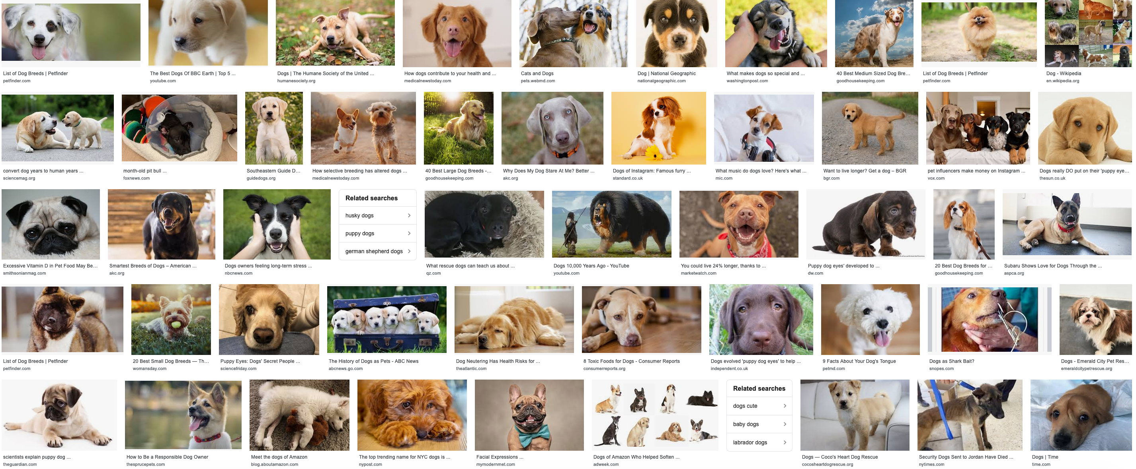
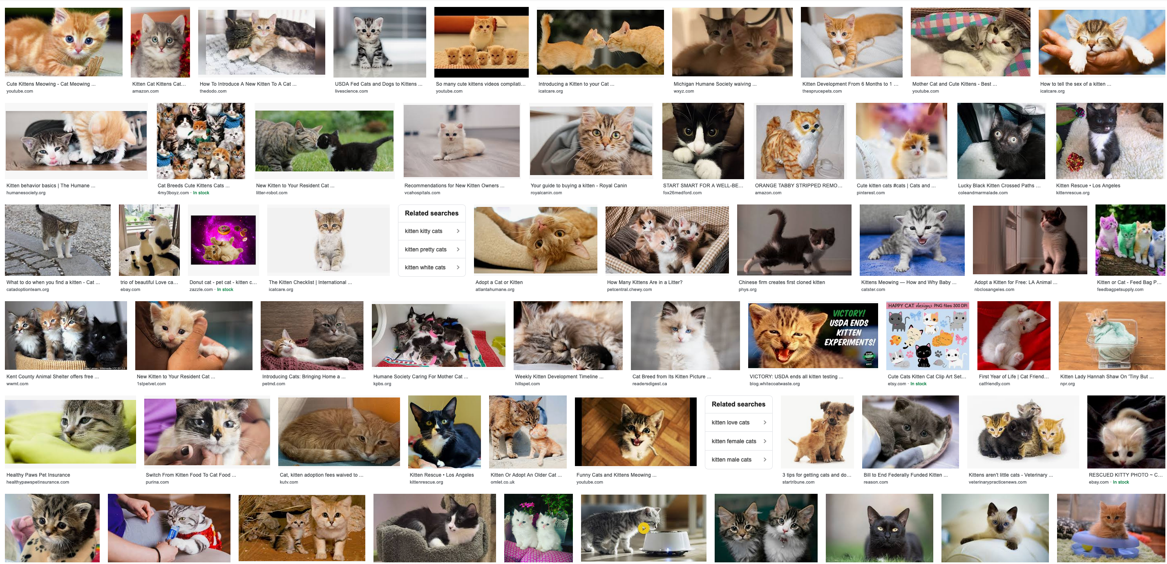
Target class/model
Real world goal
Real world mechanism
Learning problem
Data collection mechanism
Which data to collect?
Data representation
Target class/model
dog
Linear models
f
cat

Slide 28
Cartoon of how linear model works
Can you find a “better” line?

Slide 29
Training data set
Real world goal
Real world mechanism
Learning problem
Data collection mechanism
Which data to collect?
Data representation
Target class/model
Training data set

Slide 30
Pick (random) half of the dataset

Slide 31
Model training
Real world goal
Real world mechanism
Learning problem
Data collection mechanism
Which data to collect?
Data representation
Target class/model
Model training
Training data set

Slide 32
?

Slide 33
Predict on test data
Real world goal
Real world mechanism
Learning problem
Data collection mechanism
Which data to collect?
Data representation
Target class/model
Predict on test data
Model training
Training data set

Slide 34
Evaluate error
Real world goal
Real world mechanism
Learning problem
Data collection mechanism
Which data to collect?
Data representation
Target class/model
Evaluate error
Predict on test data
Model training
Training data set

Slide 35
?

Slide 36
Relation to problem statement
Real world goal
Real world mechanism
Learning problem
Data collection mechanism
Which data to collect?
Data representation
Target class/model
Problem independent techniques
Evaluate error
Predict on test data
Model training
Training data set

Slide 37
?

Slide 38
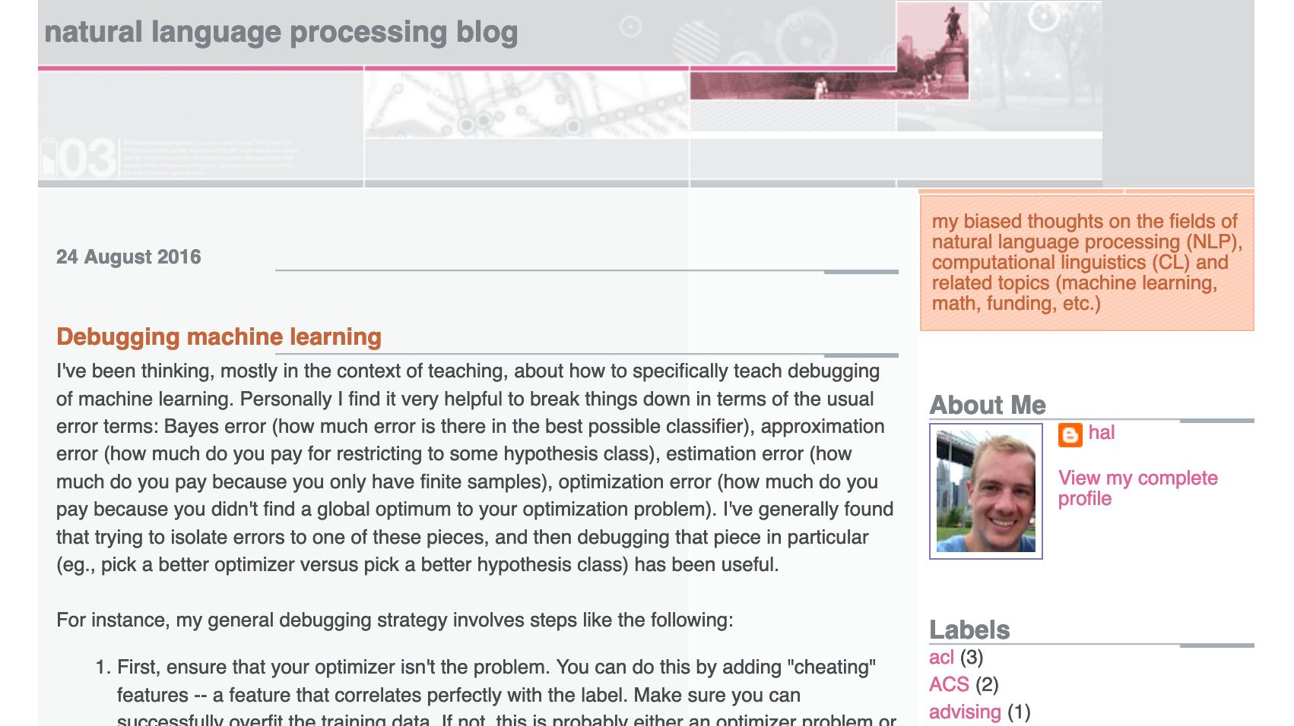
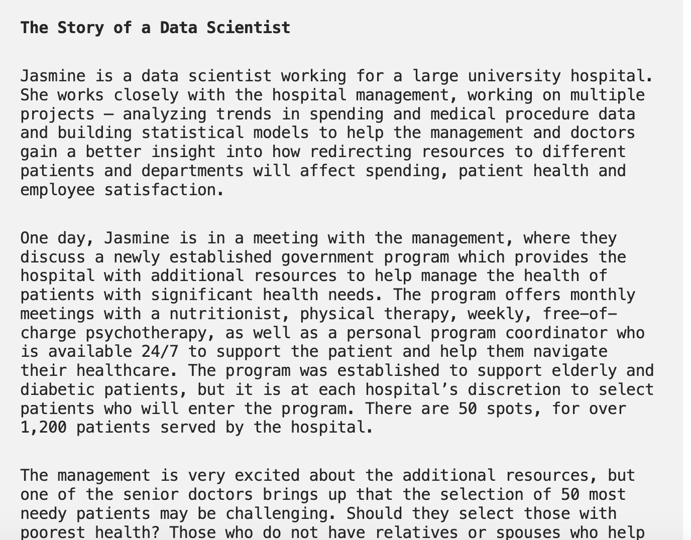
Three problems to consider
After the break
Ad display example
Hospital trying to utilize new govt program
Third example: YOU decide!

Slide 39
Pass phrase for today: Kate Crawford

Slide 40
Real world goal
Real world goal

Slide 41
Real world goal: Your choice
Real world goal
Group 1: How do you pick limited number of students that’ll benefit from a course
Group 2: Matching students to colleges where they have the best chance to succeed
Group 3: Given a budget how should a company best advertise to get max benefit

Slide 42
Real world goal: Choices from Spring 2020
Real world goal
Improve user experience for Stampede buses: 1
Figure out which laptop to buy?: 3
Figure out where to live as a student: 3
Figure out how to improve student’s class experience: 2
Improve students’ success in getting scholarships: 4
Improve on-campus parking: 3
Figure out how to improve instructor’s class experience: 2

Slide 43
Real world goal: General thoughts
Real world goal
This step generally done at higher management level
Translating this into something concrete needs remaining steps

Slide 44
?

Slide 45
Real world mechanism
Real world goal
Real world mechanism

Slide 46
Real world mechanism: Your choice
Real world goal
Real world mechanism
Choice 1: Benefit = number of degree requirements satisfied
Choice 2: Benefit = Number of options opened for future prospects

Slide 47
Real world mechanism: Spring 2020 choice
Real world goal
Real world mechanism
Improve students’ success in getting external scholarships
Improve student access to mentor (to help with the application process): 4
Improve student awareness of existing scholarships: 4
Identify students who are likely to win a scholarship
Motivate students to actually apply: 2
Make it easier to get scholarships: 4

Slide 48
Real world mechanism: General thoughts
Is improving ad display the best option?
Real world goal
Real world mechanism
ALWAYS question if the mechanism captures well the real life goal
Doctors vs. management in Example 2
There can be competing/incompatible mechanisms
CONVENIENCE trap!

Slide 49
?

