Slide 1
CSE 410
Feb 10, 2022

Slide 2
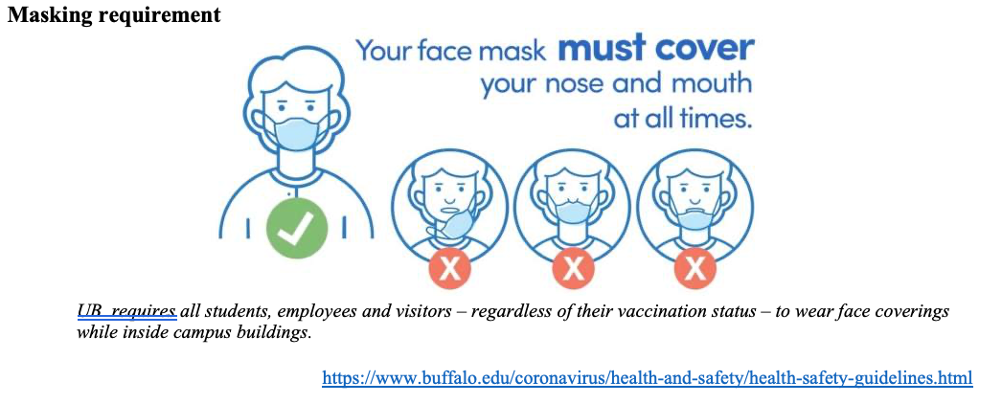
Please have a face mask on

Slide 3
Due TODAY
Th 5pm: Project choices due (via Google form)

Slide 4
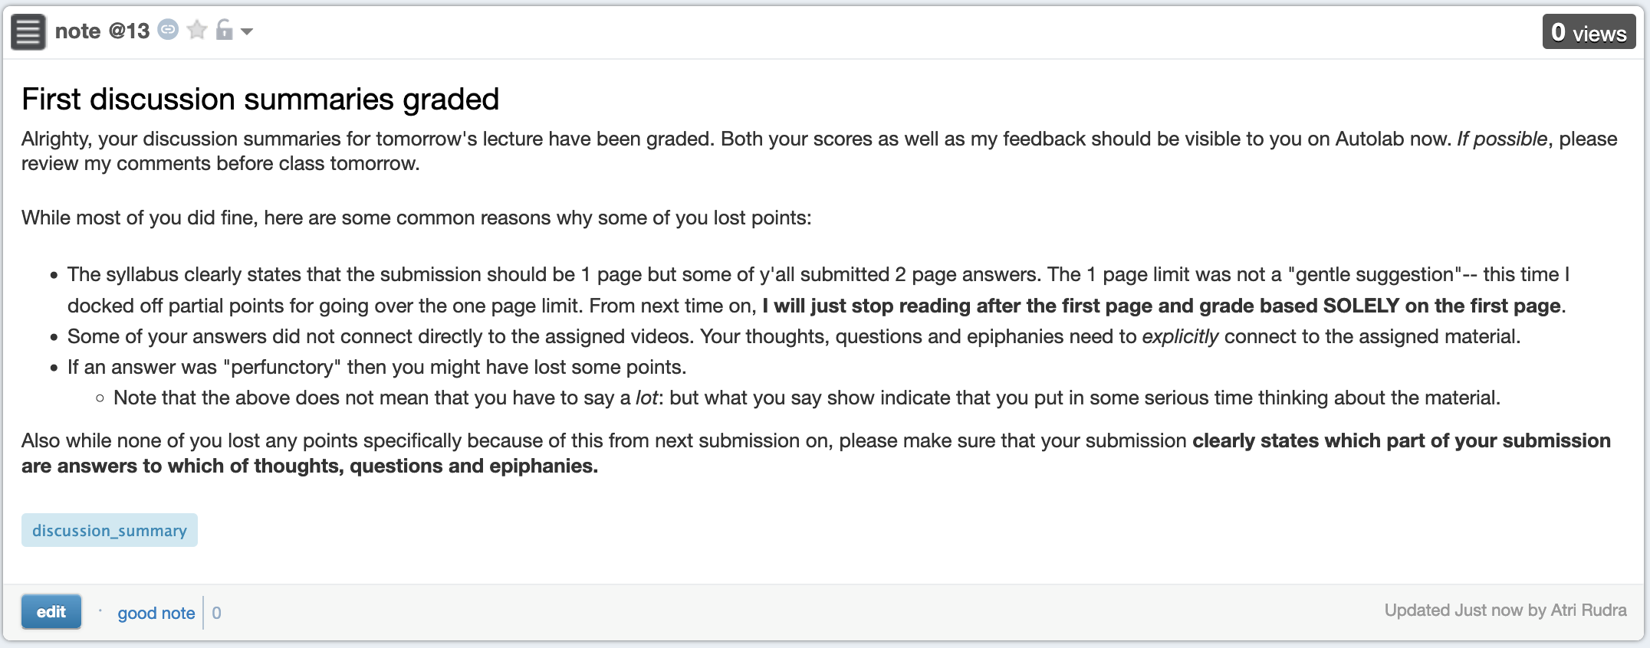
Discussion summaries graded

Slide 5
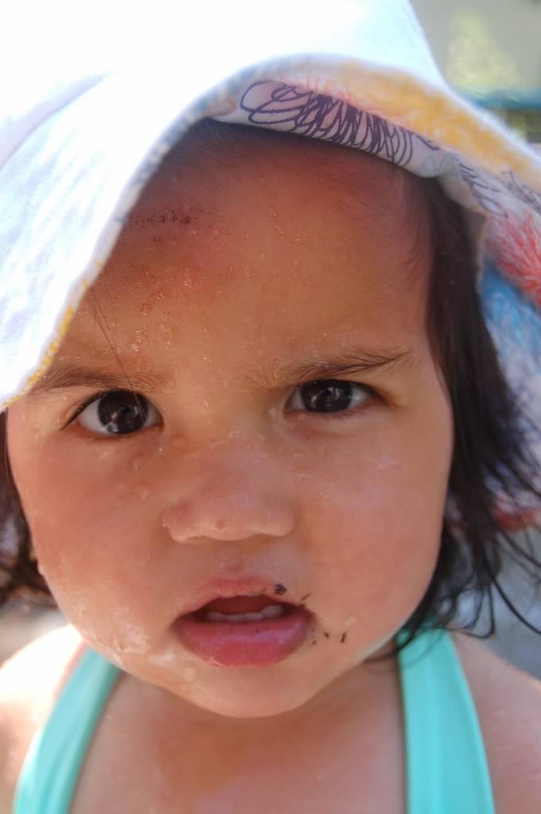
?

Slide 6
In-class discussion

Slide 7
Thing to keep in mind
You are expected to participate ☺

Slide 8
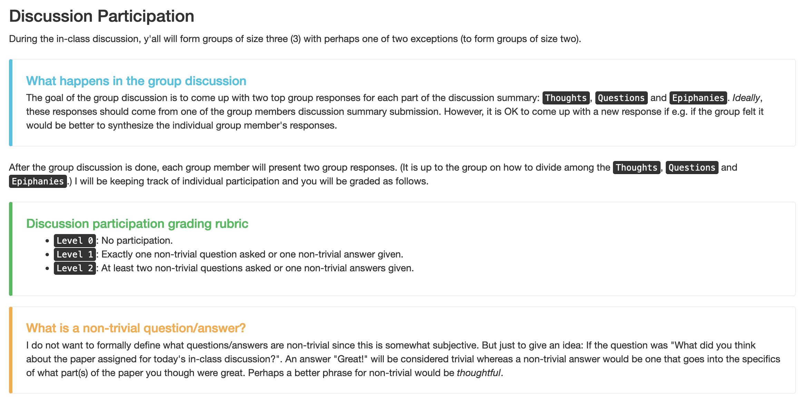
First form groups and discuss your answers

Slide 9
Discuss!

Slide 10
Thoughts

Slide 11
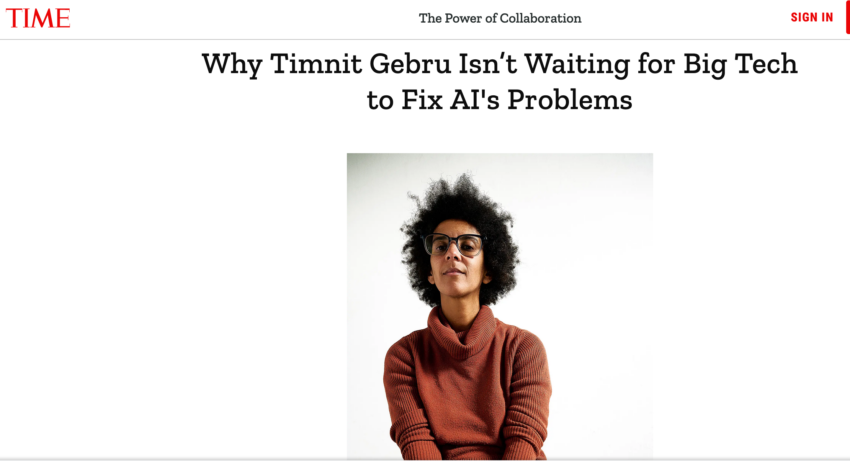
Passphrase for today: Timnit Gebru

Slide 12
Questions + Epiphanies
After the break

Slide 13
Questions

Slide 14
Epiphanies

Slide 15
Anything else we should discuss?

