Slide 1
ML and Society
Feb 15, 2022

Slide 2
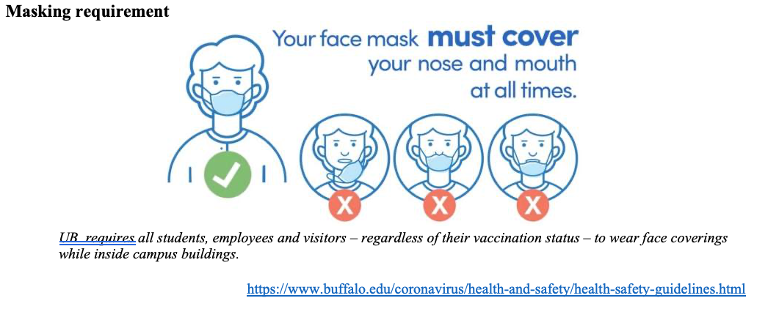
Please have a face mask on

Slide 3
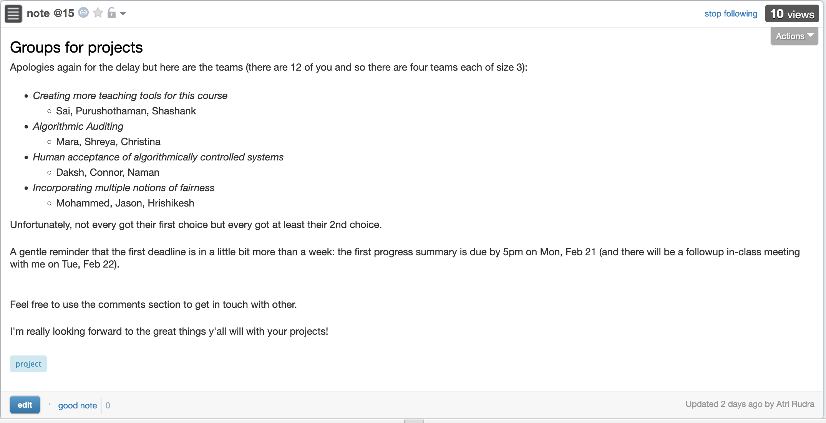
Project groups formed

Slide 4
Some Jupyter notebooks have been added

Slide 5
Relation to problem statement
Real world goal
Real world mechanism
Learning problem
Data collection mechanism
Which data to collect?
Data representation
Target class/model
Problem independent techniques
Evaluate error
Predict on test data
Model training
Training data set

Slide 6
Real world goal
Real world goal

Slide 7
Real world goal: Your choice
Real world goal
Group 1: How do you pick limited number of students that’ll benefit from a course
Group 2: Matching students to colleges where they have the best chance to succeed
Group 3: Given a budget how should a company best advertise to get max benefit

Slide 8
Real world goal: General thoughts
Real world goal
This step generally done at higher management level
Translating this into something concrete needs remaining steps

Slide 9
Real world mechanism
Real world goal
Real world mechanism

Slide 10
Real world mechanism: Your choice
Real world goal
Real world mechanism
Choice 1: Benefit = number of degree requirements satisfied
Choice 2: Benefit = Number of options opened for future prospects

Slide 11
Real world mechanism: General thoughts
Is improving ad display the best option?
Real world goal
Real world mechanism
ALWAYS question if the mechanism captures well the real life goal
Doctors vs. management in Example 2
There can be competing/incompatible mechanisms
CONVENIENCE trap!

Slide 12
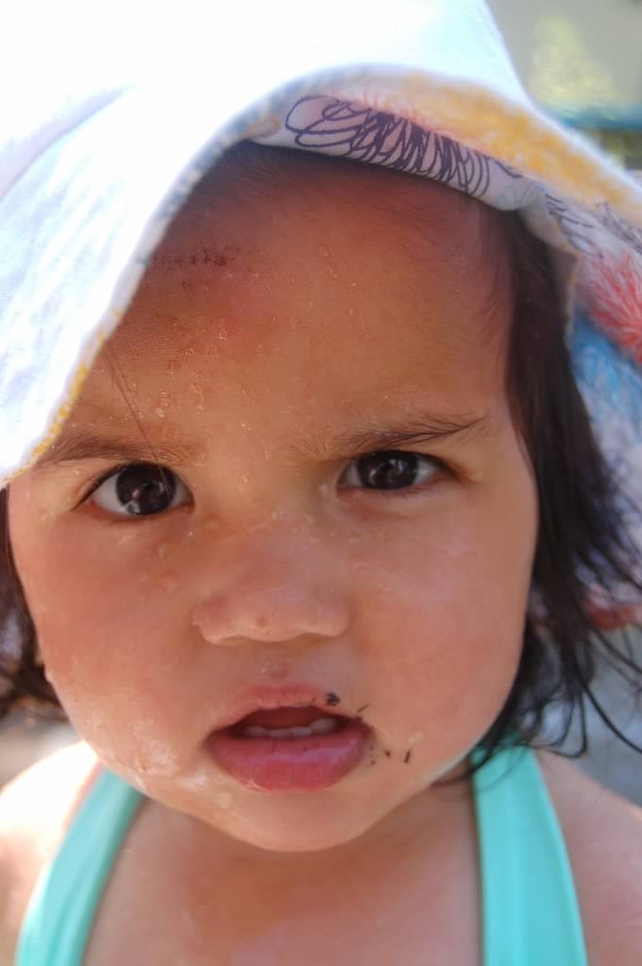
?

Slide 13
Learning problem
Real world goal
Real world mechanism
Learning problem

Slide 14
Learning problem: General thoughts
Real world goal
Real world mechanism
Learning problem
Decide NOT to use learning
Use of proxies for the real target variable
Some has to decide between competing target variables
Choosing the learning problem can have big consequence!
Convenience trap

Slide 15
?

Slide 16
Data collection mechanism
Real world goal
Real world mechanism
Learning problem
Data collection mechanism

Slide 17
Data collection mechanism: general thoughts
Real world goal
Real world mechanism
Learning problem
Data collection mechanism
Concept/distribution drift
Privacy can be a concern

Slide 18
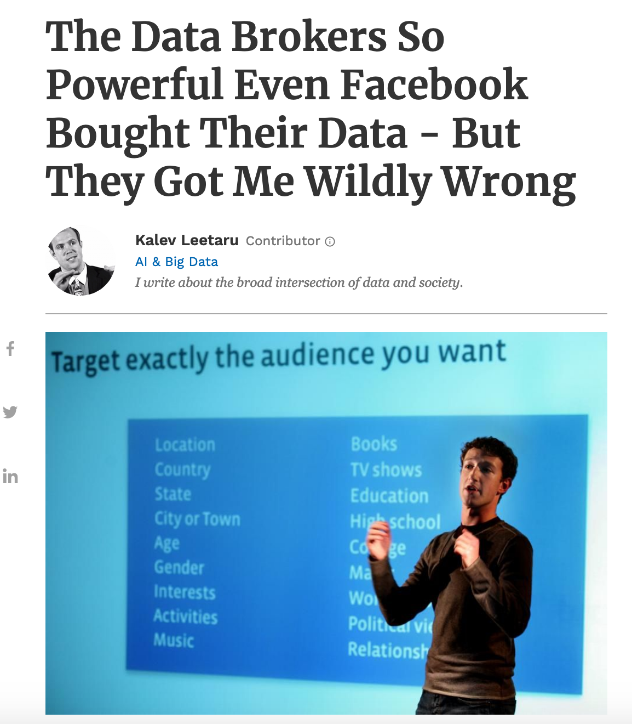
Data collection mechanism: Data doesn’t exist
Real world goal
Real world mechanism
Learning problem
Data collection mechanism
Potential issues?
Use 3rd party data brokers

Slide 19
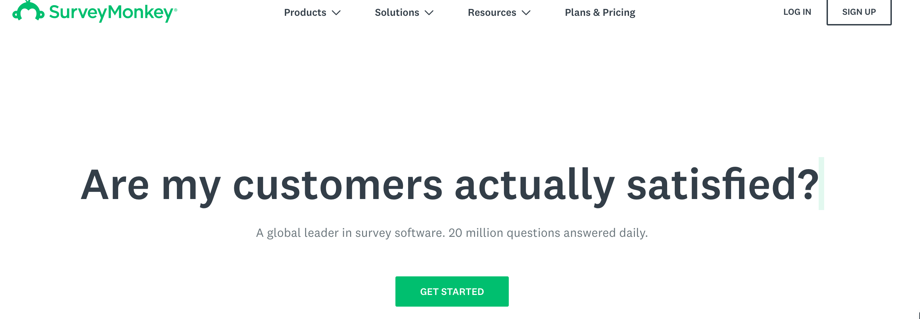
Data collection mechanism: Data doesn’t exist
Real world goal
Real world mechanism
Learning problem
Data collection mechanism
Run surveys
Potential issues?

Slide 20
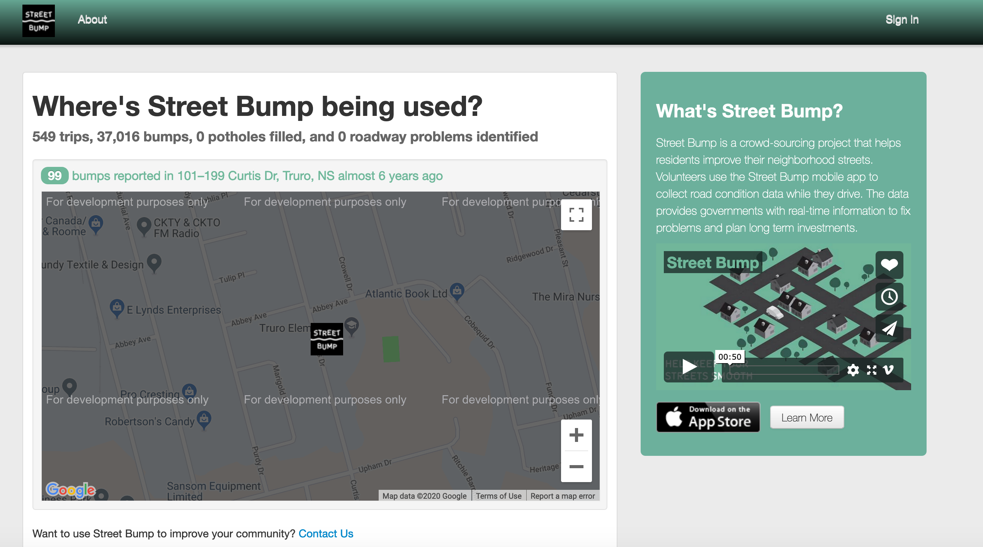
Data collection mechanism: Data doesn’t exist
Real world goal
Real world mechanism
Learning problem
Data collection mechanism
Collect data from smartphone
Potential issues?

Slide 21
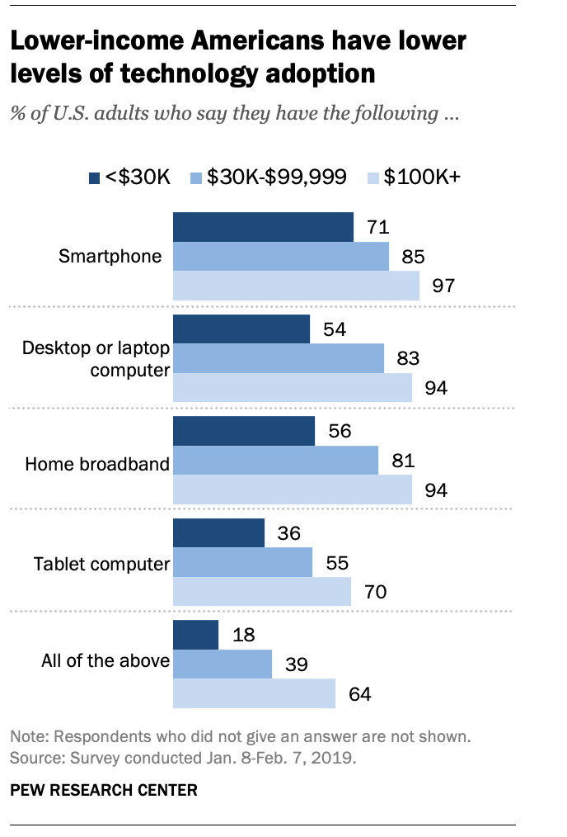
The smartphone blind-spot
Many of us in CSE assumes that ”everyone”
has smartphones

Slide 22
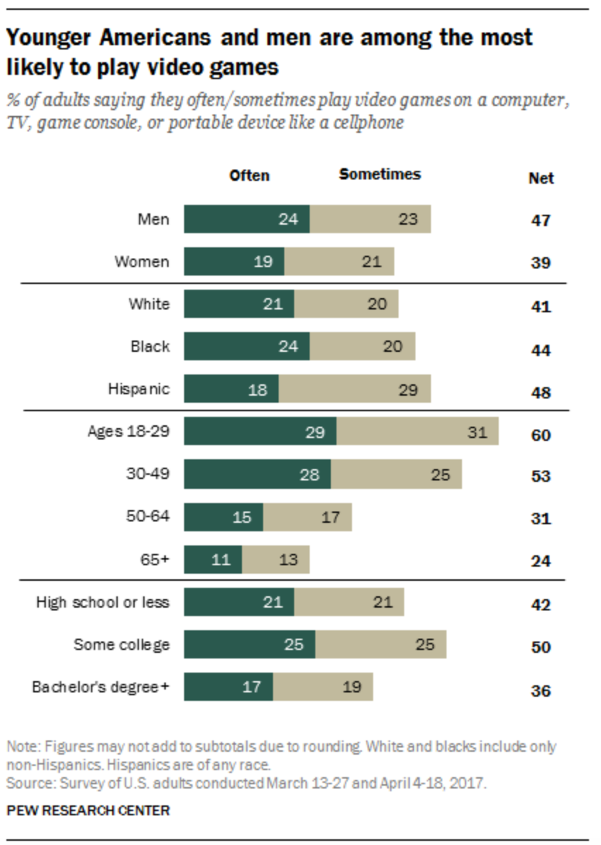
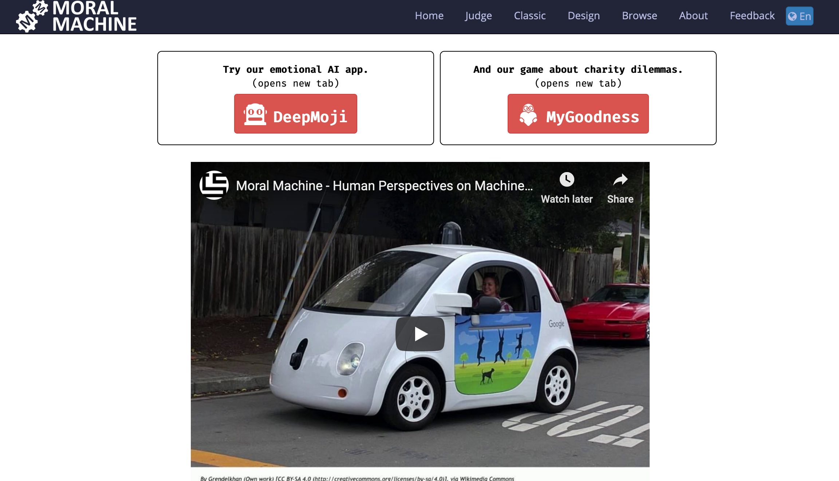
Data collection mechanism: Data doesn’t exist
Real world goal
Real world mechanism
Learning problem
Data collection mechanism
Online video games
Potential issues?

Slide 23
?

Slide 24
Which data to collect?
Real world goal
Real world mechanism
Learning problem
Data collection mechanism
Which data to collect?

Slide 25
Which data to collect?: General thoughts
Real world goal
Real world mechanism
Learning problem
Data collection mechanism
Which data to collect?
Expense might determine what gets collected
Time to finish a survey also has implications
Other restrictions, e.g. from an IRB

Slide 26
?

Slide 27
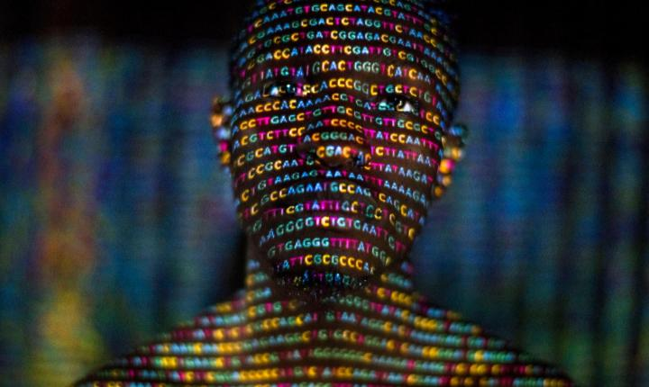
Data representation
Real world goal
Real world mechanism
Learning problem
Data collection mechanism
Which data to collect?
Data representation
https://www.history101.com/april-14-2003-the-human-genome-project-completed/

Slide 28
Data representation
Real world goal
Real world mechanism
Learning problem
Data collection mechanism
Which data to collect?
Data representation

Slide 29
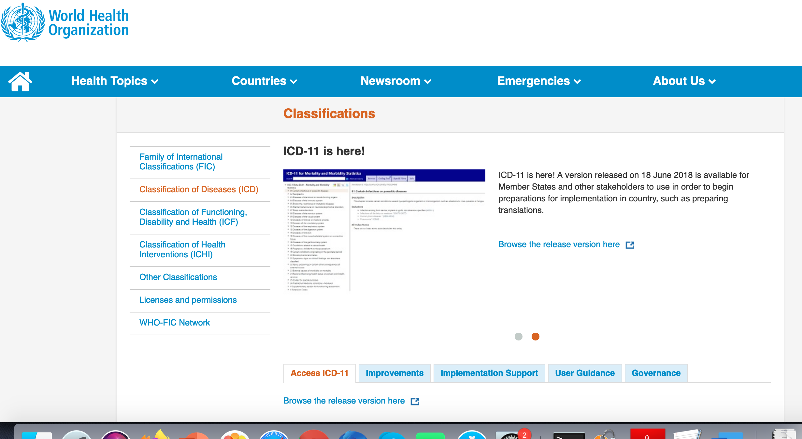
Data representation: General thoughts
Real world goal
Real world mechanism
Learning problem
Data collection mechanism
Which data to collect?
Data representation
Categorical data

Slide 30
?

Slide 31
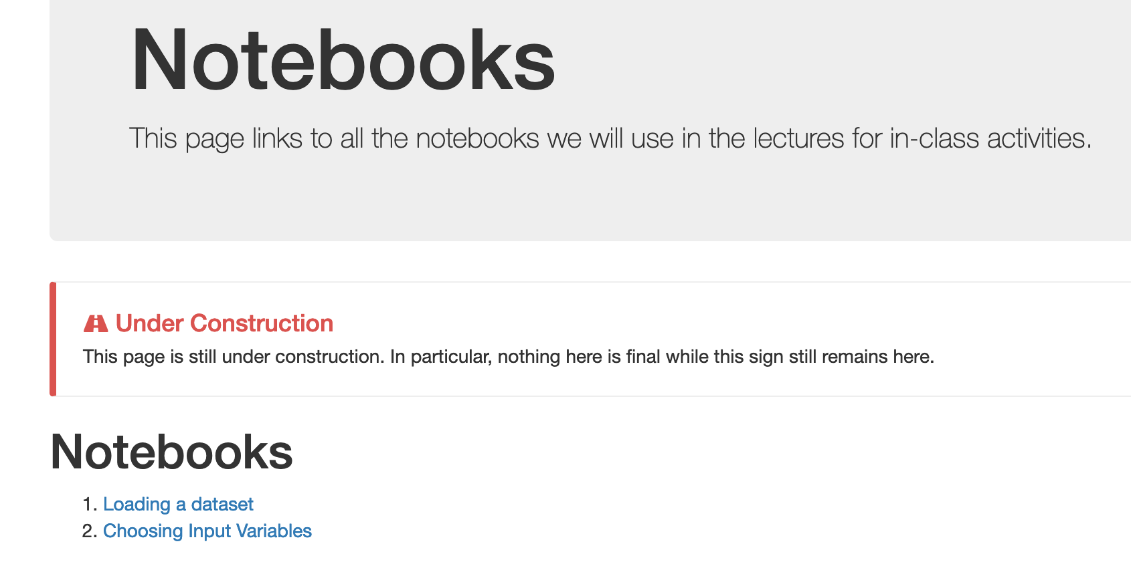
Jupyter Notebook Exercise
https://colab.research.google.com/

Slide 32
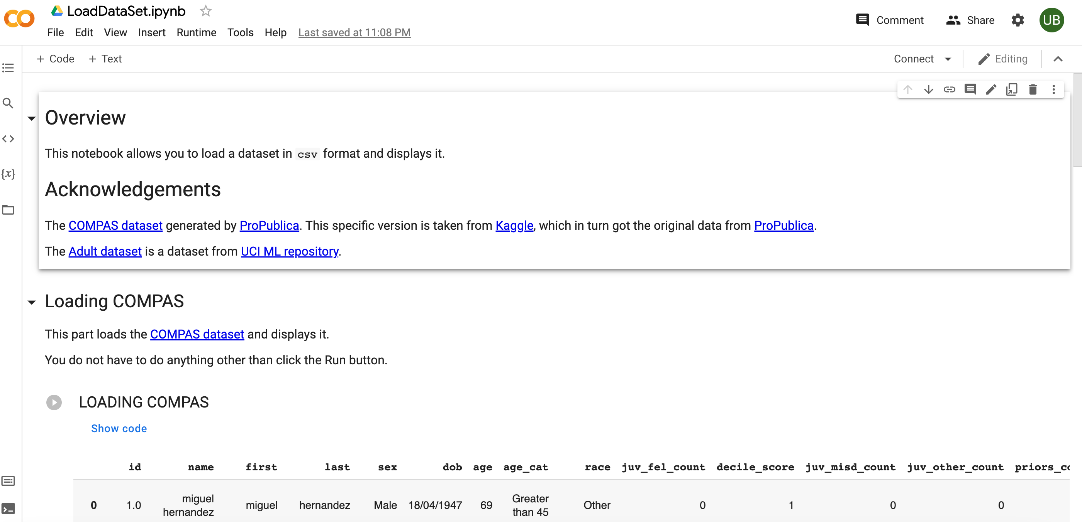
Familiarize yourself with it (and do the Ex.)

Slide 33
?

Slide 34
Another Jupyter exercise
https://colab.research.google.com/

Slide 35
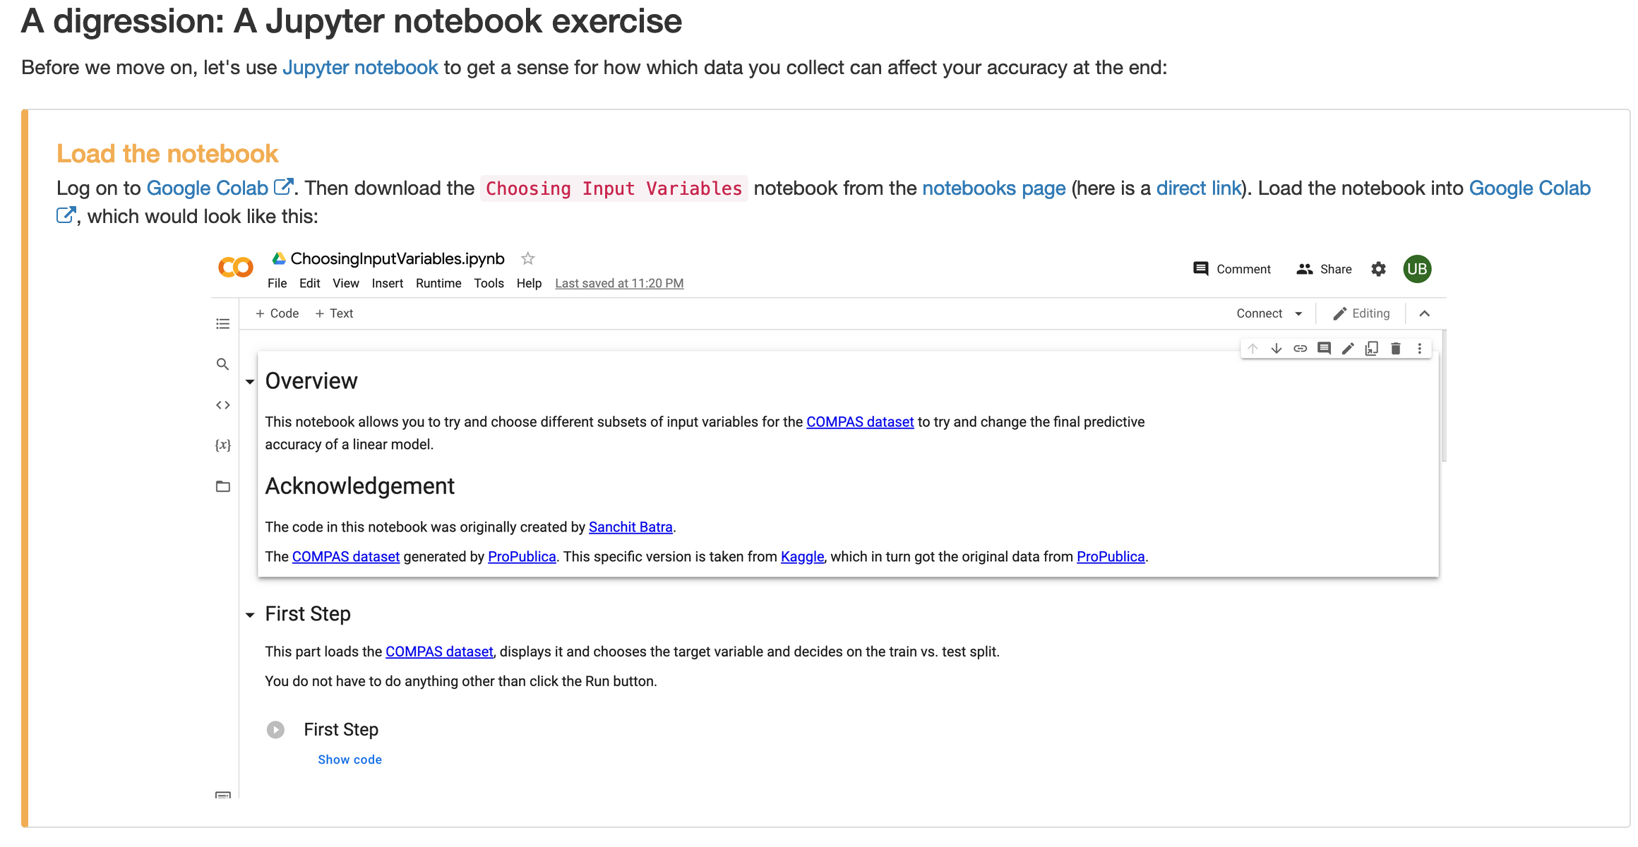
Another Jupyter exercise
https://colab.research.google.com/
Bonus point opportunity!

Slide 36
?

Slide 37
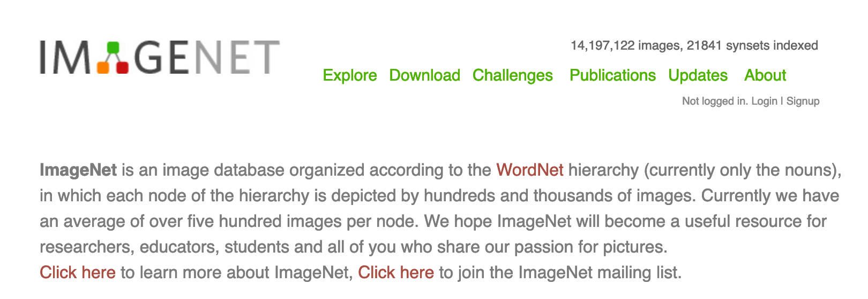
Pass phrase for today: Fei-Fei Li

Slide 38
ML model classes

Slide 39
Restrict to two input variables
700
Predict risk of heart disease
Weights (kgs)
350
150
300
Height (cms)

Slide 40
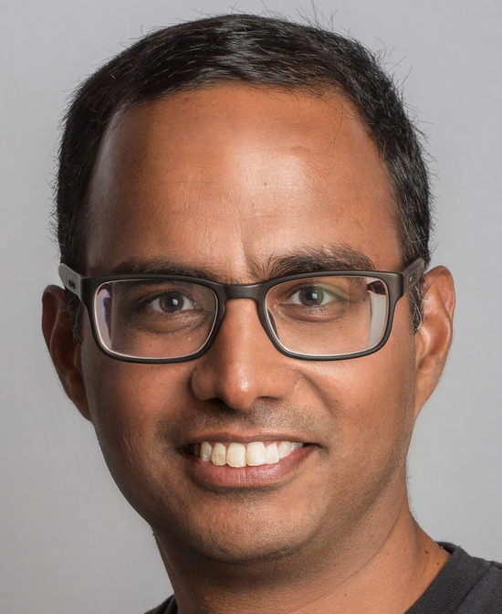
For example…
700
Weights (kgs)
350
80
150
180
300
Height (cms)

