Slide 1
ML and Society
Feb 22, 2022

Slide 2
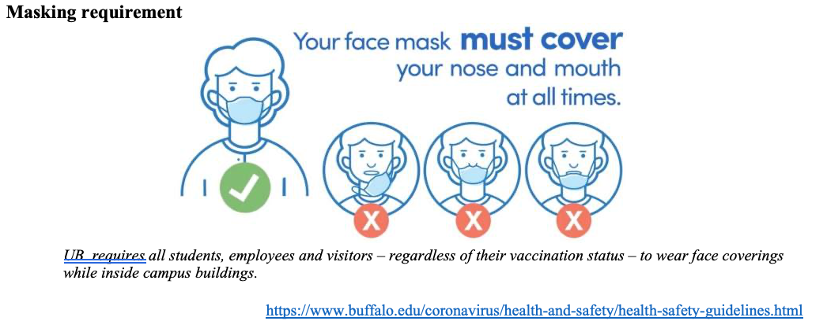
Please have a face mask on

Slide 3
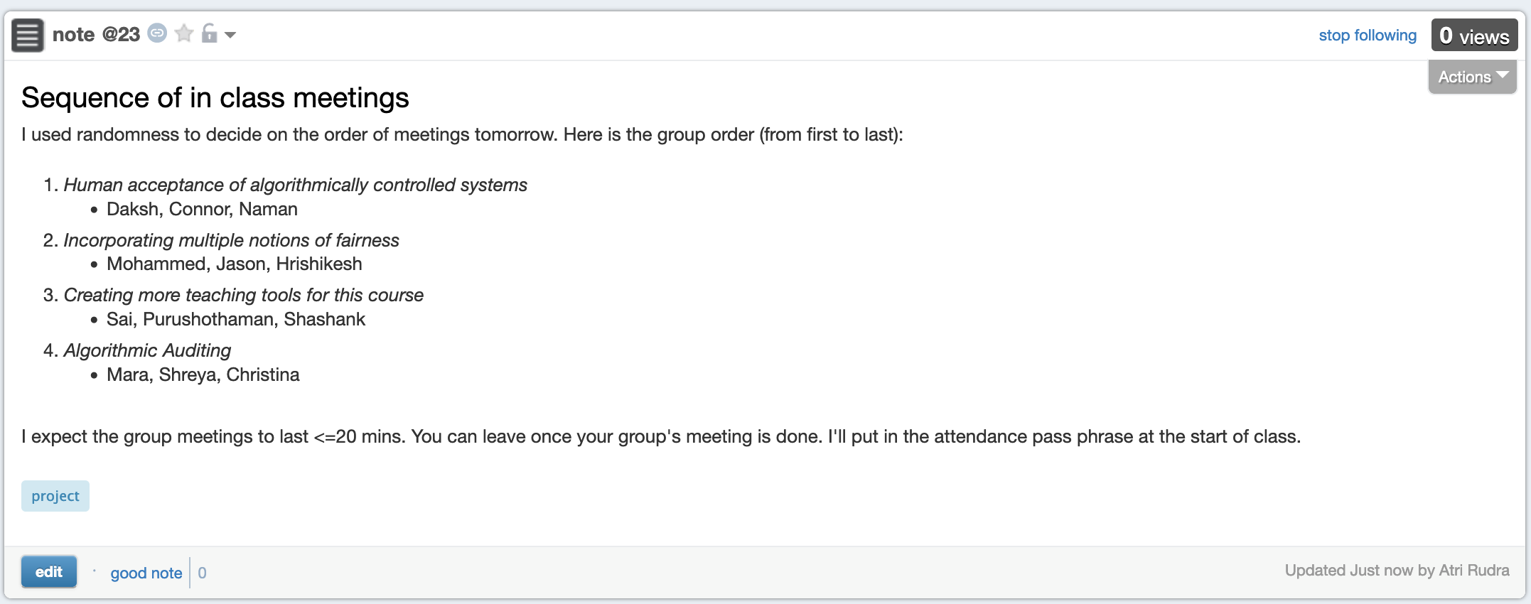
In-class meeting order

Slide 4
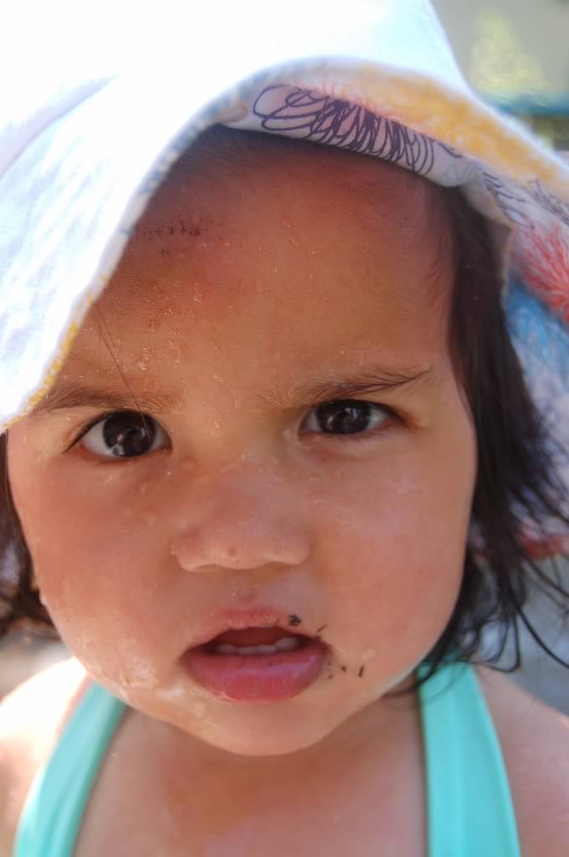
?

Slide 5
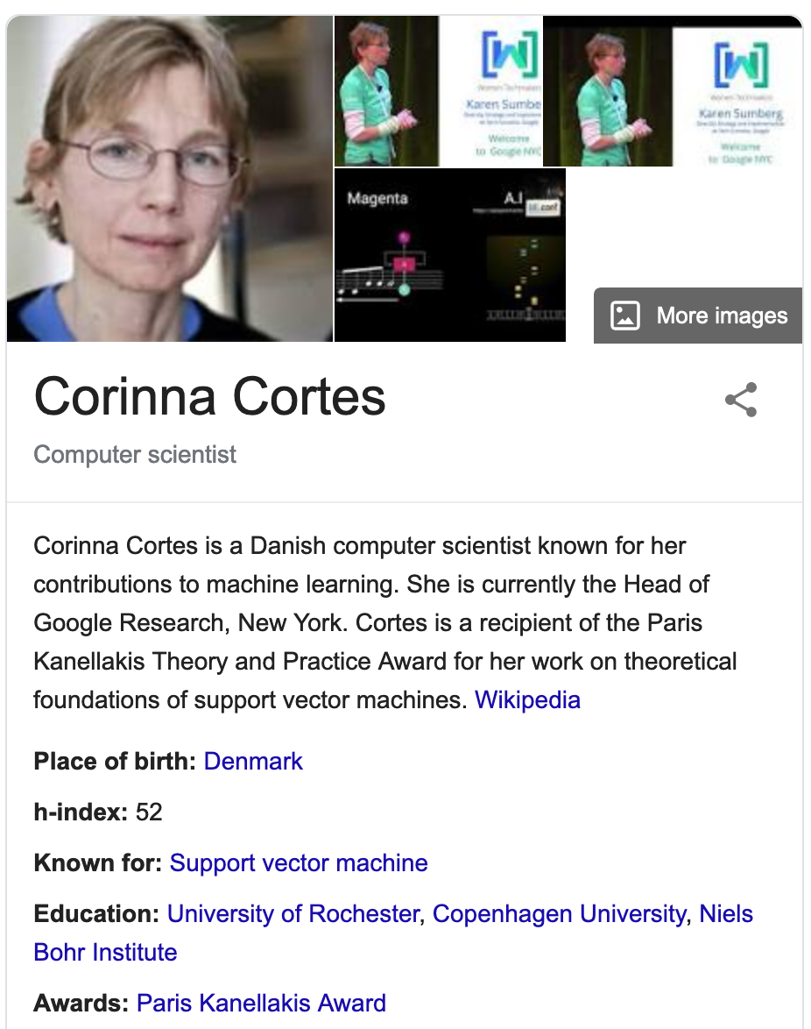
Today’s pass phrase: Corinna Cortes

Slide 6
In-class meeting order

