Slide 1
ML and Society
Feb 24, 2022

Slide 2
Please have a face mask on

Slide 3
ML model classes

Slide 4
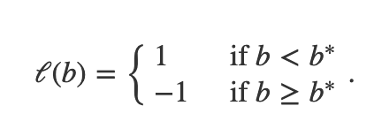
Linear model for one variable
b
b
0
b*
0
b*

Slide 5
Linear model in two variables
700
Weights (kgs)
Weights (kgs)
350
300m
c
150
300
Height (cms)

Slide 6
Properties
Efficient training ✅
Efficient prediction ✅
Expressivity ❌
Explainability ✅

Slide 7
Decision tree models
Heard of 20 Questions?

Slide 8
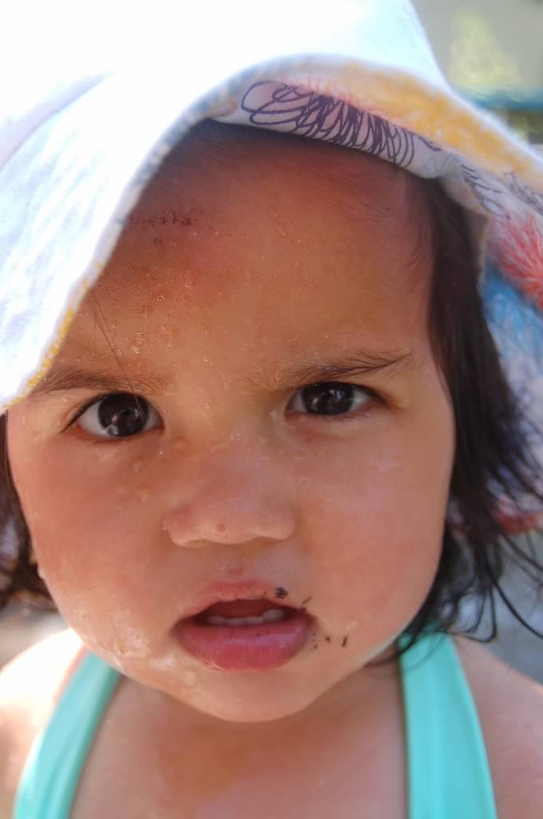
?

Slide 9
We already have seen a decision tree
700
Weights (kgs)
350
150
300
Height (cms)

Slide 10
Decision trees in one variable

Slide 11
A different representation
b $≥$ 30
1
-1
0
30
250
BMI (kg/m²)

Slide 12
Asking more questions
b $≥$ 30
1
-1
BMI (kg/m²)
b $≥$ 90
b $≥$ 10
10
30
90
250
1
-1
1
-1

Slide 13
Why is this a tree?
root
leaves

Slide 14
?

Slide 15
Model expressivity
Why?

Slide 16
Remember this?
b $≥$ 30
1
-1
0
30
250
BMI (kg/m²)

Slide 17
Strictly more powerful than linear models
Why?

Slide 18
Remember this?
b $≥$ 30
1
-1
BMI (kg/m²)
b $≥$ 90
b $≥$ 10
10
30
90
250
1
-1
1
-1

Slide 19
?

Slide 20
General result
Model training

Slide 21
Parsimonious representation

Slide 22
Model training
b $≥$ b_{i+1}
b
0
b_{i}
b_{i+1}
Decision tree?
1
-1

Slide 23
Two transition points
b $≥$ b_{i+1}
b
1
-1
0
b_{j}
b_{j+1}
b_{i}
b_{i+1}
Decision tree?
b $≥$ b_{j+1}
1
-1

Slide 24
?

Slide 25
Prediction
b $≥$ 90
1
-1
b $≥$ 200
b $≥$ 30
BMI (kg/m²)
10
30
90
200
1
-1
1
-1

Slide 26
b = 150 and b = 70
b $≥$ 90
1
-1
b $≥$ 200
b $≥$ 30
1
BMI (kg/m²)
1
10
30
90
200
-1
-1

Slide 27
Multiple decisions trees with different depth
b $≥$ 200
BMI (kg/m²)
10
30
90
200
1
-1
b $≥$ 90
b $≥$ 90
1
1
-1
-1
b $≥$ 30
b $≥$ 200
b $≥$ 30
1
1
-1
1
-1
-1

Slide 28
?

Slide 29
Other properties?

Slide 30
Decision trees in two variables
w $≥$ 350
700
1
-1
Similar properties as one variable
Weights (kgs)
350
h $≥$ 150
1
-1
150
300
Height (cms)

Slide 31
?

Slide 32
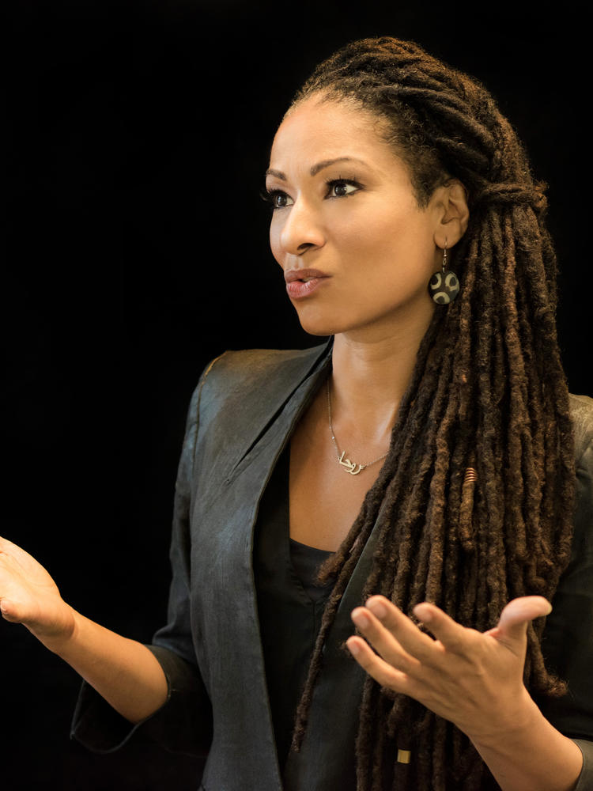
Today’s pass phrase: Ruha Benjamin

Slide 33
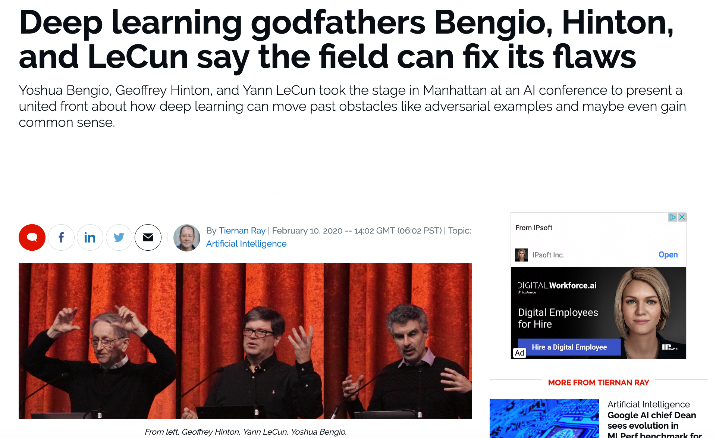
Last model class: Neural networks (NNs)

Slide 34
Away from the hype: non-deep NNs

Slide 35
NN Idea 1: Transform the underlying space
700
700
Transform
Weights (kgs)
Weights (kgs)
350
350
150
300
150
300
Height (cms)
Height (cms)

Slide 36
NN Idea 2: Apply linear model AFTER transform
700
700
700
Transform
Apply Linear model
Weights (kgs)
350
Weights (kgs)
Weights (kgs)
350
350
150
300
150
300
150
300
Height (cms)
Height (cms)
Height (cms)

Slide 37
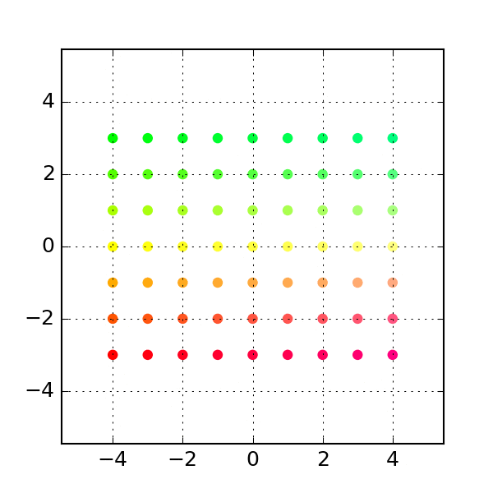
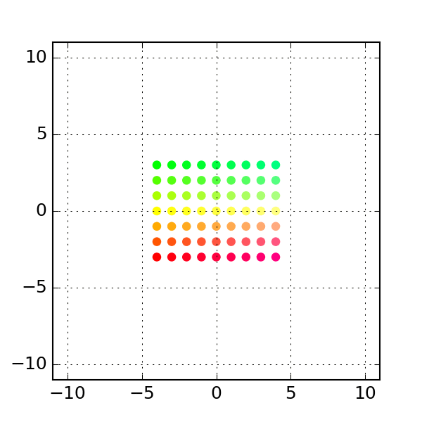
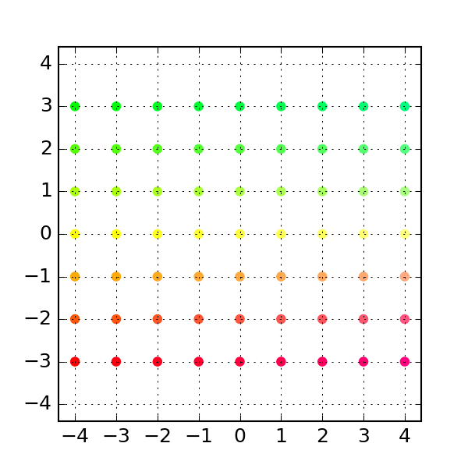
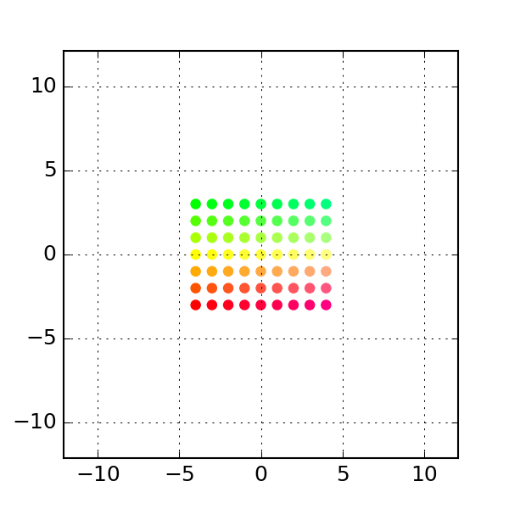
Whither the transforms?
One possibility: Linear transforms
Rotation
Shear
Permutation
General Linear
https://dododas.github.io/linear-algebra-with-python/posts/16-12-29-2d-transformations.html

Slide 38
Current overall scheme
700
700
700
Linear Transform
Apply Linear model
Weights (kgs)
350
Weights (kgs)
Weights (kgs)
350
350
150
300
150
300
150
300
Height (cms)
Height (cms)
Height (cms)

Slide 39
Linear transforms* are invertible
700
700
Inverse Transform
Weights (kgs)
Weights (kgs)
350
350
150
300
150
300
Height (cms)
Height (cms)
700
700
Inverse Transform
Weights (kgs)
350
Weights (kgs)
350
150
300
Height (cms)
150
300
Height (cms)

Slide 40
?

Slide 41
NN Idea 1’: Use a non-linear transform
700
700
Linear Transform
Weights (kgs)
Weights (kgs)
350
350
150
300
150
300
Height (cms)
Height (cms)

Slide 42
NN Idea 1’: Use a non-linear transform
700
700
ReLU
Weights (kgs)
Weights (kgs)
350
350
Replace neg values by 0
150
300
150
300
Height (cms)
Height (cms)

Slide 43
Bunch of values get zeroed out!
700
Weights (kgs)
350
150
300
Height (cms)

Slide 44
Let’s apply linear model to transformed space
700
Weights (kgs)
350
150
300
Height (cms)

Slide 45
Did we gain over linear models?
700
700
Weights (kgs)
Weights (kgs)
350
350
150
YES
300
150
300
Height (cms)
Height (cms)

Slide 46
Reminder # 1
700
Weights (kgs)
350
150
300
Height (cms)

Slide 47
Reminder # 2
700
Weights (kgs)
350
150
300
Height (cms)

Slide 48
Did we gain over linear models?
700
700
Weights (kgs)
Weights (kgs)
350
350
Why are they different?
150
300
150
300
Height (cms)
Height (cms)

Slide 49
What is really happening….
700
700
Weights (kgs)
Weights (kgs)
350
350
150
300
150
300
Height (cms)
Height (cms)

Slide 50
Side by side comparison
Non-linear map
700
700
Weights (kgs)
Weights (kgs)
350
350
150
300
150
300
Height (cms)
Height (cms)

Slide 51
?

Slide 52
An exercise to do at home (if you so choose)

Slide 53
What is so “deep” about this?
700
700
700
700
Weights (kgs)
Weights (kgs)
350
Weights (kgs)
Weights (kgs)
350
350
350
150
300
150
300
150
300
150
300
Height (cms)
Height (cms)
Height (cms)
Height (cms)
Apply Linear model
Linear Transform
ReLU

Slide 54
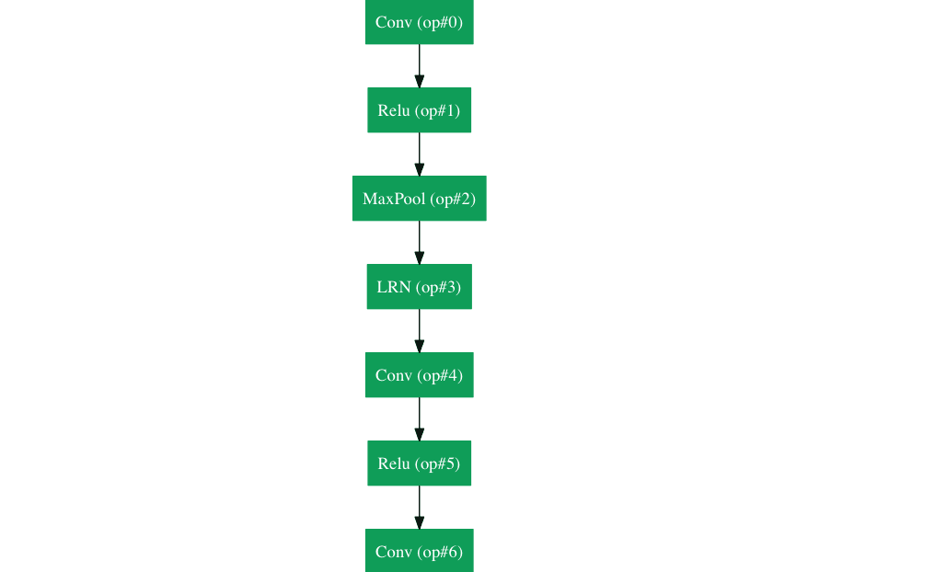
Use many non-linear transforms!

Slide 55
Desired properties of NNs

Slide 56
Another Jupyter exercise
https://colab.research.google.com/

Slide 57
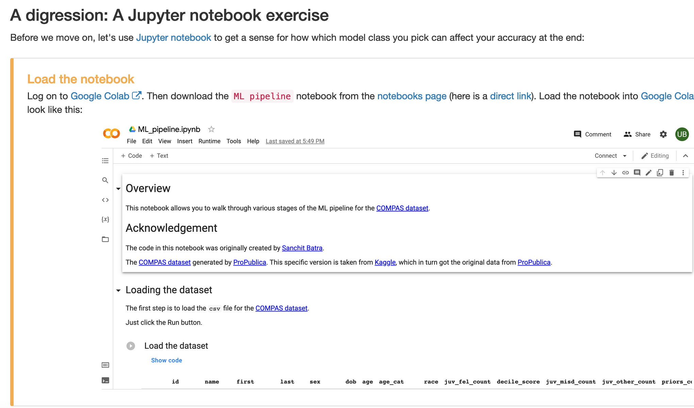
Another Jupyter exercise
https://colab.research.google.com/

Slide 58
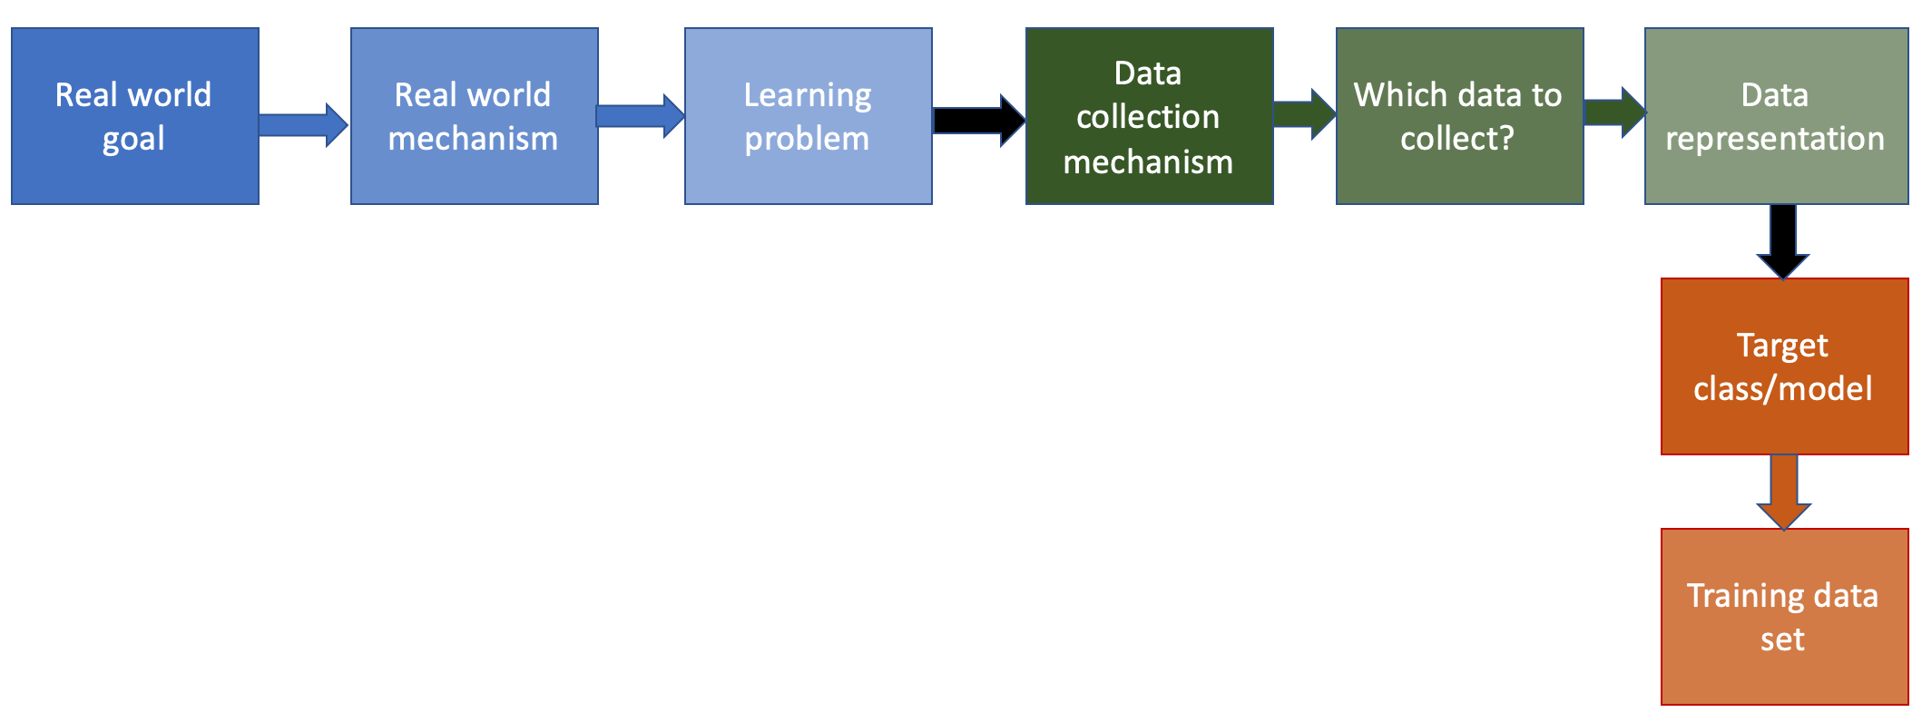
Finally to next step in the ML pipeline!
Next lecture!

