Slide 1
ML and Society
Mar 1, 2022

Slide 2
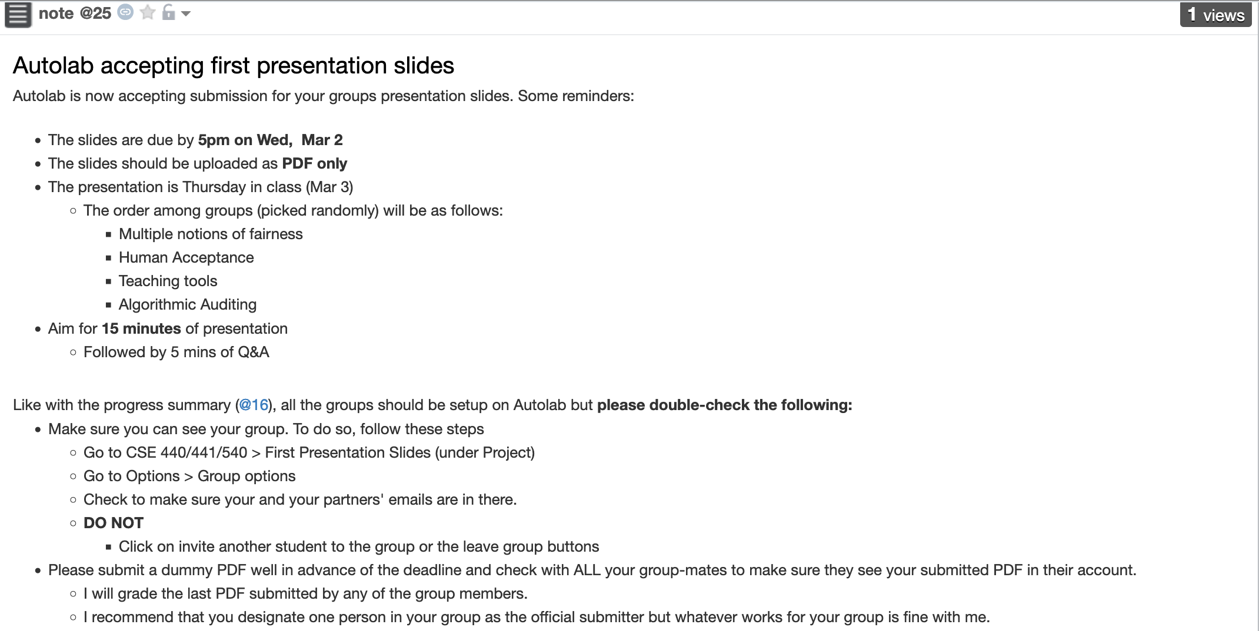
First in-class presentation this Thursday
Slides due by 5pm TOMORROW

Slide 3
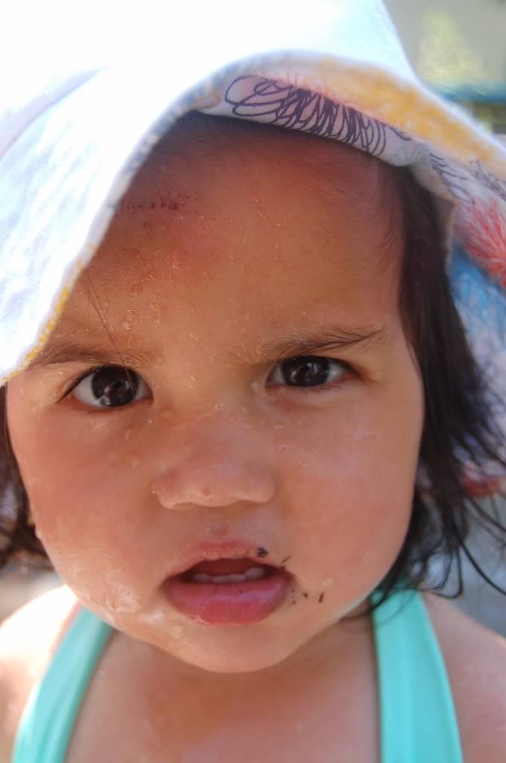
?

Slide 4
We finished the model class step

Slide 5
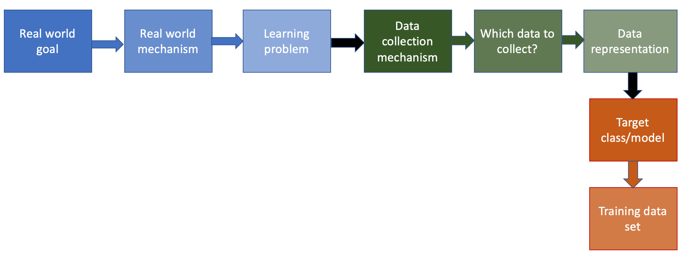
Finally to next step in the ML pipeline!

Slide 6
Choosing the training dataset

Slide 7
?

Slide 8
Training dataset = entire dataset?
700
Weights (kgs)
350
150
300
Height (cms)

Slide 9
A more realistic dataset
700
Weights (kgs)
350
150
300
Height (cms)

Slide 10
We can only collect part of the ground truth
What if we had access to the entire ground truth?
700
Weights (kgs)
350
150
300
Height (cms)

Slide 11
This is our dataset
700
Weights (kgs)
350
150
300
Height (cms)

Slide 12
Let’s find the optimal linear model
What is an optimal linear model?
700
Weights (kgs)
350
150
300
Height (cms)

Slide 13
Going back to the entire ground truth
700
700
Weights (kgs)
Weights (kgs)
350
350
150
300
150
300
Height (cms)
Height (cms)

Slide 14
What if we had a true random sample?
What is the catch?

Slide 15
Which subset to pick? Choice 1
700
700
Weights (kgs)
Weights (kgs)
350
350
150
300
150
300
Height (cms)
Height (cms)

Slide 16
Optimal linear model for Choice 1
700
Weights (kgs)
350
150
300
Height (cms)

Slide 17
Choice 2 for subset
700
700
Weights (kgs)
350
Weights (kgs)
350
150
300
150
300
Height (cms)
Height (cms)

Slide 18
Optimal linear model for Choice #2
700
Weights (kgs)
350
150
300
Height (cms)

Slide 19
How do we pick the “best” subset?
700
700
Weights (kgs)
Weights (kgs)
350
350
150
300
150
300
Height (cms)
Height (cms)

Slide 20
Answer: we don’t (or can’t)!

Slide 21
Beyond random training dataset

Slide 22
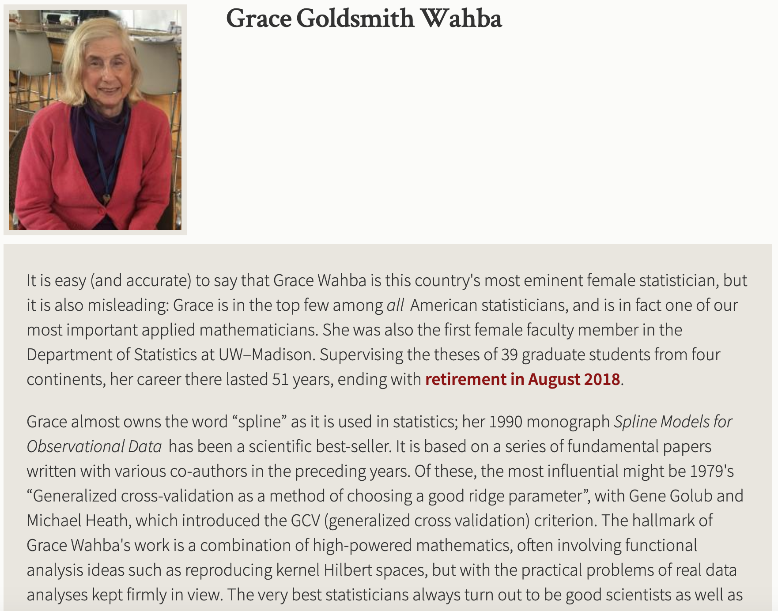
Passphrase for today: Grace Wahba

Slide 23
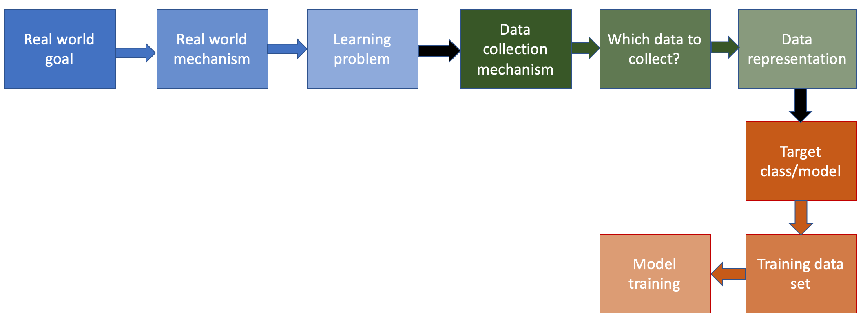
The next step…

Slide 24
Minimize number of mis-classifications
BMI (kg/m²)
10
30
50
90
130
180
220
240
280
6
6
What does the plot look for this class?
5
5
4
4
3
3
2
2
1
1
BMI (kg/m²)
BMI (kg/m²)
10
30
50
90
130
180
220
240
280
10
30
50
90
130
180
220
240
280
0
b*
250
0
b*
250
BMI (kg/m²)
BMI (kg/m²)

Slide 25
The actual “loss” function
Number of corners grows like n^{d}
Only check the corner points!
BMI (kg/m²)
10
30
50
90
130
180
220
240
280
6
6
5
5
4
4
3
3
2
2
1
1
BMI (kg/m²)
BMI (kg/m²)
10
30
50
90
130
180
220
240
280
10
30
50
90
130
180
220
240
280
0
b*
250
0
b*
250
BMI (kg/m²)
BMI (kg/m²)

Slide 26
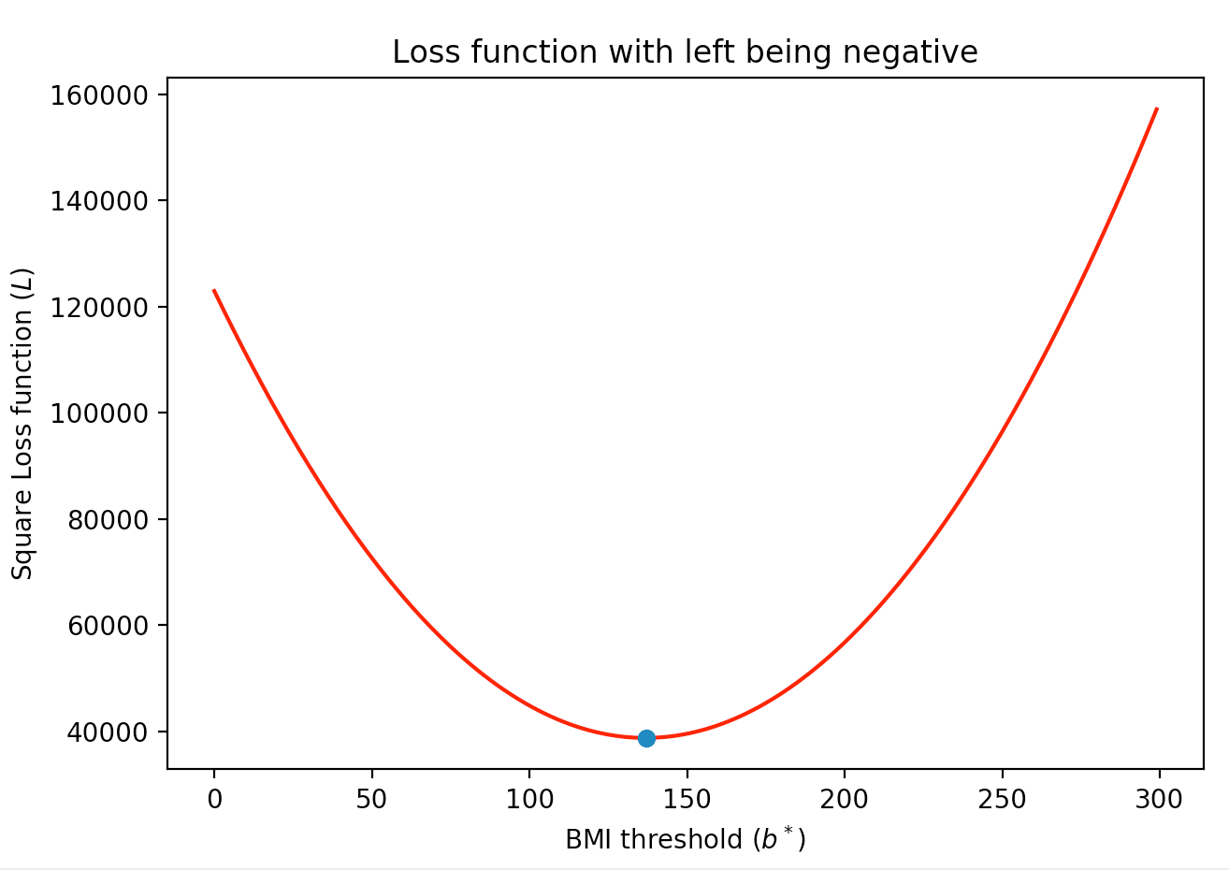
A “better” loss function
BMI (kg/m²)
10
30
50
90
130
180
220
240
280
6
5
4
3
2
1
BMI (kg/m²)
10
30
50
90
130
180
220
240
280
0
b*
250
BMI (kg/m²)

Slide 27
What is a loss function?

Slide 28
Square Loss Function
BMI (kg/m²)
10
30
50
90
130
180
220
240
280

Slide 29
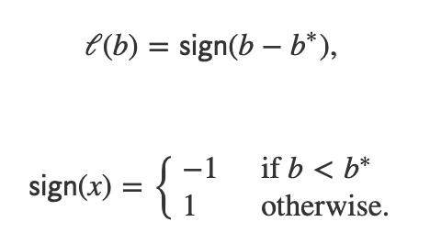
Math behind the square loss function
Linear model
0
b*
250
BMI (kg/m²)

Slide 30
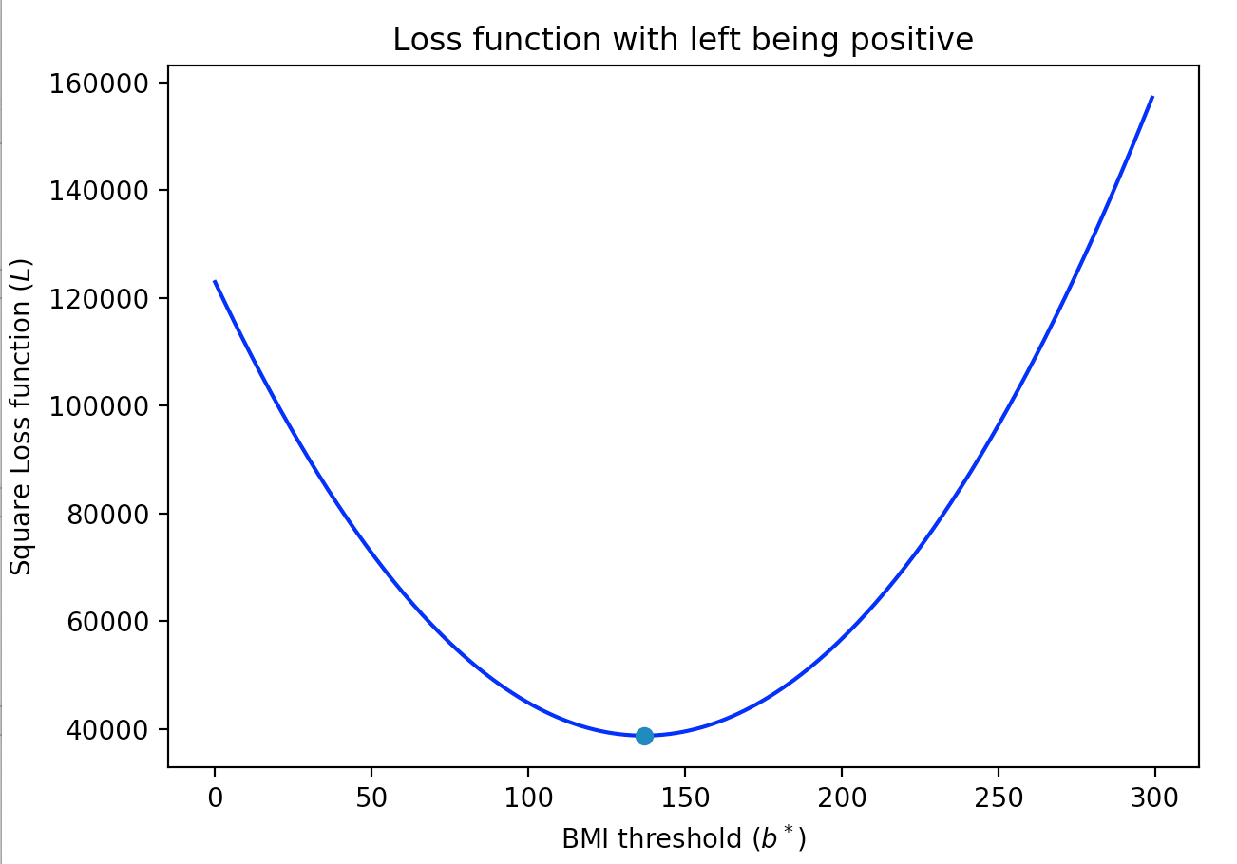
Square loss function
BMI (kg/m²)
10
30
50
90
130
180
220
240
280
0
b*
250
0
b*
250
BMI (kg/m²)
BMI (kg/m²)

Slide 31
?

Slide 32
So did we gain anything here?
Do you know what a half-pipe means in the context of sports?

Slide 33
Towards gradient descent

Slide 34
Where do we get gravity and friction?
Tangent can give two directions
Which direction to take?

Slide 35
Derivative is all you need!

Slide 36
Overall Algorithm

Slide 37
?

Slide 38
When does this work?
Convex loss functions

Slide 39
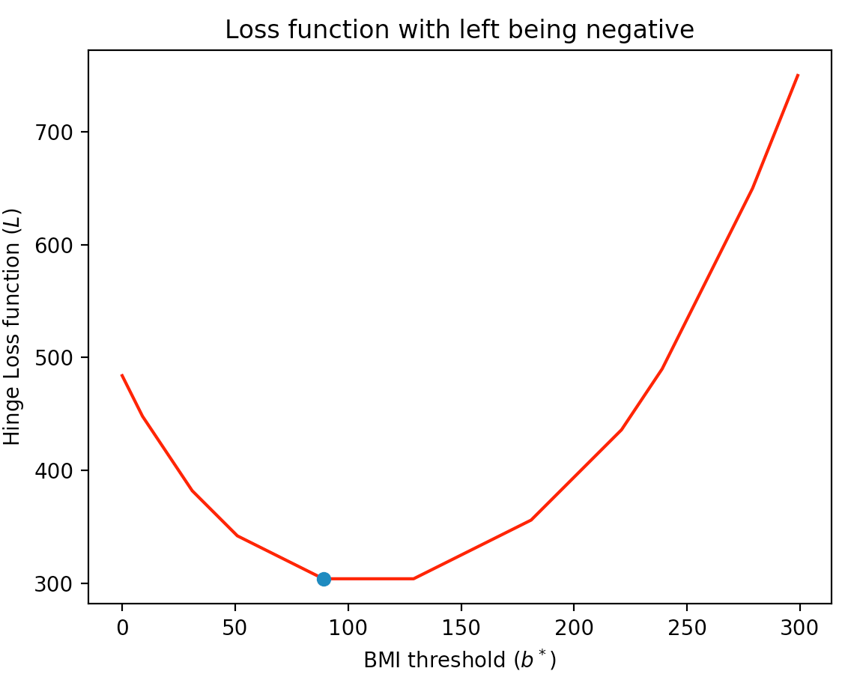
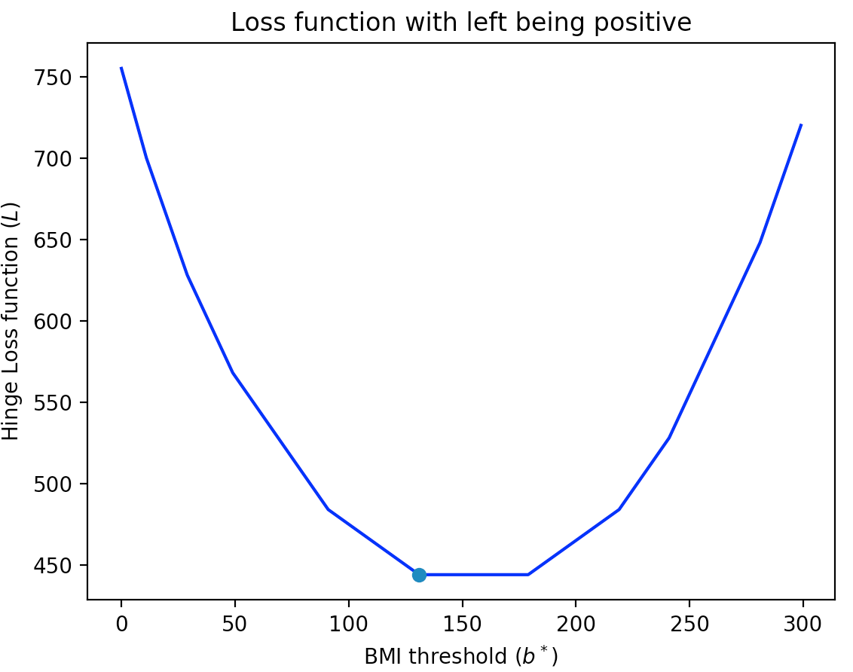
Hinge loss function
Convex functions need not be smooth!
BMI (kg/m²)
10
30
50
90
130
180
220
240
280
0
b*
250
0
b*
250
BMI (kg/m²)
BMI (kg/m²)

Slide 40
What about non-convex loss functions?
700
Loss function
350
150
300
b*

Slide 41
What can go wrong if we run GD?
700
Loss function
350
150
300
b*

Slide 42
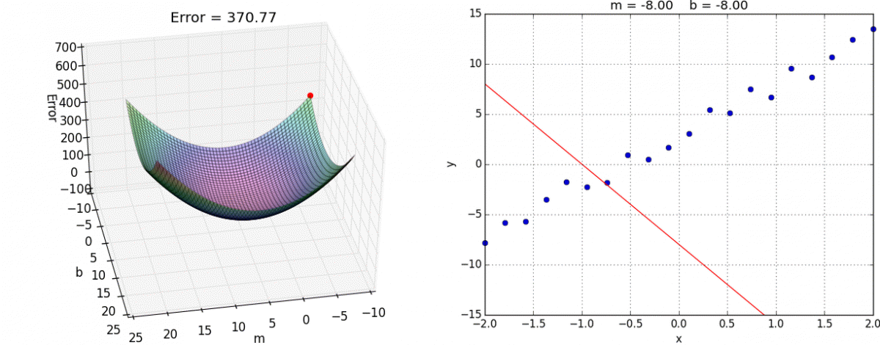
GD on more than one variable
https://alykhantejani.github.io/images/gradient_descent_line_graph.gif

Slide 43
Did we lose something?

Slide 44
Minimize number of mis-classifications
BMI (kg/m²)
10
30
50
90
130
180
220
240
280
6
6
5
5
4
4
3
3
2
2
1
1
BMI (kg/m²)
BMI (kg/m²)
10
30
50
90
130
180
220
240
280
10
30
50
90
130
180
220
240
280
0
b*
250
0
b*
250
BMI (kg/m²)
BMI (kg/m²)

