Slide 1
ML and Society
Mar 1, 2023

Slide 2
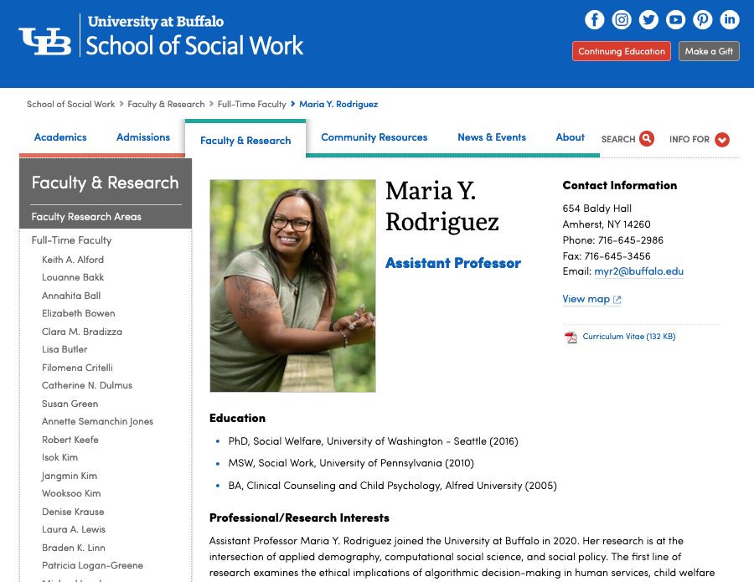
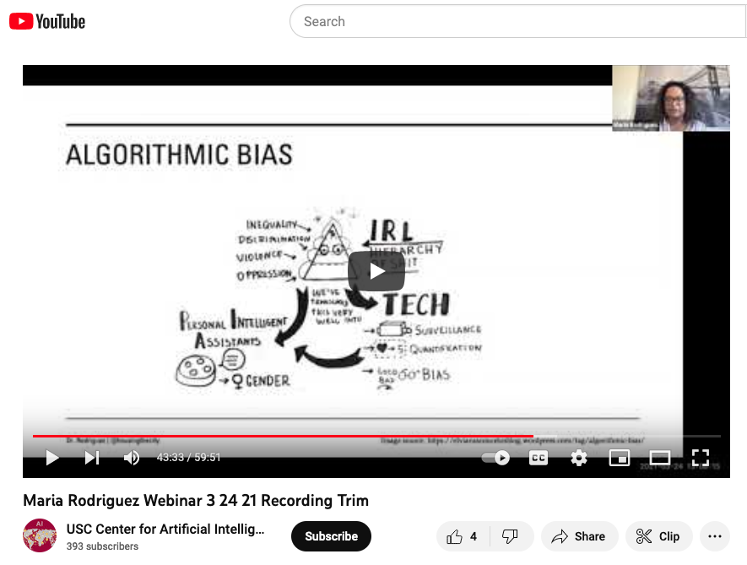
Passphrase for today: Maria Y. Rodriguez

Slide 3
“Done” with ML pipeline
Real world goal
Real world mechanism
Learning problem
Data collection mechanism
Which data to collect?
Data representation
Society
Target class/model
Deploy!
Evaluate error
Predict on test data
Model training
Training data set

Slide 4
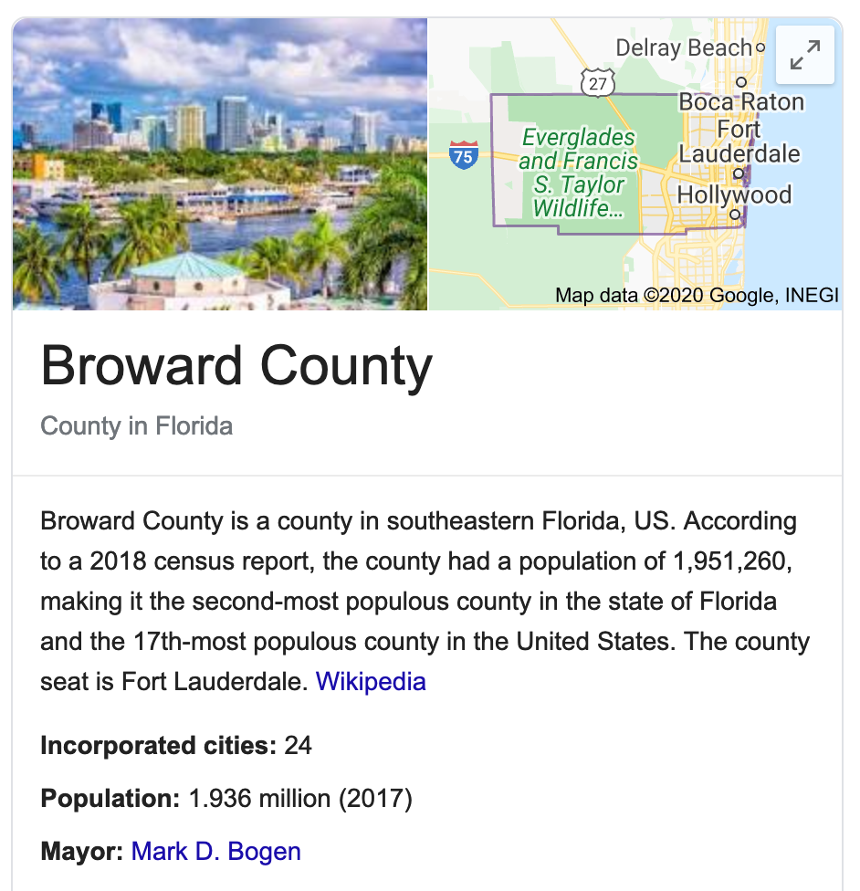
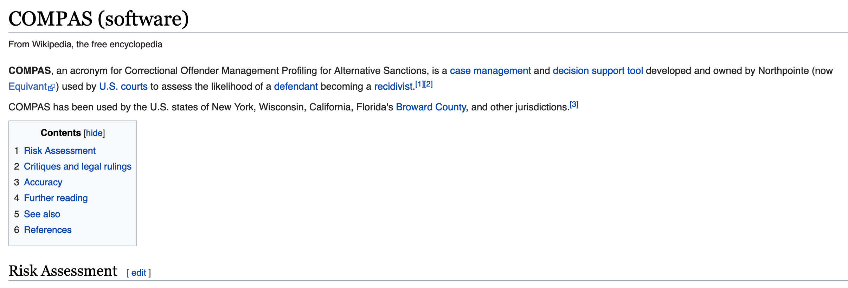
Do you remember COMPAS?

Slide 5
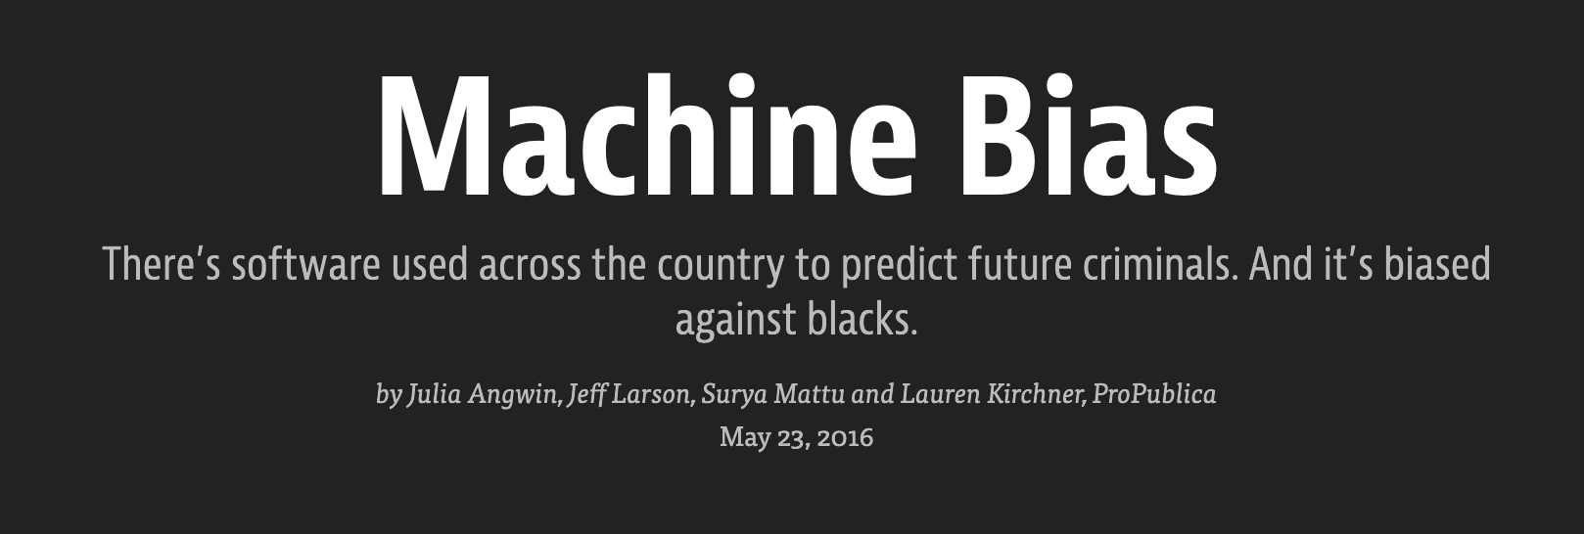

Slide 6
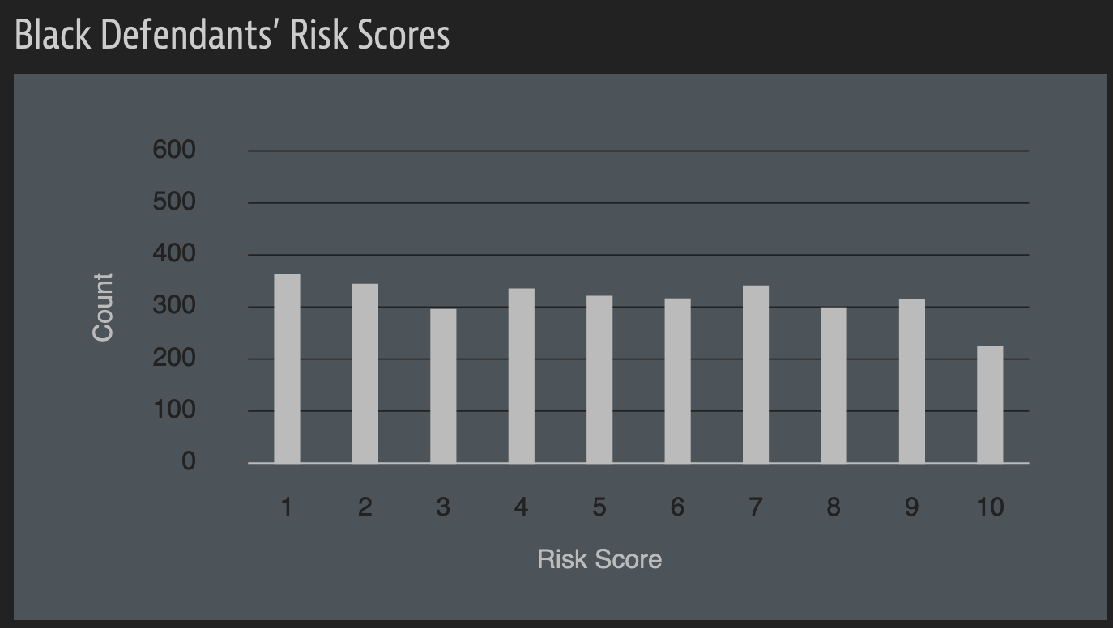
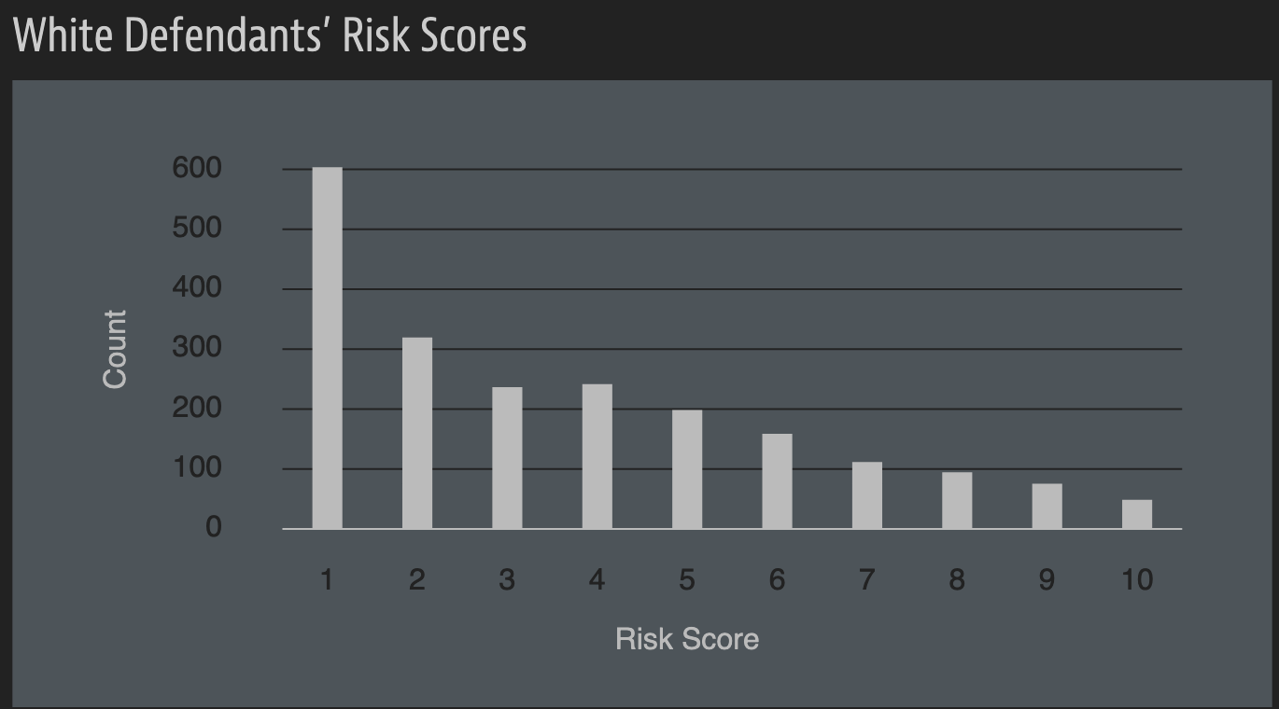
A sample of their result

Slide 7
A rejoinder

Slide 8
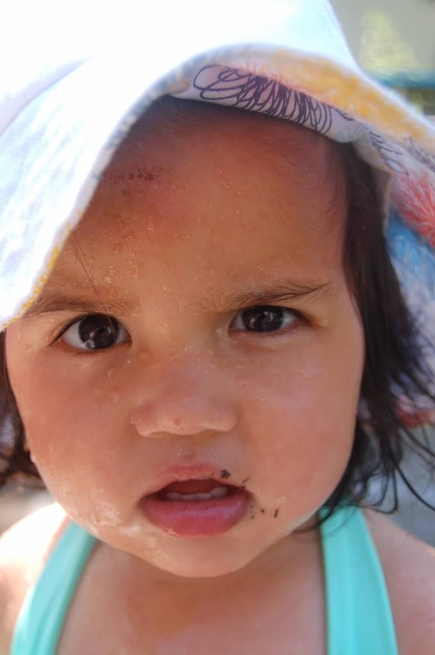
?

Slide 9
Going beyond # correctly classified points
Points are NOT 2D!
Y= 1
Y= -1

Slide 10
Binary classifier output
S = 1
S = -1

Slide 11
“Confusion matrix”
S = 1
S = -1
Y= 1
21
21
21
21
Y= -1

Slide 12
True Positive rate
S = 1
S = -1
Y= 1
21
TPR =
21
21
21
Y= -1
TPR?

Slide 13
False Negative Rate (FNR)
S = 1
S = -1
Y= 1
21
21
FNR =
21
21
Y= -1
FNR?

Slide 14
False Positive Rate (FPR)
S = 1
S = -1
Y= 1
21
FPR =
21
21
21
Y= -1
FPR?

Slide 15
True Negative Rate (TNR)
S = 1
S = -1
Y= 1
21
21
TNR =
21
21
Y= -1
TNR?

Slide 16
TPR + FNR = 1
+
=
1
S = 1
S = -1
Y= 1
Y= -1

Slide 17
FPR + TNR = 1
+
=
1
S = 1
S = -1
Y= 1
Y= -1

Slide 18
?

Slide 19
Positive Predictive Value (PPV)
S = 1
S = -1
PPV =
Y= 1
21
21
21
21
Y= -1
PPV?

Slide 20
?

Slide 21
Back to fairness

Slide 22
Why statistical parity across groups?

Slide 23
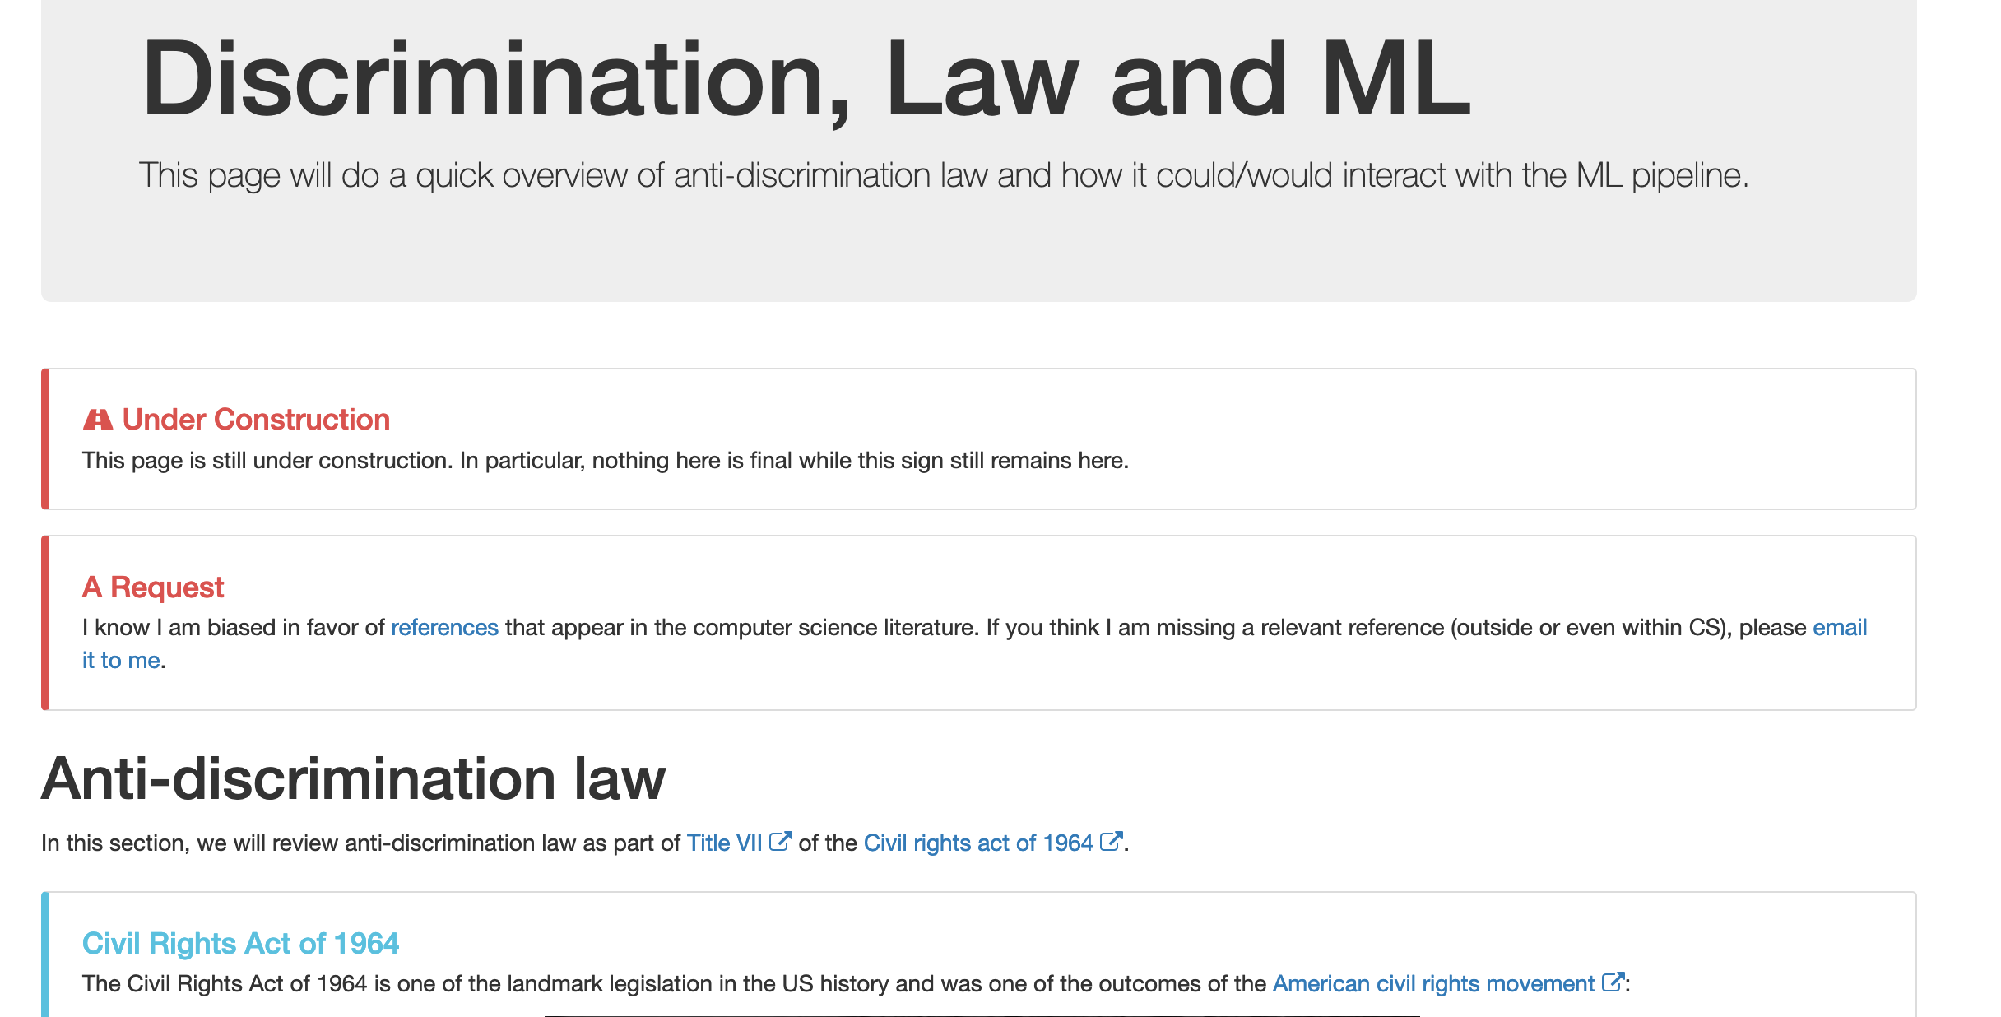
Notes on ML and law

Slide 24
Rates for groups
S = 1
S = -1
S = 1
S = -1
Y= 1
Y= 1
Y= -1
Y= -1
b
w
S = 1
S = -1
Y= 1
21
21
21
21
Y= -1

Slide 25
FPR and FNR for groups
Calculate the rates
S = 1
S = -1
Y= 1
FPR_{b} =
FPR_{w} =
Y= -1
b
S = 1
S = -1
FNR_{b} =
FNR_{w} =
Y= 1
Y= -1
w

Slide 26
PPV for groups
Calculate the values
PPV_{b} =
PPV_{w} =
S = 1
S = -1
S = 1
S = -1
Y= 1
Y= 1
Y= -1
Y= -1
b
w

Slide 27
?

Slide 28
Finally, the formal fairness definitions

Slide 29
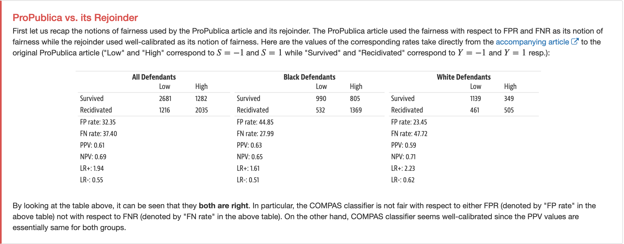
Connecting back to COMPAS story

Slide 30
?

Slide 31
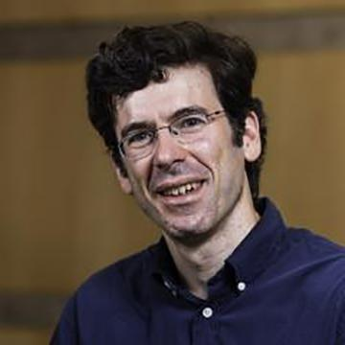
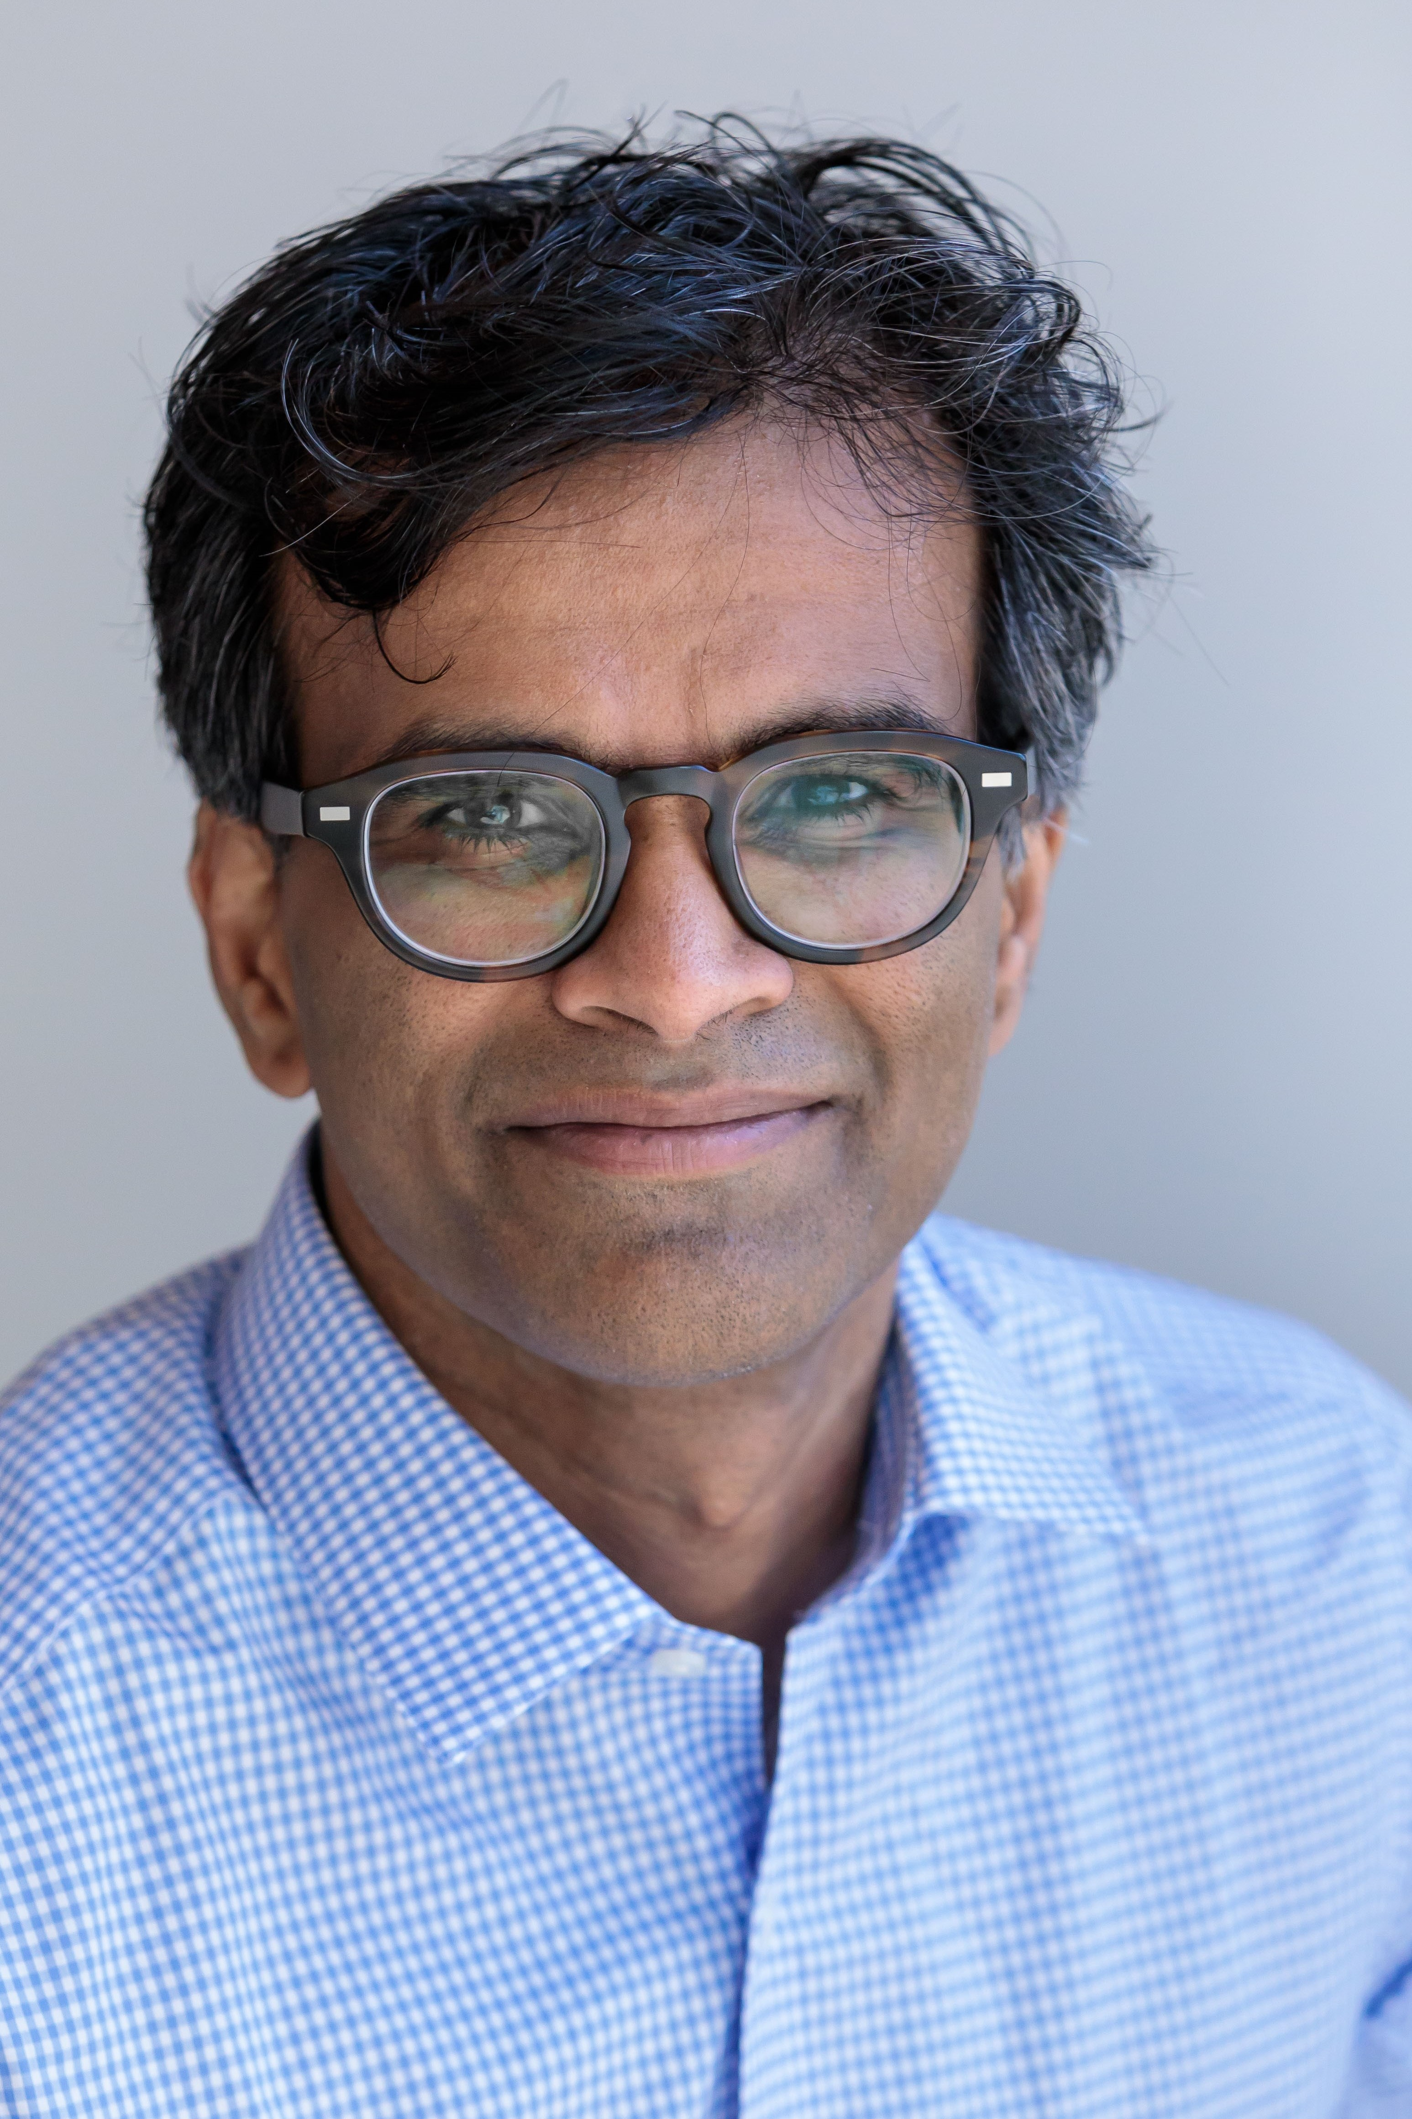
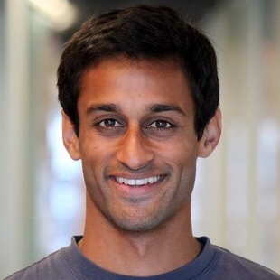
Perhaps COMPAS can be improved?

Slide 32
Discussion 3
Kenneth (Kenny) Joseph
Notes:
I always tell my students that one of the worst things you can do is to start your talk with an apology, but that is precisely what I’m going to do today.
Covid has been slowly trickling through my family for the last two weeks or so, so there are some threads in this talk that are not as cleanly tied together as I would have hoped. However, the ideas here are ones that I have thought quite a bit about over the past few years, so hopefully you find something in the next 15 minutes that piques your interest

Slide 33
Kenny’s summary
This seemed to be a difficult week for folks. We were happy to see that

Slide 34
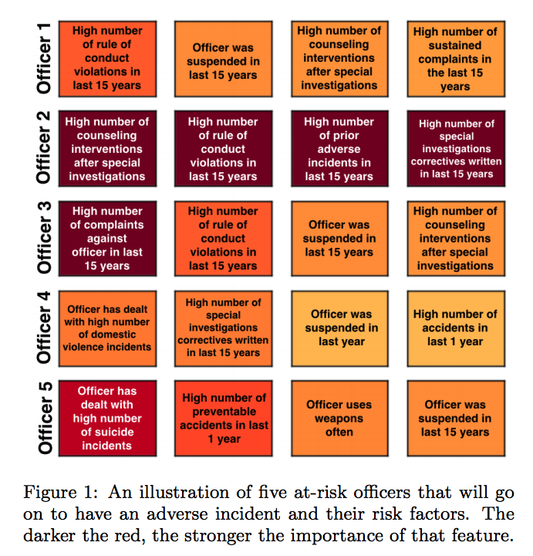
What is “AI for Social Good”?

Slide 35
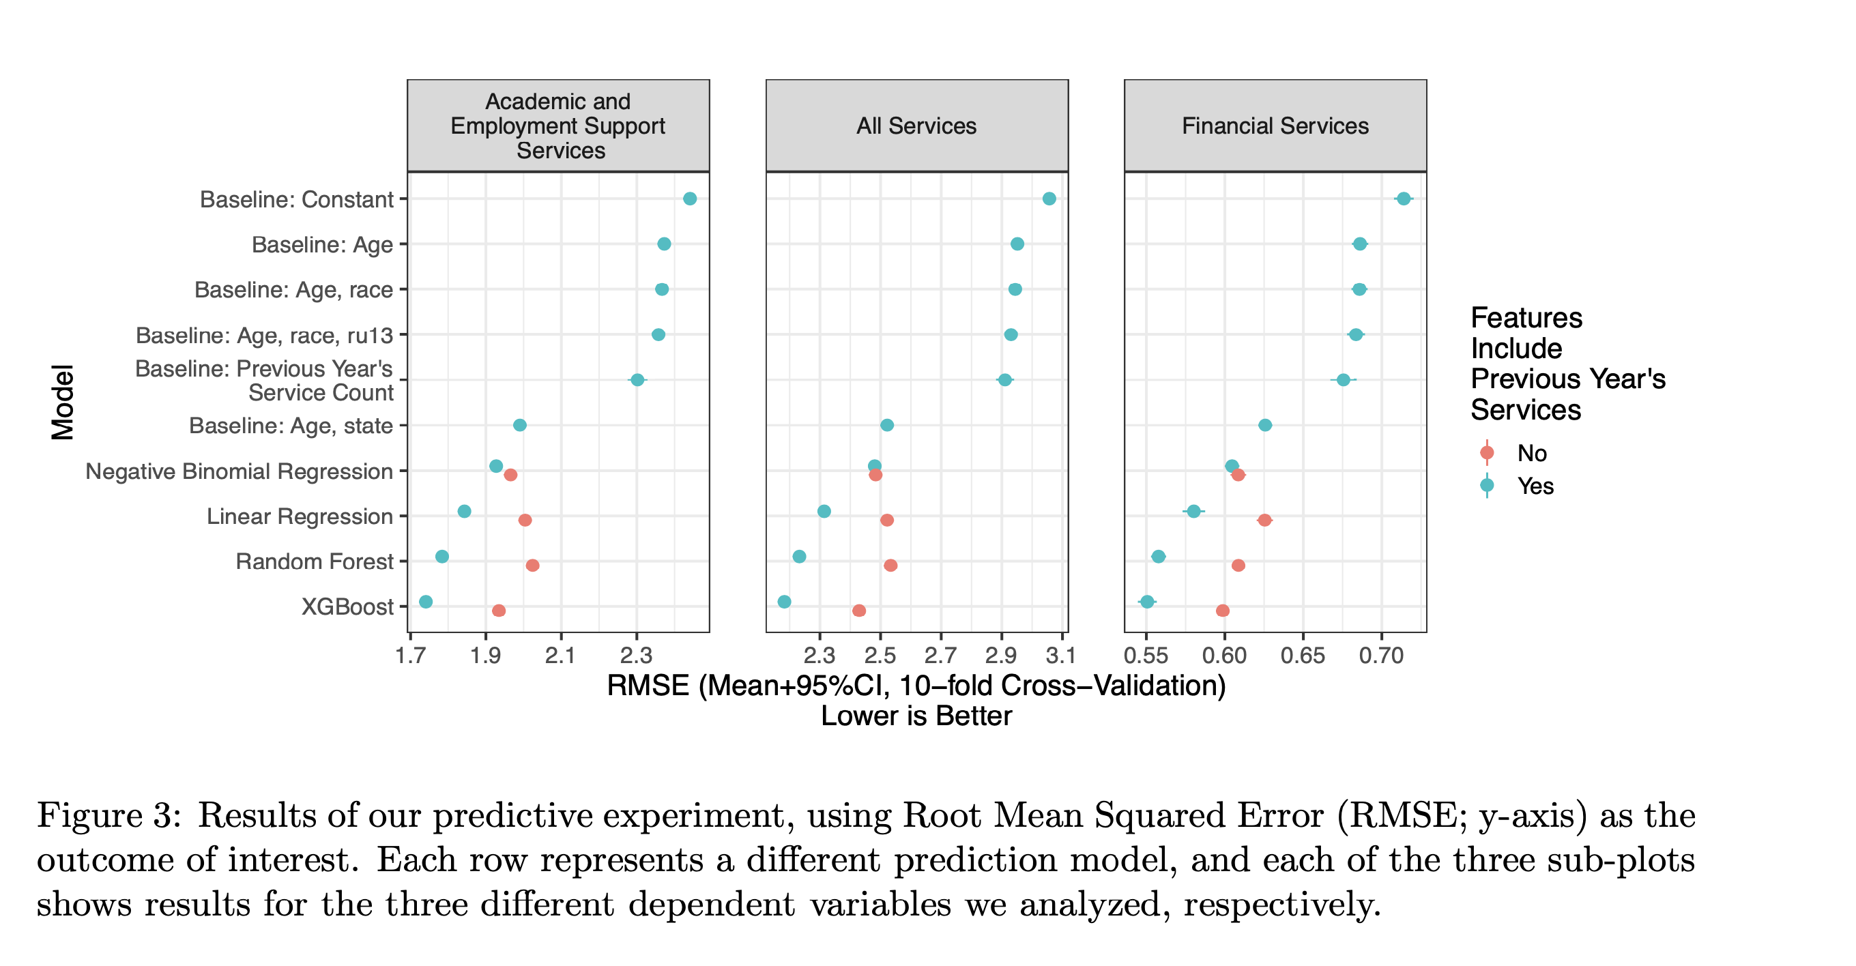
What is “AI for Social Good”?

Slide 36
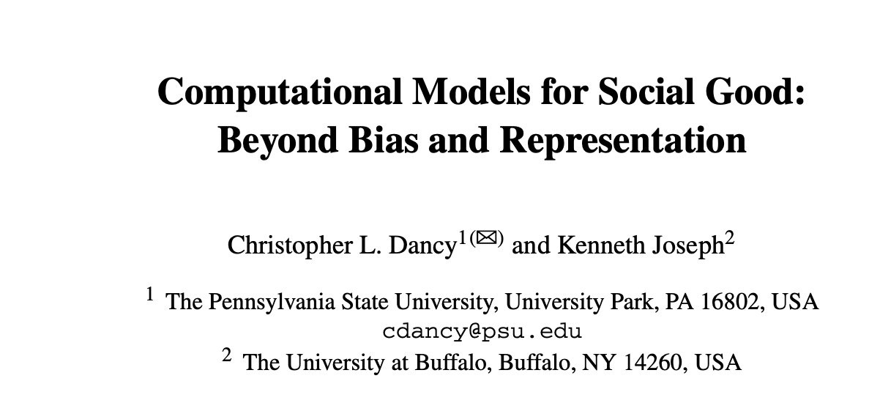
What isn’t ”AI for Social Good”

Slide 37
What is redlining?
In short, the process by which white families, governments, and private companies effectively “barred Black home buyers from qualifying for secure mortgages from many mainstream banks.” (https://www.nytimes.com/2021/08/17/realestate/what-is-redlining.html)
This was followed by the tearing apart of Black communities established in redlined areas once established as white families wanted pathways back into the city (by creating highways that ran through the center of them)

Slide 38
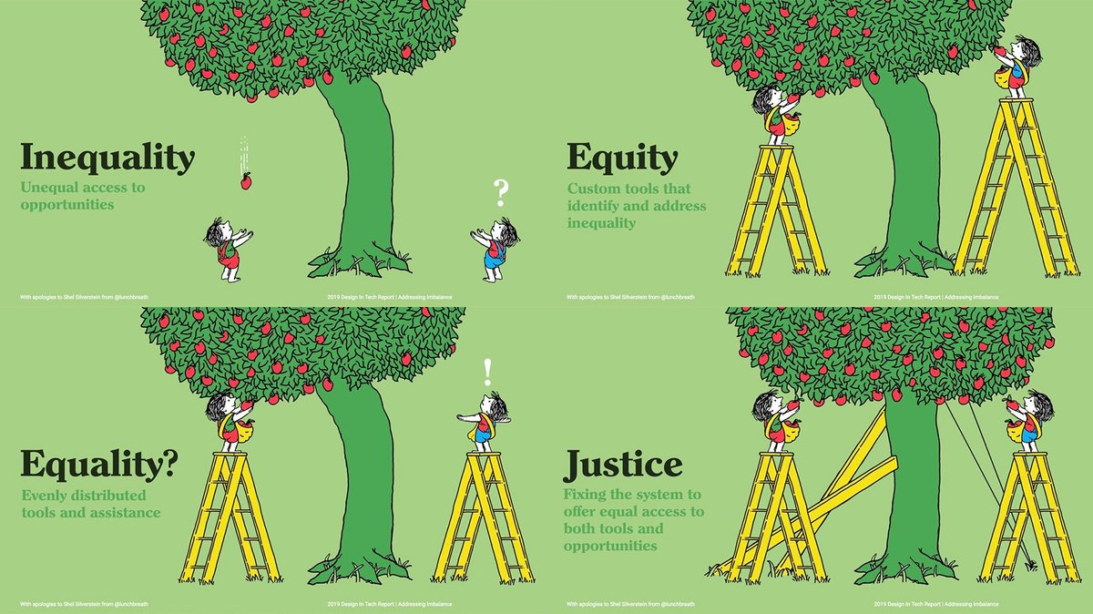
Equity vs Equality/Fairness vs Justice
https://achievebrowncounty.org/2021/05/defining-equity-equality-and-justice/

Slide 39
Round 1
Were the orphan trains really that bad? (Several folks)

Slide 40
Round 2
Is it feasible to do tech with mostly non-tech people? (Gopi)
Why isn't this always the case? (Herman)

Slide 41
Round 3
Why can't we just live together peacefully and co-exist happily? (Hitesh)
What chance do we have for Zuckerberg and Dr. Rodriguez to ever co-exist happily? (Chaithanya)

Slide 42
Round 4
What is the limit of the willingness of the advantaged group to change? (Alex)
What do we have to sacrifice for equity? For equality?
What are you willing to sacrifice for equity?

Slide 43
Other things
What percent of people need to benefit before we start building? (Aishwarya)
What is justice? (Alex)
What is justice, vs. fairness, and which is preferrable? (Joe)
Who gets to access the "minor privleges of AI" e.g. robot vaccums, not picking up dog poop (Dhiraj)?
I'm not a [Black American]. What can I really do?
Will AI cost jobs? (Several)
What is AI if we are not simply training on past data?
"To know something fully, you need to experience it" (Hitesh)... what does this mean for us?

