Slide 1
Measuring White Supremacy
Kenneth (Kenny) Joseph

Slide 2
Attendance: Abigail Z. Jacobs

Slide 3
Projects
Teams seem to have lost points in my batch on
Superficial, or no, inclusion of prior work
Superficial inclusion of history teammate
You can address the prior work part on Wednesday
Talks on Wednesday will be timed, strictly
You will be evaluated on what you present
Practice

Slide 4
Today
Why measure?
What exactly are we trying to measure when we are “measuring white supremacy”?
How do we get the data we need?
What analytical tools do we need?

Slide 5
Why do we measure?
What is the need for measurement? Think a minute, give me a concrete example of where any kind of measurement is useful

Slide 6
Why do we measure?
We measure to know or to show
Know
So we can change/improve/understand
How big is the problem?
Did what I tried have any impact?
Show
To convince other people of things
See?! Look how big this problem is!
See?! This problem impacts all of us!

Slide 7
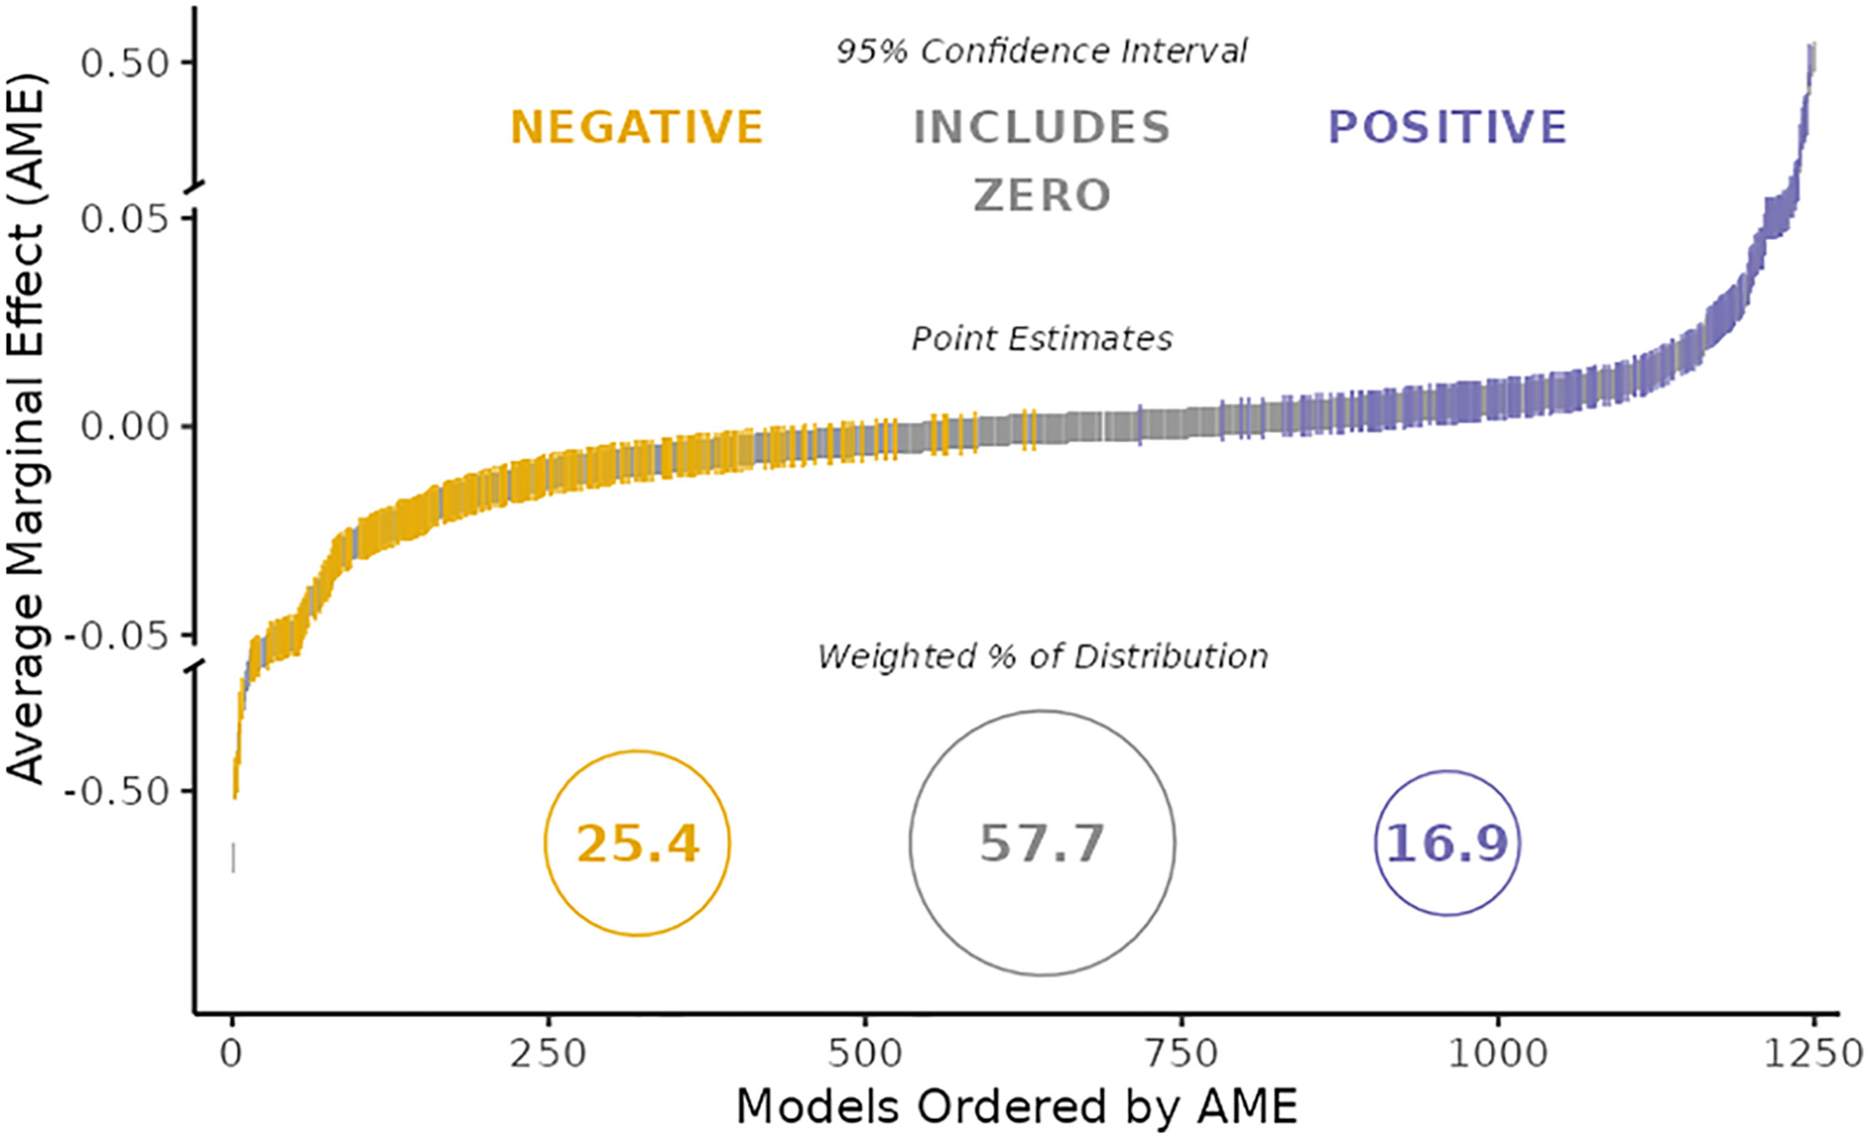
But measurement is hard
Researchers’ expertise, prior beliefs, and expectations barely predict the wide variation in research outcomes. More than 95% of the total variance in numerical results remains unexplained even after qualitative coding of all identifiable decisions in each team’s workflow
https://www.pnas.org/doi/full/10.1073/pnas.2203150119

Slide 8
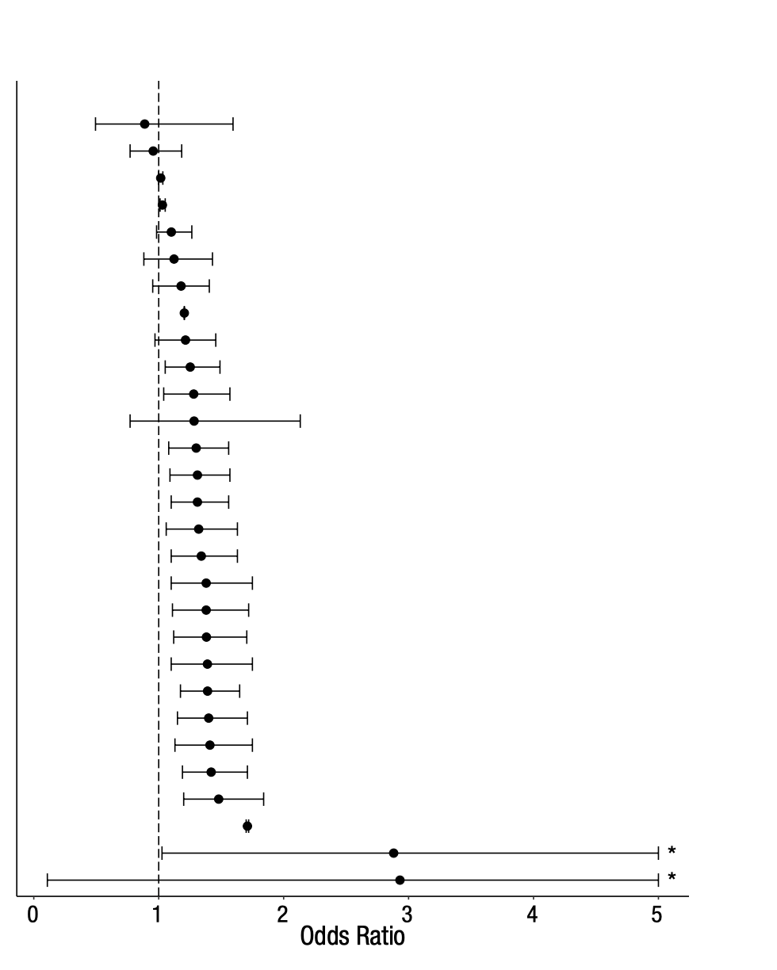
But measurement is hard
https://journals.sagepub.com/doi/pdf/10.1177/2515245917747646

Slide 9
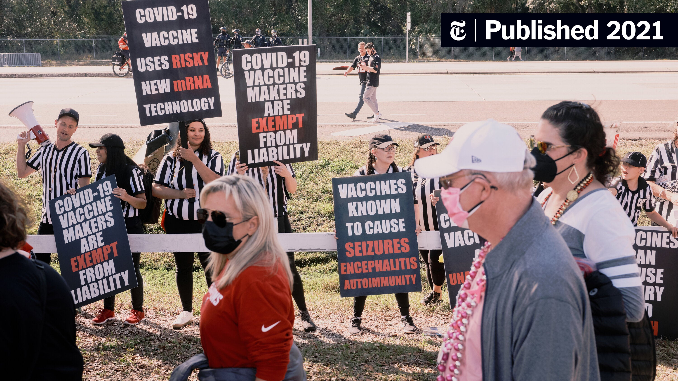
And there are other challenges to measurement

Slide 10
Bottom line
Measurement is necessary
(Good) Measurement is hard
It takes a convincing base of evidence to provide a set of measurements that, together, convince us of a truth
Even with those sets of measurements, there’s people that don’t want to believe

Slide 12
Today
Why measure?
What exactly are we trying to measure when we are “measuring white supremacy”?
How do we get the data we need?
What analytical tools do we need?

Slide 13
Well, what do you think?
What exactly are we trying to measure when we are “measuring white supremacy”?

Slide 14
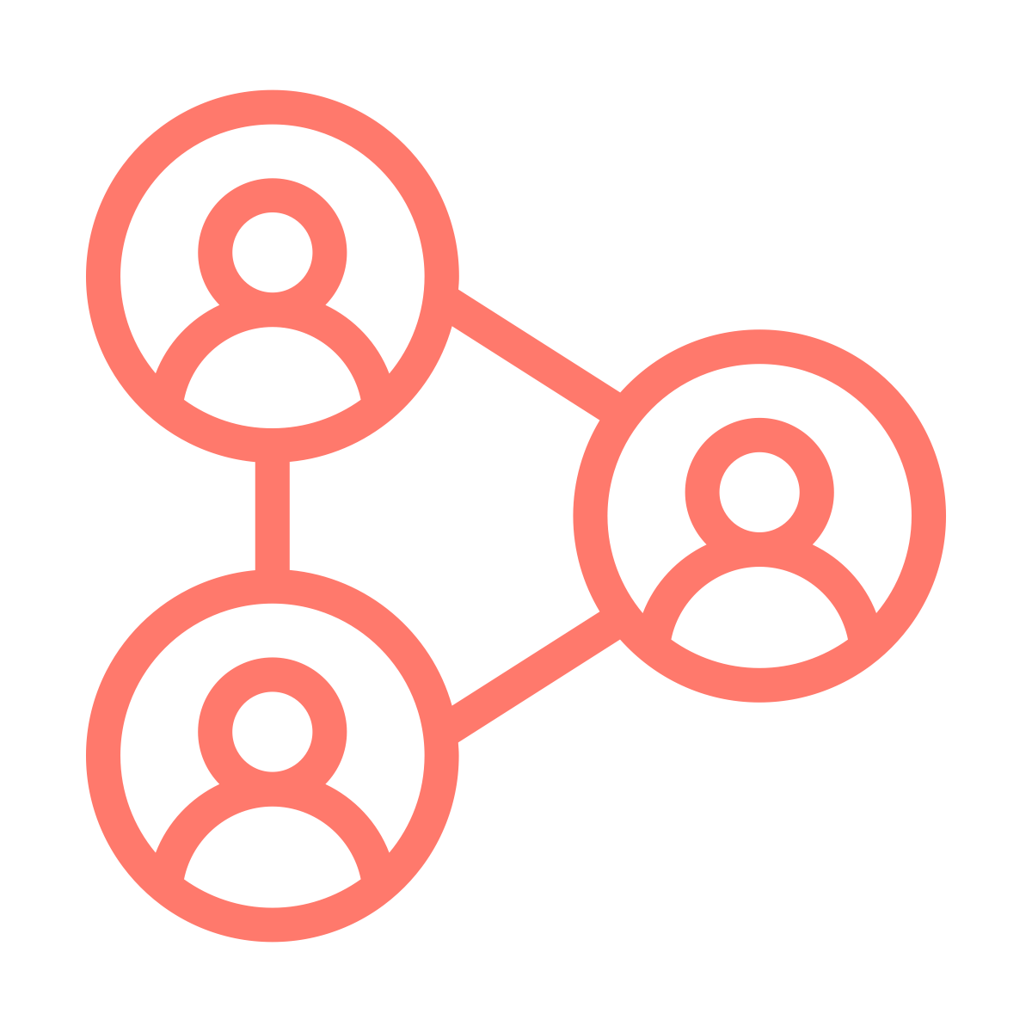
What we are trying to measure
White supremacy is a complex system comprised of beliefs, actions, and impacts at the individual (micro), organizational (meso), and structural (macro) levels. We might be interested in measuring any component of this system, or their interactions.
Beliefs
Actions
Impact
Beliefs
Actions
Impact
Beliefs
Actions
Impact

Slide 15
Some examples – Individual Beliefs
In truth, we must get considerably more specific than “beliefs”
A stereotype is a cognitive association between two ways of categorizing people. Example?
An attitude is a valence judgement of a particular issue. Example?
A prejudice is a valenced judgement of a particular “type of person.” Example?
A value is “a moral or ethical commitment to something as being right or wrong, good or bad, moral or immoral, important or unimportant”
A belief is a generalized assumption about the way the world works. Example: Essentialism vs. Constructivism
All slightly different! Why? (Precision and Independent creation of ideas)

Slide 16
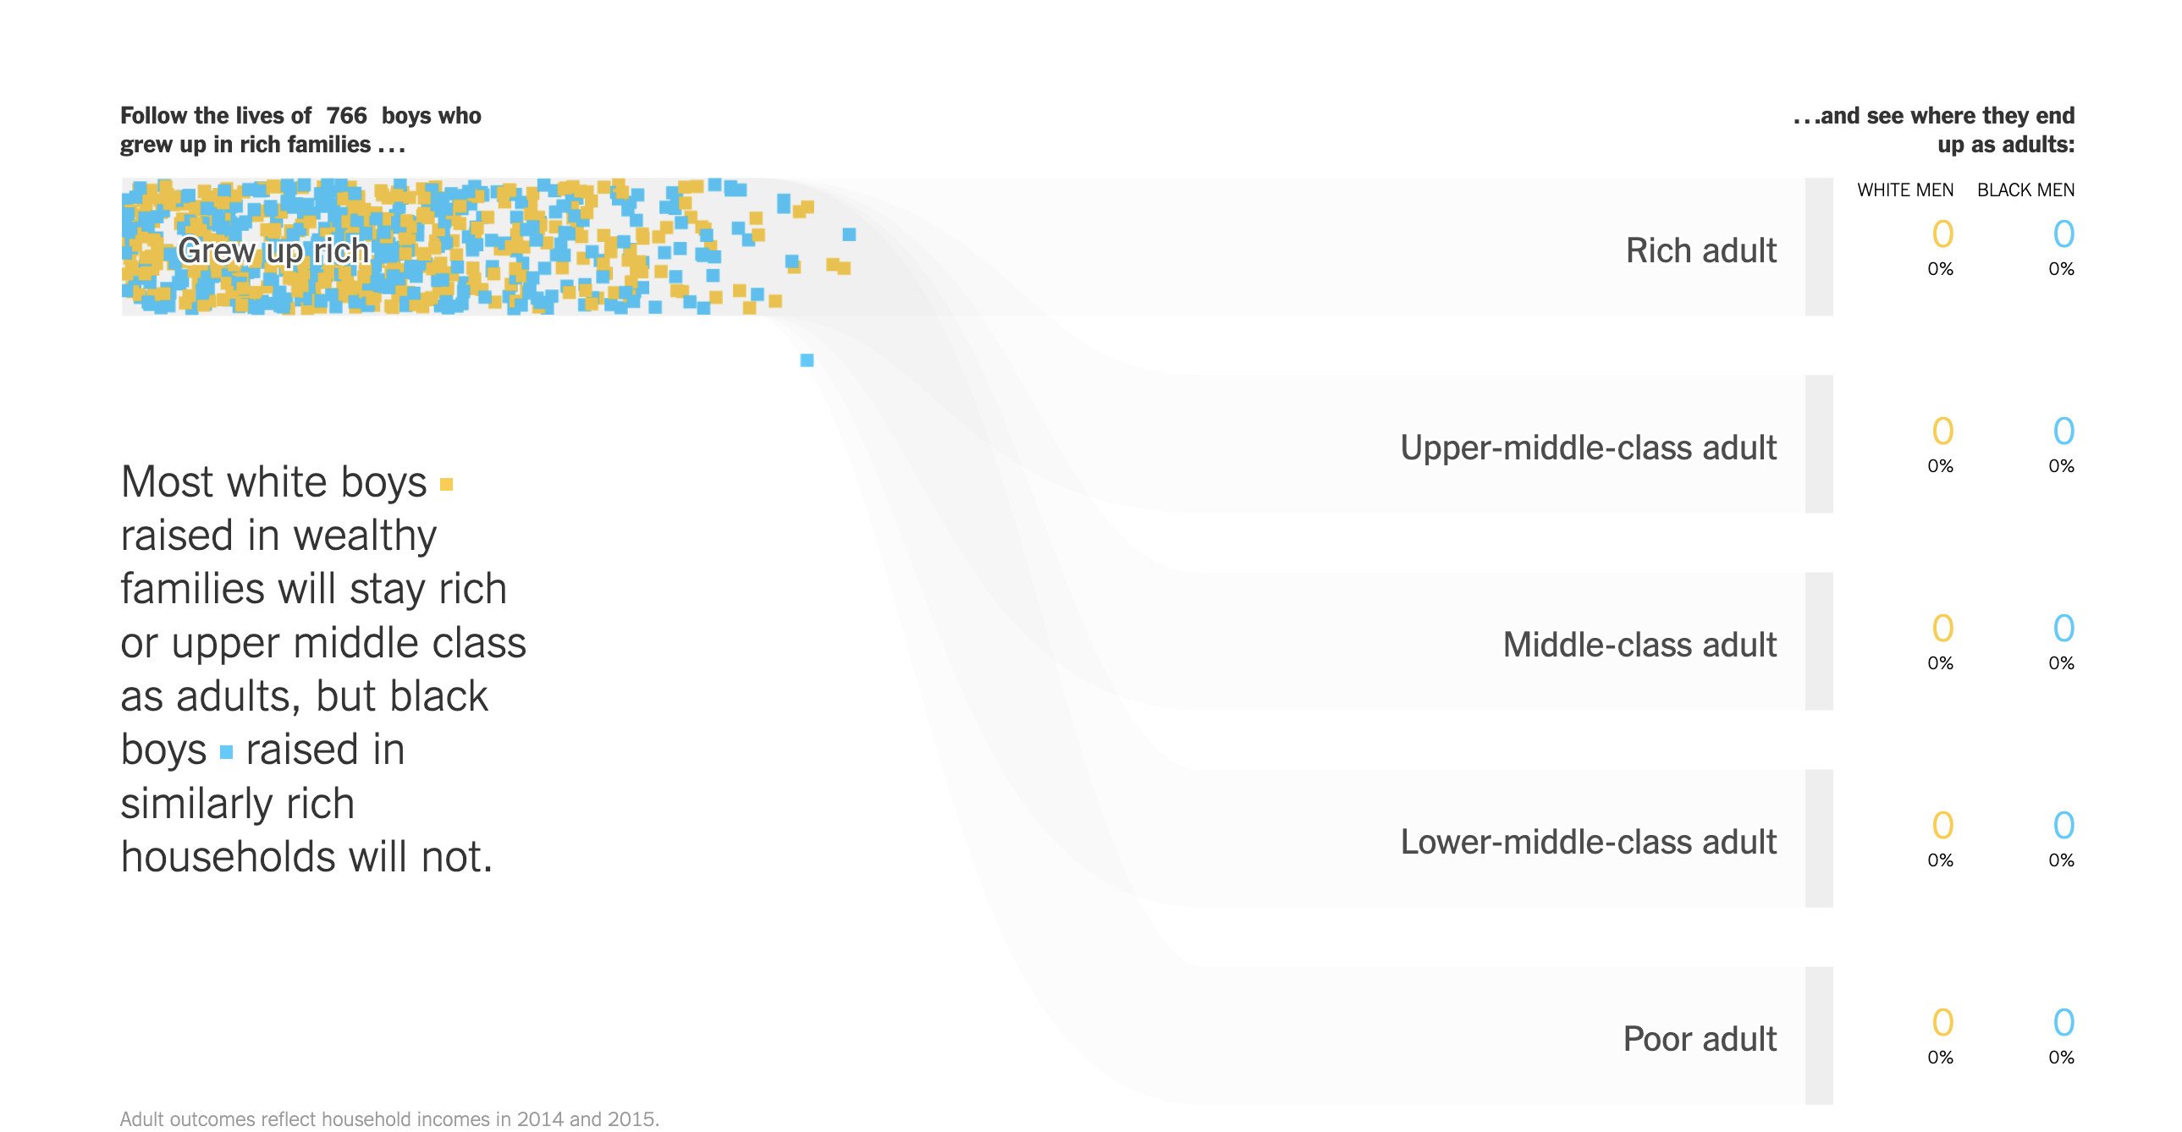
Some examples – Macro-level effects
https://www.nytimes.com/interactive/2018/03/19/upshot/race-class-white-and-black-men.html

Slide 17
A side note – “measuring” with simulation
https://ncase.me/polygons/

Slide 18
Bottom line
There are many, many things we can measure
“Beliefs” – What a person/org/policy “thinks”
Actions – What they do
Effects – What the outcomes of a collective of beliefs and actions are
We can measure these at various levels: micro, meso, macro
We have to be clear about:
What, precisely, we are (and are not) measuring (good operationalization)
Who else has measured this

Slide 19
Today
Why measure?
What exactly are we trying to measure when we are “measuring white supremacy”?
How do we get the data we need?
What analytical tools do we need?

Slide 20
Some things to keep in mind for coming exercise
Possible data sources
Administrative data
Experiments
Interviews
Surveys
Social media
APIs
Data Brokers
Web crawling
… others?
There is a field of study for each of these… i.e. we know that there are good and bad ways to do each of them

Slide 21
Exercise
Come up with a thing you think is worth measuring
State whether it is a belief, action, or impact
State what level you are measuring it
(Fake) Bonus points if this relates to your project!
Now, think about where you could get the data to measure this. Answer the following:
Who has that data right now?
If not you, how would you get it? Would you have to pay? How much? Or annotate data? How long would that take?
Is it ethical to collect this data? Could you do it ethically? Would that impact the quality of your measurement?

Slide 22
Data as a Discussion Between You and the Participants
Desirability Bias
Representativeness
Which question are you asking?
What biases exist in social media data?
What to do with individual responses?

Slide 23
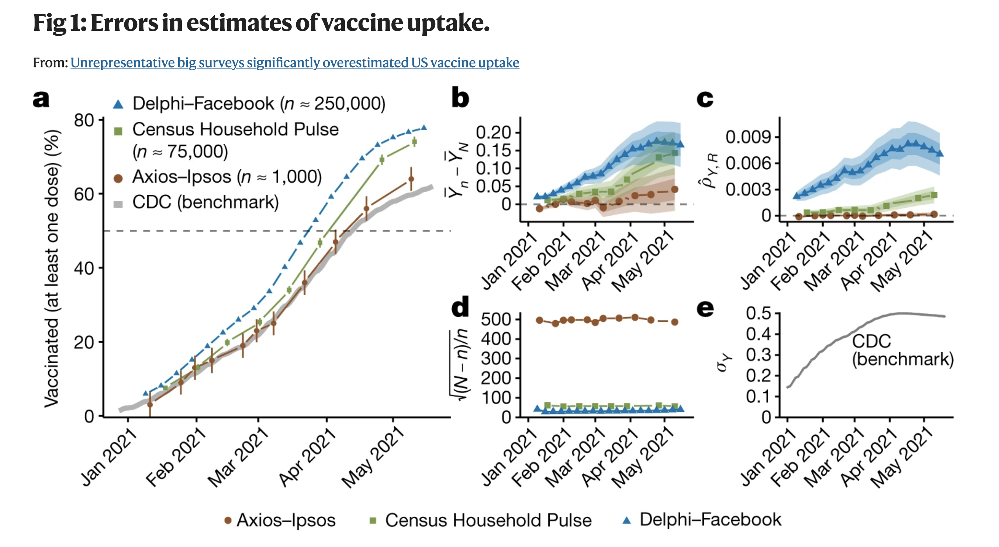
But bigger is better, right? Right?!

Slide 24
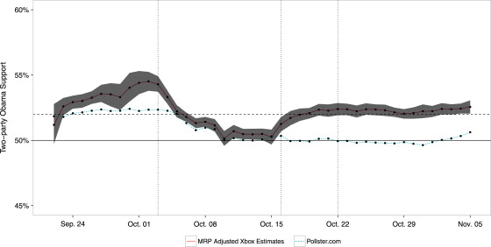
All hope is not lost

Slide 25
ML pipeline
Real world goal
Real world mechanism
Learning problem
Data collection mechanism
Which data to collect?
Data representation
Target class/model
Deploy!
Evaluate error
Predict on test data
Model training
Training data set

Slide 26
Big reveal: the ML pipeline is a measurement pipeline with different analytical tools
Real world goal
Real world mechanism
Learning problem
Data collection mechanism
Which data to collect?
Data representation
Target class/model
Tell people about your measurement
Compute and validate measure

Slide 27
Today
Why measure?
What exactly are we trying to measure when we are “measuring white supremacy”?
How do we get the data we need?
What analytical tools do we need?

Slide 28
Tools for measurement
(Aside: Machine learning can be (and often is!) a tool for measurement )
Two kinds of tools:
Tools to do the measuring
Tools to make sure the measure is valid and reliable

Slide 29
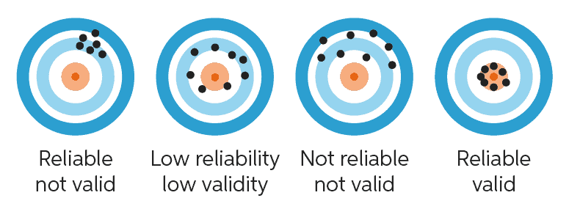
Validity and Reliability
https://www.chegg.com/writing/guides/research/reliability-vs-validity/
… lol chegg

Slide 30
(Some) Types of Validity
Face validity- passes the “sniff test”
Content validity - do you actually measure the entirety of what you think you’re measuring?
Convergent validity – aligns OK with other things that measure the same concept
Discriminant validity – doesn’t measure what it is not supposed to be measuring
Predictive validity – predicts things we expect it would predict
Consequential validity – what are the impacts of us measuring this thing?

Slide 31
Exercise
I say I am going to measure criminality based on a model trained to differentiate mugshots from profile pictures on LinkedIn
Pick two kinds of validity and assess the validity of this measure

Slide 32
Linking to Fairness

Slide 33
Linking to “Bias in AI”
https://medium.com/@blaisea/physiognomys-new-clothes-f2d4b59fdd6a

Slide 34
Tools for measuring
There are many, many ways to measure
We’ll go over three in the next few weeks:
Causal inference
Experimental: (Algorithmic) Audits
Observational: Statistical models for causal inference
Measuring beliefs using text data (NLP)
Examples of things we won’t cover:
Social network analysis
Image analysis
Simulation / Theoretical modeling

Slide 35
If time
A review of basic statistics

