Slide 1
Sasha Costanza-Chock

Slide 2
participatory Design and Participatory action research

Slide 3
History and Foundations

Slide 4
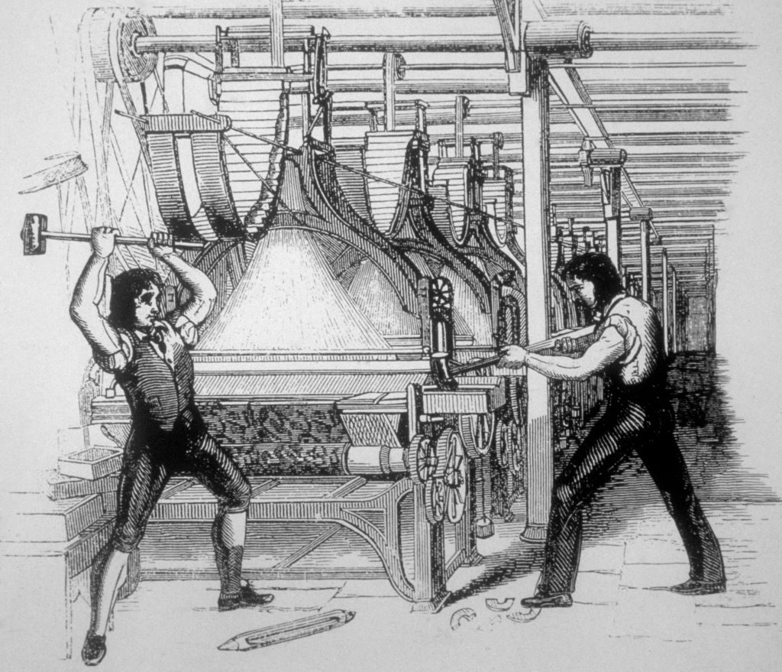
Luddites – Do these radical smashers have relevance today?
Notes:
An early expression of this feeling was the Luddite movement, still used in modern language to describe people with a “small minded opposition to new technology”
However, the real Luddites weren’t superstitious or small minded, but realized that new technology entering the workplace in the early 19th century was a real threat to their rights in the workplace and greatly shifted bargaining power in favor of management
They also rallied against the increasingly unsafe and squalid working conditions of the early Industrial Revolution

Slide 5
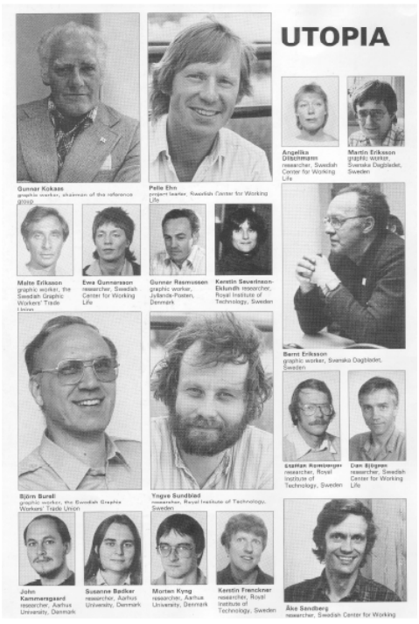
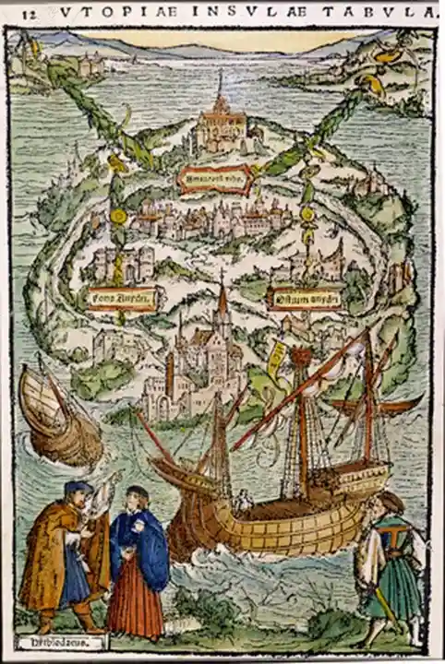
The Scandinavian Approach
1970’s Scandinavia
Growing concerns of deskilling and shift in workplace dynamics due to computerization
Foundational work by Kristen Nygaard and the Norwegian Iron and Metal Workers Union
UTOPIA
Utbildning, Teknik Och Produkt I Arbetskvalitetsperspektiv
Training, Technology and Product in Work Quality Perspective
Ambitious attempt at direct participation in development of computerized systems in the workplace
Nordic Graphic Union – newspaper graphic designers

Slide 6
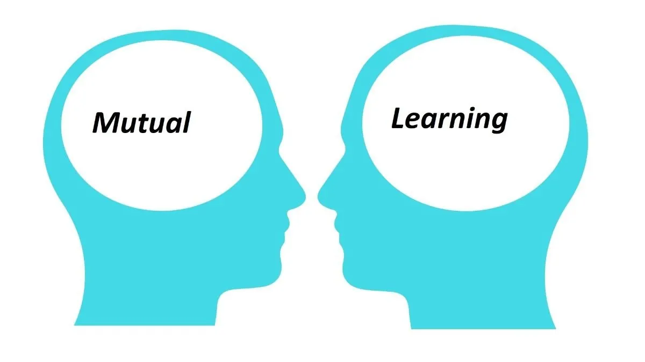
The UTOPIA Project
UTOPIA activities
Mutual learning
Common study tours
Requirement specification
Studying a pilot installation
Dissemination

Slide 7
Outcomes – Did they arrive to UTOPIA?
The final graphic design tool?
Empowerment of trade workers
HCI insight
A promising method that challenges our imagination
Is this work still relevant today?

Slide 8
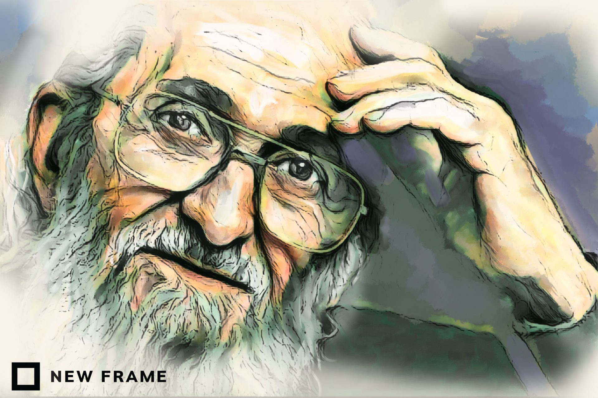
Participatory Action Research: Origins
1982: International Participatory Research Network
1960s and 70s, India: Anti-colonialist lens, inspired by social movements
1970s-1980s
Tanzania (Hall and Swantz) and Chile (Vio Grossi): restructuring life around new economic policies (e.g., land redistribution) necessitated an understanding of citizens’ experiences (e.g., obstacles to subsistence farming on newly held land)
Paulo Freire tied it altogether: Adult (popular) education, democratization of research
(Glassman & Erdem, 2014)
Notes:
Participatory action research developed in different places around the world, including Tanzania, India, Brazil, Peru, Columbia, etc. These separate projects emerged almost simultaneously, between the 50s and 70s, but it was not until 1982 that connections between them were drawn. Paulo Freire, who was primarily responsible for popularizing the movement, gave a speech at the International Participatory Research Network that tied these threads together.

Slide 9
Participatory Action Research: Components
Participation (Vivencia): Central to components 2 and 3 below and meant to represent the importance of lived experience as a driving, transformative force
Action (Praxis): The act of transforming one’s current lived experience to one that is more collectively just based on a critique of social conditions (see component 3); the focus is on changing structural power relations, both through the research process and the actions driven by the data.
Research (Conscientization): The point at which the oppressed “begin to question and critique actions they may have once believed were critical to their survival . . . [Conscientization involves] creating new community-based problem-solving processes” through research
Notes:
ELEMENTS OF PAR
Participation/Vivencia (Fals Borda, but adapted from Gasset, a Spanish philosopher): “a full experience of an event with its all possibilities, lived through direct participation” (p. 212): This is where the idea of participatory research came from, i.e., either recruiting co-researchers with lived experience or conducting research on one’s own lived experience in partnership with others. But vivencia is meant to be a transformative via “participation, sharing, sensing, feeling, and thinking” (p. 212)
Action/Praxis: “The transformation of vivencia . . . to a different collectively defined lived experience happens through action - praxis . . . Praxis implies a critical reflection, awareness of the process, and its aim . . . it must reach beyond abstract ideas about what you (must) do to improve your community and/or what you do to produce material goods, to what you do on a day-to-day basis to survive . . . Action as praxis . . . requires constant reflection and dialogue during the change process . . . The goal of PAR is . . . [to] give the oppressed members of a community or social group the capabilities of critiquing their own praxis of the immediate” (p. 212). The focus is particularly on changing power relations here - not simply including those who are marginalized in existing process (which would reflect a more positivist view where researchers are essentially “data owners” and participants are exploited for their knowledge by others who accumulate it in the form of wealth and expertise).

Slide 10
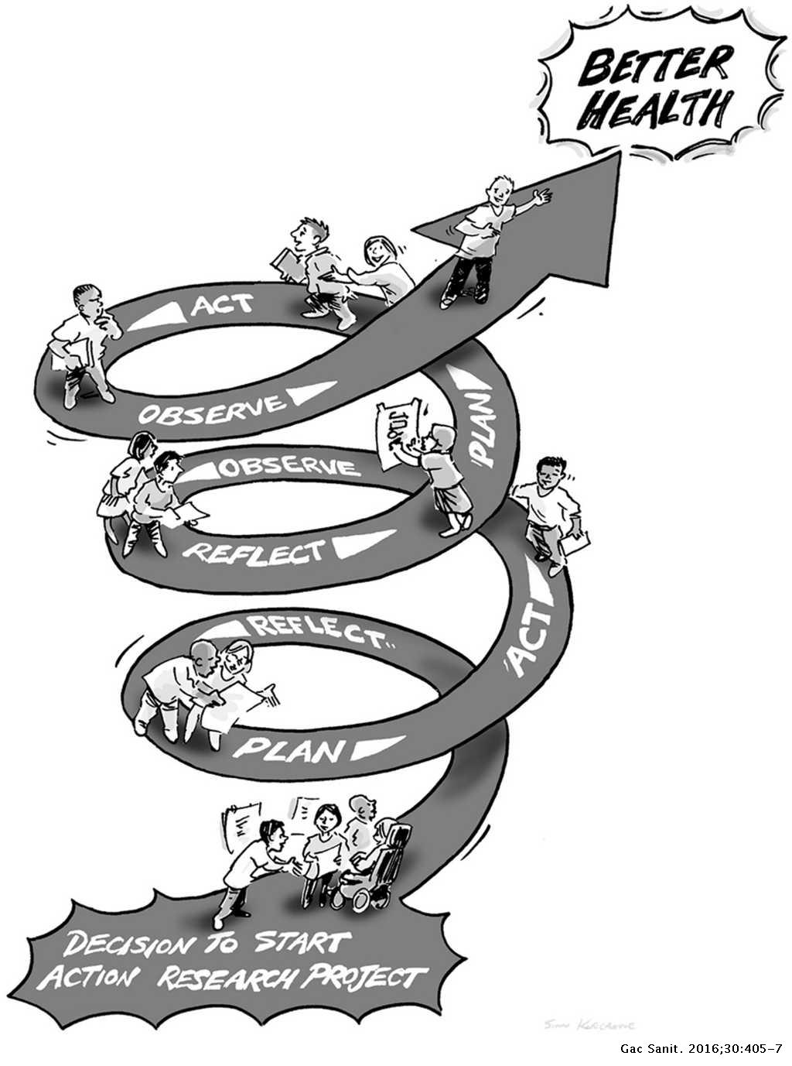
Notes:
ELEMENTS OF PAR
Participation/Vivencia (Fals Borda, but adapted from Gasset, a Spanish philosopher): “a full experience of an event with its all possibilities, lived through direct participation” (p. 212): This is where the idea of participatory research came from, i.e., either recruiting co-researchers with lived experience or conducting research on one’s own lived experience in partnership with others. But vivencia is meant to be a transformative via “participation, sharing, sensing, feeling, and thinking” (p. 212)
Action/Praxis: “The transformation of vivencia . . . to a different collectively defined lived experience happens through action - praxis . . . Praxis implies a critical reflection, awareness of the process, and its aim . . . it must reach beyond abstract ideas about what you (must) do to improve your community and/or what you do to produce material goods, to what you do on a day-to-day basis to survive . . . Action as praxis . . . requires constant reflection and dialogue during the change process . . . The goal of PAR is . . . [to] give the oppressed members of a community or social group the capabilities of critiquing their own praxis of the immediate” (p. 212). The focus is particularly on changing power relations here - not simply including those who are marginalized in existing process (which would reflect a more positivist view where researchers are essentially “data owners” and participants are exploited for their knowledge by others who accumulate it in the form of wealth and expertise).

Slide 11
What can data-driven activism look like?
Public education or awareness-/consciousness-raising campaigns
Advocacy campaigns (e.g., meeting with a decision-maker to advocate for policy reform, policy briefs)
Mobilization and organizing: Energizing people to take steps to address a social issue, and then organizing a movement around that issue
Mutual aid
(Anyon et al., 2018)

Slide 12
PD
PAR
Engineering focused
Origins in labor organizing
Technology output
Stronger execution
Vivencia (whole process approach)
Constraints created by academic settings
Antagonism / challenge to power and hierarchy
Social science focused
Origin in anticolonial practice
Research
output
Stronger
background

Slide 13
Case Studies

Slide 14
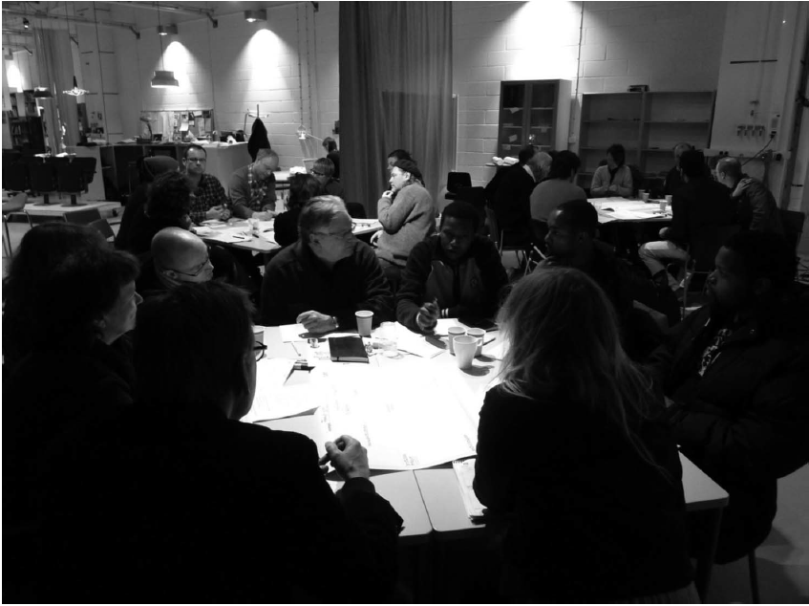
Agonistic Participatory Design: Working with Marginalized Social Movements
The complexity of designing for public space
Multiple “publics” created by interaction of diverse entities and perspectives
Navigating these interactions through tolerant disputes and challenges to hegemony
Malmö Living Labs
A number of different PD projects
Social Innovation Incubator

Slide 15
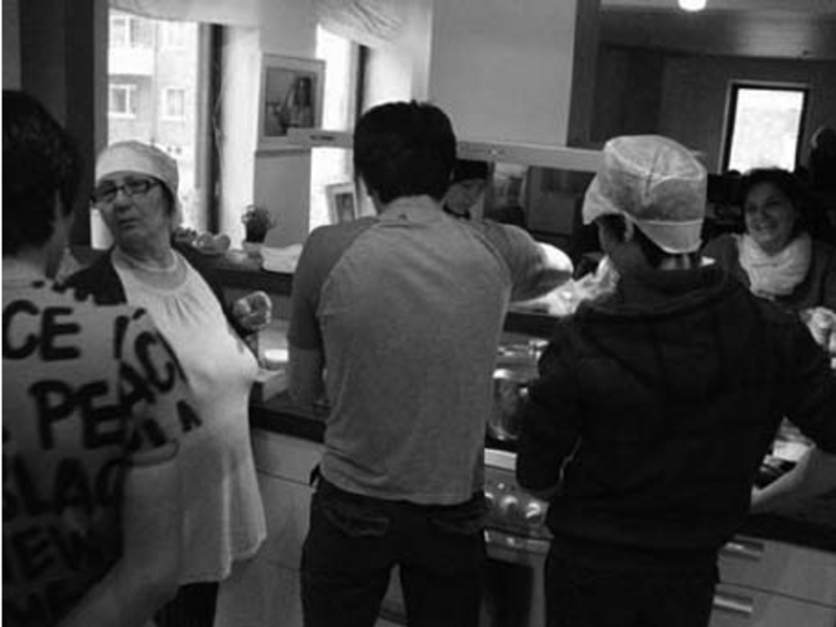
Malmö Living Labs: Working with Herrgards Women Association
Organization of immigrant women in a suburb of Malmö
Focused on social innovation – not just technological
How to support the organization in leveraging their own skills for their own ends
Developed programs to support newly arrived refugees and organize catering services
Notes:
Business partner was originally pushing for individuals to collaborate and form new group constellations, but HWA pushed back on this as they prioritized maintenance of a collective and group collaboration

Slide 16
Malmö Living Labs: Social Innovation Incubator
Three design workshops conducted with the municipality to investigate the establishment of a social innovation incubator
Who should be included? How should the process be conducted?
Broad group of stakeholders initially involved: civil servants, local citizens, potential investors, local business owners, etc.
Some powerful actors fully dropped out because of challenged hegemony
Contested structure – centralized or distributed
Ongoing process of infrastructuring – when design is focused on spaces and processes rather than final products
Notes:
Business partner was originally pushing for individuals to collaborate and form new group constellations, but HWA pushed back on this as they prioritized maintenance of a collective and group collaboration

Slide 17
PAR Case Study: Youth Participatory Action Research (YPAR) 2.0
Institute for Sustainable and Economic Educational and Environmental Design (ISEEED) in Oakland, CA: iseeed
Aim: ‘Ground-truth’ the County health department’s official database on food outlets, which had labeled East Oakland as a food oasis
Youth and adults worked together to create an app that young people could use to capture information about locations in their environment and conduct interviews and surveys with store owners and residents: streetwyze
Findings: The county claimed there were 50 grocery stores, but there were only 3. The rest were liquor or corner stores.
Action: Made recommendations to decision makers and convinced them to add a farmers market, food commissary, and urban farm to local school districts
Youth outcomes: Newfound of their social locations within systems of race and class
(Akom et al., 2016)

Slide 18
Lessons Learned and Final Thoughts
Fundamental aspects of participatory design – taken from a systematic literature review
Politics
People who are affected by a decision should have an opportunity to influence it
People
People play critical roles in design by being experts in their own lives
Context
The use situation is the fundamental starting point for the design situation
Methods
Methods are means for users to gain influence in design processes
Product
The goal of participation is to design alternatives, improving quality of life

Slide 19
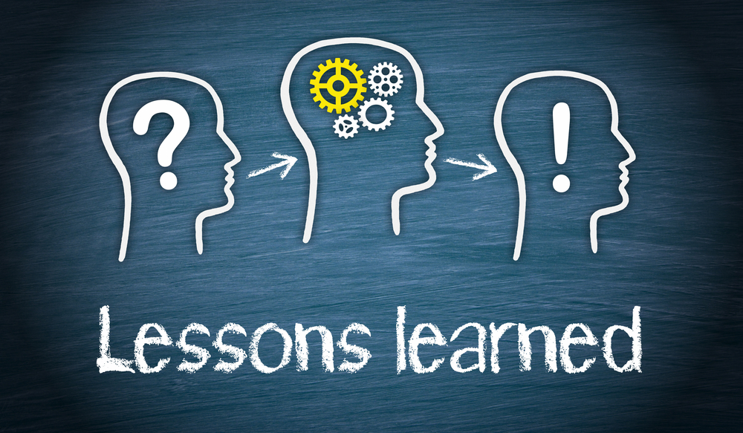
Lessons Learned and Final Thoughts
Real participatory design is challenging!
Uncertain outcomes
Long timelines
Interpersonal dynamics of participation
Buy-in from investors
Real participatory design is important!
Democratic development of public good – rather than tech for tech’s sake
Not just inclusion – empowerment
Genuinely novel design insight generated by jumping far out of the box
Projects with longevity that can thrive well after you have left the space

Slide 20
Activity
UB CSE has a massive number of applications for its CSE Masters program, several thousand for Fall 2023 alone. Administrators at UB and within the department have been considering the development of an automated system to make decisions about the admissions process. They have tasked you with developing that system. Your task:
Define the set of stakeholders who should have a say in this system, and why
Describe a participatory process by which you will design the system. Determine who will have “final say” on what, and how “final say” will be determined
Describe any feedback mechanisms that will be put into place for future changes to the system.

Slide 21
References
Sankey, M. (2013). Luddites. In (pp. 606-608).
Sundblad, Y. (2011). UTOPIA: Participatory Design from Scandinavia to the World, Berlin, Heidelberg.
Smith, R. C., & Iversen, O. S. (2018). Participatory design for sustainable social change. Design studies, 59, 9-36. doi:10.1016/j.destud.2018.05.005
Björgvinsson, E., Ehn, P., & Hillgren, P.-A. (2012). Agonistic participatory design: working with marginalised social movements. CoDesign, 8(2-3), 127-144. doi:10.1080/15710882.2012.672577
Smith, R. C., & Iversen, O. S. (2018). Participatory design for sustainable social change. Design studies, 59, 9-36. doi:10.1016/j.destud.2018.05.005
Stapleton, L., Lee, M. H., Qing, D., Wright, M., Chouldechova, A., Holstein, K., . . . Zhu, H. (2022). Imagining new futures beyond predictive systems in child welfare: A qualitative study with impacted stakeholders. arXiv.org. doi:10.1145/3531146.3533177
Halskov, K., & Hansen, N. B. (2015). The diversity of participatory design research practice at PDC 2002–2012. International journal of human-computer studies, 74, 81-92. doi:10.1016/j.ijhcs.2014.09.003
Glassman, M., & Erdem, G. (2014). Participatory action research and its meanings: Vivencia, praxis, conscientization. Adult Education Quarterly, 64(3), 206-221. https://doi.org/10.1177/0741713614523667
Anyon, Y., Bender, K., Kennedy, H., & Dechants, J. (2018). A systematic review of youth participatory research (YPAR) in the United States: Methodologies, youth outcomes, and future directions. Health Education & Behavior, 45(6), 865-878. https://doi.org/10.1177/1090198118769357
Akom, A., Shah, A., Nakai, A., & Cruz, T. (2016). Youth participatory action research (YPAR) 2.0: How technological innovation and digital organizing sparked a food revolution in East Oakland. International Journal of Qualitative Studies in Education, 29(10), 1287-1307. https://doi.org/10.1080/09518398.2016.1201609

