Slide 1
Notebooks 4 All
Kenneth (Kenny) Joseph

Slide 2
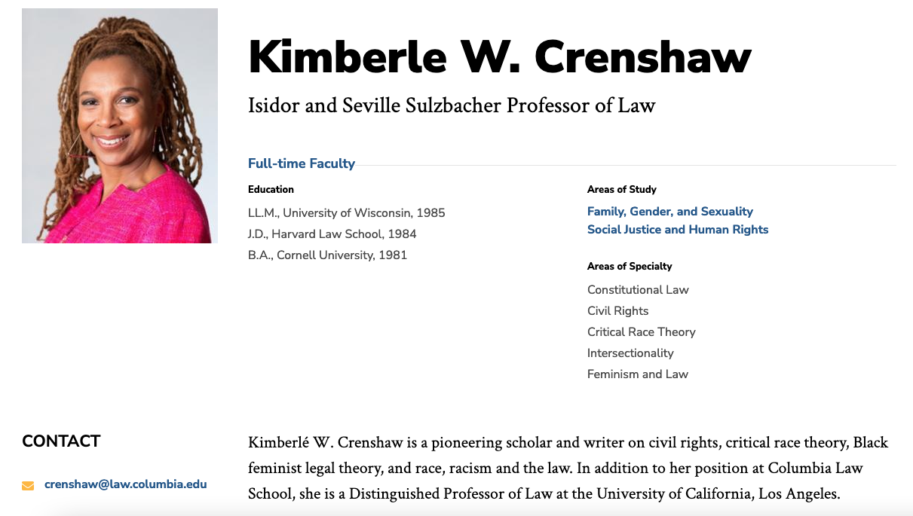
Today’s passphrase: Kimberle W. Crenshaw

Slide 3
April Project Deadlines
By March 31st,you should complete your 3rd group meeting
Goal is to prep for ML+Soc Progress summary
On April 4th: Progress summary is due for ML+Soc
Show us you’ve incorporated feedback
Both the “zoom in” and the “zoom out”
On April 11th: Consultant meeting report
Make sure this gets sent to your teammates!
By April 14th,you should complete your 4th group meeting
Goal is to prep for ML+Soc Progress summary
On April 16th: Progress summary is due for ML+Soc
Show us you’ve incorporated feedback
Should have an outline for the work you need to do for a solution
On April 24th, (slides due 23rd) your mid-project presentation
Details coming…

Slide 4
Final presentation
Updates on final presentation are coming
In response to how the group presentations went
Details after Spring Break

Slide 5
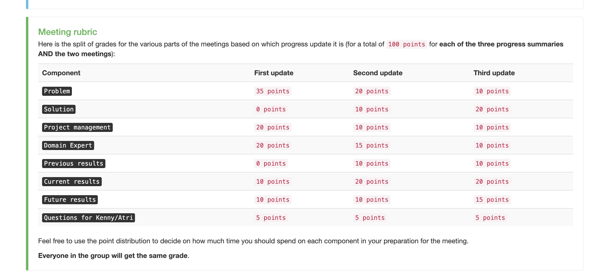
The “points” slide

Slide 6
Notebook link

