Slide 1
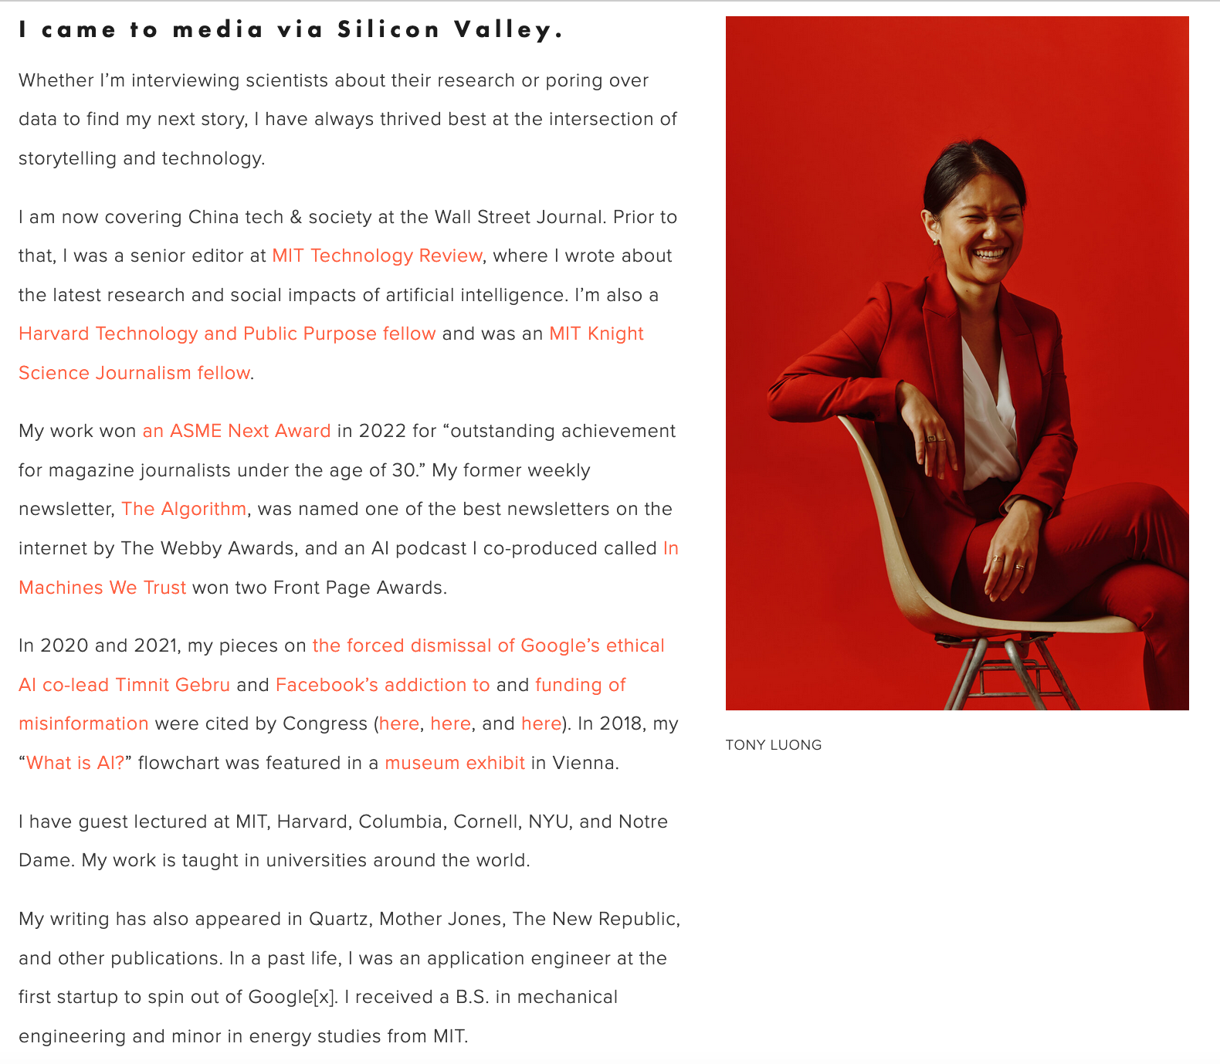
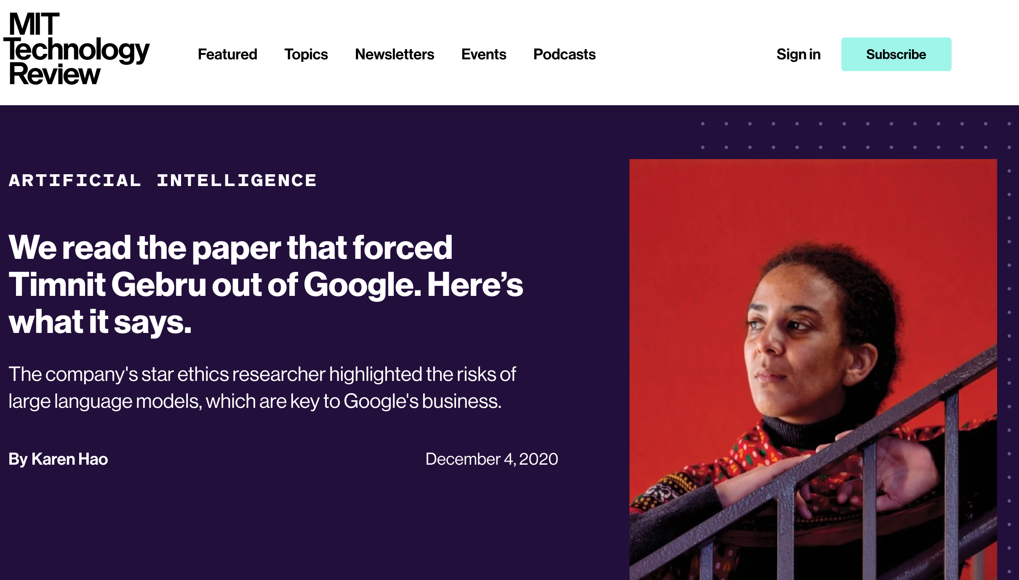
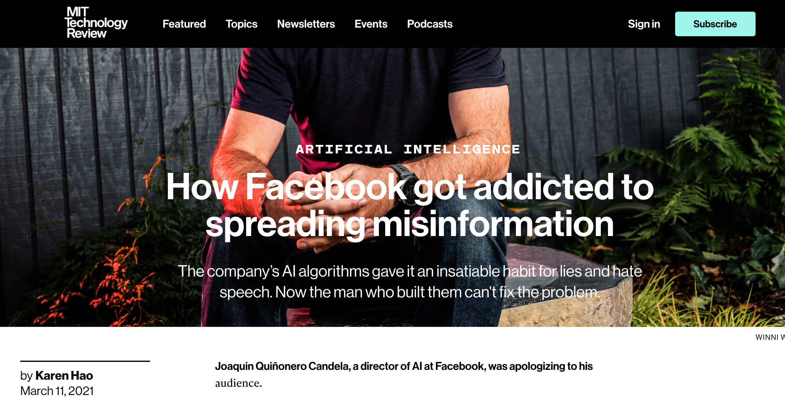
Passpharse for today: Karen Hao

Slide 2
Discussion Prompts
We’re going to start without me biasing you!
Come up, with your group, with 1 question, and post it on the relevant thread on piazza
Pending how many questions we find that we like, we’ll use some of Atri and my’s summary points, or not.

Slide 3
Some points we noted
Reflections on the IP
Why do academics talk like that?
How should we do toxic content moderation?
Is boycotting effective? Does anything ever change? Is this all hopeless?
Who is to "blame" for what happened to the workers? Is it even so bad?
What are the costs of developing “good AI” (Suradhya)
Wouldn't focusing on a marginalized group mean that it won't be applicable generally?
Questions (for next week)
What is Black feminist theory?
What is the matrix of domination?
If X doesn’t do it, won’t Y just do it?

