Slide 1
NLP & Social Media
Notes:
I always tell my students that one of the worst things you can do is to start your talk with an apology, but that is precisely what I’m going to do today.
Covid has been slowly trickling through my family for the last two weeks or so, so there are some threads in this talk that are not as cleanly tied together as I would have hoped. However, the ideas here are ones that I have thought quite a bit about over the past few years, so hopefully you find something in the next 15 minutes that piques your interest

Slide 2
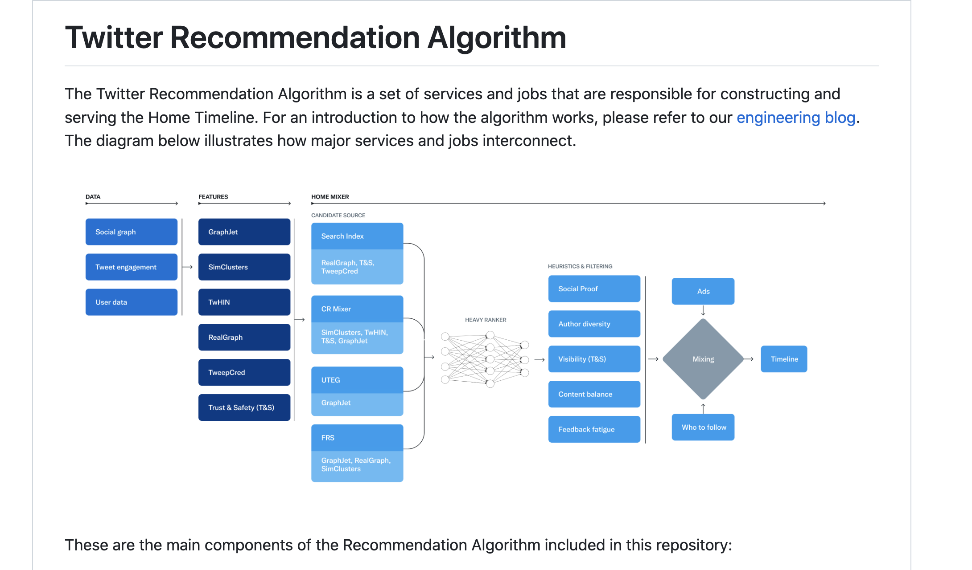

Slide 3
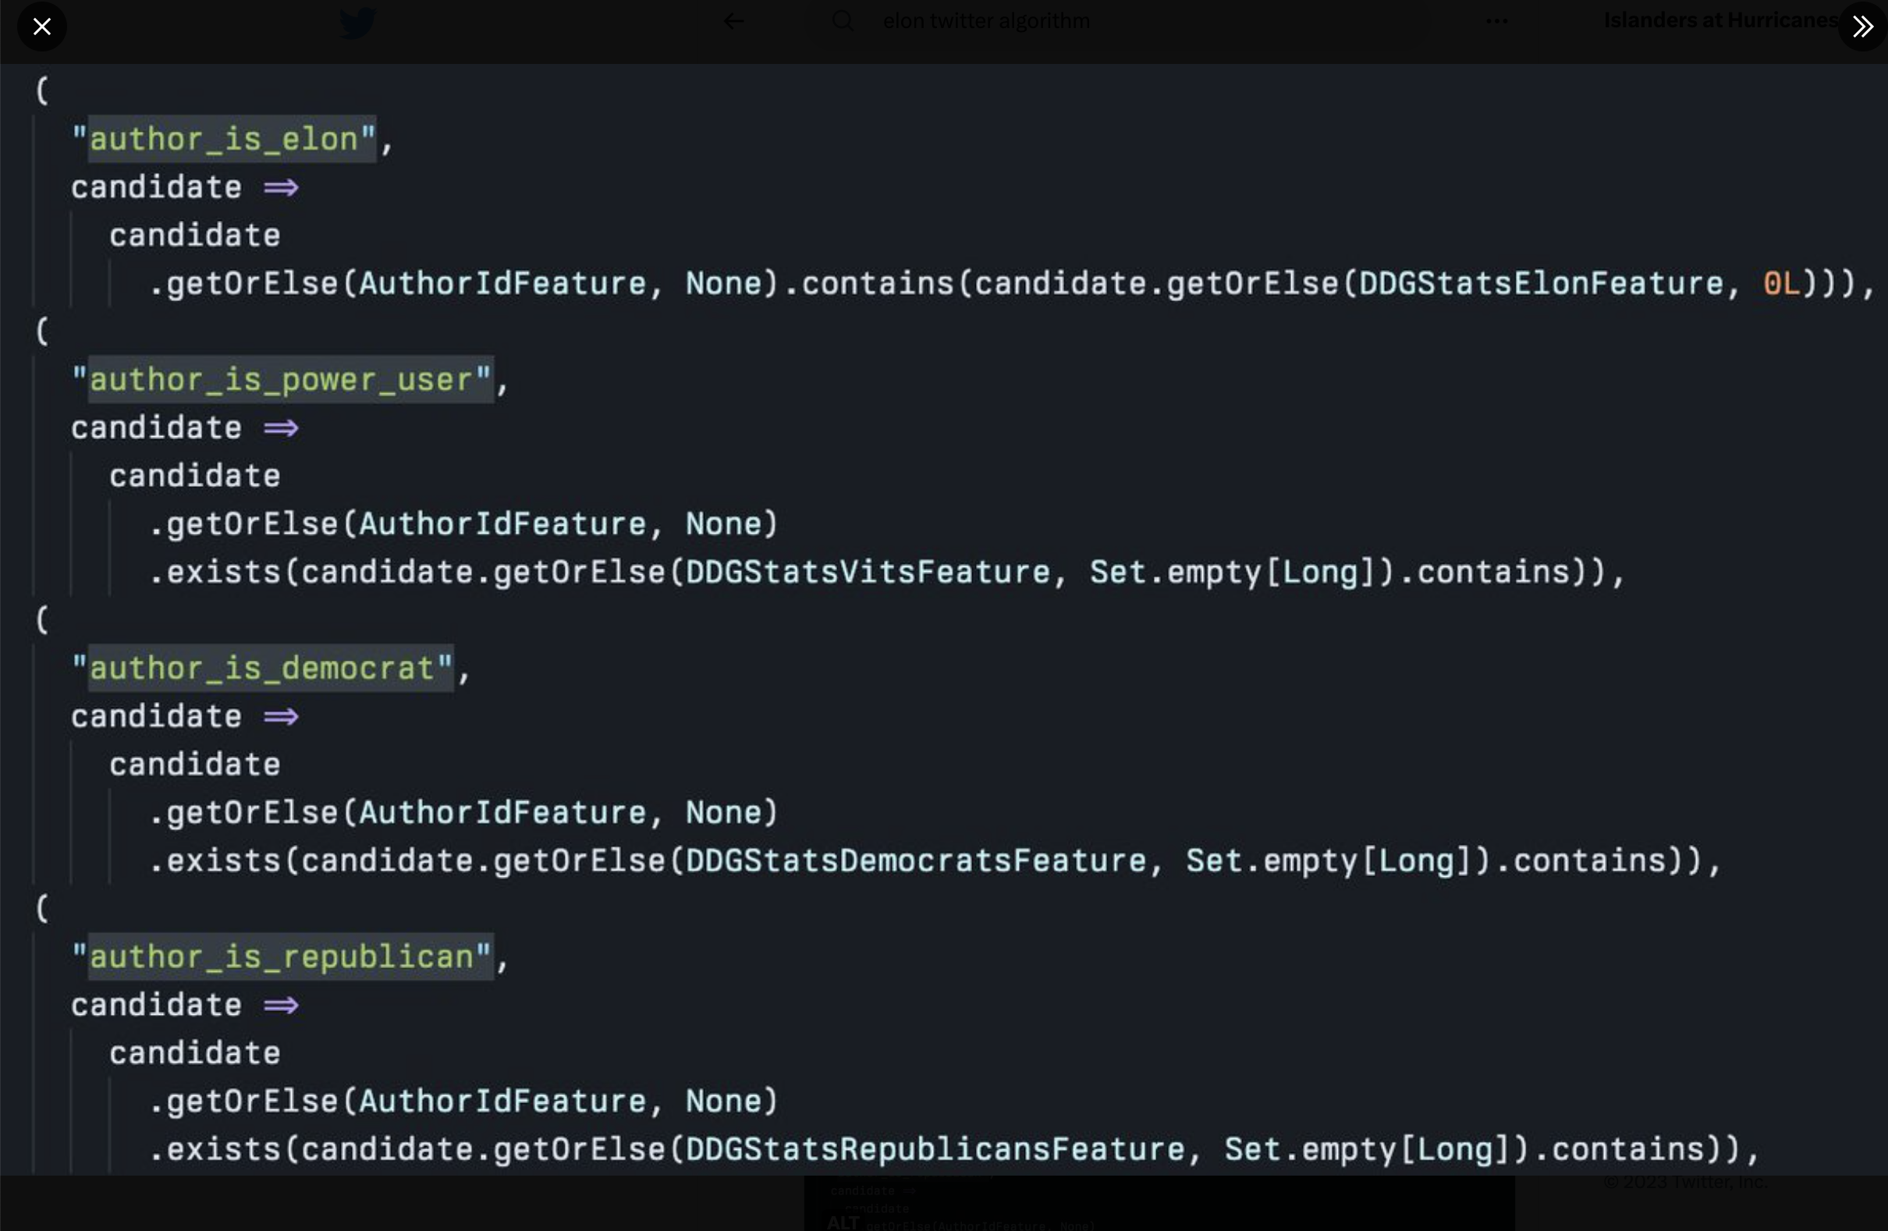

Slide 4
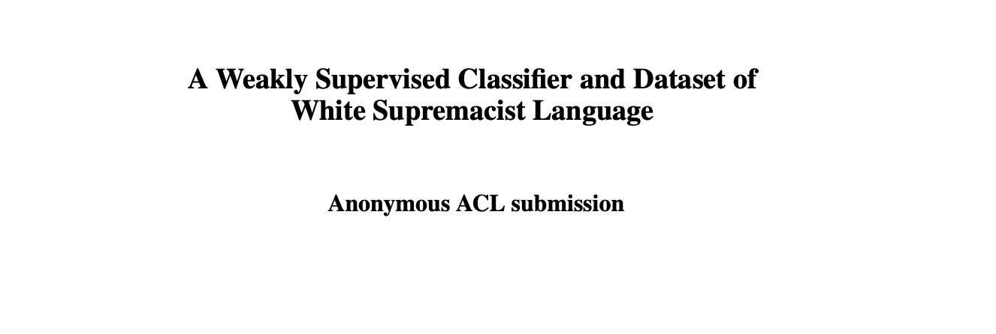

Slide 5
Kenny and Atri’s quick summary
Most people: how would this be used and what were the implications of that?
Most people liked the idea of weak supervision and the explicit incorporation of anti-racist text
Common question: Could OpenAI have used something like this? Did they?
Technical Questions
How is text different from images/video?
What is a topic / topic model?
Various questions about the data

Slide 6
Rest of today / some of Wednesday
Differentiating various ways of accessing data
An ad-hoc, mostly question-driven discussion about NLP and evaluation

Slide 7
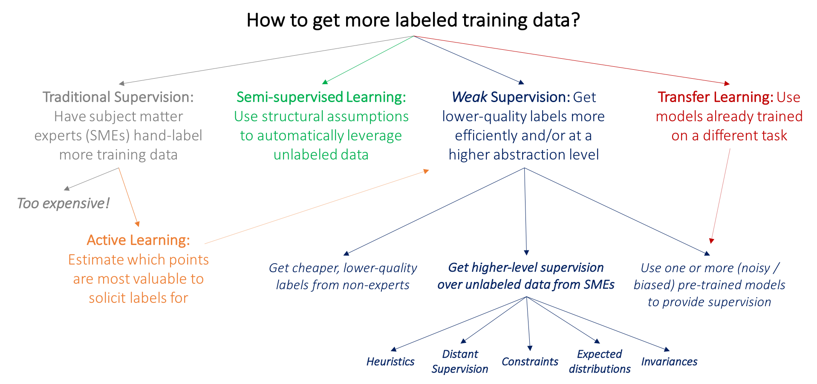
Where does data come from?
Image source: http://ai.stanford.edu/blog/weak-supervision/

Slide 8
A linear model for classification
700
Weights (kgs)
350
150
300
Height (cms)

Slide 9
Sample task: stance detection
Stance detection: The task of determining whether someone is for or against a particular thing. We’ll focus on “stance towards 4/574”
Adapted from: https://courses.cs.washington.edu/courses/cse416/21sp/

Slide 10
Sample task: stance detection
Stance detection: The task of determining whether someone is for or against a particular thing. We’ll focus on “stance towards 4/574”
Adapted from: https://courses.cs.washington.edu/courses/cse416/21sp/

Slide 11
Sample task: stance detection
Stance detection: The task of determining whether someone is for or against a particular thing. We’ll focus on “stance towards 4/574”
This class is garbage. The professor makes bad jokes and I can’t read his handwriting
Arguably the greatest moments in human history have come when Kenny takes the floor for 4/574 each week
Adapted from: https://courses.cs.washington.edu/courses/cse416/21sp/

Slide 12
Stance detection in the real world
The prof’s jokes are bad and he can’t make a quiz without an error to save his life but I occasionally learn some stuff

Slide 13
Back to the example…
This class is garbage. The professor makes bad jokes and I can’t read his handwriting
How would you approach the task of stance detection? Specifically…
What would your features be?
How would you make decisions based on those features?
What loss function would you use?
Adapted from: https://courses.cs.washington.edu/courses/cse416/21sp/

Slide 14
Approach 1: Bag of words + Linear threshold classifier
Convert each course evaluation statement into a “bag of words” representation
Fix a weight for each word in terms of how having it in a sentence implies a positive/pro or negative/anti stance
Sum up the weights for all of the words to get a score
If the score is > 0, predict “pro-5/474”, otherwise, predict “anti”
Adapted from: https://courses.cs.washington.edu/courses/cse416/21sp/

Slide 15
Approach 1, Step 1
This class is garbage. The professor makes bad jokes and I can’t read his handwriting
The prof’s jokes are bad and he can’t make a quiz without an error to save his life but I occasionally learn some stuff
Arguably the greatest moments in human history have come when Kenny takes the floor for 4/574 each week

Slide 16
Approach 1, Step 2
How might we get these values in the easiest possible way?
… later… how we can learn them from data
Word | Weight (w)
garbage | -5.0
bad | -3.0
can’t | -0.5
bad | -3.0
error | -2.1
learn | 3.0
greatest | 4.0
Arguably, human, professor, handwriting, … | 0.0
Adapted from: https://courses.cs.washington.edu/courses/cse416/21sp/

Slide 17
Approach 1, Step 2
Word | Weight (w)
garbage | -5.0
bad | -3.0
can’t | -0.5
bad | -3.0
error | -2.1
learn | 3.0
greatest | 4.0
Arguably, human, professor, handwriting, … | 0.0
This class is garbage. The professor makes bad jokes and I can’t read his handwriting
The prof’s jokes are bad and he can’t make a quiz without an error to save his life but I occasionally learn some stuff
Arguably the greatest moments in human history have come when Kenny takes the floor for 4/574 each week
Adapted from: https://courses.cs.washington.edu/courses/cse416/21sp/

Slide 18
Approach 1, Step 3
Word | Weight (w)
garbage | -5.0
bad | -3.0
can’t | -0.5
bad | -3.0
error | -2.1
learn | 3.0
greatest | 4.0
Arguably, human, professor, handwriting, … | 0.0
The prof’s jokes are bad and he can’t make a quiz without an error to save his life but I occasionally learn some stuff
Adapted from: https://courses.cs.washington.edu/courses/cse416/21sp/

Slide 19
Approach 1, Step 4
This class is garbage. The professor makes bad jokes and I can’t read his handwriting
The prof’s jokes are bad and he can’t make a quiz without an error to save his life but I occasionally learn some stuff
Arguably the greatest moments in human history have come when Kenny takes the floor for 4/574 each week
Adapted from: https://courses.cs.washington.edu/courses/cse416/21sp/

Slide 20
Cool!
We have built our first classifier!
Quiz: Did this classifier use (training) data at all?
How could it have used data to inform the model?

Slide 21
…Put another way, how to learn word weights?
CIML, pg. 43

Slide 22
…Put another way, how to learn word weights?
An online algorithm to learn weights for the words…
The perceptron algorithm.
An early, well-known approach!
IMO, can complicate understanding at this point in the class
CIML, pg. 43

Slide 23
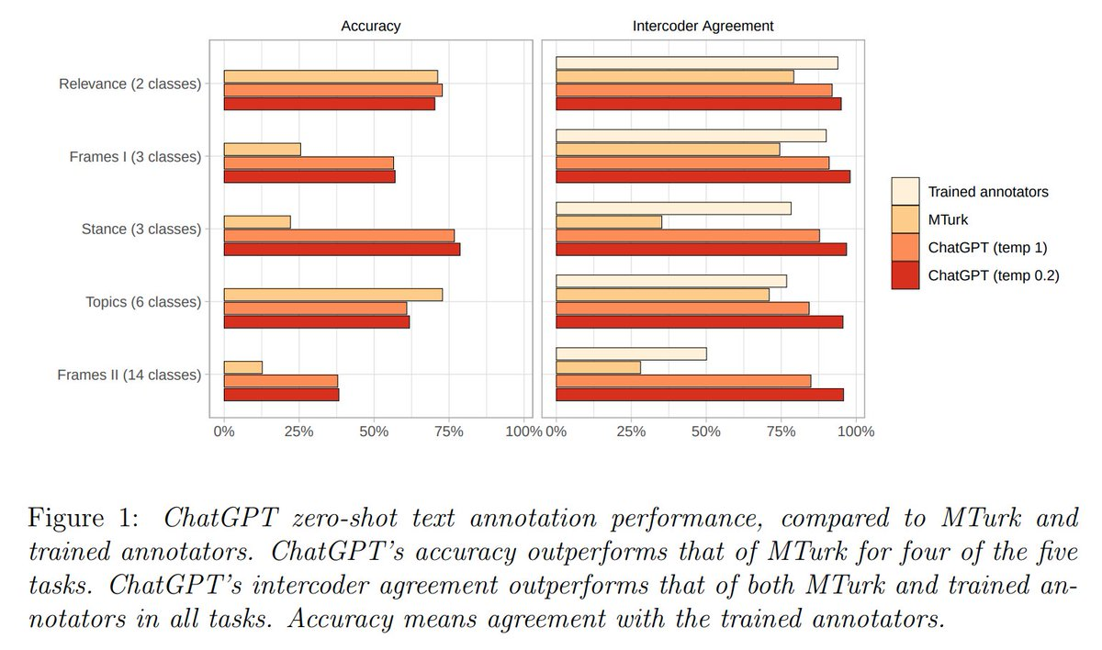
Will any of this be relevant soon?

Slide 24
OK!
What questions do you have?!

