Slide 1
Causal Inference (kind of)
Kenneth (Kenny) Joseph
Notes:
I always tell my students that one of the worst things you can do is to start your talk with an apology, but that is precisely what I’m going to do today.
Covid has been slowly trickling through my family for the last two weeks or so, so there are some threads in this talk that are not as cleanly tied together as I would have hoped. However, the ideas here are ones that I have thought quite a bit about over the past few years, so hopefully you find something in the next 15 minutes that piques your interest

Slide 2
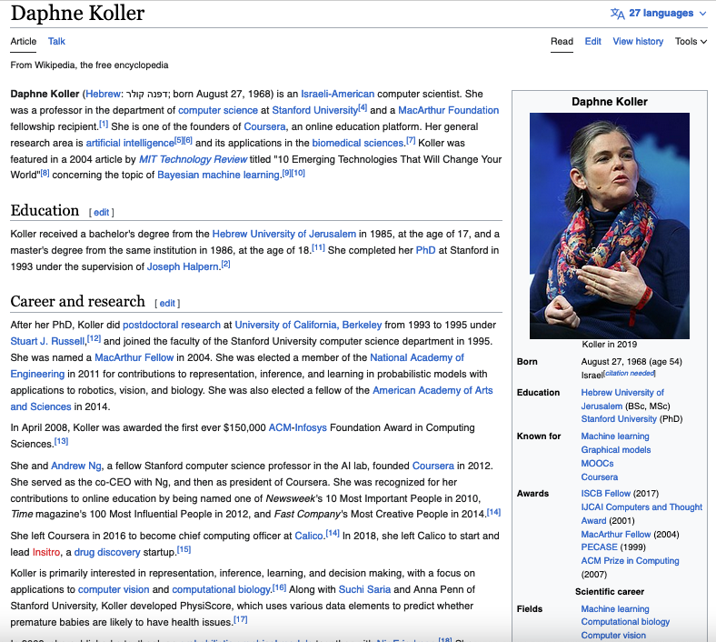
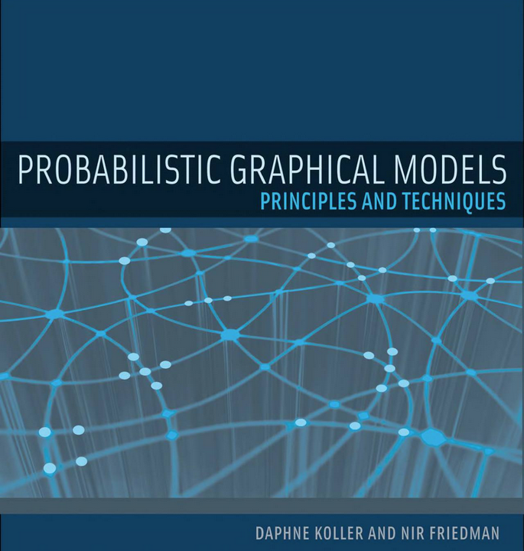
Pass phrase: Daphne Koller

Slide 3
Announcements
Putting in the effort in your group
Wednesday is now a combined class
No progress summary due, but…
Still meet with your groups
Leverage office hours
Prep for 2nd presentation

Slide 4
What is the goal of machine learning?

Slide 5
What is the goal of machine learning?
Can ML answer these questions?
Did this ad cause this person to buy this product?
Did this tweet cause this person to not get the vaccine?
Did this drug cause someone to not get cancer?
Why?

Slide 6
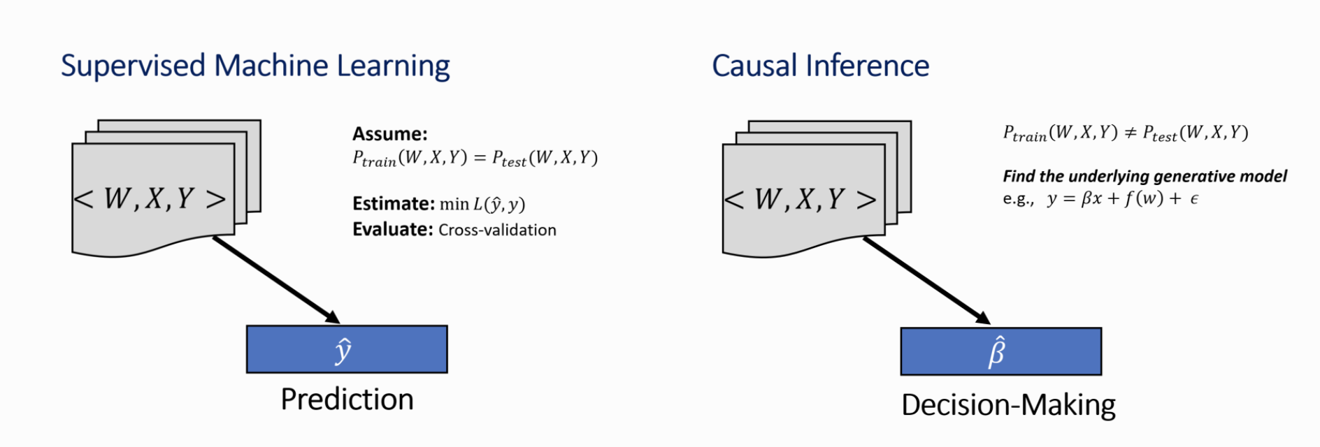
Causal Inference
Many, many interesting questions are causal inference questions
https://microsoft.github.io/dowhy/example_notebooks/tutorial-causalinference-machinelearning-using-dowhy-econml.html

Slide 7
Why causal inference is hard
I want to know if telling Vedang he is going to get an A no matter what will make his project better or worse
I can’t both give Vedang an A AND not give it to him!
This is the Fundamental Problem of Causal Inference
https://microsoft.github.io/dowhy/example_notebooks/tutorial-causalinference-machinelearning-using-dowhy-econml.html

Slide 8
What can we do, then?
Target averages/expectations instead of an individualized effect
Experiment! (Why does that work?)
Note: do operator indicates an intervention, in an RCT we intervene by randomly assigning treatment and control to comparable groups.

Slide 9
Problems with the simple story
Sometimes, experimentation is unethical
Give half of you As and the other half we don’t
Other times,
we might have wanted to experiment but simply couldn’t, and are left with a bunch of observational data
Even when we experiment, we mess it up
Since we do not always have access to experimental data, we rely on observational data for estimating causal effect.

Slide 10
How could you mess up an experiment?

Slide 11
A digression… probabilistic graphical models

Slide 12
Practice: Get Distribution from BayesNet

Slide 13
Practice: Draw Bayes Net from Specified Distribution

Slide 14
Summary: PGMs
PGMs are drawings that represent probability distributions
These probability distributions represent generative models, i.e. stories about the (social) processes you are trying to model
E.g. ChatGPT’s generative story is “the probability of the next word is defined by the previous words” … although it is much more complex than that
OK, we’ll come back to this…

Slide 15
Problems with the simple story
Sometimes, experimentation is unethical
Give half of you As and the other half we don’t
Other times,
we might have wanted to experiment but simply couldn’t, and are left with a bunch of observational data
Even when we experiment, we mess it up
Since we do not always have access to experimental data, we rely on observational data for estimating causal effect.

Slide 16
Now what?
What might we do in these settings?

Slide 17
Now what?
What might we do in these settings?
Create a fake world where we can intervene (simulation)
Try to estimate causal effects in observational data by controlling for confounders
Many ways to do this, two high level approaches:
Propensity Scoring: Try to make the people who didn’t get the treatment look like the people who did
Conditional Outcome Modeling: Try to build a predictive model of the outcome and “ask” it what happens if you change the causal feature from 1 to 0

Slide 18
Today
A basic propensity-scoring approach
Model
Define estimand
Estimate
Check
A nod to more complex approaches

Slide 19
Step 1: Model
We start by building a model of the data generating process
How?!

Slide 20
Step 1: Model
We start by building a model of the data generating process
To do so, we can hypothesize the causal structure of the data using a probabilistic graphical model (PGM)!
Using this PGM tells us what factors, aside from our treatment, impact our outcome
The task of causal inference is then to find a way to estimate, for a given estimand, the effect of the treatment on the outcome

Slide 21
Step 1: Model
What is the effect of being Black on getting a job interview once your resume is submitted?

Slide 22
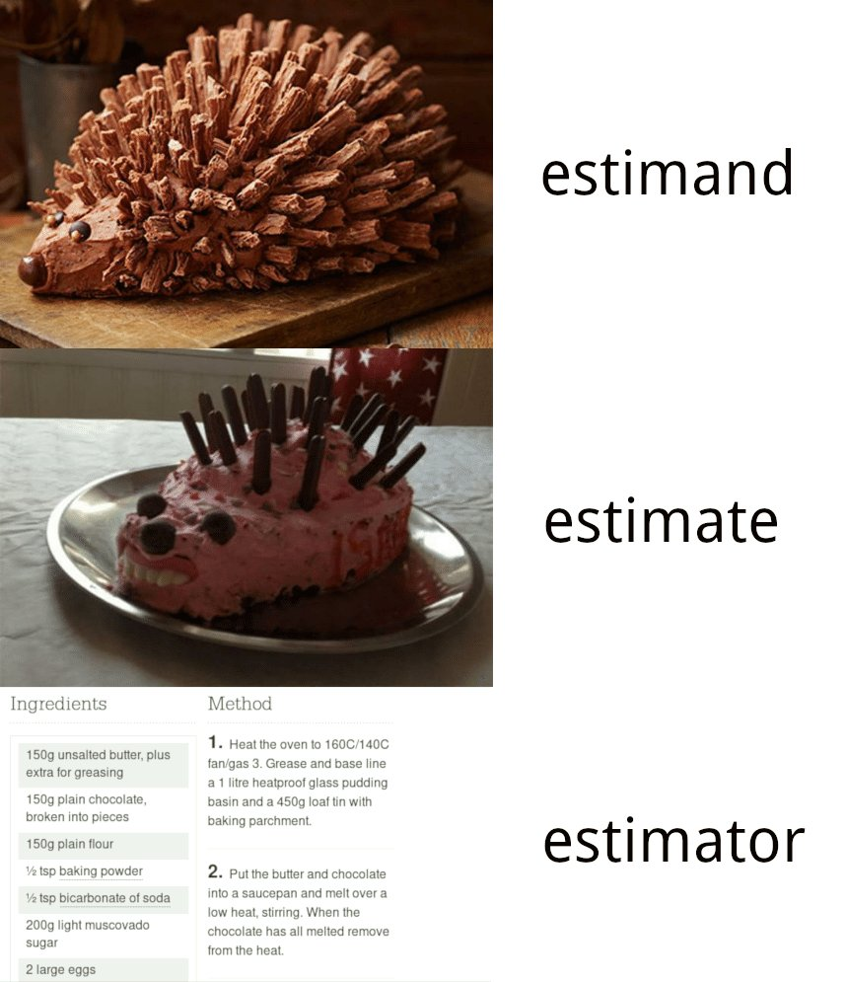
Step 2: Define an Estimand of interest
https://livefreeordichotomize.com/2019/01/17/understanding-propensity-score-weighting/

Slide 23
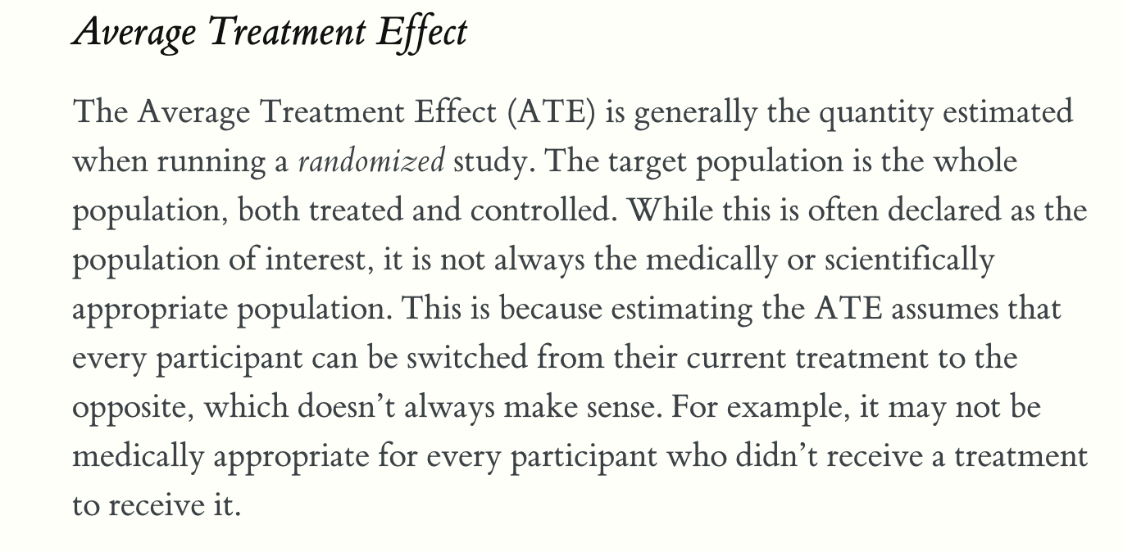
https://livefreeordichotomize.com/2019/01/17/understanding-propensity-score-weighting/

Slide 24
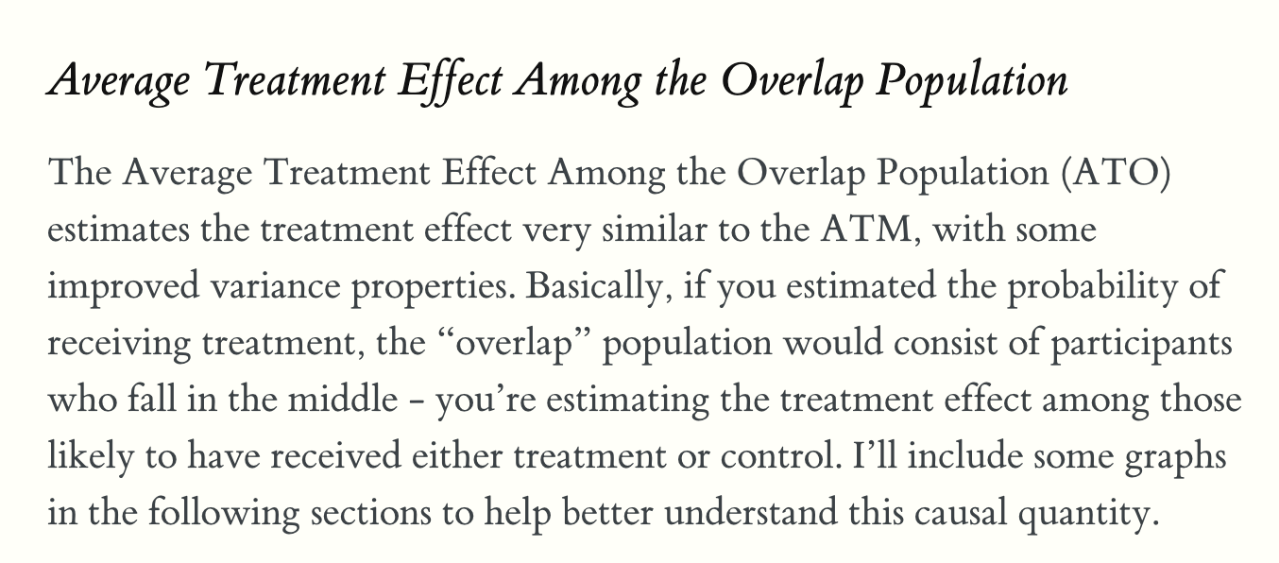
https://livefreeordichotomize.com/2019/01/17/understanding-propensity-score-weighting/

Slide 25
Step 3: Select and estimator & compute an estimate!
Several common estimators use propensity scoring
Approach to compute propensity scores (very high level):
Identify your treatment
Identify all confounding variables (informed by structure of your PGM)
Build a model to predict whether or not someone was treated from the confounders
Then you might:
Match on propensity scores
Weight based on propensity scores

Slide 26
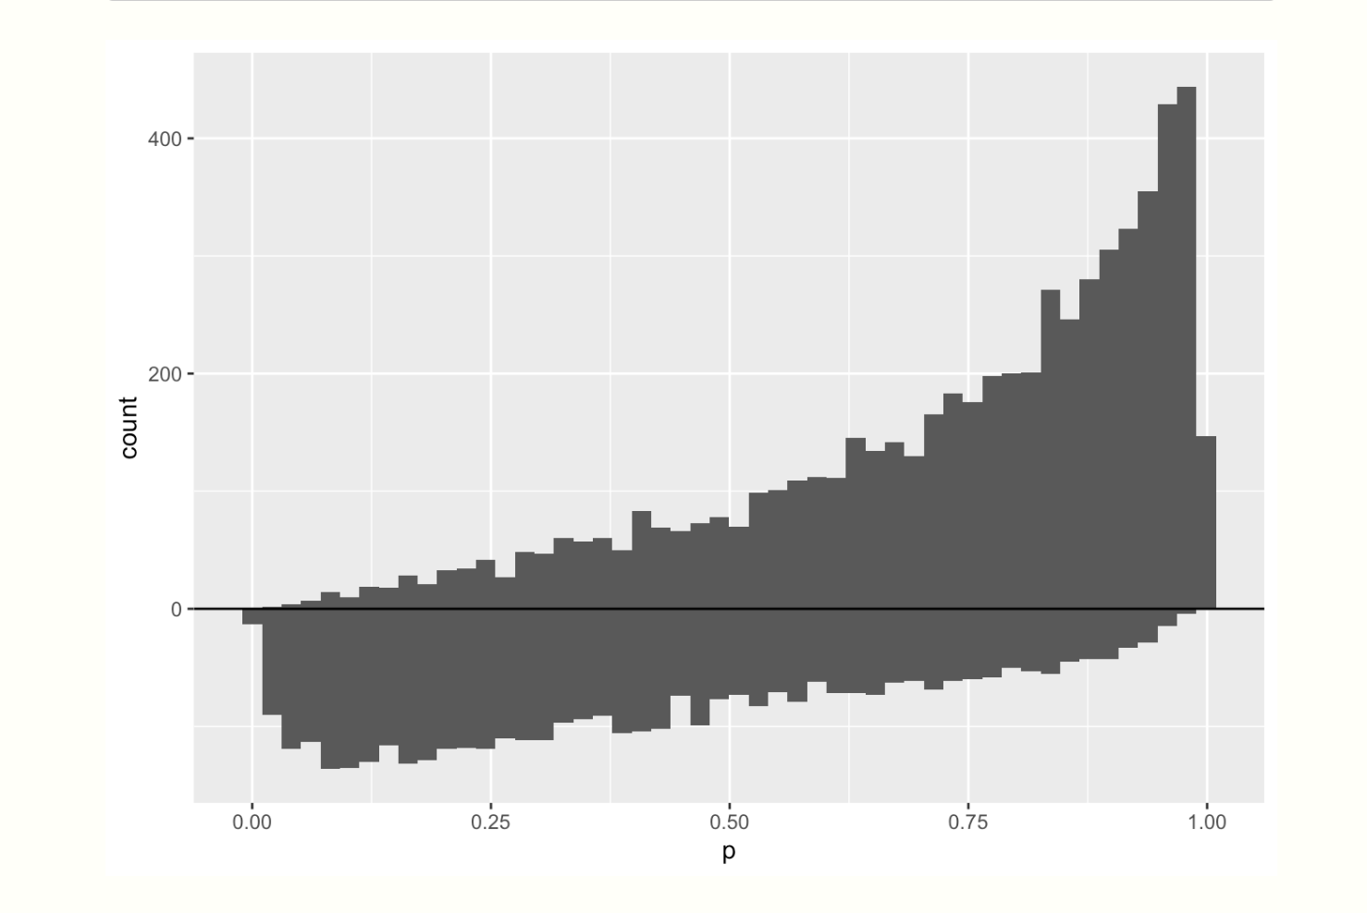
Example estimand/estimators using propensity scores
https://livefreeordichotomize.com/posts/2019-01-17-understanding-propensity-score-weighting/

Slide 27
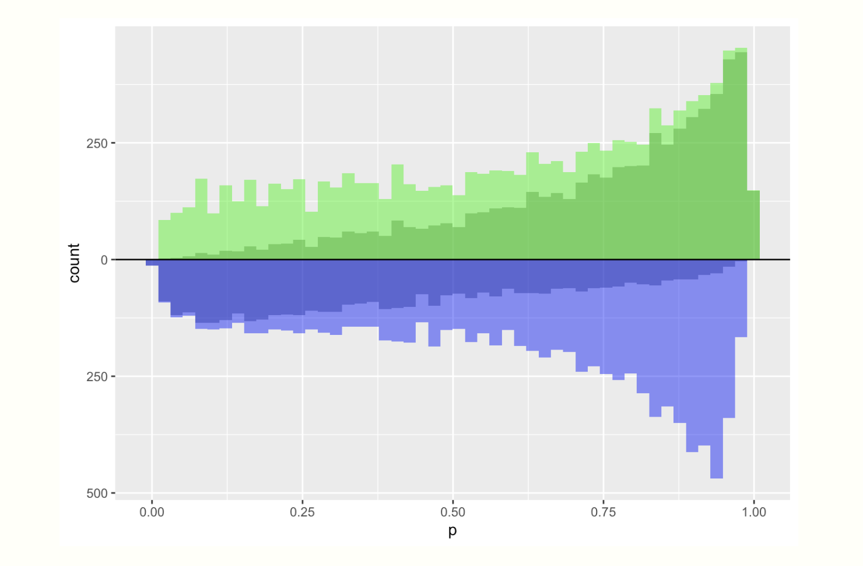
Example estimand/estimators using propensity scores for the ATE
https://livefreeordichotomize.com/posts/2019-01-17-understanding-propensity-score-weighting/

Slide 28
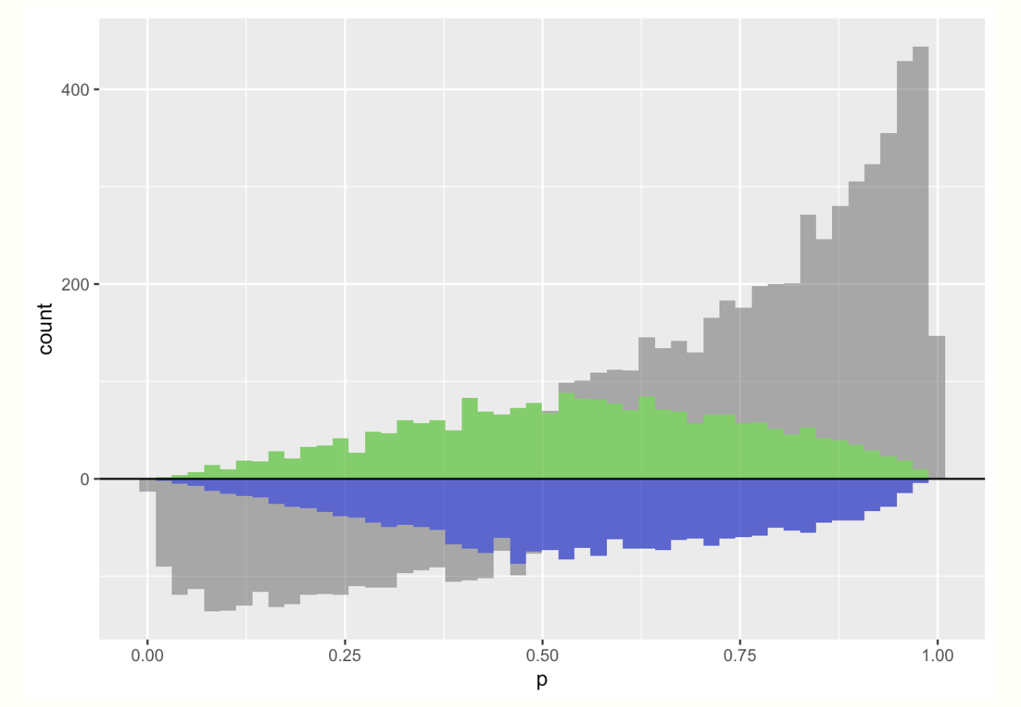
Example estimand/estimators using propensity scores for the ATO
https://livefreeordichotomize.com/posts/2019-01-17-understanding-propensity-score-weighting/

Slide 29
Misc. CI stuff
There are many, many assumptions baked in here!
Other areas of work
Inferring causal structure (e.g. the DAG)
Using ML in various ways (e.g. to do the propensity scoring)
…

Slide 30
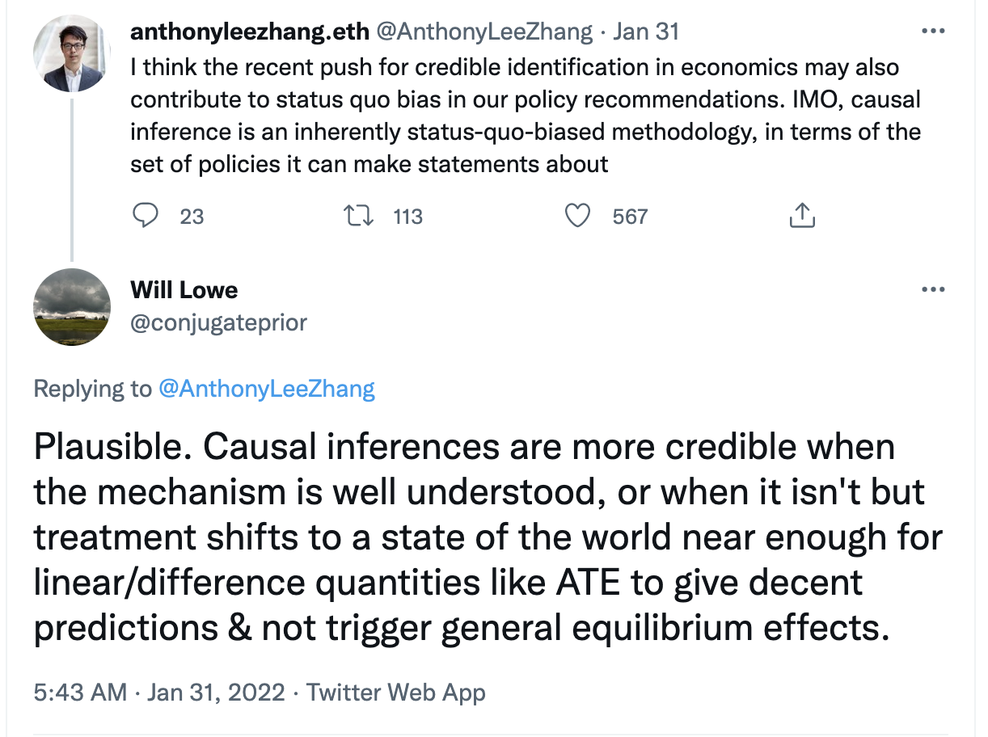
Beyond Causal Inference (to where?)

Slide 31
An example
https://colab.research.google.com/drive/106f_x1OXA6qeMFxd0EYhSQGP6dkSLk79?usp=sharing

Slide 32
Where’s the ML in this?

