Slide 1
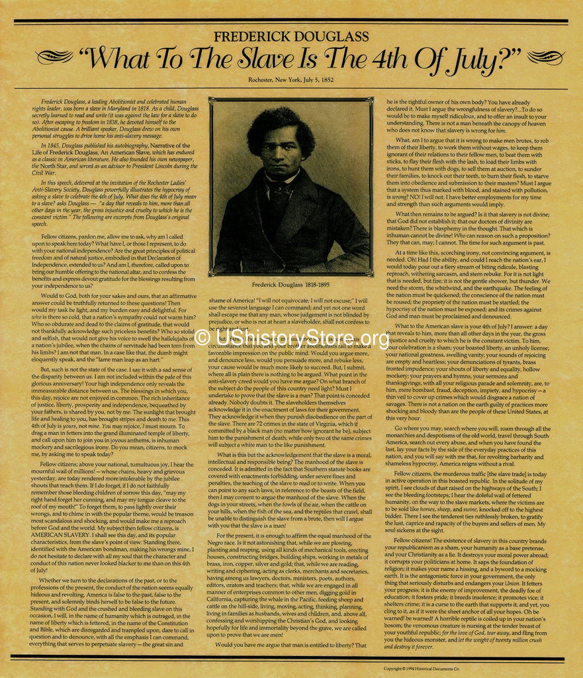
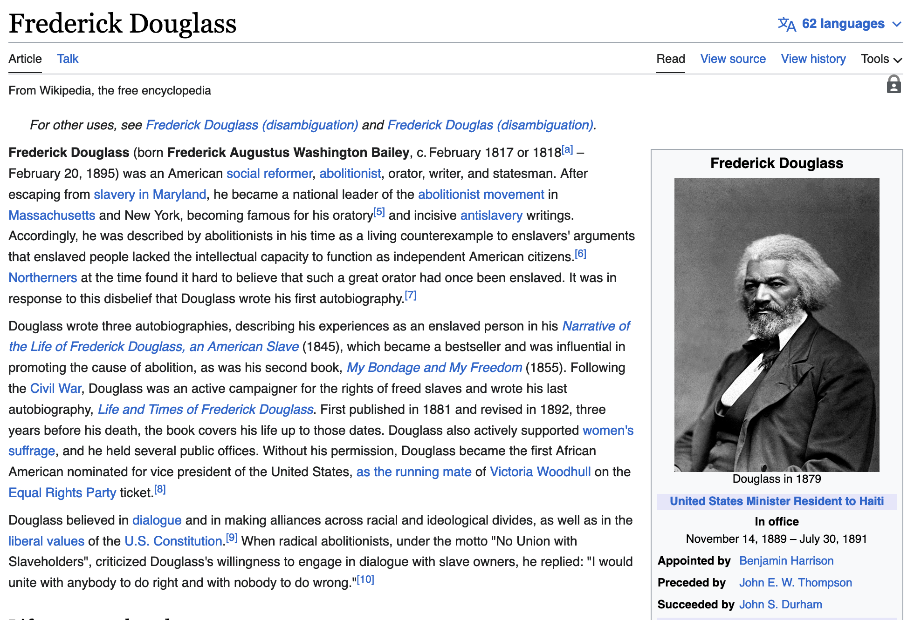
Pass phrase for today: Frederick Douglass

Slide 2
Abolition is the only way to completely dismantle white supremacy

