Slide 1
White Supremacy and the Sociotechnical System of Child Welfare

Slide 2

How foster care affected me and my outlooks
Christina Viera

Slide 3
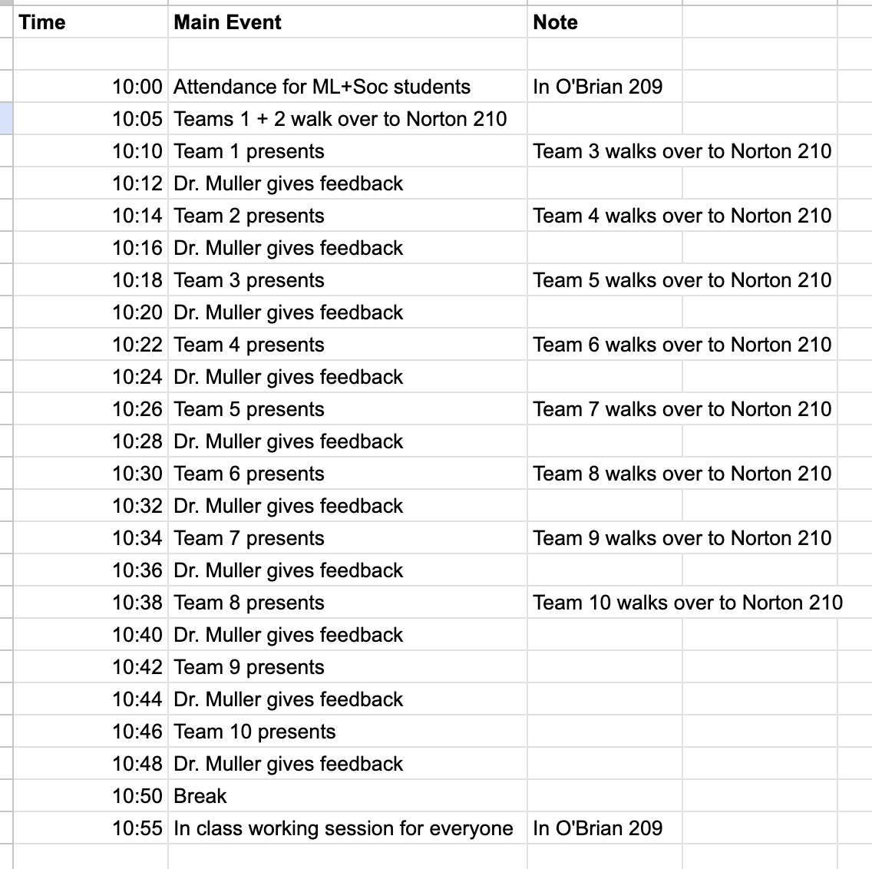
Wednesday

Slide 4
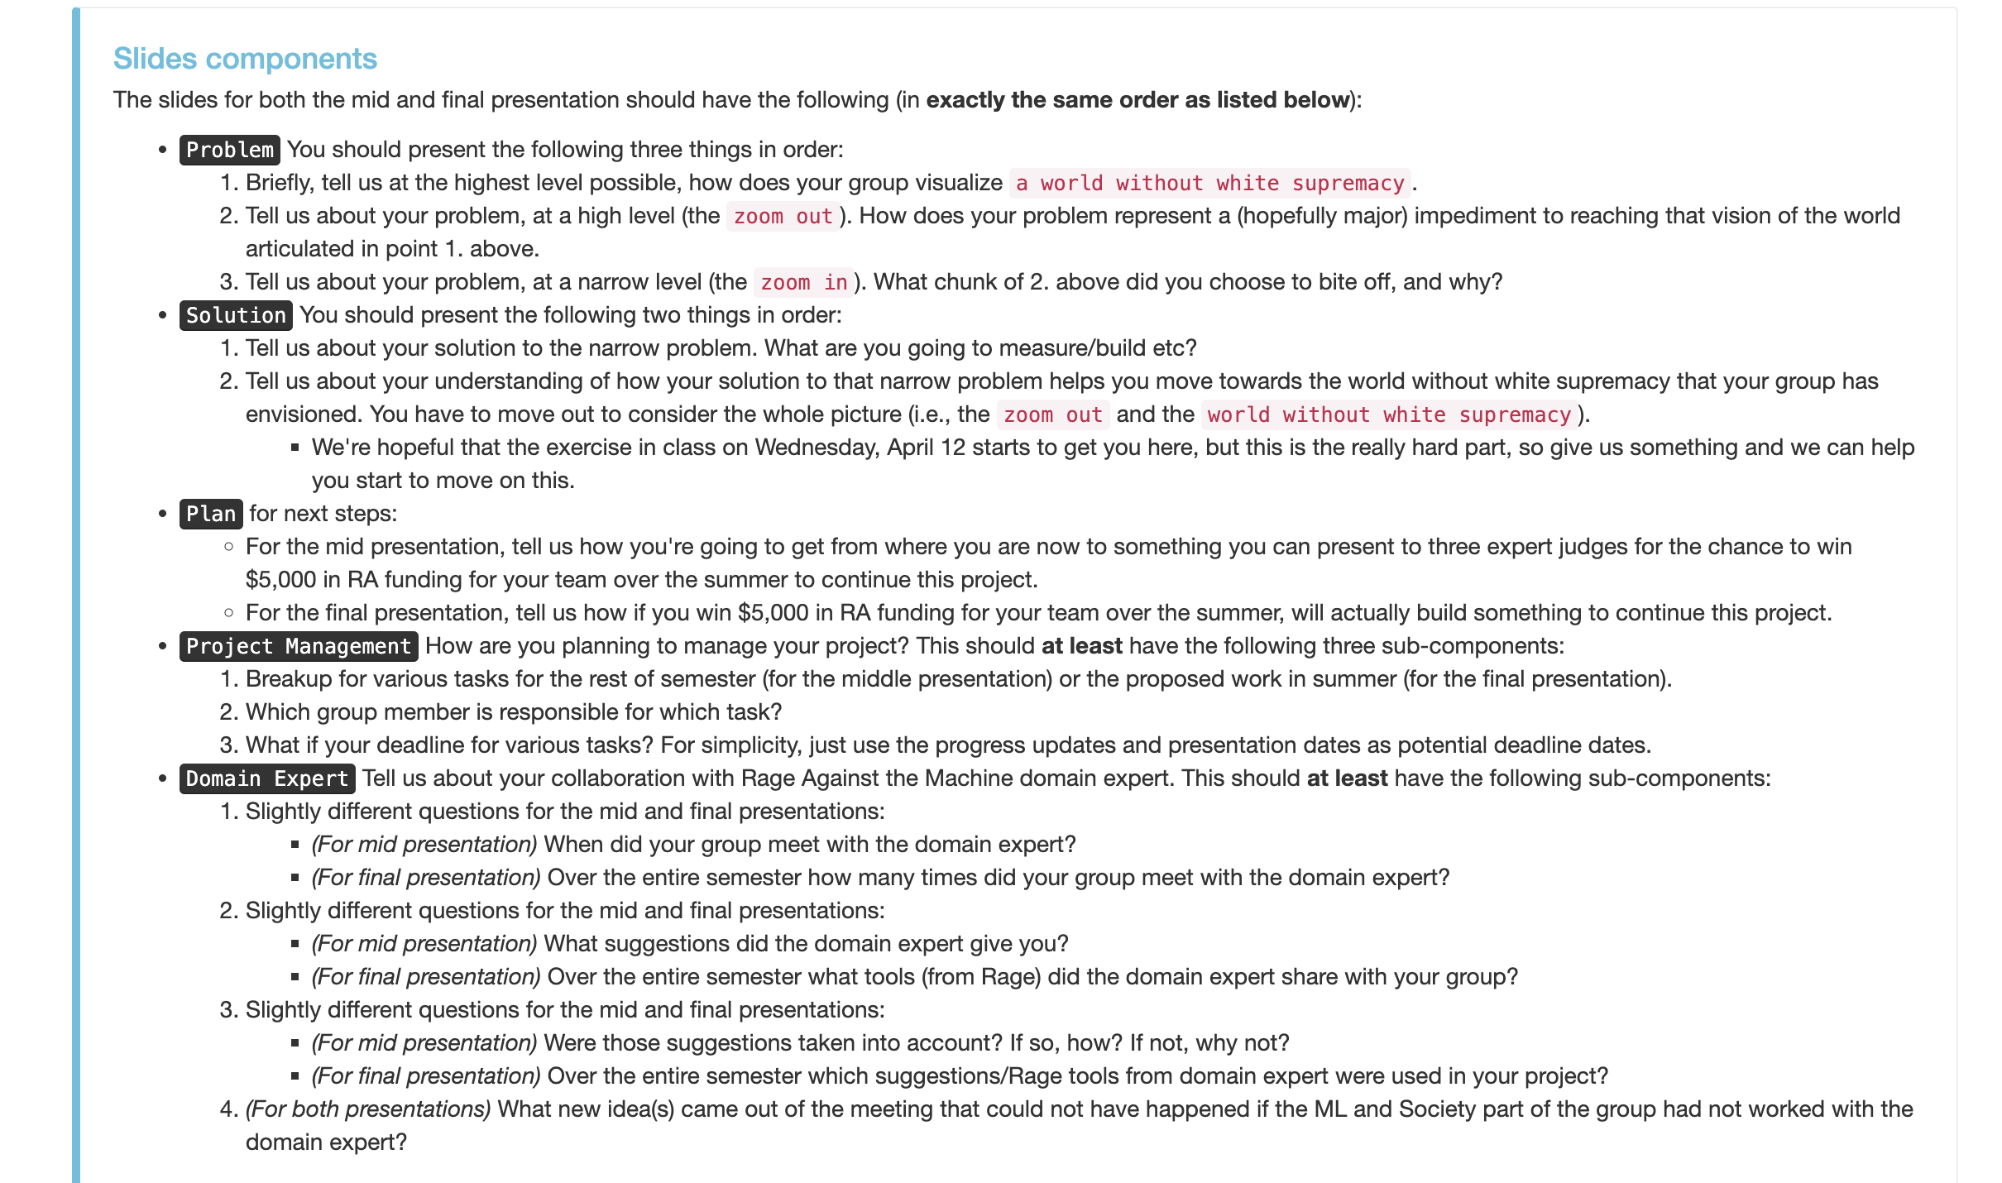
Friday and Sunday

Slide 5
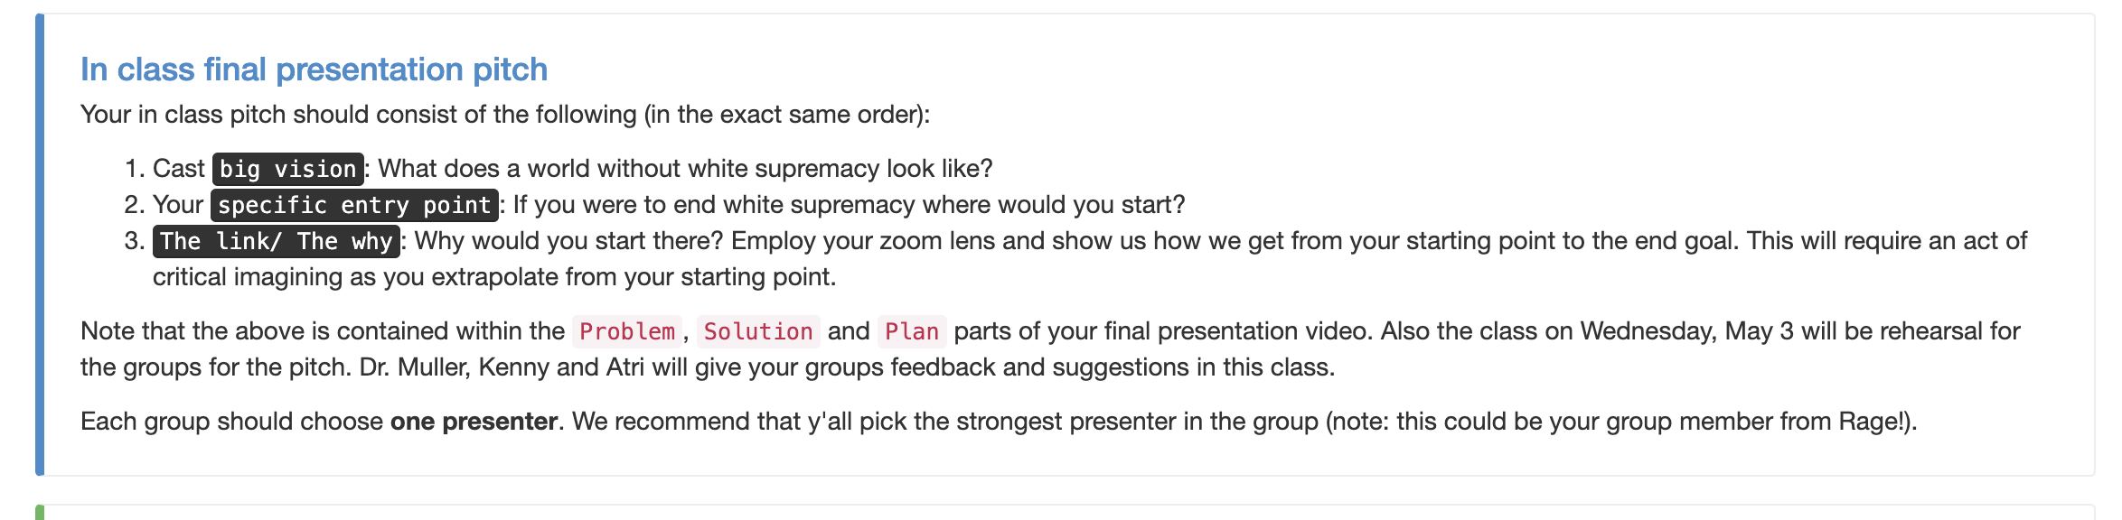
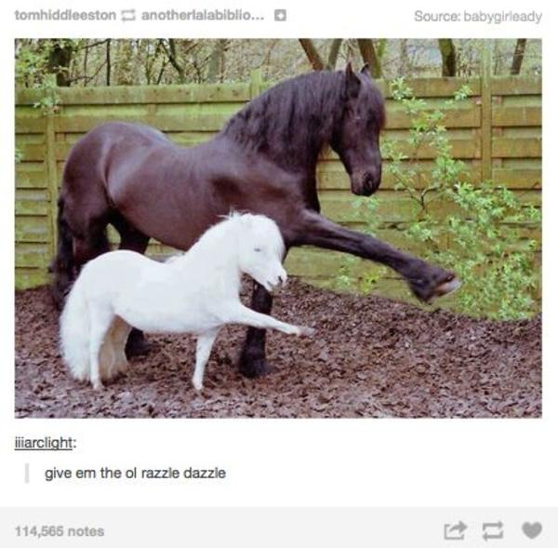
Monday

Slide 6
What is child welfare?

Slide 7
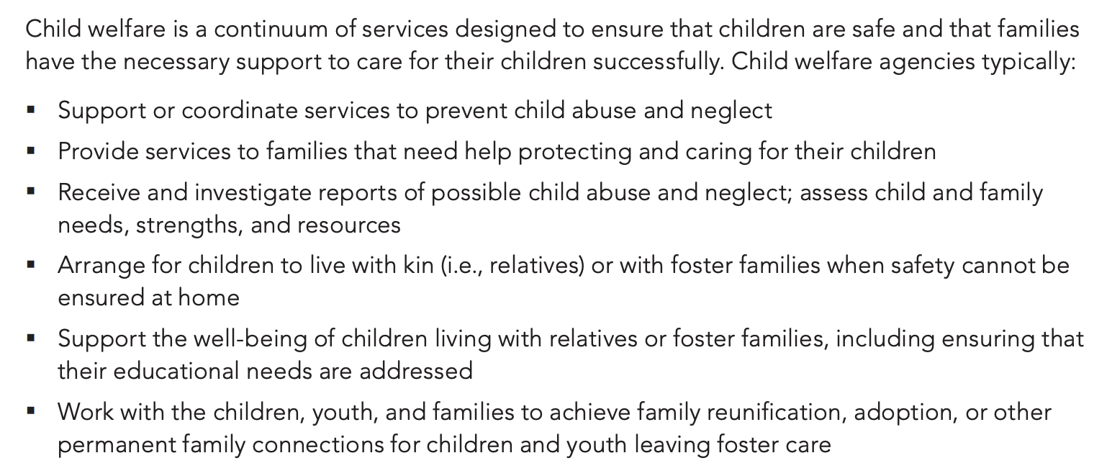
https://www.childwelfare.gov/pubpdfs/cw_educators.pdf

Slide 8
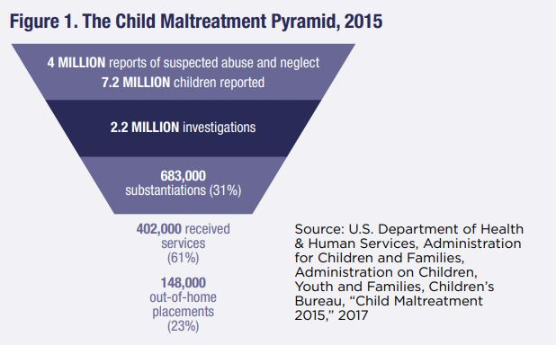

Slide 9
What is it like to be in the child welfare system?

Slide 10
Questions/discussion/break

Slide 11
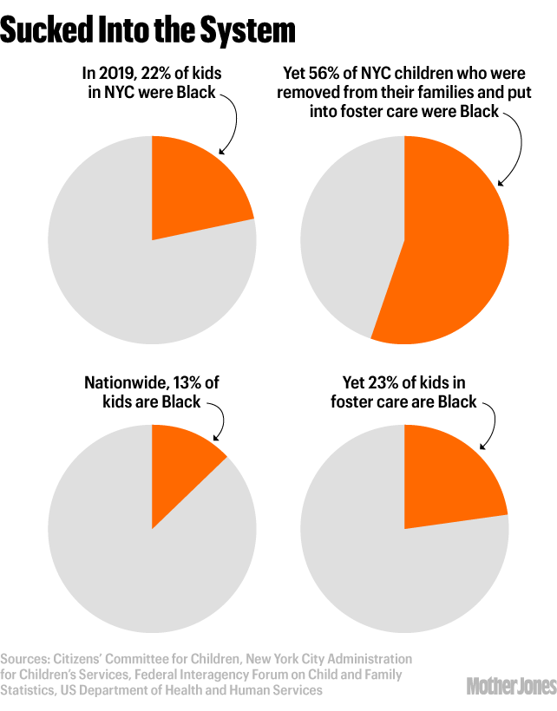
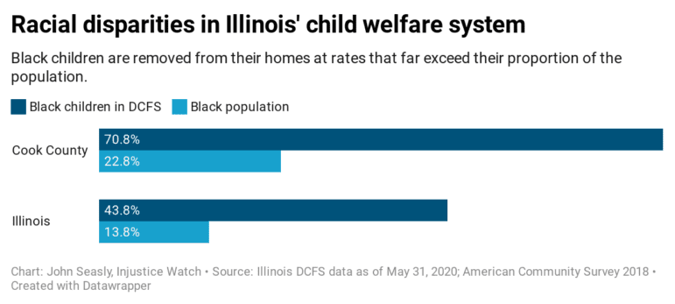
Where’s the white supremacy part?

Slide 12
Why are Black families over-represented?
Two possible reasons
Need/Risk (Black parents have less money to support children)
Discrimination/Bias (Black families are over-policed within Child Welfare)

Slide 13
Why are Black youth over-represented?
Two possible reasons
Need/Risk (Black parents have less money to support children)
Discrimination/Bias (Black families are over-policed within Child Welfare)

Slide 14
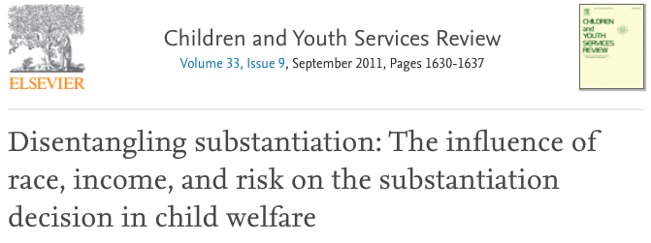
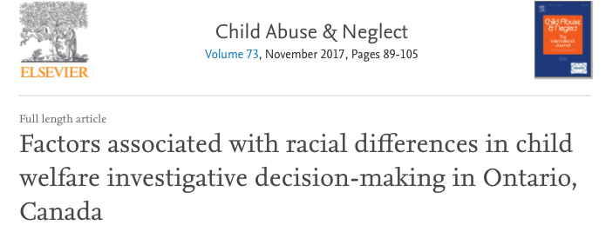
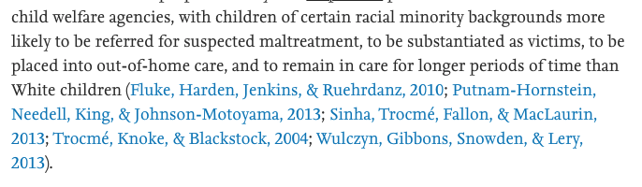
“when also controlling for caseworker perceptions of risk, race emerges as the stronger explanatory factor."

Slide 15
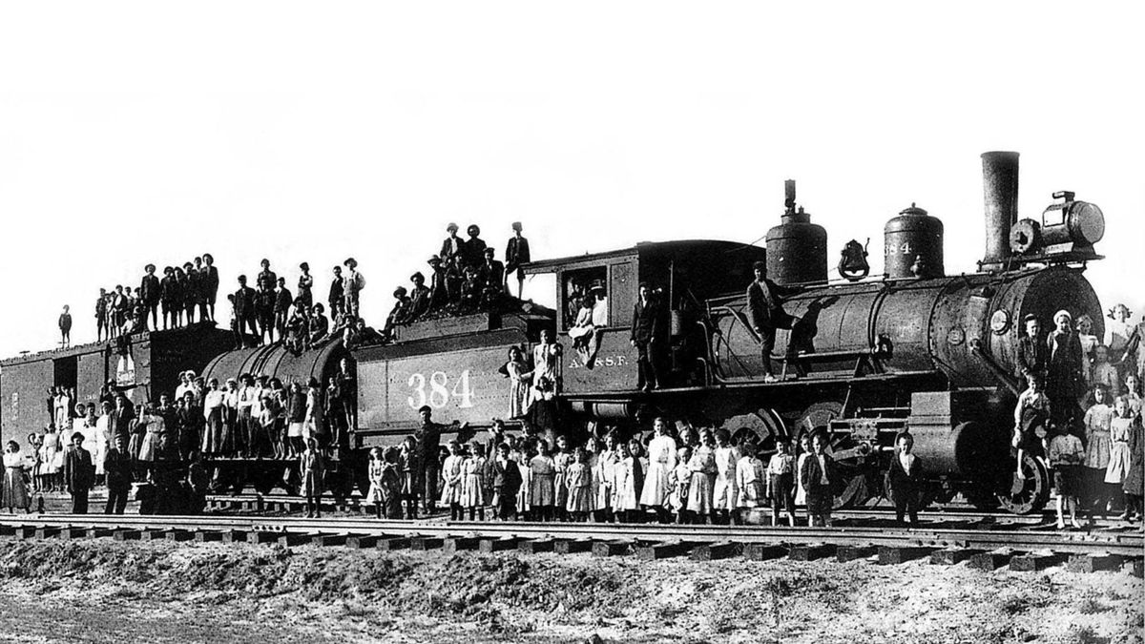

Slide 16

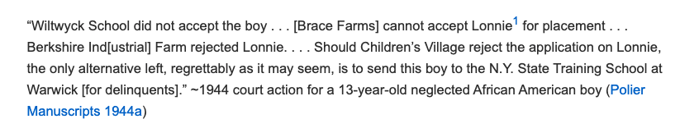
https://journals.sagepub.com/doi/full/10.1177/0003122420911062

Slide 17
Why are Black families over-represented?
Two possible reasons
Need/Risk (Black parents have less money to support children)
Discrimination/Bias (Black families are over-policed within Child Welfare)

Slide 18
What might we do?

Slide 19







If substantiated, the youth is taken into care
Youth are reported to CPS
The call is screen in (or not)
If screened in, the call is investigated. The investigation can result in substantiation (or not)
The youth’s case is then periodically reinvestigated
https://www.childwelfare.gov/pubpdfs/cpswork.pdf

Slide 20
What might we do?
If substantiated, the youth is taken into care
Youth are reported to CPS
The call is screen in (or not)
If screened in, the call is investigated. The investigation can result in substantiation (or not)
The youth’s case is then periodically reinvestigated
https://www.childwelfare.gov/pubpdfs/cpswork.pdf

Slide 21

What might we do?
If substantiated, the youth is taken into care
Youth are reported to CPS
The call is screen in (or not)
If screened in, the call is investigated. The investigation can result in substantiation (or not)
The youth’s case is then periodically reinvestigated
https://www.childwelfare.gov/pubpdfs/cpswork.pdf

Slide 22
General idea
Try to predict outcomes from substantiation phase, not screening phase
  Idea: Probably more accurate, less biased
What is our target variable in this case?

Slide 23
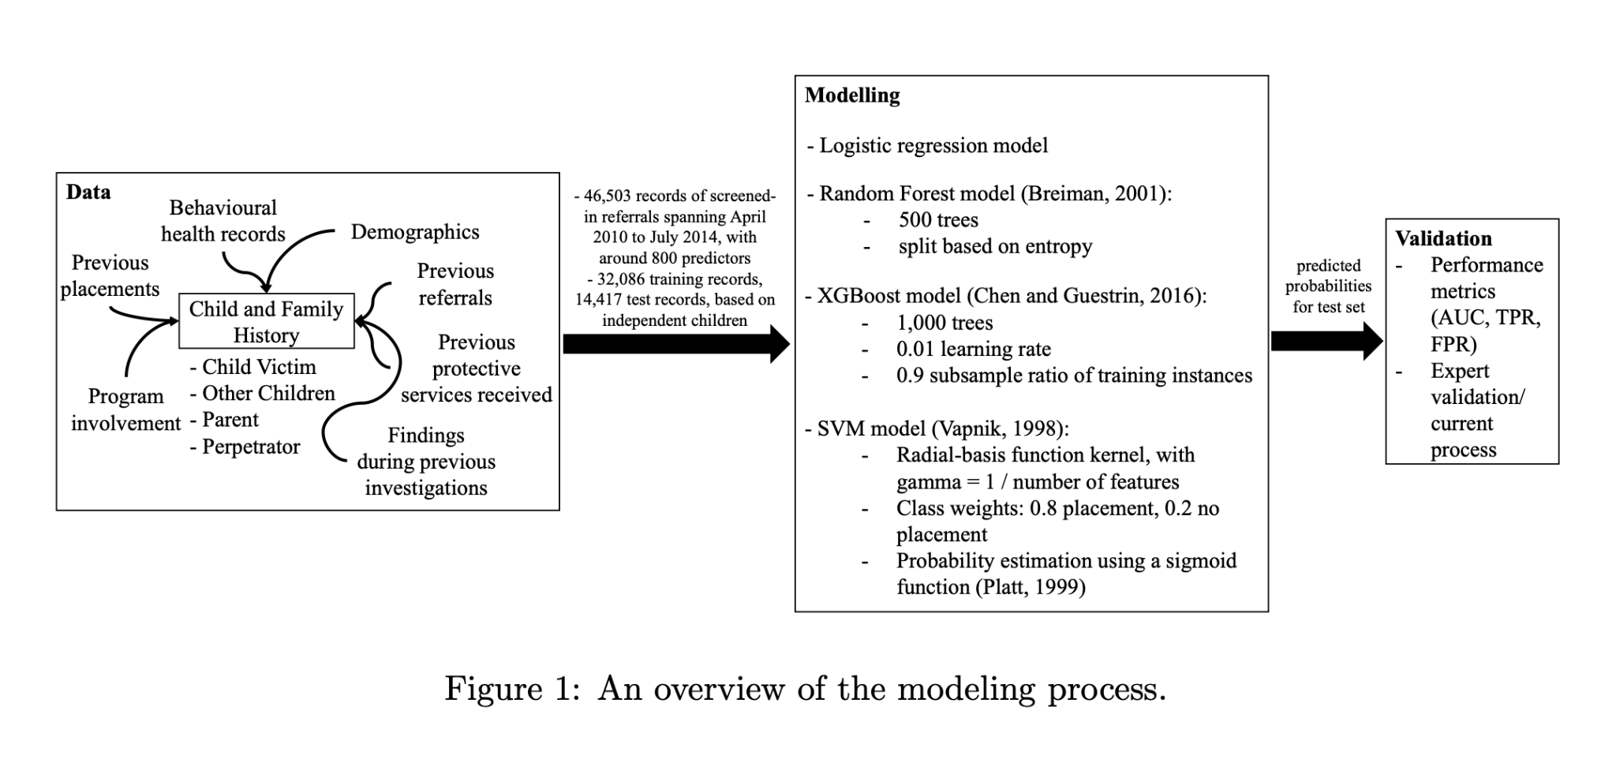

Slide 24
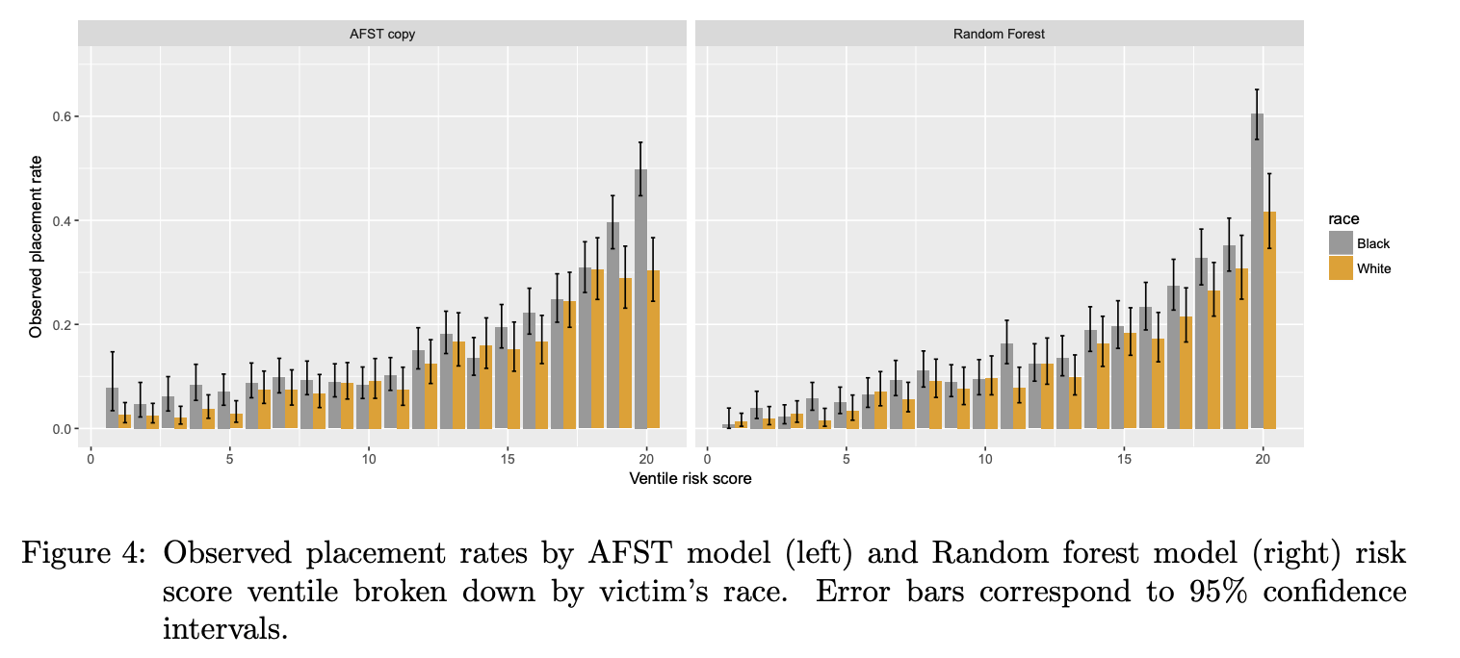
What Percentage of these youth were taken into care?
What “risk score” did the algorithm give these youth?
Notes:
Screened-in referrals that score a 20 on the AFST ventile scale are observed to result in placement in 50% of cases involving Black children and only 30% of cases involving White children. That is, at the highest ventile, the model appears to overestimate risk for White children compared to Black children. Put differently, a White child who scores 20 on the AFST has comparable placement risk to a Black child who scores 18.

Slide 25
Erm, what else might we do?

Slide 26



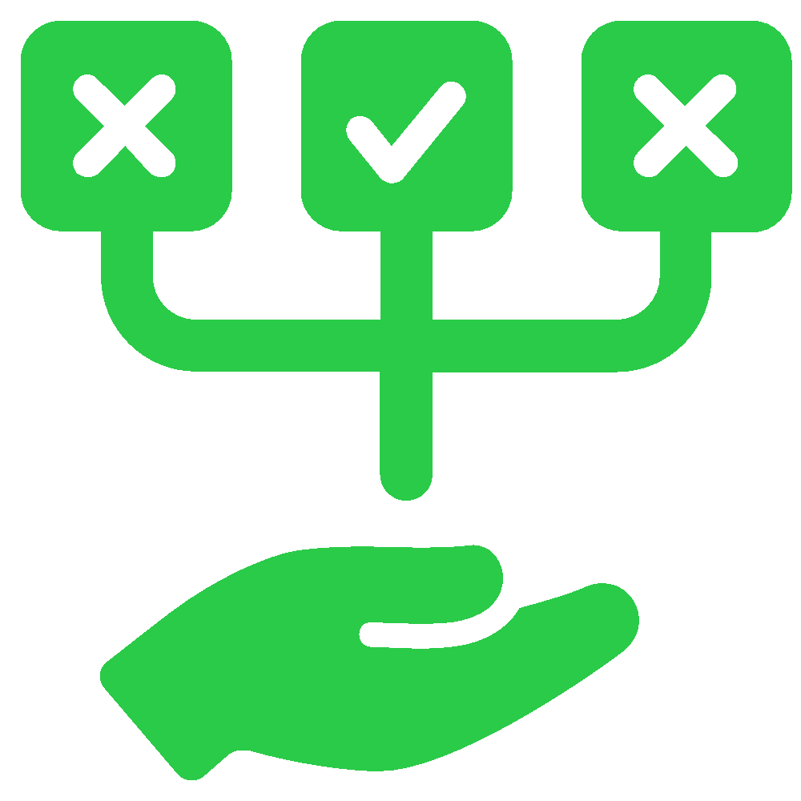

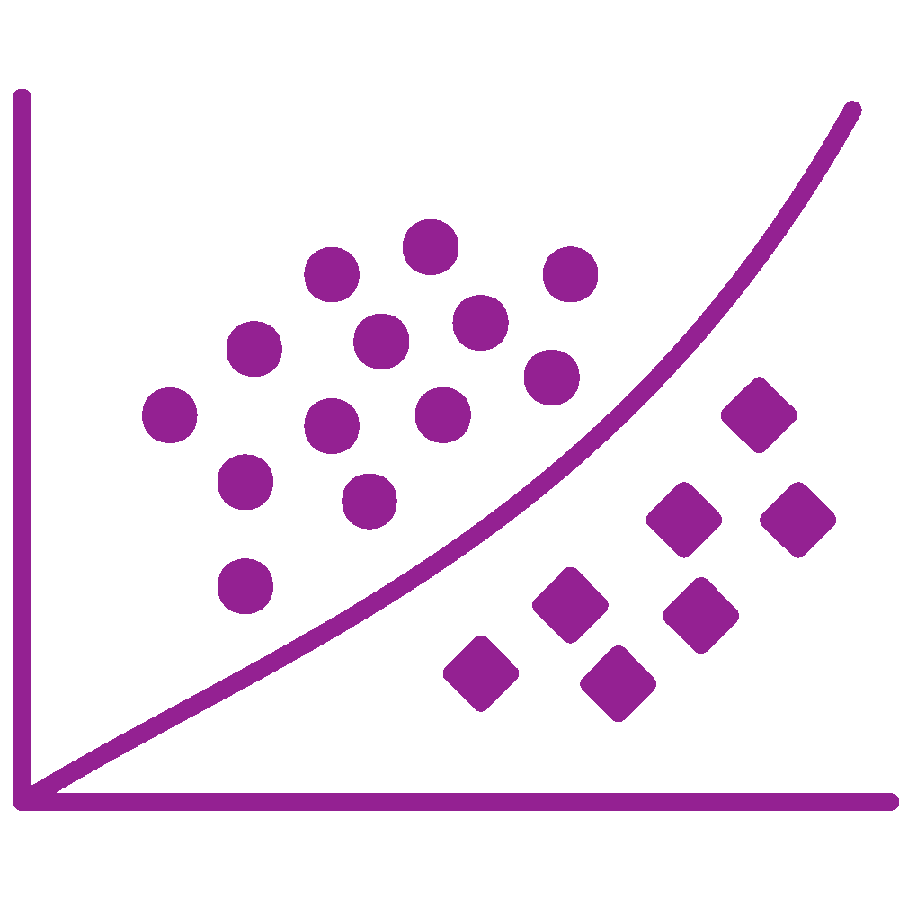
Entities within sociotechnical systems store, produce and transmit biases…
… that lead to (biased) data and optimization criteria for algorithms…
Systems
… that make (unfair) decisions…
Training & Test Data
Cognition
Optimization Criteria
… that then feedback into the original sources
Decisions on Services
Institutions

Slide 27
Original data
Model of sociotechnical system generating data
Simulation to identify bias reduction interventions
Debiased dataset
Budget constraints
Objective 1
Identify biases in training data and ways to reduce them, create unbiased (or less biased) dataset
Domain experts
Domain experts
Model for selecting fairness annotations
Fairness annotations (as pairwise rankings)
Objective 3
Service recommendation (as a ranking task) under fairness, budget constraints
Objective 2
Efficiently obtain fairness annotations from multiple stakeholders

Slide 28
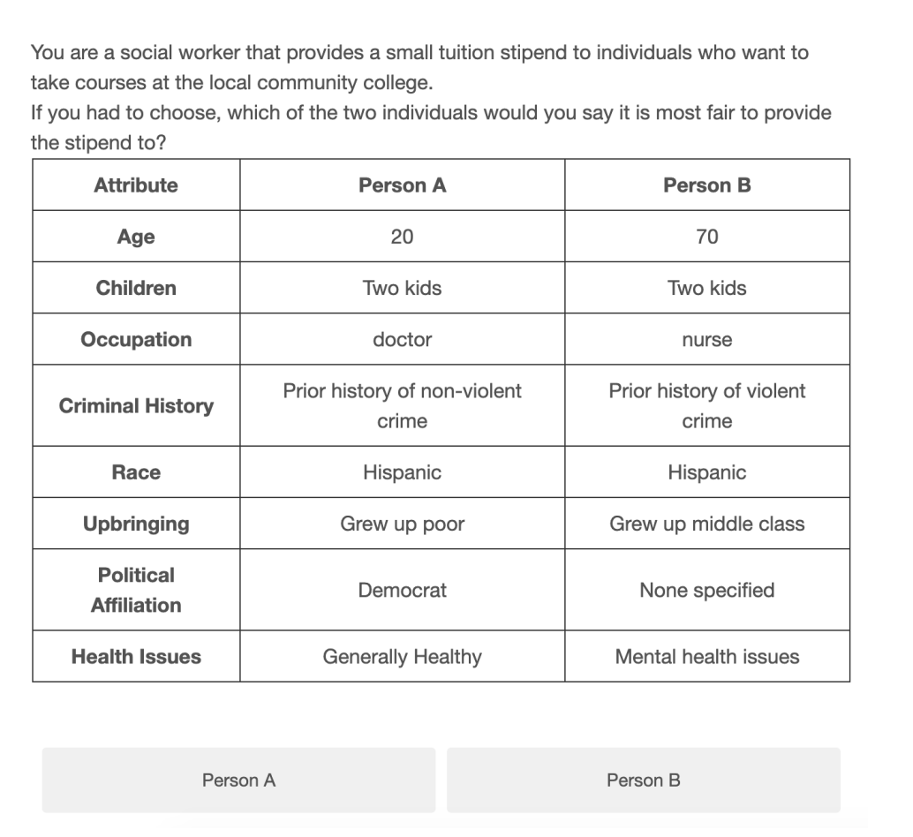
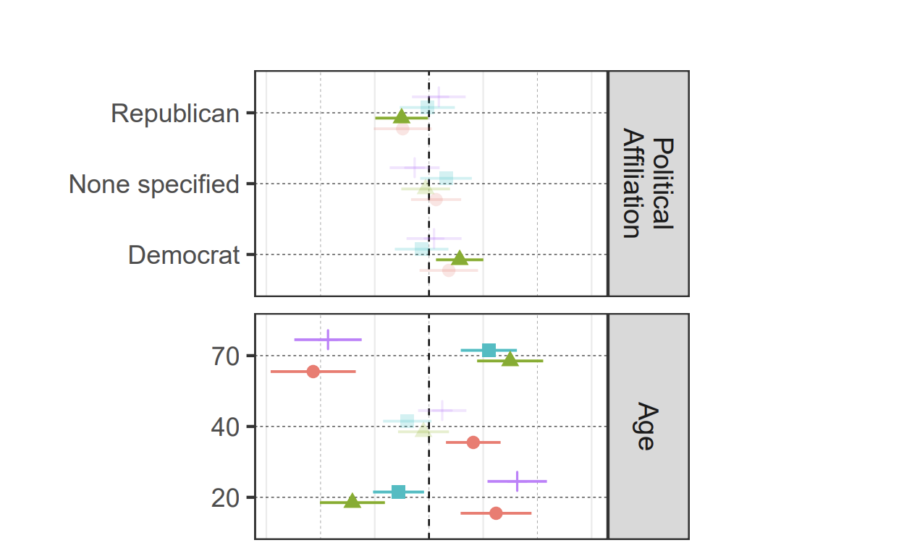

Slide 29
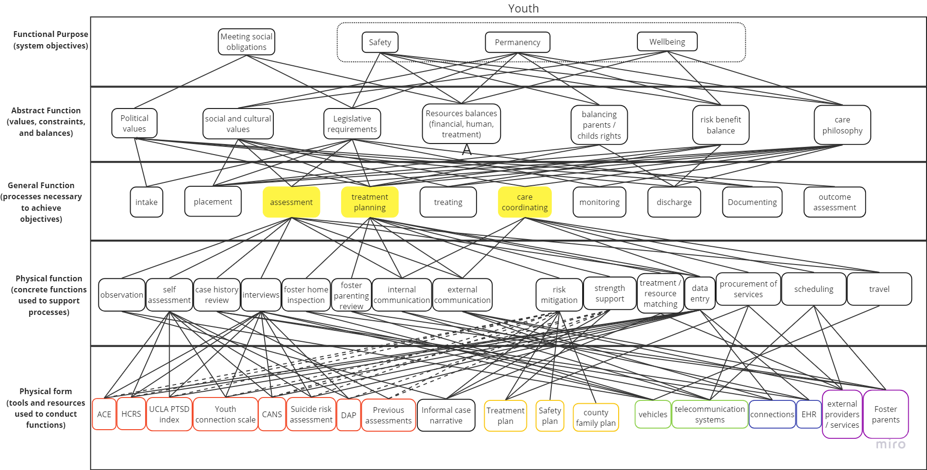

Slide 30
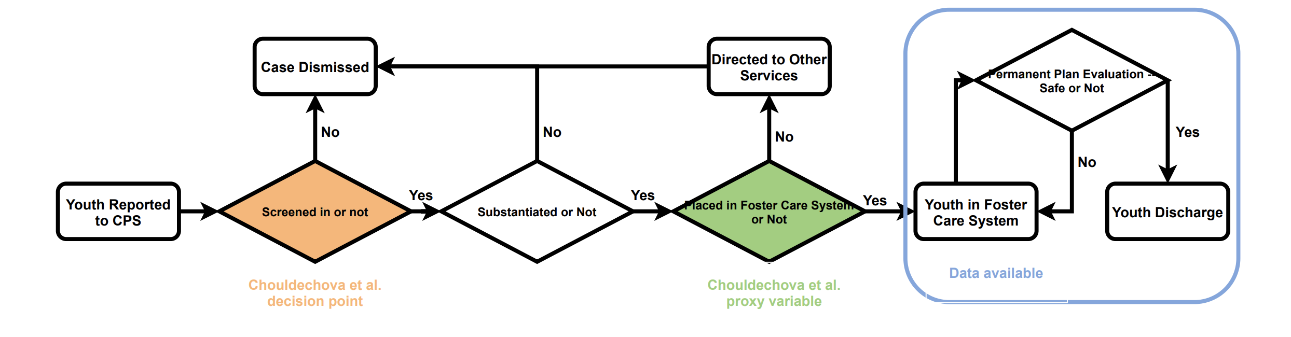
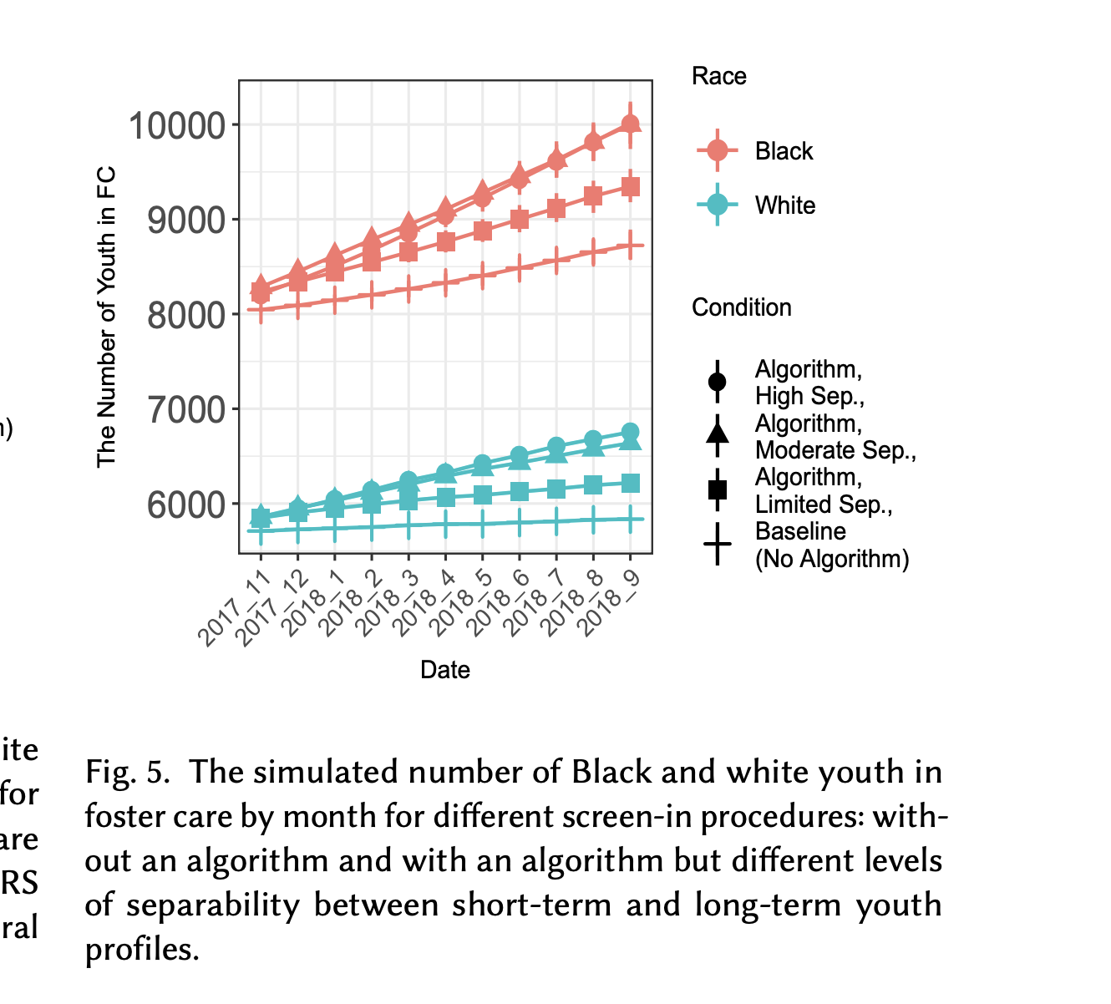

Slide 32
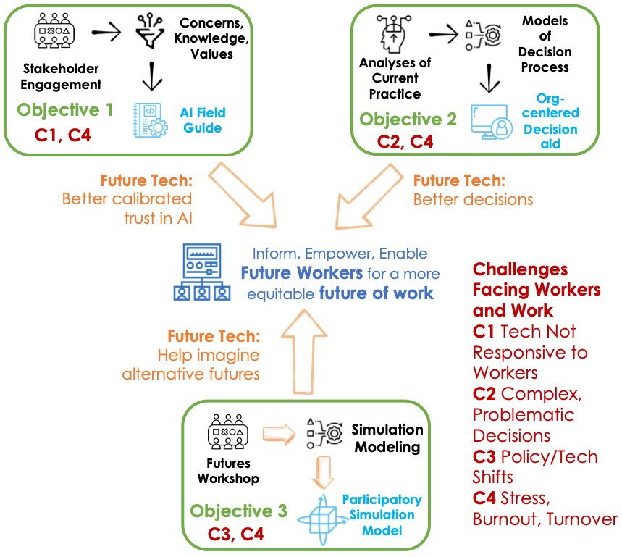

Slide 33
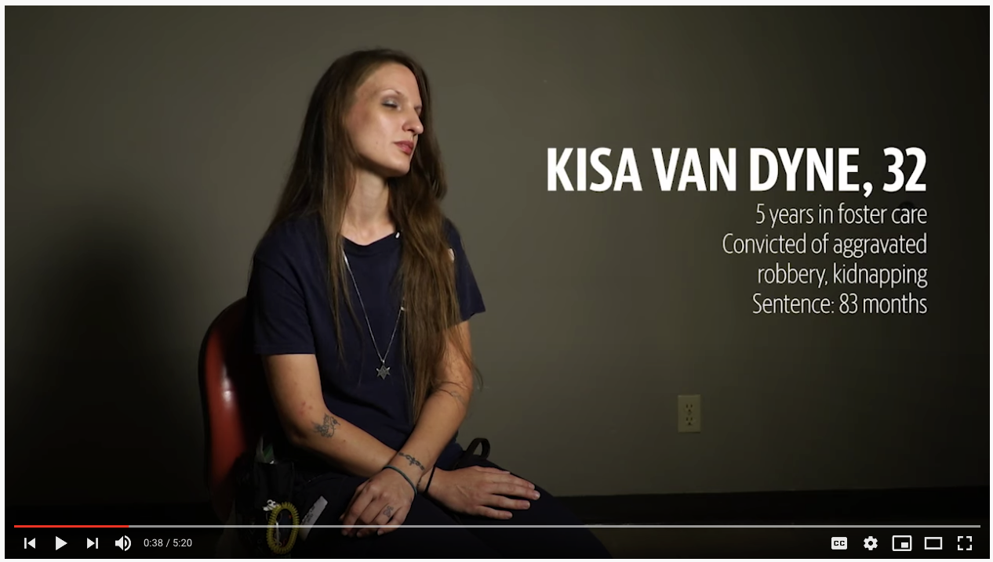

Slide 34
Do you blame these people? Why (not)?

Slide 35
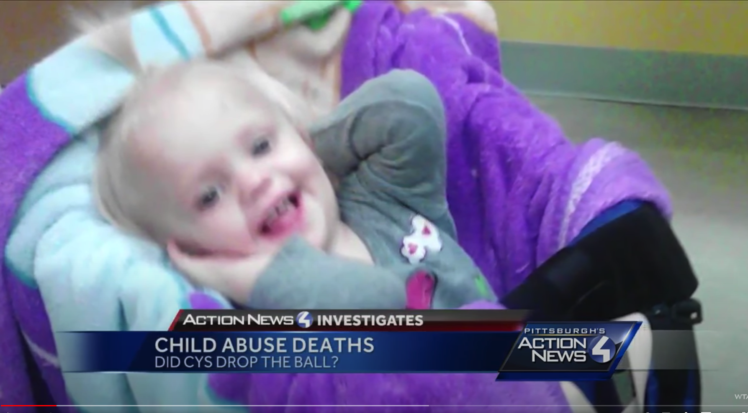

Slide 36
Who do you blame? Why?
The girl?
The dad?
The uncle?
The case worker?
The county supervisor?
The state supervisor?
The drug companies?
The state budget committee?
The US government?
…

