Slide 1
White Supremacy and the Sociotechnical System of Child Welfare

Slide 2
I have no questions on deadlines

Slide 3
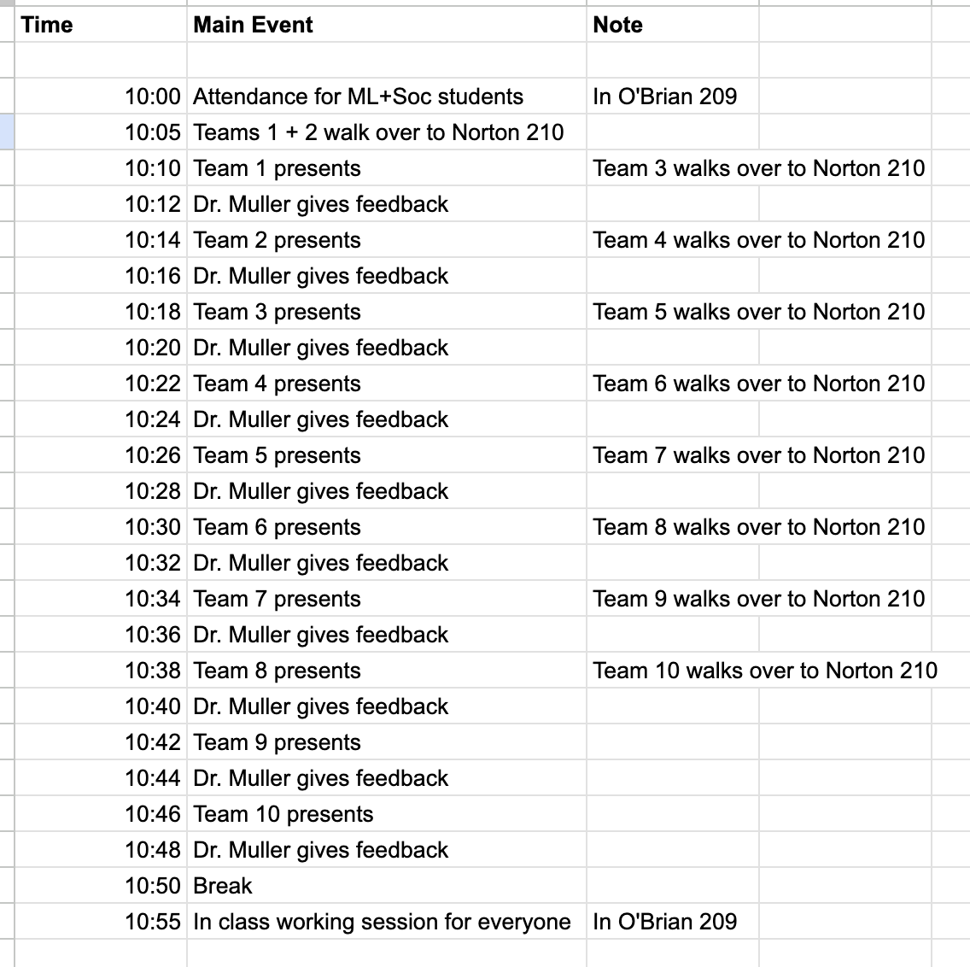

Slide 4
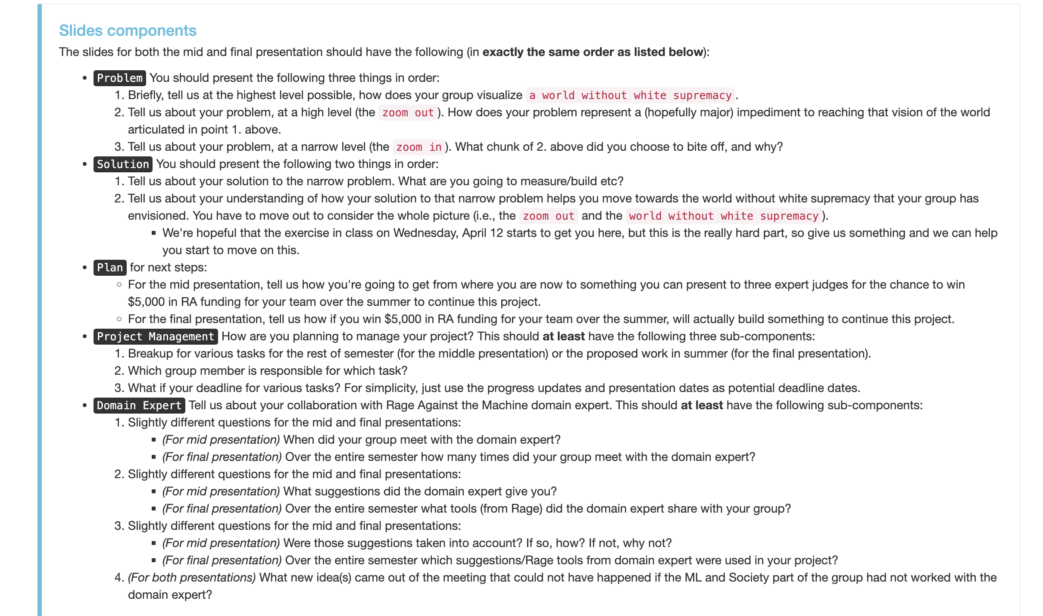
Friday and Sunday

Slide 5
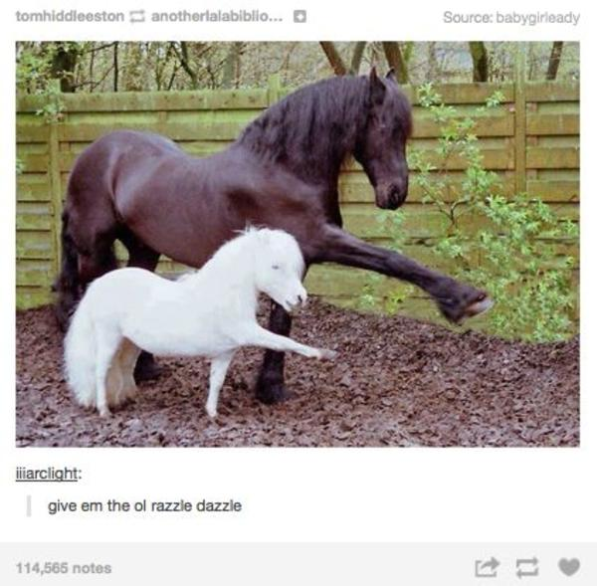
Monday

