Slide 2
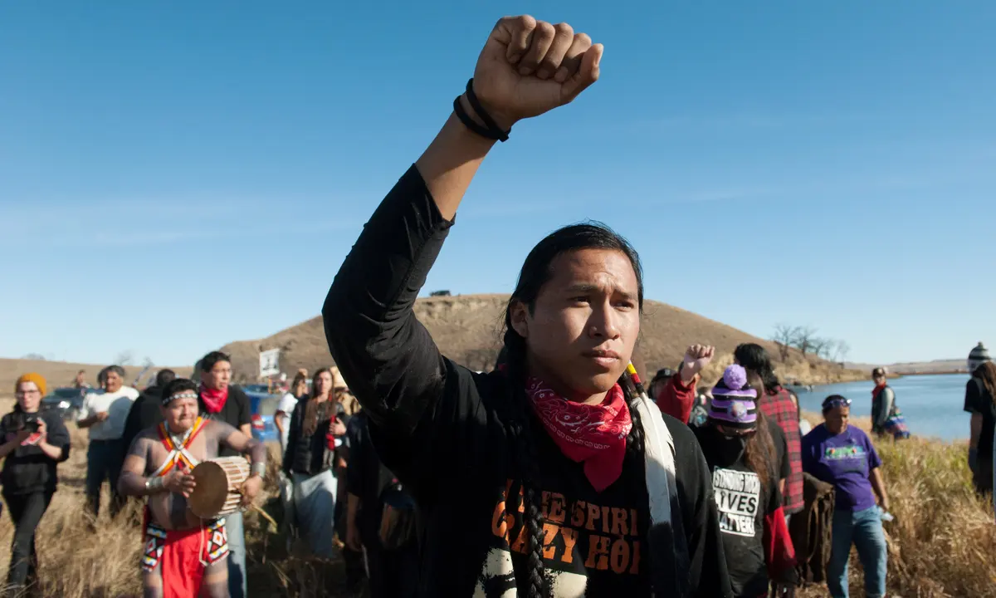
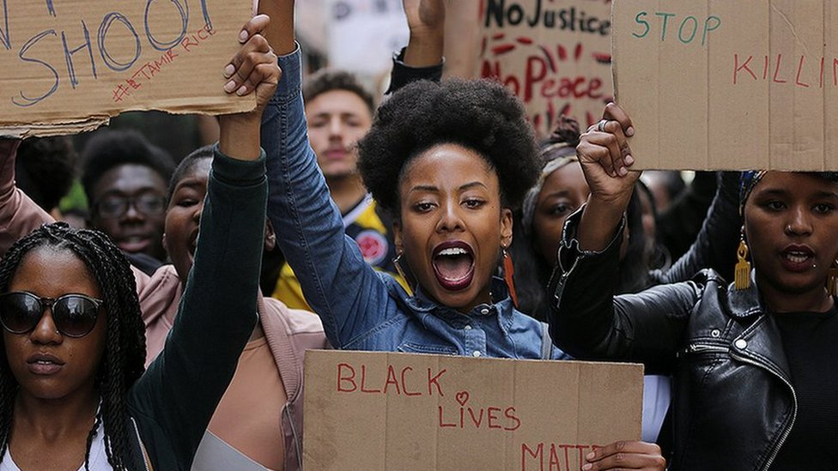
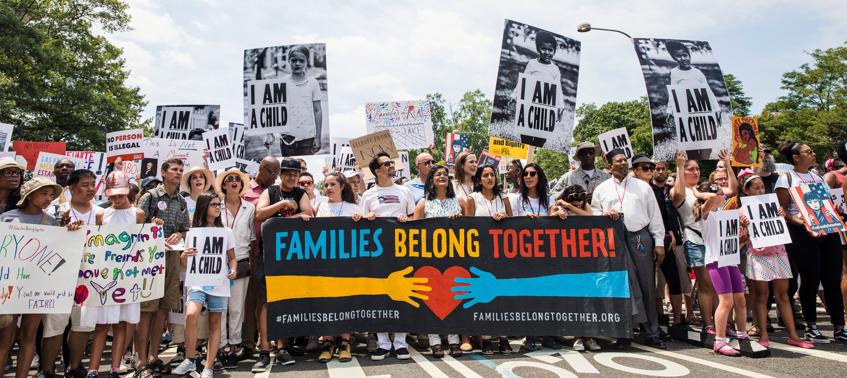
Acknowledge
And commit

Slide 3
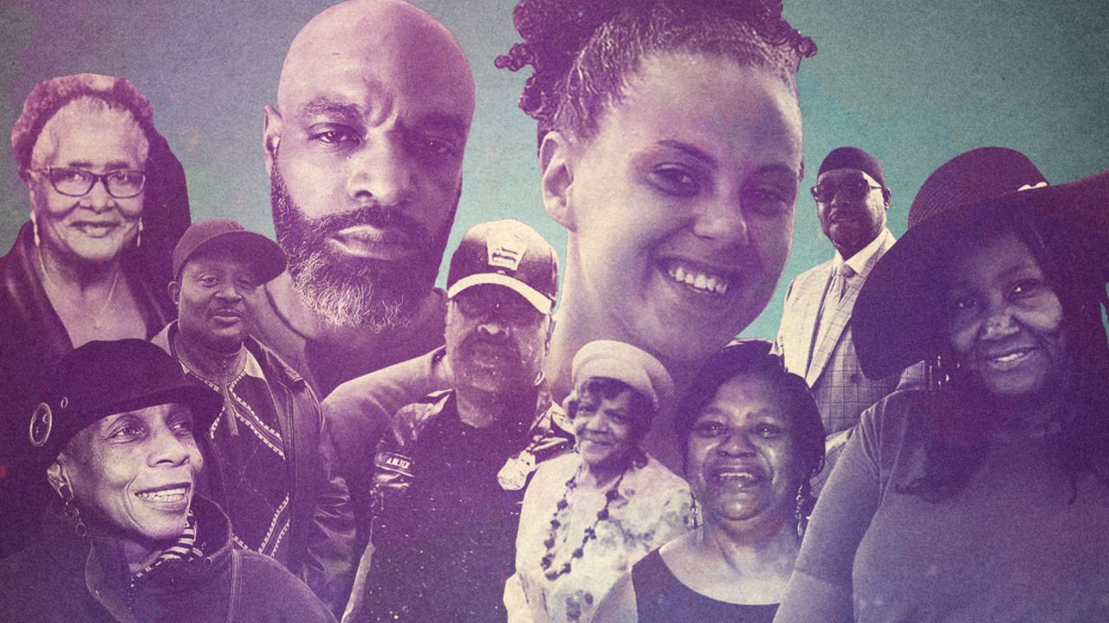
Notes:
• Roberta A. Drury, 32, of Buffalo
• Margus D. Morrison, 52, of Buffalo
• Andre Mackniel, 53, of Auburn, New York
• Aaron Salter, 55, of Lockport, New York
• Geraldine Talley, 62, of Buffalo
• Celestine Chaney, 65, of Buffalo
• Heyward Patterson, 67, of Buffalo
• Katherine Massey, 72, of Buffalo
• Pearl Young, 77, of Buffalo
• Ruth Whitfield, 86, of Buffalo
• Zaire Goodman, 20, of Buffalo, was treated and released from hospital
• Jennifer Warrington, 50, of Tonawanda, New York, was treated and released from hospital
• Christopher Braden, 55, of Lackawanna, New York, had non-life-threatening injuries

Slide 4
Why the Impossible?
The impossible interests me because everything possible has been done and the world didn’t change. -Sun Ra
The impossible is the least that we can demand.
-James Baldwin
You have to act as if it were possible to radically transform the world. And you have to do it all the time.
-Angela Davis
Notes:
Ask for feedback. Black diasporic tradition….offers a rich font of inspiration for building a better world under adversity.

Slide 5
Build True Collaboration
Enhance Collective Unlearning
Nurture Critical Imagining
Discover Purpose Through Justice Work

Slide 6
Rage Against the Machine (HIS)
Machine Learning and Society (CSE)
Impossible
Project

Slide 7
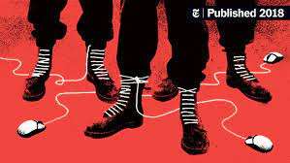
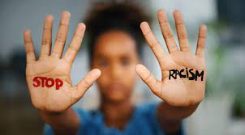
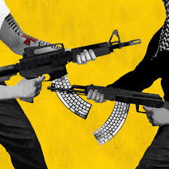
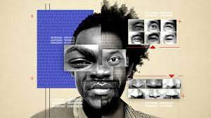
Impossible Project

Slide 8
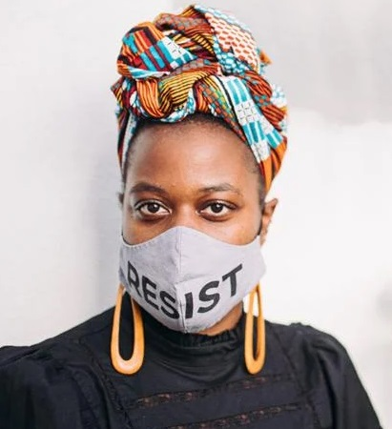
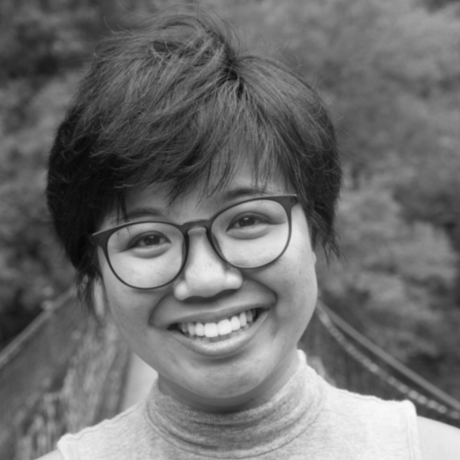
Our Judges

