Slide 1
Discussion 1
Kenneth (Kenny) Joseph
Notes:
I always tell my students that one of the worst things you can do is to start your talk with an apology, but that is precisely what I’m going to do today.
Covid has been slowly trickling through my family for the last two weeks or so, so there are some threads in this talk that are not as cleanly tied together as I would have hoped. However, the ideas here are ones that I have thought quite a bit about over the past few years, so hopefully you find something in the next 15 minutes that piques your interest

Slide 2
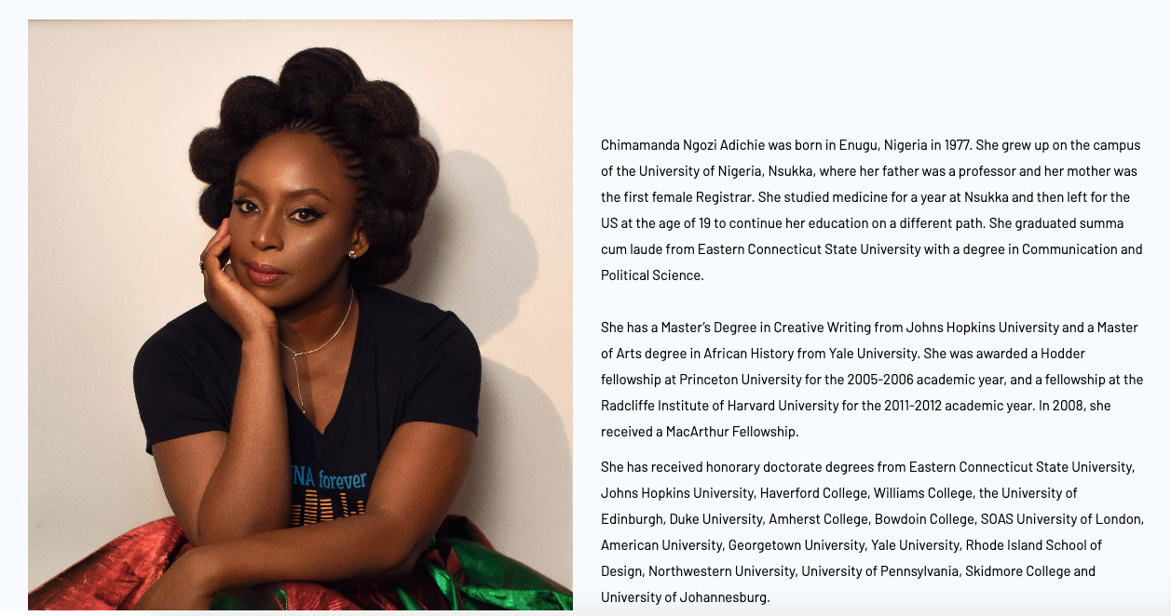
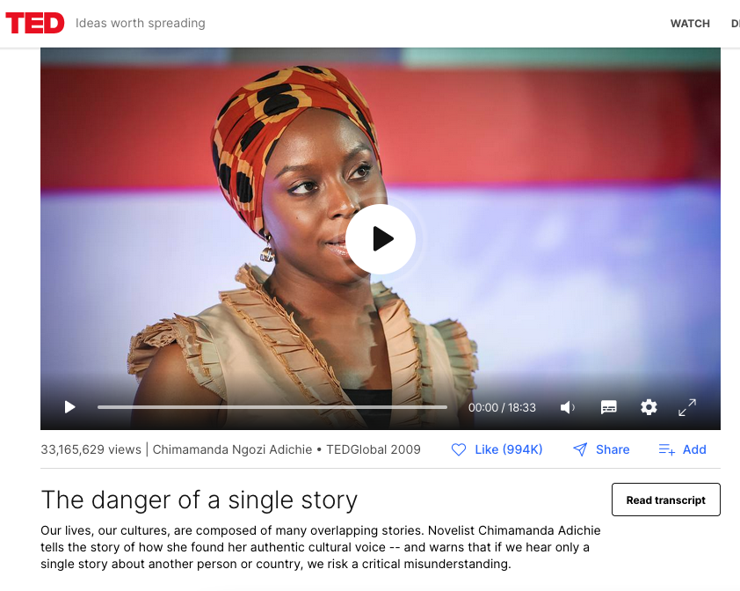
Pass phrase: Chimamanda Ngozi Adichie
https://autograder.cse.buffalo.edu/

Slide 3
Agenda
Hi new folks!
A few thoughts about your summaries
How to discuss effectively
Discussion
Class Axioms discussion

Slide 4
Hi new folks!
Name
Favorite shape
Last show you binged
One thing you at this past weekend

Slide 5
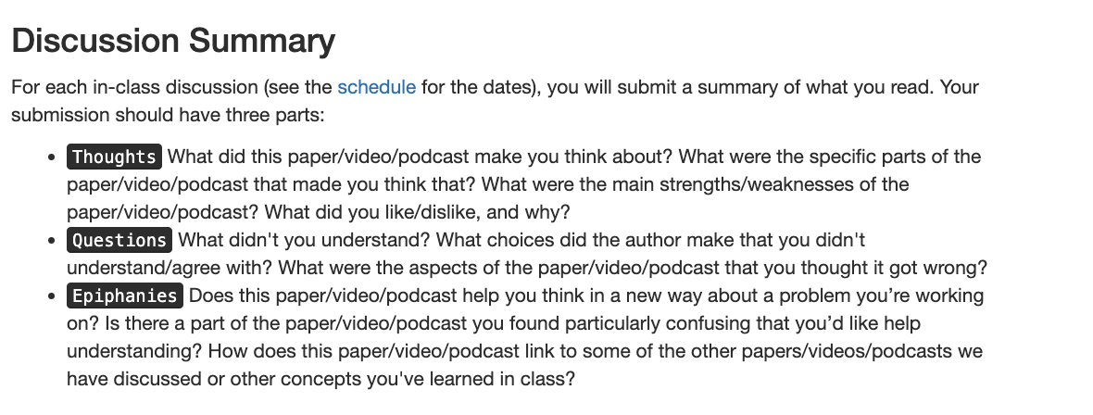
Summary of summaries
Biggest thing: Your summary is not a summary

Slide 6
OK, questions/concerns?
When done, we’ll count off for groups!
A note: you’re being graded on participation today.

Slide 7
Kenny’s summary of summaries: some points
Why “The New Jim Code”?

Slide 8
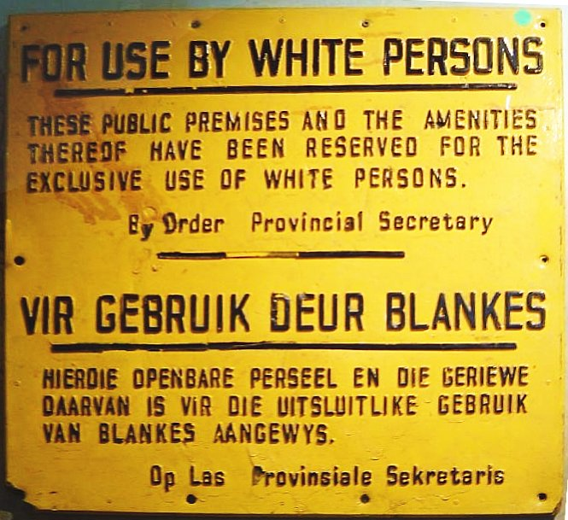
Kenny’s summary of summaries: some points
Why “The New Jim Code”?

Slide 9
Kenny’s summary of summaries: some points
Why “The New Jim Code”?

Slide 10
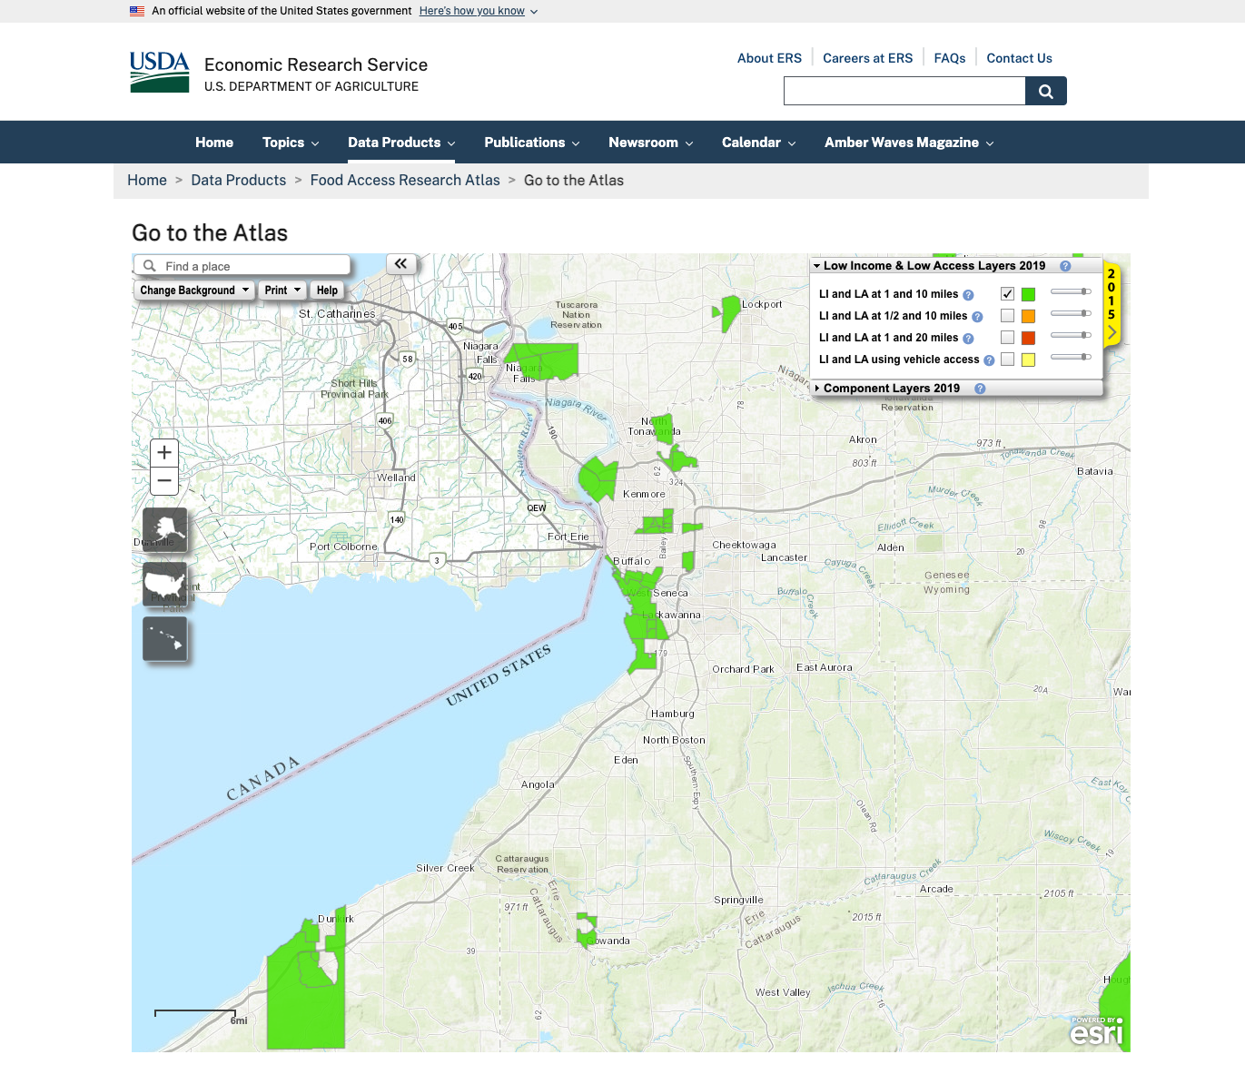
Kenny’s summary of summaries: some points
What is a food desert and why do they exist?
https://www.ers.usda.gov/data-products/food-access-research-atlas/go-to-the-atlas/

Slide 11
Kenny’s summary of summaries: some points
Why didn’t they immediately give out plowing data?

Slide 12
Kenny’s partially introspective summary of summaries: some themes
What is the cost of innovation?
”Innovation does not necessarily mean progress”
“For every AI breakthrough, how many new problems are being created, and at what rate?”
The intersection of race and class
Class != race, but they are intertwined. Why/how?
The intersection of race and white supremacy
I didn’t know!
About the level of racism
Storm wasn’t so bad for me

Slide 13
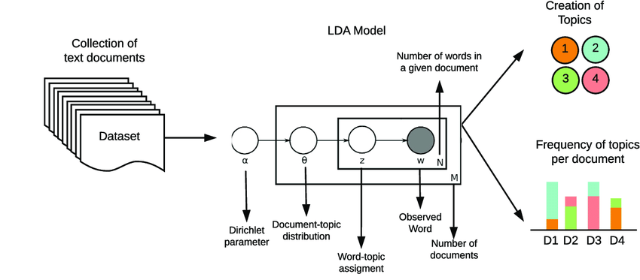
Sidebar
Later in the semester, how do we computationally identify themes?

Slide 14
Some prompts for the first round of discussion
What is white supremacy and what does it mean to you?
What were your experiences, either during or after, the storm or the shooting?

Slide 15
Axioms
Racism exists
Lived experience is not universal
Respond to actions and not people
Inaction is a choice
Y’all decide the 5th axiom!

Slide 16
Wednesday
Come with discussion questions like those we had today!
Especially those related to history given that we have experts coming in

Slide 17
Round 2 discussion
What tech could have helped, if any?

