Slide 1
Rage Against the Machine and Machine Learning and Society

Slide 2
attendance/check in
Pass Phrase: Jessie Daniels
https://autograder.cse.buffalo.edu/

Slide 3
Your Teams!
Team 1 | Afzal | Cole | Navid | Tim
Team 2 | Aishwarya | Herman | Mads | Melvin
Team 3 | Daphkar | Juliana | Ibtida | Monica
Team 4 | Joe | Ken | Vedant | Zach
Team 5 | Chaitanya | Evan | Hitesh | Sushanth
Team 6 | Hannah | Harinee | Gabriella | Suradhya
Team 7 | Alex | Connor | Gopi | Shane | Thanh
Team 8 | Aditi | Connor | Jason | Mitali
Team 9 | Botsalano | Niharika | Vedang | Yunmei
Team 10 | Dhiraj | Frank | Kashyap | Michael
Rage students in Blue. ML+Soc students in white

Slide 4
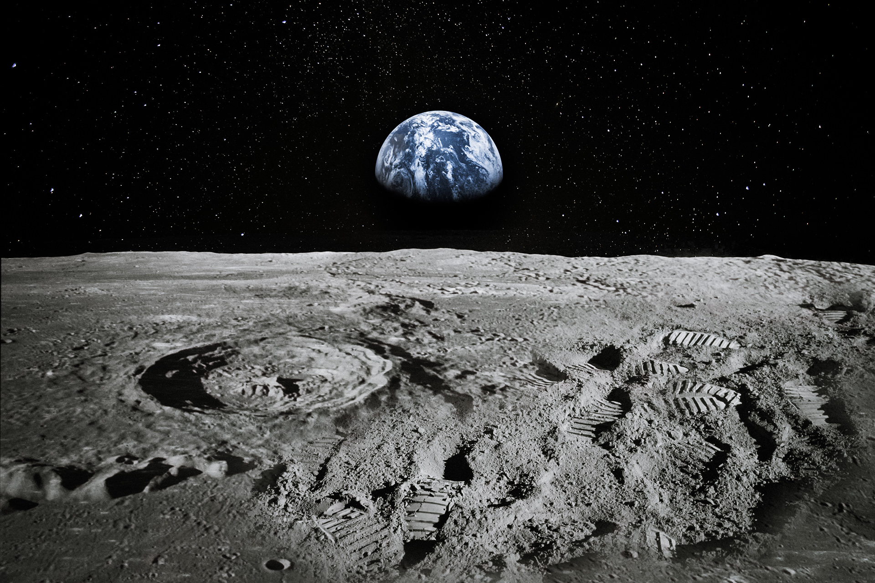
Moon Landing
Ice breaker. Moon Landing.
Moon Landing

Slide 5
Buffalo, NY
Tops Massacre, 5.14.22
Blizzard, 12.23
Notes:
White supremacy structurally
White supremacist violence
Blizzard article
Blacks 14% of the population and 51% of the deaths in the blizzard.
Tops article
“These violent episodes are not an anomaly, but part of an ongoing tradition of attacks on Black citizenship and humanity.”
Series of overlapping problems:
Gun accessibility, segregation and racialized poverty in Buffalo, white supremacy.
Note the legacy of black activism in Buffalo history. This is a place of poverty, segregation and discrimination but also resistance.
“As a Washington Post investigation notes, “Since 2015, right wing extremists have been involved in 267 plots or attacks and 91 fatalities.” The findings also revealed, “More than a quarter of right-wing incidents and just under half of the deaths in those incidents were caused by people who showed support for white supremacy or claimed to belong to groups espousing that ideology.”

Slide 6
Small groups
Reflect on the blizzard and the massacre in your teams
Pay attention to your emotions reading these pieces. Does discussing these events make you feel hopeful or hopeless?
Why is it that you CANNOT understand both tragedies without considering history?
What questions are you left with after your reading and discussing?

Slide 7
Share Backs
Emotions/thoughts/reactions.
Why history?
Questions?

Slide 8
Team discussion
What would the shooter have been able to do (or not) with the technology of 10 years ago? 30 years? 40 years?
How was tech different in the 1980s? 1990s?
Atri: “Google didn’t exist in college” old
Kenny: “Facebook was cool in college” old (also, just uncool)
What does history tell us about the answer to this question?

Slide 9
Where and When was this article published?

Slide 10
What about now?

Slide 11
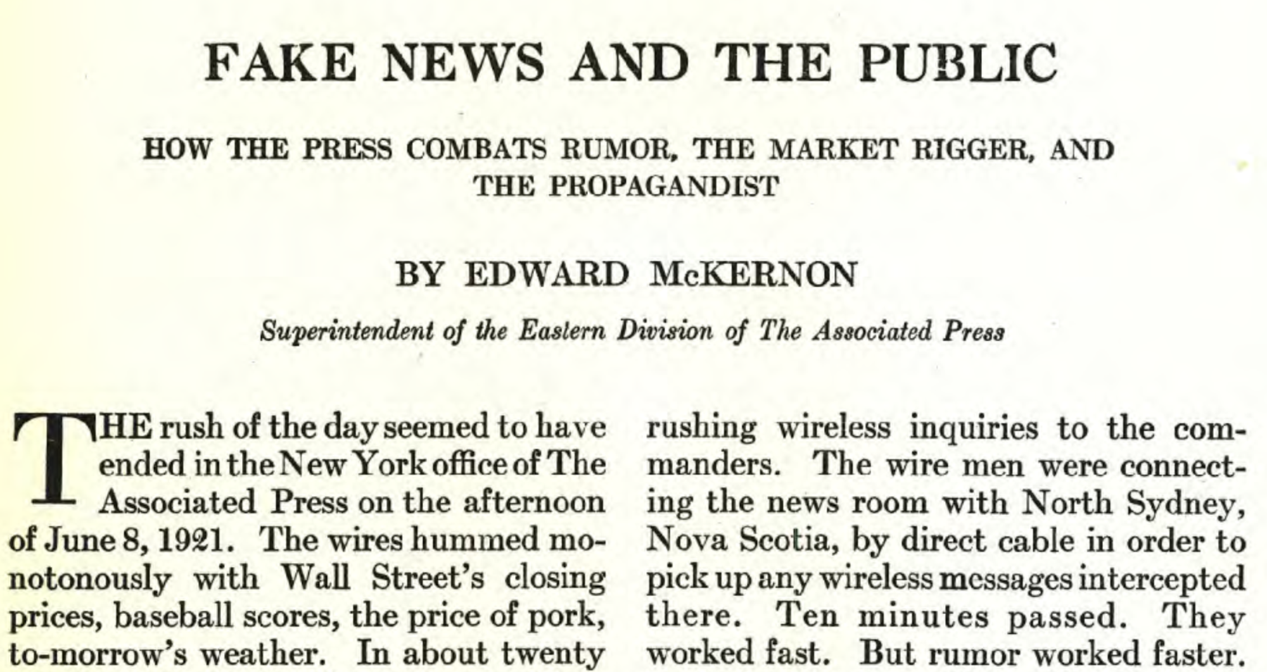

Slide 12
Share
Ask each group to share 1 idea.

Slide 13
Let’s Talk about Race and Technology
Problem
Solutions
“Not all speed is movement.”
“Racism is productive; it constructs.”
“Race and technology are co-produced.”
“We have to be able to see who and what is behind the screen that is currently animating the digital world.”
What does it mean to “integrate a burning house”?
“Cosmetic change… too often takes the place of substantive change.”
Benjamin suggests that an alternative to “integrating” might be found in building “abolitionist tools”. Getting free is different from getting integrated. How?
What might it mean to become new “patternmakers” in relation to technology and society, as Benjamin urges us?

Slide 14
White Supremacy and Cyber Racism
Why study white supremacy online?
Easy access to global linkages.
Potential to precipitate harm in real life.
Challenges it presents to upholding values like equality.
HISTORY: White supremacy is a “central organizing principle of social life” in the US, not a fringe phenomenon. White supremacy and anti-blackness are also global.
TECHNOLOGY: We are moving from a group-based society to network-based society, which decouples community and geography enabling “translocal whiteness” and global white supremacy.
Notes:
List key points. Use this as a way to wrap and get them ready for next team meeting. Also, it would be good if we could come up with some joint questions or something that we can all have in mind going forward. We need something to bring the class together.

Slide 15
What does a Solution look like?
This is your primary task in this course. To do it you need:
To understand the problem
To learn tools to help you build a solution
To build together

Slide 16
Reminders
First team meeting week 3 [anytime after Wednesday]
Next combine: March 8. Presentations on the problem we are tackling.

