Slide 1
ML and Society
Feb 15, 2023

Slide 2
Passcode: Tressie McMillan Cottom
A preeminent public scholar on race, digital media, and higher ed
If you want to see science writing done right, go read one of her books

Slide 3
Sit with your team!
Team 1 | Afzal | Cole | Navid | Tim
Team 2 | Aishwarya | Herman | Mads | Melvin
Team 3 | Daphkar | Juliana | Ibtida | Monica
Team 4 | Joe | Ken | Vedant | Zach
Team 5 | Chaitanya | Evan | Hitesh | Sushanth
Team 6 | Hannah | Harinee | Gabriella | Suradhya
Team 7 | Alex | Connor | Gopi | Shane | Thanh
Team 8 | Aditi | Connor | Jason | Mitali
Team 9 | Botsalano | Niharika | Vedang | Yunmei
Team 10 | Dhiraj | Frank | Kashyap | Michael
Rage students in Green. ML+Soc students in black

Slide 4
Who does my machine learning model serve?
How do I know?
What can I do about it?

Slide 5
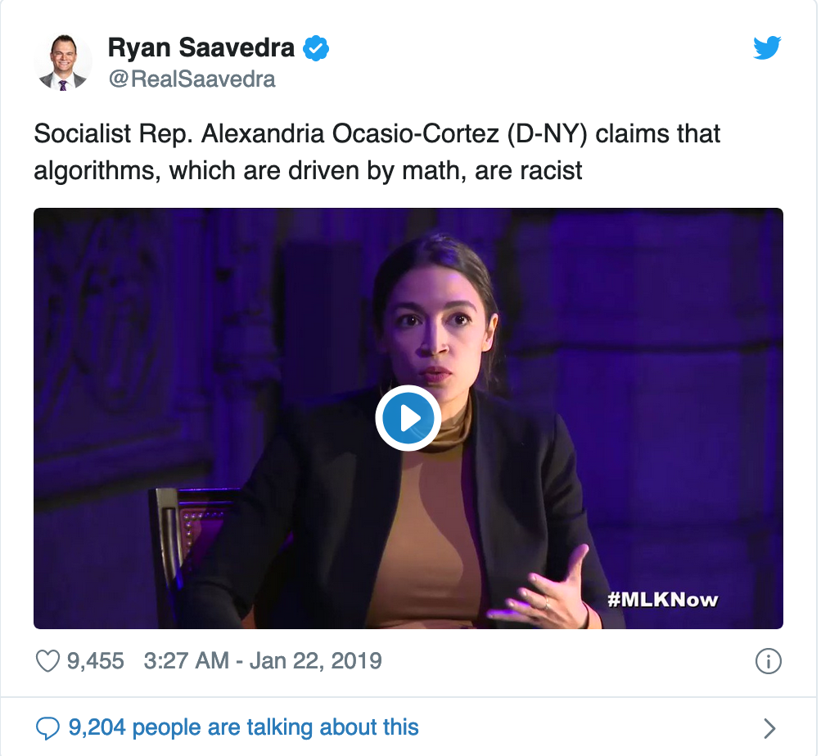
So who is right?
Depends on what you mean by “algorithm”
“Algorithms can be biased”
”Algorithms are based on math
and hence cannot be biased"

Slide 6
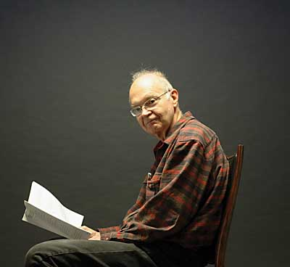
Knuth’s Definition of an algorithm
An algorithm is a finite, definitive, effective
procedure with some input and some
output

Slide 7
Main Steps in Traditional Algorithm Design
Problem Statement
Real world problem
Problem definition
Problem Definition
Precise mathematical def
Algorithm
Algorithm design
“Implementation”
Data Structures
Analysis
Correctness/Run time

Slide 8
Two main points about traditional algorithms
Though really you would be wrong there as well since the problem statement itself could be biased...
Problem is defined BEFORE algorithm is designed
Can prove algorithm is correct for ALL inputs
One could consider such algorithms not biased

Slide 9
Today
Correct for modern algorithms
“Algorithms can be biased”

Slide 10
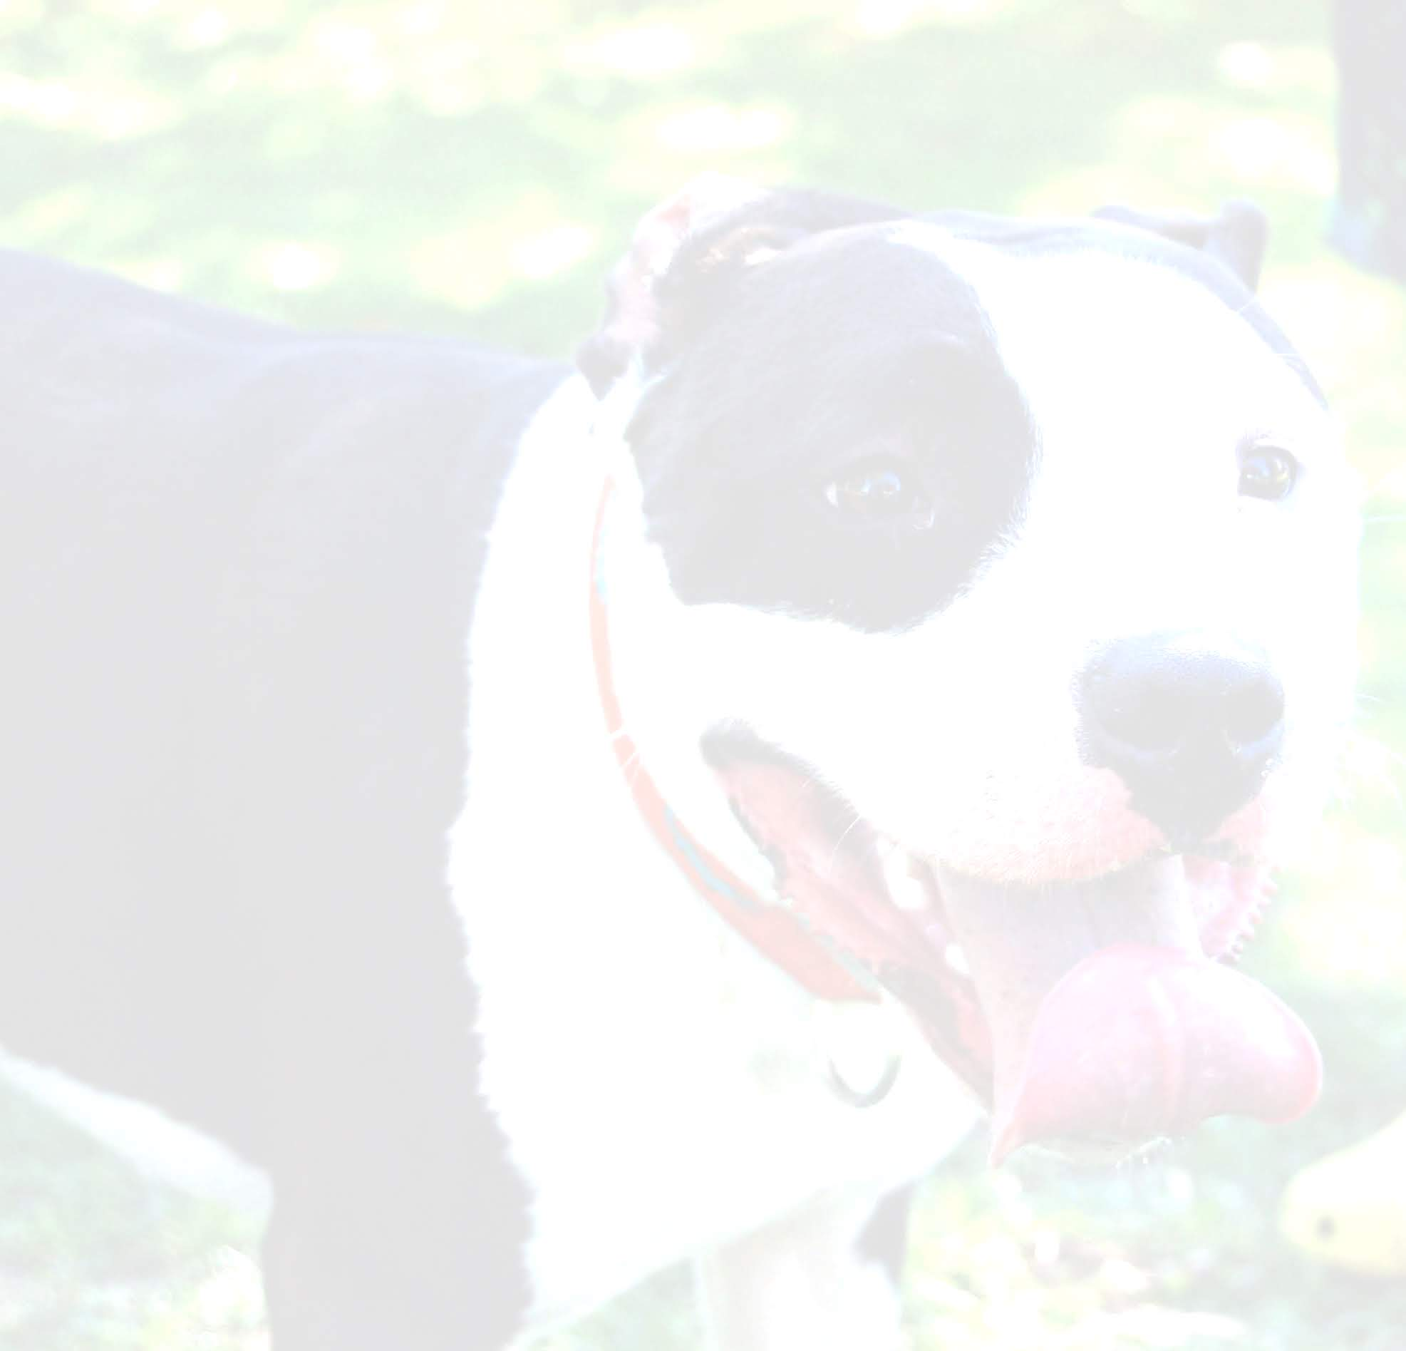
Cat vs. Dogs

Slide 11
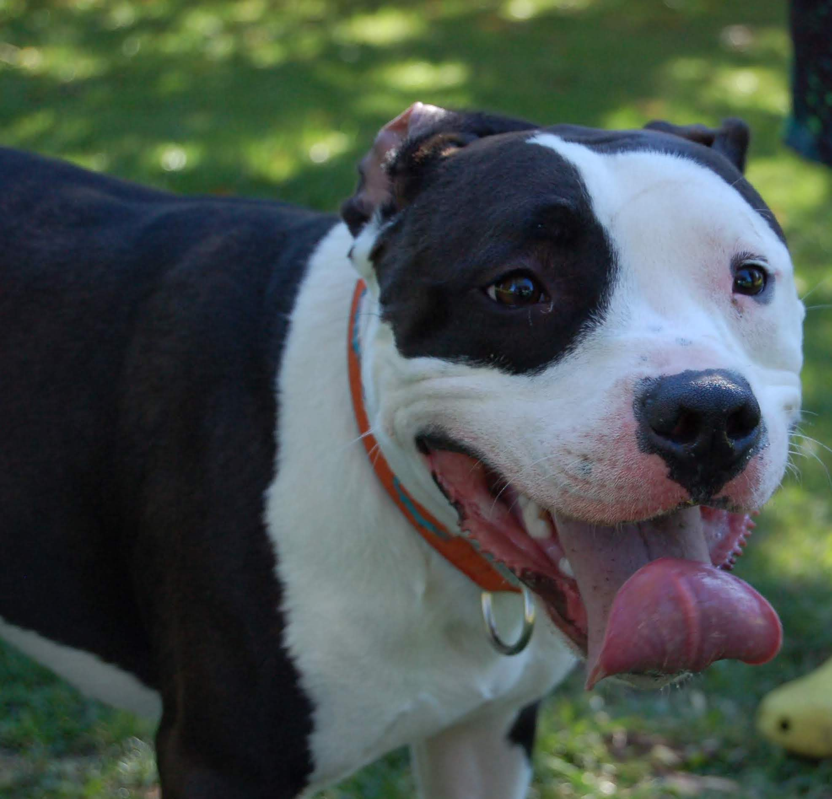
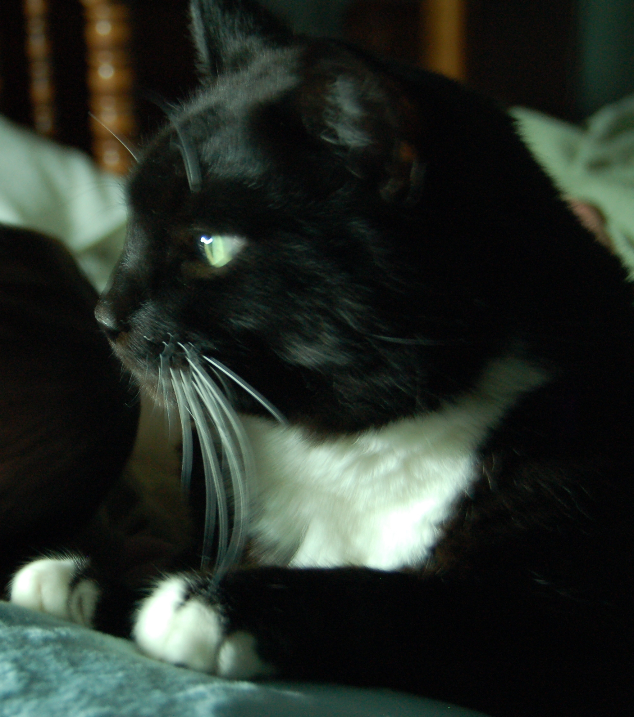
Warren and Billy

Slide 12
How do you “define” a dog vs cat image?

Slide 13
Google Images has “solved” this problem

Slide 14
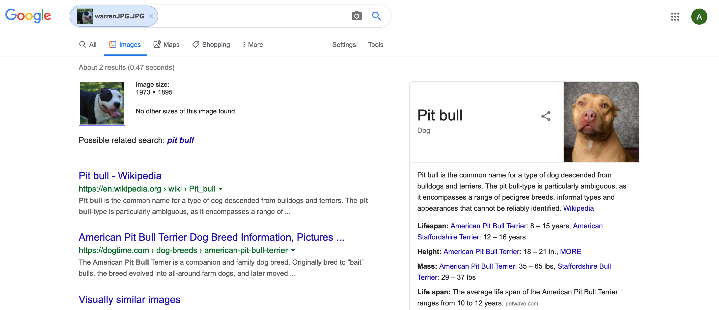
My result for Warren (Spring 20)

Slide 15
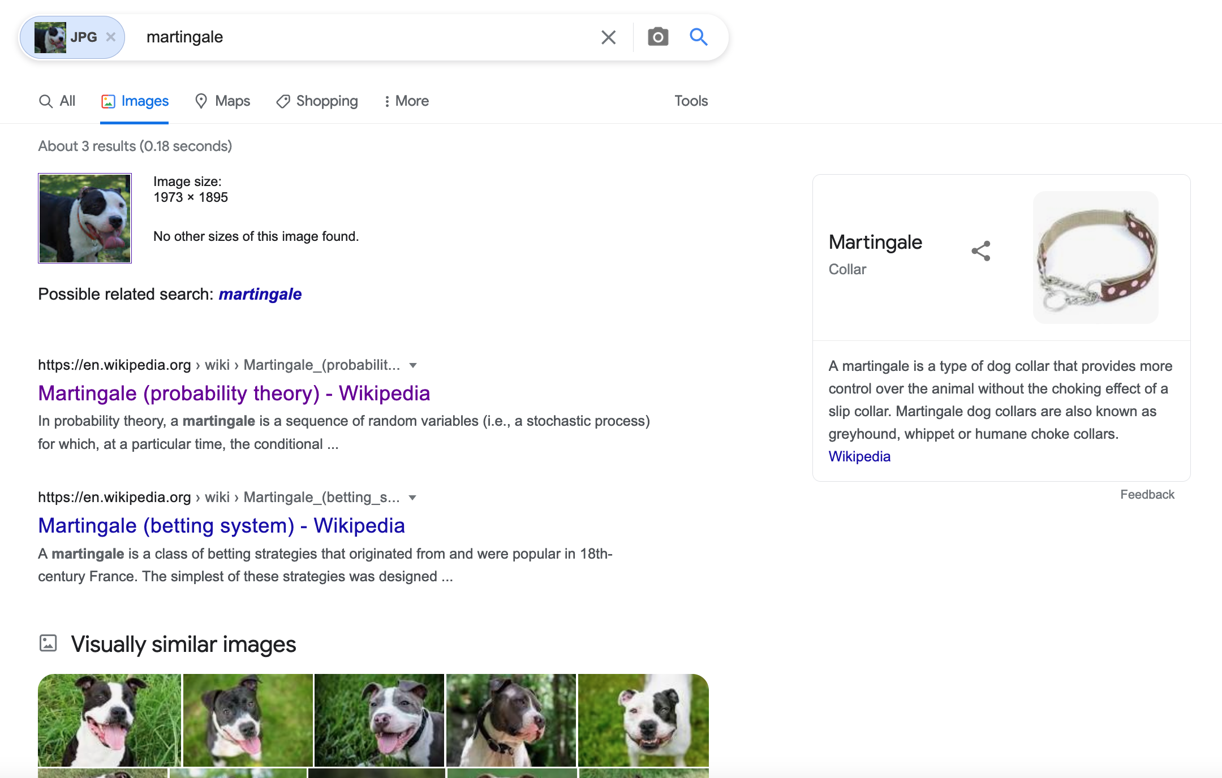
My result for Warren (Spring 22)

Slide 16
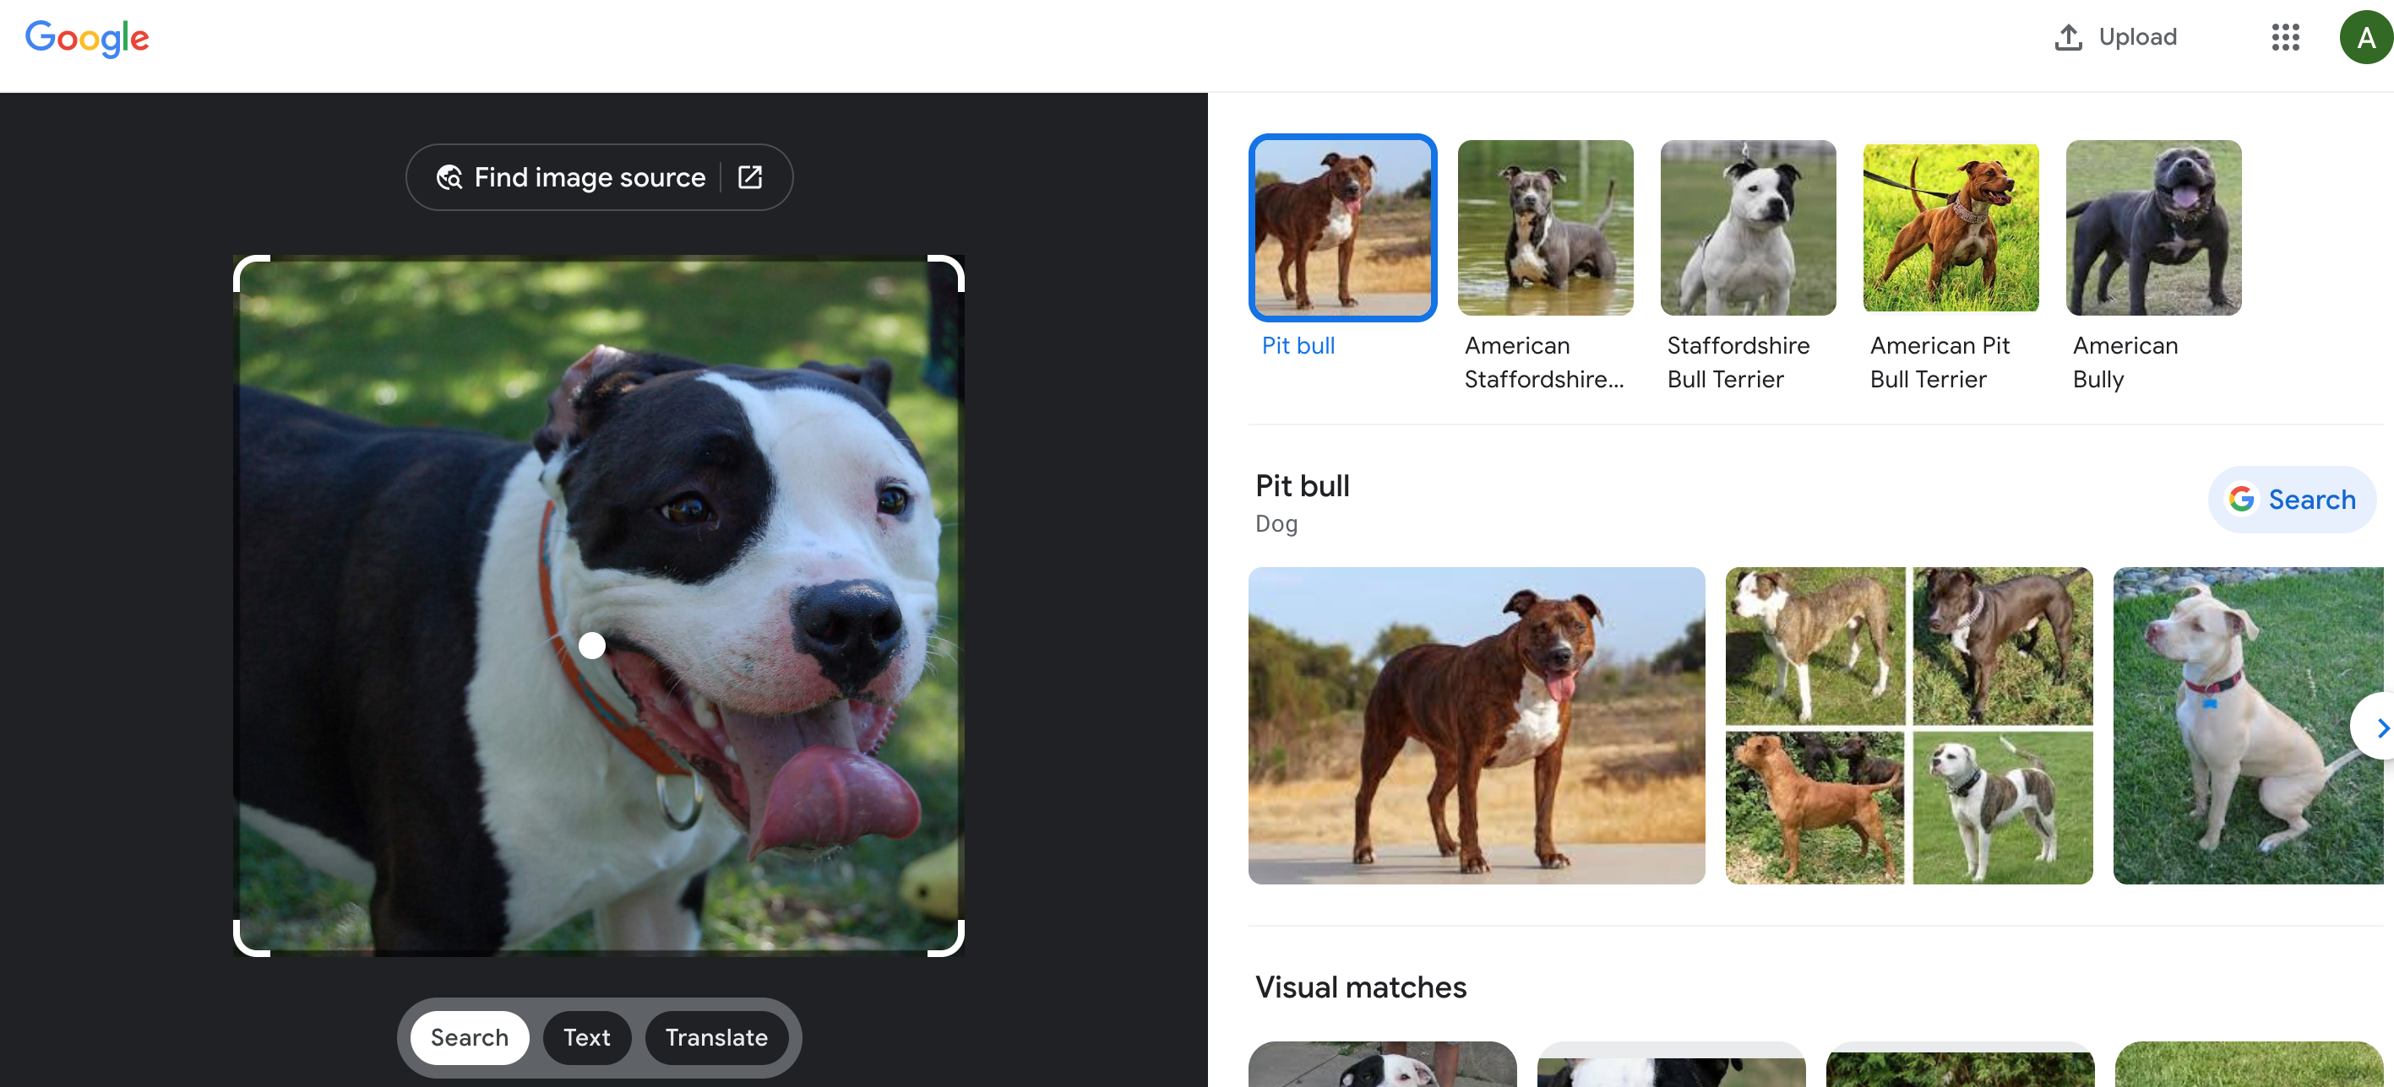
My result for Warren (Spring 23)

Slide 17
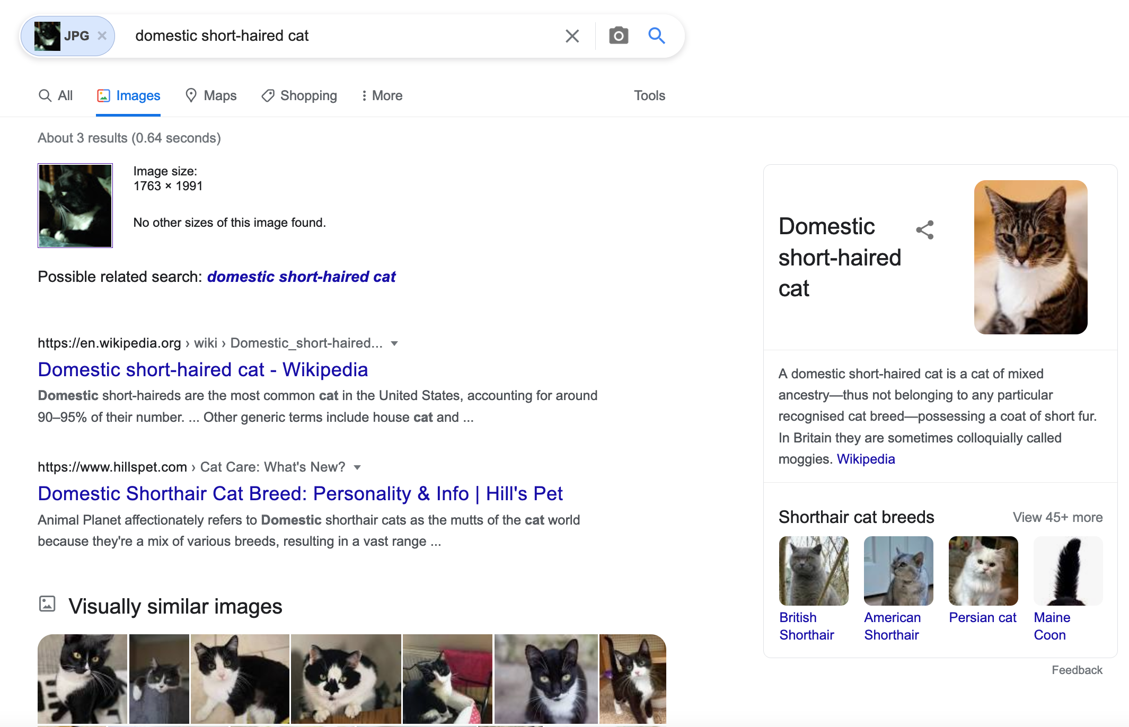
My result for Billy (Spring 20+22)

Slide 18
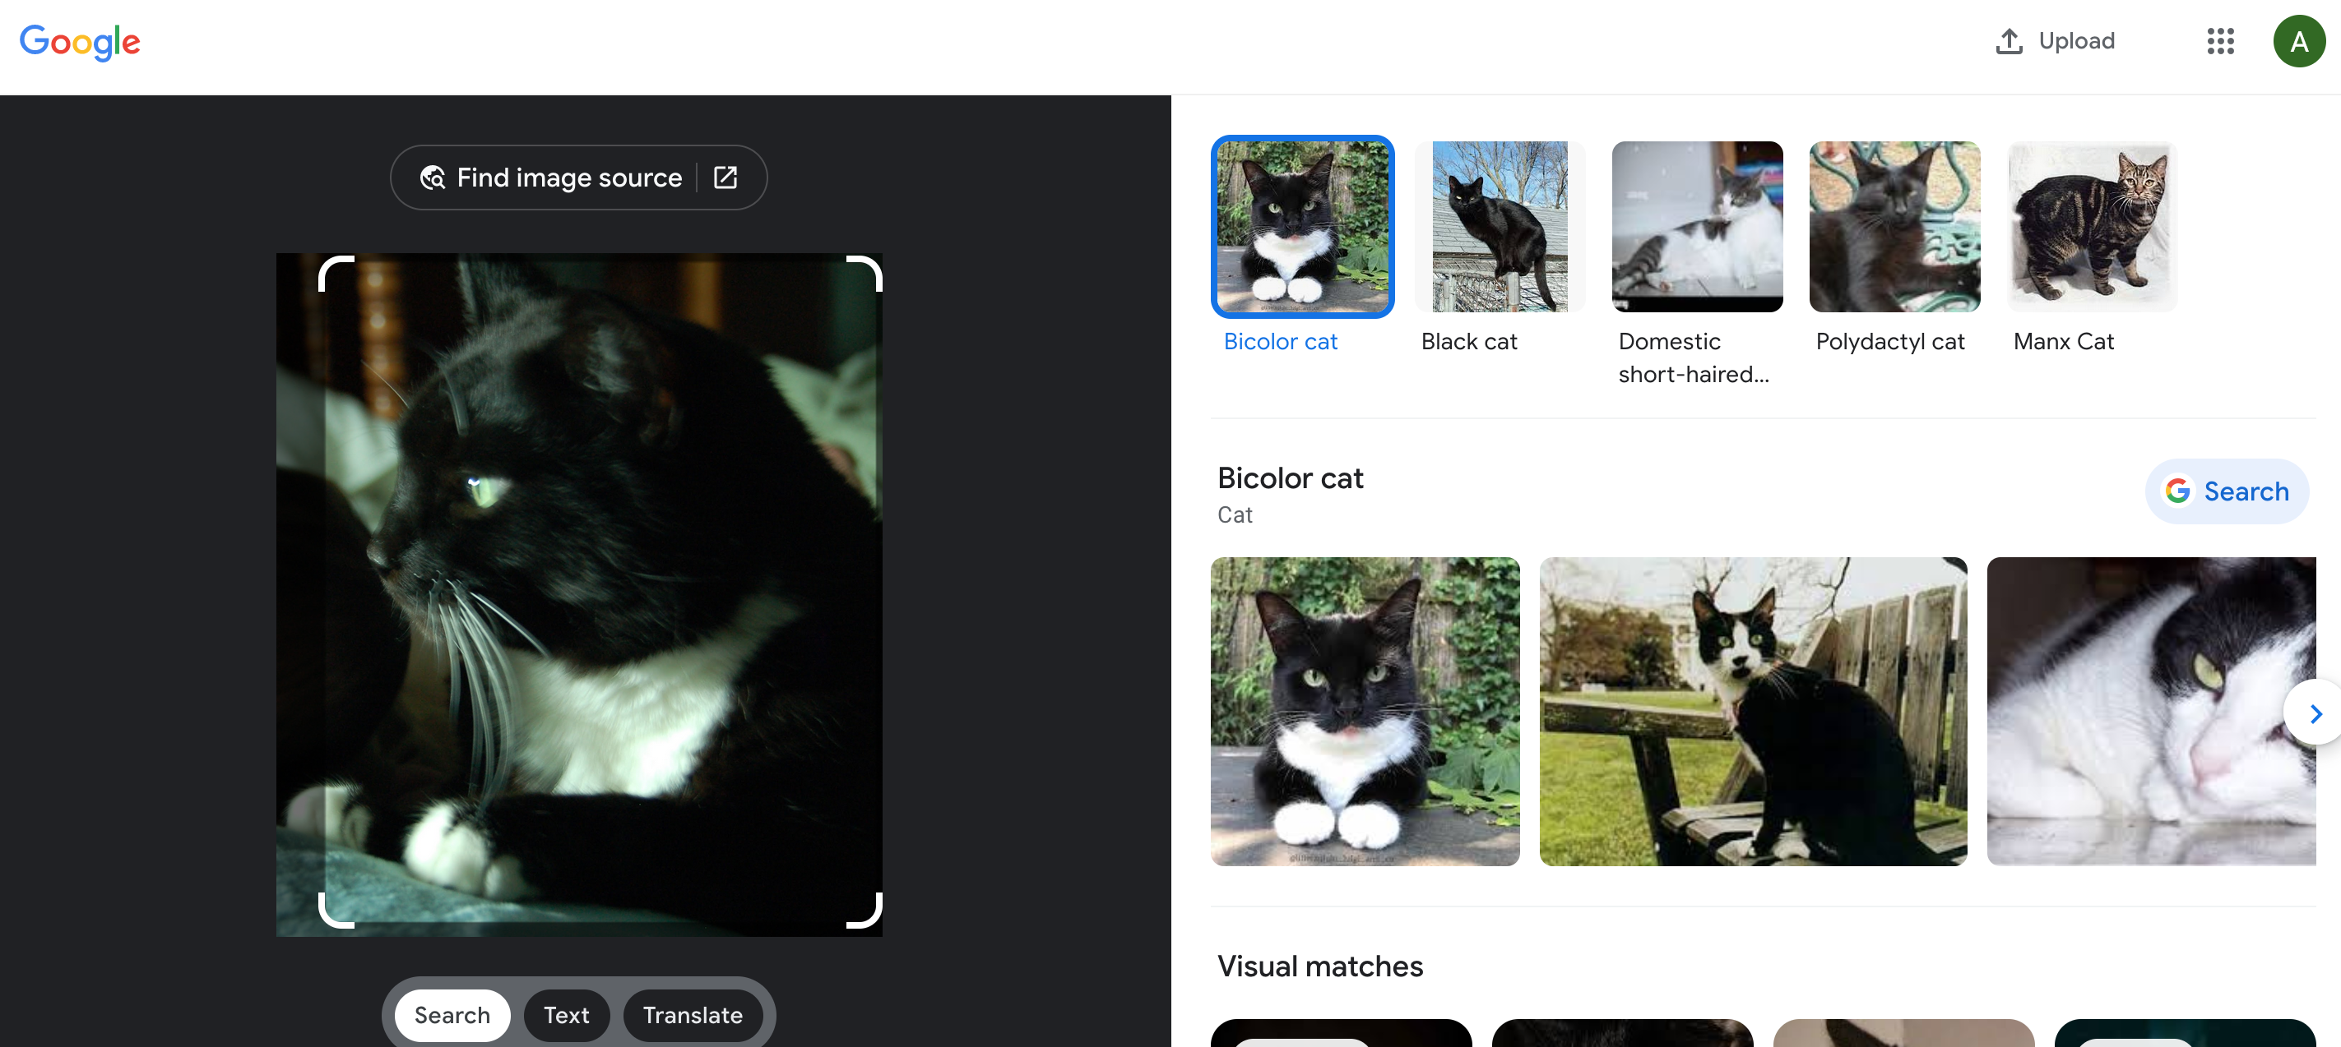
My result for Billy (Spring 23)

Slide 19
So cats vs dogs problem solved?

Slide 20
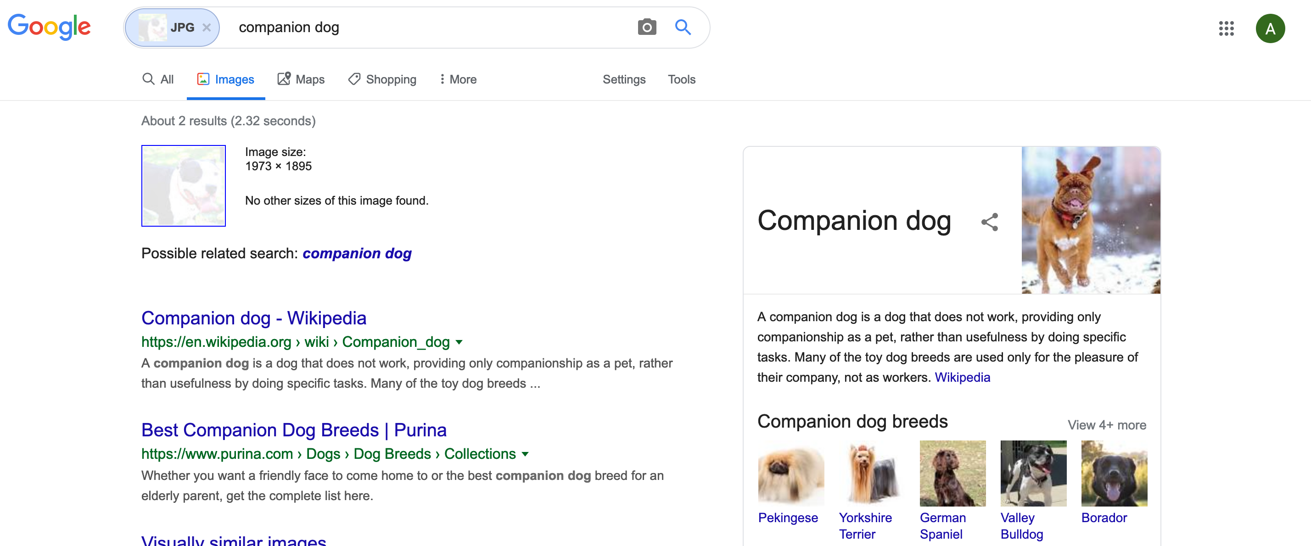
My result for modified Warren (Spring 20)

Slide 21
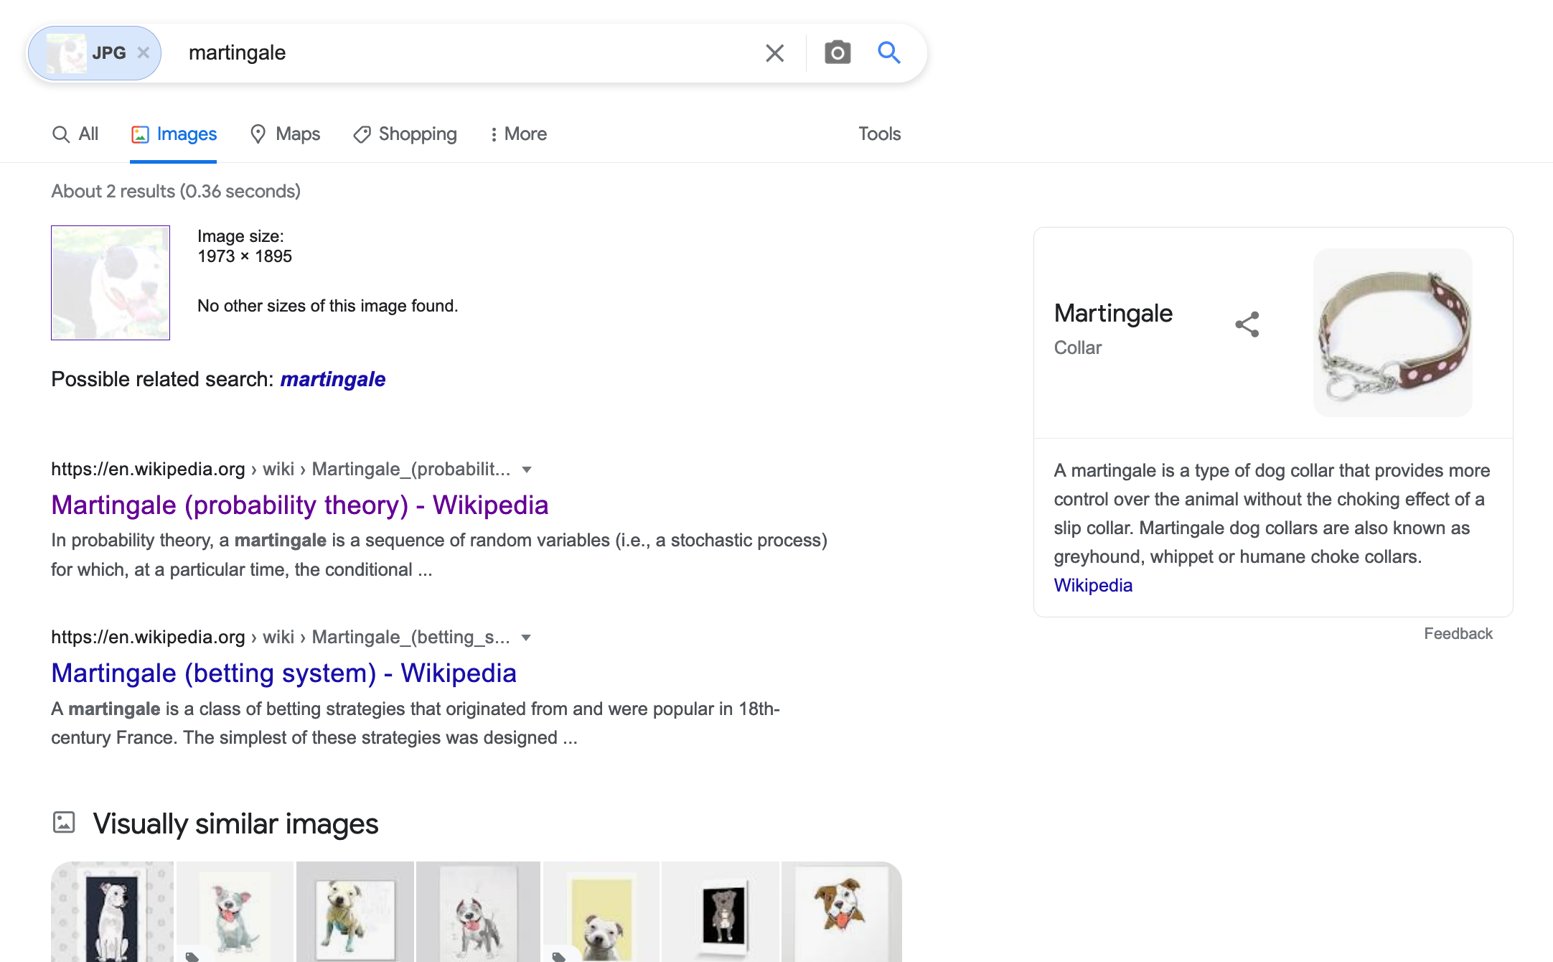
My result for modified Warren (Spring 22)

Slide 22
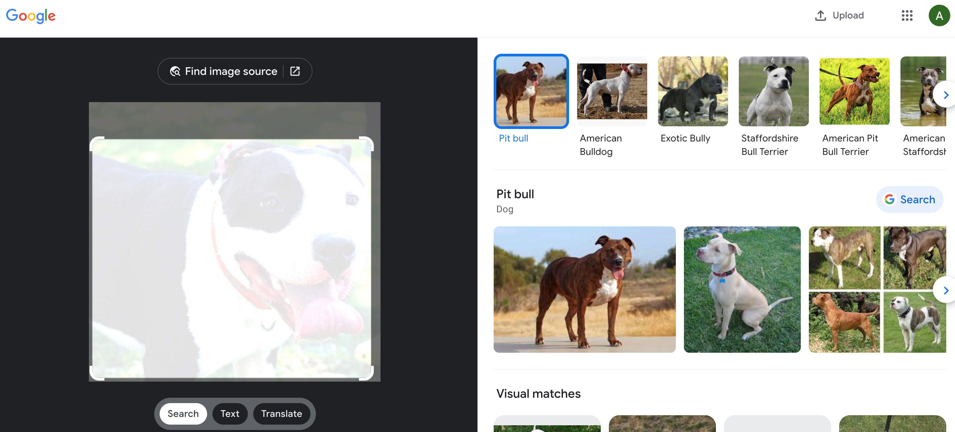
My result for modified Warren (Spring 23)

Slide 23
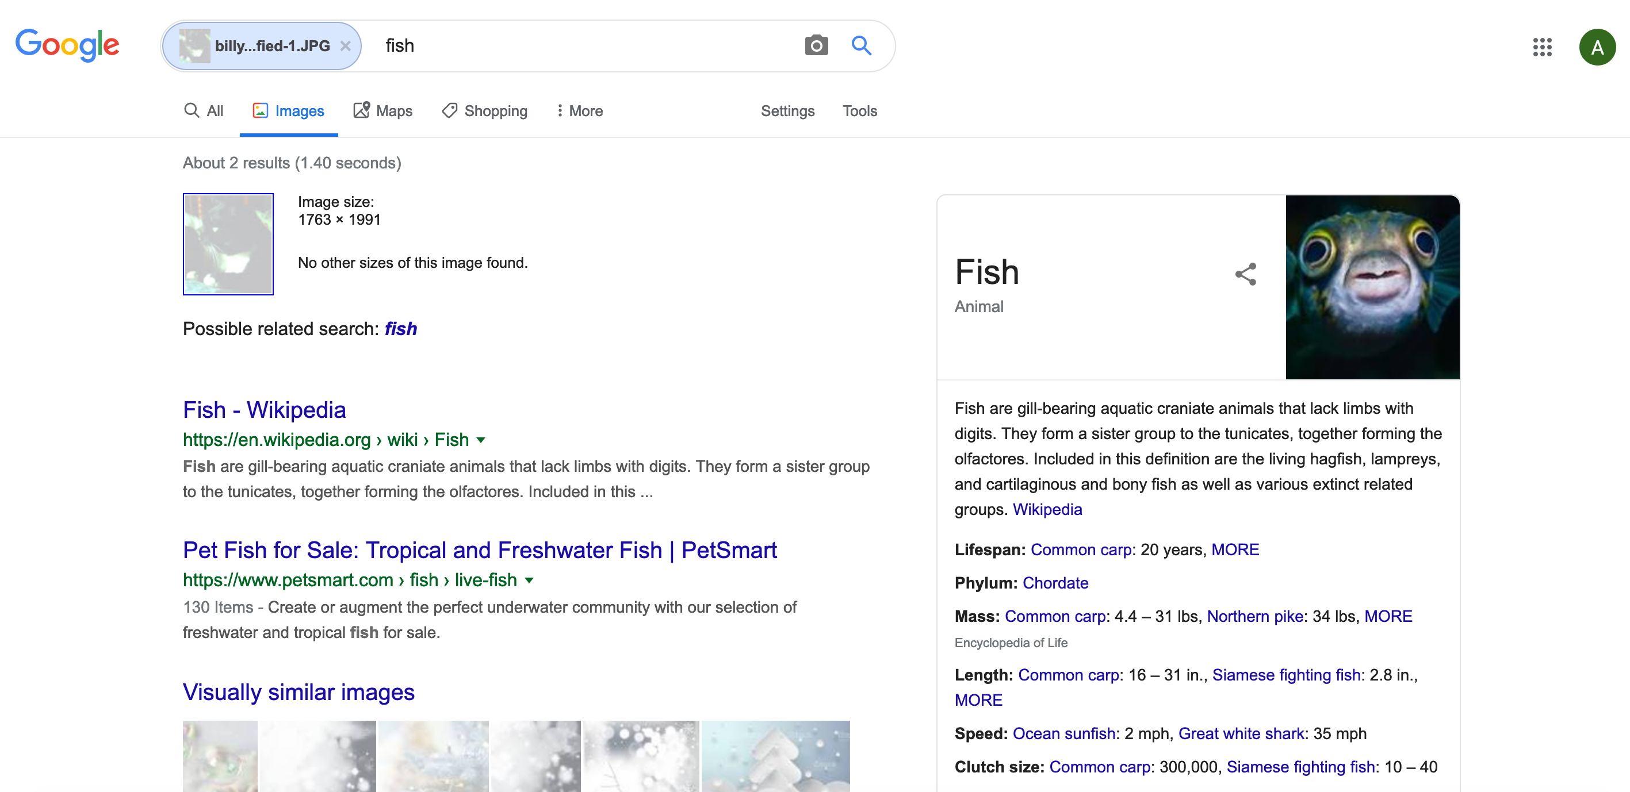
My result for modified Billy (Spring 20)

Slide 24
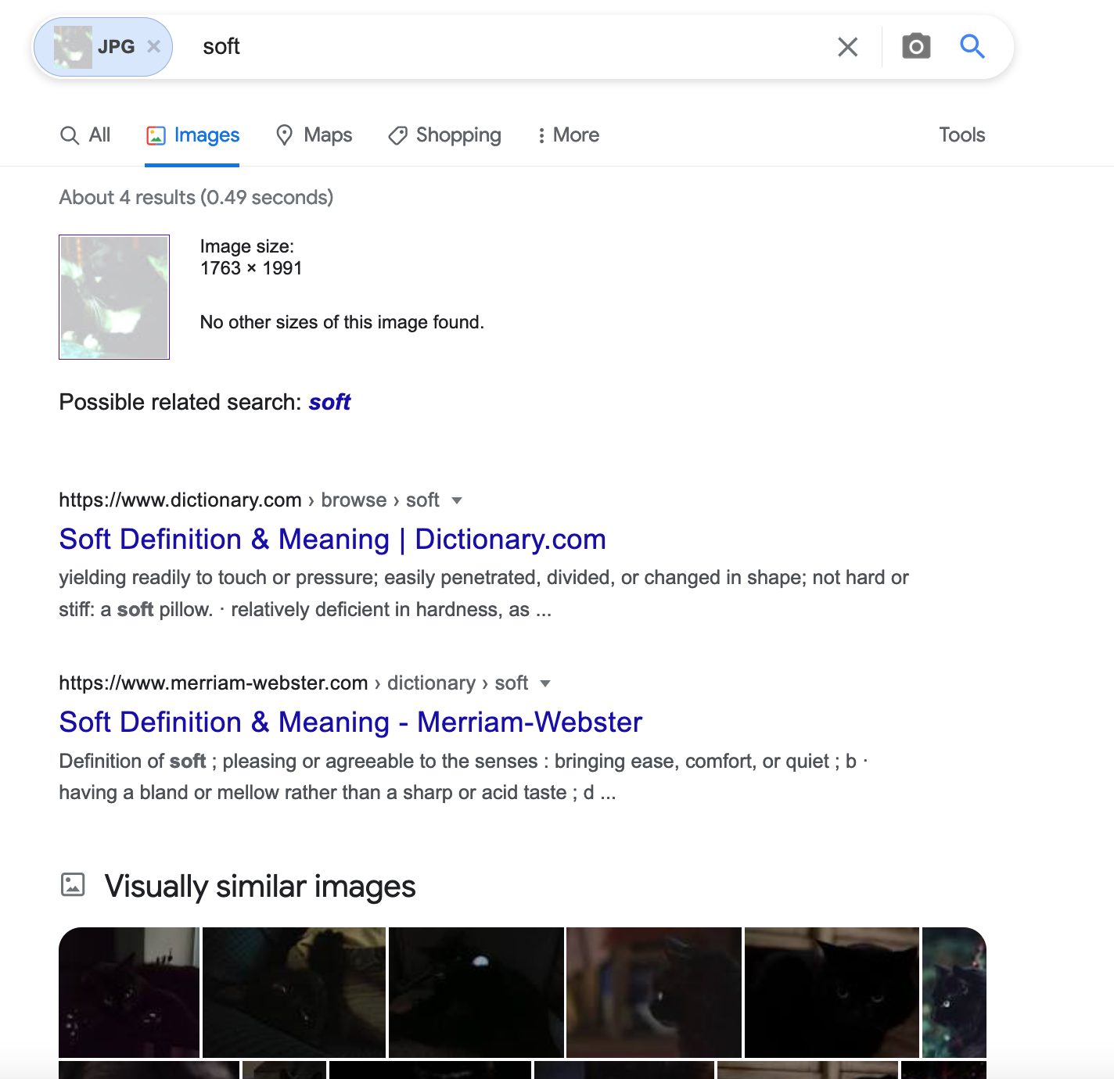
My result for modified Billy (Spring 22)

Slide 25
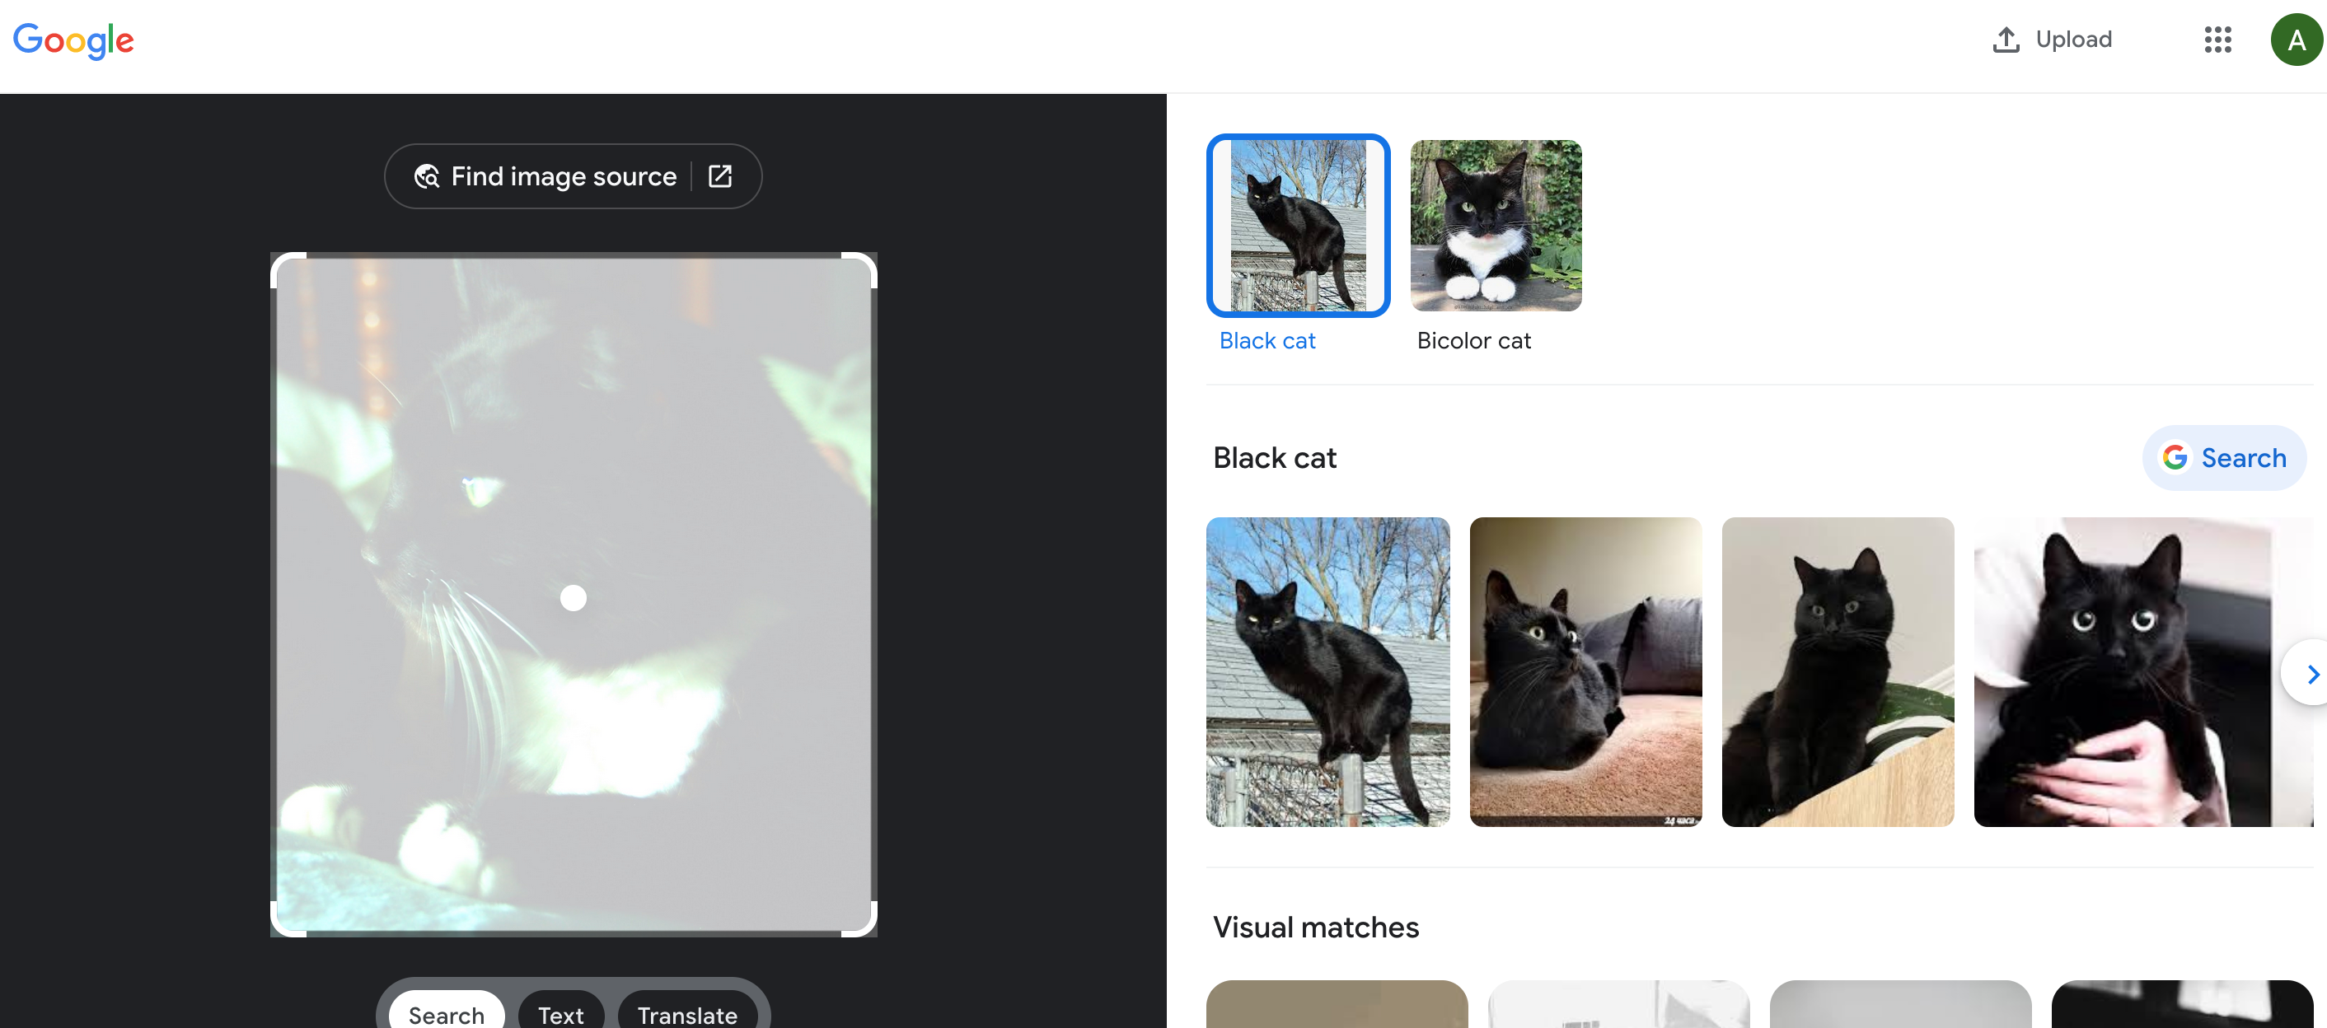
My result for modified Billy (Spring 23)

Slide 26
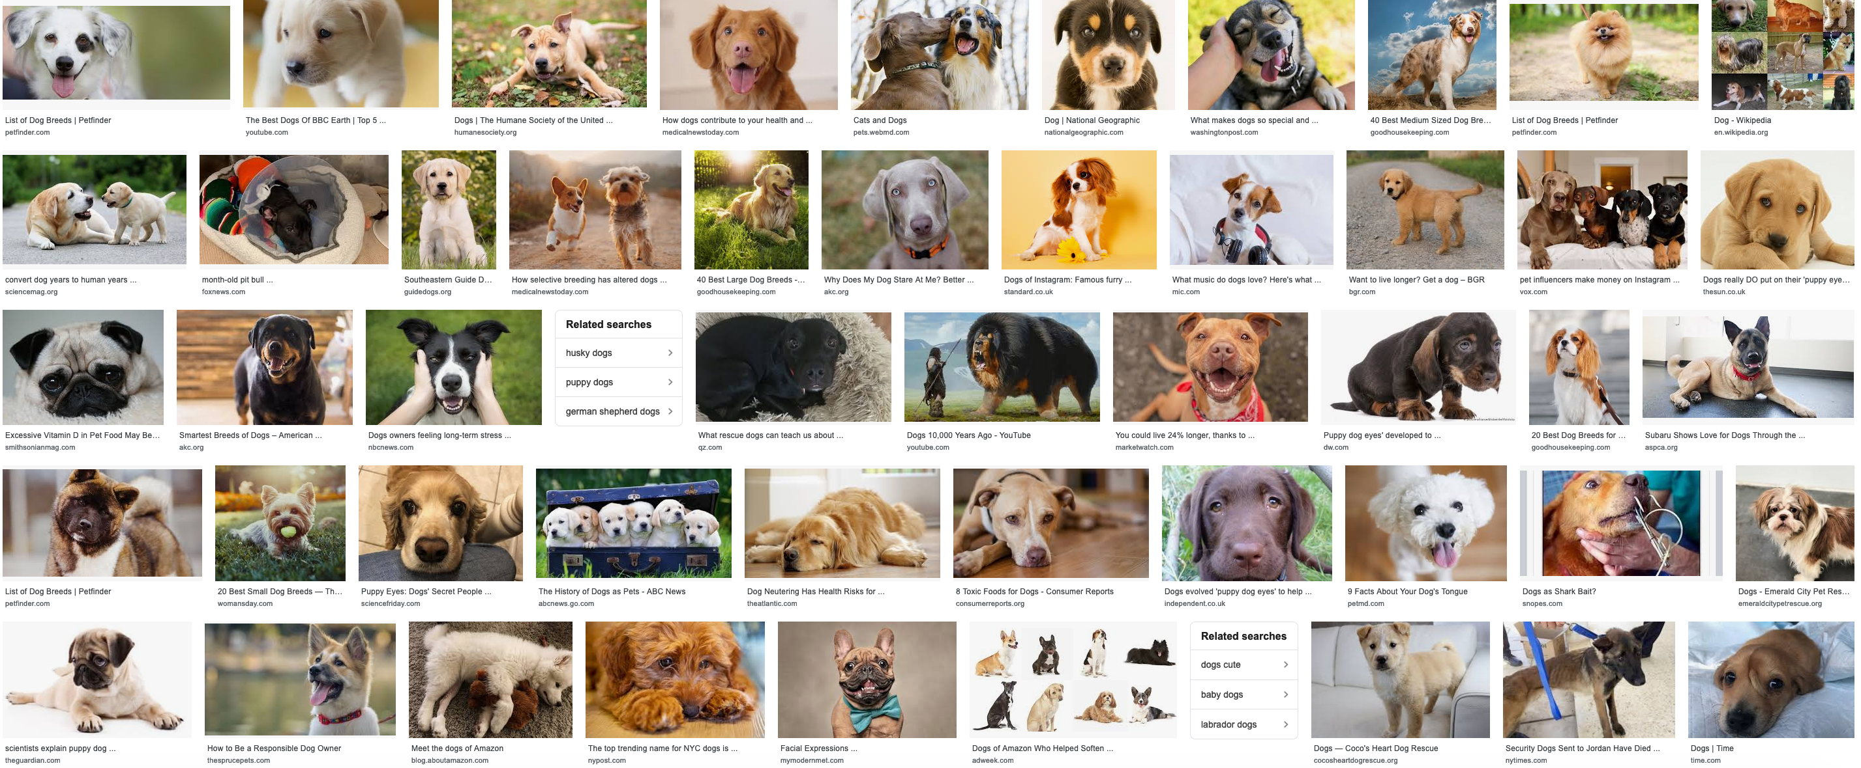
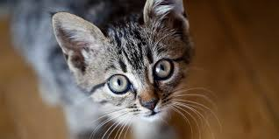
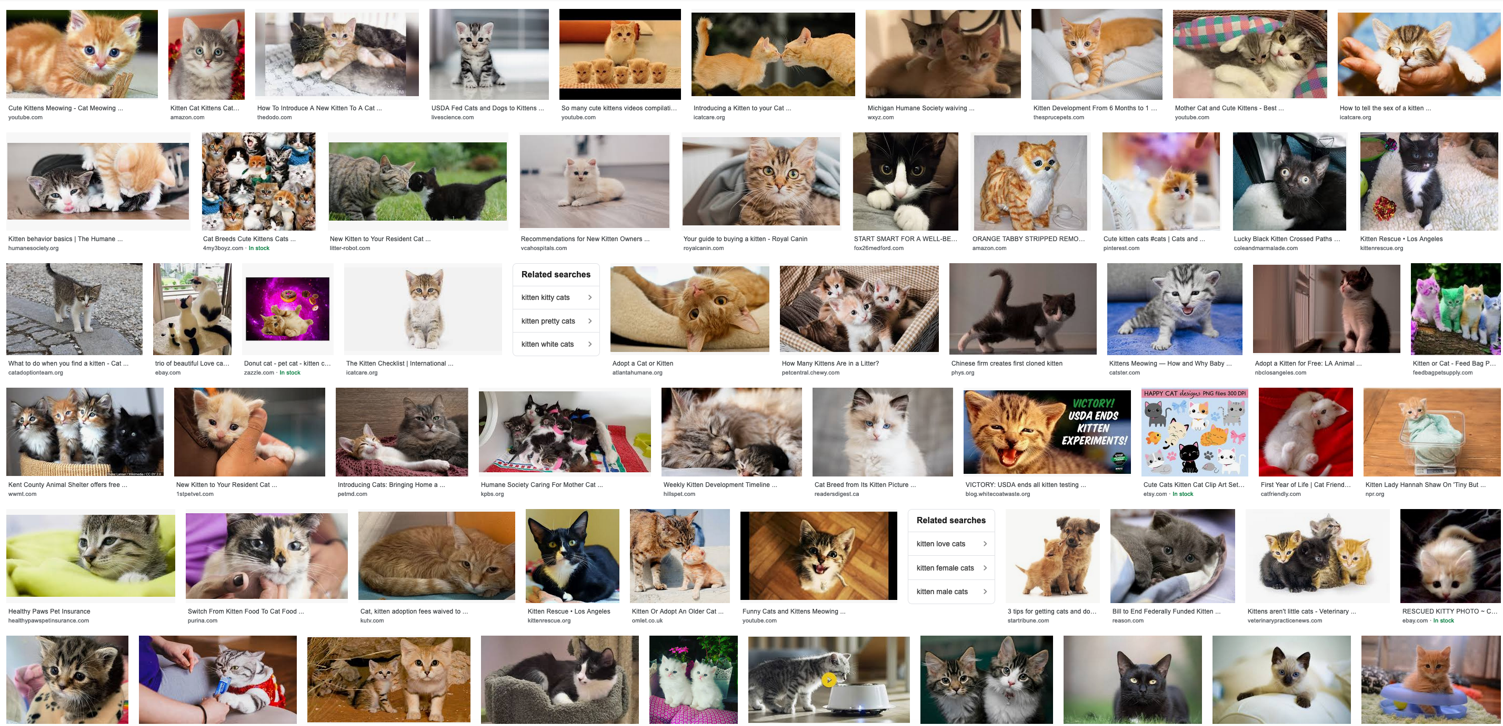
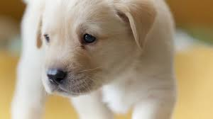
How does Google Images work?
dog
, cat
f
Training
cat
, dog

Slide 27
When a new image comes in
dog
f
cat

Slide 28
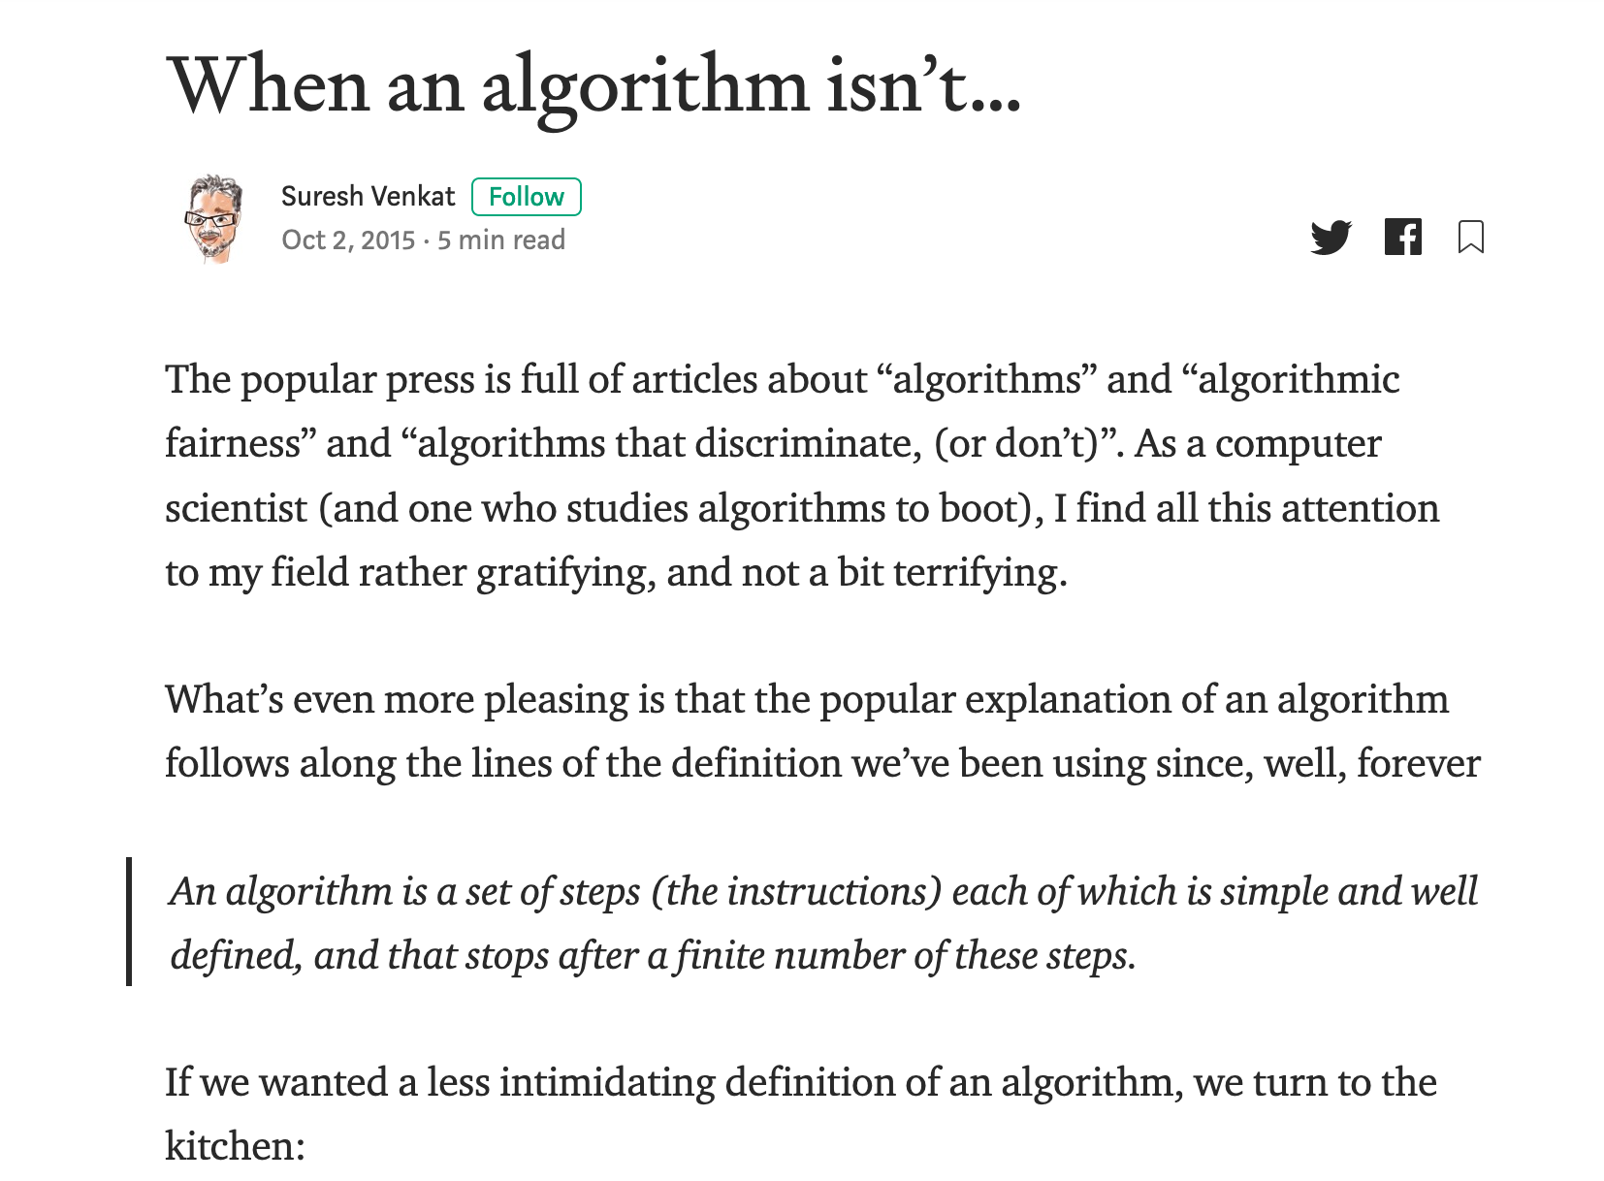
Couple of important points
Google images is learning something but not “our way” of looking at cats vs dogs
There is NO problem/ algorithm divide!
dog
, cat
Training
f
, dog
cat

Slide 29
AOC is right!
Correct for modern algorithms
“Algorithms can be biased”

Slide 30
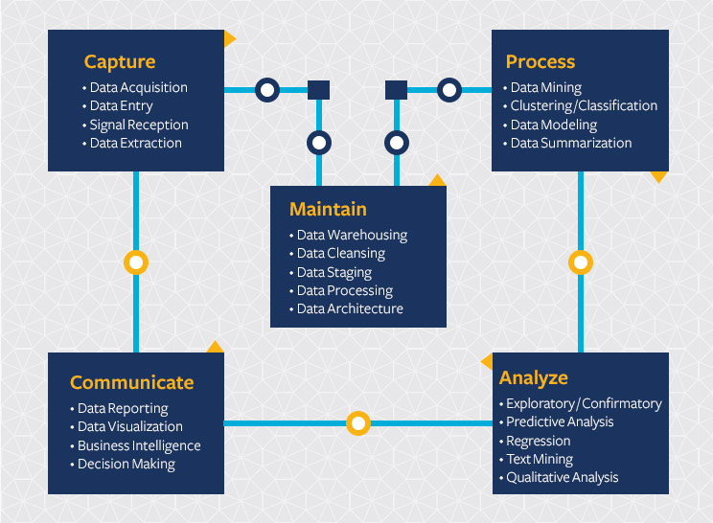
Modern Algorithm = Machine Learning (ML)
Start with a Question
Collect data
Train model
Evaluate model
Deploy!

Slide 31
The Machine Learning Pipeline
And/or some data
Train the model
?
Start with a question
Engineer the system for production use
Build a model
Evaluate the model
Slide by Kenny Joseph

Slide 32
Back to cats vs. dogs
Start with a Question
Collect data
Train model
Evaluate model
Deploy!
Classify image
as cat or dog
dog
No error,
so great!
dog
, cat
f
f
, dog
cat
cat

Slide 33
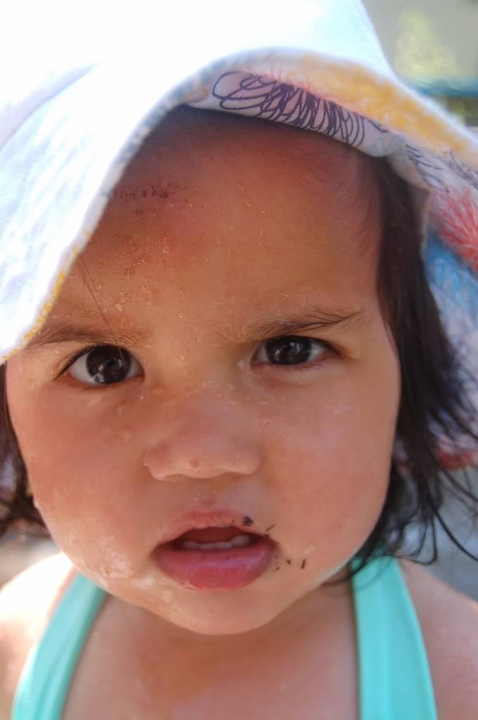
?

Slide 34
What is missing from this picture?
Start with a Question
Collect data
Train model
Evaluate model
Deploy!
Society

Slide 35
A real view of the ML Pipeline
Real world machine learning can be awesome, but there are a lot of gotchas and
?
Slide by Kenny Joseph

Slide 36
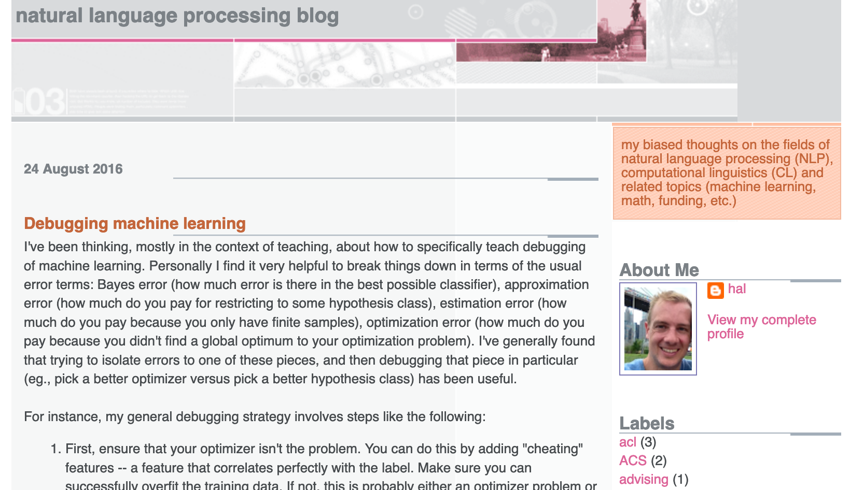
Start with a Question
Collect data
Train model
Evaluate model
Deploy!
Real world goal
Real world mechanism
Learning problem
Data collection mechanism
Which data to collect?
Data representation
Target class/model
Deploy!
Evaluate error
Predict on test data
Model training
Training data set

Slide 37
What is missing?
Real world goal
Real world mechanism
Learning problem
Data collection mechanism
Which data to collect?
Data representation
Society
Target class/model
Deploy!
Evaluate error
Predict on test data
Model training
Training data set

Slide 38
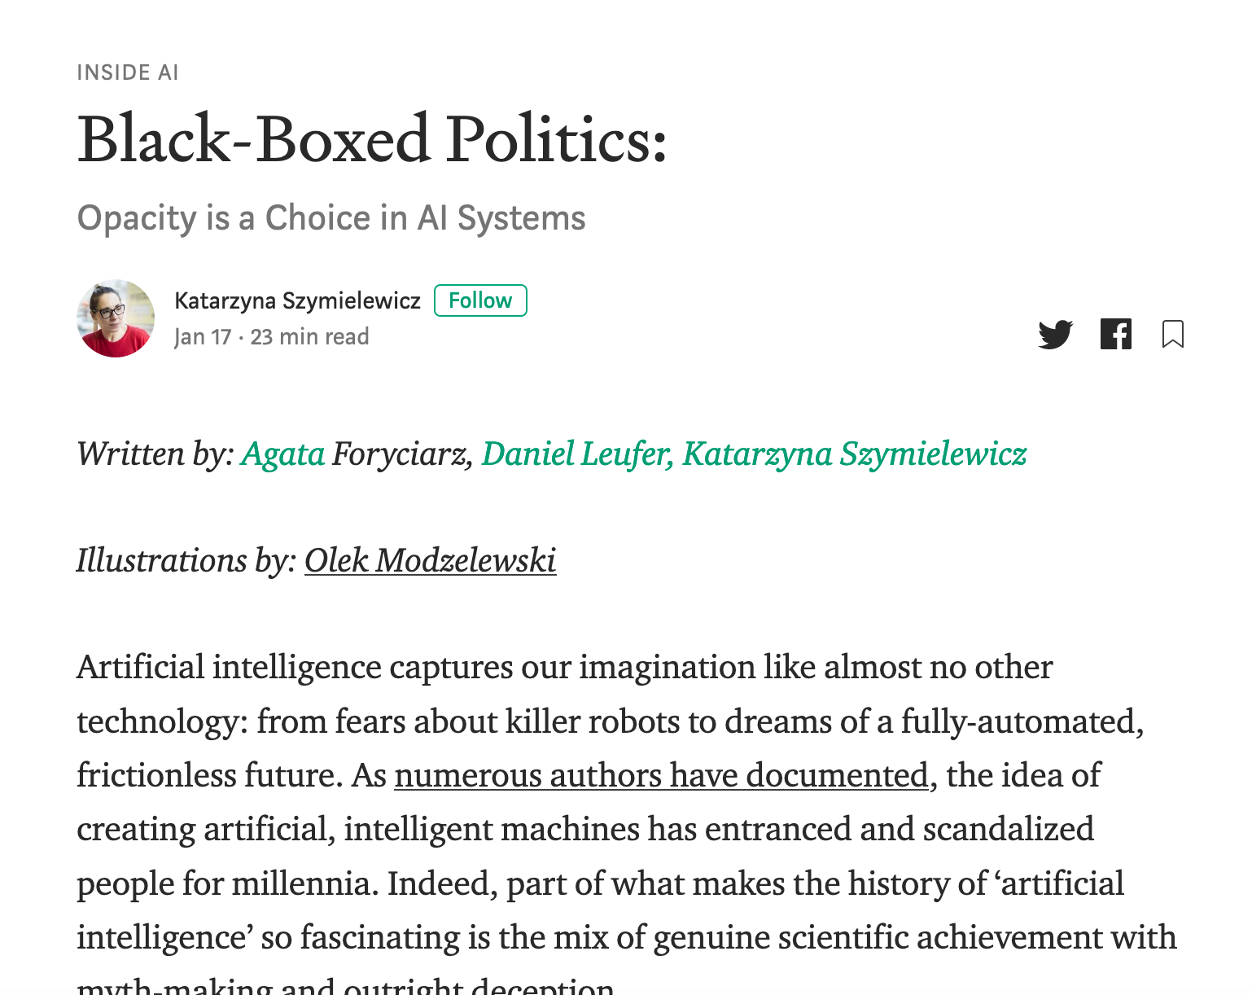
Not the only ML+society pipeline in town

Slide 39
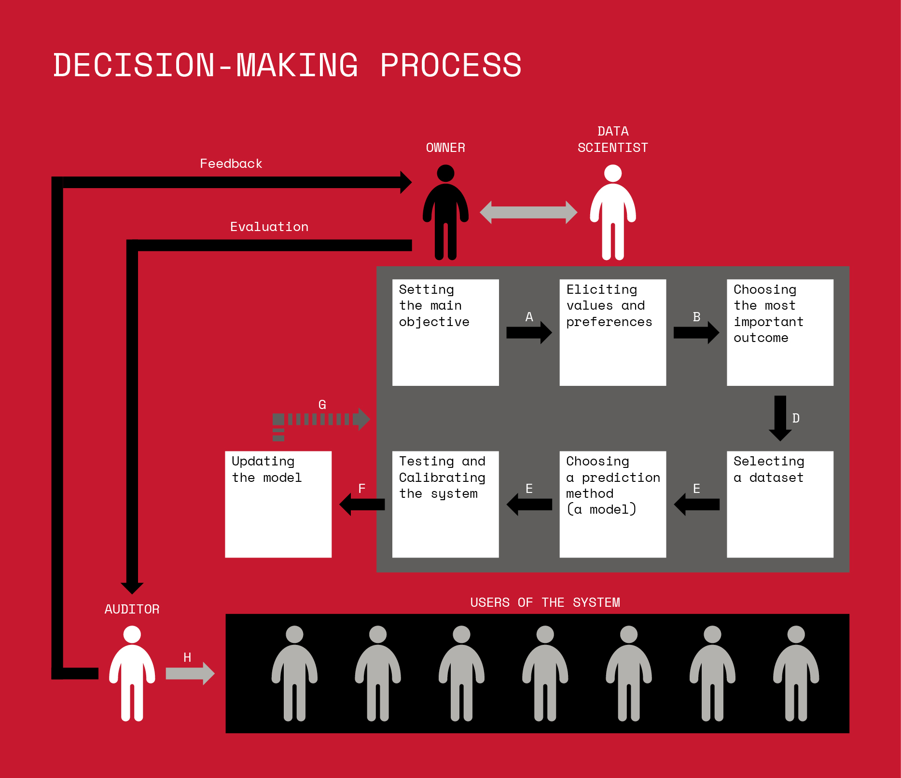
Not the only ML+society pipeline in town

Slide 40
A walkthrough

Slide 41
A walkthrough
Real world goal
Real world mechanism
Learning problem
Data collection mechanism
Which data to collect?
Data representation
After the break!
Target class/model
Deploy!
Evaluate error
Predict on test data
Model training
Training data set

Slide 42
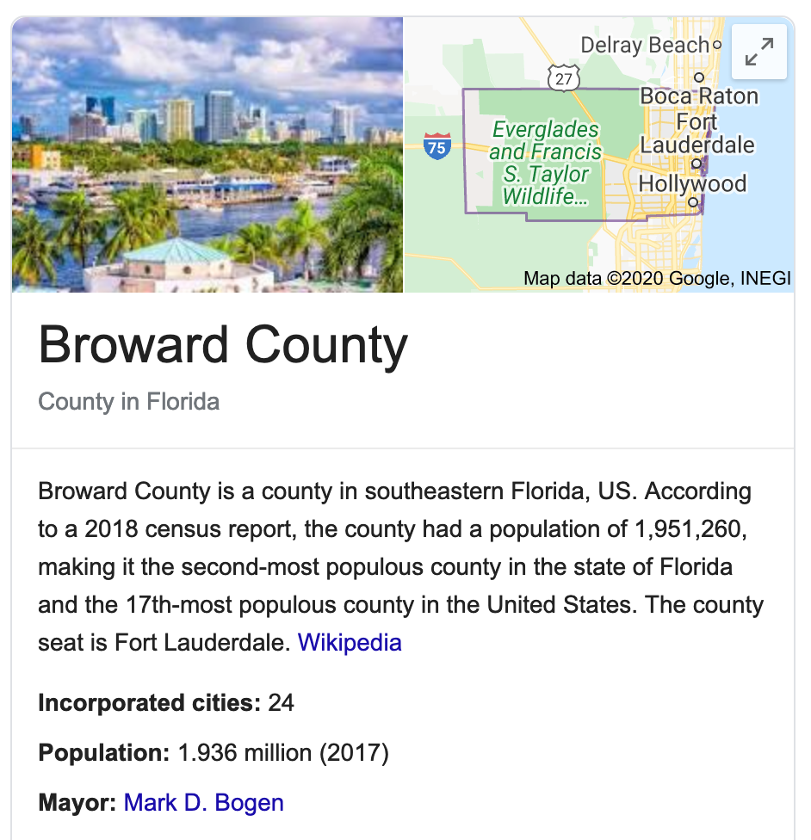
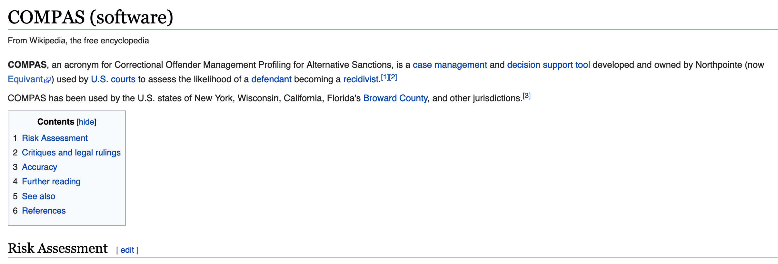
Have you heard of COMPAS?

Slide 43
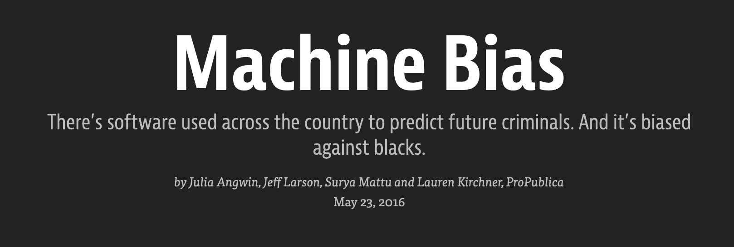

Slide 44
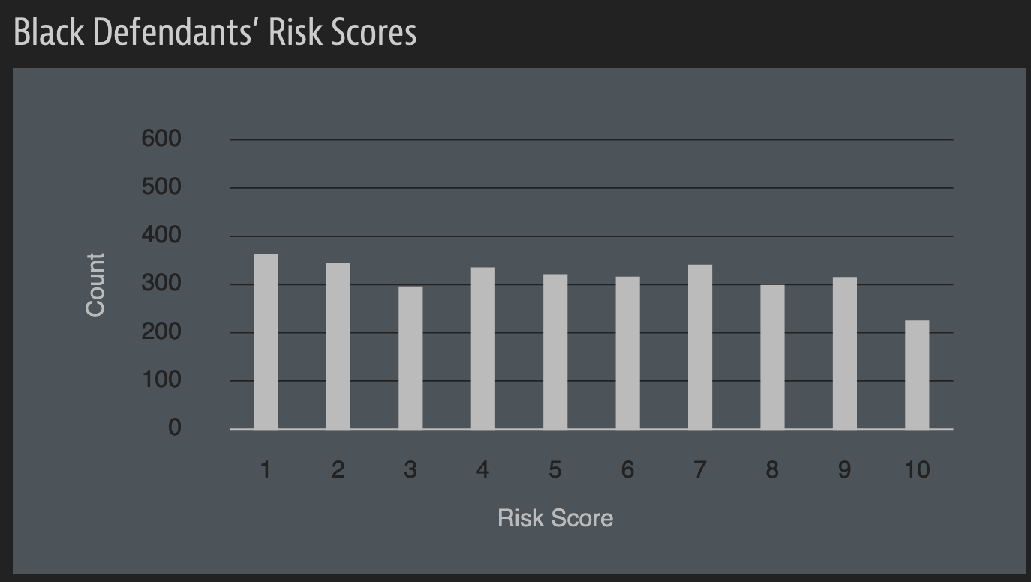
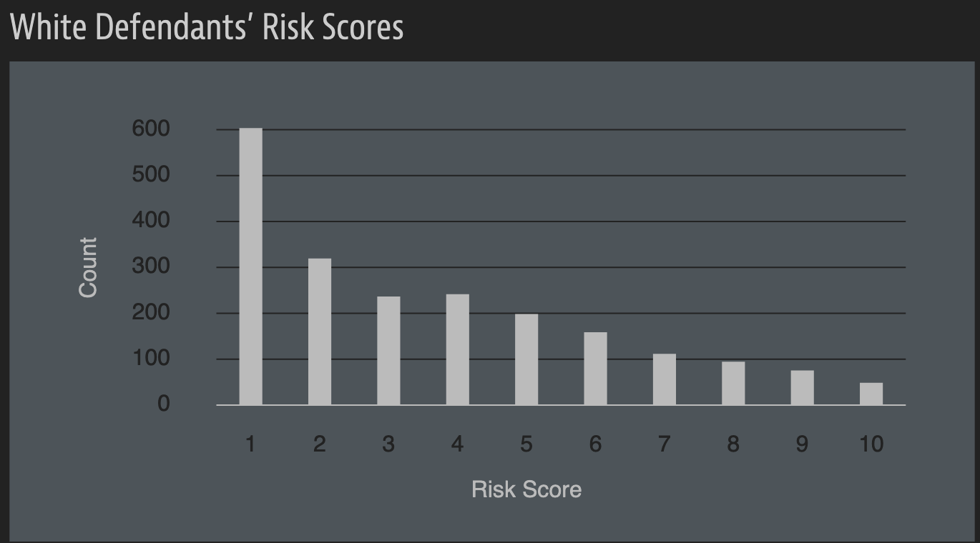
A sample of their result

Slide 45
A rejoinder

Slide 46
?

Slide 47
A walkthrough
Real world goal
Real world mechanism
Learning problem
Data collection mechanism
Which data to collect?
Data representation
Target class/model
Deploy!
Evaluate error
Predict on test data
Model training
Training data set

Slide 48
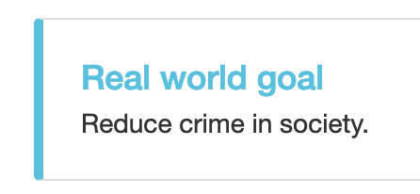
Real world goal
Real world goal

Slide 49
Real world mechanism
Real world goal
Real world mechanism

Slide 50
Learning problem
Target variable might not be obvious in other scenarios!
Real world goal
Real world mechanism
Learning problem

Slide 51
?

